Slide 1
Computer System Introduction

Slide 2
Overview
Computer systems
How do computers work?
Why computer forensics is hard?
Hard disk drives
Calculate disk partitions
PC boot process

Slide 3
Computer systems

Slide 4
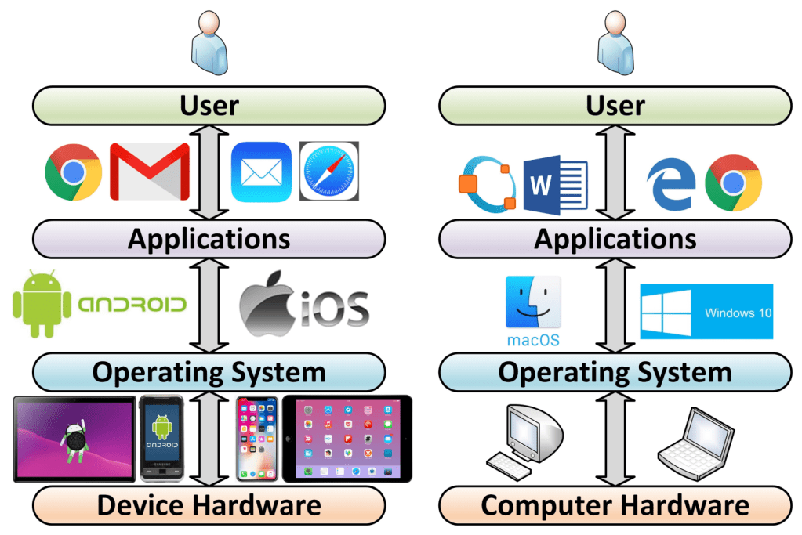
Layers of a computer system
Evidence is generated from each layer
User activities= Applications+ OS+ Disk/Memory
https://windsongtraining.ca/the-technology-layer-cake-users-apps-os-and-hardware/

Slide 5
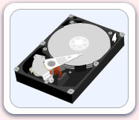
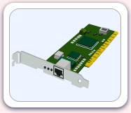
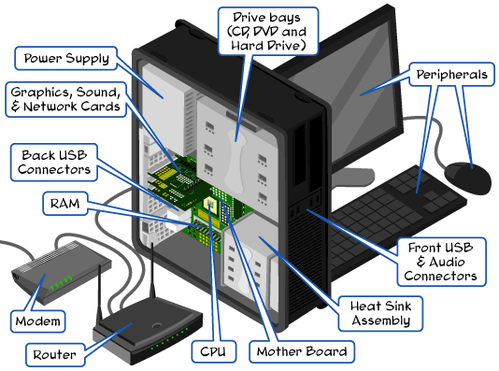
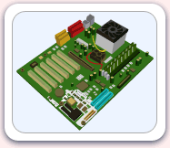
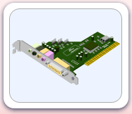
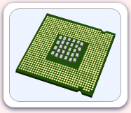
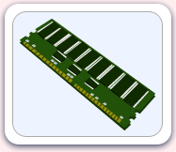
Parts of the computer
http://www.carnegiecyberacademy.com/facultyPages/computer/computers.html

Slide 6
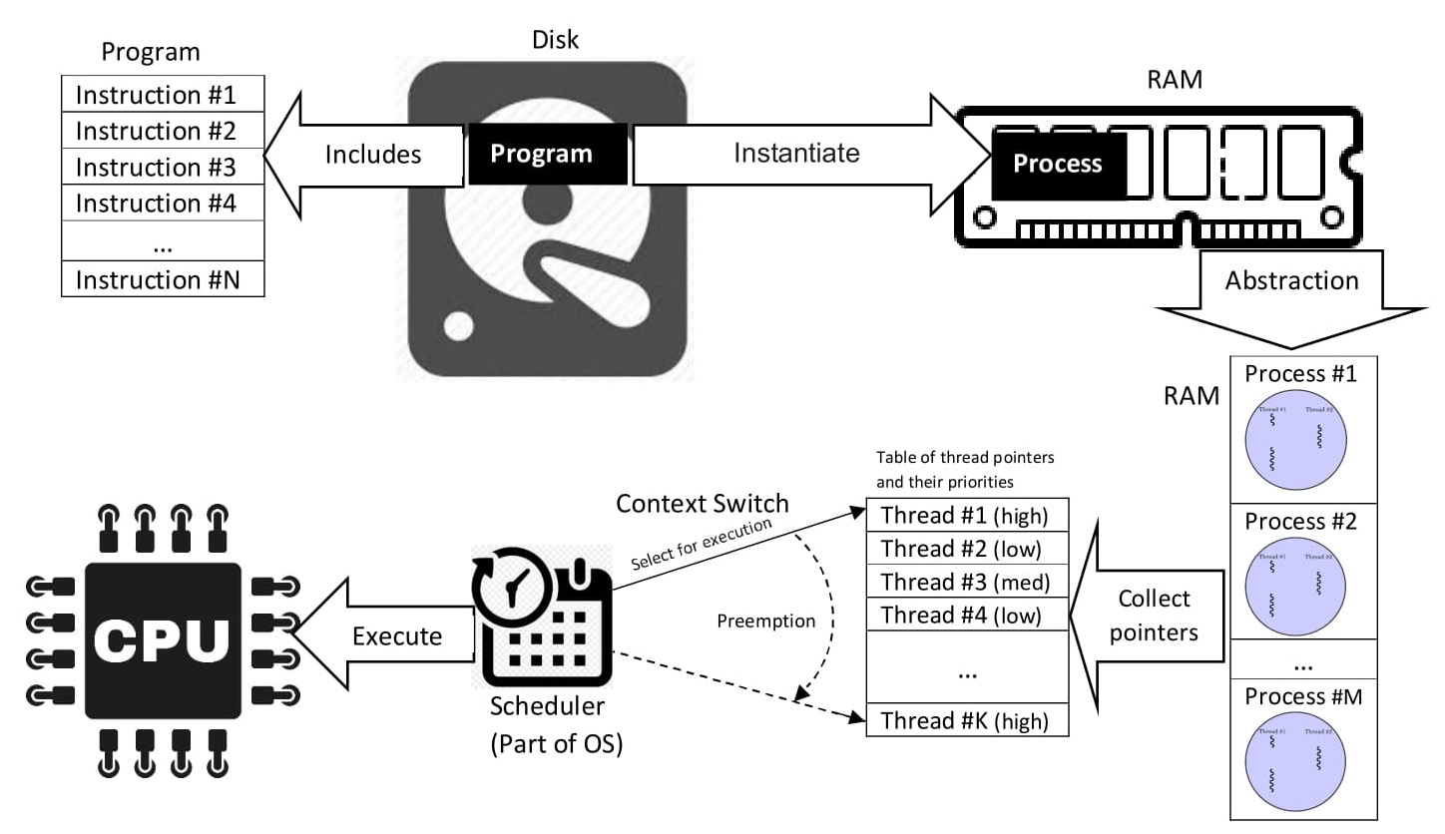
How do computers work?
Program vs. Process vs. Thread
a process is the instance of a computer program
a process may be made up of multiple threads of execution that execute instructions concurrently.
https://en.wikipedia.org/wiki/Process_(computing)

Slide 7
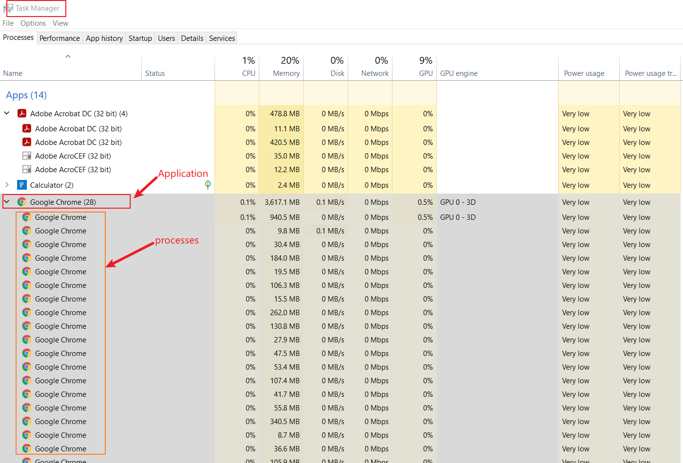

Slide 8
Why computer forensics is hard?
Technical difficulties
OS: different OS types, versions, complexity of OS
Applications: many applications, different version of application
Hardware: CPU, GPU, camera
Ever-advancing technology: e.g., database changes, SSD vs HDD, EV car
A connected world
IoT devices: Alex, Camera, Fitbit, Smart Phone
Information explosion
too much information, how to collect, analyze, validate them systematically?
Computer forensics is NOT only a computer science discipline
criminal justice, law

Slide 9
Low level Analysis: malware
OS logs, Application logs,
Memory forensics
CPU execution analysis
Dynamical Analysis:
OS PID, Application PID

Slide 10
Hard disk drives

Slide 11
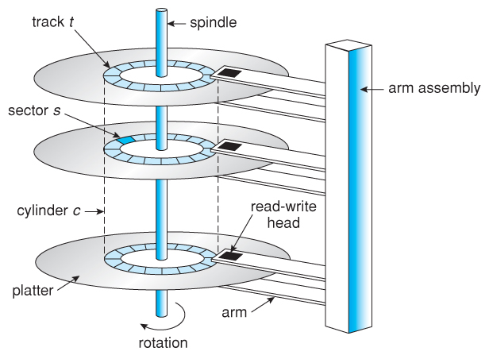
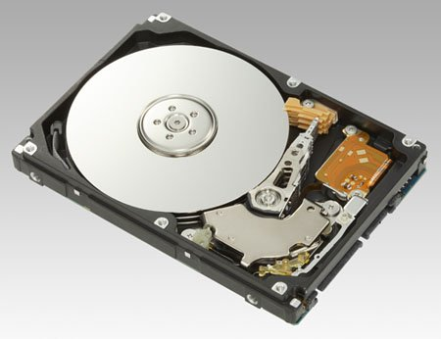
Understand disk drives
https://regmedia.co.uk/2006/12/12/fujitsu_300gb_1.jpg
Abraham Silberschatz, Greg Gagne, and Peter Baer Galvin, "Operating System Concepts, Ninth Edition "

Slide 12
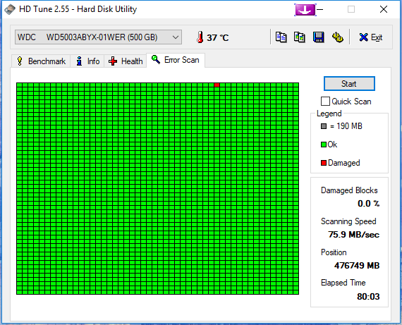
What is a disk sector?
The sector is the minimum storage unit of a hard drive.
Files occupy an integral number of sectors regardless of the file's actual size.
# bytes per sector =512 Bytes
https://i.imgur.com/26BalHW.png

Slide 13
Calculate the total sectors
#sectors per track
# tracks (cylinders)
# headers
#Size of disk=# tracks (C) x #Heads x #Sectors per track (CHS)
no of sectors: 400
no of heads: 12
cylinders: 17000
=81600000 sectors

Slide 14
Calculate the size of a disk
1024 Bytes=1K
1024 K=1M
1024 M=1G
How to compute the size of the disk
81600000 sectors * 512 bytes= 41779200000 bytes
=40800000 KB
=39843.75MB
=38.91G

Slide 15
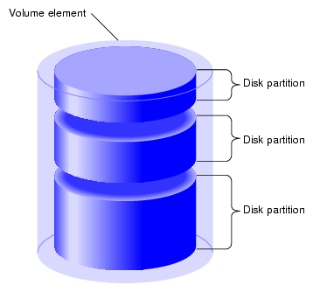
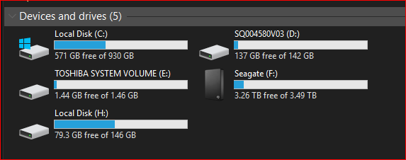
What is a partition
https://www.maketecheasier.com/assets/uploads/2012/05/partitions-partition-diagram.png

Slide 16
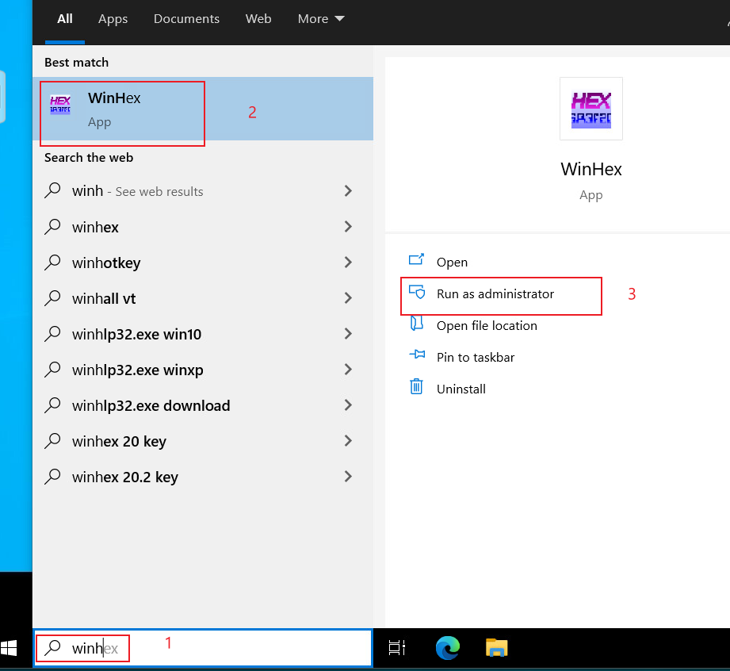
Calculate the size of partitions
Open Winhex

Slide 17
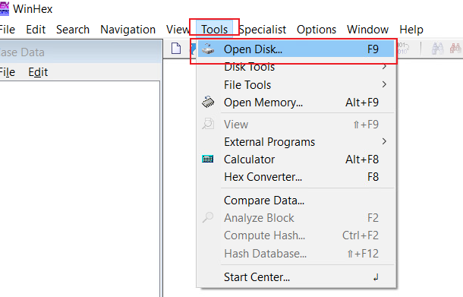
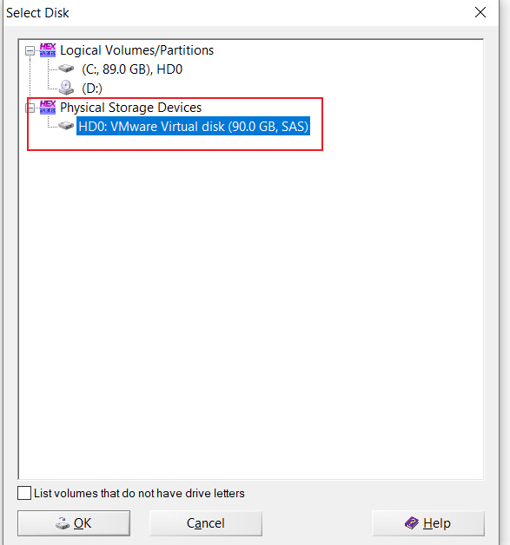
List Physical Storage Devices

Slide 18
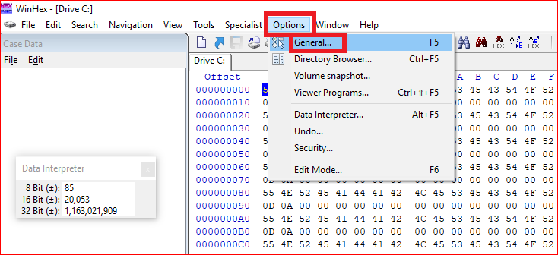
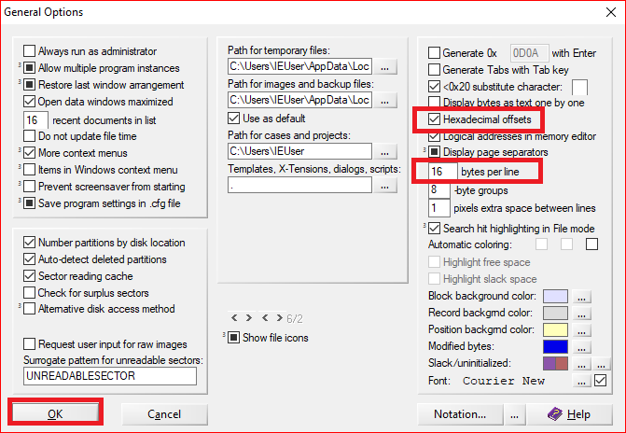
Winhex option setting

Slide 19
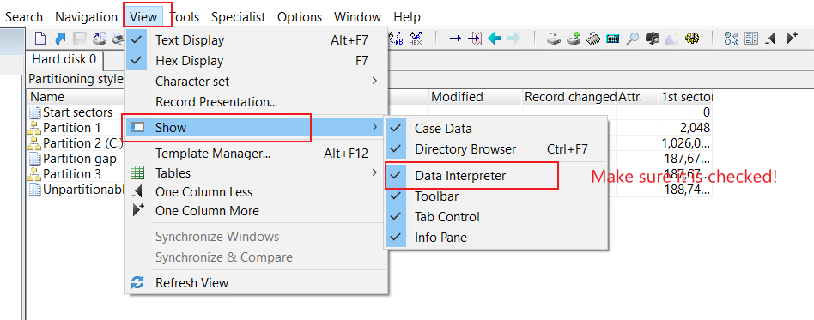
Enable Data Interpreter

Slide 20
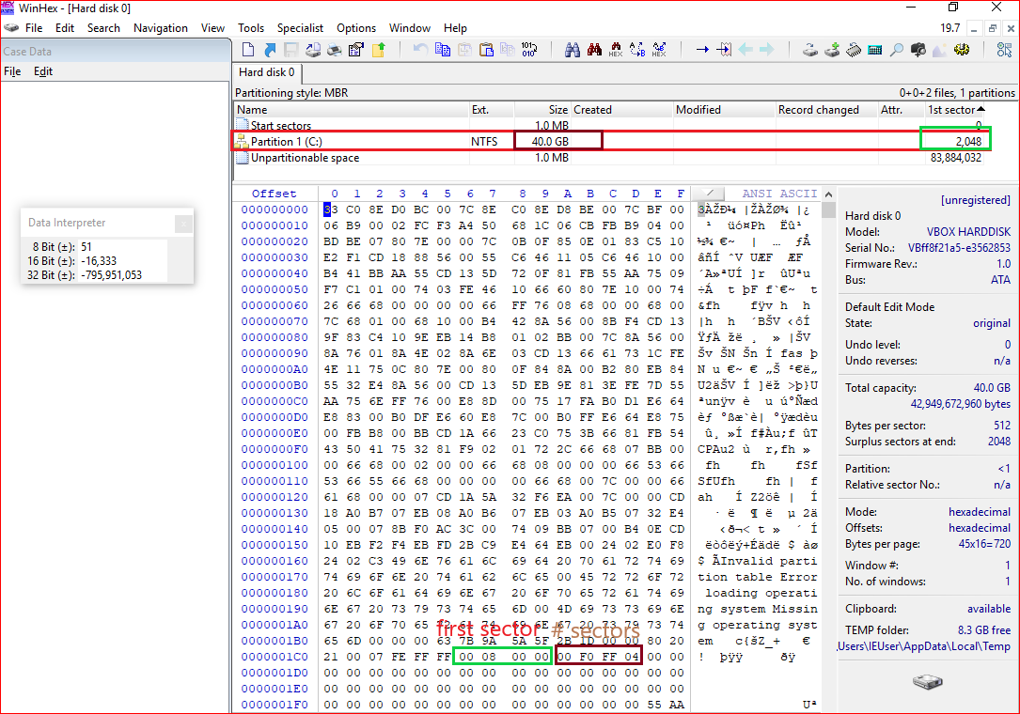
Master Boot Record:
1980s
Allow up to a maximum of 2 TB
Show the position of
the first sector

Slide 21
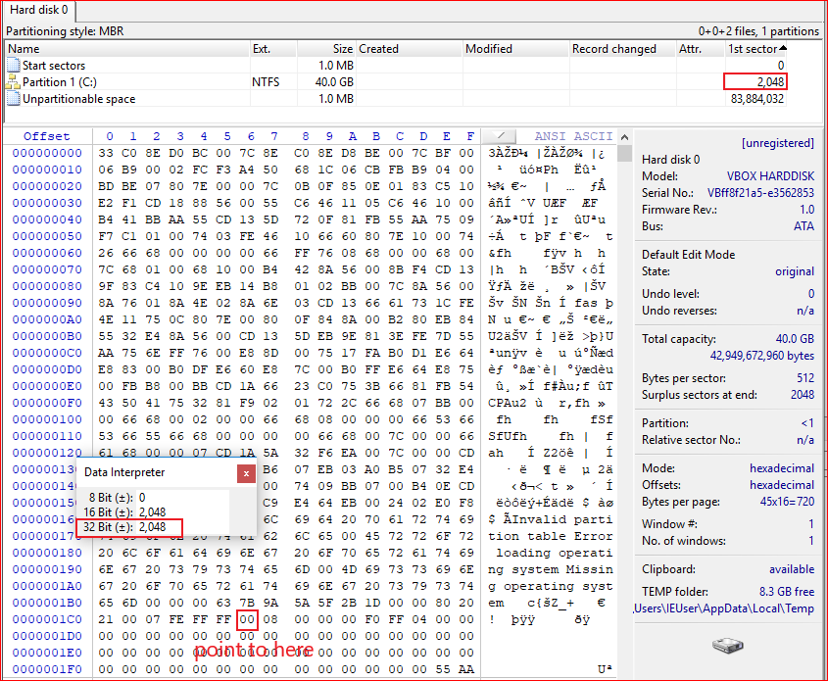
Covert Hex to decimal

Slide 22
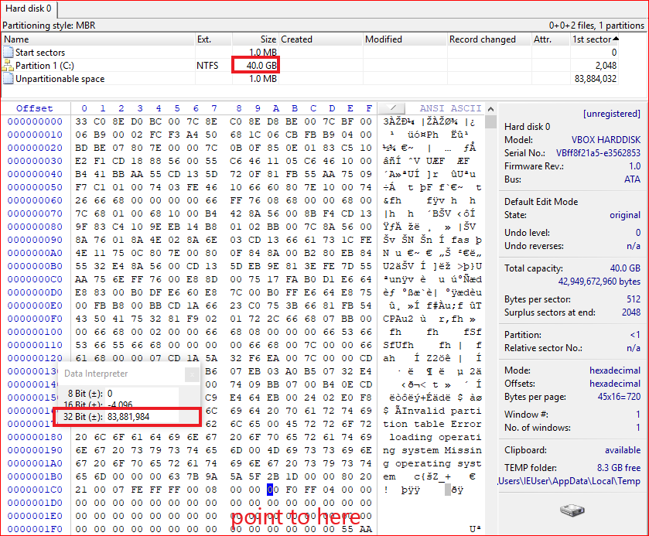
Show the size of the
total sectors in decimal
ox01CA
Compute the partition
size
83881984 sectors *512 bytes per sector = 39.99 G
Notes:
1024000*512/1024/1024=500

Slide 23
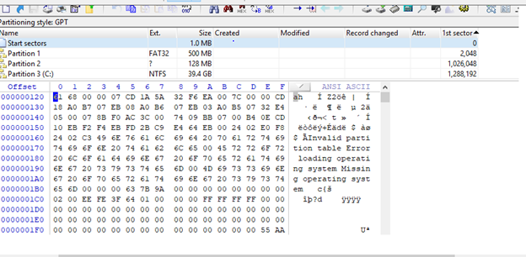
GUID Partition Table: GPT

Slide 24
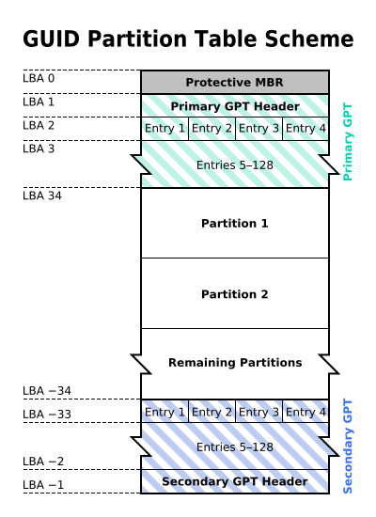
Why GPT
MBR: 1980s
Allow up to a maximum of 2 TB
GPT: maximum size is 9.4 ZB
1ZB=1024TB
logical block addressing (LBA)
Replace CHS
By The original uploader was Kbolino at English Wikipedia. - Transferred from en.wikipedia to Commons. Transfer was stated to be made by User:Kbolino., CC BY-SA 2.5, https://commons.wikimedia.org/w/index.php?curid=3036588

Slide 25
backward compatibility for MBR
Describe each partition
Backup of the primary GPT header and entries

Slide 26
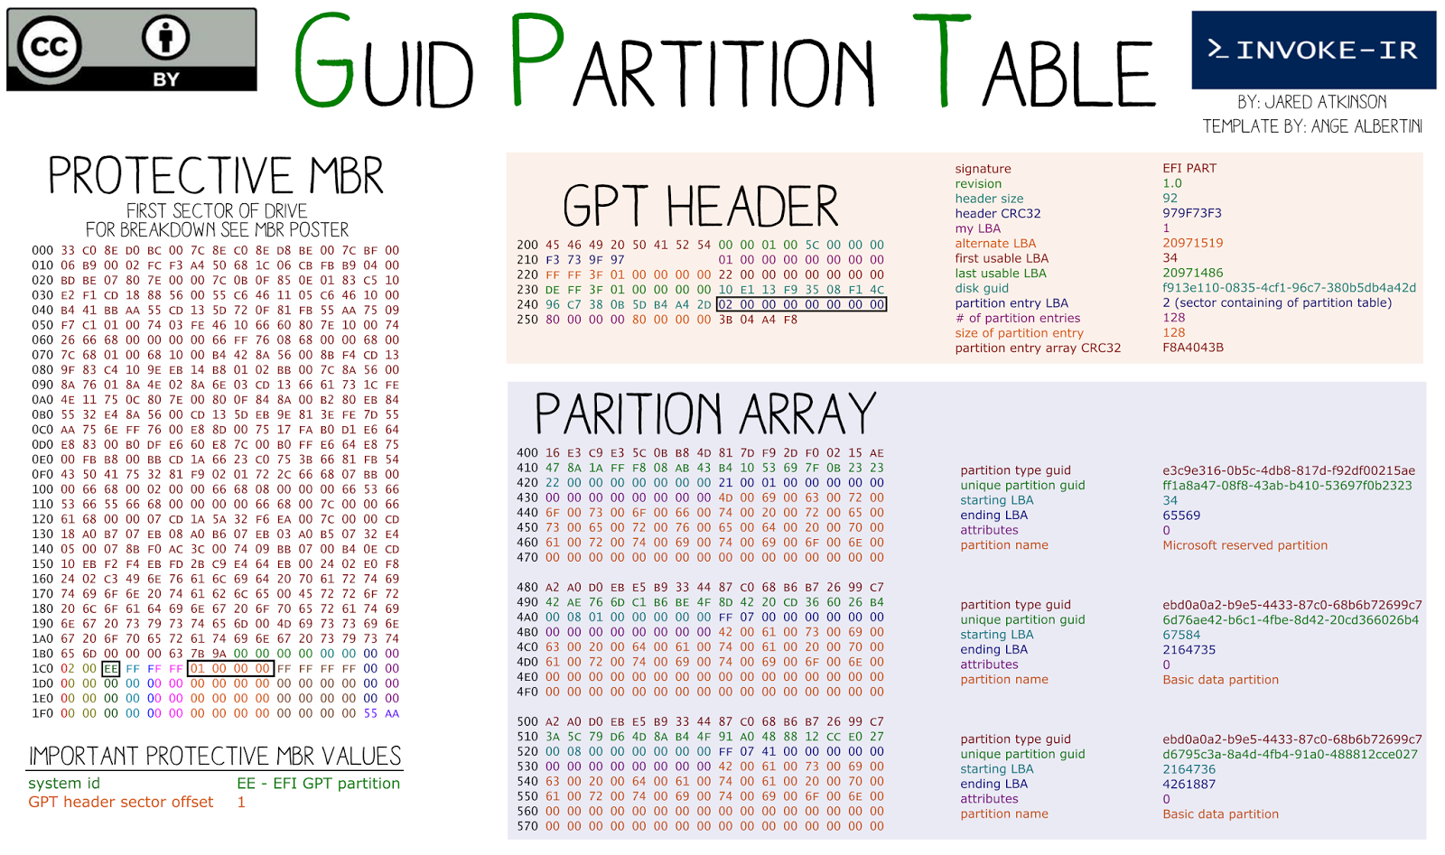
Starting LBA of array of partition entries (always 2 in primary copy)
Why 0x400?

Slide 27
PC boot process

Slide 28
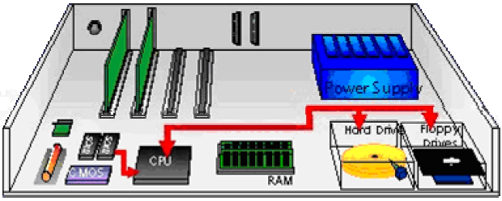
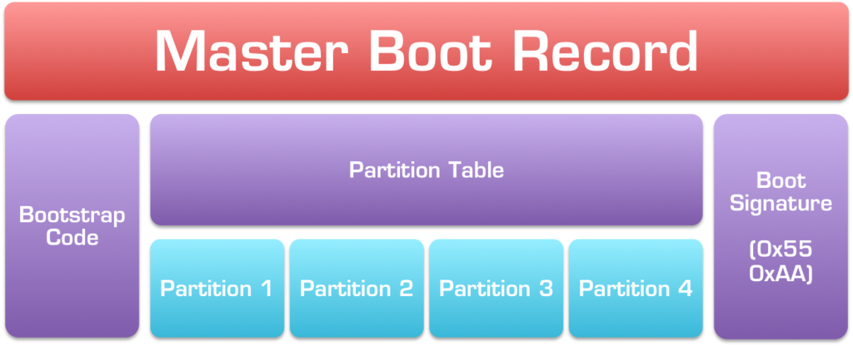
Booting a computer
Power up; computer runs power-on self-test (POST)
Boot sequence governed by (Basic input/output system) BIOS ROM
BIOS parameters stored in CMOS
Control passes to the Master Boot Record (MBR)
MBR points to boot record of selected operating system
Operating system takes control
Jump to bootable partition
http://www.c-jump.com/CIS24/Slides/Booting/Booting.html
https://i2.wp.com/neosmart.net/wiki/wp-content/uploads/sites/5/2015/01/Master-Boot-Record.png?resize=1024%2C416&ssl=1

Slide 29
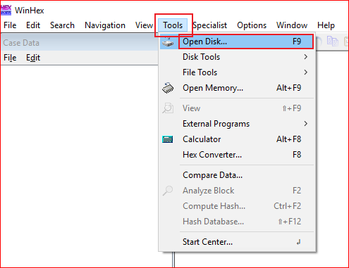
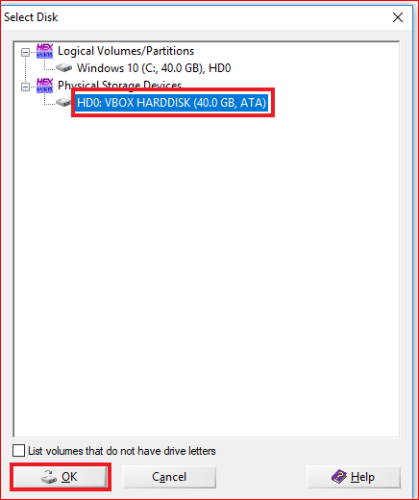
Open Physical Devices

Slide 30
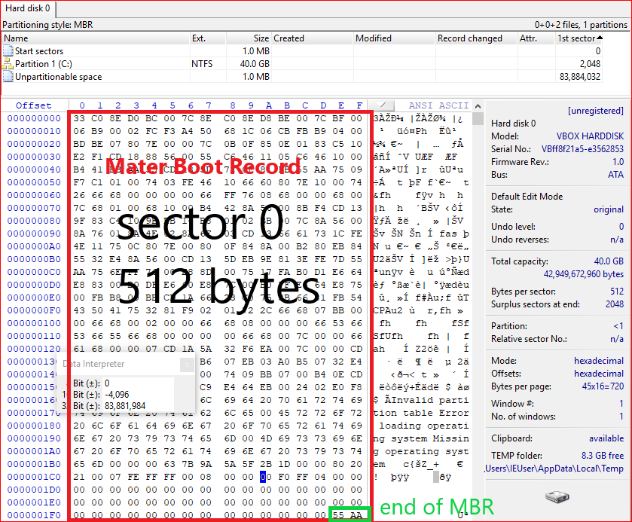
Show MBR

Slide 31
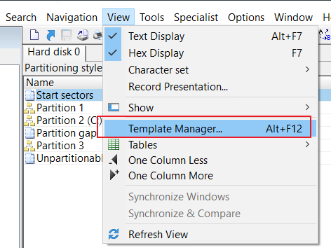
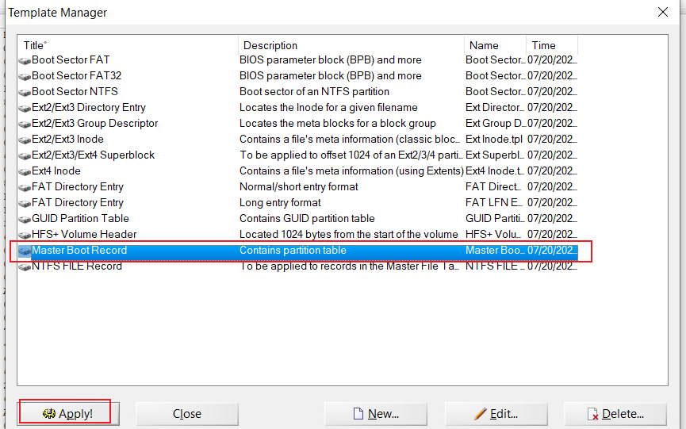
Show MBR details using template

Slide 32
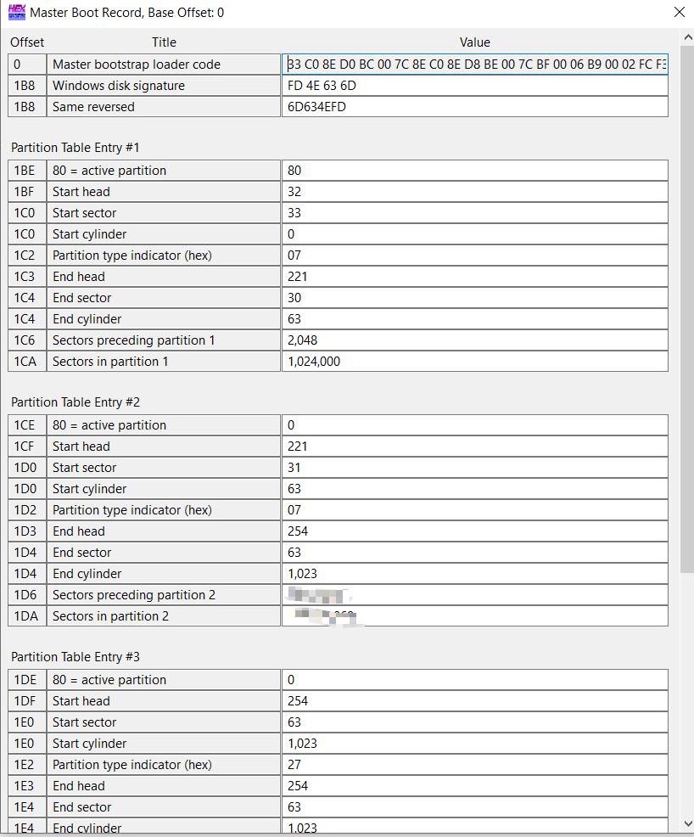
Another example of MBR details using template, which contains multiple partitions

Slide 33
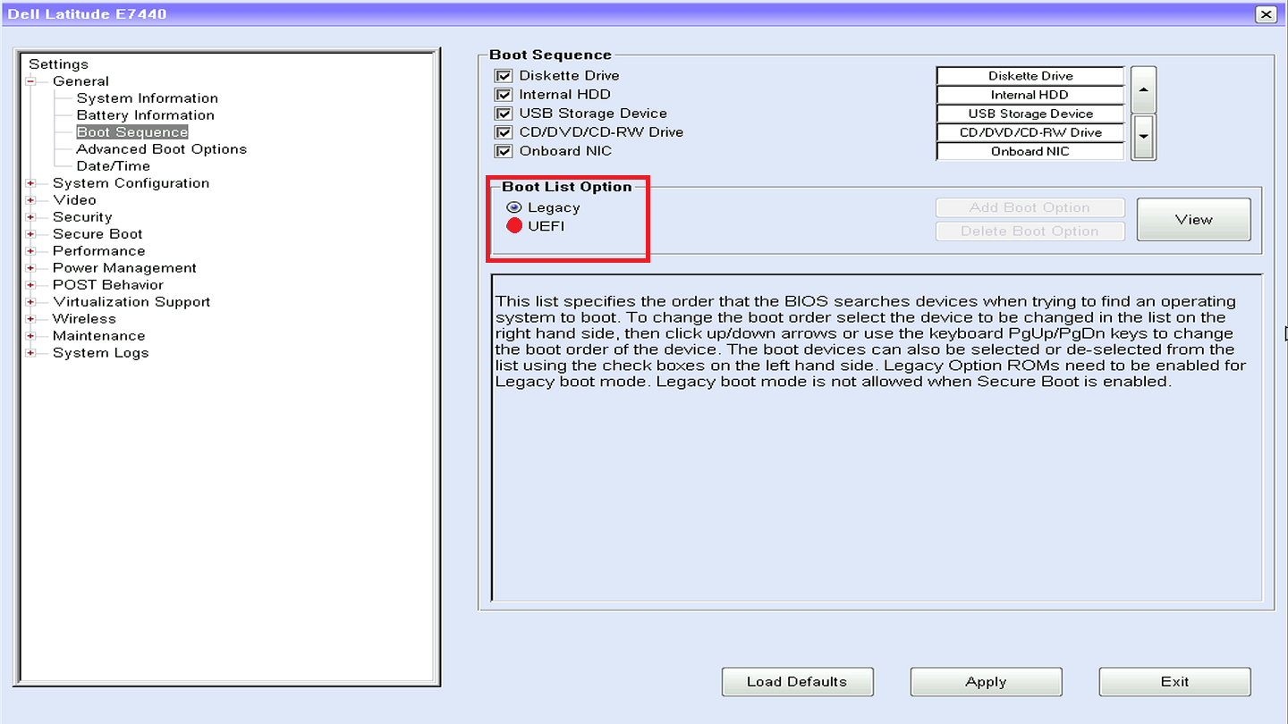

Slide 34
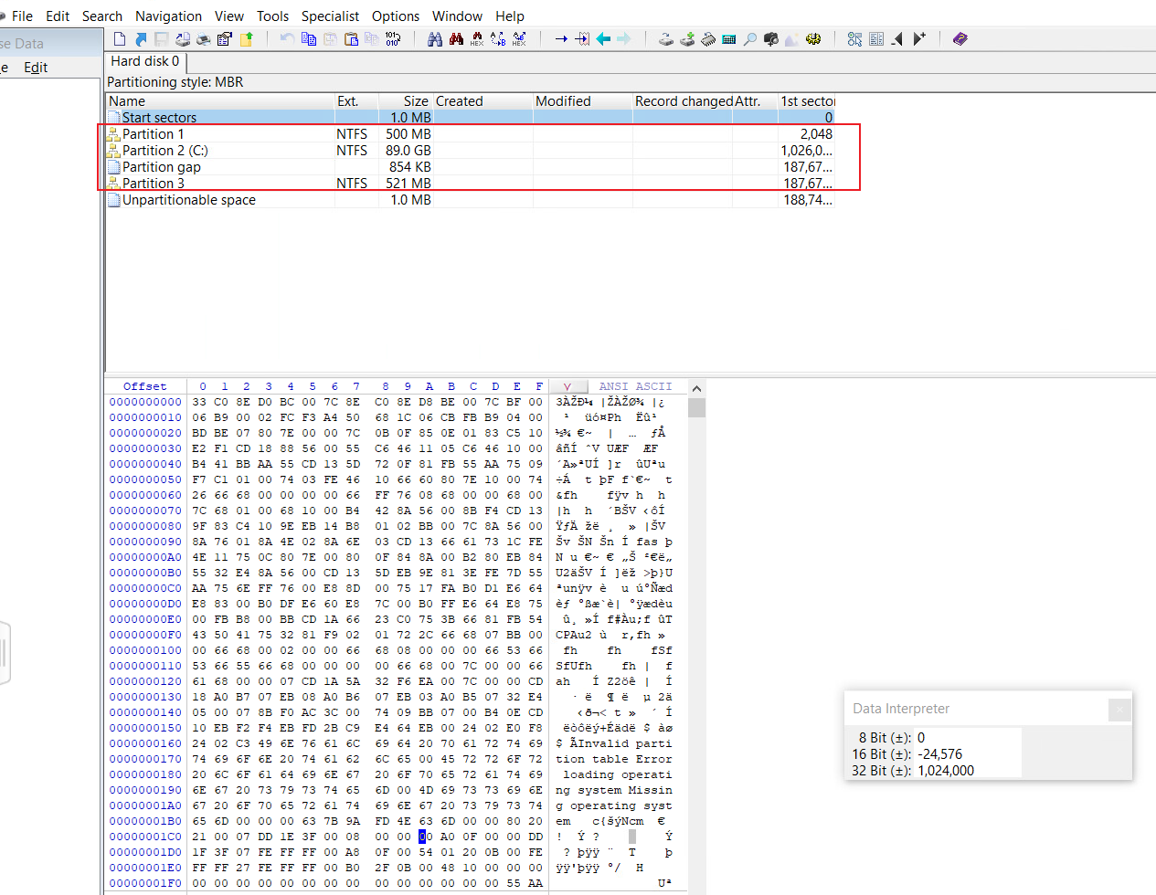
Assignment
Verify the size of the partition 1
Verify the size of the partition 2
Requirements:
Without using templates
Compute size in GB
Notes:
ID6, 1026048,186646868

