Slide 1
P2P Data Leakage (Website Analysis)
Malcolm Hayward
University of Baltimore
Forensic Science – Cyber Investigations

Slide 2
Previous Presentations
0. Lab Setup
1. Disk Image and Partitions
2. Registry and File Directory
3. MFT Timeline
4. USN Journal Timeline
5. uTorrent Log File
6. File Signature
7. Email
8. Web History

Slide 3
Objectives
Visit the ‘Social upload’ website.
Look at the ‘New Music’ post’s author and content.
Determine if the uploaded torrent file is the same as the one found on the system.
Determine if the author’s account belongs to Kamryn or not.

Slide 4
17. Someone uploaded a torrent file on a website in Kamryn’s browsing history:
a. What is the name of the website?
b. What is the URL where the torrent file was uploaded?
c. What is the name of the account that uploaded the torrent file?
d. Is the account holder Kamryn, or someone else? Can you verify this information?
Tools used:
Any web browser
md5sum

Slide 5
Why the ‘Social Upload’ website?
Recall that from Kamryn’s web history, a website called ‘Social Upload’ was visited.
The url to this website: http://dfir-projects.boards.net/
To verify what Kamryn may have posted on the website, we will look at it ourselves.
Recall that Kamryn was creating a thread on the website and visited a thread called ‘New Music’. Did Kamryn create this thread? Let’s find out!

Slide 6
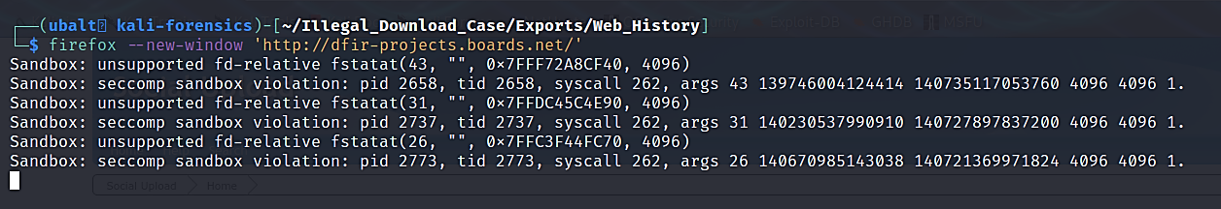
Open the website in a web browser.

Slide 7
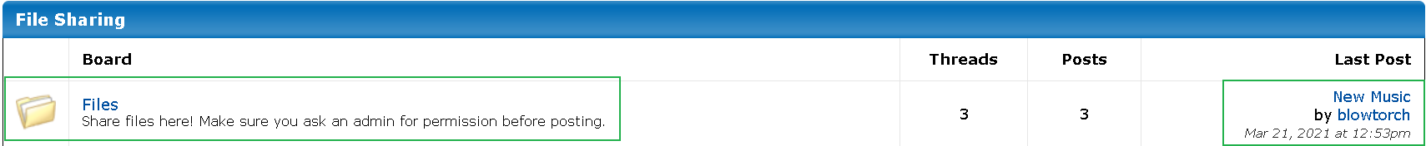
The website opens on its home page. Look under the ‘File Sharing’ section.

Slide 8
Explanation
Recall that Kamryn visited a section of the website titled ‘Files’. Kamryn visited this ‘Files’ section and was in the process of creating a thread.
The thread we are looking for – ‘New Music’ - is in this section and is the most recent post.
The author appears to be ‘blowtorch’ and was created on 3/21/2021 at 12:53pm (Treat this timestamp as PST). We will convert this timestamp to UTC format.
Notes:
We believe there is something wrong with the website’s time synchronization settings. It is showing the 12:53 time to be in PST instead of EDT, the latter of which the website is set to. This timestamp matches MFT and Web History entries if it is treated as a PST time. Therefore, we should treat it as such during the investigation.

Slide 9
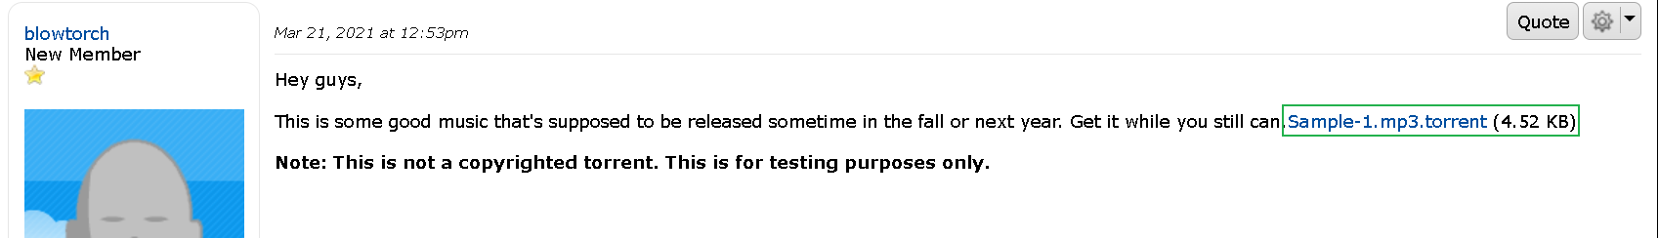
Click on the post’s title to see the post itself.

Slide 10
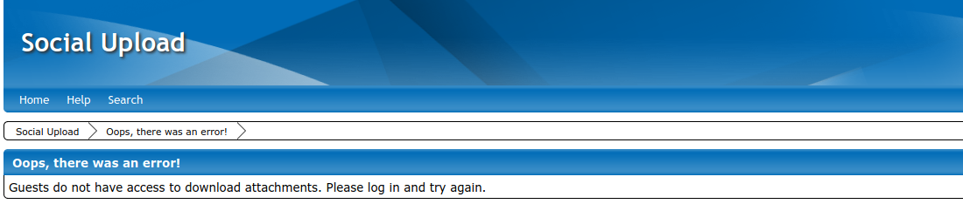
Click on the link to attempt to download the torrent file.

Slide 11
Explanation
The website is set to only allow registered users to download files.
Login to the website using these credentials:
Username: lab
Password : illegal_download_lab

Slide 12
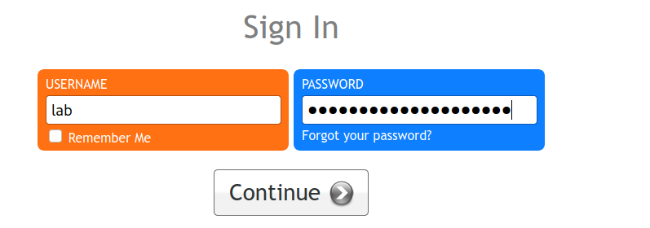
Login to your account.

Slide 13
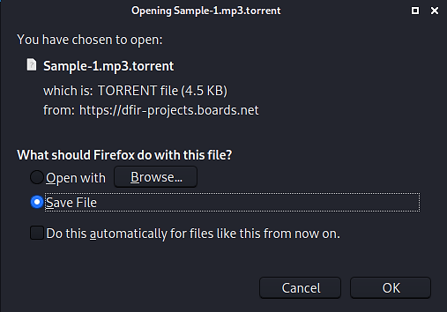
Download the torrent file.

Slide 14
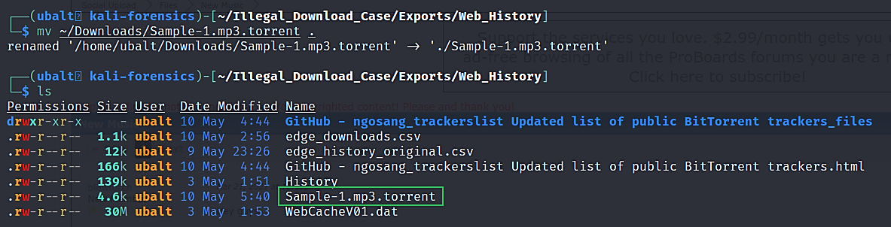
Move the downloaded torrent file to the Web_History folder.

Slide 15
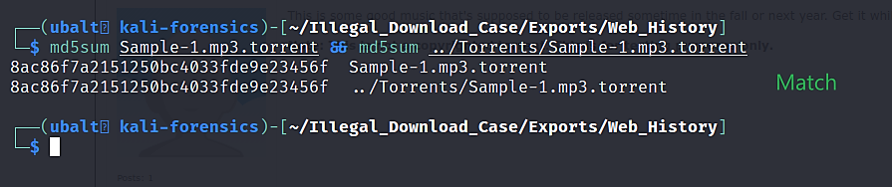
Use md5sum to compare the hash of this torrent file to the one extracted from Kamryn’s system.
Note: You are encouraged to also verify the SHA1 hash.

Slide 16
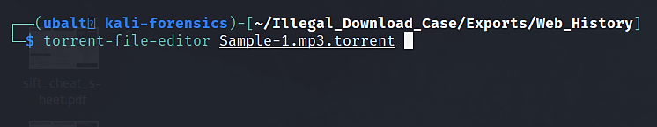
Use Torrent File Editor to verify when this torrent file was created.

Slide 17
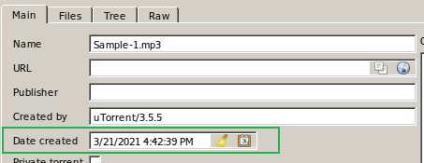
Use Torrent File Editor to verify when this torrent file was created.

Slide 18
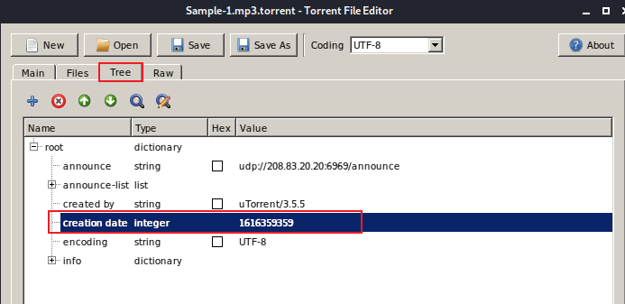
(Alternatively) Convert the epoch timestamp.
Read about epoch: https://en.wikipedia.org/wiki/Epoch_(computing)

Slide 19
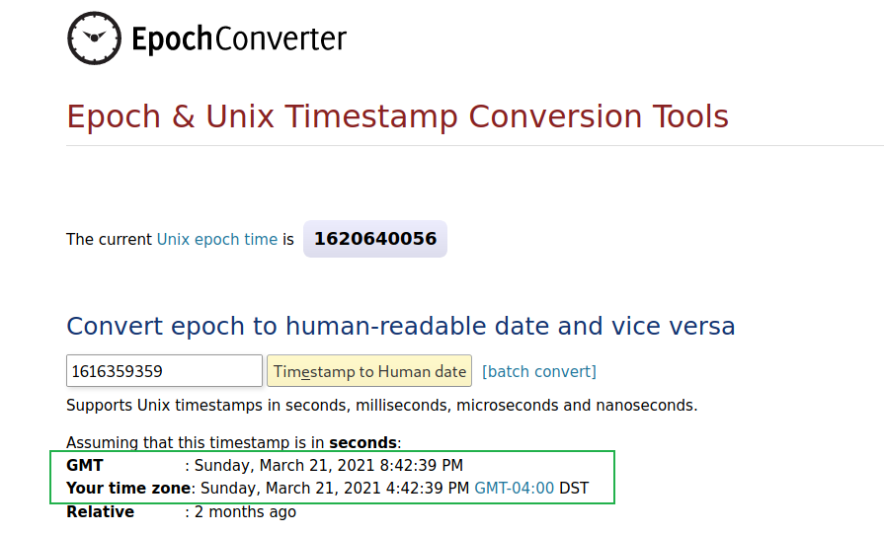
Convert the epoch timestamp on EpochConverter.
Use this website: https://www.epochconverter.com/
Note: GMT is the same time as UTC.

Slide 20
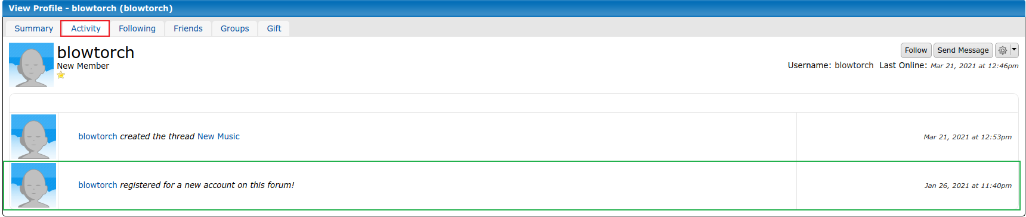
Click on blowtorch’s account to see account details.

Slide 21
Explanation
The user ‘blowtorch’ does not show enough information to determine if Kamryn owns this account.
The user ‘blowtorch’ uploaded ‘Sample-1.mp3.torrent’ on the Social Upload website on 3/21/2021 at 20:42:39.
This torrent file is the same file recovered from Kamryn’s system.

Slide 22
What this means for the investigation.
Sample-1.mp3 was uploaded to ‘Social Upload’ as a torrent file.
This torrent file is the same torrent file recovered from Kamryn’s system.
The timestamps from the Edge history file suggests that Kamryn created this forum post and uploaded this file.
What makes Kamryn the likely user of the ‘blowtorch’ account is that the uploaded torrent file is the same file as the one on Kamryn’s system.

