Slide 1
Acquiring the USB image
Notes:
https://www.youtube.com/watch?v=6G3qm60dfA8&ab_channel=PrashantThombre

Slide 2
Overview
What is a disk image?
Acquisition a USB in Windows using FTK Imager
Acquisition a USB in Linux using DD
Acquisition via Network

Slide 3
What is a disk image?
A disk image is a computer file
containing the contents and structure of a disk volume (partition) or
containing an entire data storage device,
Storage devices
a hard disk drive, tape drive, floppy disk, optical disc, or USB flash drive
The file format
open standard: such as the ISO image format for optical disc images,
unique to a particular software application: encase, FTK
Image acquisition can be done in
Windows
Linux

Slide 4
Acquisition in Windows using FTK Imager

Slide 5
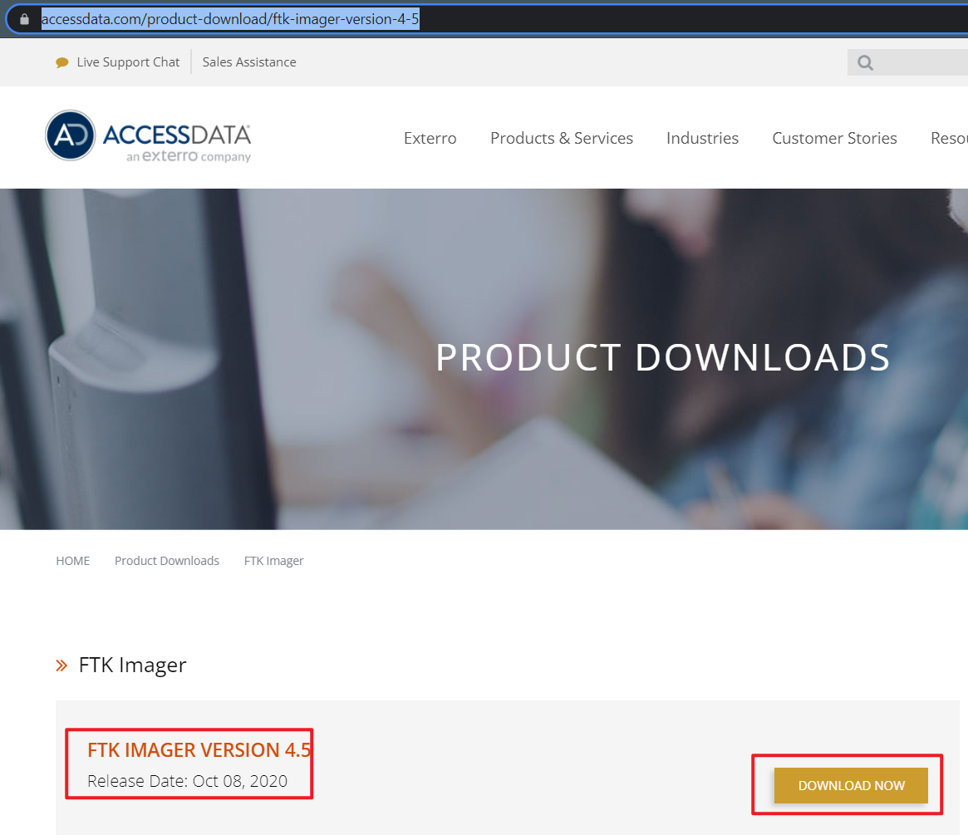
Download and install FTK
https://accessdata.com/product-download/ftk-imager-version-4-5

Slide 6
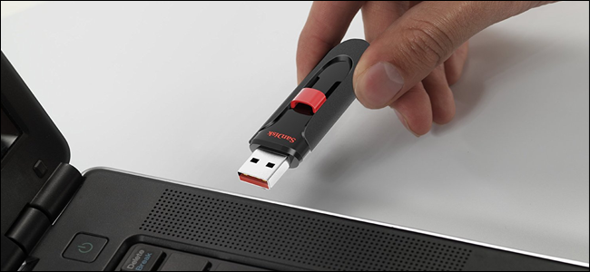
Plug in a Flash Drive to Your Computer
You can copy come files to the USB
https://www.howtogeek.com/wp-content/uploads/2017/09/ximg_59b9b8dfbb300.png.pagespeed.gp+jp+jw+pj+ws+js+rj+rp+rw+ri+cp+md.ic.2DjSUAOnqK.jpg

Slide 7
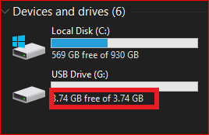
Verify your PC can read the USB drive

Slide 8

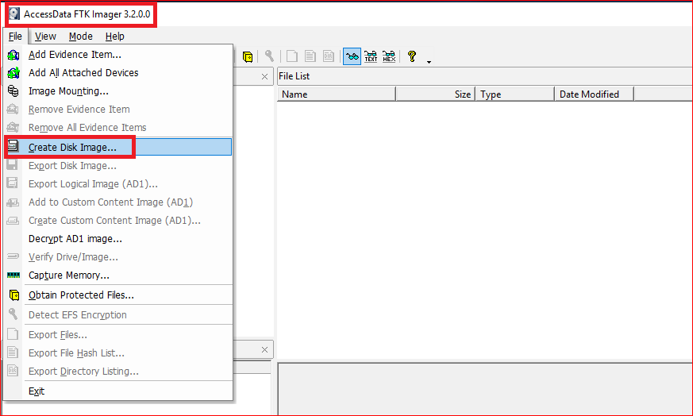
Acquiring a USB using FTK

Slide 9
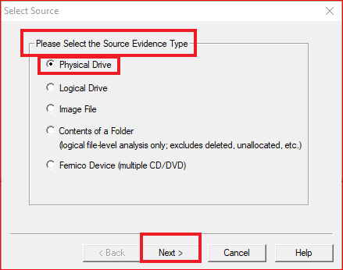
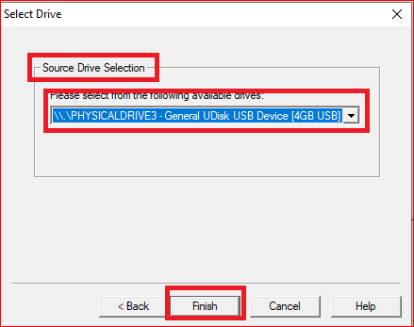

Slide 10
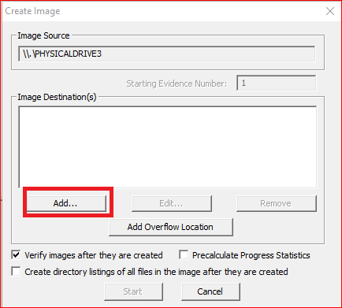
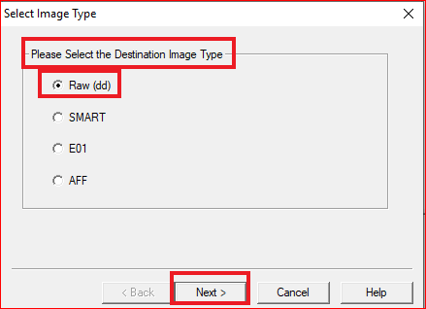

Slide 11
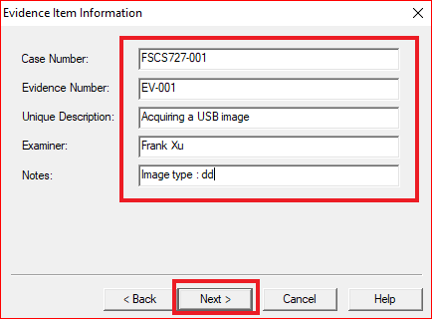

Slide 12
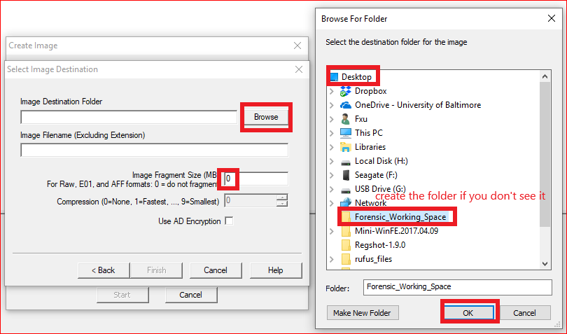

Slide 13
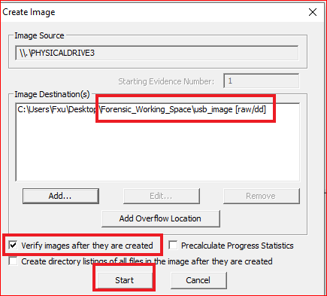
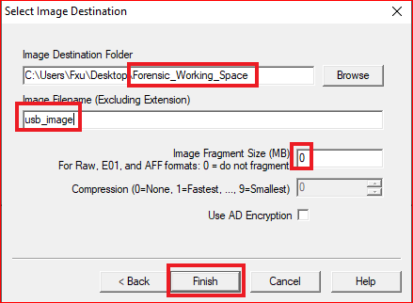

Slide 14
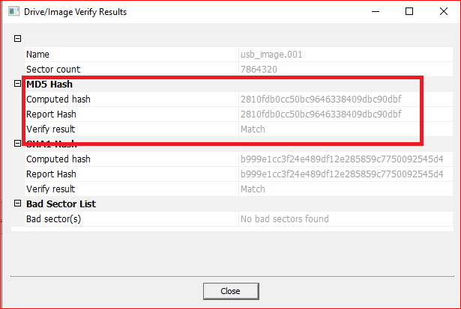
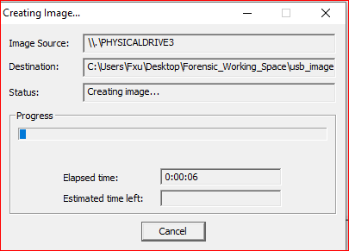

Slide 15
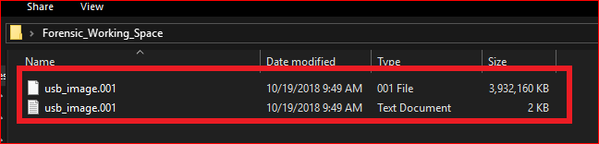

Slide 16
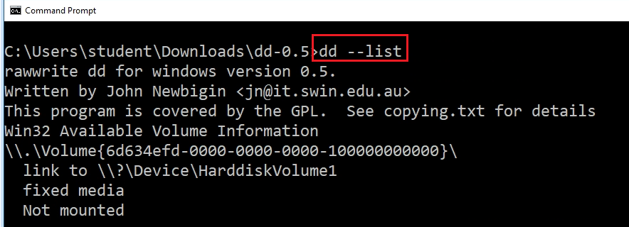
Alternative (Windows version of dd)
Download dd utility:
http://www.chrysocome.net/downloads/dd-0.5.zip
Unzip it and make a copy on your Desktop
Check disks
dd --list
Acquire the disk image
dd if=\\.\Volume{6d634efd-0000-0000-0000-501f00000000} of=c:\usb.img

Slide 17
Acquisition a USB in Linux using DD

Slide 18
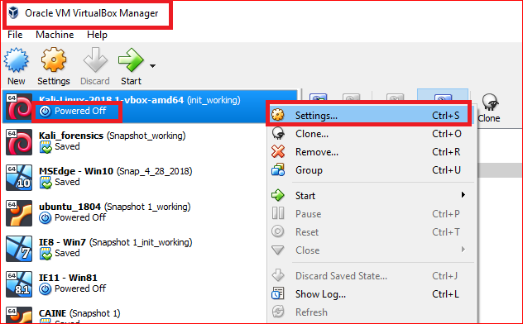

Slide 19
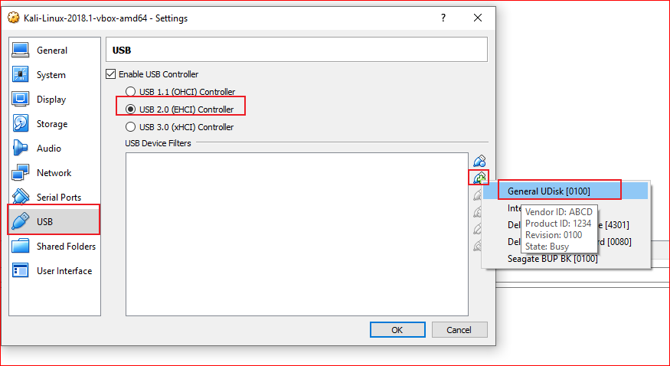

Slide 20
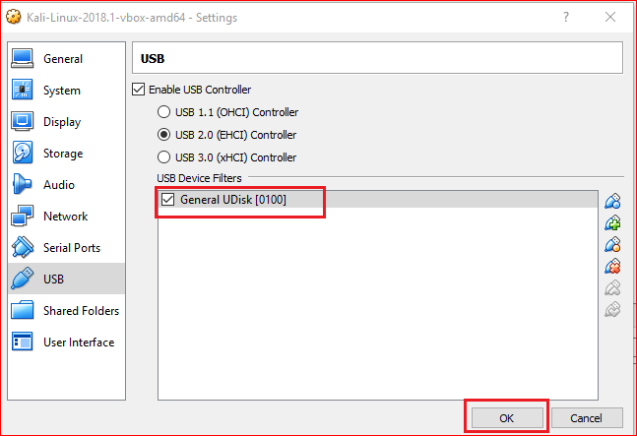

Slide 21
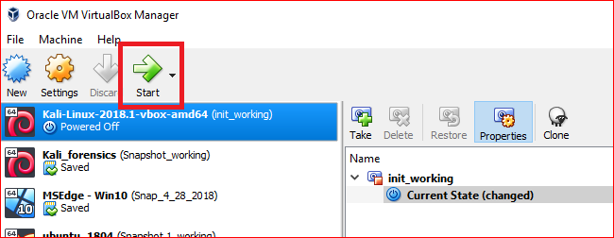

Slide 22
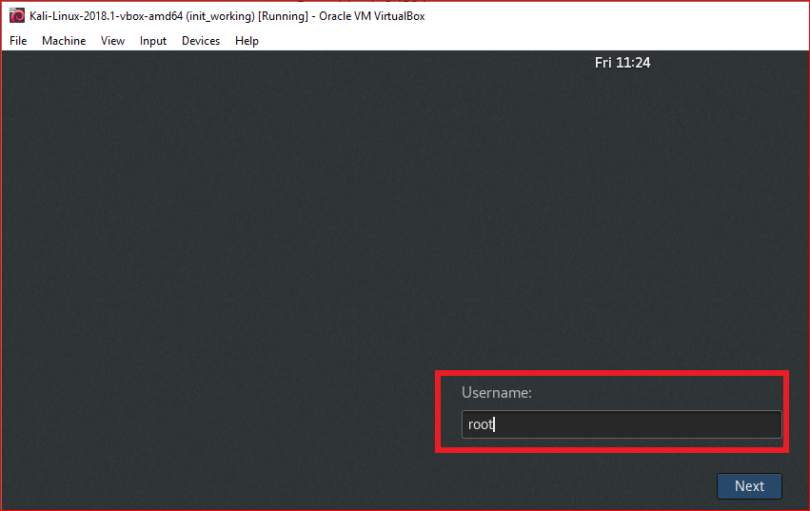
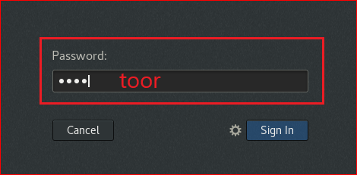

Slide 23
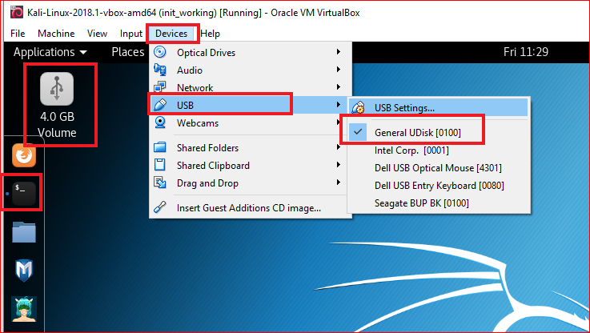

Slide 24
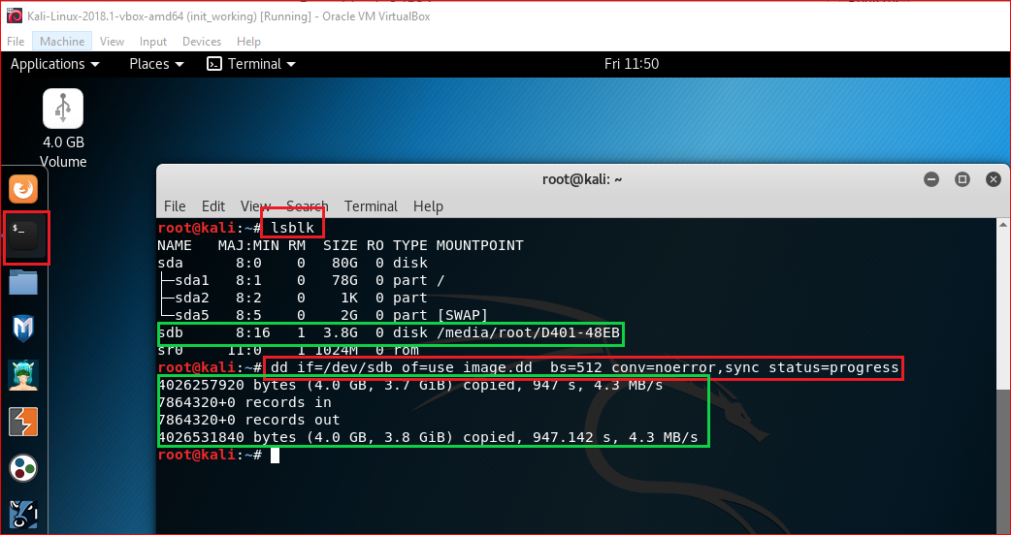
dd command to clone a USB
Notes:
If there are any errors, the above command will fail. If you give the parameter “conv=noerror” then it will continue to copy if there are read errors.

Slide 25
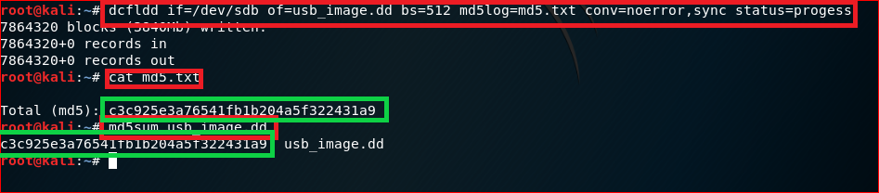
Use dcfldd
Notes:
sudo dd if=/dev/sda5 of=backup.dd status=progress
nc –lp 8080
sudo dd if=/dev/sda5 | nc 192.168.14.134 8080
md5sum /dev/sda5 | nc 192.168.14.134 8080

Slide 26
Image Acquisition via Network

Slide 27
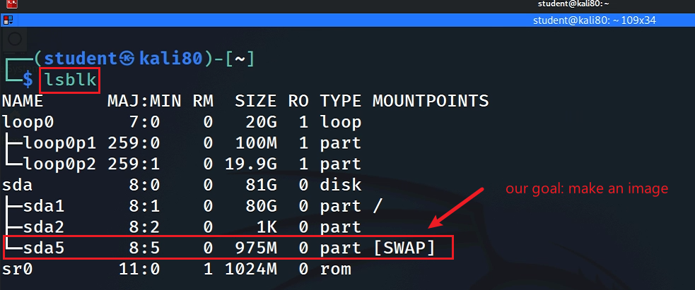
Goal 1: Kali => Windows
Set up a listener in Windows to listen to network traffic
Acquire a disk image in Kali using DD and send the image to Windows
Verify hash code of images at both OS

Slide 28
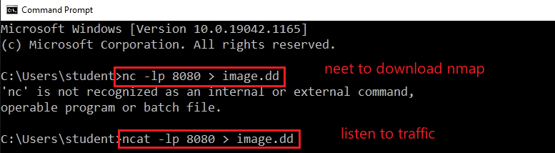
Windows as listener

Slide 29
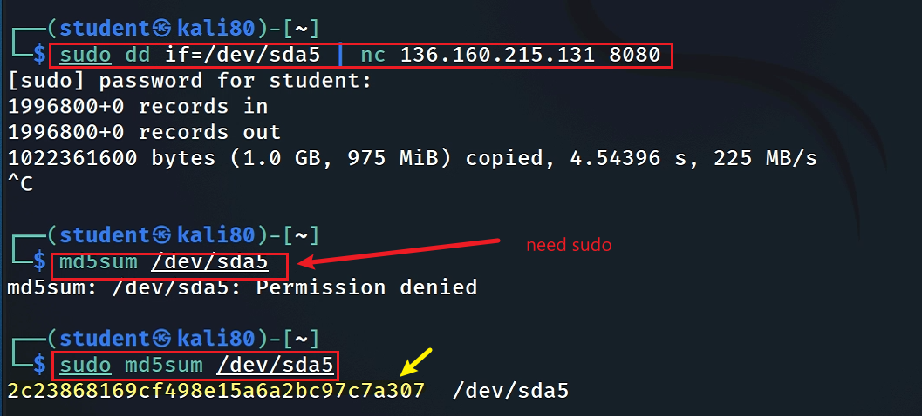
Network Acquisition

Slide 30
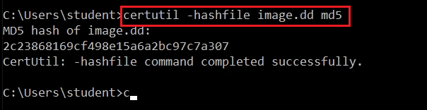
Verify the acquired image hash

Slide 31
Goal 2: Windows => Kali
Set up a listener in Kali to listen to network traffic
Acquire a file in Windows and send the file to Kali (ncat)
Verify hash code of images at both OS

Slide 32
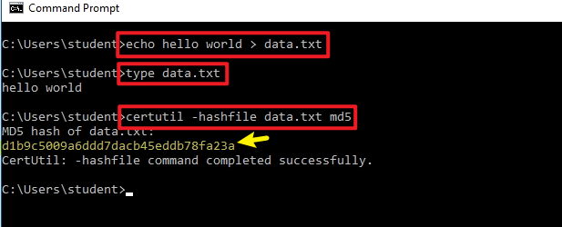
Create an example file

Slide 33
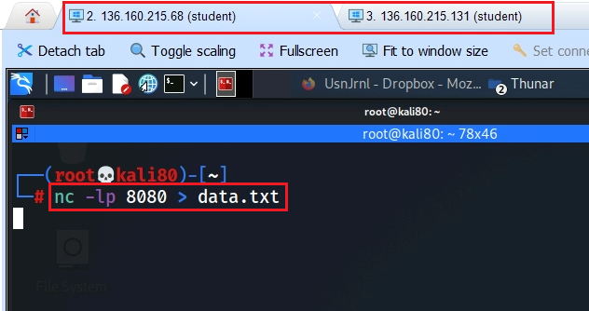
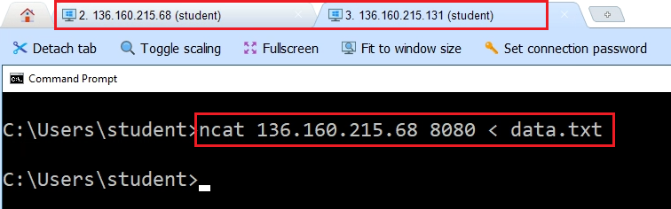
Listen and send
Listen in Kali
Send from Windows

Slide 34
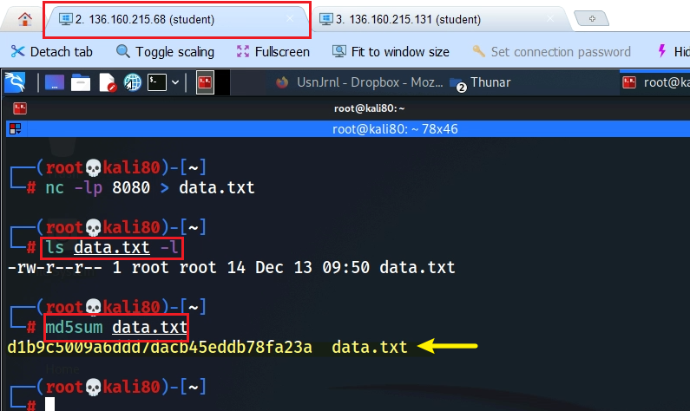
Verify the acquired file hash

