Slide 1
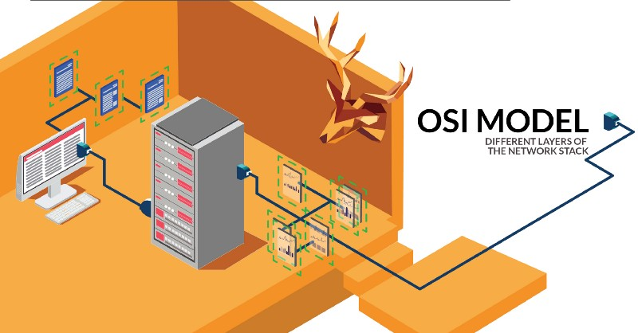
HTTP, Wireshark, and Digital Forensics
Notes:
https://www.youtube.com/watch?v=6G3qm60dfA8&ab_channel=PrashantThombre

Slide 2
Overview
Observe HTTP traffic with curl
Is understanding HTTP enough for forensic investigations?
Open Systems Interconnection Model (OSI)
Exam HTTP traffics with Wireshark
Three-way handshake (TCP)
Communication (HTTP request/response)
Close connection (TCP)

Slide 3
Observe HTTP traffic

Slide 4
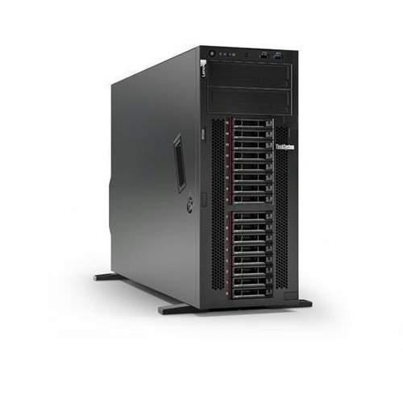

What is HTTP?
HTTP stands for hypertext transfer protocol and is used to transfer data across the Web
HTTP Request
HTTP Response

Slide 5
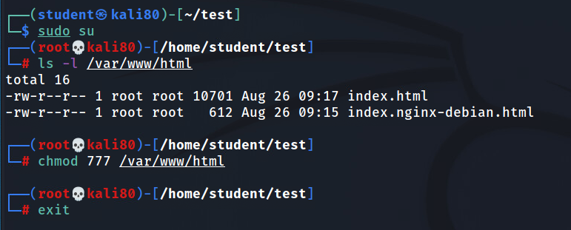
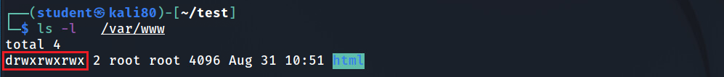
Create a simple html page to be observed in Wireshark
(optional) if you are logged in as student, you must change the html folder permission

Slide 6
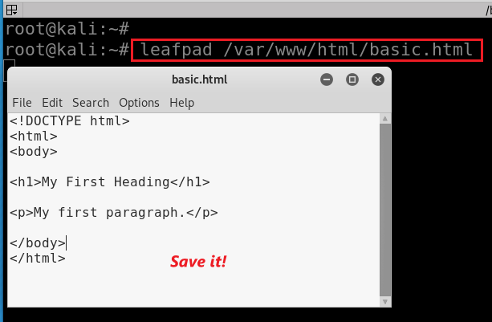
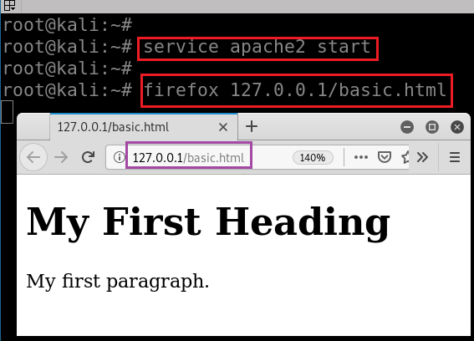
Create a simple webpage, named basic.html, and
Put it in the folder /var/www/html
Start web service
Show the webpage
service apache2 stop service apache2 restart
Notes:
<!DOCTYPE html>
<html>
<body>
<h1>My First Heading</h1>
<p>My first paragraph.</p>
</body>
</html>
https://www.w3schools.com/html/tryit.asp?filename=tryhtml_basic_document

Slide 7
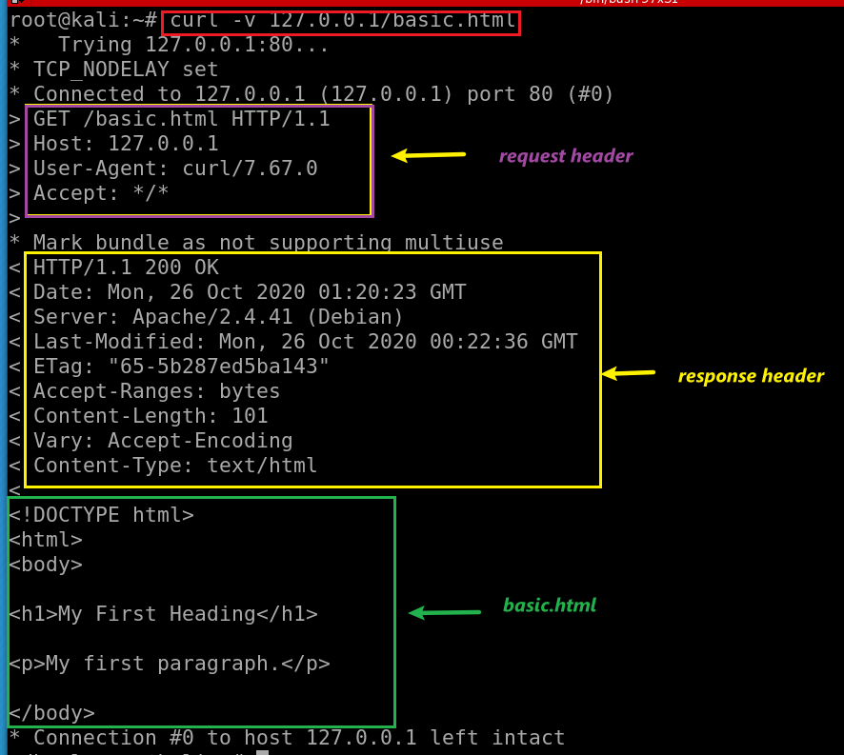
-v: verbose, show headers
cURL (pronounced 'curl')
A command-line tool
Open source
Transferring data
Support many network protocols

Slide 8
Is understanding HTTP enough for forensic investigations?

Slide 9
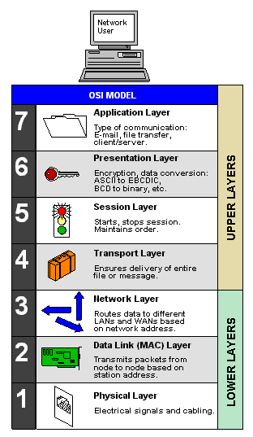
Importance of understanding underneath of HTTP
Many layers (OSI Model) are defined to form computer networks
HTTP is one protocol at an application layer
Forensic investigation focus on all layer
Malware analysis
Attack analysis
File extraction
The OSI Model (Open Systems Interconnection Model)
is a conceptual framework used to describe the functions of a networking system.

Slide 10

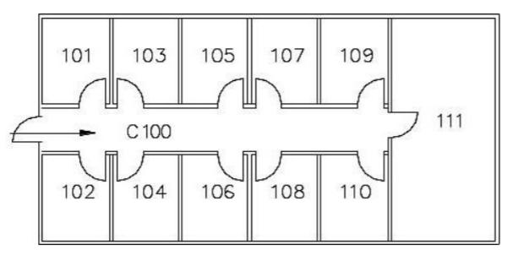


Building A
Building B
Mailroom
Mailroom
from: Building A 102
to: Building B 103
from: Building A 102
to: Building B 103
part 1
part 2
part 3
part 1
part 2
part 3
to mailroom
to mailroom
to mailroom
to 103
to 103
to 103

Slide 11
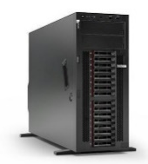
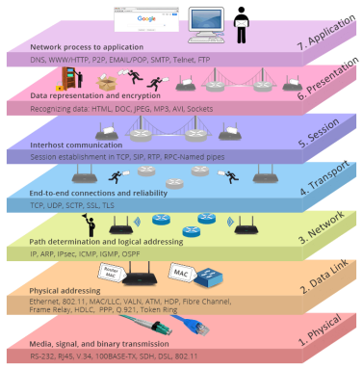
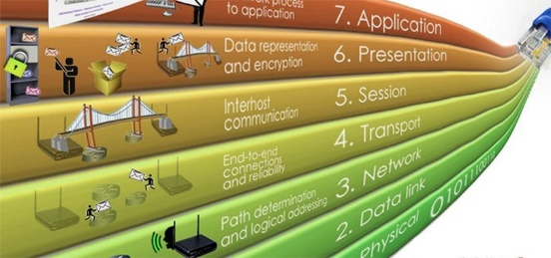
HTTP Request
HTTP Response

Slide 12
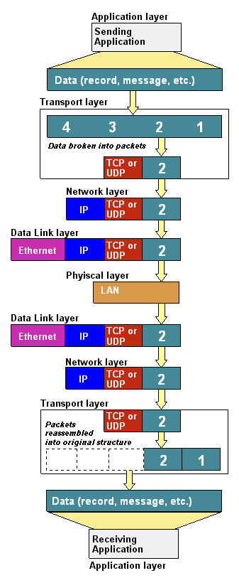

Data
Segment:
Packet
Frame
bit
Notes:
https://www.youtube.com/watch?v=-6Uoku-M6oY

Slide 13

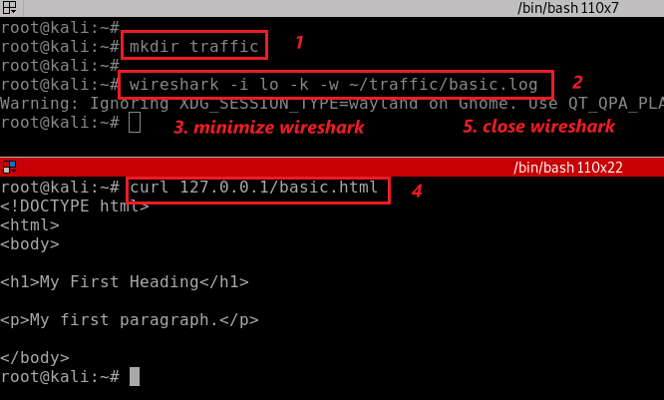
Clear browser cache
Notes:
rm -r ~/.cache/mozilla/firefox/*default*
wireshark -i lo -k -w ~/traffic/basic.log
curl 127.0.0.1/basic.html

Slide 14
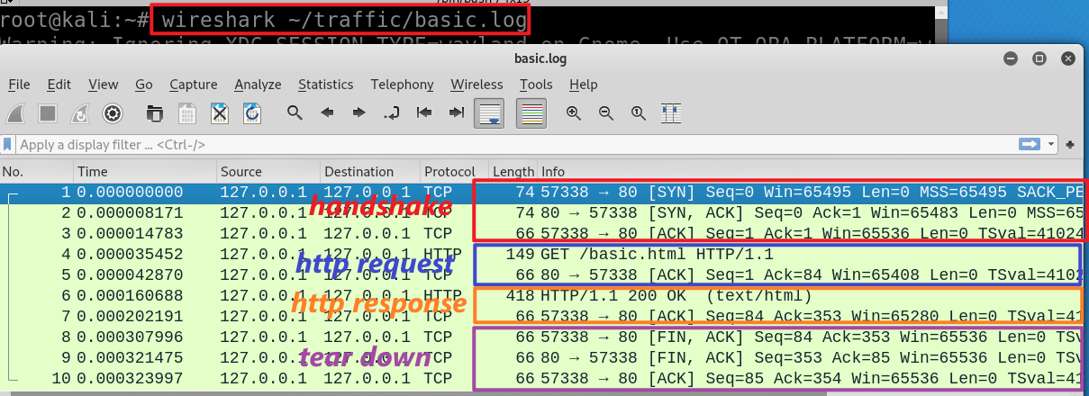
wget https://raw.githubusercontent.com/frankwxu/digital-forensics-lab/main/Illegal_Possession_Images/lab_files/traffic/basic.log
Notes:
wireshark ~/traffic/basic.log

Slide 15
Three-way handshake
No. 1, 2, and 3

Slide 16
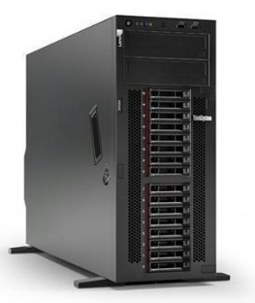

Sequence #:
the byte number of the first byte of data in the TCP packet sent
beginning at random # or 0 (relative seq#)
ACKnowledge #: the sequence number of the next byte the receiver expects to receive.
Seq # + size of packet + 1
The receiver ack'ing sequence number x acknowledges receipt of all data bytes less than (but not including) byte number x
+1 for SYN
Port 57338
Port 80
client state
Server state
CLOSED
CLOSED
choose init seq num, m
1
SYN (seq =m)
LISTEN
SYN-SEND
SYN-RECEIVED
SYN (seq =n) + ACK (m+1)
2
received SYNACK
indicates server is live;
send ACK;
ACK (n+1)
3
ESTABLISHED
ESTABLISHED
n, m are in bytes
Notes:
https://www.freecodecamp.org/news/an-introduction-to-http-understanding-the-open-systems-interconnection-model-9dd06233d30e/
https://www.geeksforgeeks.org/tcp-3-way-handshake-process/
https://www.geeksforgeeks.org/tcp-connection-termination/

Slide 17
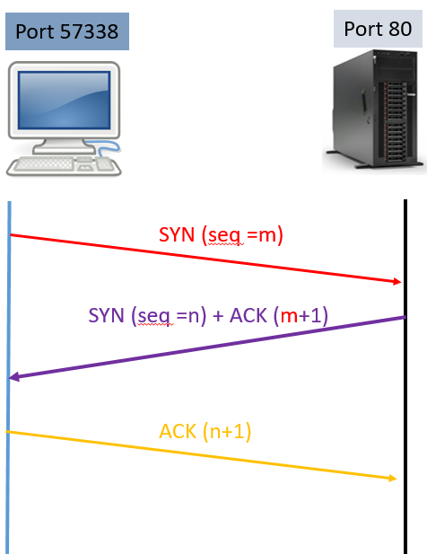
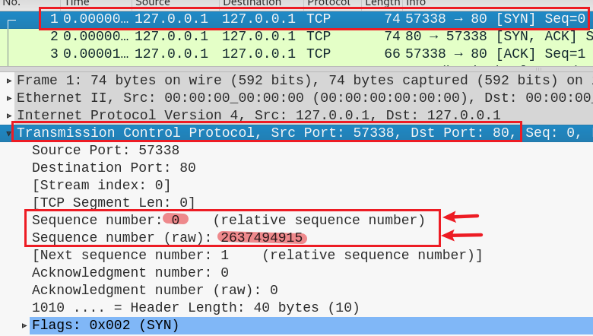
1
m
Client:
I am sending seq # m
I will use the seq # m to indicate the byte number of the first byte of data in the TCP packet sent

Slide 18
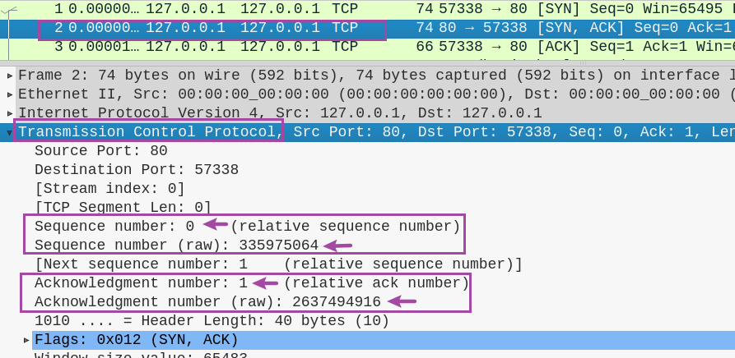
2
n
Server:
I’ve received your seq # m
I expect to receive your next seq# m+ 1
I’m sending seq # n and I will use it to indicate the byte number of the first byte of data in the TCP packet I am sending
m+ 1

Slide 19
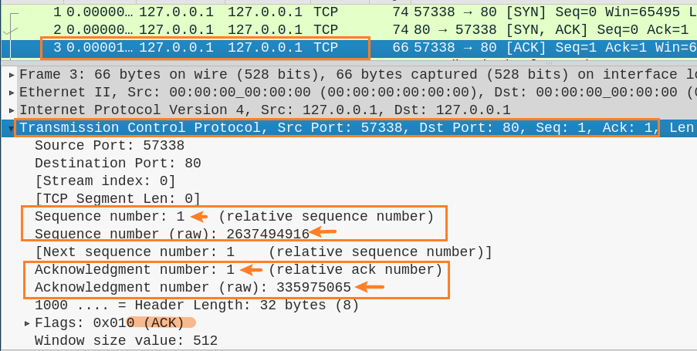
3
m+ 1
Client:
OK. I am sending seq # m+ 1 as you requested
I expect to receive seq # n +1
n +1

Slide 20
HTTP request protocol
No. 4

Slide 21


Port 57338
Port 80
1
SYN (seq =0)
SYN (seq =0) , ACK (0+1)
2
handshake
3
(seq =1) , ACK (0+1)
http request/TCP
4
(seq =1) , ACK (0+1), TCP len=t1
(seq =1) , ACK (1+t1), TCP len=0
5
Transfer
(seq =1) , ACK (1+t1), TCP len=t2
6
http response/TCP
7
(seq =1+t1) , ACK (1+t2), TCP len=0

Slide 22
Port 57338
Port 80
TCP length t1=83
TCP length t2=352
1
SYN (seq =0)
SYN (seq =0) , ACK (0+1)
2
handshake
3
(seq =1) , ACK (0+1)
http request/TCP
4
(seq =1) , ACK (0+1), TCP len=83
(seq =1) , ACK (1+83), TCP len=0
5
Transfer
(seq =1) , ACK (1+83), TCP len=352
6
http response/TCP
7
(seq =1+83) , ACK (1+352), TCP len=0

Slide 23
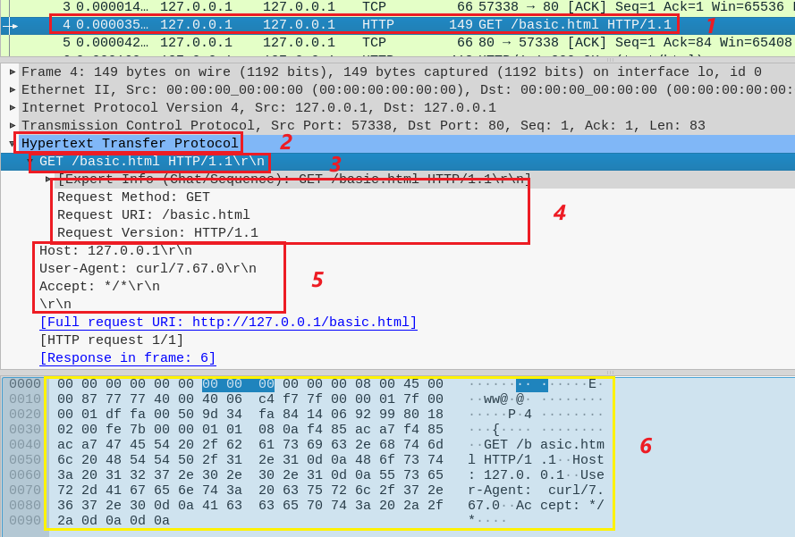
Show http request
4

Slide 24
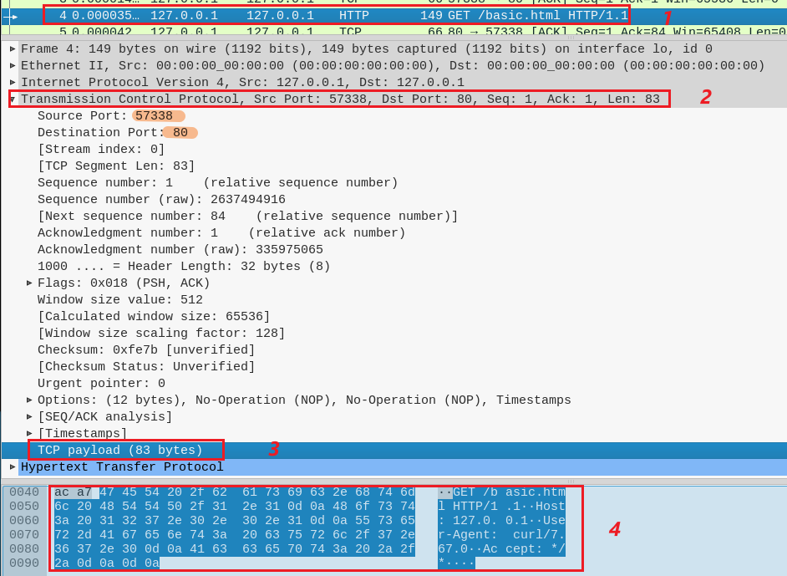
Show http request
4
Show TCP segment 4
Show TCP payload

Slide 25
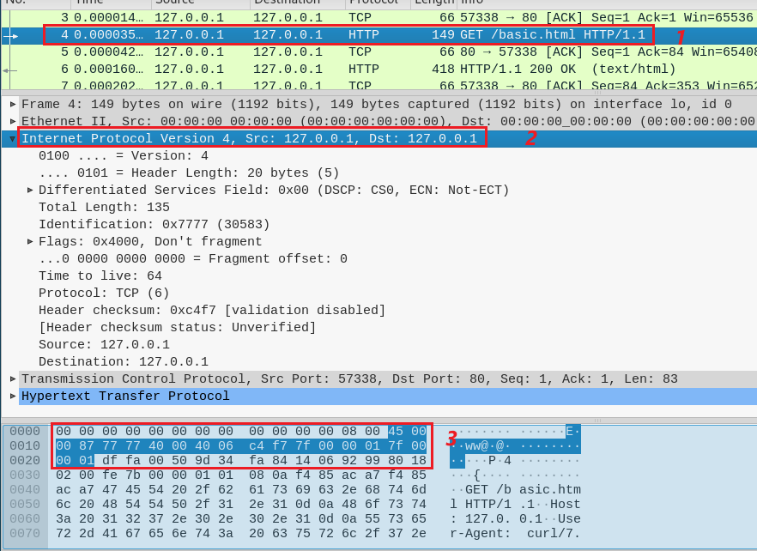
Show http request
4
Show IP packet 4

Slide 26
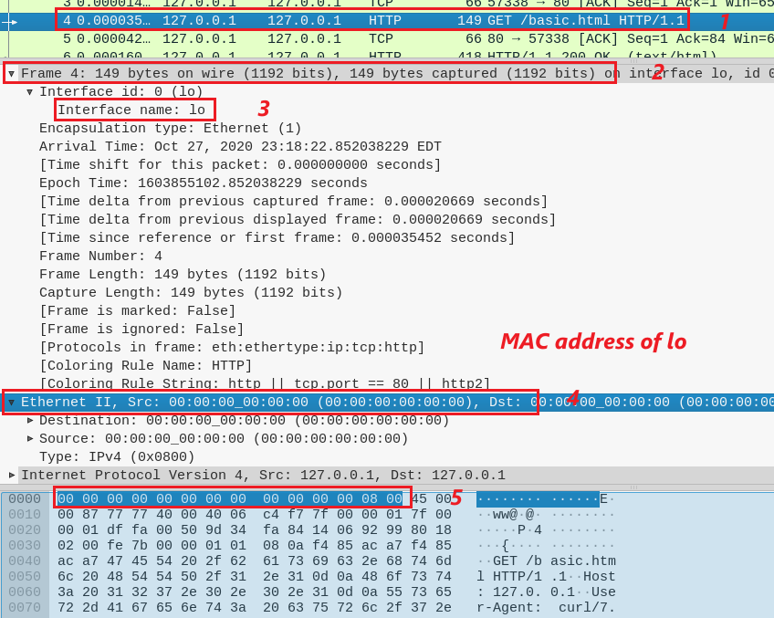
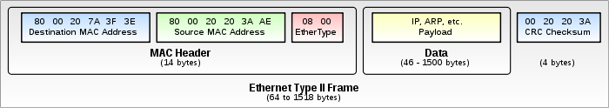
Show http request
4
Ethernet Frame 4
Show Ethernet 802.3
lo interface is not associated with a hardware network interface (it's a virtual loopback interface), it does not have an Ethernet hardware address (MAC address).
ARP (0x0806)

Slide 27
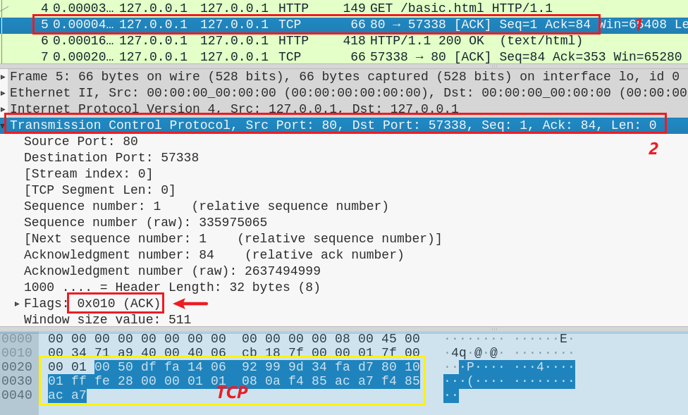
Server ACKnowledges the request
5
ACK 84 =1+ TCP length

Slide 28
HTTP response protocol
No. 5 and 6

Slide 29
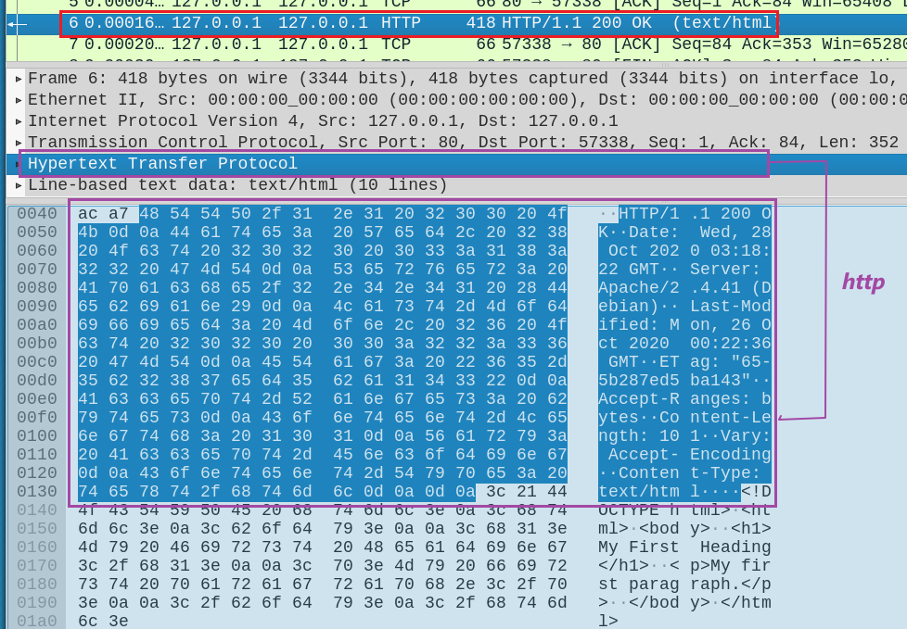
Server send HTTP response head
6
HTTP head

Slide 30
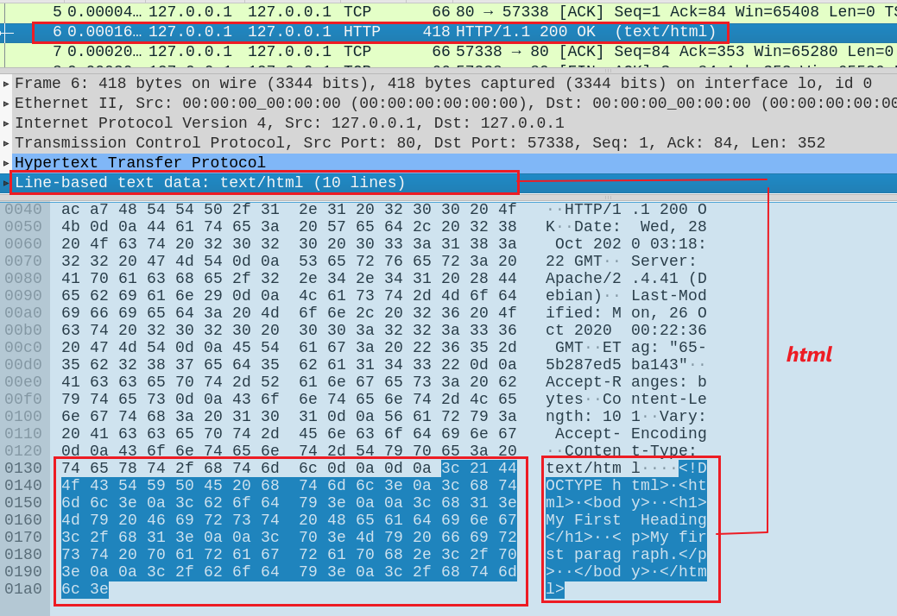
Server send HTTP response data (simple.html)
6
simple.html

Slide 31
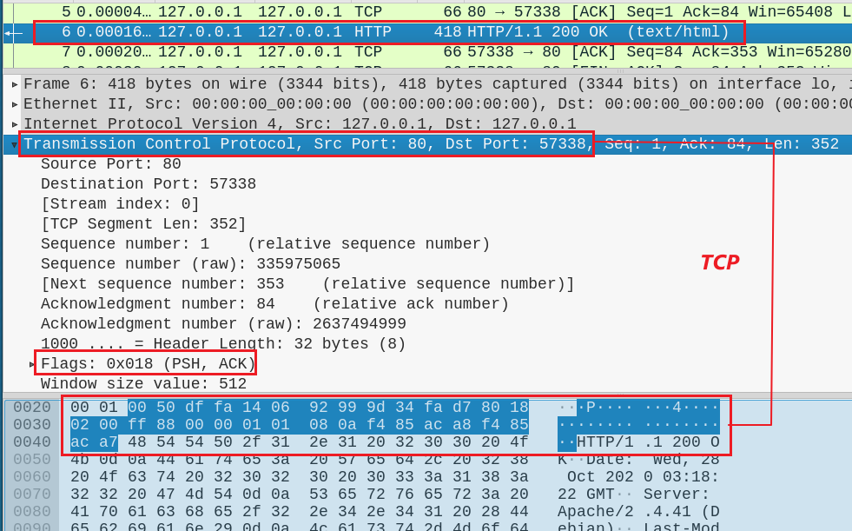
Server send HTTP response data (simple.html)
6
TCP
PSH: data must be transmitted promptly to the receiver

Slide 32
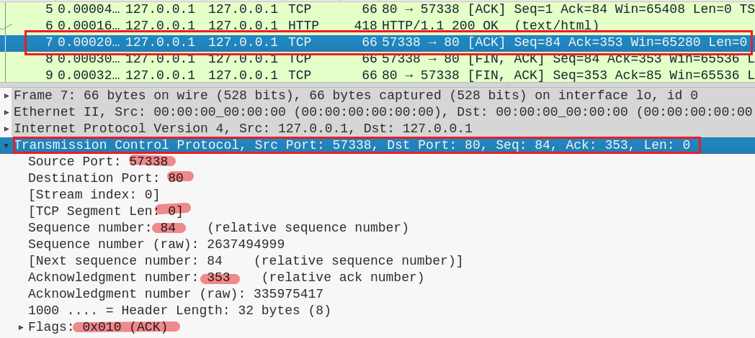
Client sends TCP acknowledgement
7

Slide 33
TCP Close connection

Slide 34
Port 57338
Port 80
client state
server state
ESTAB
ESTAB
8
FIN_WAIT_1
can no longer
send but can
receive data
FIN, ACK=353, seq=84
CLOSE_WAIT
ACK=84+1
can still
send data
FIN_WAIT_2
wait for server
close
9
LAST_ACK
FIN, ACK=84+1, seq=353
TIMED_WAIT
can no longer
send data
10
ACK=353+1
timed wait
for 2*max
segment lifetime
CLOSED
CLOSED

Slide 35
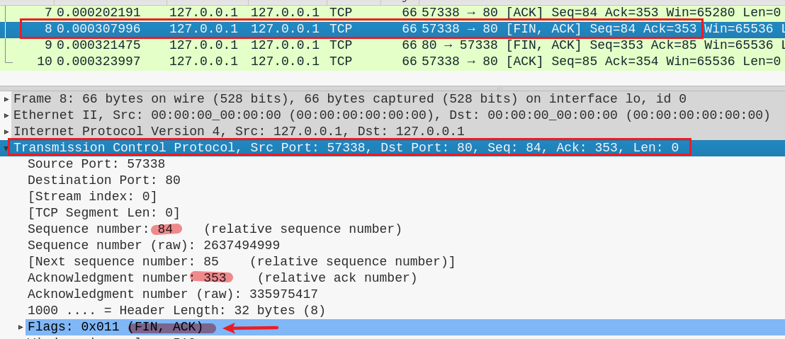
8

Slide 36
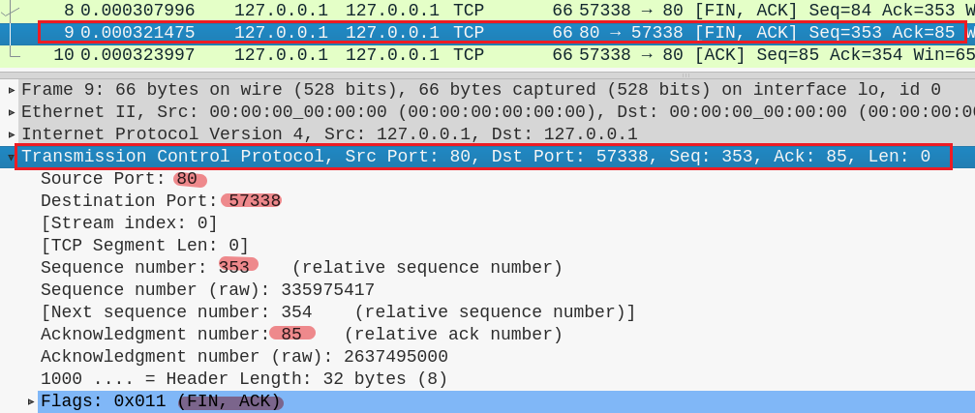
9

Slide 37
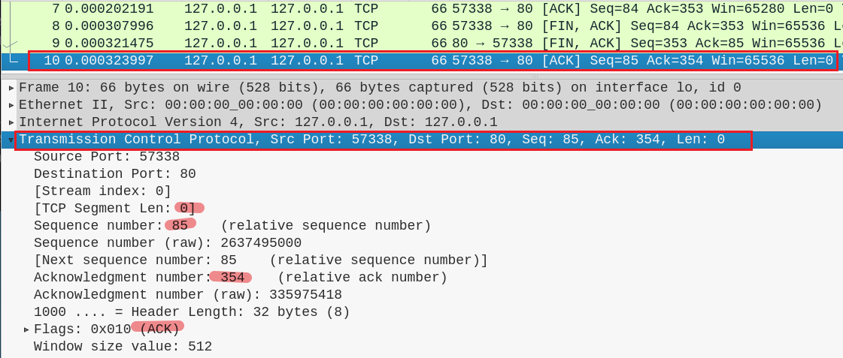
10

