Slide 1
Acquiring the USB image
Notes:
https://www.youtube.com/watch?v=6G3qm60dfA8&ab_channel=PrashantThombre

Slide 2
What is a disk image?
A disk image is a computer file
containing the contents and structure of a disk volume or
containing an entire data storage device,
Storage devices
a hard disk drive, tape drive, floppy disk, optical disc, or USB flash drive
The file format
open standard: such as the ISO image format for optical disc images,
unique to a particular software application: encase, FTK
Image acquisition can be done in
Windows
Linux

Slide 3
Acquisition in Windows using FTK Imager

Slide 4
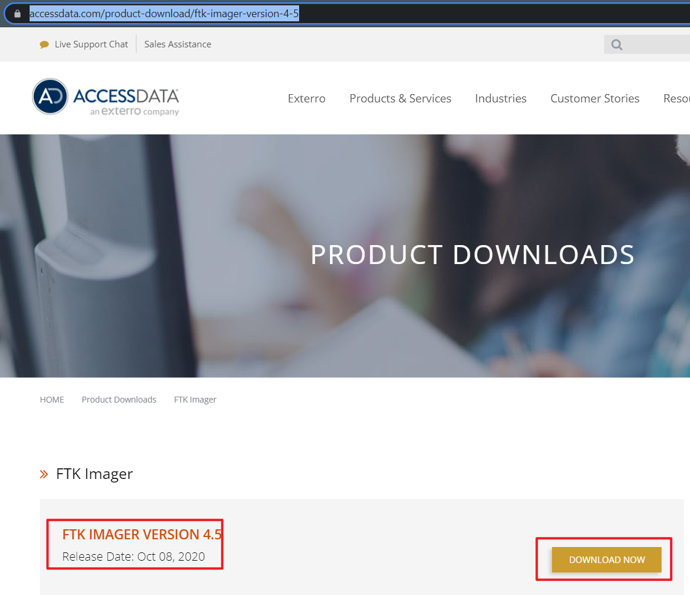
Download and install FTK
https://accessdata.com/product-download/ftk-imager-version-4-5

Slide 5
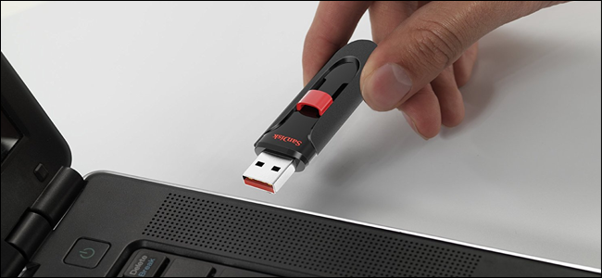
Plug in a Flash Drive to Your Computer
You can copy come files to the USB
https://www.howtogeek.com/wp-content/uploads/2017/09/ximg_59b9b8dfbb300.png.pagespeed.gp+jp+jw+pj+ws+js+rj+rp+rw+ri+cp+md.ic.2DjSUAOnqK.jpg

Slide 6
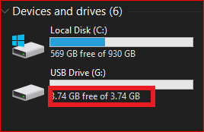
Verify your PC can read the USB drive

Slide 7

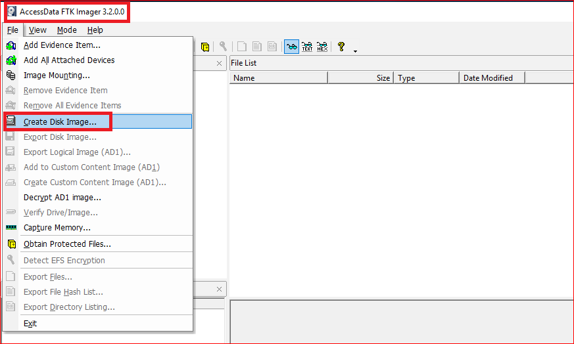
Acquiring a USB using FTK

Slide 8
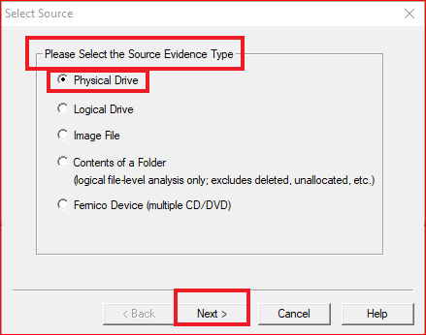
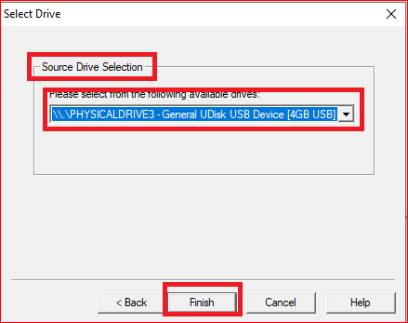

Slide 9
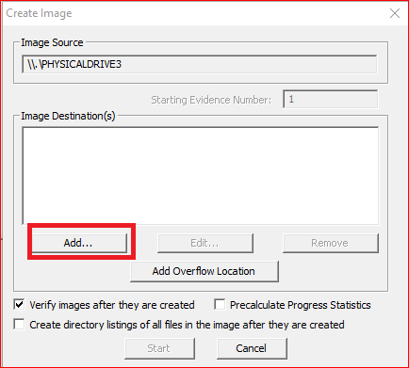
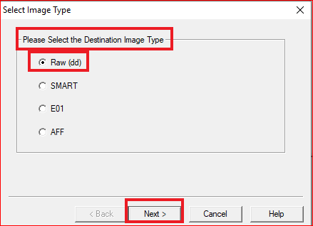

Slide 10
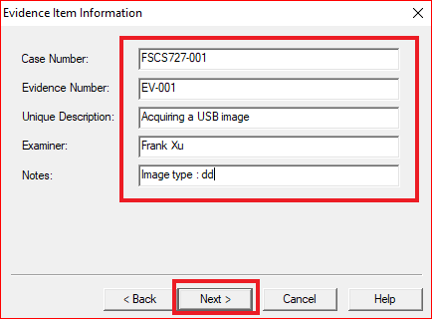

Slide 11
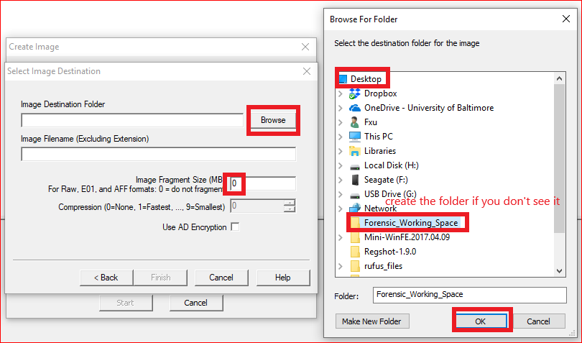

Slide 12
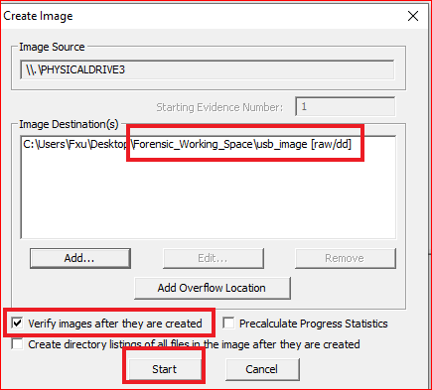
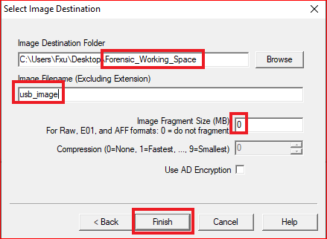

Slide 13
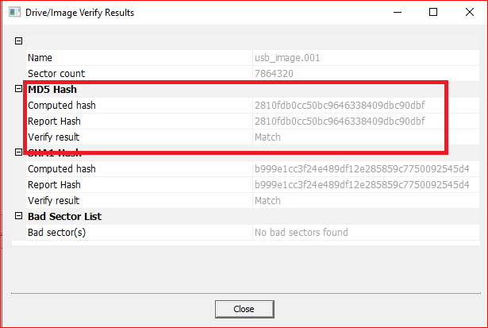
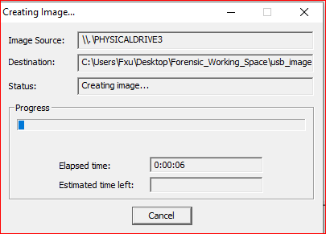

Slide 14
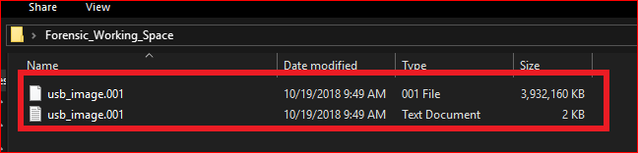

Slide 15
Acquisition a USB in Linux

Slide 16
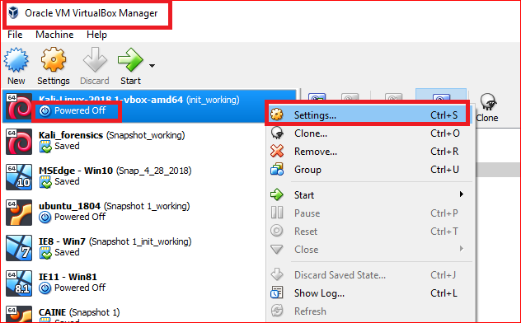

Slide 17
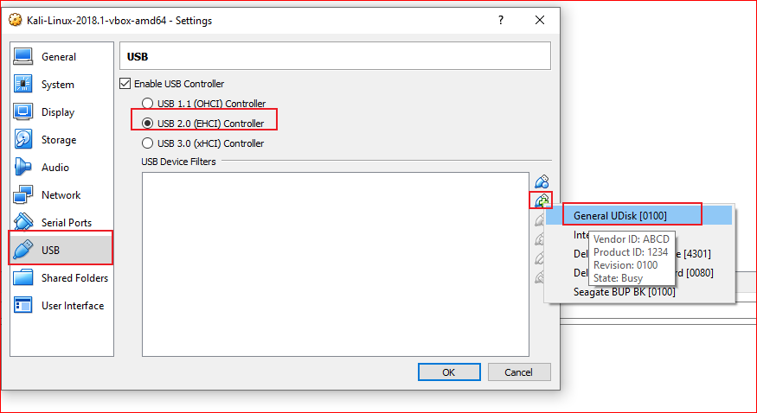

Slide 18
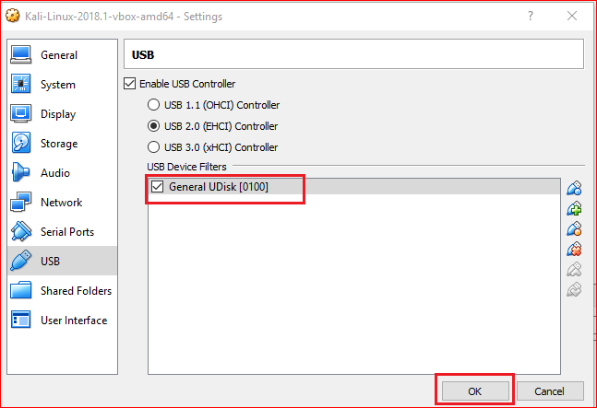

Slide 19
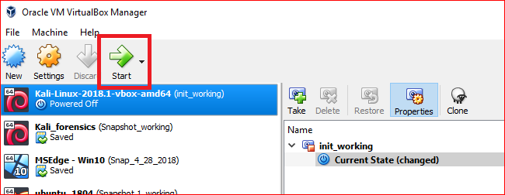

Slide 20
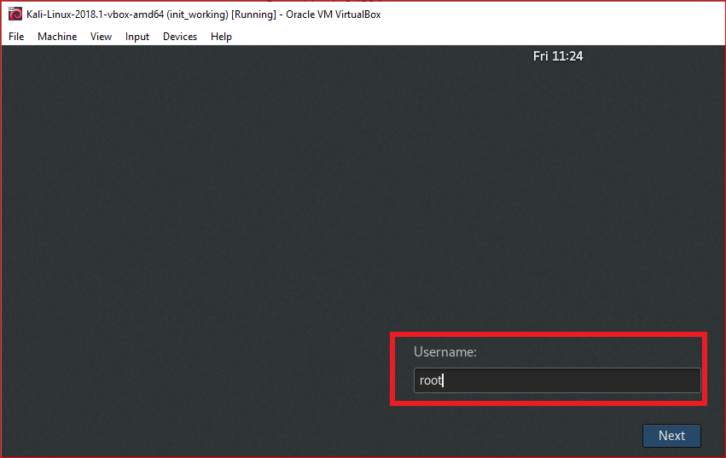
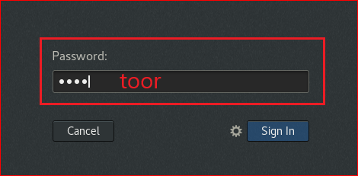

Slide 21
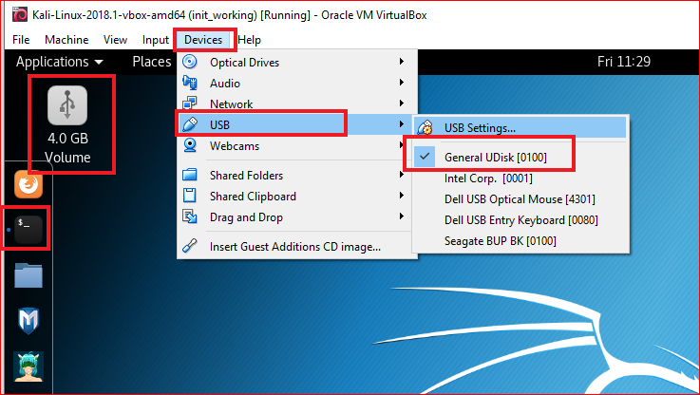

Slide 22
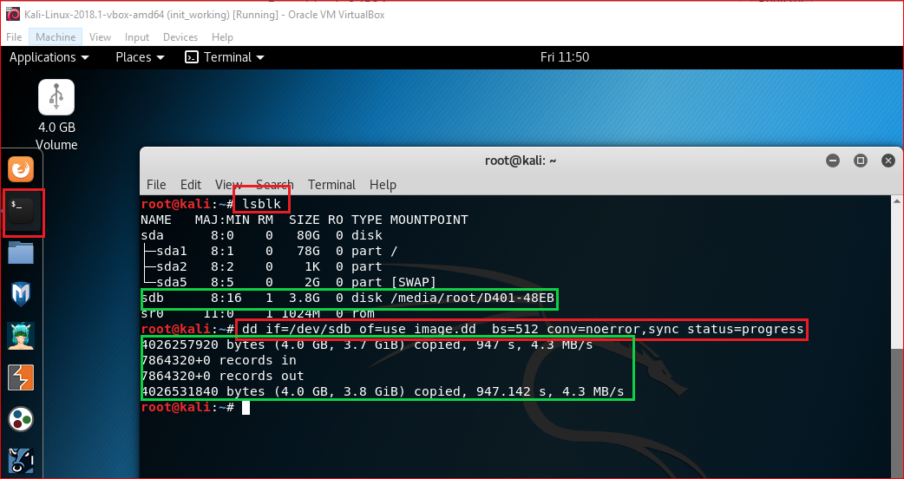
dd command to clone a USB
Notes:
If there are any errors, the above command will fail. If you give the parameter “conv=noerror” then it will continue to copy if there are read errors.

Slide 23
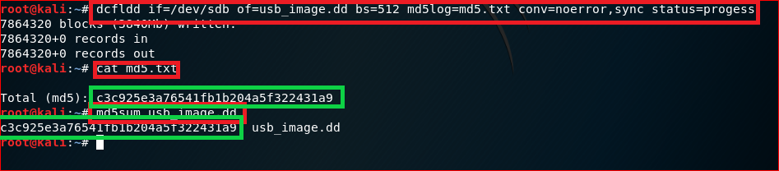
Use dcfldd
Notes:
sudo dd if=/dev/sda5 of=backup.dd status=progress

