Slide 1
DNS Spoofing Forensics
Traffic files: https://github.com/frankwxu/digital-forensics-lab/tree/main/Networking_Forensics/lab_files/dns_spoof
Notes:
https://www.youtube.com/watch?v=6G3qm60dfA8&ab_channel=PrashantThombre

Slide 2
Goal
Create a fake bank login page
Redirect users to the fake page if a user types an incorrect URL address
The user must in the same LAN

Slide 3
What is DNS Spoofing Attack

Slide 4
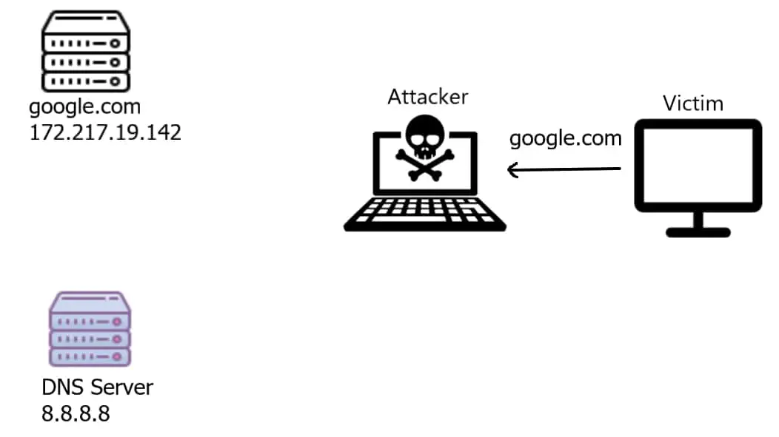
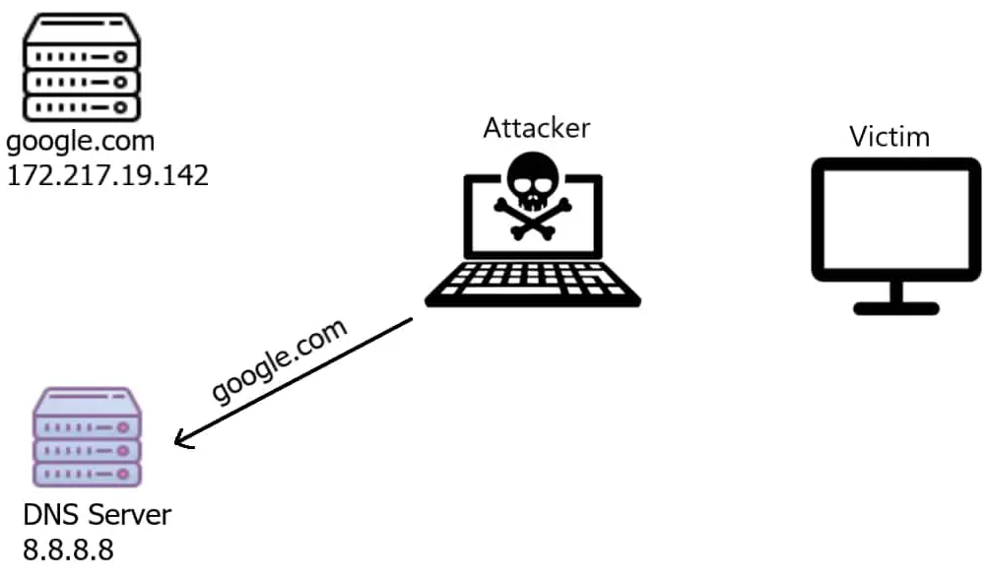

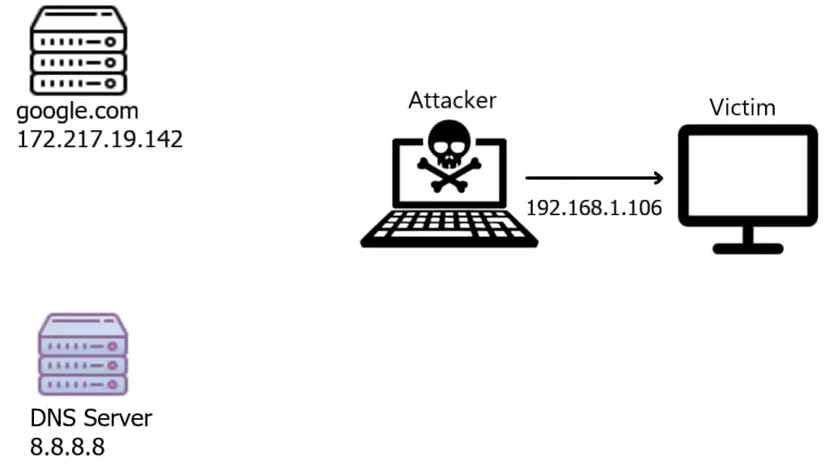
iptables
router
1. Attacker intercepts a DNS request
2. Attacker forwards the DNS request to the DNS server
3. Attacker receives the DNS response
4. Attacker modifies the DNS response and back a fake IP to the victim

Slide 5
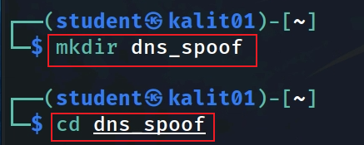
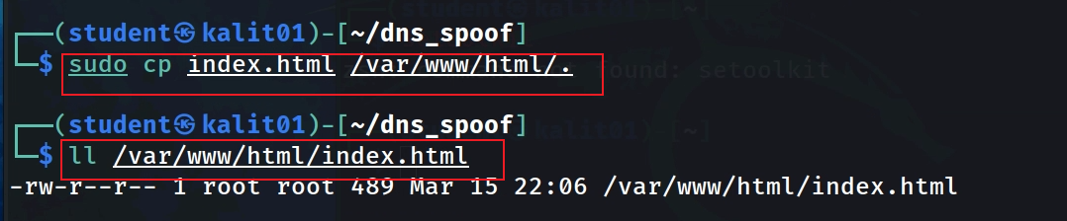
Create a fake bank login page
Create a working folder
Copy the login page to /var/www/html
Notes:
https://raw.githubusercontent.com/frankwxu/digital-forensics-lab/main/Networking_Forensics/lab_files/dns_spoof/index.html

Slide 6
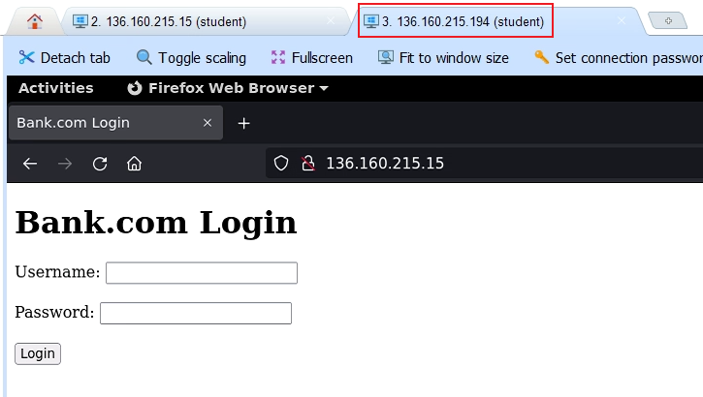
Verify the fake page

Slide 7
Key components of DNS attacks
ARP poisoning
Attack (Kali) launches the Man-In-The-Middle attack
DSN spoof
Attack (Kali) forwards the DSN query to the DSN server
Attack (Kali) intercepts the DSN response and provides a fake IP

Slide 8
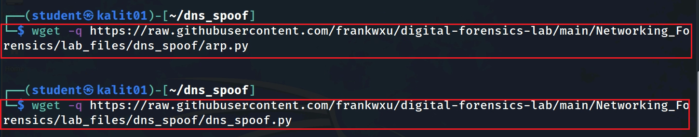
Download two files
Notes:
wget -q https://raw.githubusercontent.com/frankwxu/digital-forensics-lab/main/Networking_Forensics/lab_files/dns_spoof/arp.py
wget -q https://raw.githubusercontent.com/frankwxu/digital-forensics-lab/main/Networking_Forensics/lab_files/dns_spoof/dns_spoof.py

Slide 9
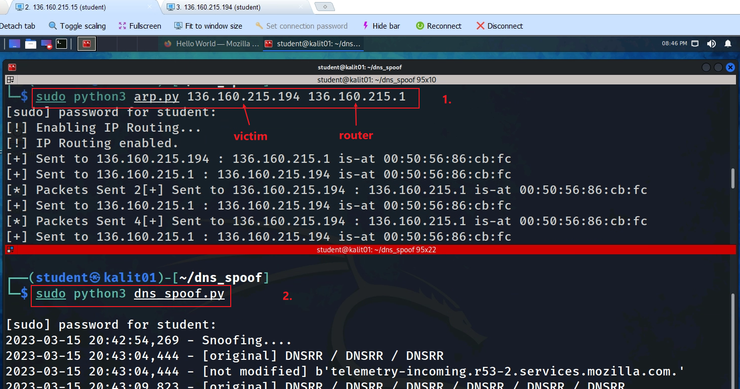
Notes:
sudo python3 arp.py 136.160.215.194 136.160.215.1
sudo python3 dns_spoof.py

Slide 10
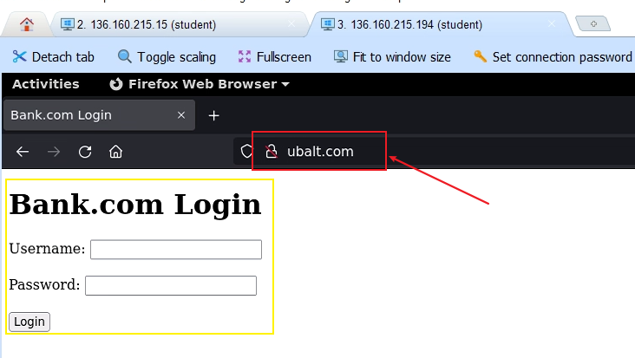
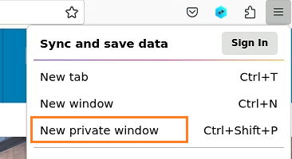
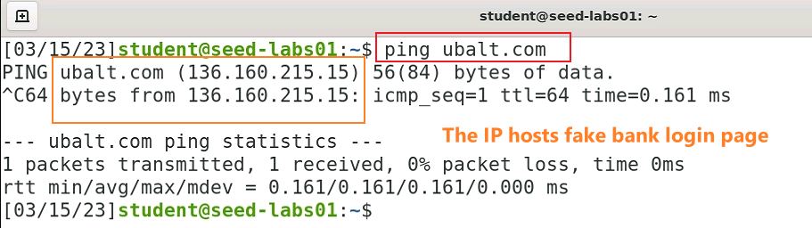

Slide 11
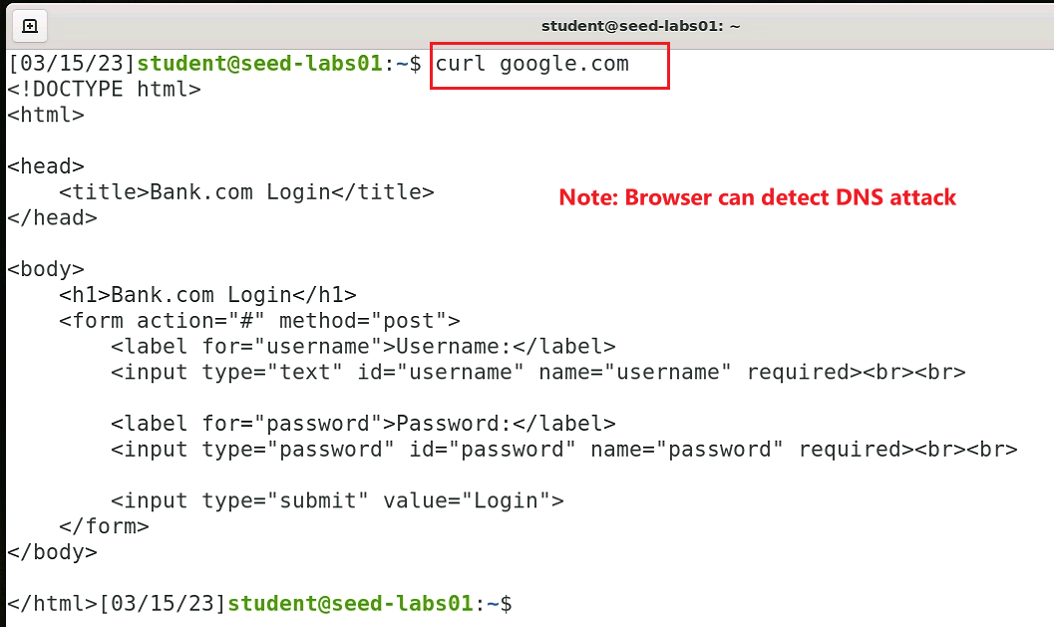

Slide 12
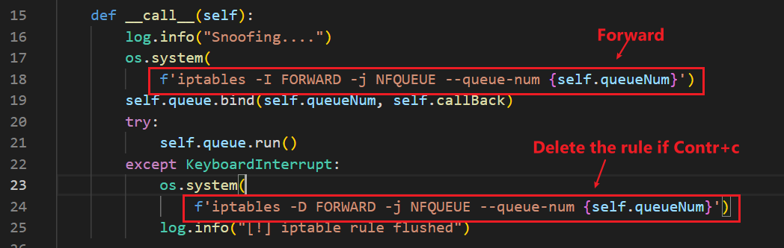
Key functions
The rule triggers a callback function

Slide 13
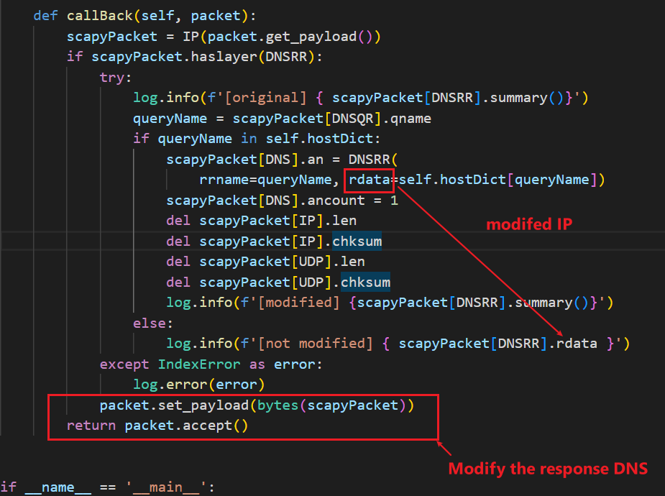

Slide 14
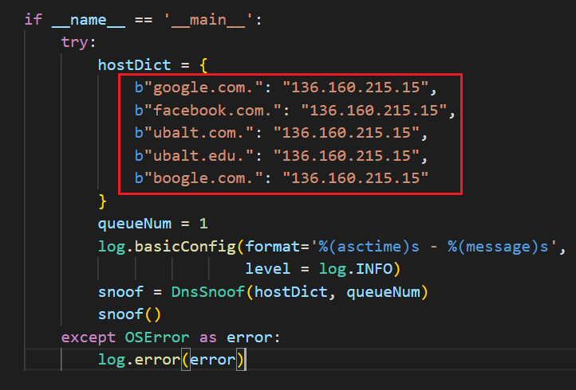

Slide 15
Analyze DNS spoof traffic

Slide 16
Will work on this

