Slide 1
DNS Spoofing Forensics
Traffic files: https://github.com/frankwxu/digital-forensics-lab/tree/main/Networking_Forensics/lab_files/dns_spoof
Notes:
https://www.youtube.com/watch?v=6G3qm60dfA8&ab_channel=PrashantThombre

Slide 2
DNS Spoofing Attack

Slide 3
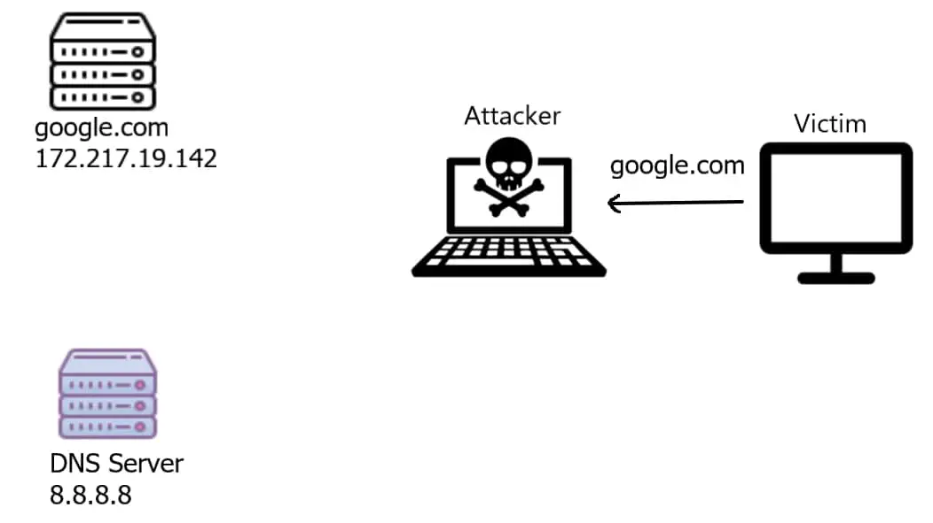
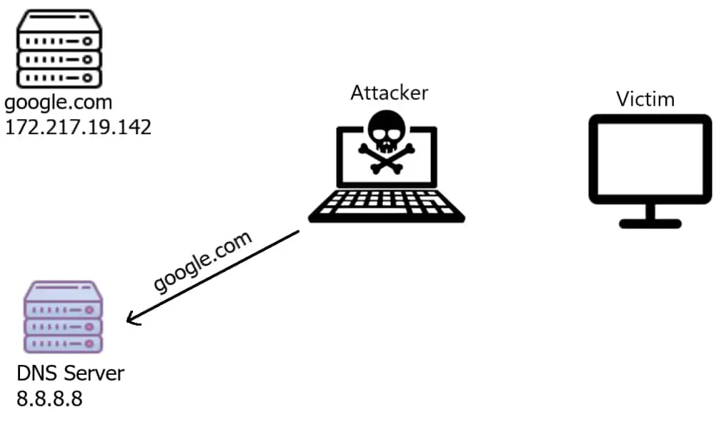

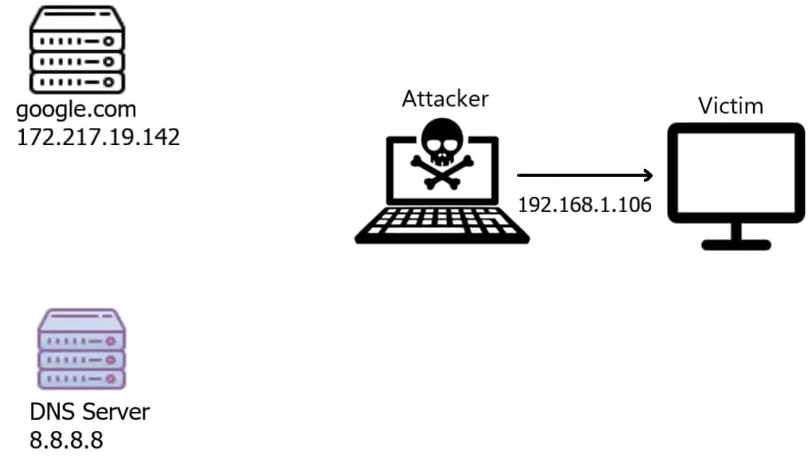
iptables
router
1. Attacker intercepts a DNS request
2. Attacker forwards the DNS request to the DNS server
3. Attacker receives the DNS response
4. Attacker modifies the DNS response and back a fake IP to the victim

Slide 4
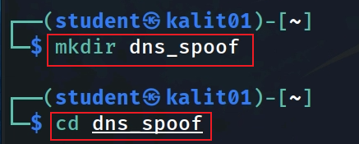
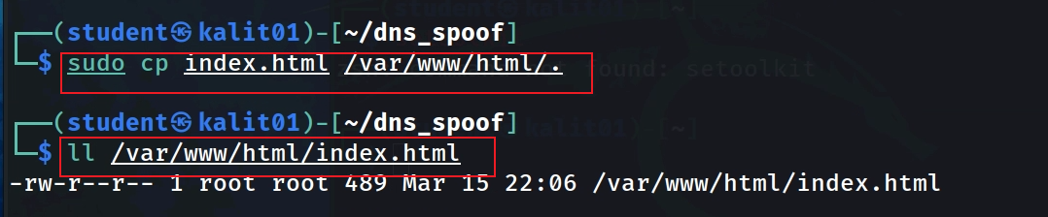
Create a fake bank login page

Slide 5
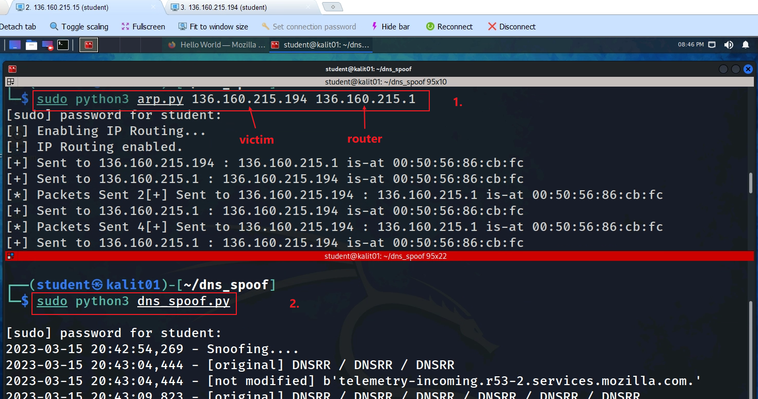
Notes:
sudo python3 arp.py 136.160.215.194 136.160.215.1
sudo python3 dns_spoof.py

