Slide 1
Investigate Data Leakage Case
Keywords: USN Journaling
Notes:
http://xmlstar.sourceforge.net/doc/UG/

Slide 2
23. Identify all traces related to ‘renaming’ of files in Windows Desktop.
Backup whole volume is time consuming
Solution: only save changed files -> keep tracking of changed files
Doesn’t need to include the details of data changes
USN (Update Sequence Number) Journal
Is a feature of the Windows NT file system (NTFS)
Records all files changes (e.g.., rename) that are made to volume
Changes are described using bit flags
From Win7, Journal Function is activated by default
USN is a treasure trove of information for a forensic investigation.
Keep track of suspect’s behaviors to volumes
Notes:
https://en.wikipedia.org/wiki/USN_Journal#:~:text=The%20USN%20Journal%20(Update%20Sequence,the%20NTFS%20file%20system%20journaling.

Slide 3
Format of record of USN Journal
Time of change
Reason for the change
File/directory’s name
File/directory’s attributes
File/directory’s MFT record number
File record number of the file’s parent directory
Security ID
USN of the record
Information about the source of the change

Slide 4
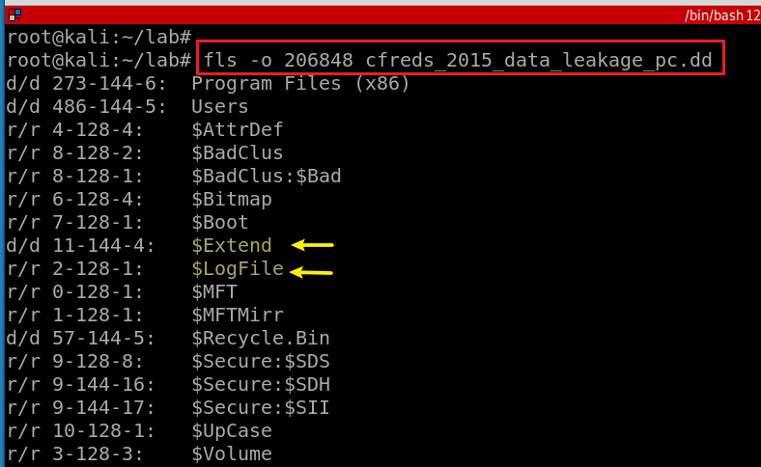
USN Journal location $Extend
Notes:
fls -o 206848 cfreds_2015_data_leakage_pc.dd

Slide 5
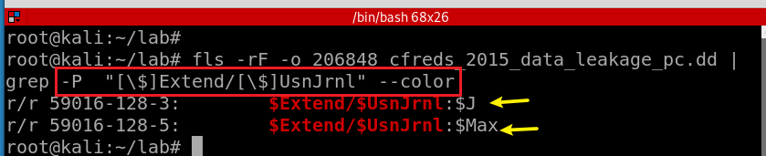
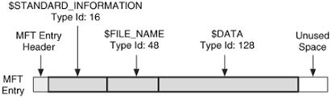
$Extend\$UsnJrnl contains two alternate data streams
Search for $Extend\$UsnJrnl
[ ]: Match a single character
$J: The actual change log records: the date and time of the change, the reason for the change, the Master File Table (MFT) entry, the parent entry and others.
$Max: The meta data of change log: e.g., the maximum size.
Notes:
fls -rF -o 206848 cfreds_2015_data_leakage_pc.dd | grep -P "[\$]Extend/[\$]UsnJrnl" --color
https://countuponsecurity.com/tag/ntfs-logfile/

Slide 6
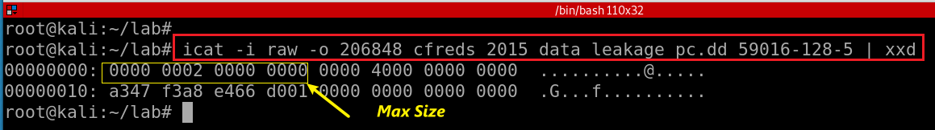
$Extend\$UsnJrnl: $Max attribute
Offset | Size | Stored | Information Detail
0x00 | 8 | Maximum Size | The maximum size of log data
0x08 | 8 | Allocation Size | The size of allocated area when new log data is saved.
0x10 | 8 | USN ID | The creation time of "$UsnJrnl" file(FILETIME)
0x18 | 8 | Lowest Valid USN | The least value of USN in current records With this value, investigator can approach the start point of first record within "$J" attribute
Notes:
icat -i raw -o 206848 cfreds_2015_data_leakage_pc.dd 59016-128-5 | xxd
http://forensicinsight.org/wp-content/uploads/2013/07/F-INSIGHT-Advanced-UsnJrnl-Forensics-English.pdf

Slide 7
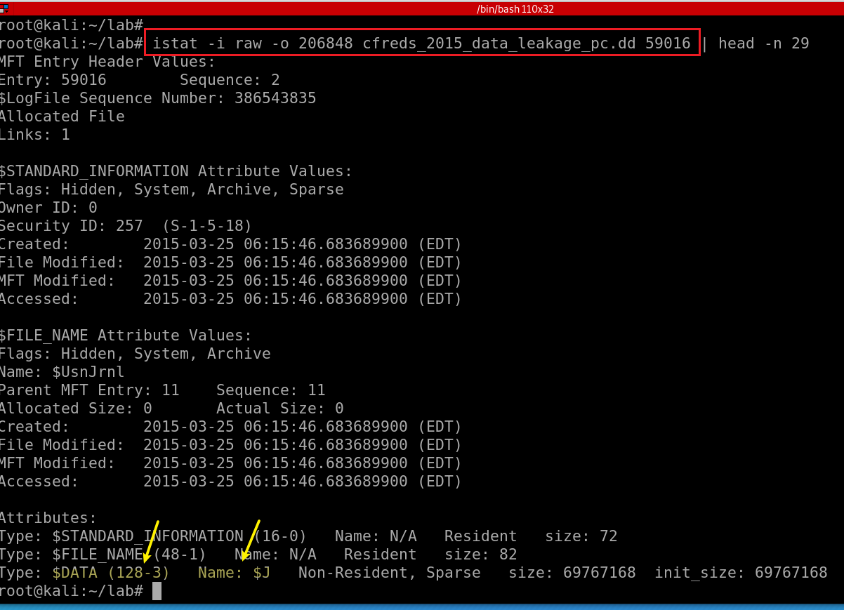
View $Extend\$UsnJrnl: $J attribute
59016: inode #
Notes:
istat -i raw -o 206848 cfreds_2015_data_leakage_pc.dd 59016 | head -n 29

Slide 8
$Extend\$UsnJrnl: $J
It begins as an empty file.
Whenever a change is made to the volume, a record is added to the file.
Each record is identified by a 64-bit Update Sequence Number (USN, for this reason Change Journals are sometimes called USN Journals).
Each record in the Change Journal contains the USN, the name of the file, and information about what the change was.
Tt does not include all the data or details associated with the change.
Cannot be used to undo operations on files within NTFS
Will be reused when journal reaches its maximum size
Clusters of the journal’s disk space are marked unallocated by OS
Unallocated space can be extremely valuable

Slide 9
The Structure of $J
Sparse Area | USN1 | USN2 | USN3 | USN4 | … | USNn
"Sparse Area“ : zero-filled
The structure allow OS to keeps the same size of the log data
The new records are added at the end of the attribute.
If the total size of the added records exceeds "Allocation Size",
the operation system assures that the size of the entire log data exceeds "Maximum Size“
If the size of the entire log data exceeds "Maximum Size",
the front area of attribute is occupied by zero as much as size of "Allocation Size".(Actually, disk area is not filled by zero.)
Lowest Valid USN

Slide 10
$J record format
Offset | Size | Stored Information | Explaination
0x08 | 8 | File Reference Number | The ordinal number of the file or directory for which this record notes changes.
0x10 | 8 | Parent File Reference Number | The ordinal number of the directory where the file or directory that is associated with this record is located.
0x18 | 8 | Usn | The USN of this record
0x20 | 8 | TimeStamp | The standard UTC time stamp (FILETIME) of this record, in 64-bit format.
0x28 | 4 | Reason flag | The flags that identify reasons for changes that have accumulated in this file or directory journal record since the file or directory opened.
0x34 | 4 | File Attributes | The attributes for the file or directory associated with this record, as returned by the GetFileAttributes function. Attributes of streams associated with the file or directory are excluded.
0x3A | 2 | FileNameOffset | The offset of the FileName member from the beginning of the structure.
0x3C | N | Filename | The name of the file or directory associated with this record in Unicode format.
Notes:
https://docs.microsoft.com/en-us/windows/win32/api/winioctl/ns-winioctl-usn_record_v2?redirectedfrom=MSDN

Slide 11
Reason Flag
When a file or directory closes,
A final USN record is generated with the USN_REASON_CLOSE flag set.
The next change (for example, after the next open operation or deletion) starts a new record with a new set of reason flags.
A rename or move operation
Generates two USN records, one that records the old parent directory for the item, and one that records a new parent.

Slide 12
Flag | Value | Description
0x00000100 | FILE_CREATE | The file or directory is created for the first time.
0x00000002 | DATA_EXTEND | The file or directory is extended (added to).
0x00002000 | RENAME_NEW_NAME | A file or directory is renamed, and the file name in the USN_RECORD_V2 structure is the new name.
0x00001000 | RENAME_OLD_NAME | The file or directory is renamed, and the file name in the USN_RECORD_V2 structure is the previous name.
0x00000200 | FILE_DELETE | The file or directory is deleted.
0x80000000 | CLOSE | The file or directory is closed.
0x00008000 | BASIC_INFO_CHANGE | A user has either changed one or more file or directory attributes (for example, the read-only, hidden, system, archive, or sparse attribute), or one or more time stamps.
0x00010000 | HARD_LINK_CHANGE | An NTFS file system hard link is added to or removed from the file or directory.
0x00000004 | DATA_TRUNCATION | The file or directory is truncated.
Hard link: you need a file stored in two different folders.

Slide 13
How to read $Extend\$UsnJrnl
(Scenario 1) If the change journal doesn’t reaches its maximum size
icat : extract binary or https://github.com/jschicht/ExtractUsnJrnl
bless/xxd or UsnJrnl2Csv: convert to csv
(Scenario 2) As the change journal reaches its maximum size
Clusters of the journal's disk space are marked unallocated by OS
That space to be used when needed at a later time
usncarve: usncarve records in unallocated space
Usnparser: convert to csv

Slide 14
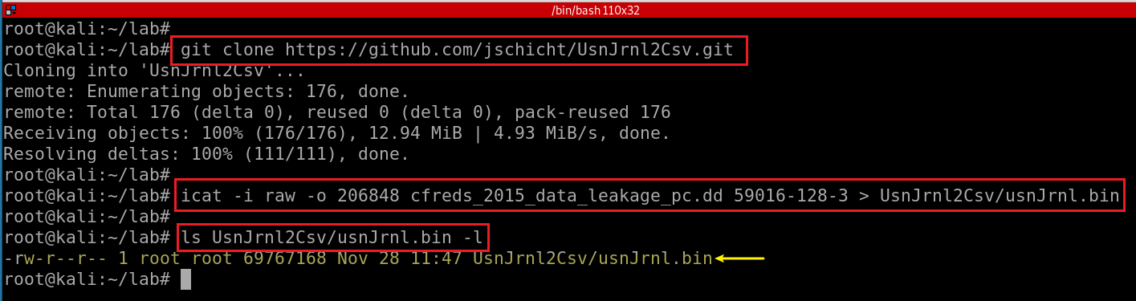
Scenario 1
Install UsnJrnl2Csv tool

Slide 15
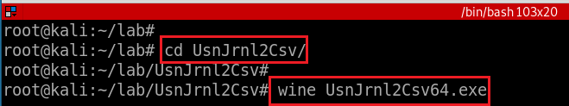
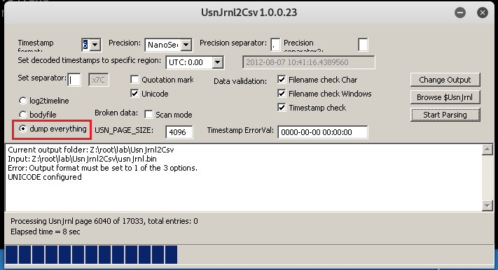
Run UsnJrnl2.exe to covert UsnJrnl.bin to .csv
Set configuration: Browser to usnJrnl.bin
Issue of using usnJrnl.bin extracted from icat
$J may be sparse, which would mean parts of the data is just 00's.
This may be a significant portion of the total data, and most tools will extract this data stream to its full size (which is annoying and a huge waste of disk space).
Consider using the tool https://github.com/jschicht/ExtractUsnJrnl
This process might take some time,

Slide 16
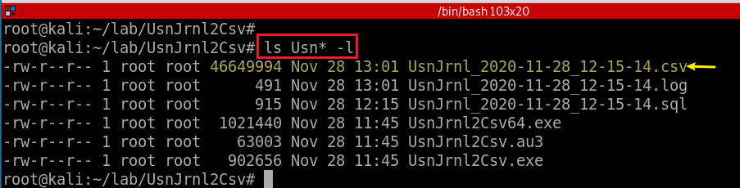
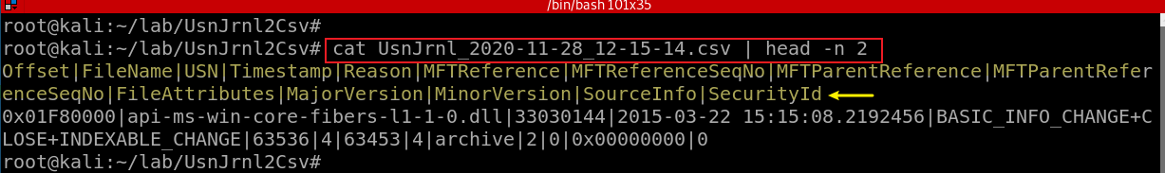
Show the extract USN journal file

Slide 17
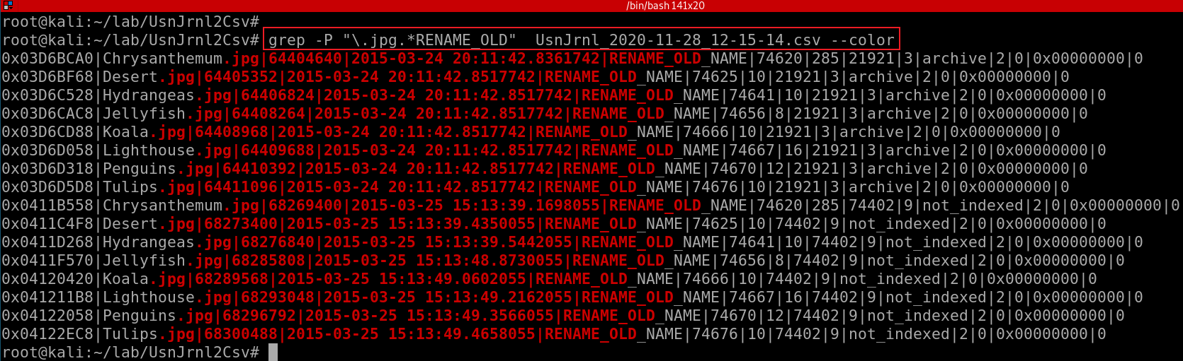
Offset|FileName|USN|Timestamp|Reason|MFTReference|MFTReferenceSeqNo|MFTParentReference|MFTParentReferenceSeqNo|FileAttributes|MajorVersion|MinorVersion|SourceInfo|SecurityId
Only show “RENAME_OLD” information of any .jpg files
Timestamps are written UTC 0.00 by default. You have to configure it.
With NTFS journal file only, it may be hard to find full paths.
(+ $MFT for identifying full paths of files)
You can consider the Registry ShellBags for further information.
Notes:
grep -P "\.jpg.*RENAME_OLD" UsnJrnl_2020-11-28_12-15-14.csv --color

Slide 18
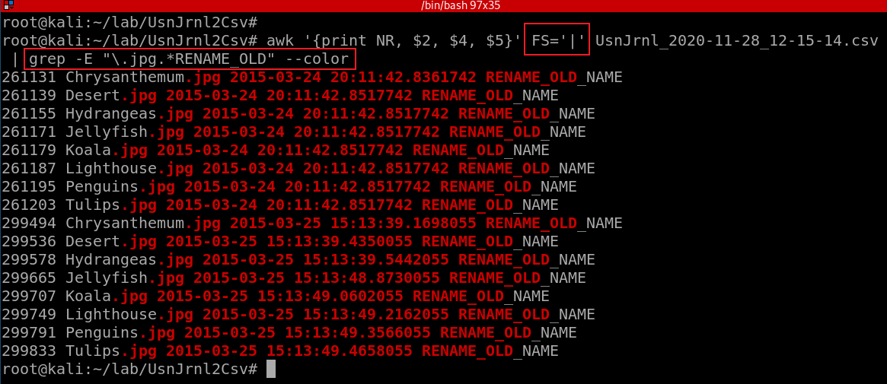
Offset|FileName|USN|Timestamp|Reason|MFTReference|MFTReferenceSeqNo|MFTParentReference|MFTParentReferenceSeqNo|FileAttributes|MajorVersion|MinorVersion|SourceInfo|SecurityId
Only show “RENAME_OLD” information of any .jpg files. Only show three columns, FileName, Timestamp, Reaso

Slide 19
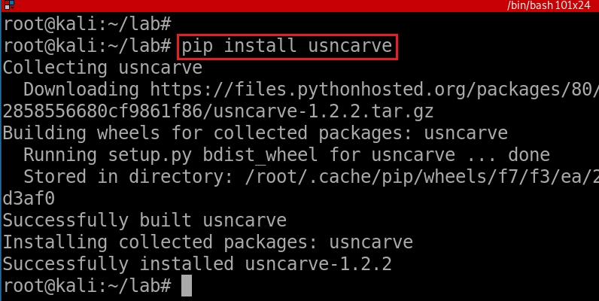
Scenario 2
Install usncarve tool (note we have changed the path)
Notes:
pip install usncarve

Slide 20
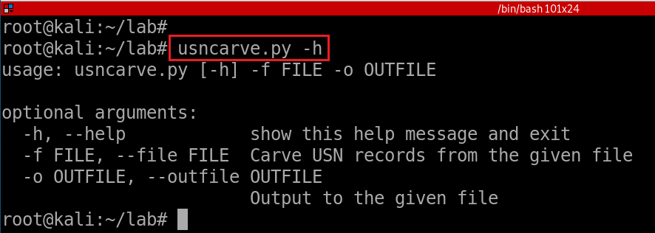
Verify installation
Notes:
usncarve.py -h

Slide 21
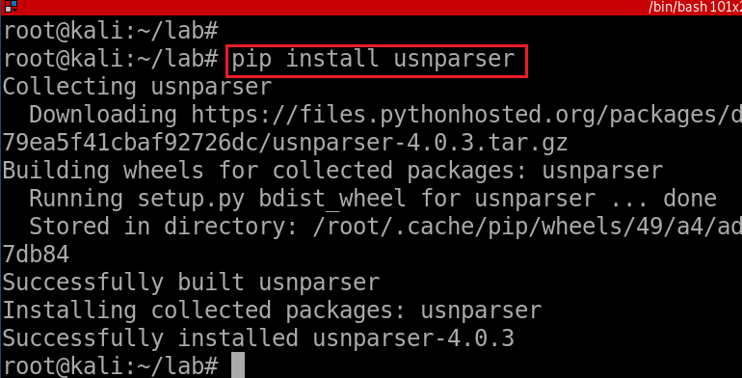
Install usnparser tool
Install via pip
Notes:
pip install usnparser

Slide 22
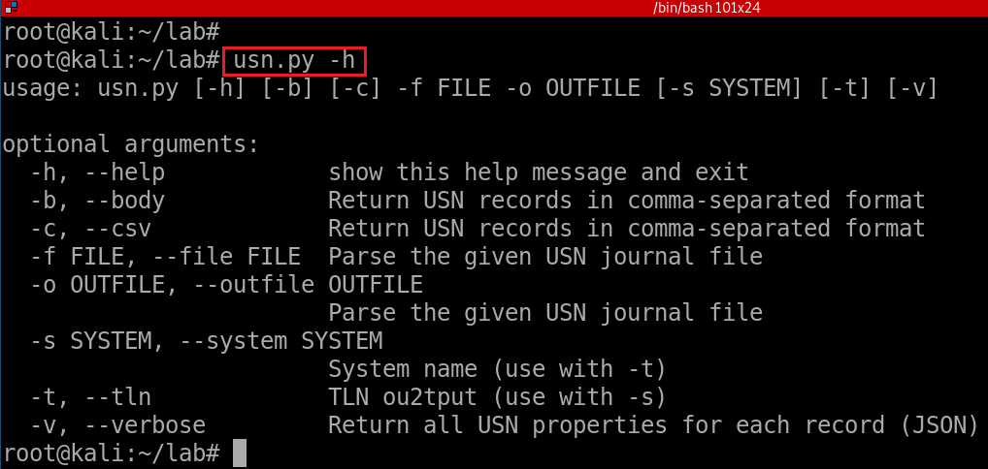
Verify installation
Notes:
usn.py -h

Slide 23
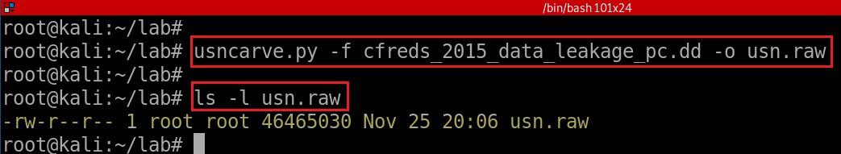
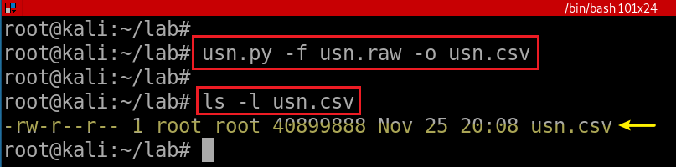
usncarve.py -f input file -o output file
usn.py -f input file -o output file
Notes:
usncarve.py -f cfreds_2015_data_leakage_pc.dd -o usn.raw
usn.py -f usn.raw -o usn.csv

Slide 24
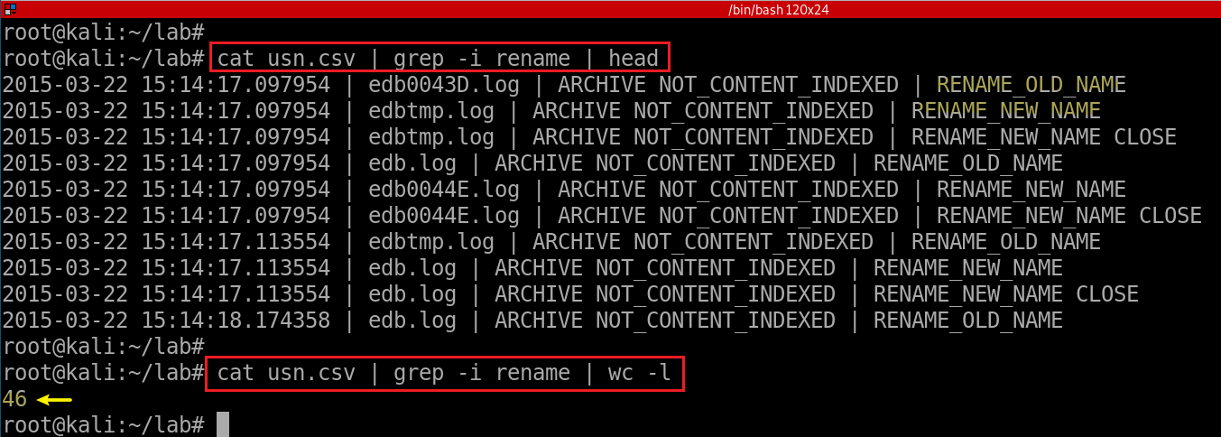
View renamed files
- NTFS journal file analysis (→ $UsnJrnl)
- \$Extend\$UsnJrnl·$J (+ $MFT for identifying full paths of files)
- You can also consider the Windows Search database. (See Questions 46)

Slide 25
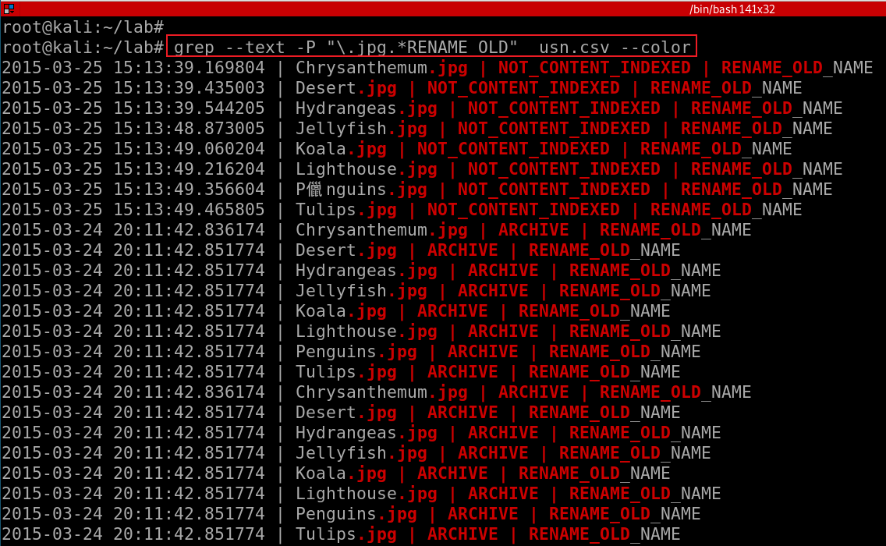
--text: equivalent to --binary-files=text
Notes:
grep --text -P "\.jpg.*RENAME_OLD" usn.csv –color
Without --text, it will show “binary file .cvs matches”

Slide 26
USN Journal vs. NTFS file system journaling
NTFS file journaling uses the NTFS Log ($LogFile) to record metadata changes to the volume.
USN Journal only has change flags, no metadata.
NTFS file journaling ensures that its complex internal data structures will remain consistent in case of
system crashes or data moves performed by the defragmentation API,
NTFS file journaling allows easy rollback of uncommitted changes to these critical data structures when the volume is remounted.

