Slide 1
Investigate Data Leakage Case
Key words: Windows Registry
Notes:
https://www.cfreds.nist.gov/data_leakage_case/data-leakage-case.html

Slide 2
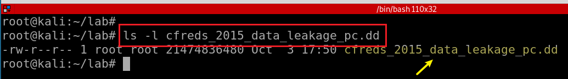
1. What are the hash values (MD5 & SHA-1) of the image? (Linux)
Verify you have the dd image
Notes:
https://www.cfreds.nist.gov/data_leakage_case/images/pc/cfreds_2015_data_leakage_pc.7z.001
https://www.cfreds.nist.gov/data_leakage_case/images/pc/cfreds_2015_data_leakage_pc.7z.002
https://www.cfreds.nist.gov/data_leakage_case/images/pc/cfreds_2015_data_leakage_pc.7z.003

Slide 3
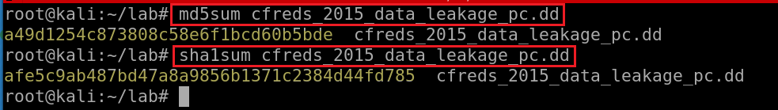
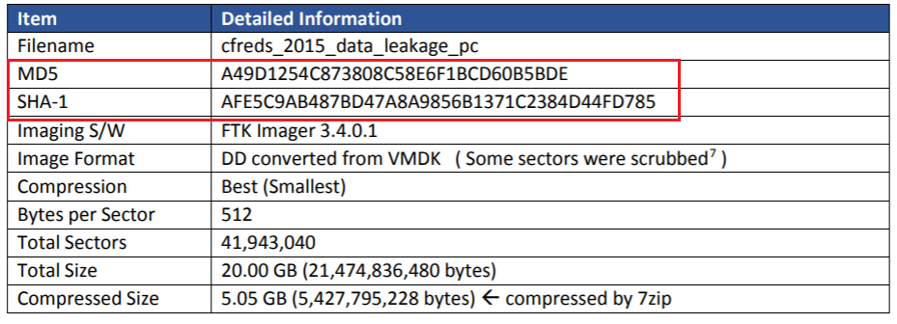
Compute MD5 and SHA1 of the DD image
Notes:
md5sum cfreds_2015_data_leakage_pc.dd
sha1sum cfreds_2015_data_leakage_pc.dd

Slide 4
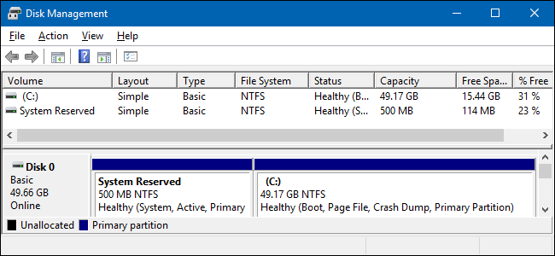
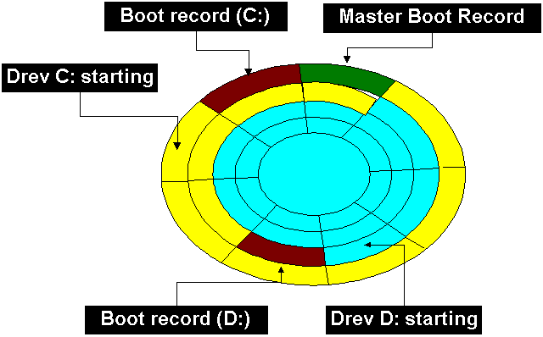
2. How to identify the partition information of PC image? (Method 1 -fdisk)
What is partition/volume?
Boot partition
OS foder: %systemroot%
System partition
Contains the boot loader/bootstrap/MBR/GPT for booting OS
Partitions shown on a physical disk

Slide 5
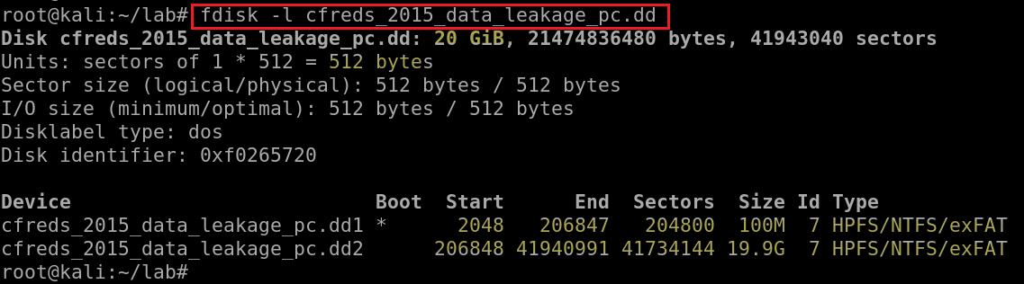
Since it is a file containing a copy of the entire disk, you can simply treat it like any other block device and run fdisk
Show partitions of the image
“System" volume: bootstrap
“Boot" volume: the remainder of an operating system
What is Block devices? hard drives, CD-ROM drives, RAM
What is fdisk ? Format disk
Notes:
http://blog.hakzone.info/posts-and-articles/linux/disk-analysis-with-fdisk-mmls-fsstat-and-fls/
Block devices are characterized by random access to data organized in fixed-size blocks. Examples of such devices are hard drives, CD-ROM drives, RAM disks, etc.
fdisk also known as format disk is a dialog-driven command in Linux used for creating and manipulating disk partition table. It is used for the view, create, delete, change, resize, copy and move partitions on a hard drive using the dialog-driven interface.

Slide 6
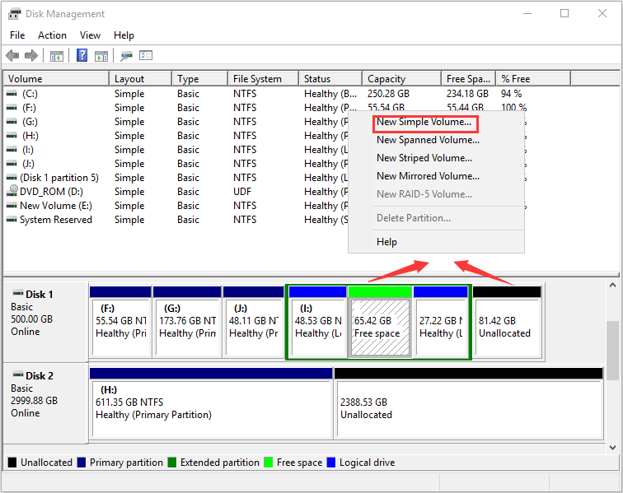
How to Identify the partition information of PC image? (Method 2 -mmls)
What is Unallocated Space?
Any physical space on a hard drive that doesn't belong to a partition.
No programs can write to the space.
The space doesn't exist to the operating system.
To make use of unallocated space
you need to either create a new partition using the space or expand an existing partition.
Media management ls (mmls):
Can show unallocated sectors so it can be used to search for hidden data
Notes:
Similarly, the mmls tool can be used to display the partition layout of a volume system. However, mmls can be different by showing which sectors are not being used so that those can be searched for hidden data. In addition, mmls display info in sectors by default and if no options are used to filter the result then all volumes will be listed.

Slide 7
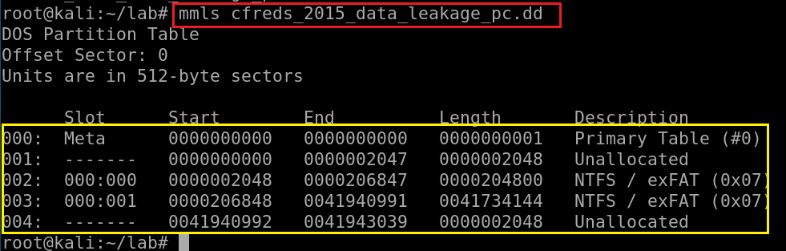
Show partitions and unallocated space using mmls
media management ls (mmls): Can show unallocated sectors so it can be used to search for hidden data
MBR

Slide 8
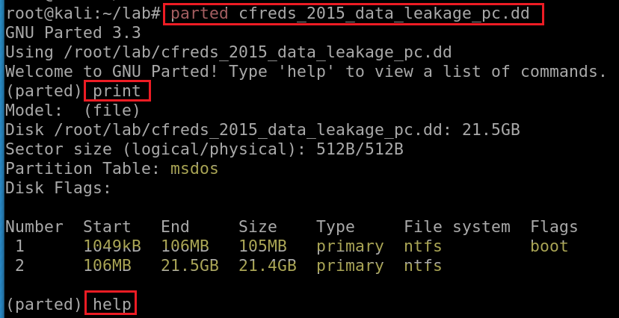
How to Identify the partition information of PC image? (Method 3 -parted)
do not list partitions whose size is greater than 2 TB
Notes:
Similarly, the mmls tool can be used to display the partition layout of a volume system. However, mmls can be different by showing which sectors are not being used so that those can be searched for hidden data. In addition, mmls display info in sectors by default and if no options are used to filter the result then all volumes will be listed.

Slide 9

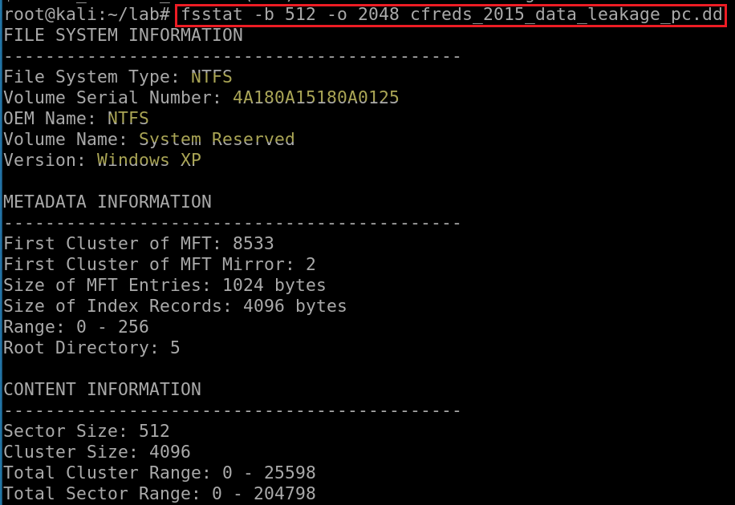
List the first partition details using file system stat (fsstat)
-b: block size (default is 512)
-o: image offset
Notes:
fsstat -b 512 -o 2048 cfreds_2015_data_leakage_pc.dd

Slide 10
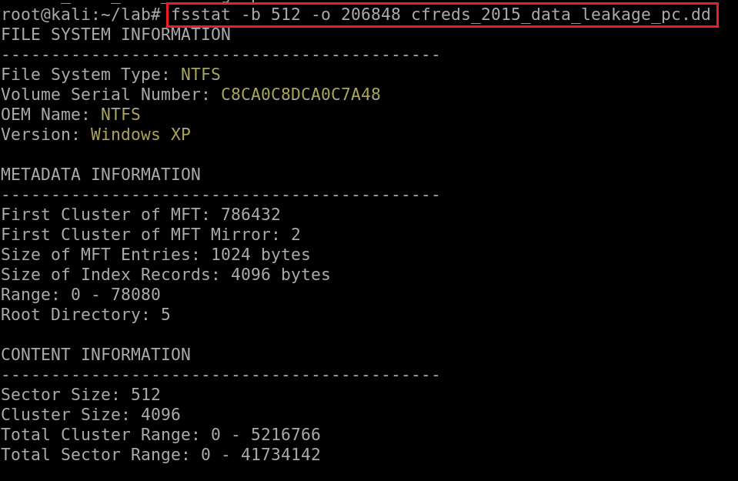
List the second partition details
-b: block size
-o: image offset
Serial number. Remember the #. We will use it later.
Notes:
fsstat -b 512 -o 206848 cfreds_2015_data_leakage_pc.dd

Slide 11
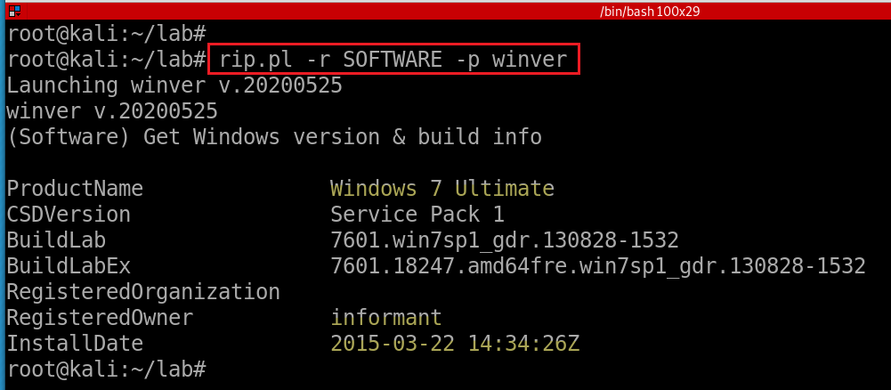
2.1 What is Win version?
Notes:
rip.pl -r SOFTWARE -p winver

Slide 12
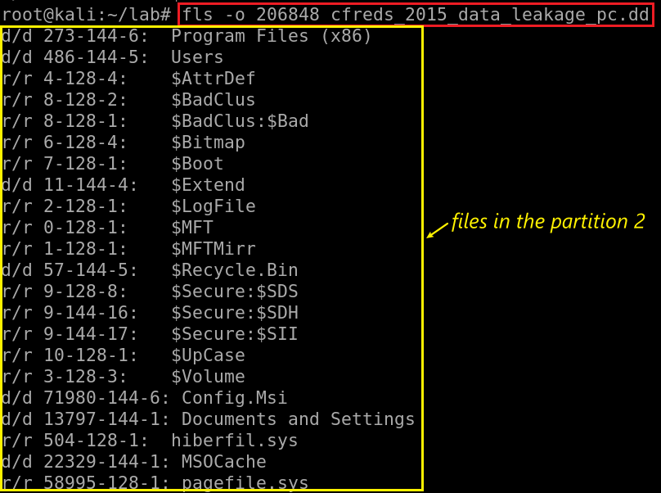

2.2 How to show files (directories) in 2nd partition?
Use head/tail command to limit the number of files to display
fls: List file and directory names in a disk image
File Type | Metadata Address | File Name
Notes:
fls -o 206848 cfreds_2015_data_leakage_pc.dd
The '-l' argument causes the "long" format with more details.
file type as reported in file name and metadata structure (see above)
Metadata Address
name
mtime (last modified time, change content)
atime (last accessed time)
ctime (last changed time)
crtime (created time)
size (in bytes)
uid (User ID)
gid (Group ID)
https://wiki.sleuthkit.org/index.php?title=Fls#-l_format

Slide 13
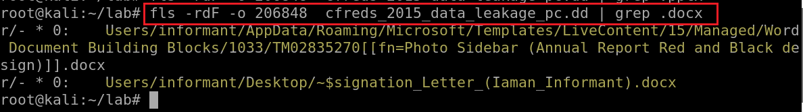
2.2 How to list all deleted .docx files in the whole partition?
Other useful parameters
-d display deleted entries only -D directories only -r recursively display directories
-l long format
-F Display file (all non-directory) entries only
-u Display undeleted entries only
Notes:
https://syang.io/2015/01/30/Sleuth-Kit-05.html
fls -rdF -o 206848 cfreds_2015_data_leakage_pc.dd

Slide 14
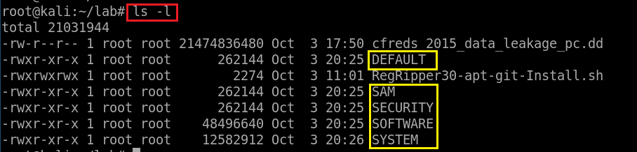
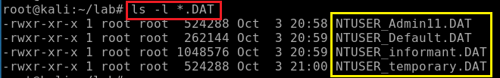
Verify system information
Verify Users’ information

Slide 15

Windows Registry Analysis Requirements
All investigations involve Windows Registry requires
Installed RegRipper 3.0
Extracted files contain PC’s registry information
Please follow the pptx to meet requirements
Verify files on next slide before any tasks
Notes:
https://raw.githubusercontent.com/siftgrab/siftgrab/master/regripper.conf/RegRipper30-apt-git-Install.sh
https://medium.com/@stdout_/installing-regripper-v2-8-on-ubuntu-26dc8bc8a2d3
https://github.com/keydet89/RegRipper3.0

Slide 16
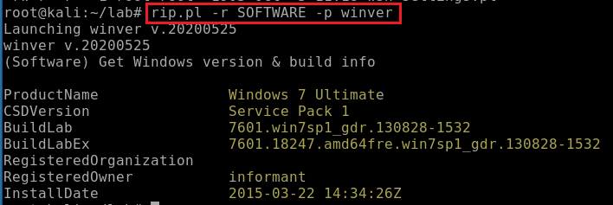
3. What is the installed OS information in detail?
-r: registry hive file to parse
-p: plugin
(GMT)
HKLM\SOFTWARE\Microsoft\Windows NT\CurrentVersion

Slide 17
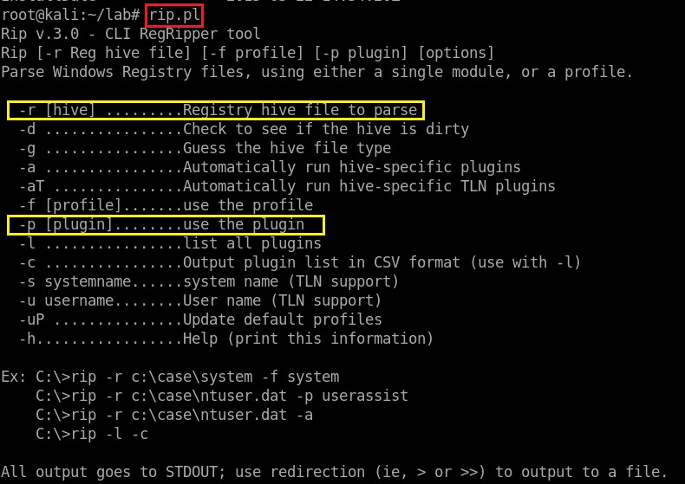
Show rip.pl command help
Try it

Slide 18
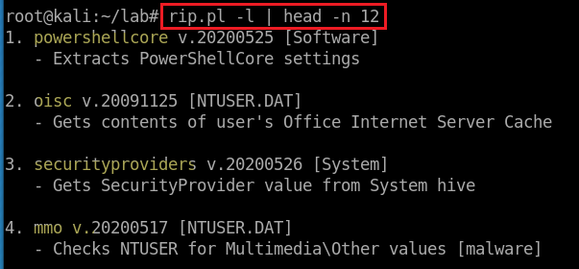
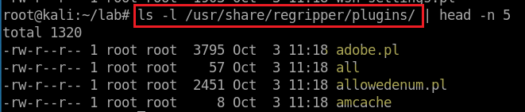
List all 243 plugins of SOFTWARE
-l: list
Show the location of all plugins

Slide 19

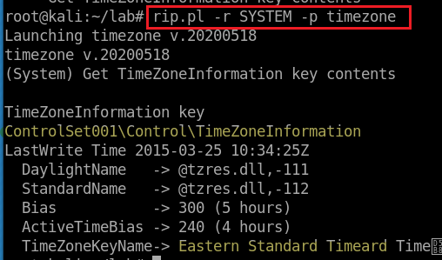
4. What is the time zone setting?
Search for timezone plugin and the file that contains timezone
Run timezone plugin
The Bias property represents the difference in minutes between Greenwich Mean Time (GMT—also known as Coordinated Universal Time, or UTC) and local time. For example, Eastern time (US and Canada) has a Bias property value of -300.
'Z' stands for Zulu time, which is also GMT and UTC.
HKLM\SYSTEM\ControlSet###\Control\TimeZoneInformation

Slide 20
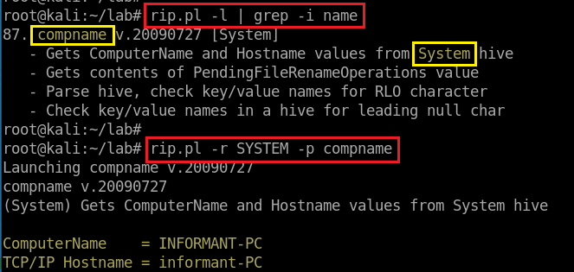
5. What is the computer name?
Search for computer name plugin and the file that contains timezone
Run compname plugin
HKLM\SYSTEM\ControlSet###\Control\ComputerName\ComputerName (value: ComputerName)
HKLM\SYSTEM\ControlSet###\Services\Tcpip\Parameters (value: Hostname)......

Slide 21
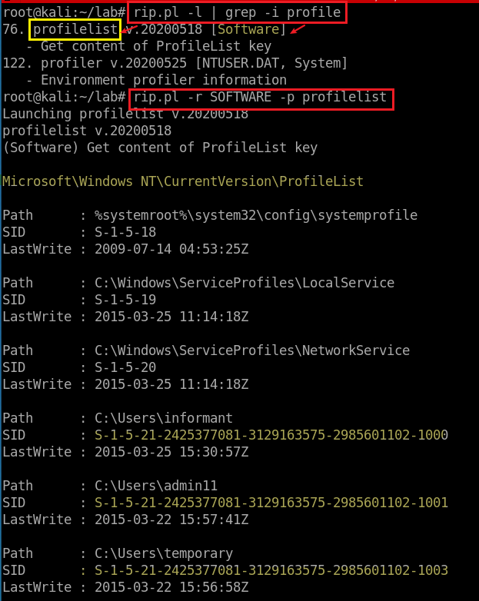
6. How many accounts does the system have? (except Administrator, Guest, systemprofile, LocalService, NetworkService)
Search for profiles
resolve SIDs to user to resolve SIDs to user

Slide 22
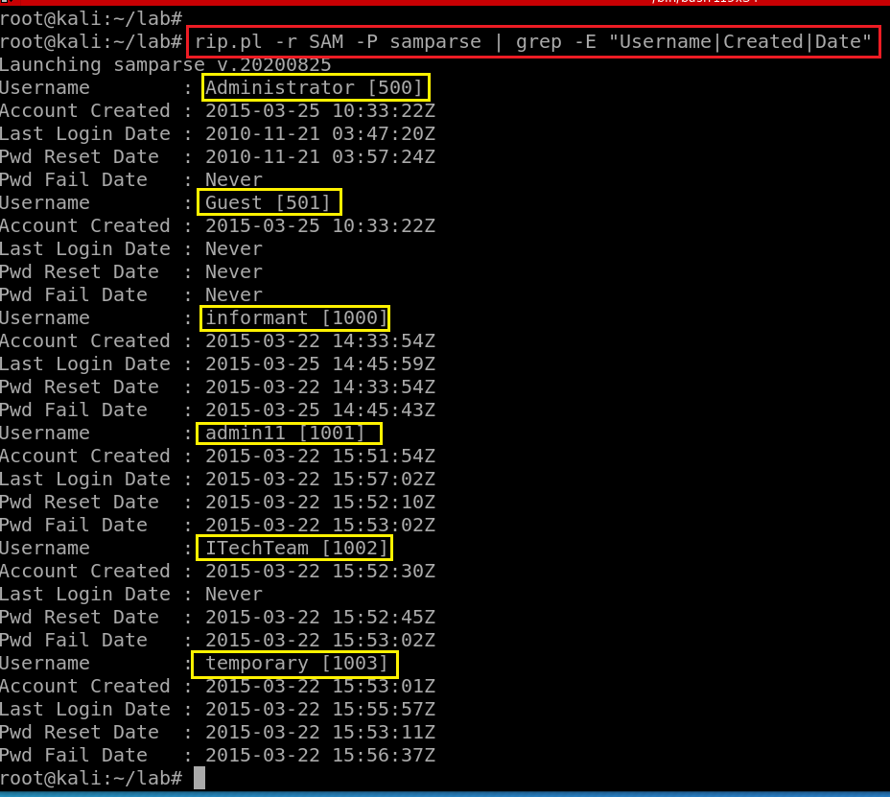
Find and search for Security Accounts Manager (SAM) information
SAM stores accounts information, e.g., passwords in a hashed format (NTLM).
grep –E <regular expression>
Notes:
rip.pl -r SAM -P samparse | grep -E "Username|Created|Date"

Slide 23
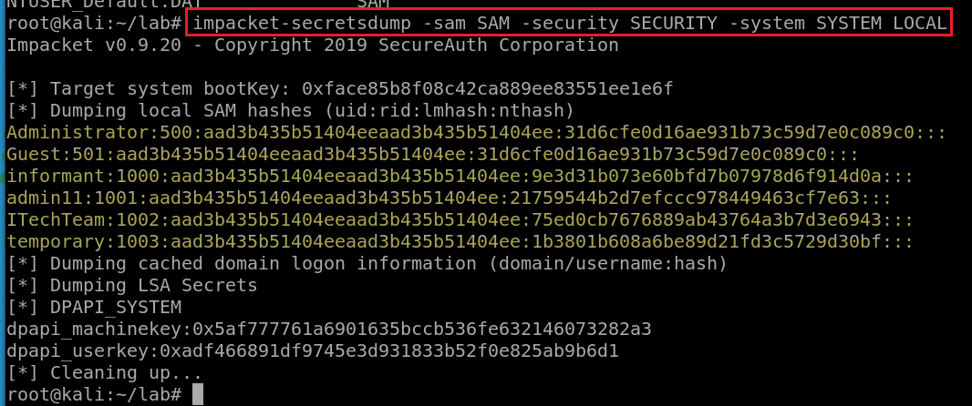
6.1 What are NTLM of these account?
Notes:
https://pentestlab.blog/tag/lsa/#:~:text=LSA%20Secrets%20is%20a%20registry,host%2C%20local%20security%20policy%20etc.&text=Registry%20keys%20of%20interest%20are,as%20they%20contain%20password%20hashes.

Slide 24
6.2 How to Crack Windows 10 passwords?
Crack Win 10 password using NTLM and Rainbow table. Follow the PPTs

Slide 25
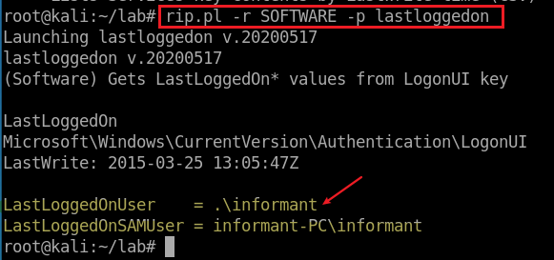
7. Who was the last user to logon into PC?
HKLM\Software\~
HKLM\SAM\~

Slide 26
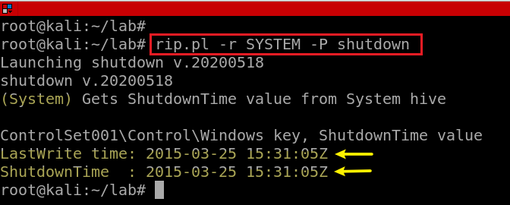
8. When was the last recorded shutdown date/time?
A control set contains system configuration information such as device drivers and services.
ControlSet001 may be the last control set you booted with.
ControlSet002 could be what is known as the last known good control set, or the control set that last successfully booted Windows NT.
HKLM\SYSTEM\ControlSet###\Control\Windows (value: ShutdownTime)
Notes:
rip.pl -r SYSTEM -P shutdown

Slide 27
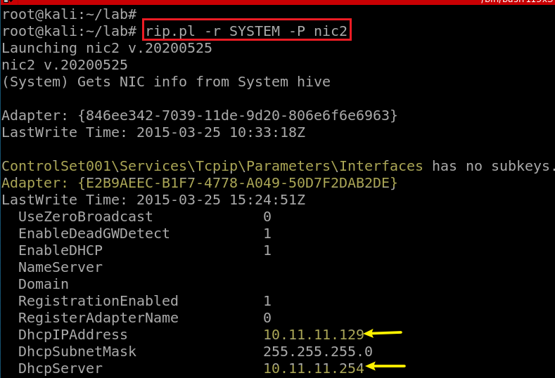
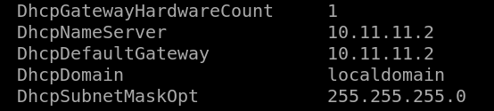
9. Explain the information of network interface(s) with an IP address assigned by DHCP.
HKLM\SYSTEM\ControlSet###\Services\Tcpip\Parameters\Interfaces\{GUID}
Notes:
rip.pl -r SYSTEM -P nic2

Slide 28
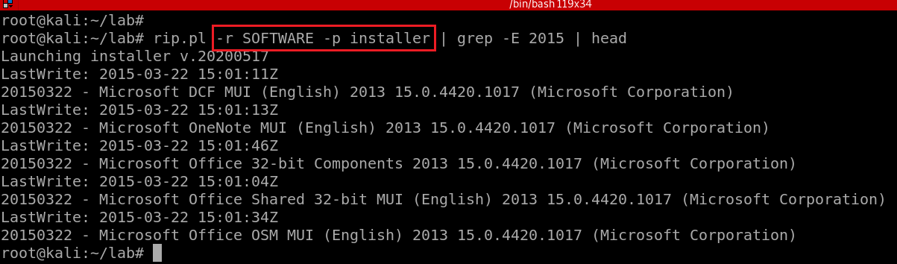
10. What applications were installed by the suspect after installing OS?
HKLM\SOFTWARE\Microsoft\Windows\CurrentVersion\Installer\UserData

Slide 29
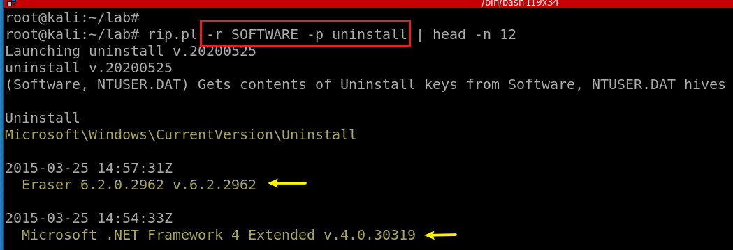
10.1 What applications can be uninstalled by the suspect after installing OS?
HKLM\SOFTWARE\Microsoft\Windows\CurrentVersion\Uninstall\~
HKLM\SOFTWARE\Wow6432Node\Microsoft\Windows\CurrentVersion\Uninstall\~
Notes:
rip.pl -r SOFTWARE -p uninstall | head -n 12

Slide 30
11. List application execution logs (Executable path, execution time, execution count...)
Shimcache: Application Compatibility Cache
RecentFileCache/Amcache
UserAssist
Prefetch
MuiCache: Multilingual User Interface

Slide 31
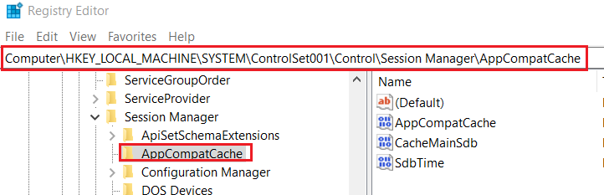
11.1 Shimcache
Created to identify application compatibility issues
It is used for quick search to decide whether modules need shimming (make them fit) for compatibility or not
Known as AppCompatCache
Created by Microsoft
HKLM\SYSTEM\ControlSet###\Control\Session Manager\AppCompatCache\
Two actions that can cause the Shimcache to record an entry
A file is executed.
This is recorded on all versions of Windows beginning with XP.
A user interactively browses a directory
if a directory contains the files “foo.txt” and “bar.exe”, a Windows 7 system may record entries for these two files in the Shimcache.
On Windows Vista, 7, Server 2008, and Server 2012
Notes:
https://www.fireeye.com/blog/threat-research/2015/06/caching_out_the_val.html#:~:text=These%20Application%20Compatibility%20Cache%20(%E2%80%9CShimcache,compatibility%20issues%20with%20executed%20programs.

Slide 32
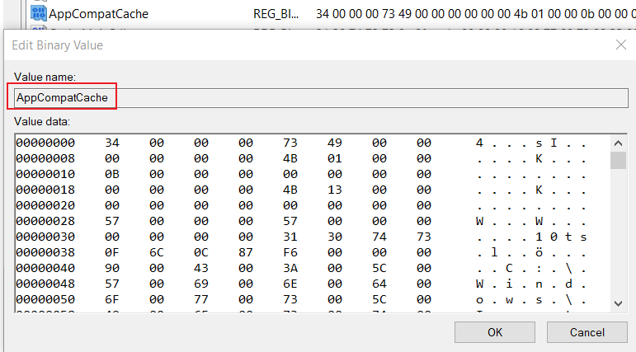
11.1 Shimcache
Stores various file metadata depending on the operating system
File Full Path
File Size
$Standard_Information (SI) Last Modified time
Shimcache Last Updated time
Process Execution Flag : set this flag during process creation/execution
Only contains the information prior to the system’s last startup
current entries are stored only in memory
The oldest data is replaced by new entries.
Notes:
https://www.fireeye.com/blog/threat-research/2015/06/caching_out_the_val.html#:~:text=These%20Application%20Compatibility%20Cache%20(%E2%80%9CShimcache,compatibility%20issues%20with%20executed%20programs.
https://lifars.com/wp-content/uploads/2017/03/Technical_tool_Amcache_Shimcache.pdf

Slide 33
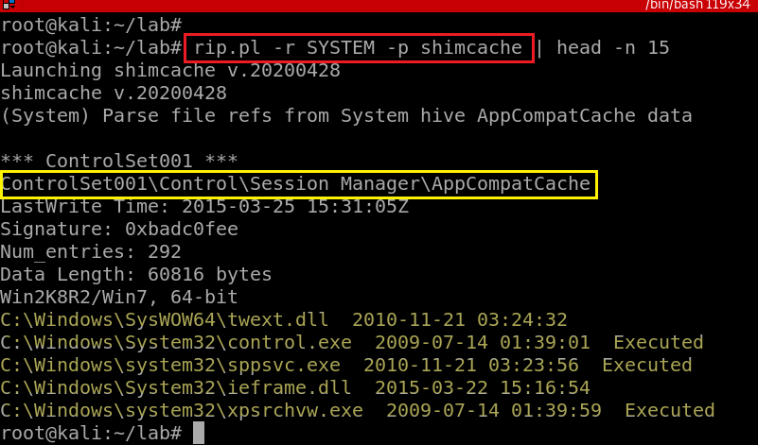
Extract shimcache from registry
Notes:
rip.pl -r SYSTEM -p shimcache

Slide 34
11.2 RecentFileCache.bcf
The RecentFileCache.bcf file on the other hand only contained references to programs that recently executed.
ShimCache contains references to numerous programs over an extended period of time.
Windows 7
RecentFileCache.bcf file is a temporary storage location used during the process creation.
The storage location is not used during all process creation;
It's mostly used for those processes that spawned from executables which were recently copied or downloaded to the system.
Notes:
https://www.ssi.gouv.fr/uploads/2019/01/anssi-coriin_2019-analysis_amcache.pdf
http://journeyintoir.blogspot.com/2013/12/revealing-recentfilecachebcf-file.html

Slide 35
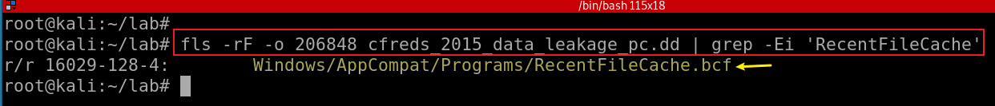
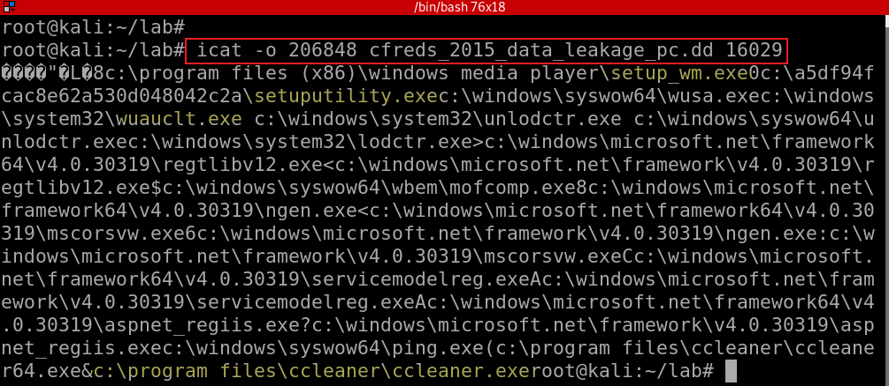
Find the location of RecenfFileCache.bcf
Show RecenfFileCache.bcf
Notes:
fls -rF -o 206848 cfreds_2015_data_leakage_pc.dd | grep -Ei 'RecentFileCache‘
icat -o 206848 cfreds_2015_data_leakage_pc.dd 16029

Slide 36
Amcache replaces RecentFileCache.bcf
Stores metadata related to PE execution and program installation
on Windows 8 and Server 2008 R2 and above.
Also an important artifact to record the traces of anti-forensic programs, portable programs, and external storage devices.
Location:
C:\Windows\AppCompat\Programs\Amcache.hve
Because we can’t find amcache.hve in .DD, if so we can use the following command
rip.pl –r Amcache.hve –p amcache
Notes:
https://www.ssi.gouv.fr/uploads/2019/01/anssi-coriin_2019-analysis_amcache.pdf

Slide 37
11.3 UserAssist
Microsoft uses UserAssist to populate a user’s start menu with frequently used applications.
Every GUI-based program launched from the desktop are tracked
These values are located in each user’s NTUSER.DAT
ROT-13 encoded.
Timestamp of last run
Count: HKCU\Software\Microsoft\Windows\CurrentVersion\Explorer\UserAssist\{GUID}\Count

Slide 38
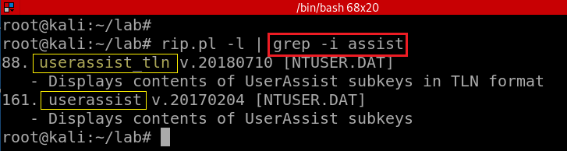

Slide 39
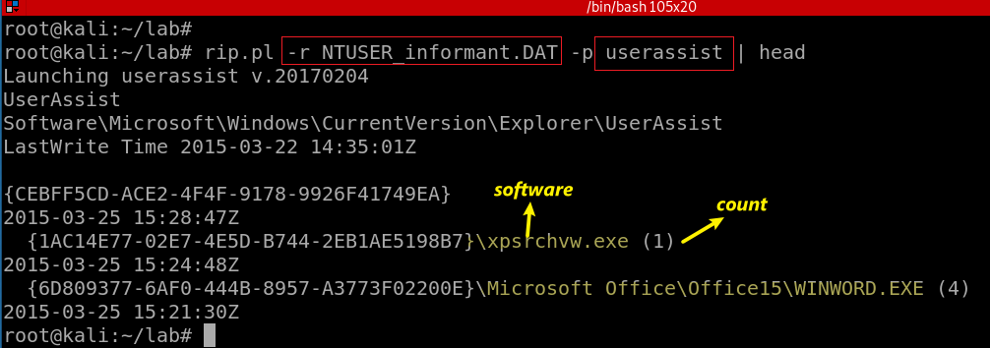
List executed programs by the user informant
Notes:
rip.pl -r NTUSER_informant.DAT -p userassist | head
https://www.andreafortuna.org/2018/05/23/forensic-artifacts-evidences-of-program-execution-on-windows-systems/

Slide 40
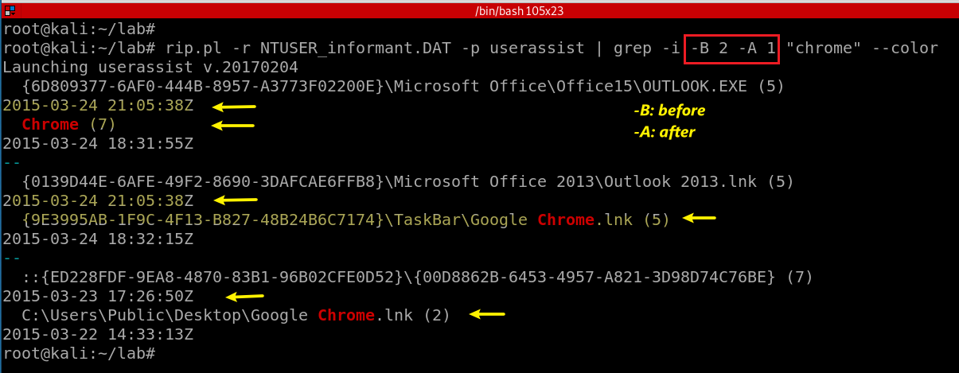
Search if “chrome” has been executed by the user informant. Show lines before and after the matches

Slide 41
11.4 Prefetch
A memory management technology
To improve customer experience,
Introduced by Microsoft in Windows XP and Windows 2003 Server.
Preloads most frequently used software into memory
To speed the operating system booting and application launching.
SuperFetch On Windows Vista
An improved version of Prefetch
Notes:
https://countuponsecurity.com/2016/05/16/digital-forensics-prefetch-artifacts/

Slide 42
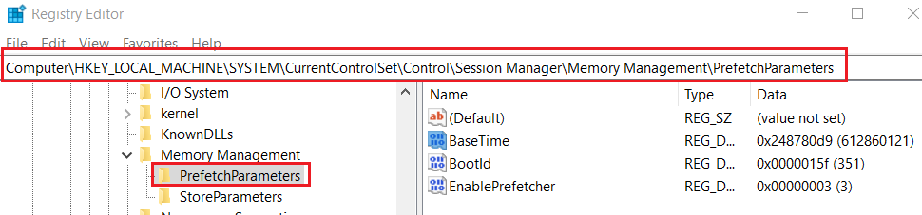
Stored in %SYSTEMROOT%\Prefetch and have a .pf extension

Slide 43
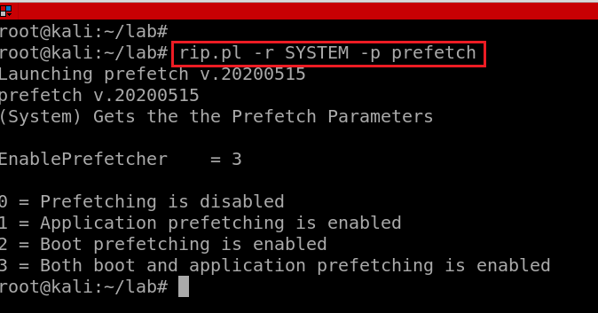
Exam prefetch setting from registry

Slide 44
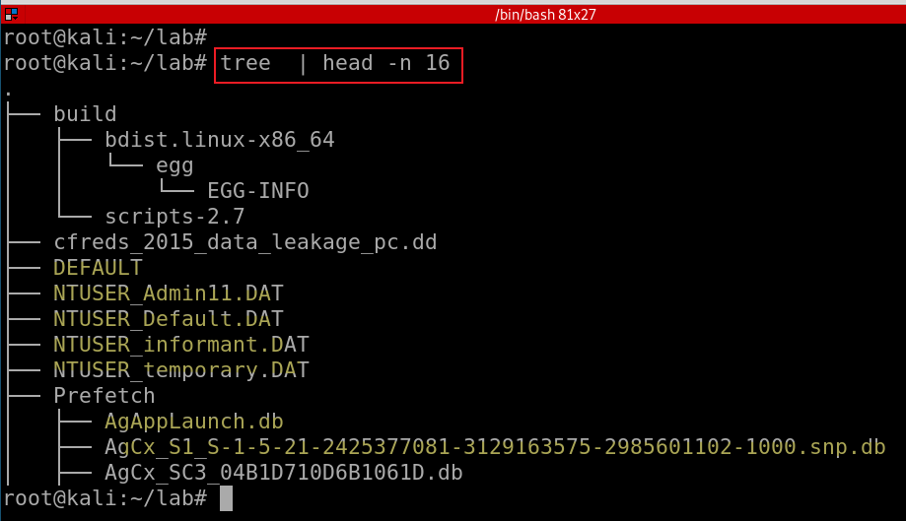
Verify Prefetch folder has .pf files
Notes:
sudo apt-get install tree

Slide 45
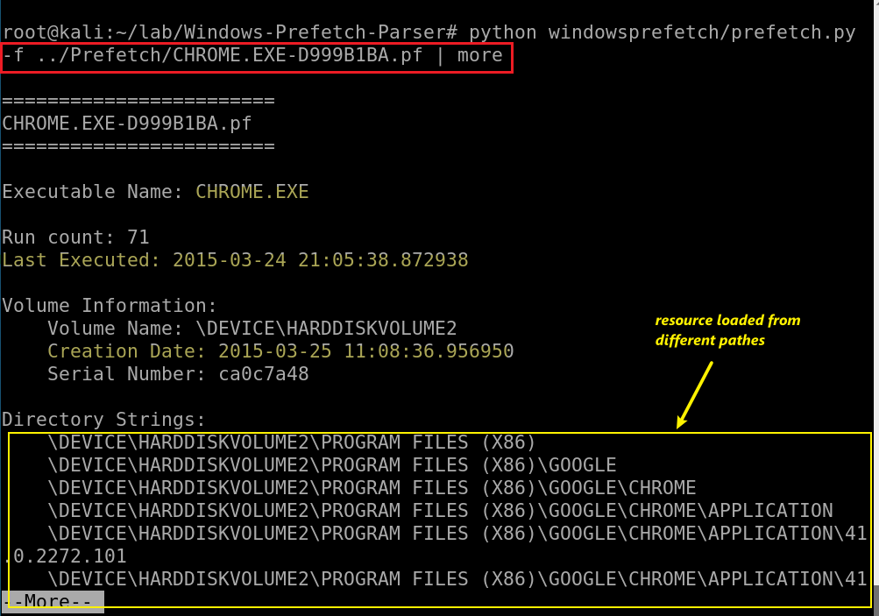
Parse Prefetch of chrome.exe
-f FILE, --file FILE Parse a given Prefetch file
Notes:
python windowsprefetch/prefetch.py -f ../Prefetch/CHROME.EXE-D999B1BA.pf -c

Slide 46
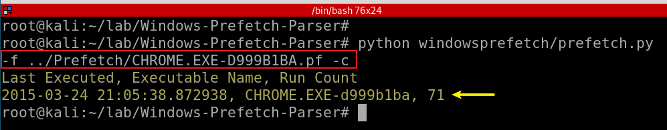
Parse Prefetch of chrome.exe and save the results to .CSV
-c, --csv Present results in CSV format
Notes:
ls -l ../Prefetch/ | grep -i chrome
python windowsprefetch/prefetch.py -f ../Prefetch/CHROME.EXE-D999B1BA.pf -c

Slide 47
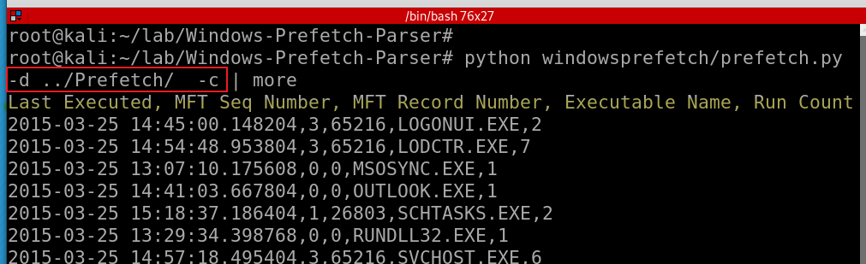
Parse the whole Prefetch folder and save the results to .CSV
-d DIRECTORY, --directory, parse all PF files in a given directory
Notes:
python windowsprefetch/prefetch.py -d ../Prefetch/ -c | more

Slide 48
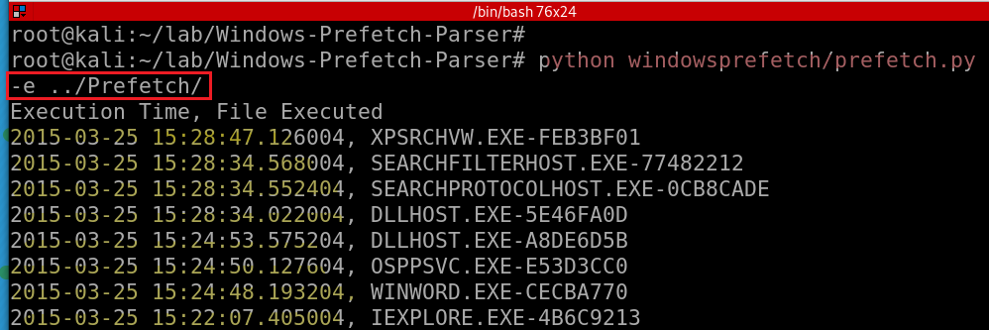
Parse the whole Prefetch folder and sort by execution times
-e EXECUTED, --executed EXECUTED, Sort PF files by ALL execution times

Slide 49
11.5 MuiCache: Multilingual User Interface
What is MUI
To support multiple language for software
Drawback
the MUI scheme is that it’s a bit slower
Solution: MUI caching for localized strings
When the right version of a string is retrieved from MUI file for a given app, it’s stored in the registry.
Then if the string is needed again, it can be retrieved from the registry, which is faster than having to open up the MUI file again.

Slide 50
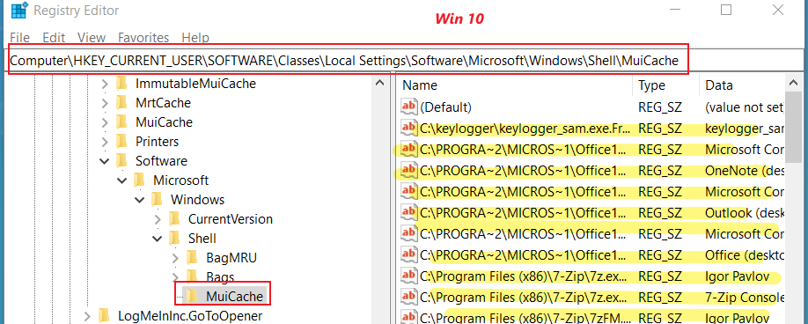
Windows 2000, Windows XP, Windows Server 2003: HKEY_CURRENT_USER\Software\Microsoft\Windows\ShellNoRoam\MUICache.
Windows 10:

Slide 51
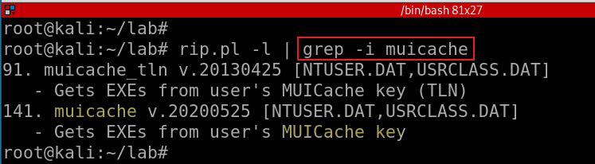
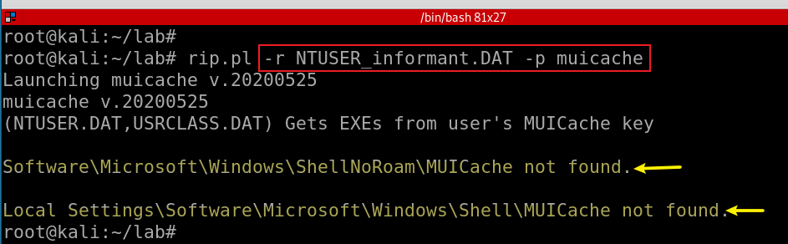
Search for muicache plugin
Exam muicache

Slide 52
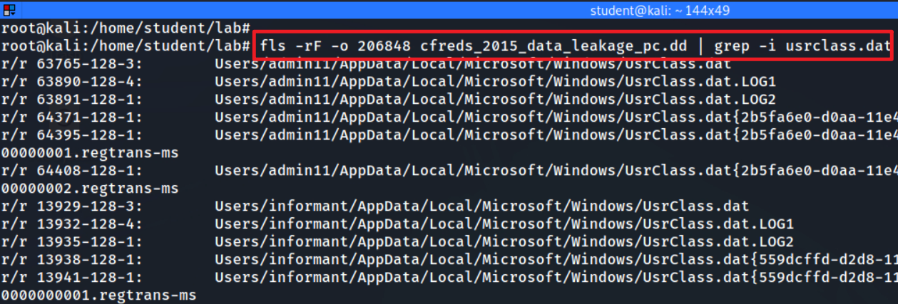
Search usrclass.dat
Notes:
fls -rF -o 206848 cfreds_2015_data_leakage_pc.dd | grep -i usrclass.dat

Slide 53


Extract usrclass.dat
Search muicache from usrclass.dat
Notes:
icat -o 206848 cfreds_2015_data_leakage_pc.dd 70107 > usrclass_informant.dat
rip.pl -r usrclass_informant.dat -p muicache

Slide 54
Summary of 11.
[File] Windows Prefetch folder \Windows\Prefetch\*.pf Executable file paths and their execution timestamps (+ execution counts)
[File] IconCache \Users\informant\AppData\Local\IconCache.db Executable file paths and their icon images
[Reg] UserAssist HKU\informant\Software\Microsoft\Windows\CurrentVersion\Explorer\UserAssist\*\Count\ Executable file paths and their execution timestamps (+ execution counts)
[Reg] Application Compatibility (Shimcache) HKLM\SYSTEM\ControlSet###\Control\Session Manager\AppCompatCache\ Executable file paths and their modified timestamps
[Reg] Application Compatibility Cache HKU\informant\Software\Microsoft\Windows NT\CurrentVersion\AppCompatFlags\Compatibility Assistant\ Executable file paths and their modified timestamps
[Reg] MuiCache HKU\informant\Software\Classes\Local Settings\Software\Microsoft\Windows\Shell\MuiCache\ Executable file paths

