Slide 1
Computer System Introduction

Slide 2
Overview
Computer systems
Hard disk drives
Calculate disk partitions
PC boot process

Slide 3
Computer systems

Slide 4
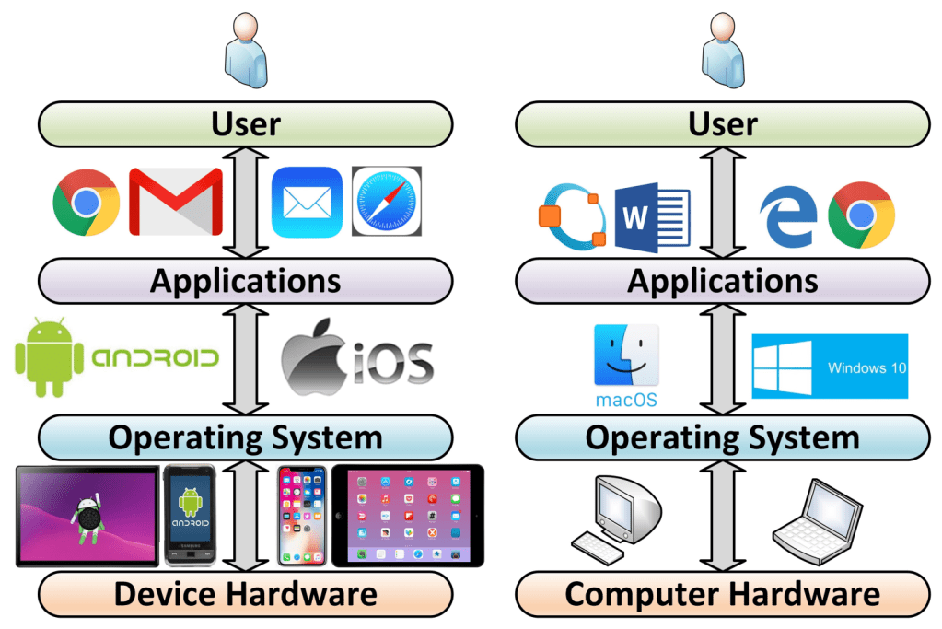
Layers of a computer system
https://windsongtraining.ca/the-technology-layer-cake-users-apps-os-and-hardware/

Slide 5
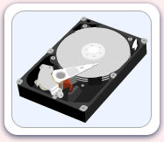
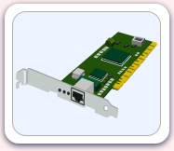
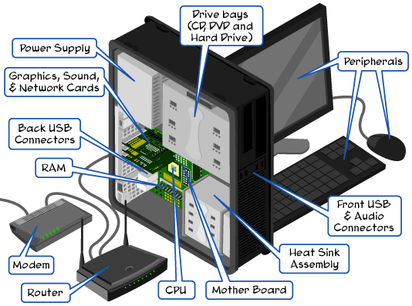
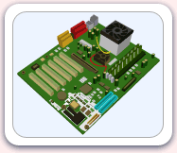
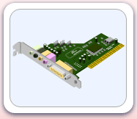
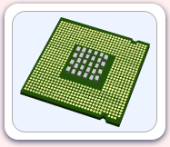
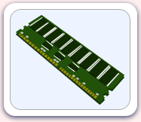
Parts of the computer
http://www.carnegiecyberacademy.com/facultyPages/computer/computers.html

Slide 6
Hard disk drives

Slide 7
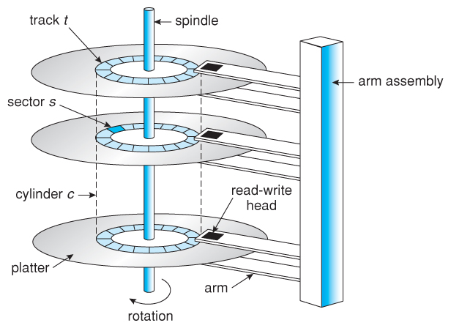
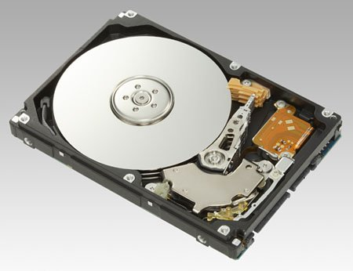
Understand disk drives
https://regmedia.co.uk/2006/12/12/fujitsu_300gb_1.jpg
Abraham Silberschatz, Greg Gagne, and Peter Baer Galvin, "Operating System Concepts, Ninth Edition "

Slide 8
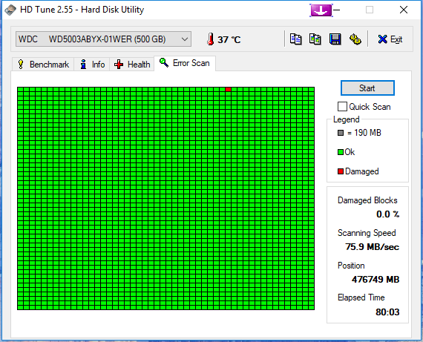
What is a disk sector?
The sector is the minimum storage unit of a hard drive.
Files occupy an integral number of sectors regardless of the file's actual size.
# bytes per sector =512 Bytes
https://i.imgur.com/26BalHW.png

Slide 9
Calculate the total sectors
#sectors per track
# tracks (cylinders)
# headers
#Size of disk=# tracks (C) x #Heads x #Sectors per track (CHS)
no of sectors: 400
no of heads: 12
cylinders: 17000
=81600000 sectors

Slide 10
Calculate the size of a disk
1024 Bytes=1K
1024 K=1M
1024 M=1G
How to compute the size of the disk
81600000 sectors * 512 bytes= 41779200000 bytes
=40800000 KB
=39843.75MB
=38.91G

Slide 11
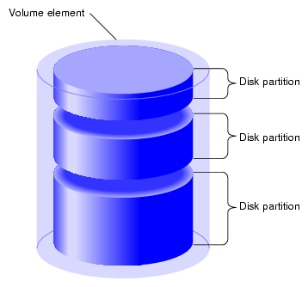
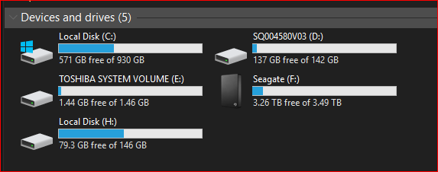
What is a partition
https://www.maketecheasier.com/assets/uploads/2012/05/partitions-partition-diagram.png

Slide 12
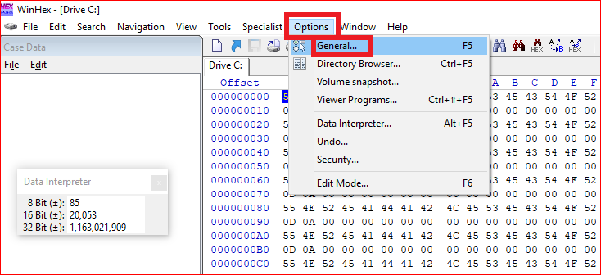
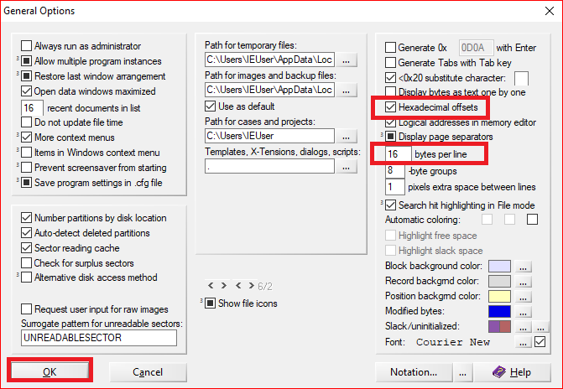
Calculate the size of partitions
Winhex option setting

Slide 13
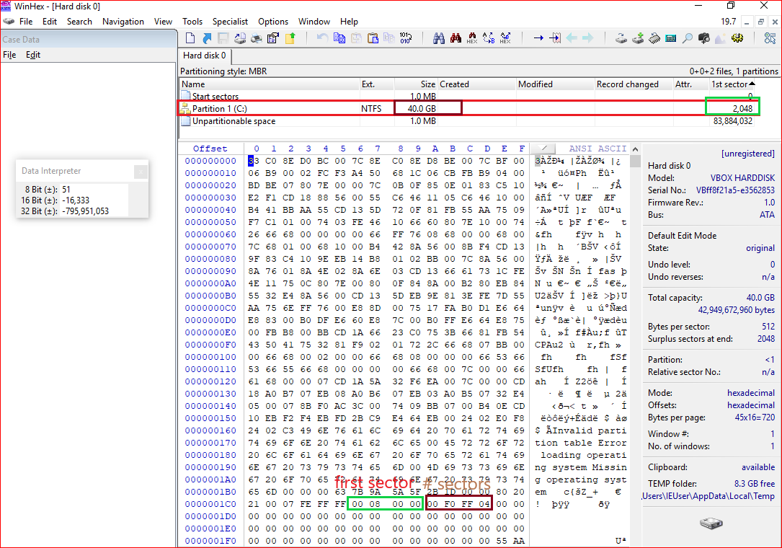
Master Boot Record:
1980s
Allow up to a maximum of 2 TB
Show the position of
the first sector

Slide 14
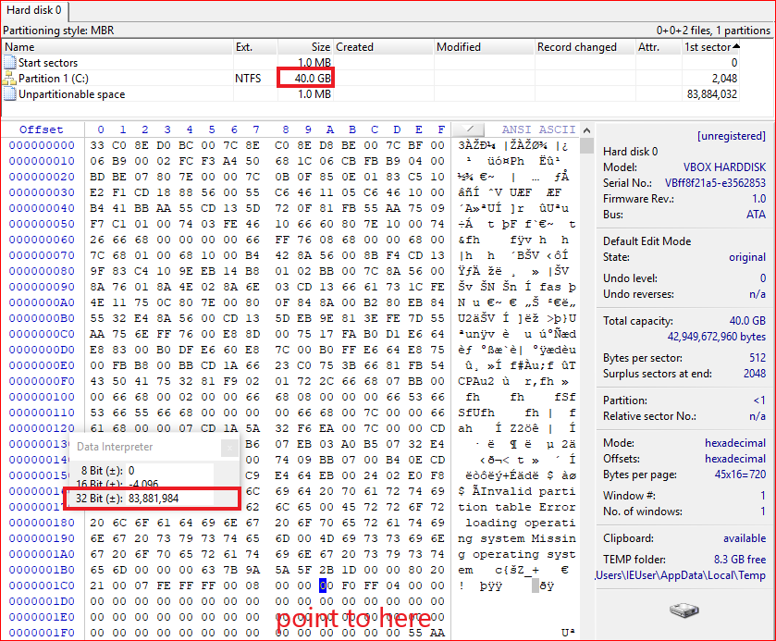
Show the size of the
total sectors in decimal
ox01CA
Compute the partition
size
83881984 sectors *512 bytes per sector = 39.99 G

Slide 15
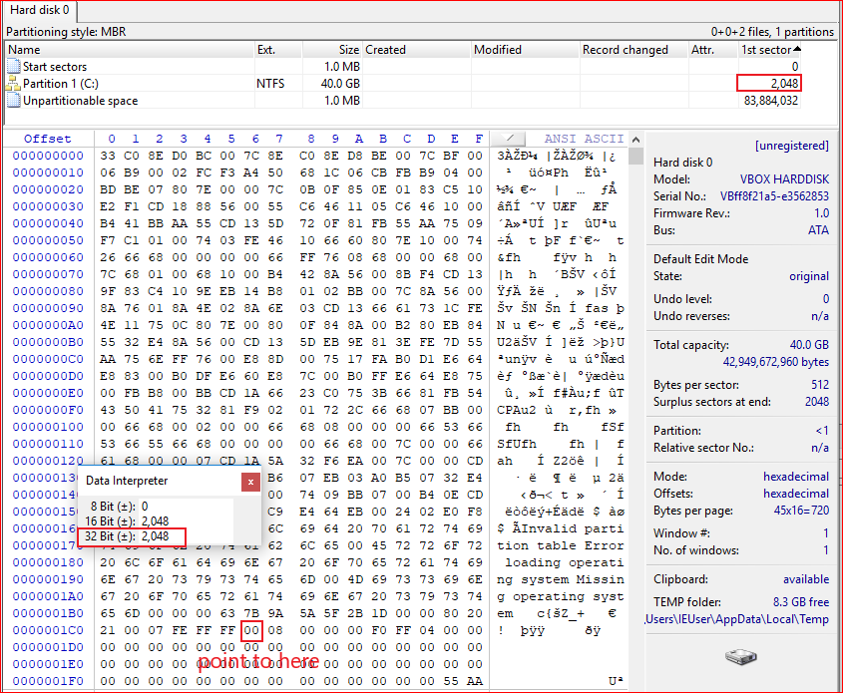
Covert Hex to decimal

Slide 16
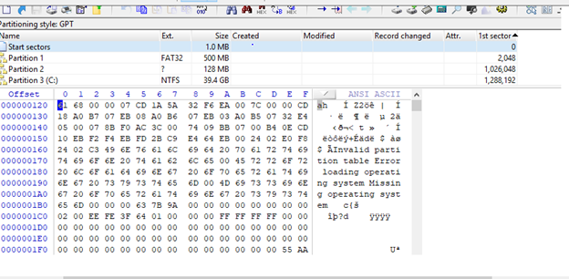
GUID Partition Table: GPT

Slide 17
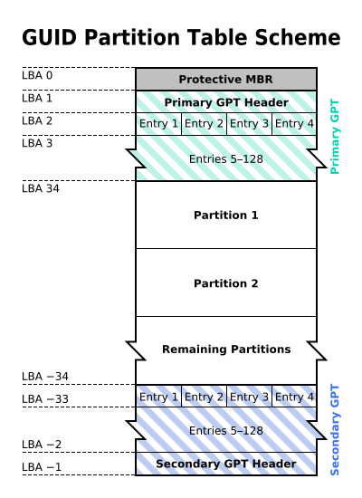
Why GPT
MBR: 1980s
Allow up to a maximum of 2 TB
GPT: maximum size is 9.4 ZB
1ZB=1024TB
logical block addressing (LBA)
Replace CHS
By The original uploader was Kbolino at English Wikipedia. - Transferred from en.wikipedia to Commons. Transfer was stated to be made by User:Kbolino., CC BY-SA 2.5, https://commons.wikimedia.org/w/index.php?curid=3036588

Slide 18
backward compatibility for MBR
Describe each partition
Backup of the primary GPT header and entries

Slide 19
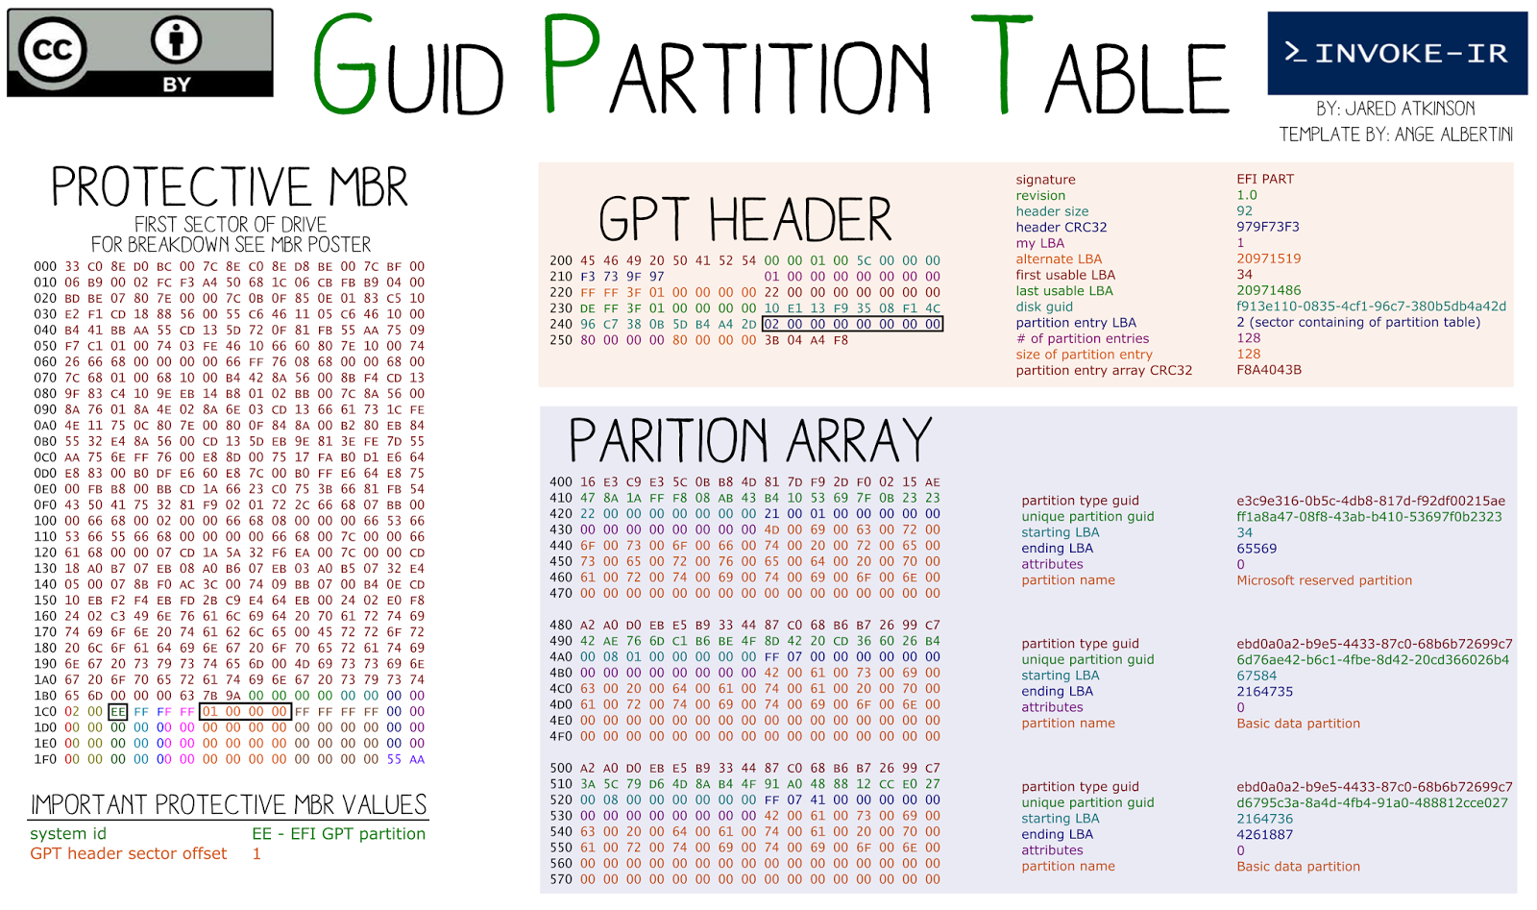
Starting LBA of array of partition entries (always 2 in primary copy)
Why 0x400?

Slide 20
PC boot process

Slide 21
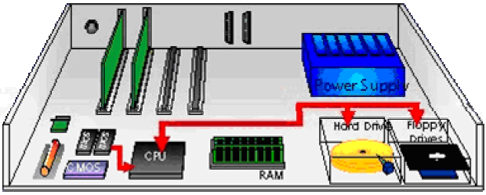
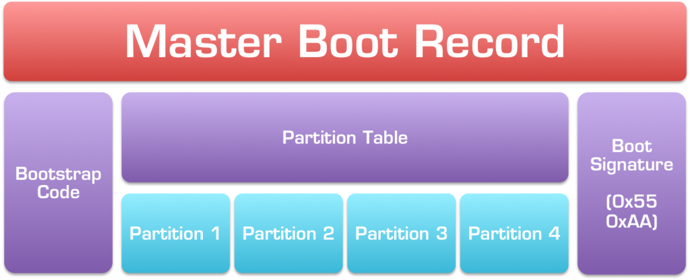
Booting a computer
Power up; computer runs power-on self-test (POST)
Boot sequence governed by (Basic input/output system) BIOS ROM
BIOS parameters stored in CMOS
Control passes to the Master Boot Record (MBR)
MBR points to boot record of selected operating system
Operating system takes control
Jump to bootable partition
http://www.c-jump.com/CIS24/Slides/Booting/Booting.html
https://i2.wp.com/neosmart.net/wiki/wp-content/uploads/sites/5/2015/01/Master-Boot-Record.png?resize=1024%2C416&ssl=1

Slide 22
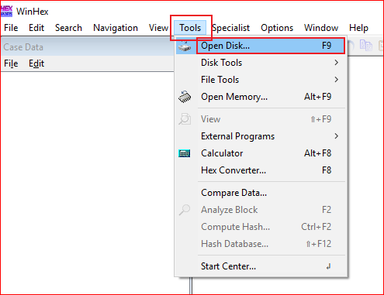
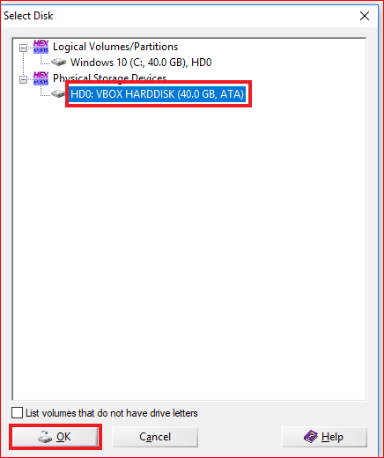

Slide 23
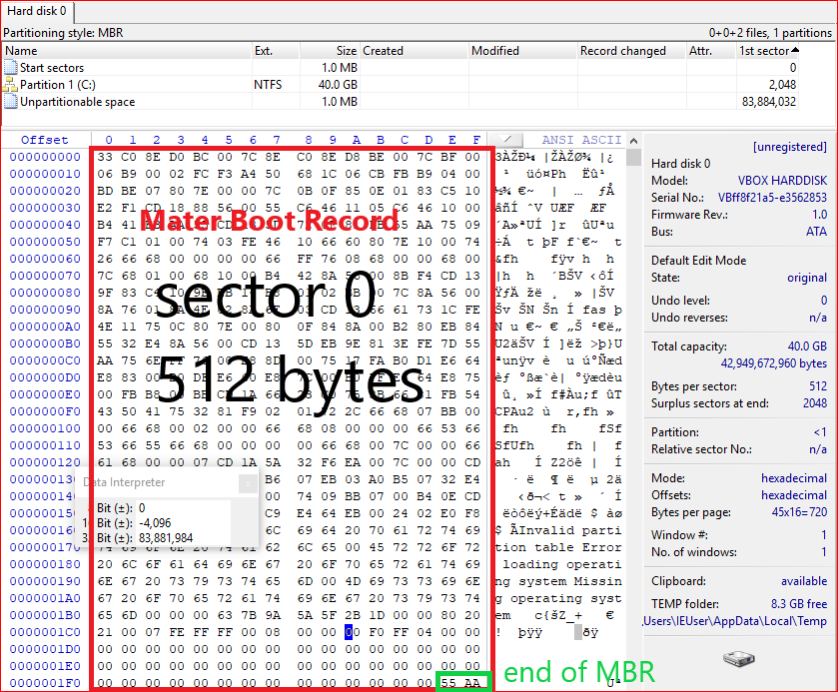

Slide 24
