Slide 1
Windows Command Line Tutorial

Slide 2
Overview
File Structure
Create folders and files
File Copy & Deletion
Networks
Search for information
Create a batch file

Slide 3
File Structure

Slide 4
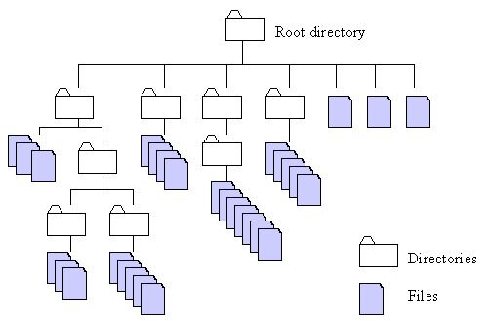
http://home.easy-key.info/images/stories/file_structure.gif

Slide 5
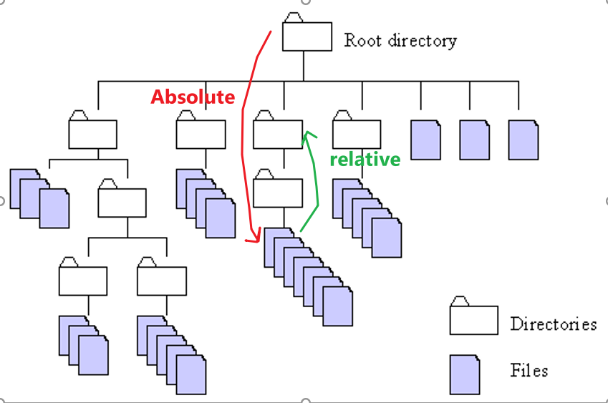
Absolute and relative paths
Absolute path
a path is built starting from the system root
Relative path
a path is built starting from the current location,
as it is relative to the present position

Slide 6
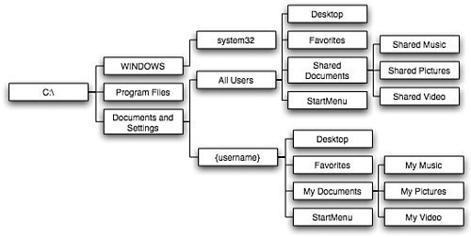
Windows System file structure (Tree-like)

Slide 7
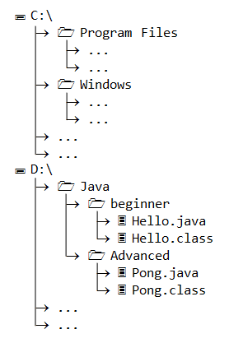
Example of paths
Write absolute path to Hello.java
D:\Java\beginner.java
Under Beginner folder, write path to Pong.java
absolute path
D:\Java\Advanced\Pong.java
relative path
..\Advance\Pong.java

Slide 8
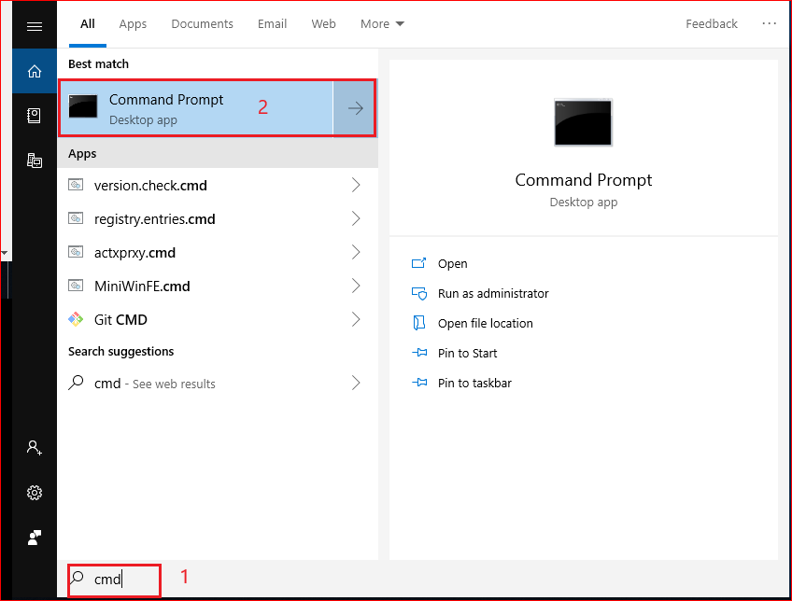
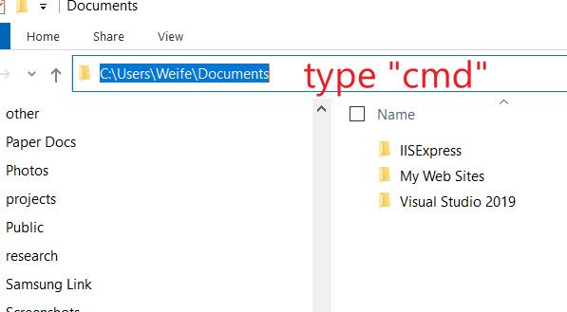
How to Open Command Prompt?
Method 1
Method 2

Slide 9
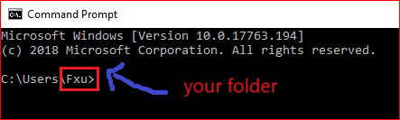

Absolute path example
Root directory
A volume or drive letter
C:
\Users
\Fxu

Slide 10

Change path using relative path
C:
C:
Change to an upper directory
\Users
\Users
\Fxu
Now you are here
You are here

Slide 11

C:
C:
Change to an upper directory/root
\Users

Slide 12
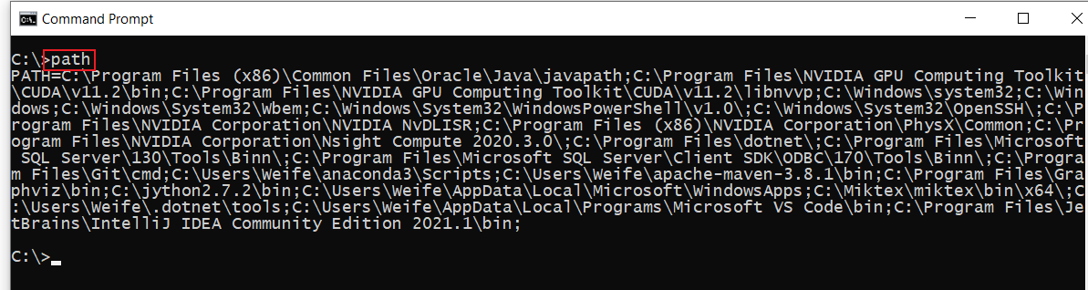
Displays or sets a search path for executable files

Slide 13
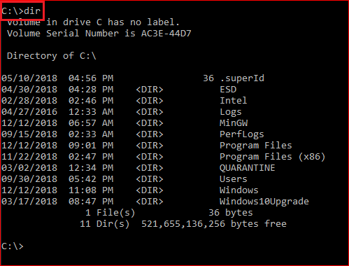
Display root

Slide 14
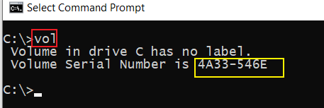
Displays a disk volume label and serial number

Slide 15
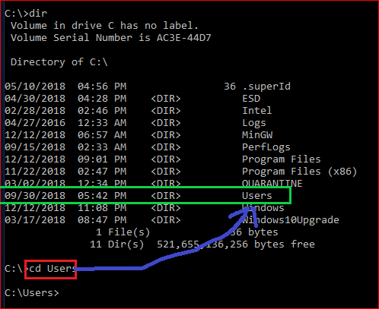
Change to \users directory
cls
Clears the screen

Slide 16
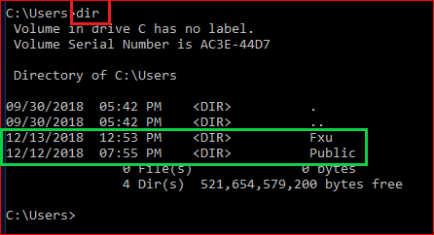
Show all files under the \Users

Slide 17
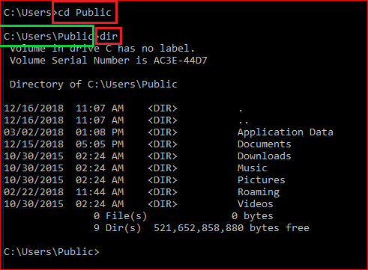
Change directory to \Public and display the content of the folder

Slide 18
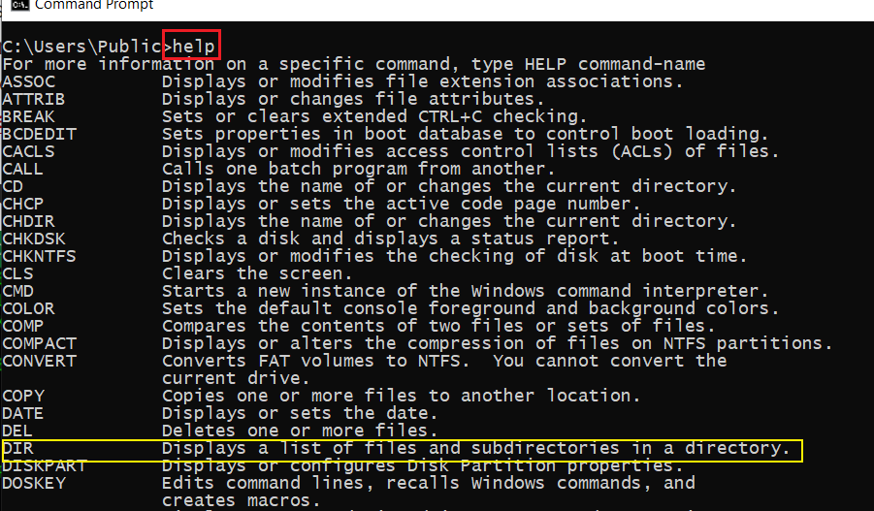
Help command

Slide 19
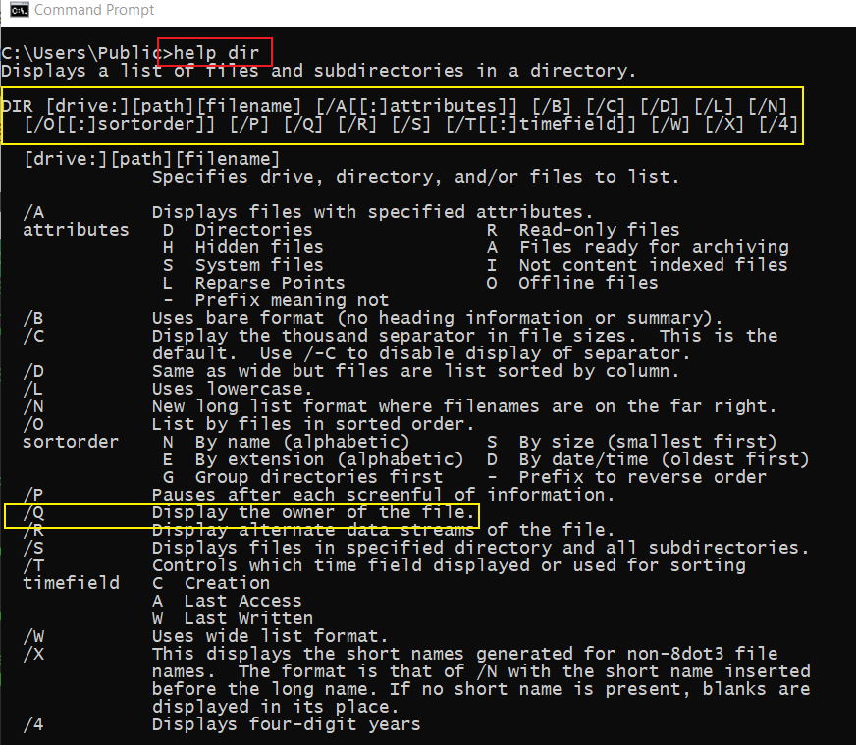
Get help when use dir

Slide 20
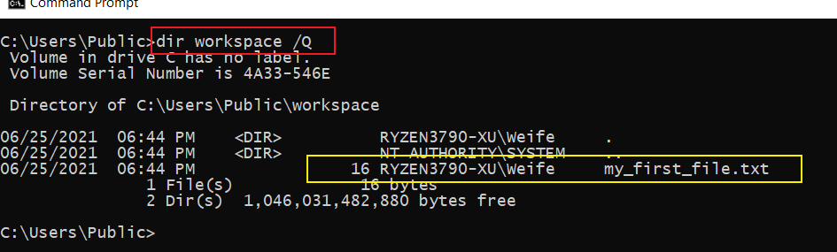
Find the owner of the file

Slide 21
Create folders and files

Slide 22
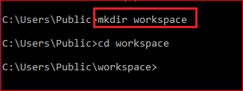
C:
C:
\Users
\Users
Create a folder
\Public
\Public
\workspace

Slide 23
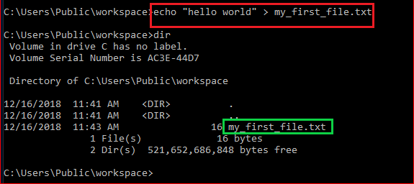
Create a new text file
C:
\Users
\Public
\workspace
hello world
my_first_file.txt

Slide 24
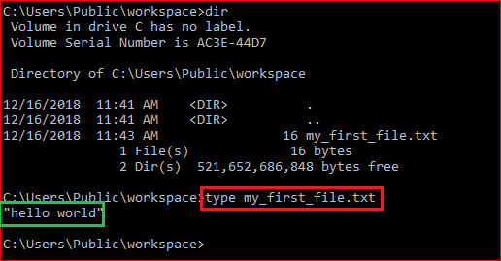
Show the content of the file: type

Slide 25
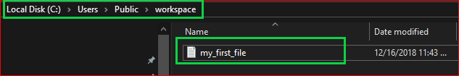

Show the content of the file

Slide 26
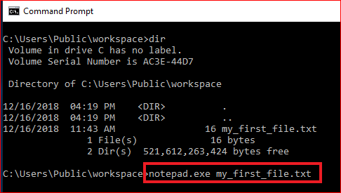
Show the content of the file: exe command

Slide 27
File Copy & Deletion

Slide 28
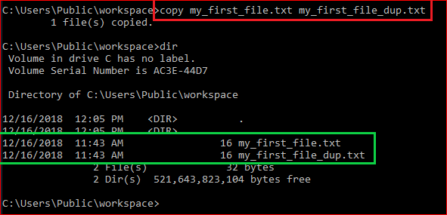
Duplicate files

Slide 29
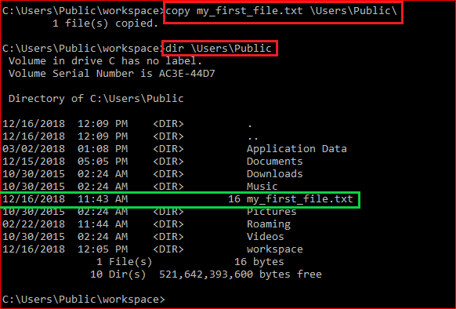
Copy a file to a different location

Slide 30
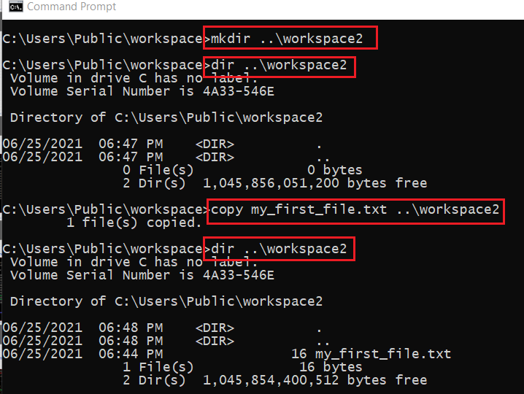
Copy a file to /workspace2 without using cd command
C:
create a folder
copy a file
.. parent folder
\Users
create a folder
copy a file
\Public
\workspace
\workspace2

Slide 31
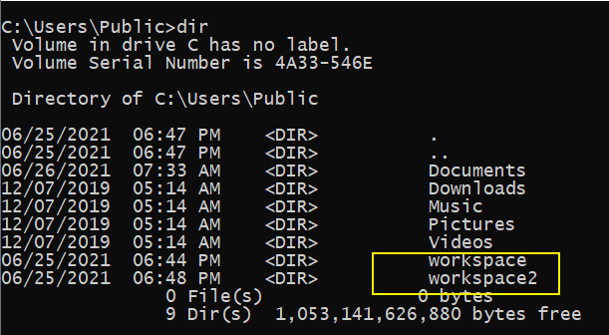

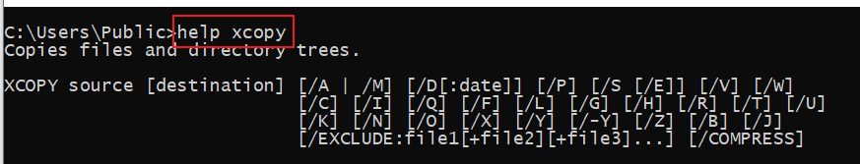
copy the whole folder to /workspace2
C:
\Users
\Public
you are here
\workspace
\workspace2
\workspace2
?

Slide 32
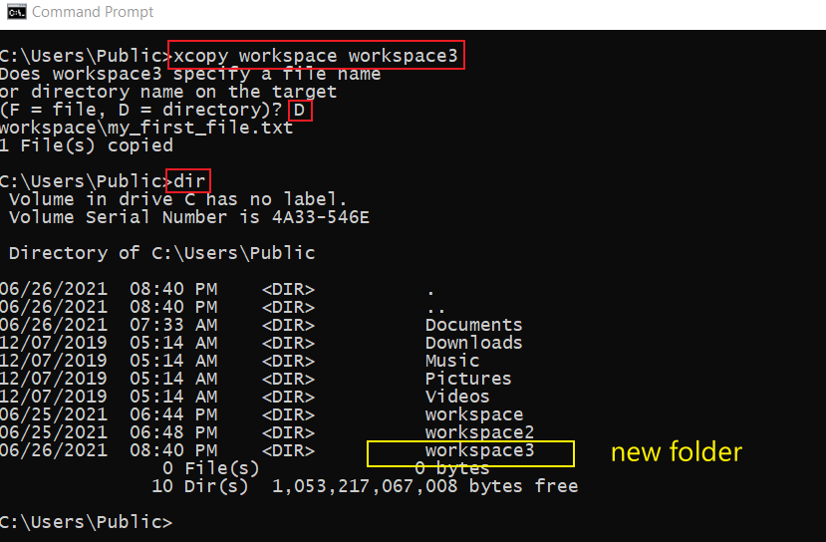

Slide 33
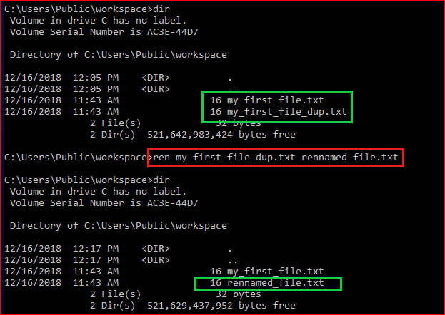
Rename a file

Slide 34
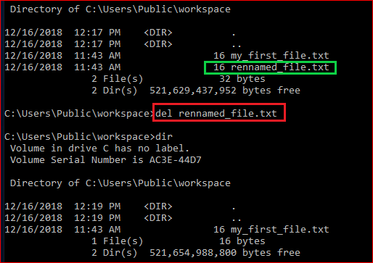
Delete a file

Slide 35
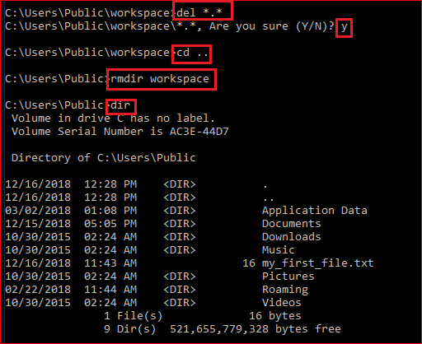
Delete a folder (rmdir/rd)

Slide 36
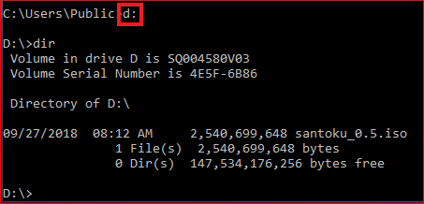
Change to a different drive

Slide 37
Networking

Slide 38
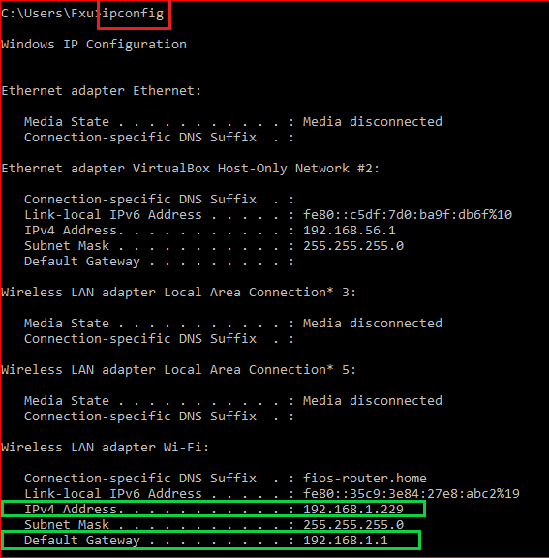
IP and default gateway

Slide 39
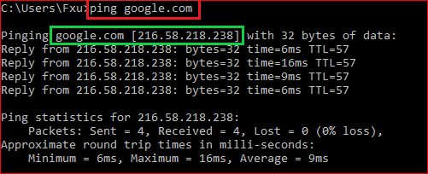
Test network connection

Slide 40
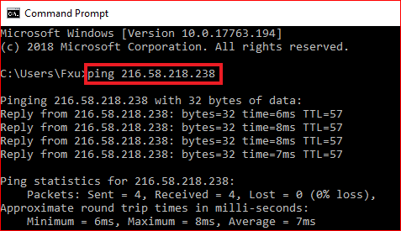
Test network connection

Slide 41
Search for information

Slide 42
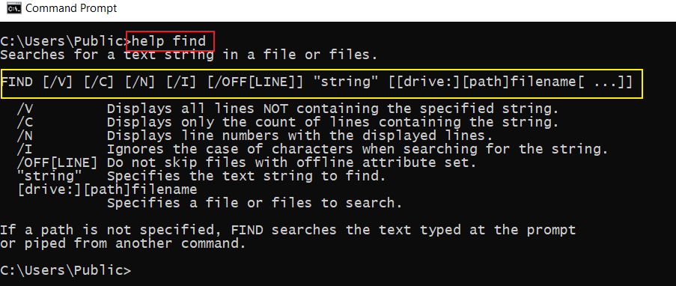
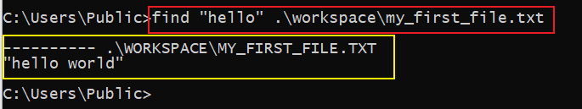
How to search for a string in a file?

Slide 43
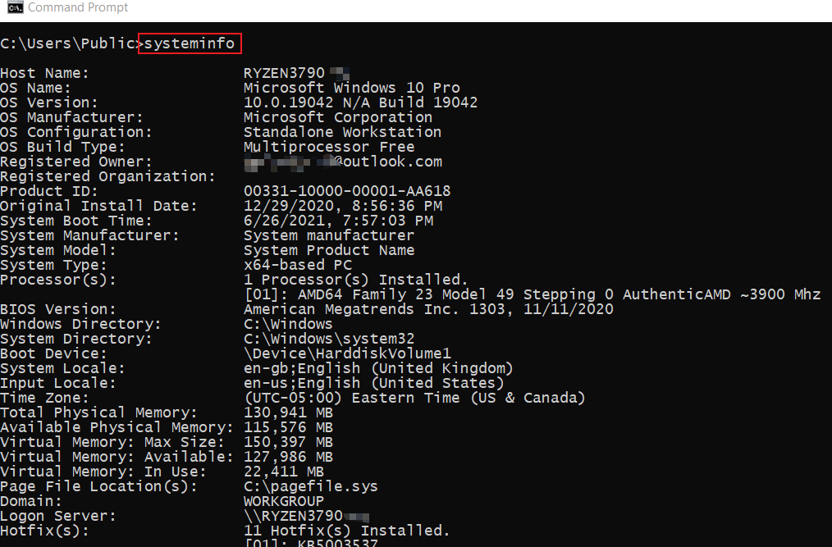
How to find system information?

Slide 44
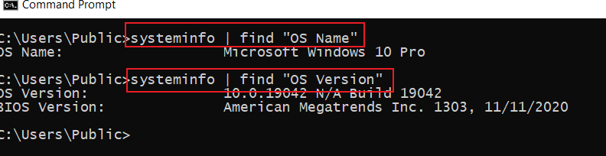
How to find specific system information using pipeline |

Slide 45
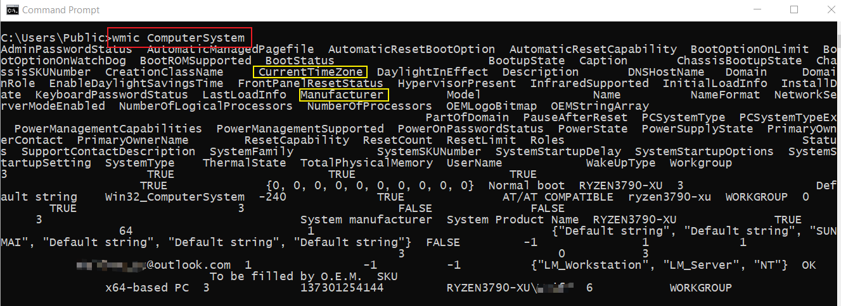
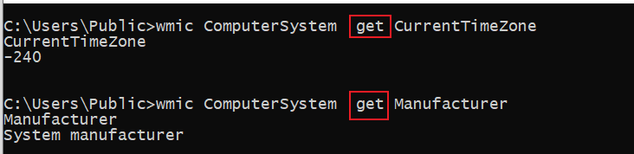
How to find system information using wmic?
Windows Management Interface Command
find property using get

Slide 46
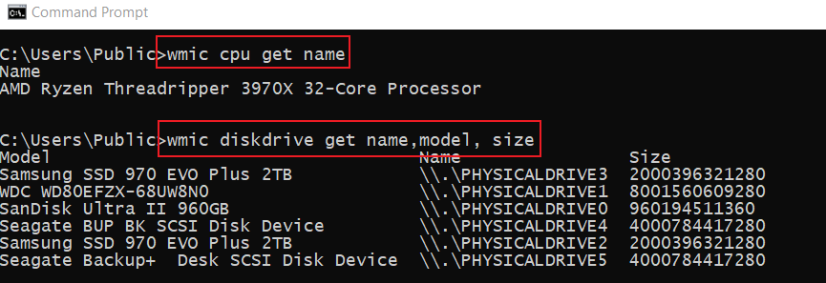
Find CPU/disk information

Slide 47
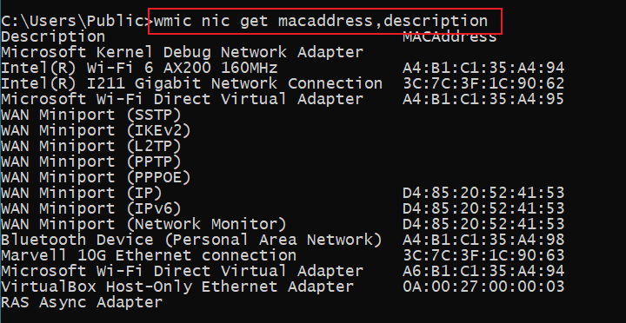
How to Find the MAC Address of Your Computer ?
Notes:
wmic nic get macaddress,description

Slide 48
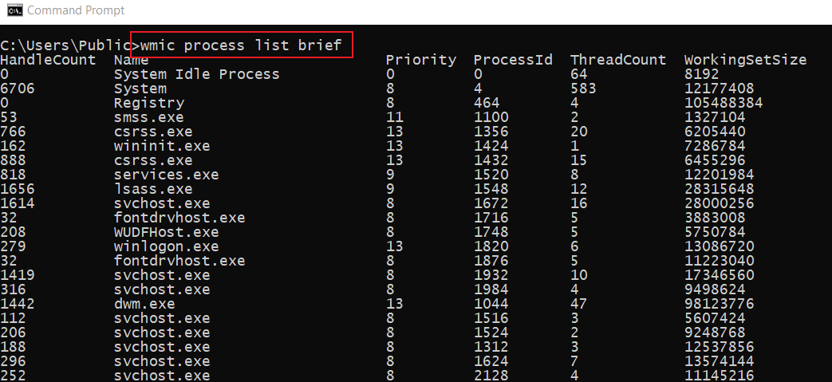
List Processes
Notes:
wmic process list brief

Slide 49
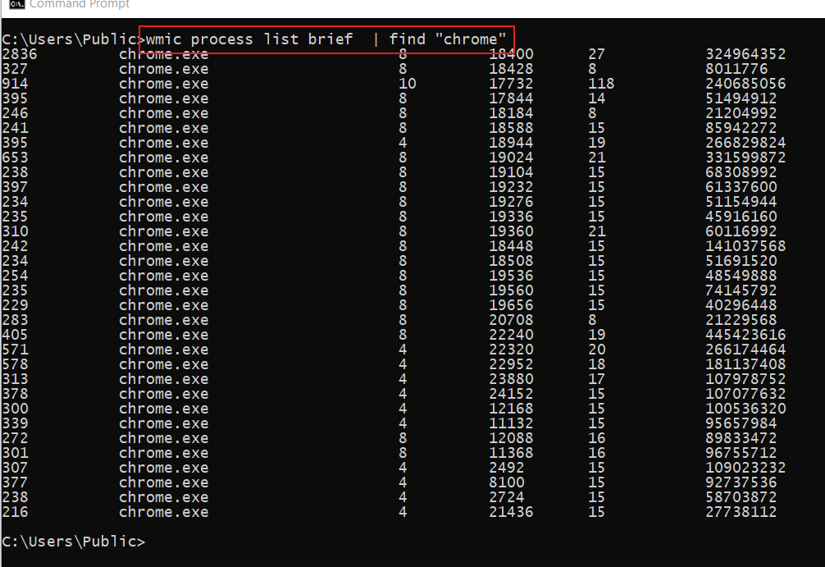
List all Chrome Browser process

Slide 50
Create a batch file

Slide 51
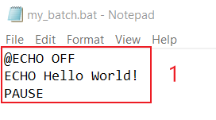
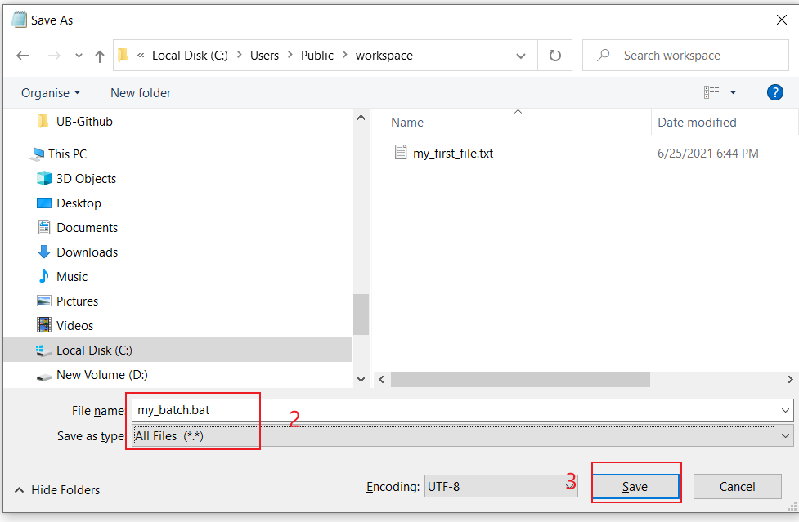
Create a “Hello world” batch
Notes:
@ECHO OFF
ECHO Hello World!
PAUSE

Slide 52
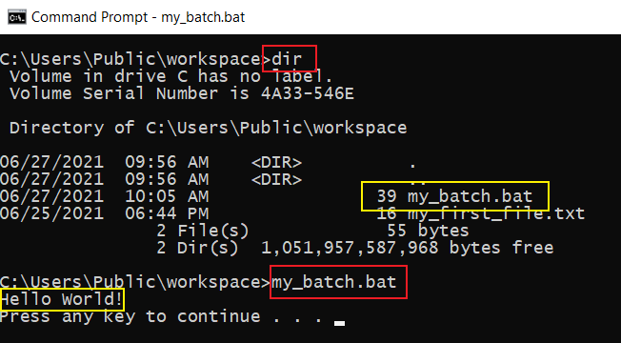
Execute “Hello World” batch

Slide 53
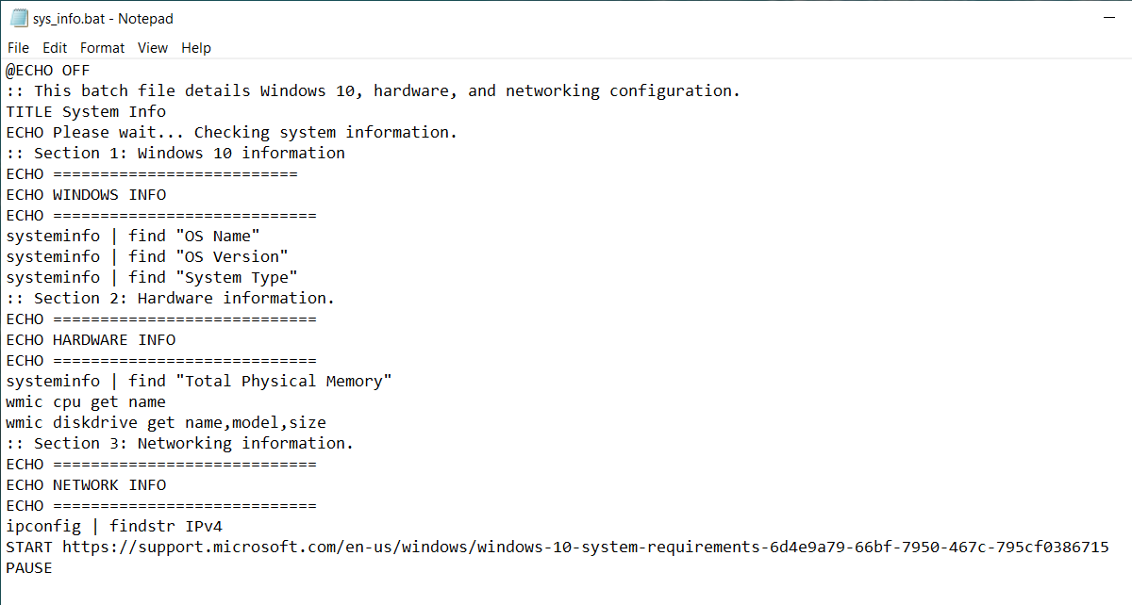
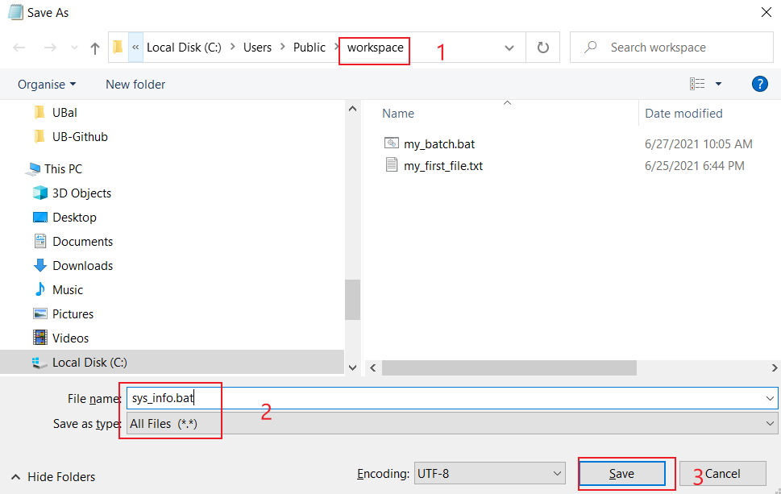
Batch for showing system information
Notes:
@ECHO OFF
:: This batch file details Windows 10, hardware, and networking configuration.
TITLE System Info
ECHO Please wait... Checking system information.
:: Section 1: Windows 10 information
ECHO ==========================
ECHO WINDOWS INFO
ECHO ============================
systeminfo | find "OS Name"
systeminfo | find "OS Version"
systeminfo | find "System Type"
:: Section 2: Hardware information.
ECHO ============================
ECHO HARDWARE INFO
ECHO ============================
systeminfo | find "Total Physical Memory"
wmic cpu get name
wmic diskdrive get name,model,size
:: Section 3: Networking information.
ECHO ============================
ECHO NETWORK INFO
ECHO ============================
ipconfig | findstr IPv4
START https://support.microsoft.com/en-us/windows/windows-10-system-requirements-6d4e9a79-66bf-7950-467c-795cf0386715
PAUSE

Slide 54
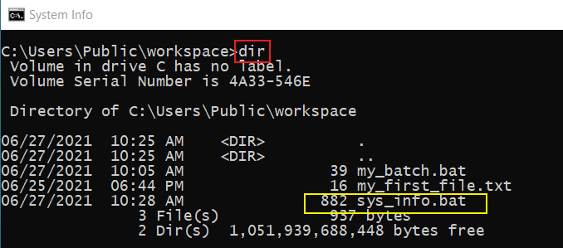

Execute the batch sys_info.bat
Where you are?
Show sys information

