Slide 1
Investigating Harassment Emails
Email, TShark, and Digital Forensics

Slide 2




Harassment Scenario
Created by Dr. Simson Garfinkel at Naval Postgraduate School
Mimics "Nitroba University Harassment Scenario”
sends email
Lily Tuckrige
lives
forwards email
monitors
Scenario and network traffic can be accessed here: https://digitalcorpora.org/corpora/scenarios/nitroba-university-harassment-scenario

Slide 3
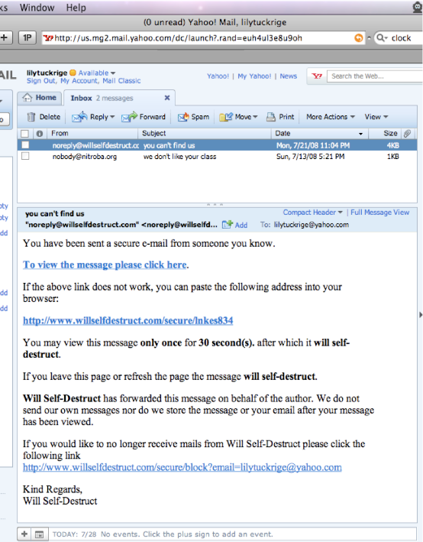
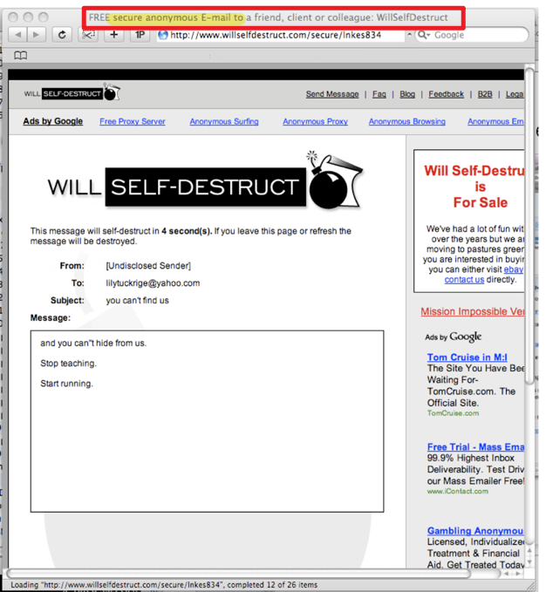
The second harassment email
The second email was sent from www.willselfdestruct.com
When the faculty click a link in the email, the faculty read the content provided by the website
The screenshot is provided by the faculty
The second email traffic is captured by the system admin

Slide 4





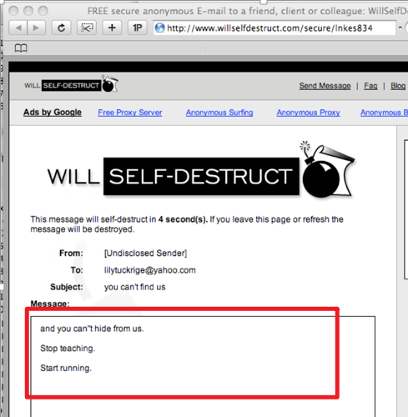
Assumed Scenario
A student in dorm
www.willselfdestruct.com
1
Get www.willselfdestruct.com
A student accesses the website
Website provides a form
A student fills out the form (contains harassment content) on the website
The website sends a notification email to faculty
Faculty click the link in the email
Website sends the harassment content saved on the website
1
2
2
3
POST www.willselfdestruct.com/form
3
Faculty
Save harassment content on server
4
4
5
5
Get www.willselfdestruct.com/secure/linkes834
6
6

Slide 5
Mapping scenario to evidence
A student accesses the website
Website provides a form
A student fills out the form (contains harassment content) on the website
The website sends a notification email to the faculty
Faculty click the link in the email
Website sends the harassment content saved on the website
1
ID | Who | Did | What | When
1 | IP, mac | HTTP get | www.willselfdestruct.com | ?
3 | IP, mac | HTTP post | harassment content in a form From To Subject content | ?
6 | faculty | HTTP get | harassment content = email content received by the faculty | ?
2
3
4
5
6

Slide 6

Find evidence to reconstruct the scenario if our assumption is correct.

Slide 7
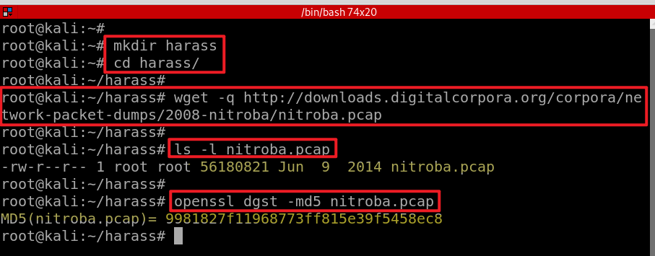
The captured network traffic log
Create a working folder
Download traffic log
Verify hash code
Notes:
https://downloads.digitalcorpora.org/corpora/network-package-dumps/2008-nitroba/nitroba.pcap

Slide 8
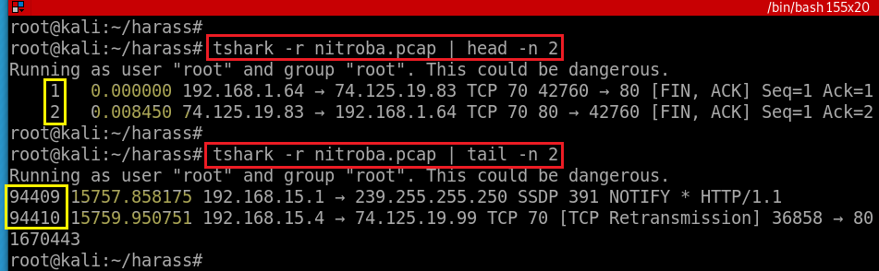
Traffic data review
Notes:
https://linux.die.net/man/1/tshark

Slide 9
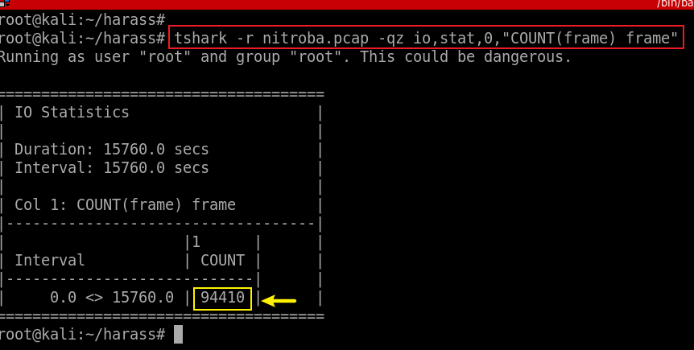
Count the number of packets
-q: quit (don’t show packets)
-z: statistics, io,stat is one of stats
0: over all packets, otherwise is interval seconds
[COUNT|SUM|MIN|MAX|AVG](<field>)<filter>
Notes:
tshark -r nitroba.pcap -qz io,stat,0,"COUNT(frame) frame"

Slide 10
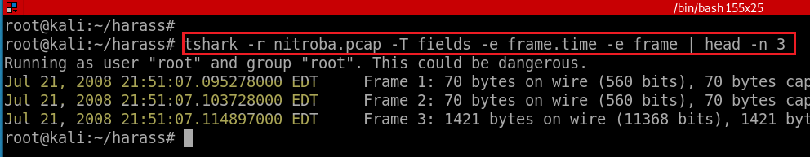
Show the first three packets
Notes:
tshark -r nitroba.pcap -T fields -e frame.time -e frame | head -n 3

Slide 11
Evidence collection
tshark

Slide 12
List of questions
Which IP accessed www.willselfdestruct.com?
Does the IP post harassing comments to the website?
Does the HTTP post contain the harassment message?
Is the IP associated with any suspects?
Is the suspect in the faculty’s class?
When did the suspect use www.willselfdestruct.com?

Slide 13
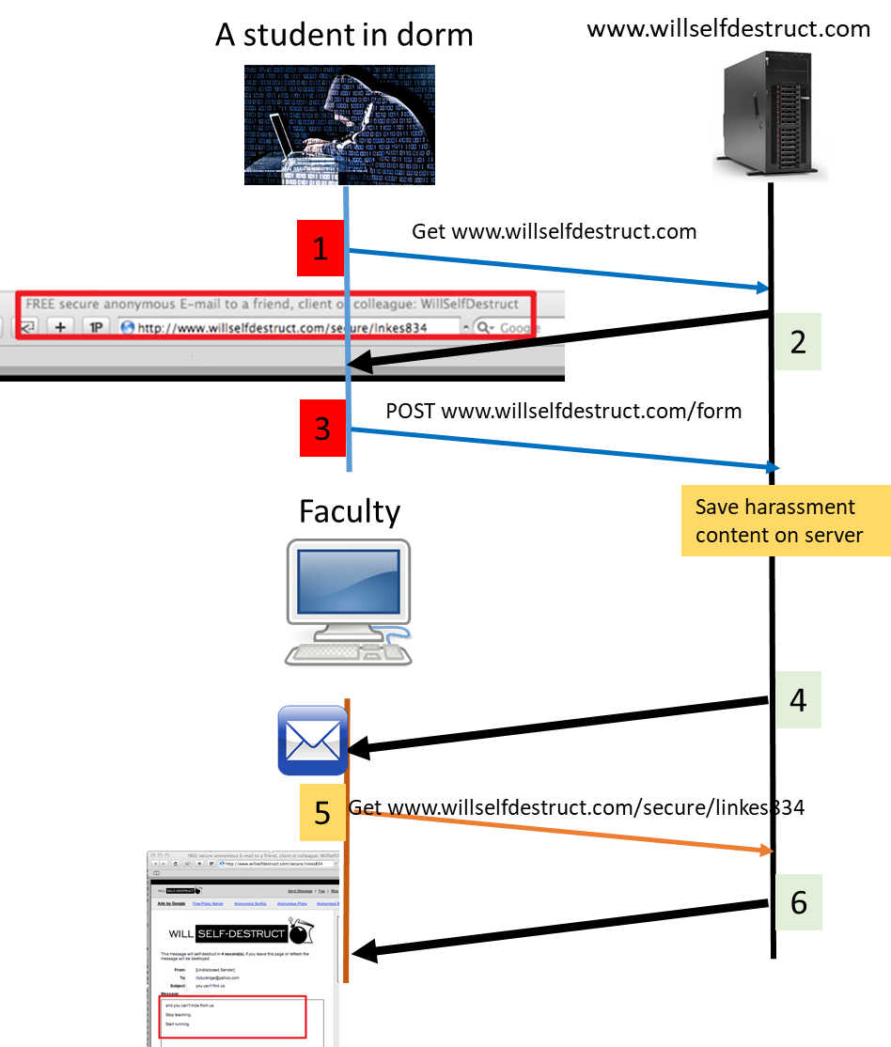
Which IP accessed www.willselfdestruct.com?
The IP is associated with HTTP Requests and responses
Start investigating
1
2
3
1

Slide 14
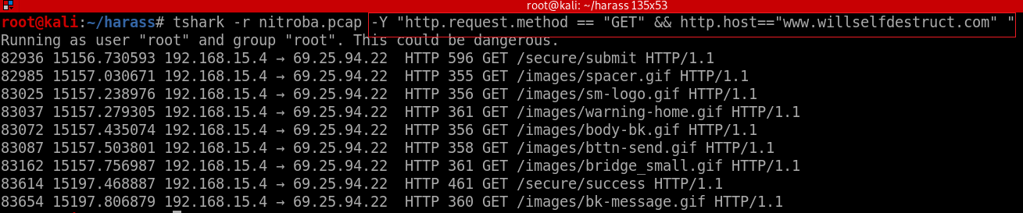
Find all packets between HTTP request and web page “www.willselfdestruct.com”
1
frame.time
Make conclusion: 69.25.94.22 is the web’s IP and 192.168.15.4 is the suspect’s IP address
Notes:
tshark -r nitroba.pcap -Y "http.request.method == "GET" && http.host=="www.willselfdestruct.com" "

Slide 15
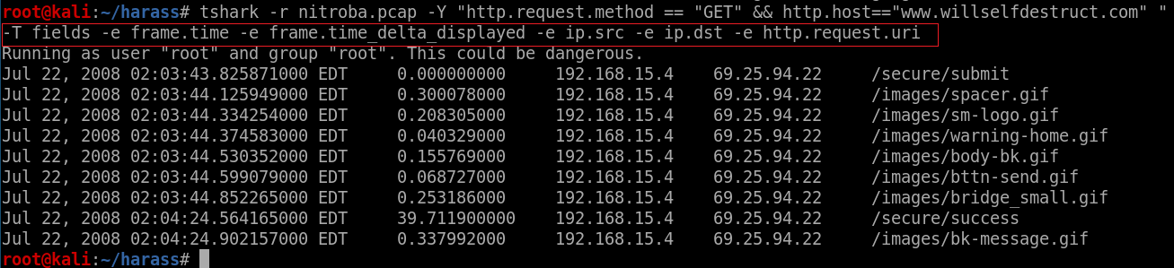
-e frame.time
-e frame.time_delta_displayed
-e ip.src
-e ip.dst
-e http.request.uri
Show specific fields
1
Notes:
tshark -r nitroba.pcap -Y "http.request.method == "GET" && http.host=="www.willselfdestruct.com" " -T fields -e frame.time -e frame.time_delta_displayed -e ip.src -e ip.dst -e http.request.uri

Slide 16
Alternative: find IP from HTTP response.
2
Anyone accessed the website will see the webpage title
Title in .html
<title>FREE secure anonymous E-mail to a friend, client or colleague: WillSelfDestruct</title>
We can search keywords in the title
How?

Slide 17
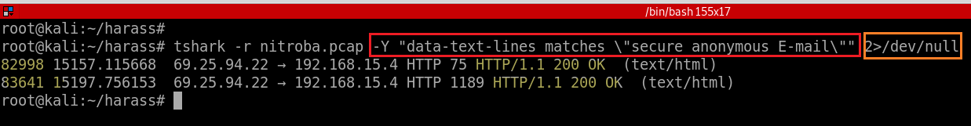
<title>FREE secure anonymous E-mail to a friend, client or colleague: WillSelfDestruct</title>
Find IP by searching the title of a web page.
2
2>/dev/null : redirect error message
Make conclusion:
69.25.94.22 is the web’s IP and 192.168.15.4 is the suspect’s ID
Server is accessed twice because there are two response 200 OK
Notes:
tshark -r nitroba.pcap -Y "data-text-lines matches \"secure anonymous E-mail\"" 2>/dev/null

Slide 18
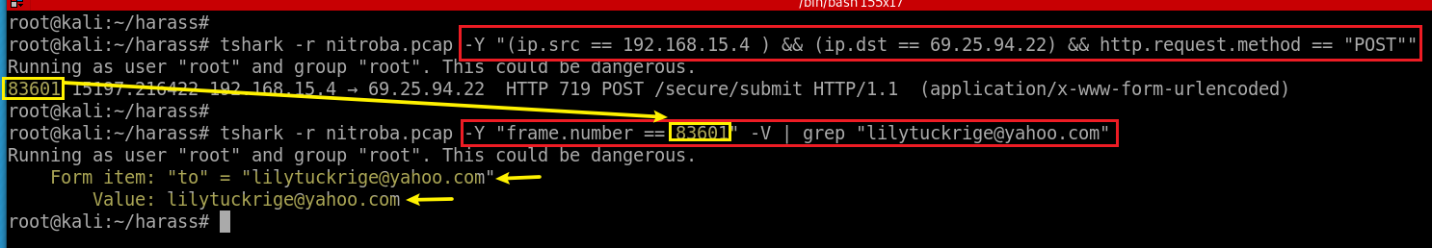
Does the IP post harassing comments to the website?
3
method 1: grep specific value
Search HTTP POST request.
3
Note: We are only interested in the traffic between 69.25.94.22 (suspect’s IP) and 192.168.15.4 (the web’s IP)
Harassing “to”email founded!
Notes:
(ip.src == 192.168.15.4 ) && (ip.dst == 69.25.94.22) && http.request.method == "POST"

Slide 19
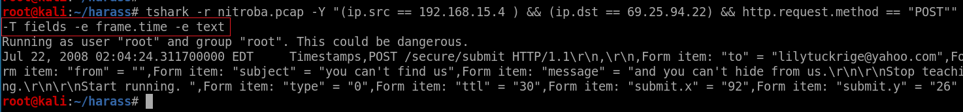
method 2: -e text
show outputs in a text format
3
Notes:
tshark -r nitroba.pcap -Y "(ip.src == 192.168.15.4 ) && (ip.dst == 69.25.94.22) && http.request.method == "POST"" -T fields -e frame.time -e text

Slide 20
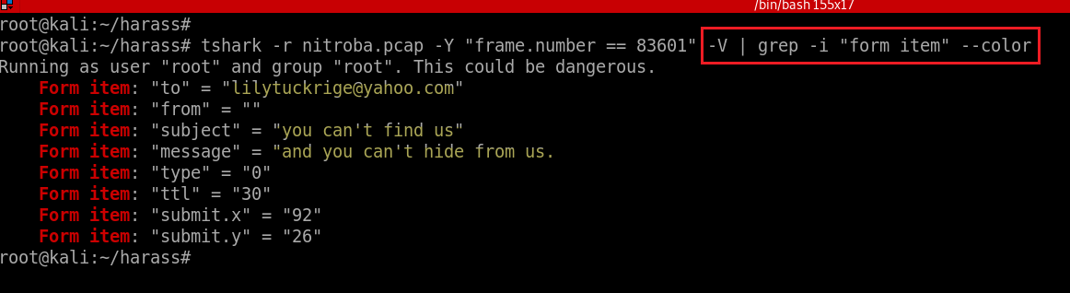
method 3: grep ”form item”
Grep form filled by suspects using key words “form item”
3
Notes:
tshark -r nitroba.pcap -Y "frame.number == 83601" -V | grep -i "form item" --color

Slide 21
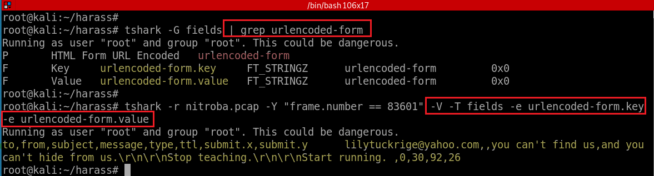
method 4: --e urlencoded-form.key -e urlencoded-form.value
Grep form filled by suspects using field names
3
Notes:
tshark -r nitroba.pcap -Y "frame.number==83601" -T fields -e urlencoded-form.key -e urlencoded-form.value

Slide 22
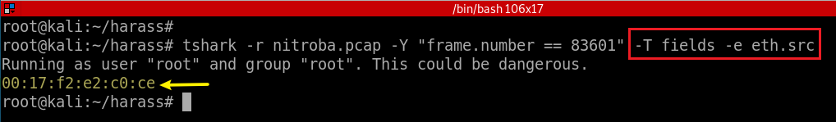
Is the IP associated with any suspects?
No: A few students may use the same IP
Need to find the unique MAC address
Show mac address of packet 83601
Notes:
tshark -r nitroba.pcap -Y "frame.number == 83601" -T fields -e eth.src
00:17:f2:e2:c0:ce

Slide 23
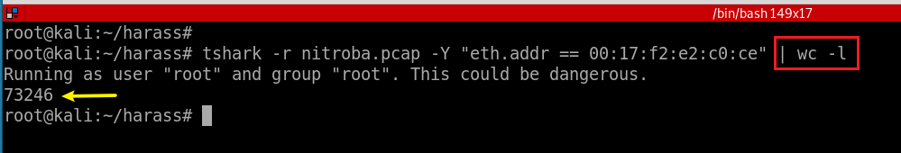
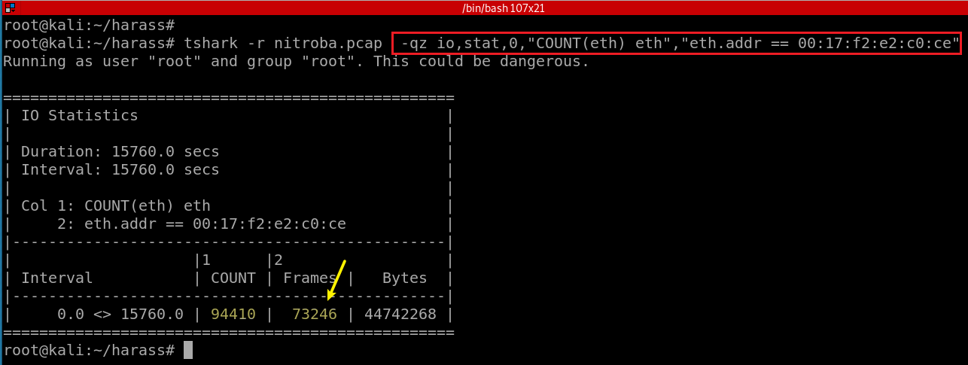
Search all packets sending and receiving by the suspect’s Apple device (Method 1)
Too many packets, need refine the results
(Method 2)
Total Ethernet frame
Ethernet with mac address “00:17:f2:e2:c0:ce”
No space between two filters
Notes:
eth.addr == 00:17:f2:e2:c0:ce
tshark -r nitroba.pcap -qz io,stat,0,"COUNT(frame) frame","eth.addr == 00:17:f2:e2:c0:ce"

Slide 24
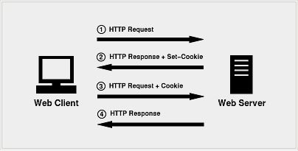
How to connect MAC address with suspect’s ID?
HTTP is a stateless protocol
each request is executed by server independently, without any knowledge of the requests that were executed before it
How to let server remember you?
HTTP cookie (web cookie, browser cookie)
A cookie
Is a small piece of data that a server sends to the user's web browser.
The client browser may store it and send it back with later requests to the same server.
Notes:
eth.addr == 00:17:f2:e2:c0:ce && http.cookie contains "@"

Slide 25
Purpose of Cookies
Session management
Logins, shopping carts, game scores, or anything else the server should remember
Personalization
User preferences, themes, and other settings
Tracking
Recording and analyzing user behavior
We may be able to find suspects’ profiles from Cookies!
Notes:
eth.addr == 00:17:f2:e2:c0:ce && http.cookie contains "@"

Slide 26
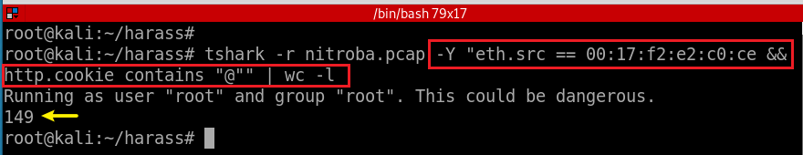
Narrow down the search result using cookie
@ hopefully cookies have email information.
Notes:
tshark -r nitroba.pcap -Y "eth.src == 00:17:f2:e2:c0:ce && http.cookie contains "@""

Slide 27
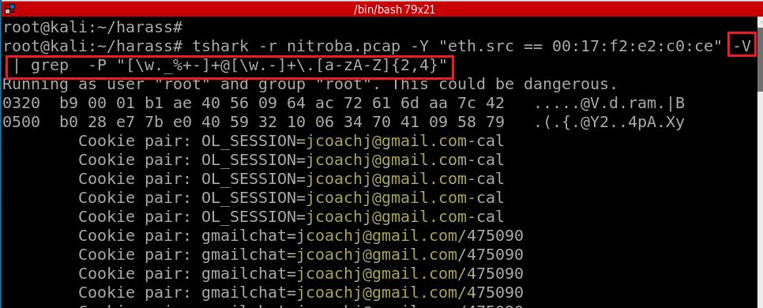
Search all email associated with the mac address
[\w-] is the same as [A-Za-z0-9_-]
Notes:
tshark -r nitroba.pcap -Y "eth.src == 00:17:f2:e2:c0:ce" -V | grep -P "[\w._%+-]+@[\w.-]+\.[a-zA-Z]{2,4}"

Slide 28
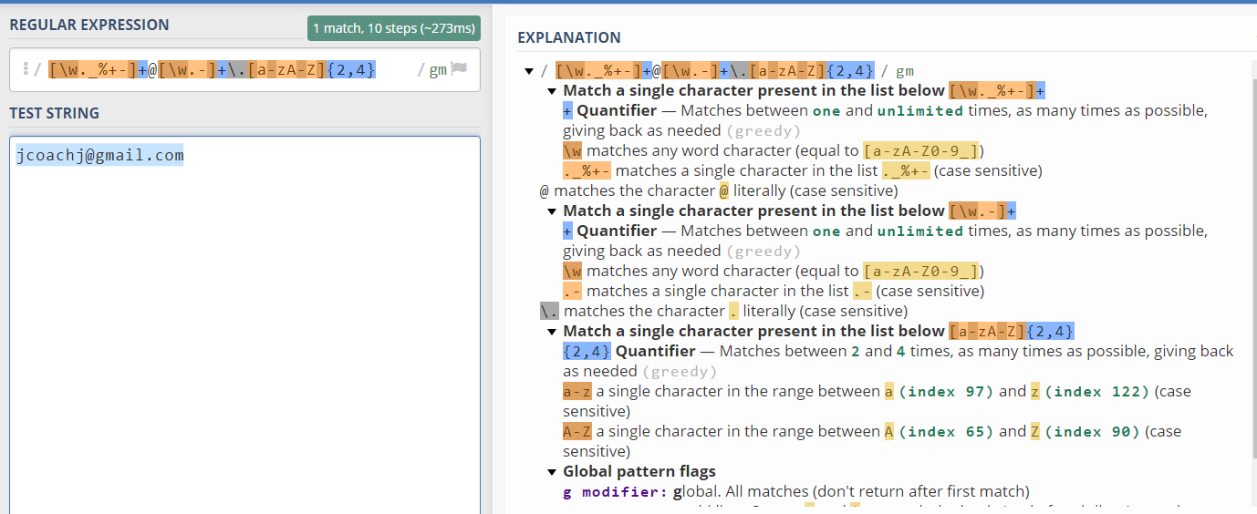
https://regex101.com/

Slide 29
Is the suspect in faculty’s class?
Teacher: Lily Tuckrige
Students:
Amy Smith
Burt Greedom
Tuck Gorge
Ava Book
Johnny Coach
Jeremy Ledvkin
Nancy Colburne
Tamara Perkins
Esther Pringle
Asar Misrad
Jenny Kant

Slide 30
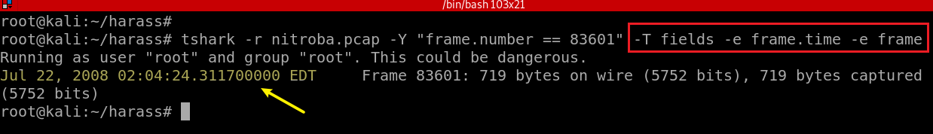
When did the suspect use www.willselfdestruct.com?
Show the form submitted time in EDT
Notes:
tshark -r nitroba.pcap -Y "frame.number == 83601" -T fields -e frame.time -e frame

Slide 31
Other helpful filters
http.set_cookie
ip.dst == 192.168.15.4
http.user_agent == "Mozilla/4.0 (compatible; MSIE 6.0; Windows NT 5.1; SV1)“
http.request.uri contains "?"
http.request.method=="POST"

