Slide 1
Rhino Hunting – Illegal Possession Investigation
Steganography
https://www.cfreds.nist.gov/dfrws/Rhino_Hunt.html
Notes:
https://www.youtube.com/watch?v=6G3qm60dfA8&ab_channel=PrashantThombre

Slide 2
Steganography
Discover hidden rhino photos

Slide 3
How to extract hidden rhino photos?
STEP 1: Detect which tool are used for hiding photos
stegdetect -> steghide?
STEP 2: Crack passwords (steghide)
stegcrack
STEP 3: Use the same steg tool to recover the photos
steghide/stegseek

Slide 4
STEP 1: Detect which tool is used for hiding photos
What is stegdetect?
It analyses image files for steganographic content.
It runs statistical tests to determine if steganographic content is present,
It tries to find the system that has been used to embed the hidden information.
It tests if information has been embedded with
Jsteg, outguess, jphide, invisible secrets, F5
It tests if information has been added at the end of file
Camouflage
appendX
Notes:
https://linux.die.net/man/1/stegdetect#:~:text=The%20stegdetect%20utility%20analyses%20image,to%20embed%20the%20hidden%20information.

Slide 5
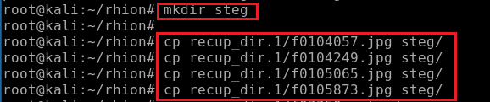
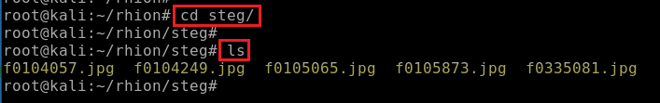
Create a steg folder
Copy 5 non-rhino photos to the steg folder
Navigate to steg folder
Verify the folder contains 5 photos

Slide 6

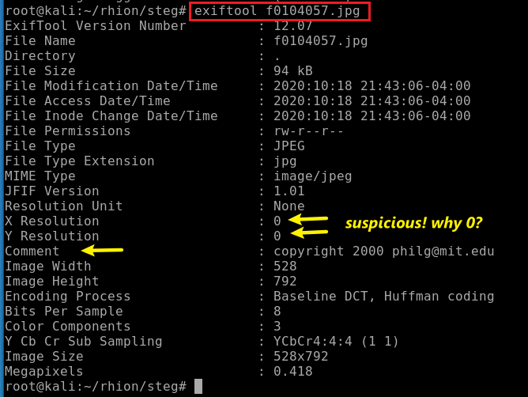
Any suspicious data in photo metadata?
Install exiftool to view metadata of the file
View the metadata of the file
Sometimes important stuff is hidden in the metadata of the image or the file

Slide 7
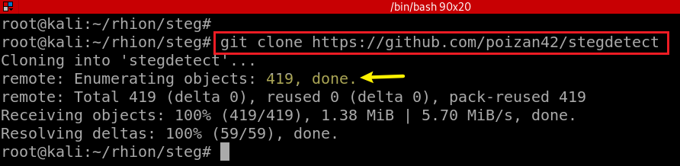
Download stegdetect source code
Trigger rebuilds
autoreconf is a Autotool which is used to create automatically buildable source code for Unix-like systems.
Preparation:
hello.c: hello world source code
configure.ac : Describes configuration required for compile source code, such as dependency generation.
Makefile.am : Describes sources code and compiled name
Executable generation:
autoreconfg –i: force to rebuild
./configure -> configure.ac
make -> Makefile.am
Results:
executable hello
Notes:
$ git clone https://github.com/poizan42/stegdetect
$ cd stegdetect/
$ autoreconf -f -i
$ linux32 ./configure
$ linux32 make
https://stackoverflow.com/questions/33278928/how-to-overcome-aclocal-1-15-is-missing-on-your-system-warning
https://www.geeksforgeeks.org/autoreconf-command-in-linux-with-examples/

Slide 8

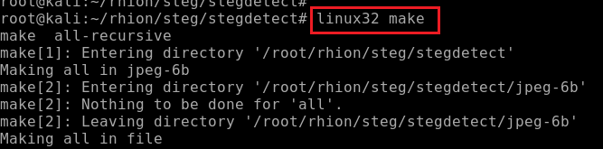
Set compilation environments
Compile source code to stegdetect executable

Slide 9
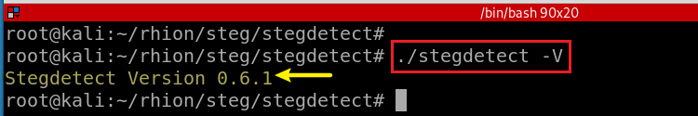
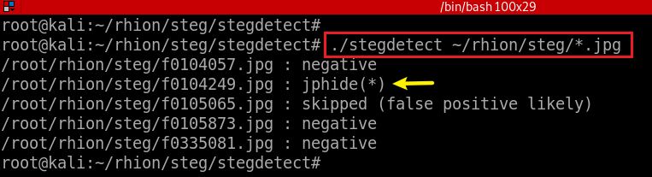
Verfiy stegdetect works
Detect the tools used for hide photos
Notes:
https://linux.die.net/man/1/stegdetect#:~:text=The%20stegdetect%20utility%20analyses%20image,to%20embed%20the%20hidden%20information.

Slide 10
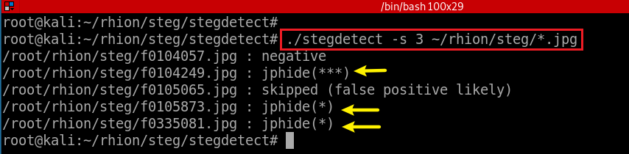
Increase the sensitivity of detection algorithms from 1 (default) to 3

Slide 11
STEP 2: How to use stegcrack to find jphide passwords?
What is stegbreak?
a brute-force dictionary attack on embedded JPG images
Shipped with stegdetect
Target on embedding used by
Outguess
Jphide, and
steg-shell.
Rules on how to manipulate words for the dictionary attack
/usr/local/share/stegbreak/rules.ini, from John the Ripper.

Slide 12

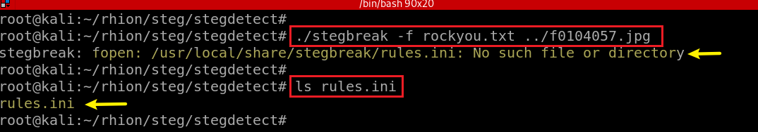

Missing rules.ini in /usr/local/share/stegbreak folder
Copy rules.ini to /usr/local/share/stegbreak folder

Slide 13
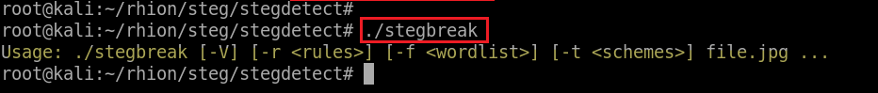
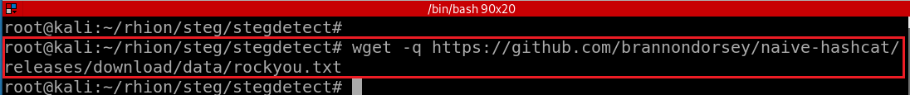
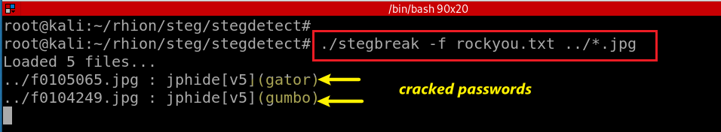
Test stegbreak
Download wordlist required by stegbreak
Crack passwords used for hiding photos
Notes:
wget –q https://github.com/brannondorsey/naive-hashcat/releases/download/data/rockyou.txt

Slide 14
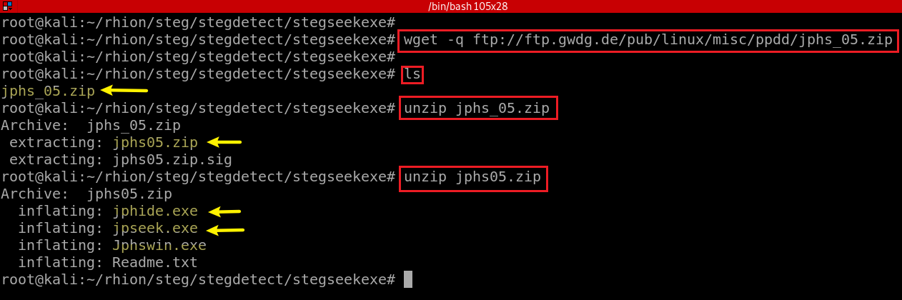
STEP 3: How to use the steghide/stegseek to recover the photos?
Create working directory
Download and unzip jphide

Slide 15
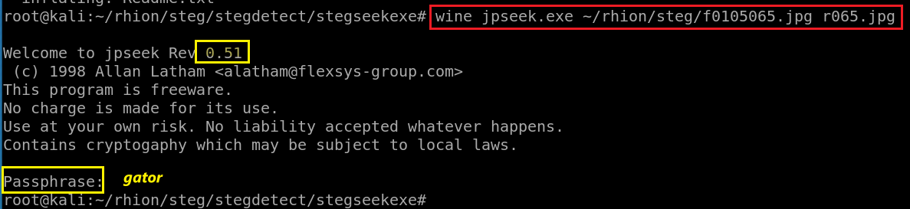
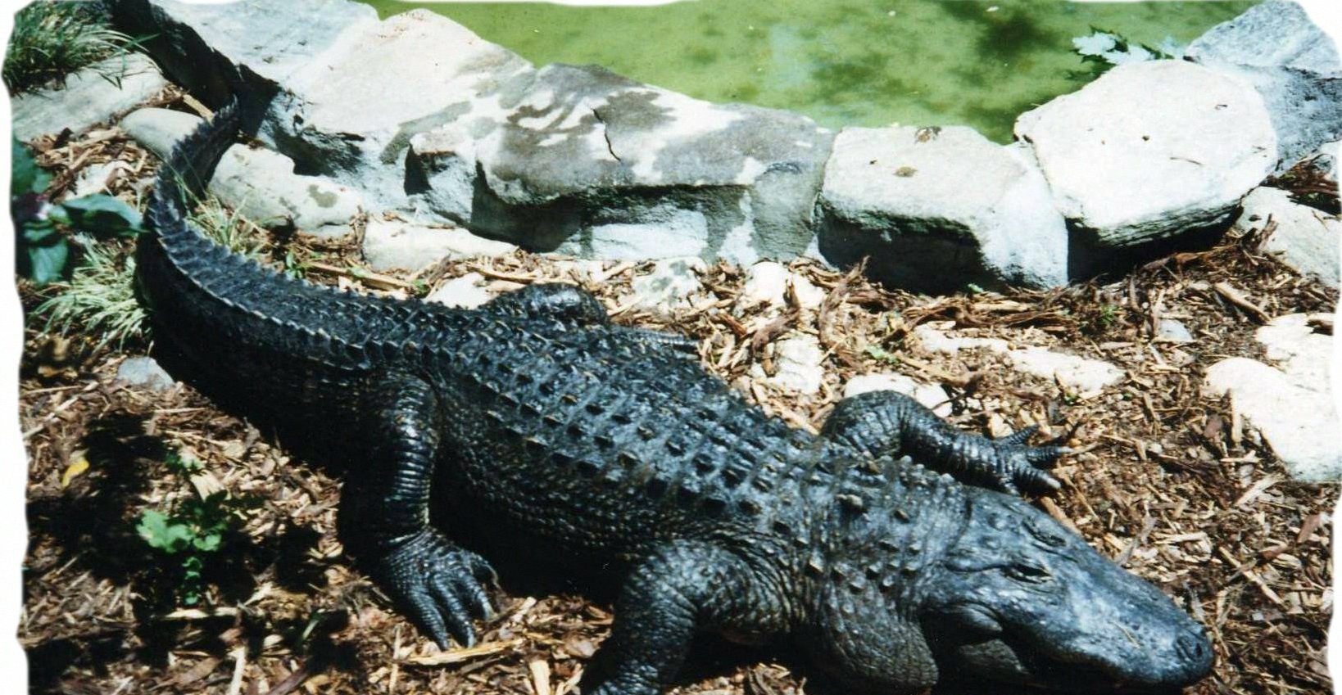

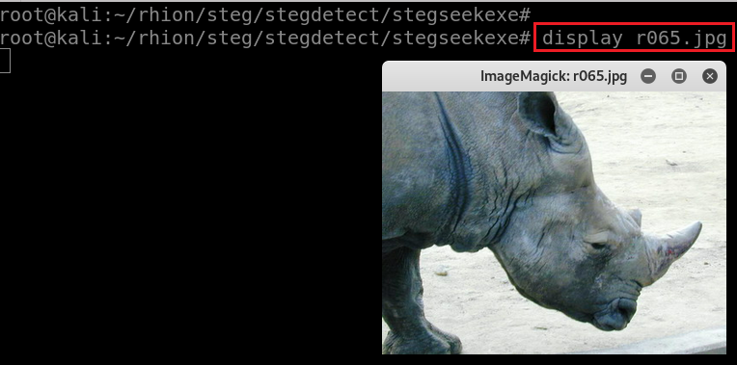

Extract the first hidden photo using jpseek
It seems only jpseek.exe (windows version) works
Display the extract photo
5
63a39823f80b321c2dcd112158b55011

Slide 16
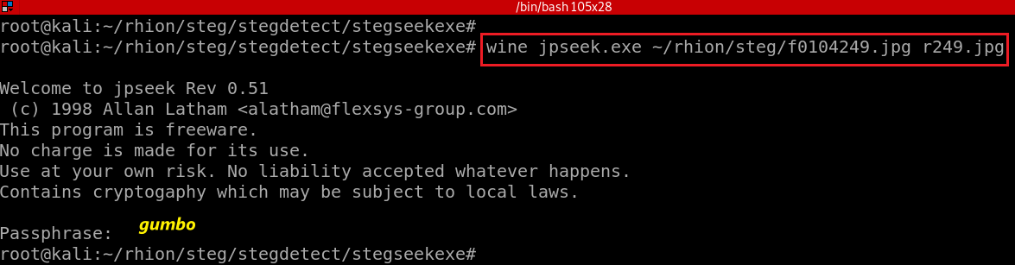
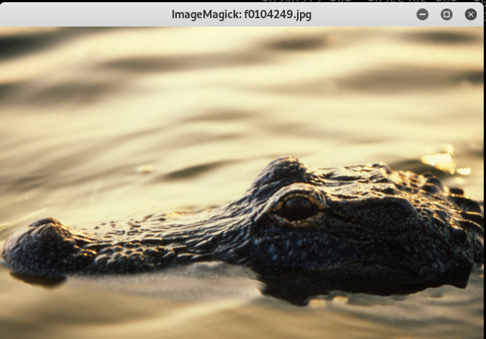
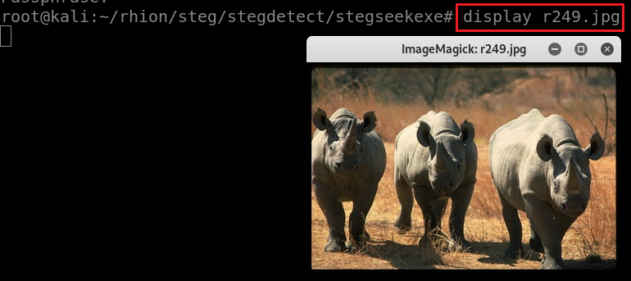
Extract the second hidden photo using jpseek
Display the extract photo
6
87018ef0cfdb91e818d92efeb9c19338

Slide 17
Evidence
What is the evidence can hep you make decision
the suspect hide images
Two tools
stegdetect
jpseek/stegbreak (stegdetec and stegbreak is the same tool)
passwords
decoded pictures
content rhino images

Slide 18
Steg Toolkit - Other useful tools collection

Slide 19
Any other tools doing steganography?
Tool | File types | Description | How to hide | How to recover
mp3stego | Audio (MP3) | Old program. Encrypts and then hides a message (3DES encryption!). Windows tool running in Wine. Requires WAV input (may throw errors for certain WAV files. what works for me is e.g.: ffmpeg -i audio.mp3 -flags bitexact audio.wav). Important: use absolute path only! | mp3stego-encode -E secret.txt -P password /path/to/cover.wav /path/to/stego.mp3 | mp3stego-decode -X -P password /path/to/stego.mp3 /path/to/out.pcm /path/to/out.txt
openstego | Images (PNG) | Various LSB stego algorithms (check out this blog). Still maintained. | openstego embed -mf secret.txt -cf cover.png -p password -sf stego.png | openstego extract -sf openstego.png -p abcd -xf output.txt (leave out -xf to create file with original name!)
outguess | Images (JPG) | Uses "redundant bits" to hide data. Comes in two versions: old=outguess-0.13 taken from here and new=outguess from the package repos. To recover, you must use the one used for hiding. | outguess -k password -d secret.txt cover.jpg stego.jpg | outguess -r -k password stego.jpg output.txt
https://github.com/DominicBreuker/stego-toolkit#tools
Notes:
https://github.com/DominicBreuker/stego-toolkit#tools

Slide 20
Any other tools detecting steganography?
Tool | File types | Description | How to use
stegoVeritas | Images (JPG, PNG, GIF, TIFF, BMP) | A wide variety of simple and advanced checks. Check out stegoveritas.py -h. Checks metadata, creates many transformed images and saves them to a directory, Brute forces LSB, … | stegoveritas.py stego.jpg to run all checks
zsteg | Images (PNG, BMP) | Detects various LSB stego, also openstego and the Camouflage tool | zsteg -a stego.jpg to run all checks
stegdetect | Images (JPG) | Performs statistical tests to find if a stego tool was used (jsteg, outguess, jphide, …). Check out man stegdetect for details. | stegdetect stego.jpg
stegbreak | Images (JPG) | Brute force cracker for JPG images. Claims it can crack outguess, jphide and jsteg. | stegbreak -t o -f wordlist.txt stego.jpg, use -t o for outguess, -t p for jphide or -t j for jsteg
Notes:
https://www.prodefence.org/stego-toolkit-collection-of-steganography-tools-helps-with-ctf-challenges/

Slide 21
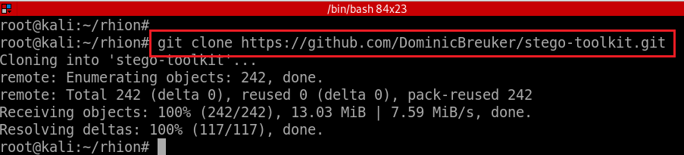
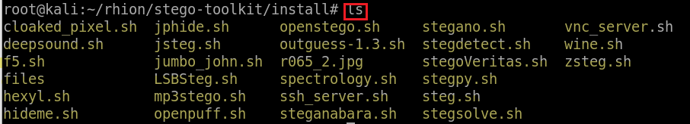
Stego Toolkit
Download toolkit
List other available tools
Notes:
github.com/DominicBreuker/stego-toolkit
sudo apt-get update
sudo git clone https://github.com/DominicBreuker/stego-toolkit.git
cd stego-toolkit
cd install
chmod +x jphide.sh
sudo ./jphide.sh

Slide 22
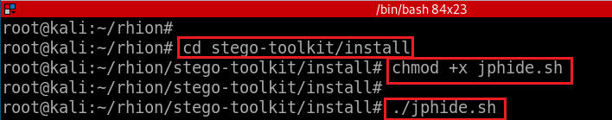
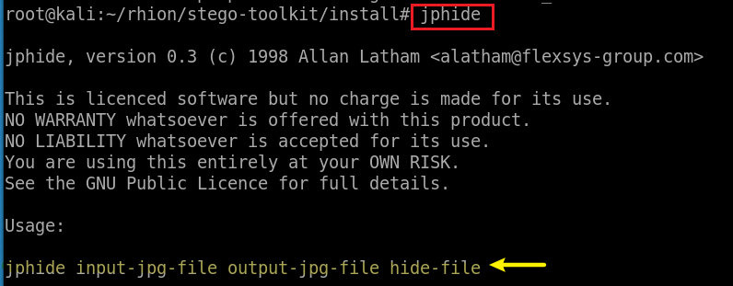
Install one of the tools, jphide/jpseek
Try jphide

Slide 23
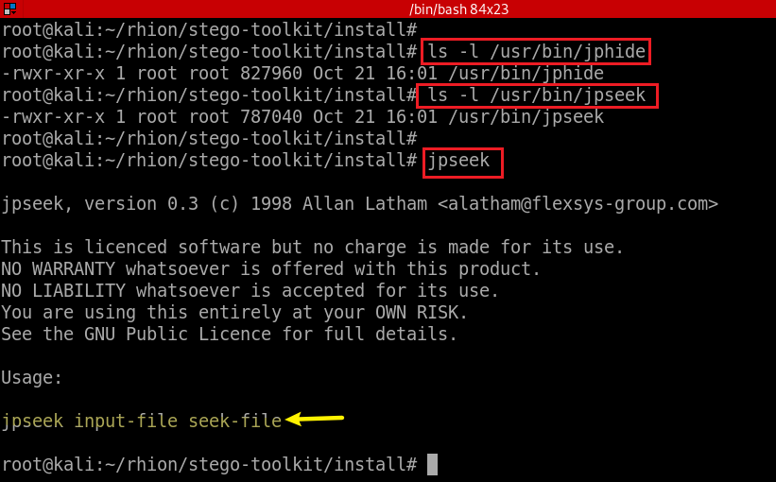
Find the location of jphide and jpseek
Try jpseed

Slide 24
Practices
Install and try a different tool in Steg-toolkit
Install and try Foremost
Foremost is a forensic data recovery program for Linux used to recover files using their headers, footers, and data structures through a process known as file carving
Install and try Scalpel
The first version of Scalpel, released in 2005, was based on Foremost 0.69.
The newest public release v2.0,

