Slide 1
Rhino Hunting – Illegal Possession Investigation
Traffic Log Analysis: FTP
Notes:
https://www.youtube.com/watch?v=6G3qm60dfA8&ab_channel=PrashantThombre

Slide 2
Investigate rhino.log
FTP traffic forensics

Slide 3
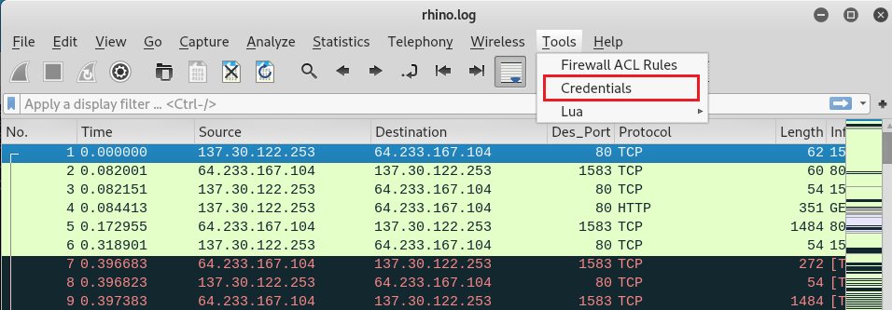
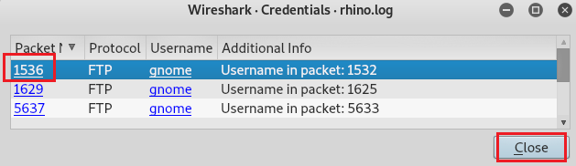
Open rhino.log with Wireshark
Check credentials (in case users using FTP, which is not encrypted)
Check the first credentials
Click the first one

Slide 4
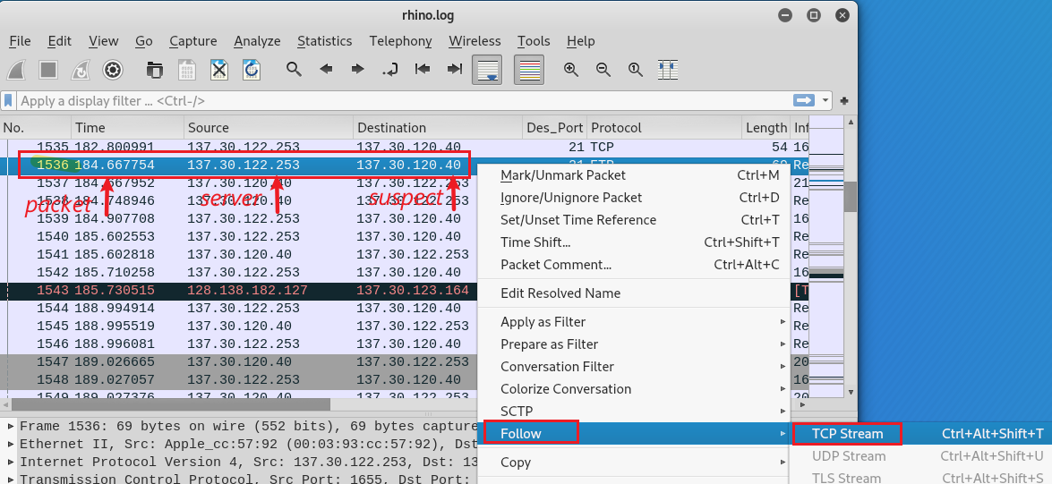
Investigate the first FTP session
Right Click
See a protocol in the way that the application layer sees it
Applies a display filter which selects all the packets in the current stream.

Slide 5
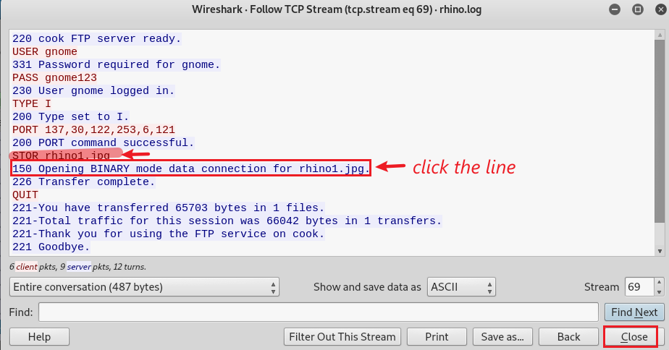
Check the first FTP connection and find traffic of rhino1.jpg
User name: gnome
Password: gnome123

Slide 6
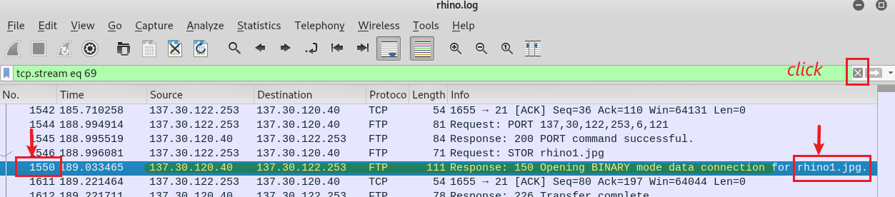
Open rhino.log with Wireshark
server tells the Suspect’s PC that it is ready to receive the photo

Slide 7
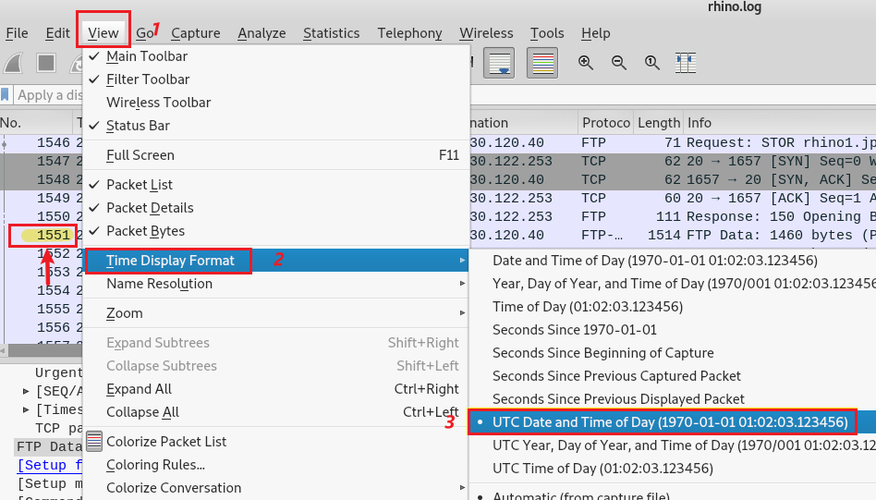
Change time display format

Slide 8
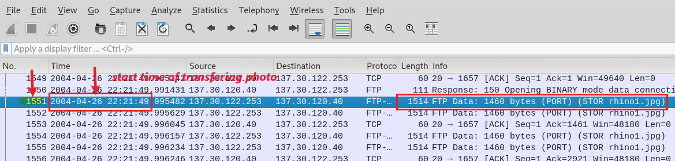
Show the UTC time (2004-04-20 22:21) that suspect starts to transfer photo (at the packet 1550+1)

Slide 9
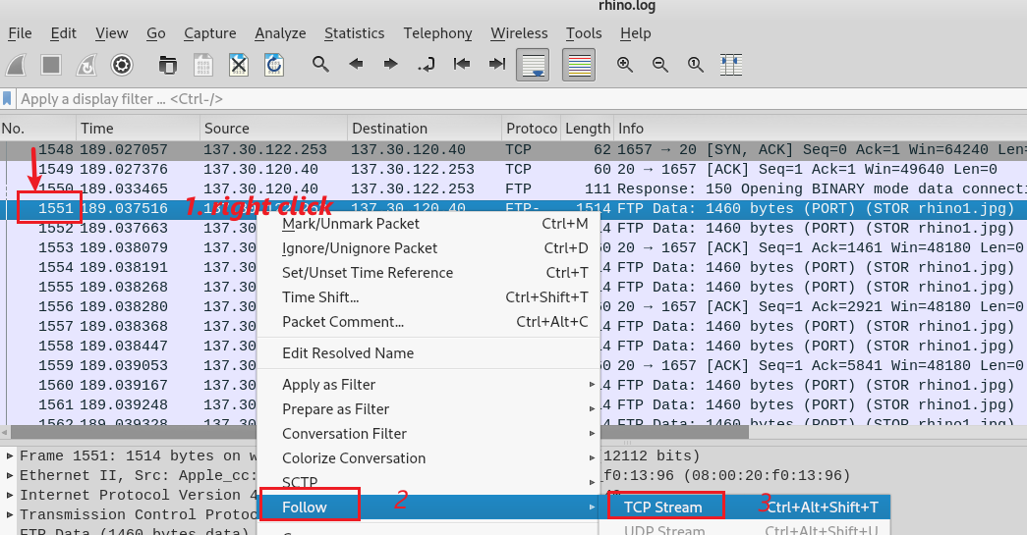
Follow the next packet (1550+1, server to suspect’s PC) to collect all packets

Slide 10
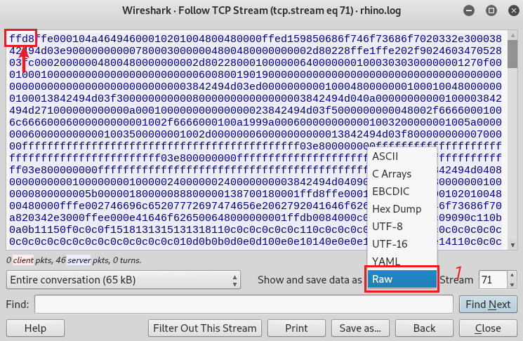
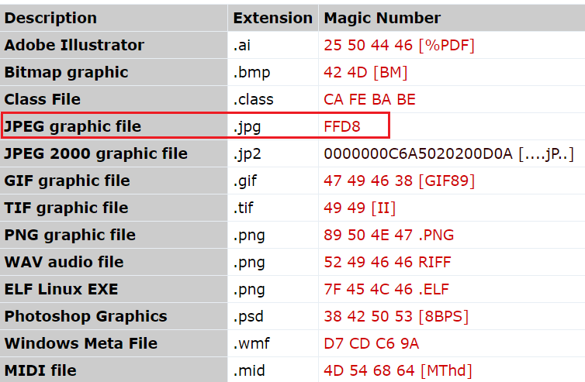
Verify rhino1.jpg magic number
Other commonly file types and their magic numbers
magic number
Notes:
https://asecuritysite.com/forensics/magic

Slide 11
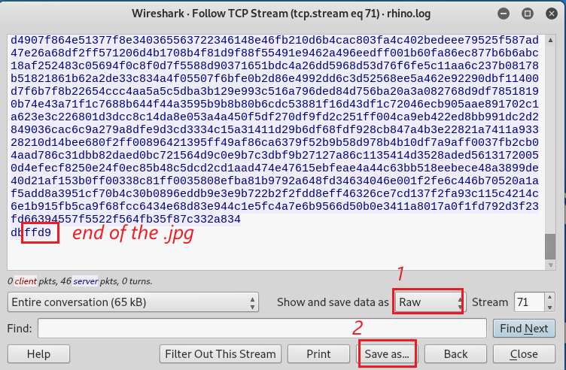
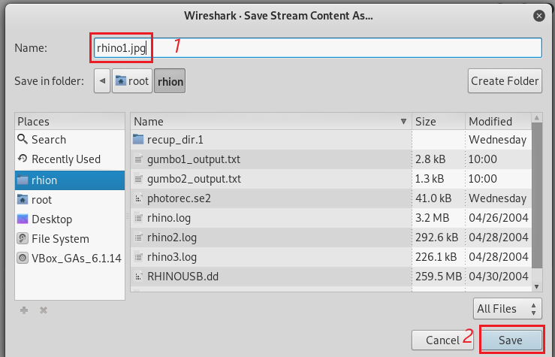
Verify the end of the rhino1.jpg magic number
Save the Raw data to rhino1.jpg

Slide 12
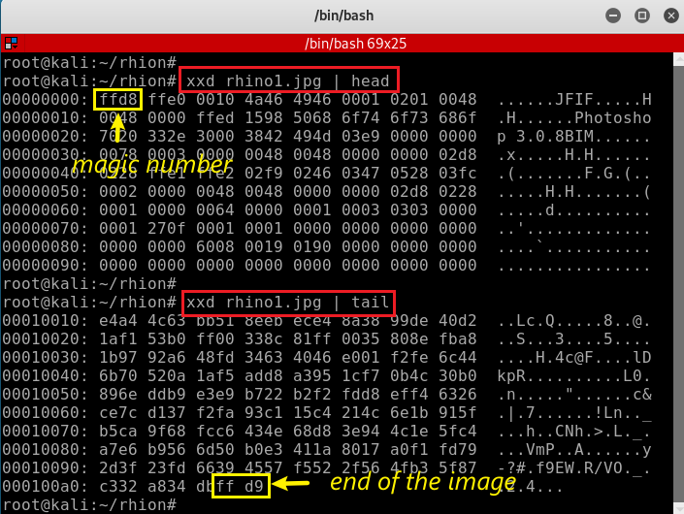
Verify rhino1.jpg magic number
Verify rhino1.jpg trailer

Slide 13
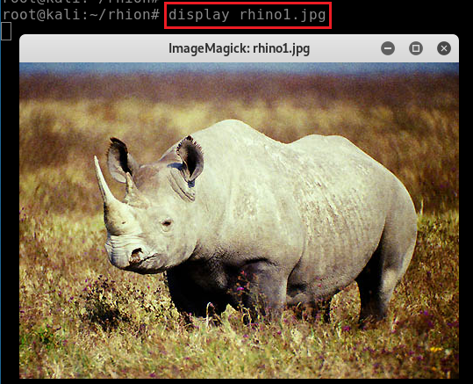

Show rhino1.jpg. You can close it after see it.
5
d5a83cde0131c3a034e5a0d3bd94b3c9

Slide 14
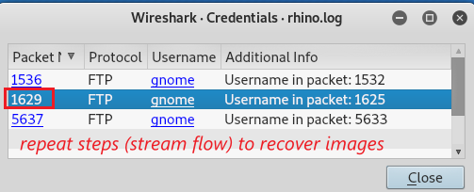
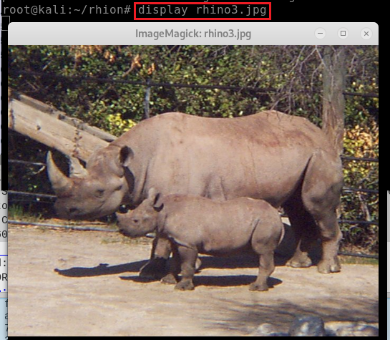
Investigate the second FTP session
Choose the second FTP session
Repeat previous steps to find rhino3.jpg
6
b058218ea0060092d4e01ef3d7a3b815

Slide 15
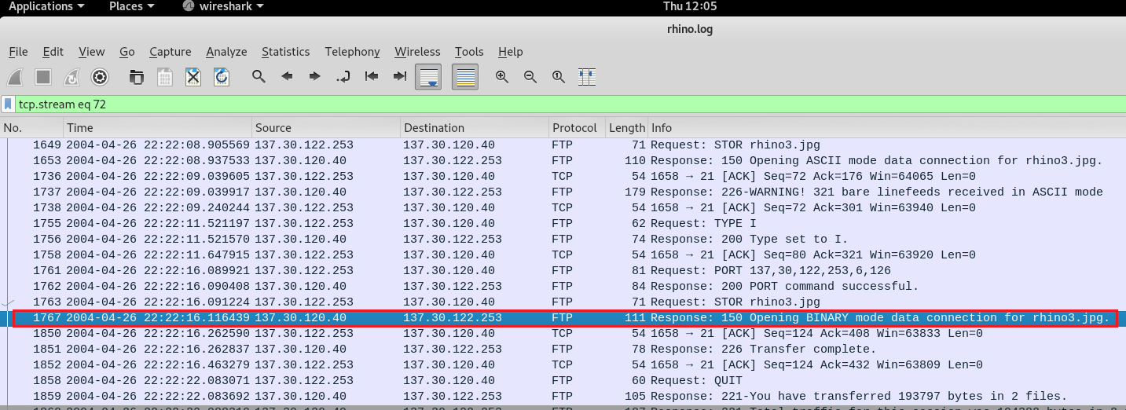
Notes:
1767 2004-04-26 22:22:16.116439 137.30.120.40 137.30.122.253 FTP 111 Response: 150 Opening BINARY mode data connection for rhino3.jpg.

Slide 16
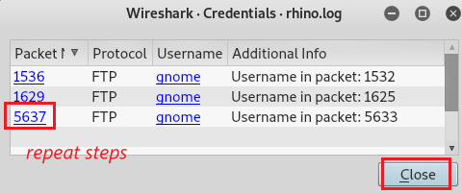
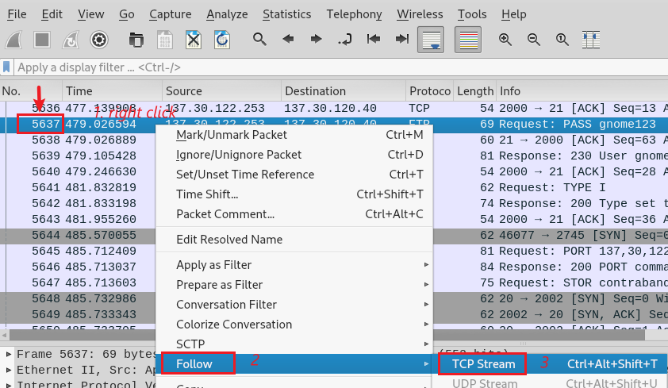
Investigate the third FTP session
Choose the third FTP session
Repeat previous steps to follow TCP stream
Notes:
5651 2004-04-26 22:26:46.699221 137.30.120.40 137.30.122.253 FTP 115 Response: 150 Opening BINARY mode data connection for contraband.zip.

Slide 17
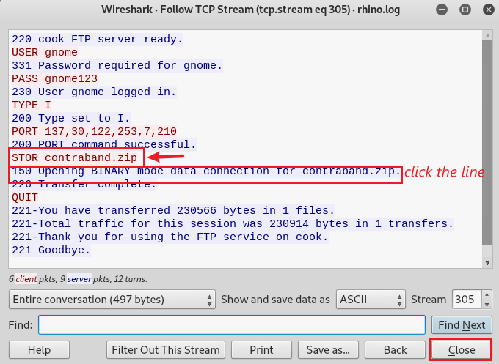
Suspect wants to upload contraband.zip file to a server
The server is ready to accept data

Slide 18
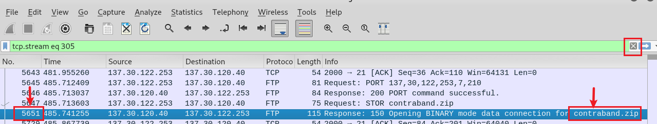
The packet number 5651 shows that the server is ready to upload

Slide 19
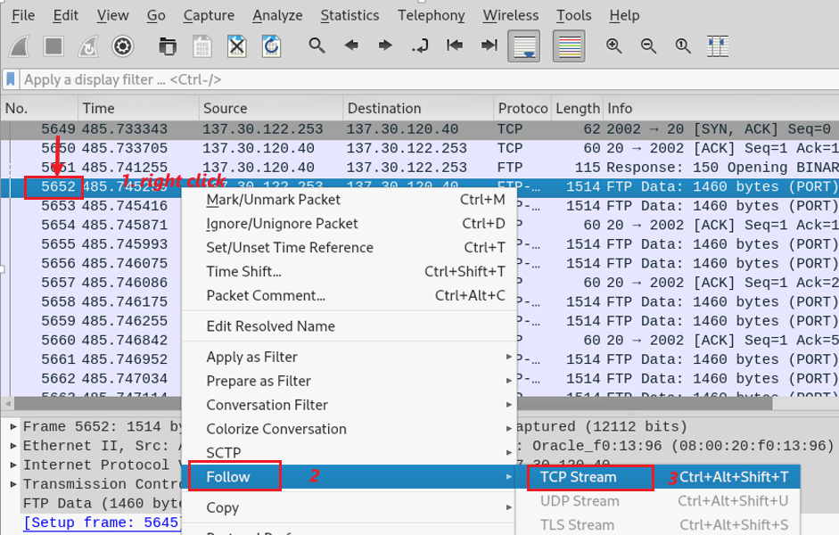
Next packet number (5651+1) indicates that the suspect starts to upload, and we need to follow the TCP stream

Slide 20
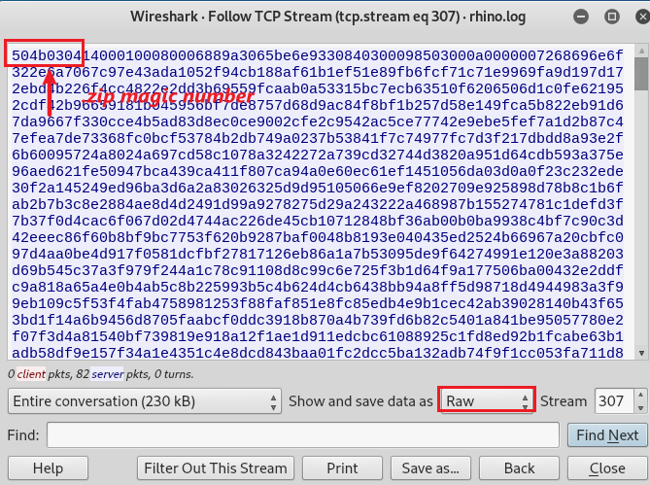
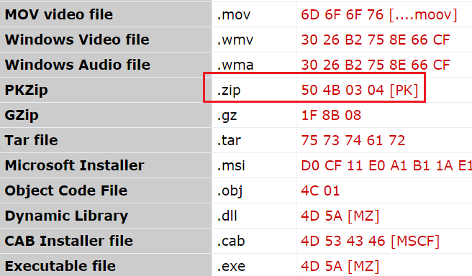
Verify the .zip magic number

Slide 21
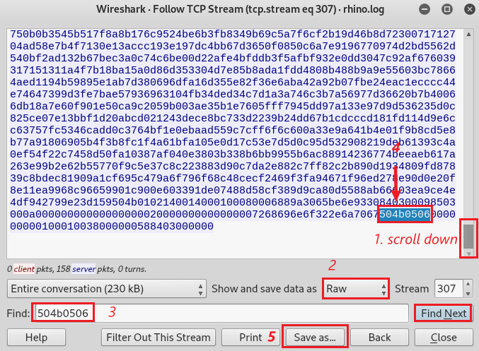
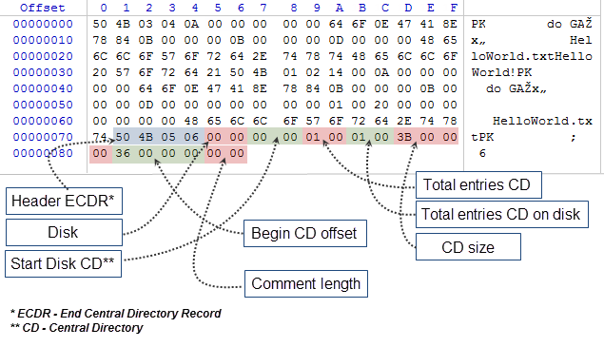
Verify the trailer of the .zip file and Save as Raw format
The structure of central directory
signature of end of central directory
Notes:
https://www.mql5.com/en/articles/1971

Slide 22
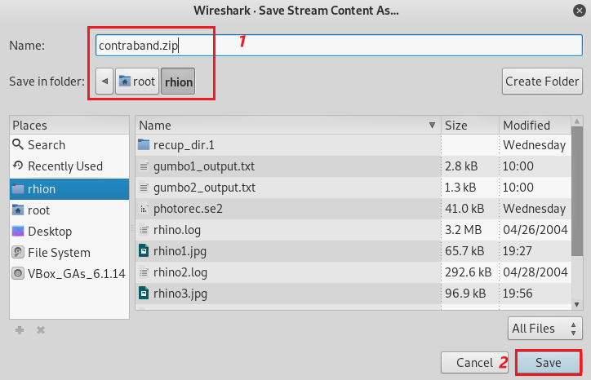

Save as contraband.zip
Verify the file

Slide 23
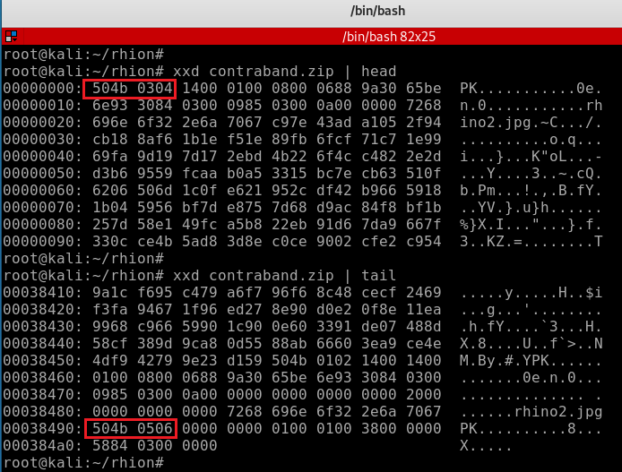
Verify the magic number of the zip file

Slide 24


How to find password of the zip file?
Unzip the file and found the contraband zip file is encrypted
Install a zip-crack software, named fcrackzip (fast zip cracker)

Slide 25
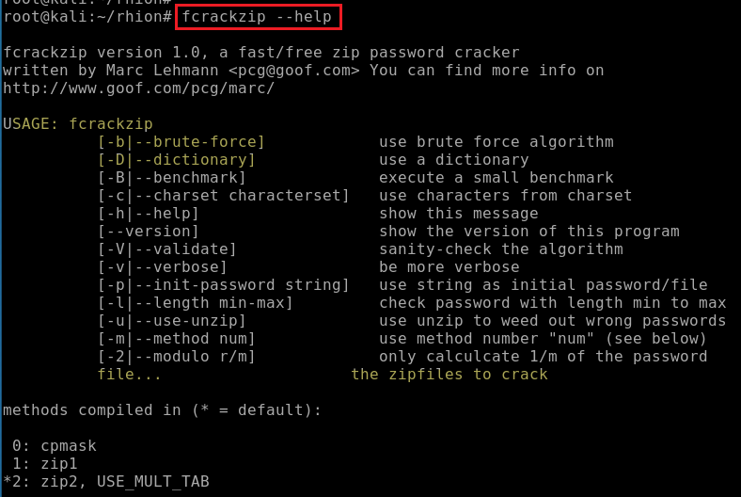
Show all functions of crack software

Slide 26
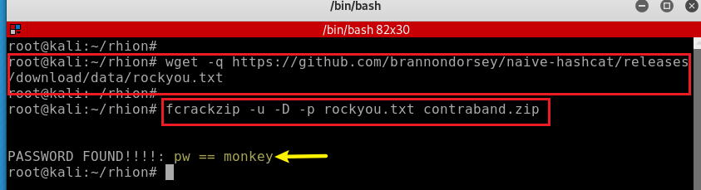
Crack the encrypted zip file
Notes:
https://github.com/brannondorsey/naive-hashcat/releases/download/data/rockyou.txt

Slide 27
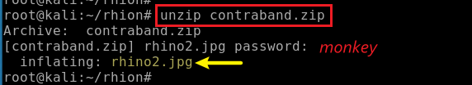
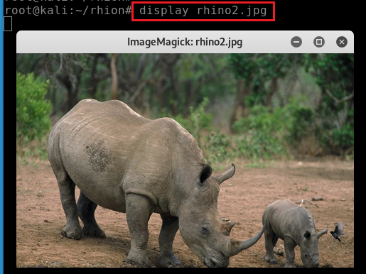
Unzip the file with password
Show timestamp
Show rhino2.jpg
Same the photo 2 by comparing md5
2
ed870202082ea4fd8f5488533a561b35

