Slide 1


Investigate Data Leakage Case
Keywords: Network device IP, Shellbag, Jumplist
Notes:
http://xmlstar.sourceforge.net/doc/UG/

Slide 2
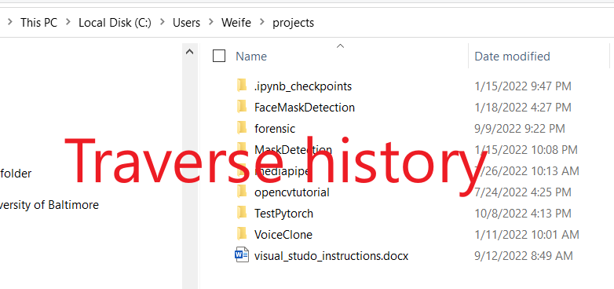

Goals
How to find mapped network device IP
Recover a user’s traverse (viewed folders) history
folders in mounted devices
folders in mapped network devices (next PPT)
Find whether a user clicked (opened) a file

Slide 3
24. What is the IP address of company’s shared network drive?
Possible Answer | 10.11.11.128
Considerations | HKU\informant\Software\Microsoft\Windows\CurrentVersion\Explorer\RunMRU\ > timestamp: 2015-03-23 16:23:28 Mon > value: b > data: ‘\\10.11.11.128\secured_drive’ HKU\informant\Software\Microsoft\Windows\CurrentVersion\Explorer\Map Network Drive MRU\ > timestamp: 2015-03-23 16:26:04 Mon > value: a > data: ‘\\10.11.11.128\secured_drive’ HKU\informant\Software\Classes\Local Settings\Software\Microsoft\Windows\Shell\BagMRU\8\0\ ……

Slide 4

What is network drive?
A network drive or mapped drive is a drive, Network Attached Storge (NAS), or share on another computer or server on the Local Area Network (LAN)
Often used in a corporate network

Slide 5
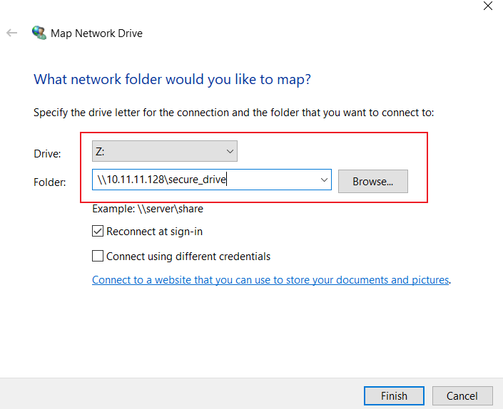
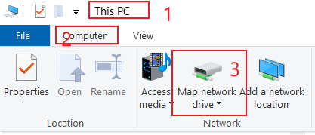
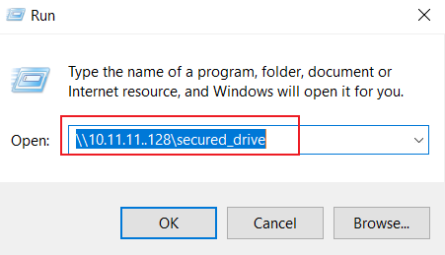
How to map network drives?
Method 1
mount point
Method 2: Start->Run

Slide 6
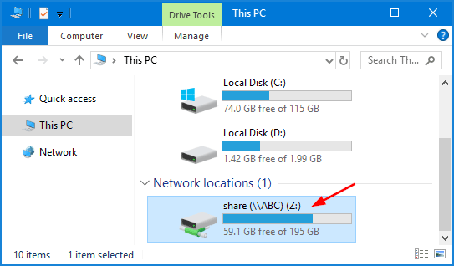
After mapping
Notes:
https://www.top-password.com/blog/map-a-network-drive-in-windows-10/

Slide 7



Evidence saved in registry
Mapping process
Most Recently Used (MRU) Run Command line
After mapping
Mounting Points (MP) for remote devices
Using mapped devices
Most Recently Used (MRU) network devices
The content of usages

Slide 8
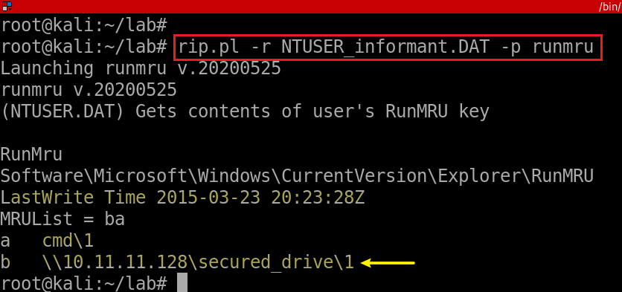


Most recently used Run Registry
Most Recently Used (MRU) : recently opened webpages, documents, files, images and other applications.
For example, when a computer user opens Microsoft Word, he/she may see a list of previously opened Word documents within the application.
Again, seems the timestamp is inaccurate.
Notes:
rip.pl -r NTUSER_informant.DAT -p runmru

Slide 9
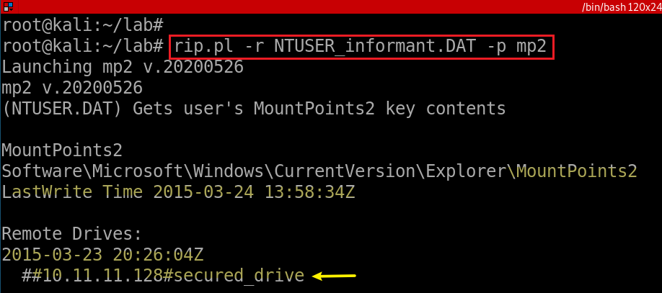
Mounting points (MP) for remote devices
Notes:
rip.pl -r NTUSER_informant.DAT -p mp2

Slide 10
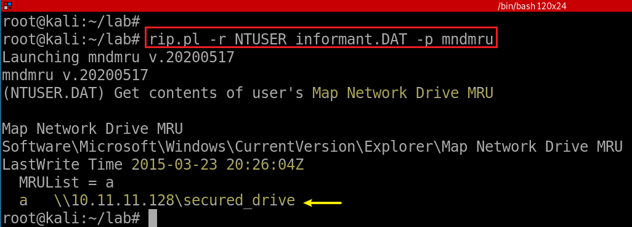
Most recently used Map Network Drive (MND)
Map Network Drive Most Recently Used
Notes:
rip.pl -r NTUSER_informant.DAT -p mndmru

Slide 11
Recover a user’s traverse history

Slide 12
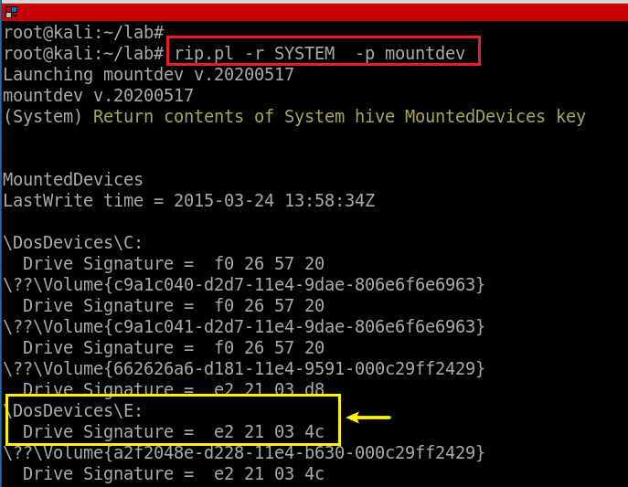
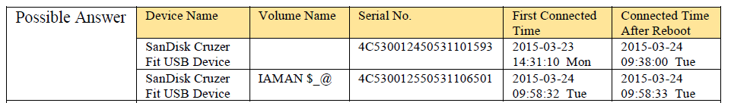
25. List all directories(Not files) that were traversed in ‘RM#2’.
What is RM#2
We don’t know the device, but we know there are two SanDisk Cruzer Fit USB Devices attached (from question 22)
We also know one of the attached device is E:
E: letter is shared by two USBs?

Slide 13
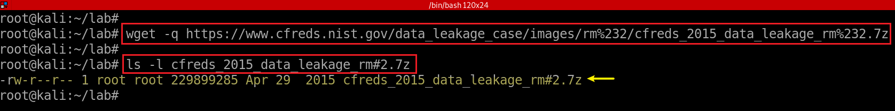
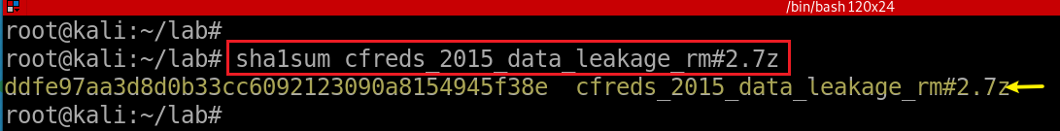
(Optional)Download RM#2
Download RM#2 DD images
https://cfreds-archive.nist.gov/data_leakage_case/images/rm%232/cfreds_2015_data_leakage_rm%232.7z
Notes:
wget -q https://cfreds-archive.nist.gov/data_leakage_case/images/rm%232/cfreds_2015_data_leakage_rm%232.7z
7z e cfreds_2015_data_leakage_rm#2.7z

Slide 14
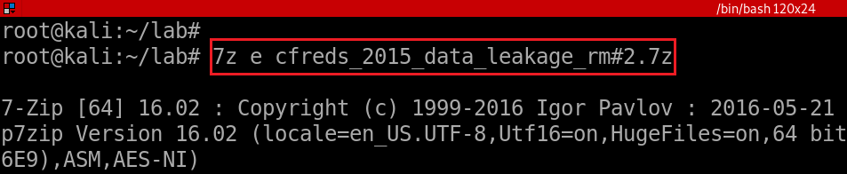
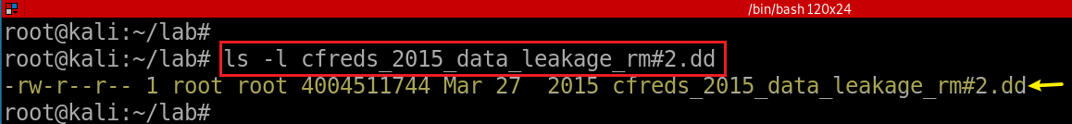
unzipped the DD image
Verify the unzipped DD image
Notes:
7z e cfreds_2015_data_leakage_rm#2.7z
sha1sum cfreds_2015_data_leakage_rm#2.7z

Slide 15

What evidence left on disk that records directory traverse history?
We can answer the question using Shellbag
Shellbags is a tree-like structure

Slide 16
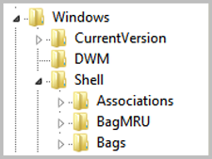
What is Shellbag?
Track user behavior using Shellbags
Windows uses the Shellbag keys to store user preferences for GUI folder display within Windows Explorer.
to improve user experience and “remember” preferences
Remember display mode (icons, details, list, etc.), browsing folders, etc.,
If directory is saved in Shellbags
it MUST exists now or be existed before deleted (USBs, or mapped devices)
There are MAC timestamps in Shellbags
Available since Windows 7 +
Notes:
https://cfreds.nist.gov/all/NIST/DataLeakageCase
wget -q https://www.cfreds.nist.gov/data_leakage_case/images/rm%232/cfreds_2015_data_leakage_rm%232.7z
7z e cfreds_2015_data_leakage_rm#2.7z

Slide 17
Usages of Shellbag data
Shellbags can be used to answer the difficult questions of
Data enumeration in intrusion cases,
Identify the contents of long-gone removable devices
a USB in our case
Show the contents of previously mounted encrypted volumes.
network drives
Notes:
wget -q https://www.cfreds.nist.gov/data_leakage_case/images/rm%232/cfreds_2015_data_leakage_rm%232.7z
7z e cfreds_2015_data_leakage_rm#2.7z

Slide 18
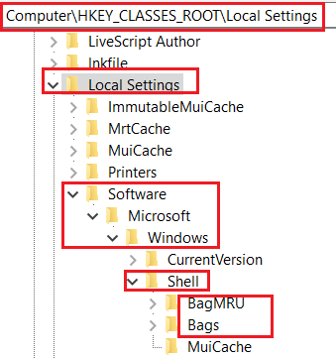
25.1 What are registry keys that shellbags are structured from?
Structured from two main registry keys
BagMRU: stores folder names and records folder paths by creating the similar tree structure.
Bags: stores the view preferences such as the window size, location and view mode
Physical location (Win7 +)
%UserProfile%\NTUSER.dat
%UserProfile%\AppData\Local\Microsoft\Windows\UsrClass.dat.

Slide 19
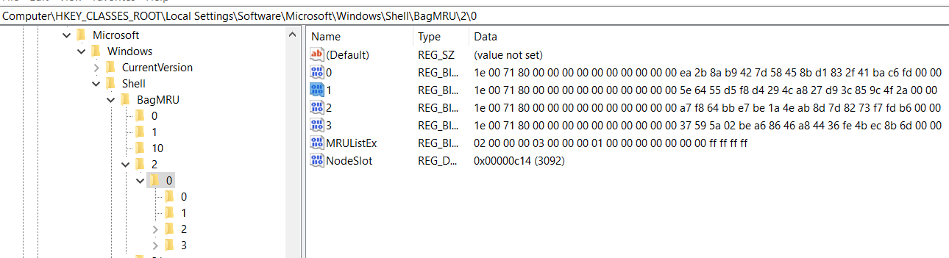
25.2 How shellbags are structured?
Structured in hierarchy
each numbered folder representing a parent or child folder of the one previous.
ShellBag information is available only for folders that have been opened and closed in Windows Explorer at least once.
Notes:
https://www.sans.org/reading-room/whitepapers/forensics/windows-shellbag-forensics-in-depth-34545

Slide 20
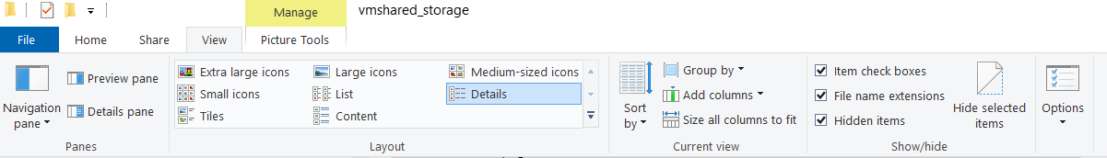
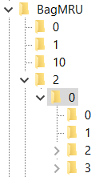
Desktop
Creation time: Shellbag entries are created the first time the folder is opened
If open a child directory, a shellbag entry is added
Entry ID starts from 0, increase by 1
Access time: Last time accessed
Modification time: Every Entry is modified when a user change folder view preference
Last write time: may be the time of last manipulation
File 0
File 1
File 2
My PC
C: \
Folder02
Folder03
Notes:
https://www.sans.org/reading-room/whitepapers/forensics/windows-shellbag-forensics-in-depth-34545
https://lifars.com/wp-content/uploads/2020/04/LIFARS-WhitePaper-Windows-ShellBags-Forensics-Investigative-Value-of-Windows-ShellBags.pdf

Slide 21
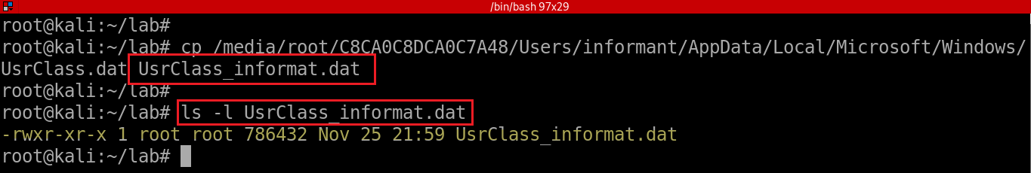
25.3 How shellbags are saved?
The UsrClass.dat stores the Shellbags information
Including the Desktop, ZIP files, remote folders, local folders, Windows special folders and virtual folders.
Copy UsrClass.dat file and rename it to UsrClass_informat.dat
Notes:
losetup --partscan --find --show --read-only cfreds_2015_data_leakage_pc.dd

Slide 22
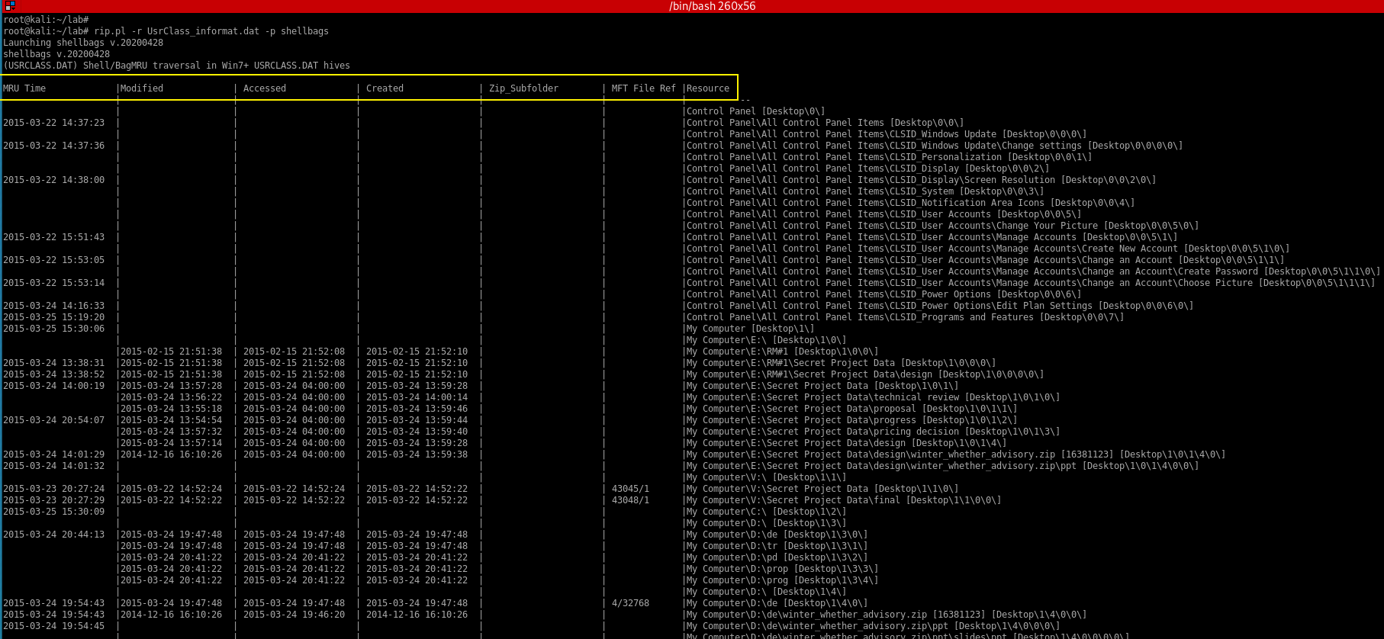
Open a ZIP file in Windows Explorer and close it or open a folder in the same window
folder opened timestamp
Notes:
rip.pl -r /media/student/C8CA0C8DCA0C7A48/Users/informant/AppData/Local/Microsoft/Windows/UsrClass.dat -p shellbags

Slide 23
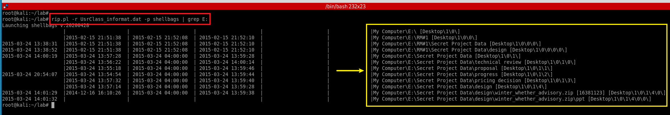
Note: E drive is a USB/RM#2
Notes:
rip.pl -r UsrClass_informat.dat -p shellbags | grep E:

Slide 24
Find whether a user clicked (opened) a file
files information in RM#2 saved in jump list

Slide 25
26. List all files that were opened in ‘RM#2’.
What is Jump Lists?
Investigate process
download Jump List artifacts
install Jump List parser
parse Jump List
grep the information

Slide 26

What are Jump Lists (1)?
Jump lists are a collection of lnk files wrapped in a single file.
Allow users “jump” directly to recently opened files and folders
Provide users a graphical indication of recent items accessed by each application
Windows uses the same mechanics to open an item on a jump list as it does when you open a program by double clicking a shortcut on your Desktop.
Notes:
https://www.blackbagtech.com/blog/windows-10-jump-list-forensics/
https://cyberforensicator.com/wp-content/uploads/2017/01/1-s2.0-S1742287616300202-main.2-14.pdf

Slide 27
What is Jump Lists (2)?
user
App1
Jumplist1
Jumplist2
App2
Link A
Link B
Link C
Link D
Created by software applications or OS
group them as per application basis within user’s profile
e.g., MS Word has list of files that recently opened
Provide more information than MRU
Windows 7+
The service itself can be configured by the user
Notes:
https://www.blackbagtech.com/blog/windows-10-jump-list-forensics/
https://cyberforensicator.com/wp-content/uploads/2017/01/1-s2.0-S1742287616300202-main.2-14.pdf

Slide 28
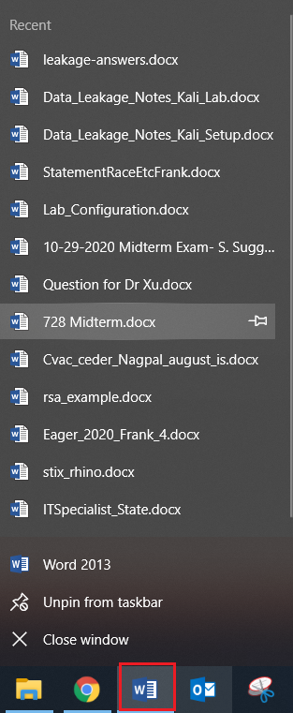
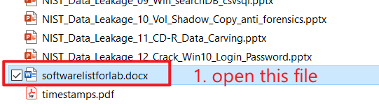
Types of Jump Lists
Created by users’ behaviors (pin)
\Users\<username>\AppData\Roaming\Microsoft\Windows\Recent\CustomDestinations-ms
Created by Windows OS
users don’t need to do anything (open a file)
\Users\<username>\AppData\Roaming\Microsoft\Windows\Recent\AutomaticDestinations-ms
Notes:
https://www.blackbagtech.com/blog/windows-10-jump-list-forensics/

Slide 29
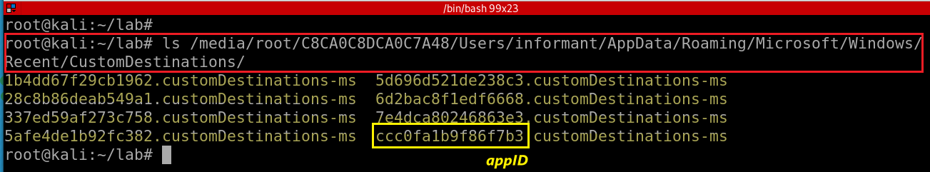
Analysis Of Jump Lists: CustomDestinations-ms
generated when a user
“pins” a file to the Start Menu or Task Bar
Notes:
https://www.blackbagtech.com/blog/windows-10-jump-list-forensics/

Slide 30
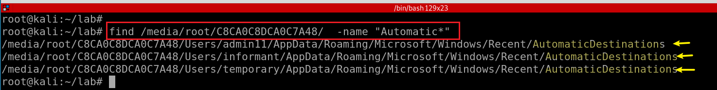
Analysis Of Jump Lists: AutomaticDestinations-ms
When a user interacts with the system performing such acts as opening applications or accessing files.
\Users\<username>\AppData\Roaming\Microsoft\Windows\Recent\AutomaticDestinations-ms
List all AutomaticDestinations-ms directories
Notes:
https://www.blackbagtech.com/blog/windows-10-jump-list-forensics/
find /media/root/C8CA0C8DCA0C7A48/ -name "Automatic*"

Slide 31
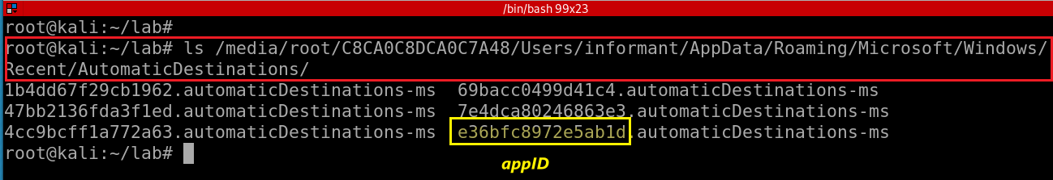
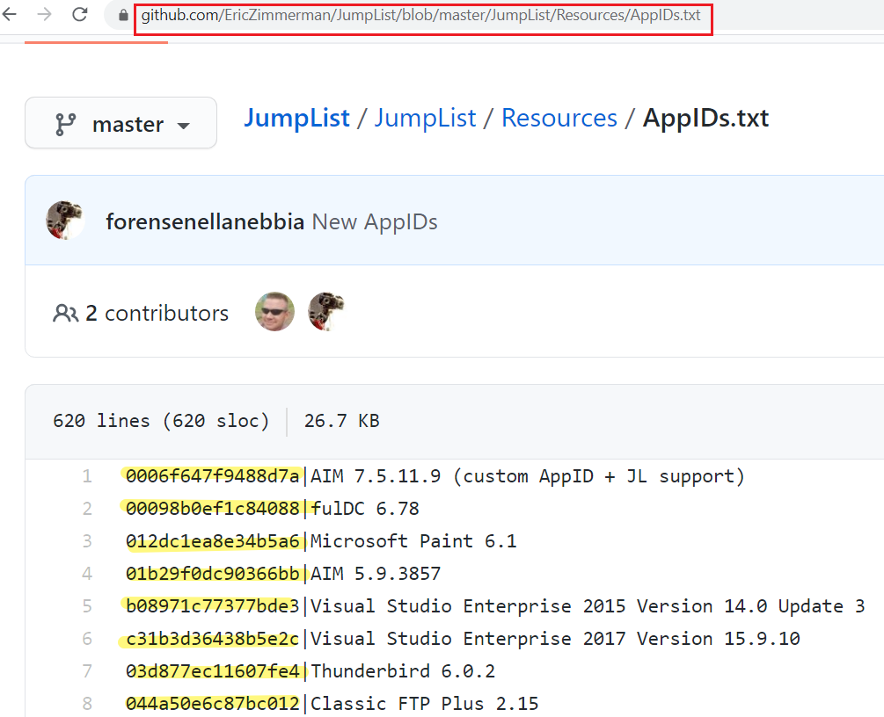
List informant’s AutomaticDestinations-ms
https://github.com/EricZimmerman/JumpList/blob/master/JumpList/Resources/AppIDs.txt
28c8b86deab549a1.automaticDestinations-ms = IE8 Pinned and Recent a7bd71699cd38d1c.automaticDestinations-ms = Word 2010 Pinned and Recent adecfb853d77462a.automaticDestinations-ms = Word 2007 Pinned and Recent a8c43ef36da523b1.automaticDestinations-ms = Word 2003 Pinned and Recent 1b4dd67f29cb1962.automaticDestinations-ms = Windows Explorer Pinned and Recent 918e0ecb43d17e23.automaticDestinations-ms = Notepad Pinned and Recent d7528034b5bd6f28.automaticDestinations-ms = Windows Live Mail Pinned and Recent c7a4093872176c74.automaticDestinations-ms = Paint Shop Pro Pinned and Recent b91050d8b077a4e8.automaticDestinations-ms = Media Center f5ac5390b9115fdb.automaticDestinations-ms = PowerPoint 2007 23646679aaccfae0.automaticDestinations-ms = Adobe Reader 9 aff2ffdd0862ff5c.automaticDestinations-ms = Visual Studio 2012
Notes:
ls /media/root/C8CA0C8DCA0C7A48/Users/informant/AppData/Roaming/Microsoft/Windows/Recent/AutomaticDestinations/

Slide 32
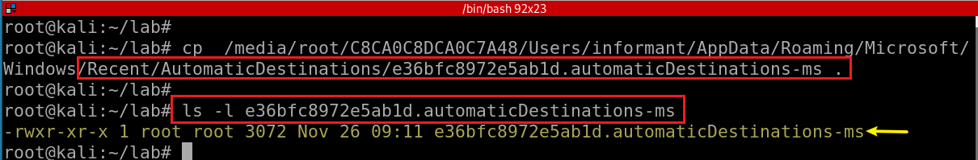
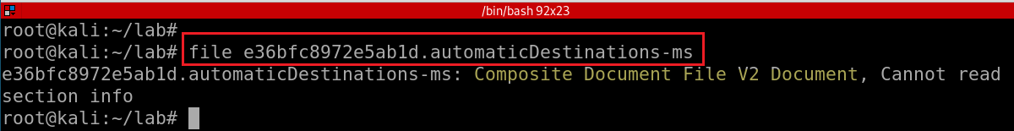
Copy one AutomaticDestinations-ms to the current directory
Determine AutomaticDestinations-ms file format
Notes:
cp /media/root/C8CA0C8DCA0C7A48/Users/informant/AppData/Roaming/Microsoft/Windows/Recent/AutomaticDestinations/e36bfc8972e5ab1d.automaticDestinations-ms .
ls -l e36bfc8972e5ab1d.automaticDestinations-ms

Slide 33
How to read AutomaticDestinations-ms?
JLECmd: Jump List Explorer Command line
A tool to decode information contained in custom and automatic destinations jump list files found on Windows operating systems
Windows 7 - 10
JLECmd only runs on Win
Need Wine to run Windows applications on Linux
We need to install Wine first
Refer to Wine installation tutorial
Notes:
https://binaryforay.blogspot.com/2016/03/introducing-jlecmd.html
https://www.youtube.com/watch?v=RSM4wygz39Q&ab_channel=KernelPanic%21AtTheDisco

Slide 34
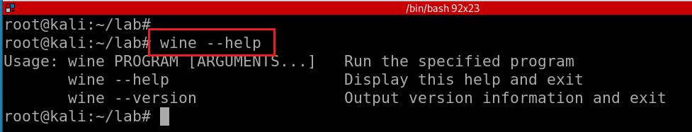
Test wine installation

Slide 35
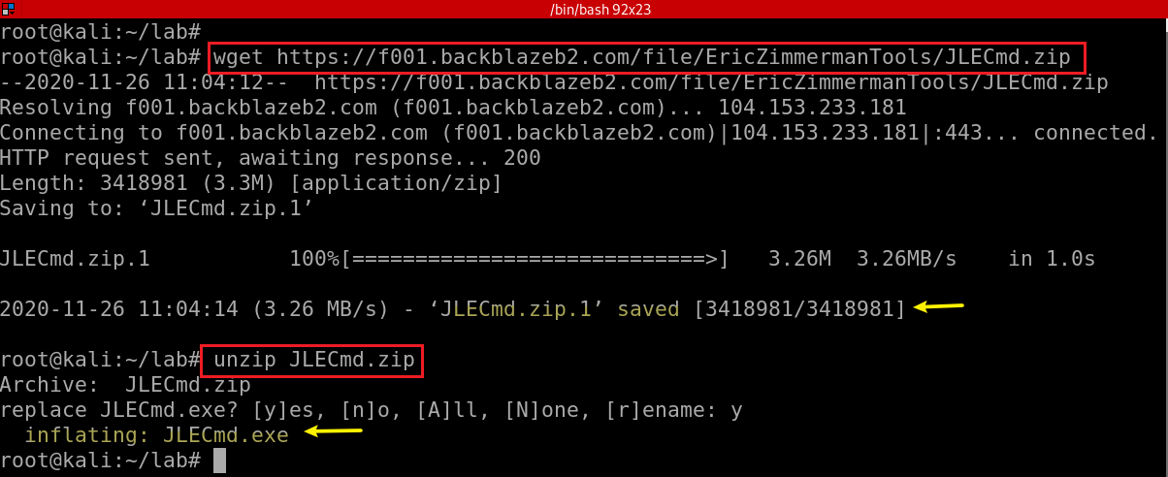
Download JLECmd.zip
https://raw.githubusercontent.com/frankwxu/digital-forensics-lab/main/NIST_Data_Leakage_Case/tools/JLECmd.zip
Notes:
https://raw.githubusercontent.com/frankwxu/digital-forensics-lab/main/NIST_Data_Leakage_Case/tools/JLECmd.zip
# wget https://f001.backblazeb2.com/file/EricZimmermanTools/JLECmd.zip
unzip JLECmd.zip

Slide 36
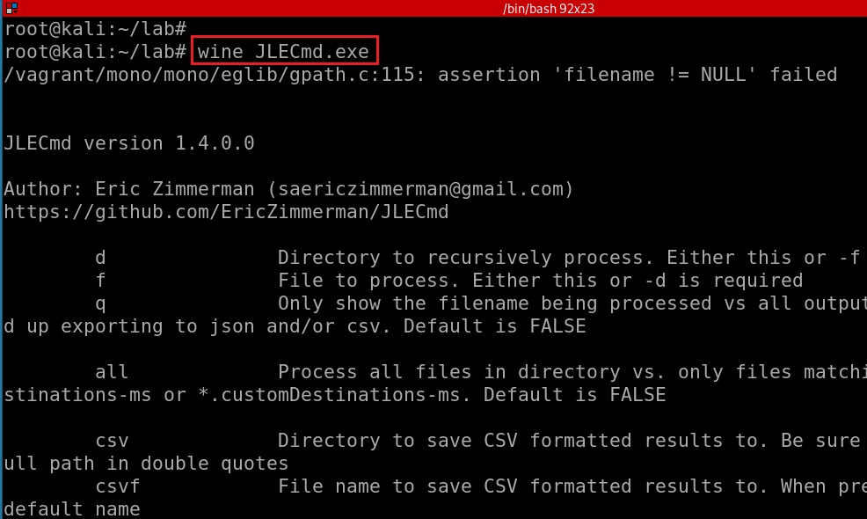
Test wine and JLECmd.exe
Notes:
https://binaryforay.blogspot.com/2016/03/introducing-jlecmd.html
https://ericzimmerman.github.io/#!index.md

Slide 37
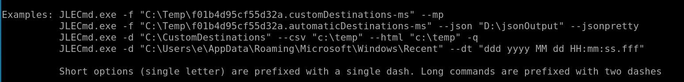

Slide 38
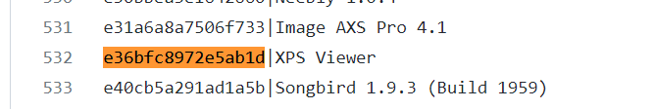
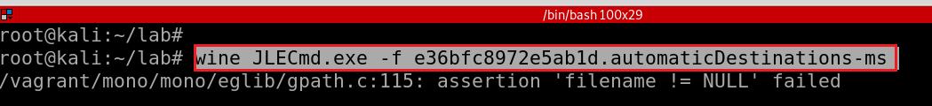
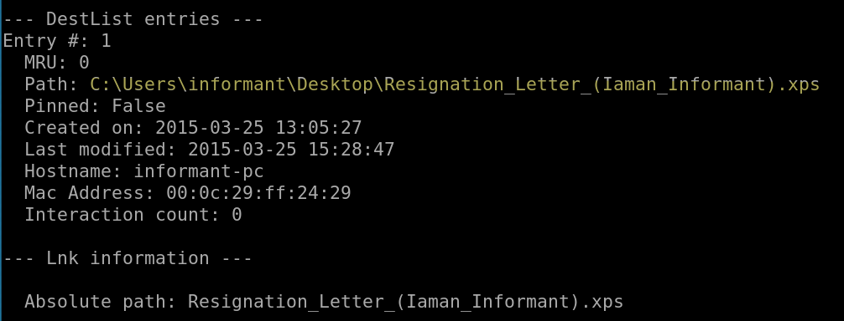
The XPS format is Microsoft’s alternative to PDF. It was introduced in Windows Vista, but never gained much traction. However, modern versions of Windows continue to include better support for XPS files than PDF files
Test one opened file e36bfc8972e5ab1d.automaticDestinations-ms
-f: file
Notes:
wine JLECmd.exe -f e36bfc8972e5ab1d.automaticDestinations-ms
https://www.howtogeek.com/148499/what-is-an-xps-file-and-why-does-windows-want-me-to-print-to-one/

Slide 39

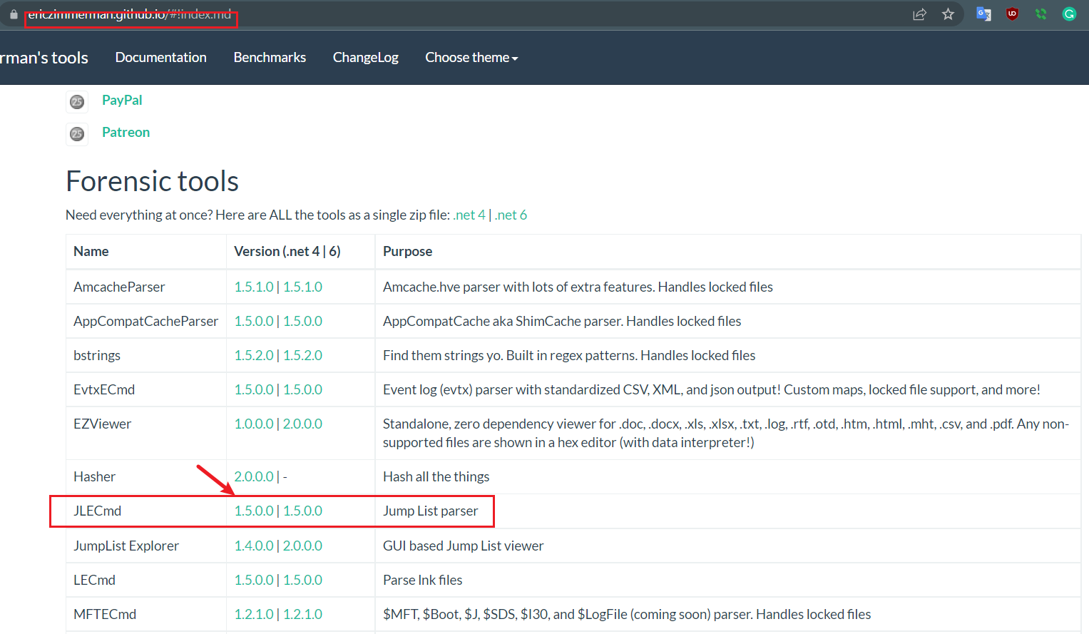

Run on Windows
Notes:
https://ericzimmerman.github.io/#!index.md

Slide 40
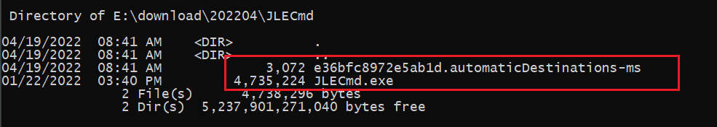
https://raw.githubusercontent.com/frankwxu/digital-forensics-lab/main/NIST_Data_Leakage_Case/NIST_Answers/lab_generated_file/JumpList/e36bfc8972e5ab1d.automaticDestinations-ms
Show .exe and the JumpList

Slide 41
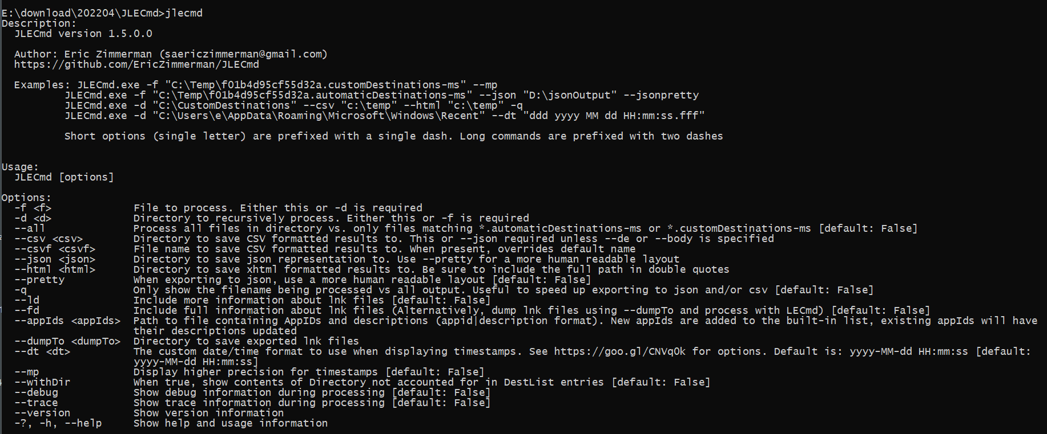

Slide 42
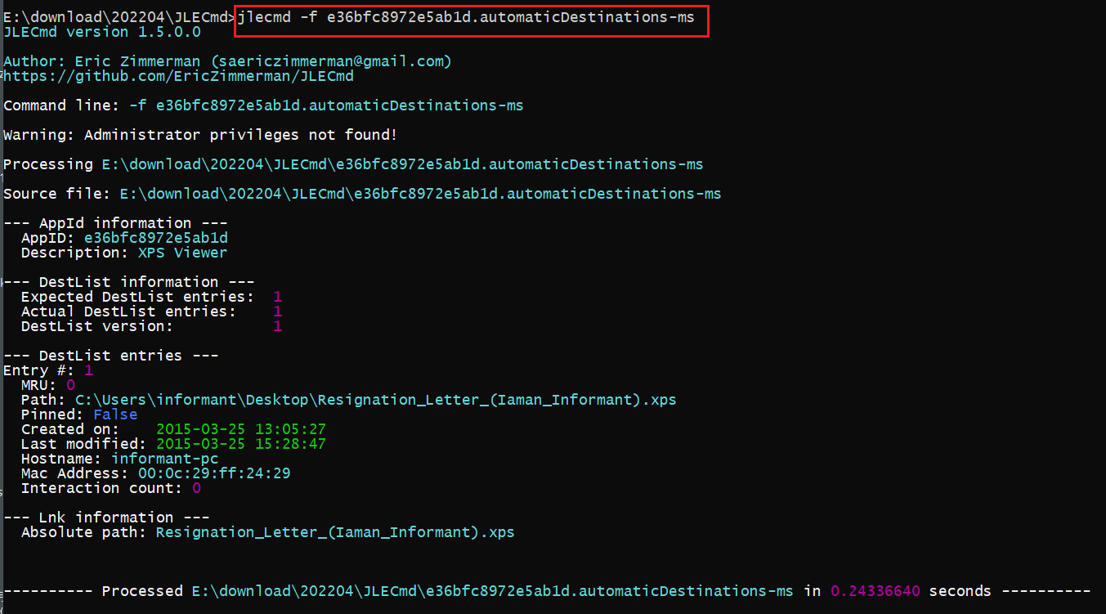

Slide 43
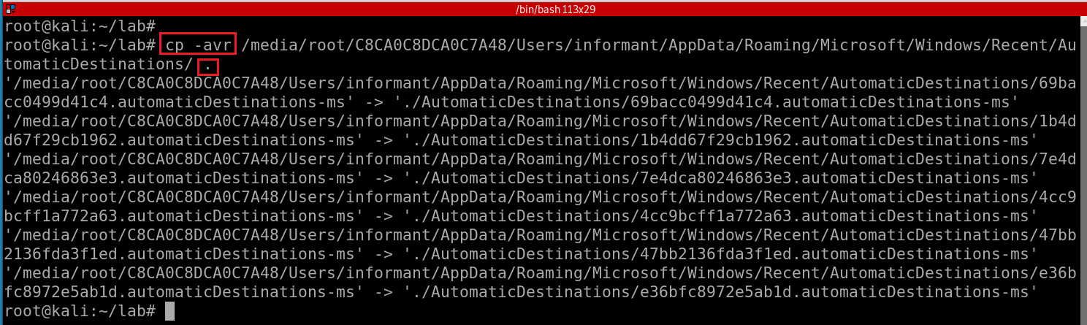
Process the whole folder
Copy the whole folder of AutomaticDestinations
-a : Preserve the specified attributes such as directory a file mode, ownership, timestamps, if possible additional attributes: context, links, xattr, all.
-v : Verbose output.
-r : Copy directories recursively.
Notes:
cp -avr /media/root/C8CA0C8DCA0C7A48/Users/informant/AppData/Roaming/Microsoft/Windows/Recent/AutomaticDestinations/ .

Slide 44
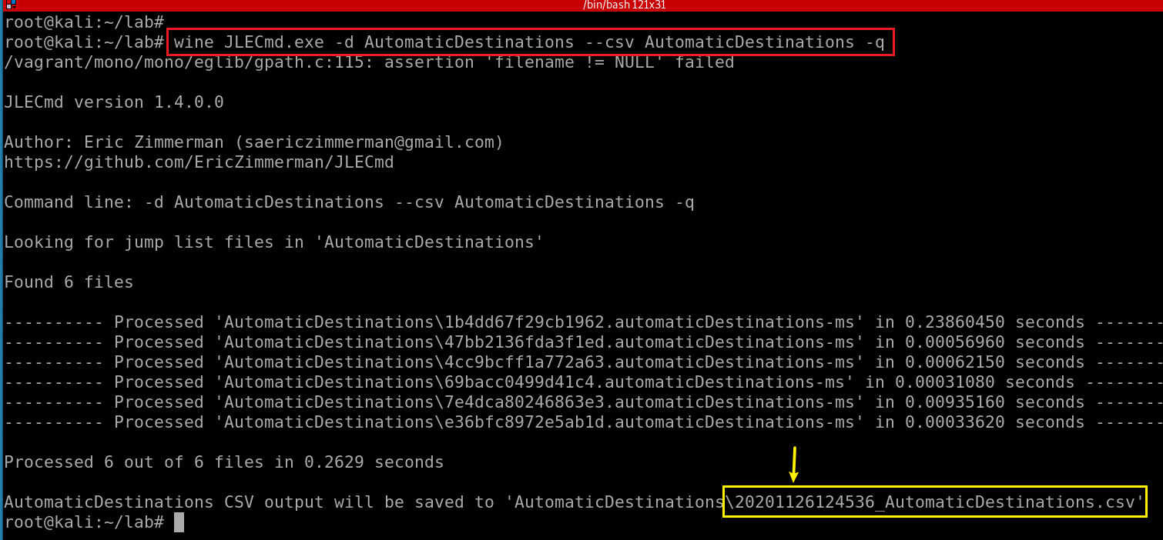
Extract all Jump list and save to a .csv file
Notes:
wine JLECmd.exe -d AutomaticDestinations --csv AutomaticDestinations -q

Slide 45
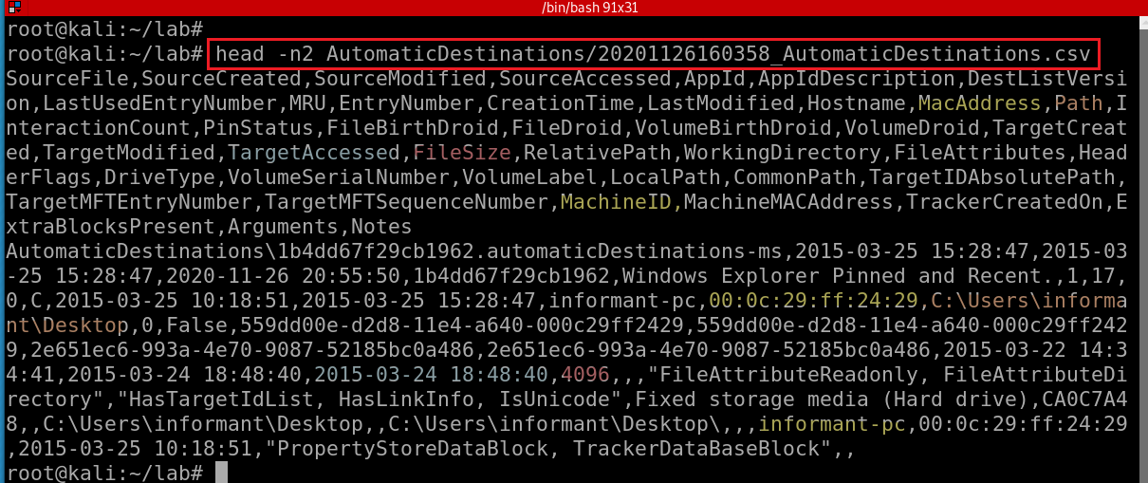
wget https://raw.githubusercontent.com/frankwxu/digital-forensics-lab/main/NIST_Data_Leakage_Case/NIST_Answers/lab_generated_file/JumpList/20220419105824_AutomaticDestinations.csv
head -n2 20220419105824_AutomaticDestinations.csv
Notes:
head -n2 AutomaticDestinations/20201126160358_AutomaticDestinations.csv
SourceFile,SourceCreated,SourceModified,SourceAccessed,AppId,AppIdDescription,DestListVersion,LastUsedEntryNumber,MRU,EntryNumber,CreationTime,LastModified,Hostname,MacAddress,Path,InteractionCount,PinStatus,FileBirthDroid,FileDroid,VolumeBirthDroid,VolumeDroid,TargetCreated,TargetModified,TargetAccessed,FileSize,RelativePath,WorkingDirectory,FileAttributes,HeaderFlags,DriveType,VolumeSerialNumber,VolumeLabel,LocalPath,CommonPath,TargetIDAbsolutePath,TargetMFTEntryNumber,TargetMFTSequenceNumber,MachineID,MachineMACAddress,TrackerCreatedOn,ExtraBlocksPresent,Arguments,Notes

Slide 46
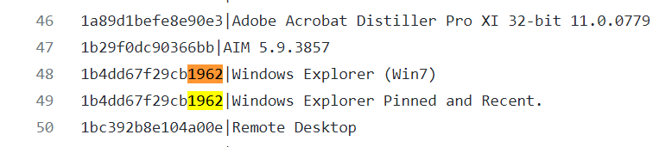
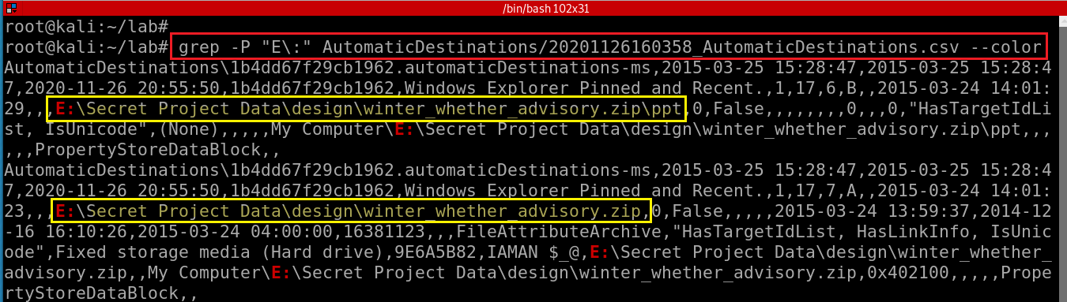
List opened files or applications
Notes:
grep -P "E\:" AutomaticDestinations/20201126160358_AutomaticDestinations.csv --color

Slide 47
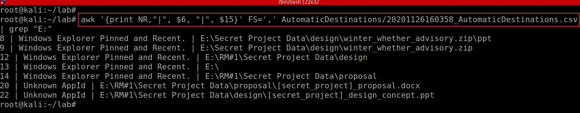
$6: AppIdDescription
$15: Path
List opened files in E: volumn using akw
Notes:
awk '{print NR,"|", $6, "|", $15}' FS=',' AutomaticDestinations/20201126160358_AutomaticDestinations.csv | grep "E:"

