Slide 1
Investigate Data Leakage Case
Keywords: Traversing directories in network drive
File transferring evidence in Cloud

Slide 2

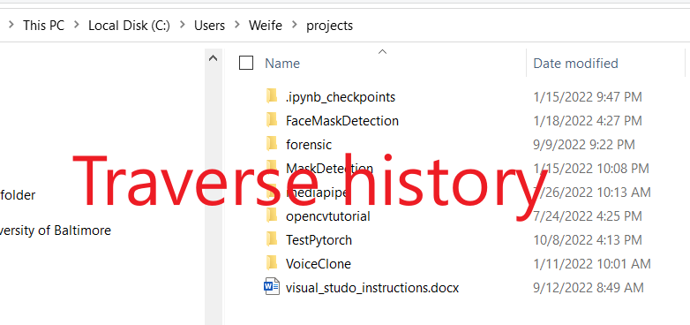


Recap
How to find mapped network device IP
Recover a user’s traverse (viewed folders) history
folders in mounted devices
folders in mapped network devices (this PPT)
Find whether a user clicked (opened) a file

Slide 3
Evidence related to traversed directories
Investigate artifacts that contain only traversed directories
shellbag,
Investigate artifacts that traversed files also contain traversed directories
Jumplist (AutomaticDestinations, CustomDestinations)

Slide 4

27.1 List all directories that were traversed in the company’s network drive.
- V:\ is mapped on \\10.11.11.128
HKU\informant\Software\Classes\Local Settings\Software\Microsoft\Windows\Shell\BagMRU\
\User\informant\AppData\Roaming\Microsoft\Windows\Recent\AutomaticDestinations
\User\informant\AppData\Roaming\Microsoft\Windows\Recent\CustomDestinations
\User\informant\AppData\Roaming\Microsoft\Windows\Recent\*.lnk
\User\informant\AppData\Roaming\Microsoft\Office\Recent\*.lnk
Notes:
rip.pl -r UsrClass_informat.dat -p shellbags | grep 10.11.11.128
- ‘Timestamp’ may not be accurate.

Slide 5
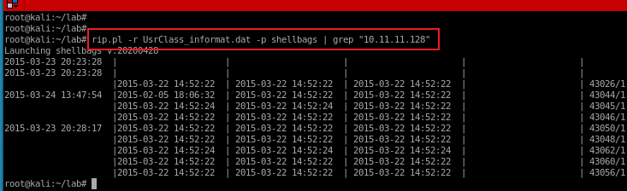
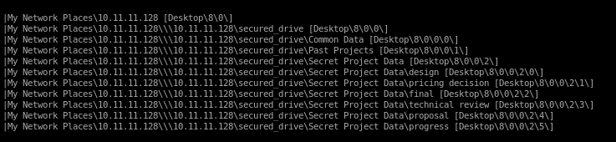
27.1 shellbag
13929-128-3: Users/informant/AppData/Local/Microsoft/Windows/UsrClass.dat
Exam shellbag with the IP
Notes:
rip.pl -r UsrClass_informat.dat -p shellbags | grep "10.11.11.128"

Slide 6

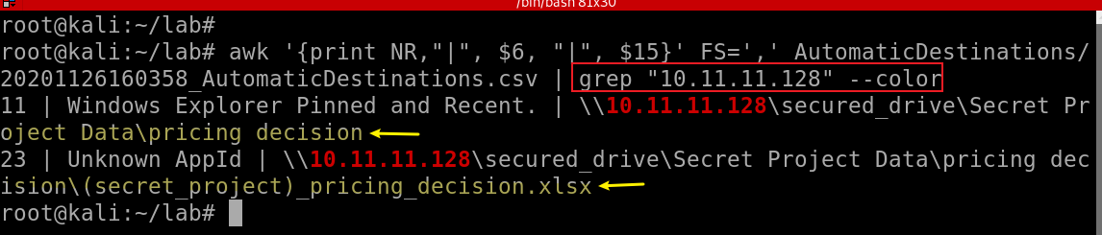
27.2 Jump List
wget https://raw.githubusercontent.com/frankwxu/digital-forensics-lab/main/NIST_Data_Leakage_Case/NIST_Answers/lab_generated_file/JumpList/20220419105824_AutomaticDestinations.csv
Exam Jump list with the IP
We want to search for folder “Secret Project Data” to find possible Mapped Letter.
Notes:
awk '{print NR,"|", $6, "|", $15}' FS=',' AutomaticDestinations/20201126160358_AutomaticDestinations.csv | grep "10.11.11.128" --color

Slide 7
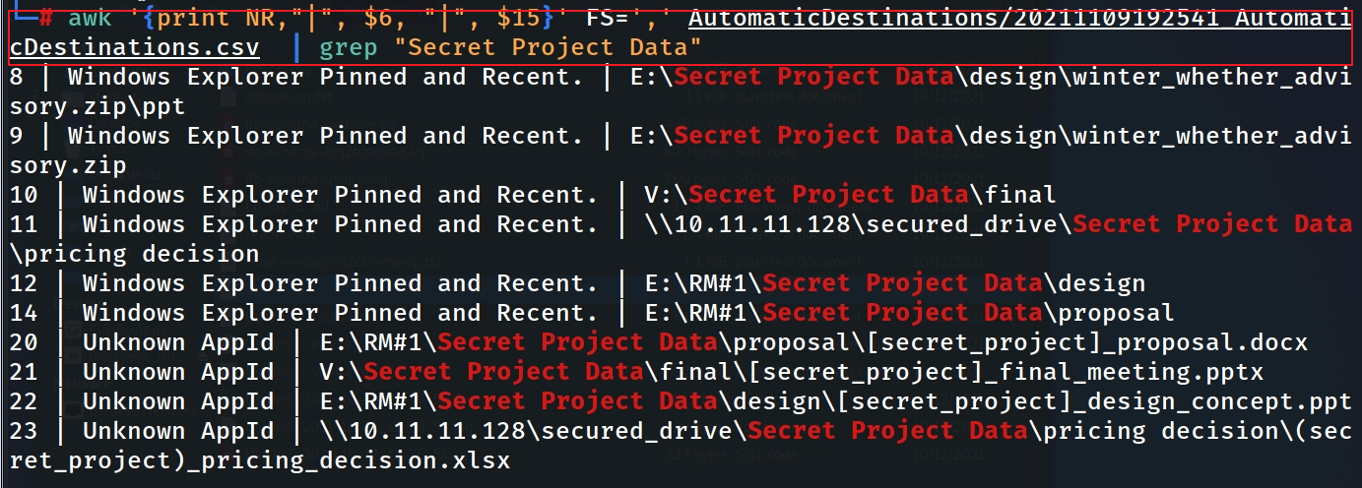
Search for mapped drive letter

Slide 8
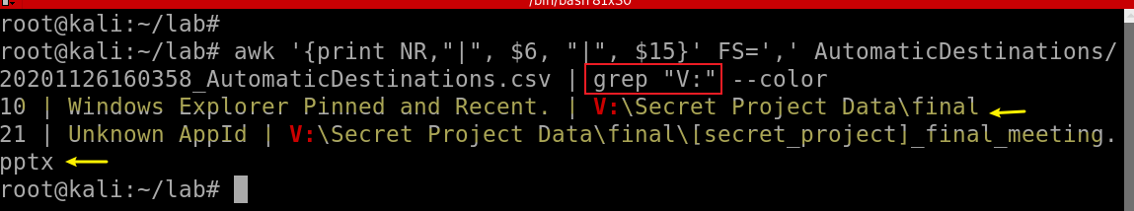
Find traversed folders by examining Jump list volume letter V:
Notes:
awk '{print NR,"|", $6, "|", $15}' FS=',' AutomaticDestinations/20201126160358_AutomaticDestinations.csv | grep "V:" --color

Slide 9
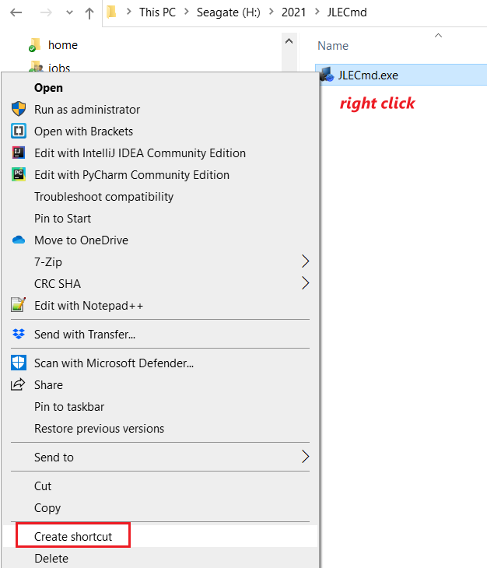
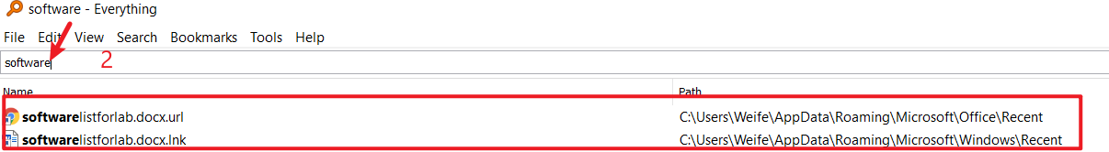

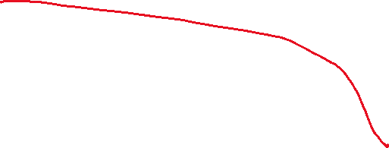


27.3 Link .lnk Files
Is a shortcut or "link" used by Windows as a reference to an original file, folder, or application
Similar to an alias on the Macintosh platform.
It contains the shortcut target type, location, and filename as well as the program that opens the target file and an optional shortcut key.

Slide 10
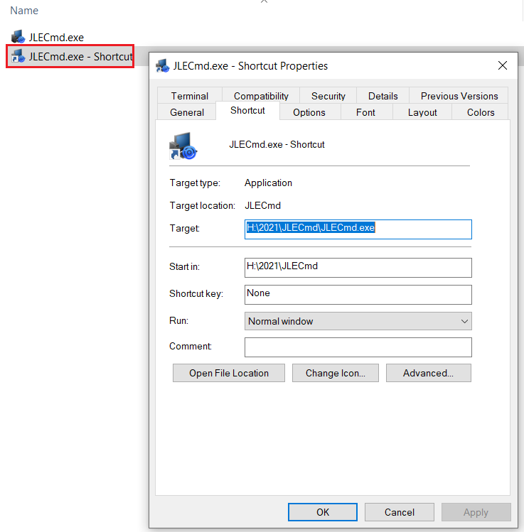

Slide 11
Link .lnk Files Location
Recently used files via links
Windows and Office
Windows 7 to 10
C:\Users\%USERNAME%\AppData\Roaming\Microsoft\Windows\Recent C:\Users\%USERNAME%\AppData\Roaming\Microsoft\Office\Recent\
Windows XP
C:\Documents and Settings\%USERNAME%\Recent

Slide 12
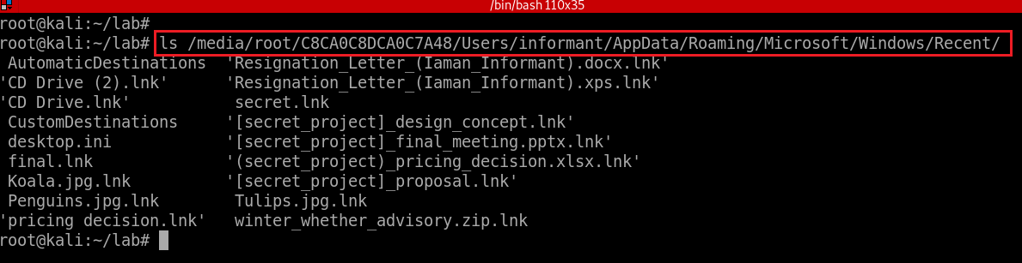
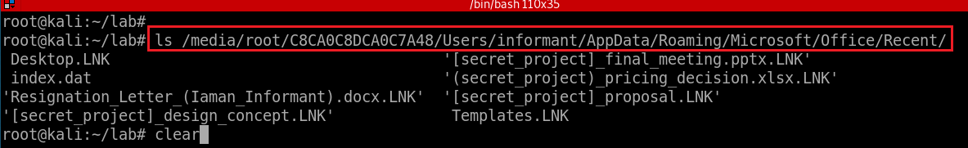
Check Windows .lnk
Check Office .lnk
Notes:
ls /media/root/C8CA0C8DCA0C7A48/Users/informant/AppData/Roaming/Microsoft/Windows/Recent/
ls /media/root/C8CA0C8DCA0C7A48/Users/informant/AppData/Roaming/Microsoft/Office/Recent/

Slide 13
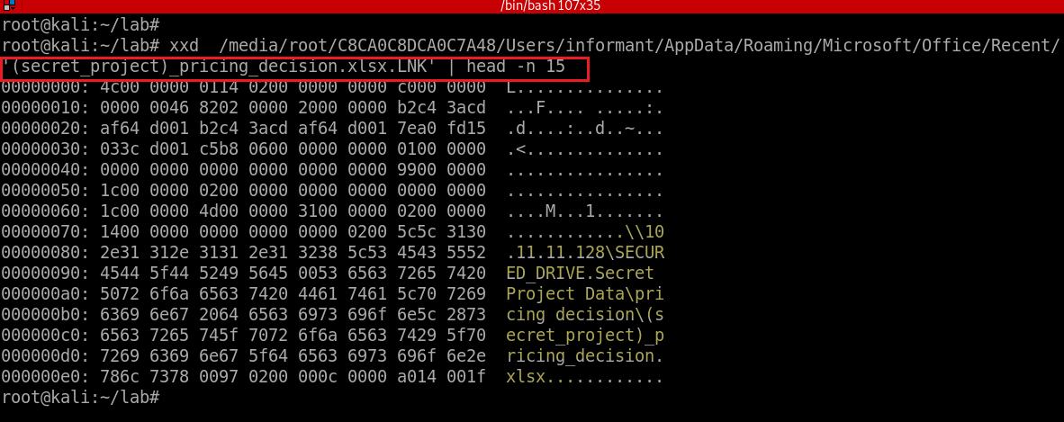
How to view .lnk
View a .lnk in binary form
Notes:
xxd /media/root/C8CA0C8DCA0C7A48/Users/informant/AppData/Roaming/Microsoft/Office/Recent/'(secret_project)_pricing_decision.xlsx.LNK' | head -n 15

Slide 14
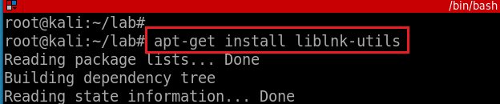
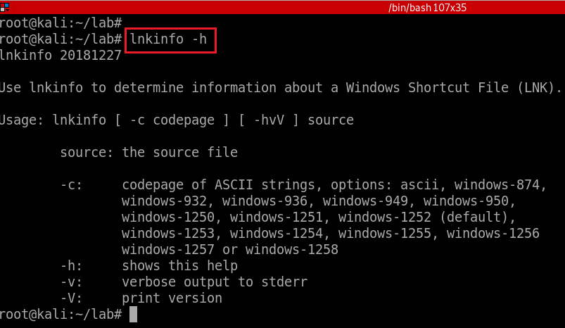
Parse .lnk files
Install .lnk parser
Verify installation
Notes:
apt-get install liblink-tuils

Slide 15
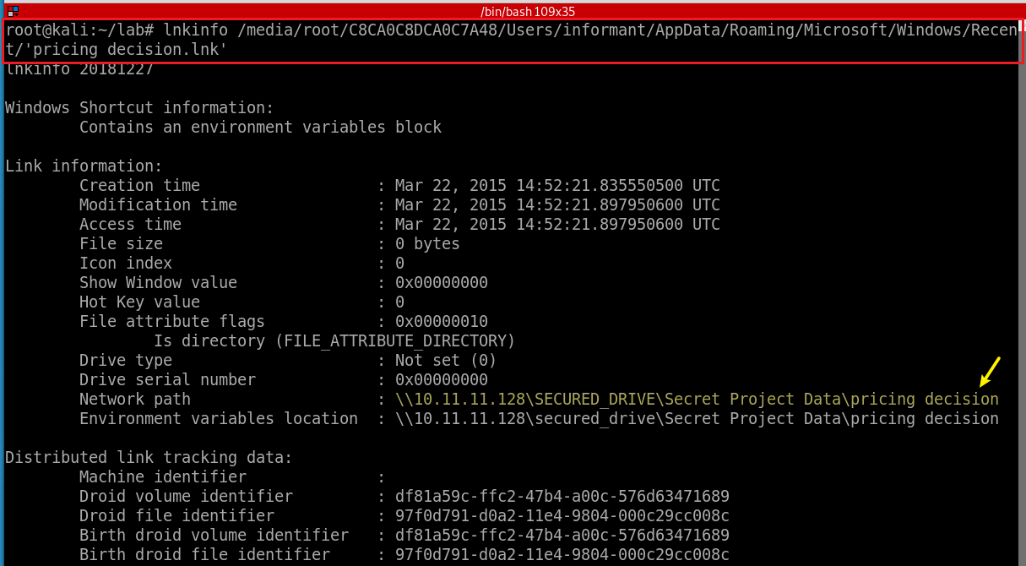
Parse a directory .lnk
what's this?
Notes:
lnkinfo /media/root/C8CA0C8DCA0C7A48/Users/informant/AppData/Roaming/Microsoft/Windows/Recent/'pricing decision.lnk'

Slide 16
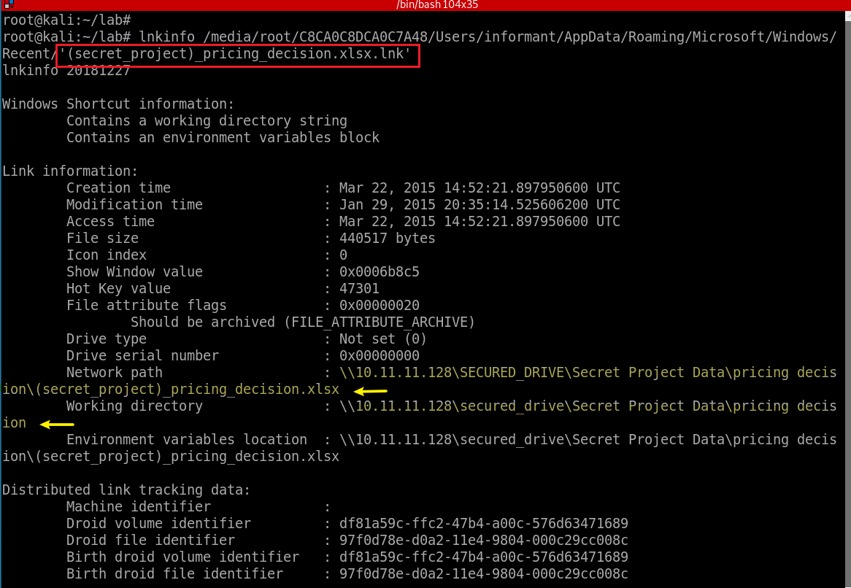
Parse a file .lnk
Notes:
lnkinfo /media/root/C8CA0C8DCA0C7A48/Users/informant/AppData/Roaming/Microsoft/Windows/Recent/'(secret_project)_pricing_decision.xlsx.lnk'

Slide 17
28. List all files that were opened in the company’s network drive (similar to 27.)
- V: is mapped on \\10.11.11.128
Link
\User\informant\AppData\Roaming\Microsoft\Windows\Recent\*.lnk
\User\informant\AppData\Roaming\Microsoft\Office\Recent\*.lnk
JumpList
\User\informant\AppData\Roaming\Microsoft\Windows\Recent\AutomaticDestinations
\User\informant\AppData\Roaming\Microsoft\Windows\Recent\CustomDestinations
Most Recently Used
HKU\informant\Software\Microsoft\Office\15.0\Excel\File MRU
HKU\informant\Software\Microsoft\Office\15.0\PowerPoint\File MRU
focus on

Slide 18
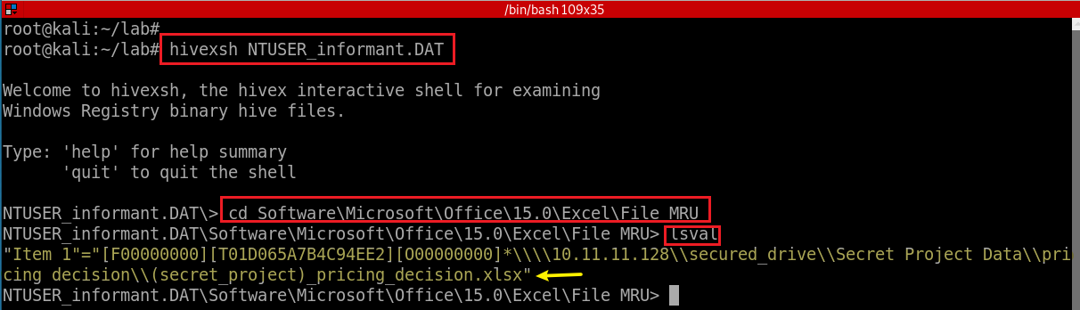
Check File MRU
Notes:
hivexsh NTUSER_informant.DAT
cd Software\Microsoft\Office\15.0\Excel\File MRU
lsval
"Item 1"="[F00000000][T01D065A7B4C94EE2][O00000000]*\\\\10.11.11.128\\secured_drive\\Secret Project Data\\pricing decision\\(secret_project)_pricing_decision.xlsx“
https://www.taksati.org/mru/

Slide 19
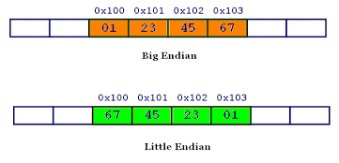
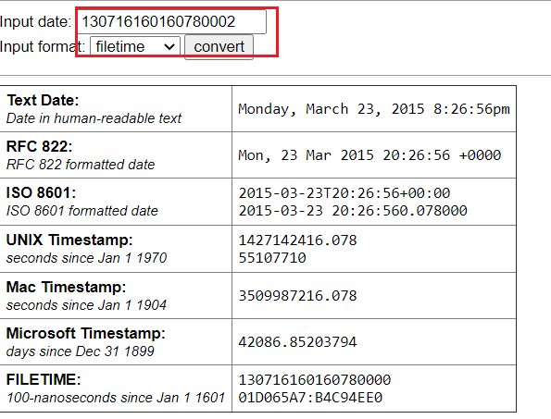
File MRU Format
x = 0x01234567
[F00000000][T01D065A7B4C94EE2][O00000000] *\\\\10.11.11.128\\secured_drive\\Secret Project Data\\pricing decision\\(secret_project)_pricing_decision.xlsx“
F00000000: marker
[T<datetime>]: <datetime> is a hex string representing a win32 FILETIME (64 bits) in big endian
O00000000:
Last: an ASCII string of a full path and file name.
Win32 FILETIME: Contains a 64-bit value representing the number of 100-nanosecond intervals since January 1, 1601 00:00:00.0000000 UTC
0x01D065A7B4C94EE2= 130716160160780002
130716160160780002 * 100-nanosecond = 13071616016,078,000,2 00 nanosecond
=13071616016.078001022 seconds = 217860266 Minutes = 3631004 hours
= 151291 days 20 hours = 414 years 84 days 20 hours (note that leap year is 366 days)
Notes:
https://www.dmares.com/maresware/html/dateconv.htm
https://www.silisoftware.com/tools/date.php?inputdate=130716160160780002&inputformat=filetime

Slide 20
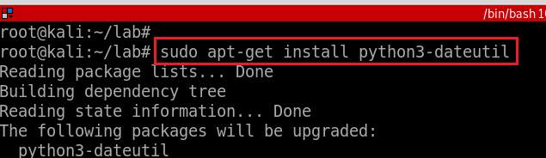
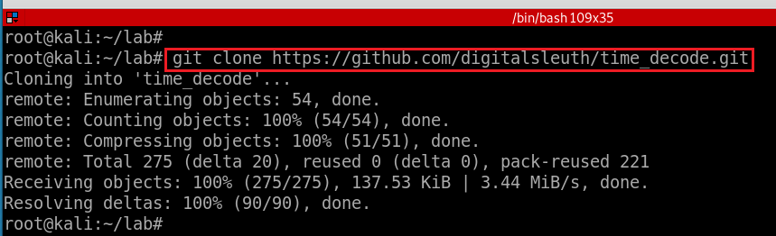
How to view win32 FILETIME (64 bits)
Install time_decode
Notes:
sudo apt install python3-dateutil
cd ..
https://github.com/digitalsleuth/time_decode.git
https://dfdatetime.readthedocs.io/en/latest/index.html

Slide 21
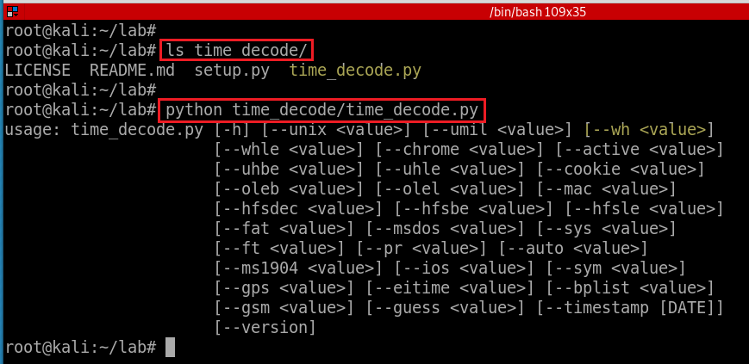
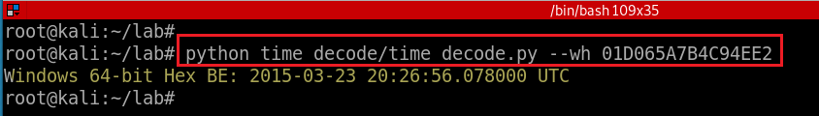
python3 if throws errors
--wh: Windows Hex
python3 if throws errors
Notes:
time_decode.py --wh 01d065a7b4c94eec

Slide 22
29. Find traces related to cloud services on PC (Service name, log files...)
Download directory
\User\informant\Downloads\icloudsetup.exe
\User\informant\Downloads\googledrivesync.exe
Installed directory
User\informant\AppData\Google\Drive\user_default\
Registry that related to Installation/Uninstall/Execution
Configuration
Autoruns
UserAssist,
Classes…

Slide 23
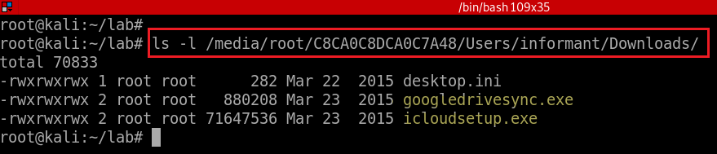
29.1 Search download folder
Find traces in download directory

Slide 24
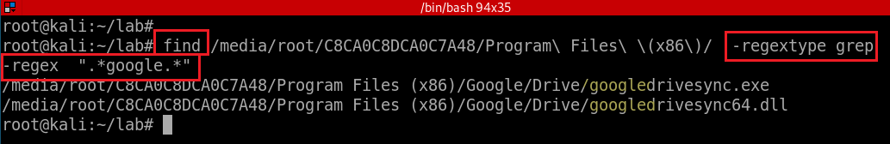
29.2 Search Installation directory
Find all file names contains the key words “google” using regex (practice a different method other than fls)
-regextype: ‘findutils-default’, ‘ed’, ‘emacs’, ‘gnu-awk’, ‘grep’, ‘posix-awk’, ‘awk’, ‘posix-basic’, ‘posix-egrep’, ‘egrep’, ‘posix-extended’, ‘posix-minimal-basic’, ‘sed’.
-regex: find expression matches the whole name ".*google.*"
Notes:
find /media/root/C8CA0C8DCA0C7A48/Program\ Files\ \(x86\)/ -regextype grep -regex ".*google.*“
Review: find . -type f -exec grep "example" '{}' \; -print
https://www.linode.com/docs/guides/find-files-in-linux-using-the-command-line/

Slide 25
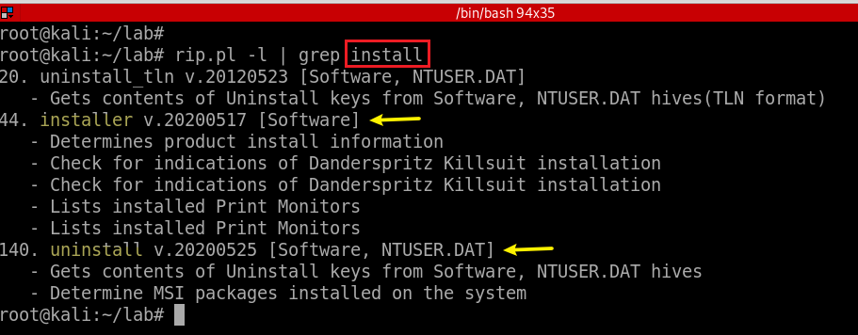
29.3 Search Registry (installation/uninstallation/execution)

Slide 26
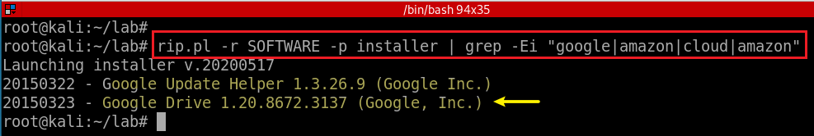
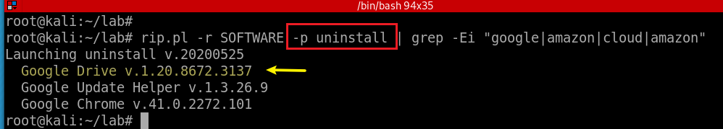
Search installer registry
Search uninstaller registry
When a software is installed, often save uninstallation information in a registry
Notes:
rip.pl -r SOFTWARE -p installer | grep -Ei "google|amazon|cloud|amazon“
rip.pl -r SOFTWARE -p uninstall | grep -Ei "google|amazon|cloud|amazon"

Slide 27
Windows Automatic Startup Registry
HKCU\SOFTWARE\Microsoft\Windows\CurrentVersion\Run
HKCU\SOFTWARE\Wow6432Node\Microsoft\Windows\CurrentVersion\Run (only on 64-bit systems)
HKCU\Software\Microsoft\Windows NT\CurrentVersion\Windows\Run
HKCU\Software\Microsoft\Windows\CurrentVersion\RunOnce (runs the program/command only once, clears it as soon as it is run)
HKCU\Software\Microsoft\Windows\CurrentVersion\RunOnceEx (runs the program/command only once, clears it as soon as execution completes)
HKCU\Software\Microsoft\Windows\CurrentVersion\RunServices
HKCU\Software\Microsoft\Windows\CurrentVersion\RunServicesOnce
HKLM\System\CurrentControlSet\Services
Notes:
https://www.ghacks.net/2016/06/04/windows-automatic-startup-locations/

Slide 28
30. What files were deleted from Google Drive?
Trace locations
\User\informant\AppData\Local\Google\Drive\user_default\sync_log.log
\User\informant\AppData\Local\Google\Drive\user_default\snapshot.db
\User\informant\AppData\Local\Google\Drive\user_default\snapshot.db-wal
Last two files are deleted because of the logoff activity.
Need to recover records from unused area of SQLite file.
If ‘sync_log.log’ file is missing, deleted SQLite record recovery should be considered.
wal: Write Ahead Log
Used in nearly all modern RDBMS systems to provide durable and atomic transactions.
Any transaction performed on the database is first written out as a WAL file, then applied to the actual on-disk table data files.

Slide 29
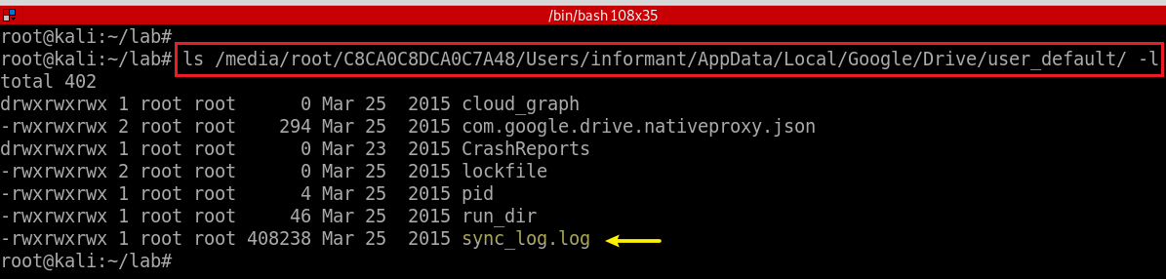
Search the location of google log file sync_log.log

Slide 30


sync_log.log
DIRECTION.UPLOAD
DIRECTION.DOWNLOAD
Listing of three actions taken by Google Drive
Action.CREATE, Action.MODIFY, and Action.DELETE
Three actions are paired up with
DIRECTION.UPLOAD: actions taken on the local machine which are synced to other Google Drive folders
DIRECTION.DOWNLOAD: actions taken elsewhere which are synced to the local machine
Assume a suspect created the folder on this local machine's Google Drive
Search for Action.CREATE with DIRECTION.UPLOAD
Notes:
https://dpmforensics.com/2018/01/03/500-words-or-less-getting-more-from-google-accounts/

Slide 31
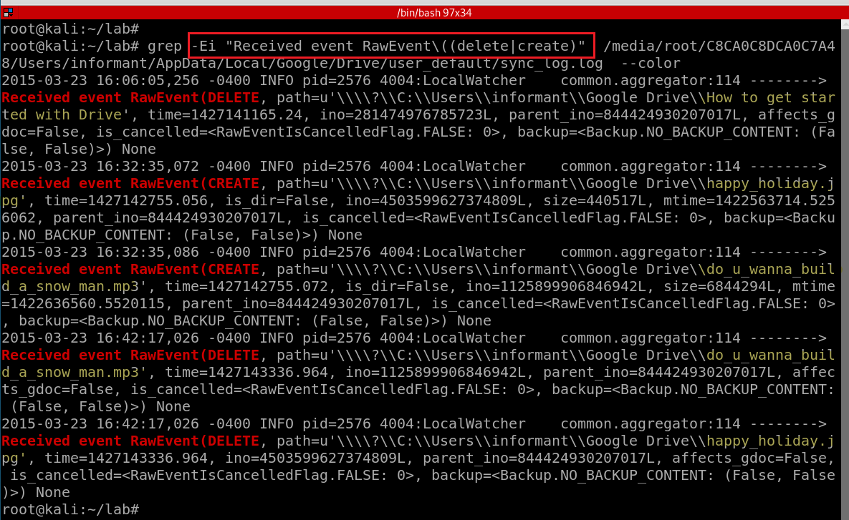
Search Delete or Create actions recorded by the log file
Notes:
grep -Ei "Received event RawEvent\((delete|create)" /media/root/C8CA0C8DCA0C7A48/Users/informant/AppData/Local/Google/Drive/user_default/sync_log.log --color

Slide 32
31. Identify account information for synchronizing Google Drive
Trace locations
\User\informant\AppData\Google\Drive\user_default\sync_log.log
Account information, i.e., email, is needed when sync local and remote hosts
\User\informant\AppData\Google\Drive\user_default\sync_config.db
\User\informant\AppData\Google\Drive\user_default\sync_config.db-wal
If ‘sync_log.log’ file is missing, deleted SQLite record recovery should be considered
the topic will be covered in Volume Shadow Copy

Slide 33
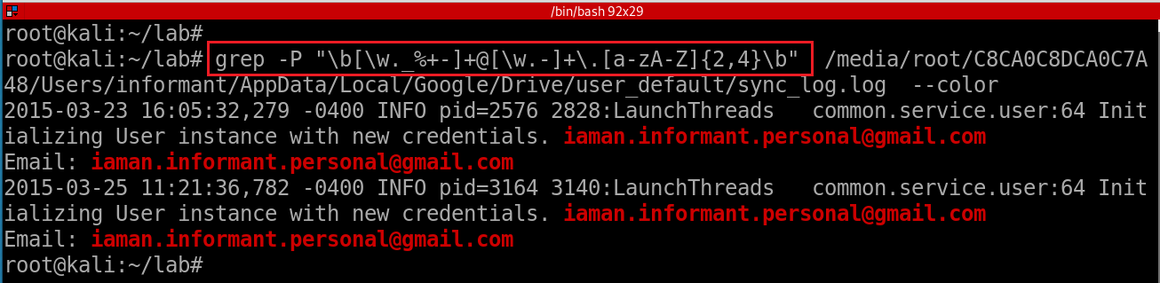
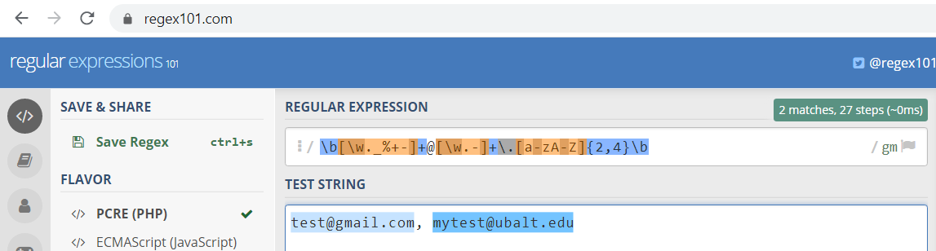
Search email via regex
\b assert position at a word boundary
\w matches any word character (equivalent to [a-zA-Z0-9_])
Notes:
grep -P "\b[\w._%+]+@[\w.]+\.[a-zA-Z]{2,4}\b" /media/root/C8CA0C8DCA0C7A48/Users/informant/AppData/Local/Google/Drive/user_default/sync_log.log --color
\w: [a-zA-Z0-9_]
echo "fxu@ubalt.edu" | grep -E "[a-z]+@[a-z]+\.edu"
echo "test@test.com" | grep -E "[a-z]+@[a-z]+\.[a-zA-Z]{2,4}"
echo "fxu001@ubalt.com" | grep -E "[a-z0-9]+@[a-z]+\.(edu|com)"

Slide 34
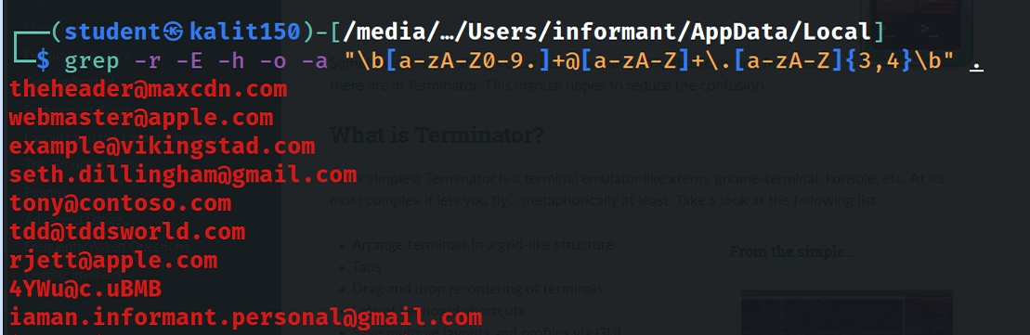
Search email via regex under a folder
-h: no file name
-o: show only match
-a: search binary too
Notes:
grep -r -E -h -o -a "\b[a-zA-Z0-9.]+@[a-zA-Z]+\.[a-zA-Z]{3,4}\b" .

Slide 35

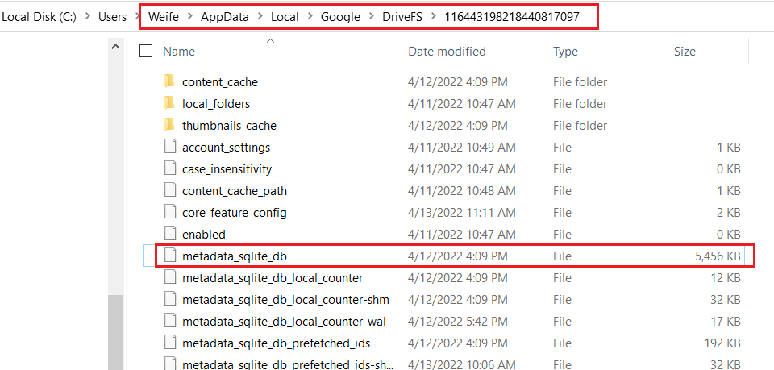
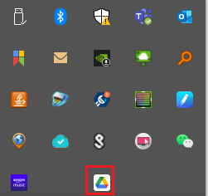
New Google Drive Log location
changes are saved to

