Slide 1
Investigate Data Leakage Case
Keywords: Windows Security Event Logs, XML
Notes:
http://xmlstar.sourceforge.net/doc/UG/

Slide 2
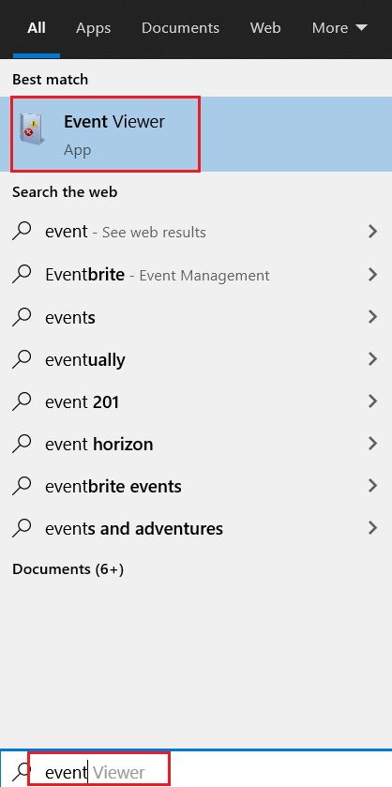
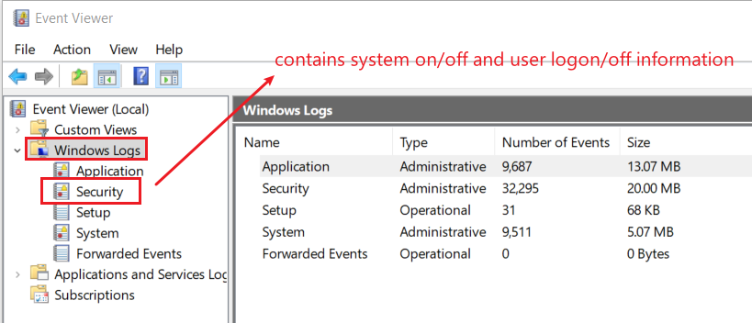
12. List all traces about the system on/off and the user logon/logoff (It should be considered only during a time range between 09:00 and 18:00 in the timezone (Eastern Time) from Question 4.
The Windows event log is a detailed record of system, security and application notifications stored by the Windows
It’s a useful tool for
troubleshooting all kinds of different Windows problems
forensics analysis
Notes:
evtx_dump.py Security.evtx > SecurityEvt.xml

Slide 3
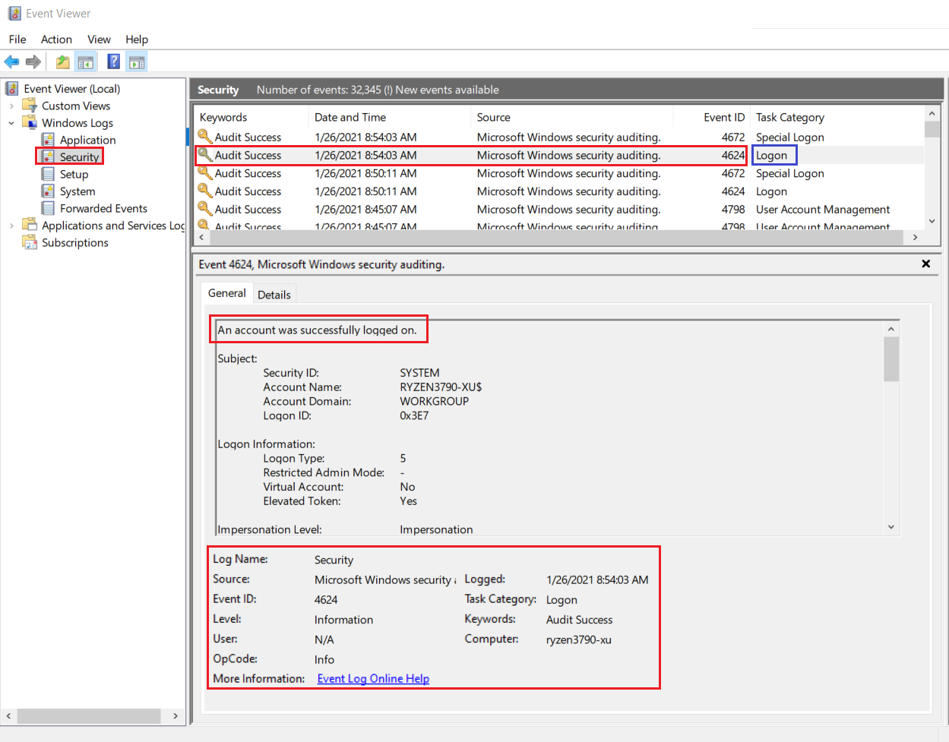
Logon event 4624

Slide 4
Overview
Get a copy of security event log
Analyze the event log
Install XML parser (xmlstarlet)
Validating Security Event Log XML documents
Display element structure of XML document
Format XML document
Query XML documents
Modify or edit XML documents

Slide 5
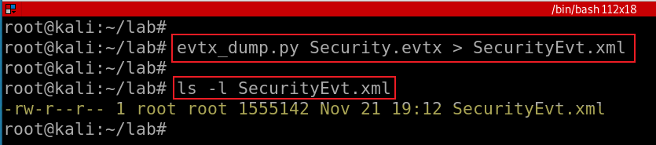
Get a copy of security event log
Exam security event logs for logon/logoff
Notes:
evtx_dump.py Security.evtx > SecurityEvt.xml

Slide 6
Install XML parser

Slide 7
xmlstarlet
Is a set of command line utilities (tools)
transform, query, validate, and edit XML documents and files
Using simple set of shell commands
Similar to grep, sed, awk
http://xmlstar.sourceforge.net/doc

Slide 8
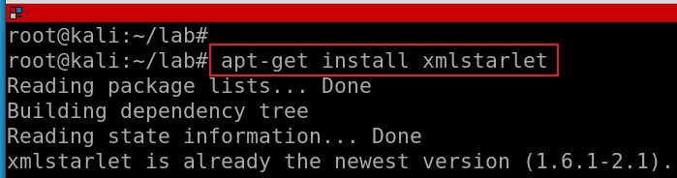
Install xmlstartlet
Notes:
apt-get install xmlstarlet

Slide 9
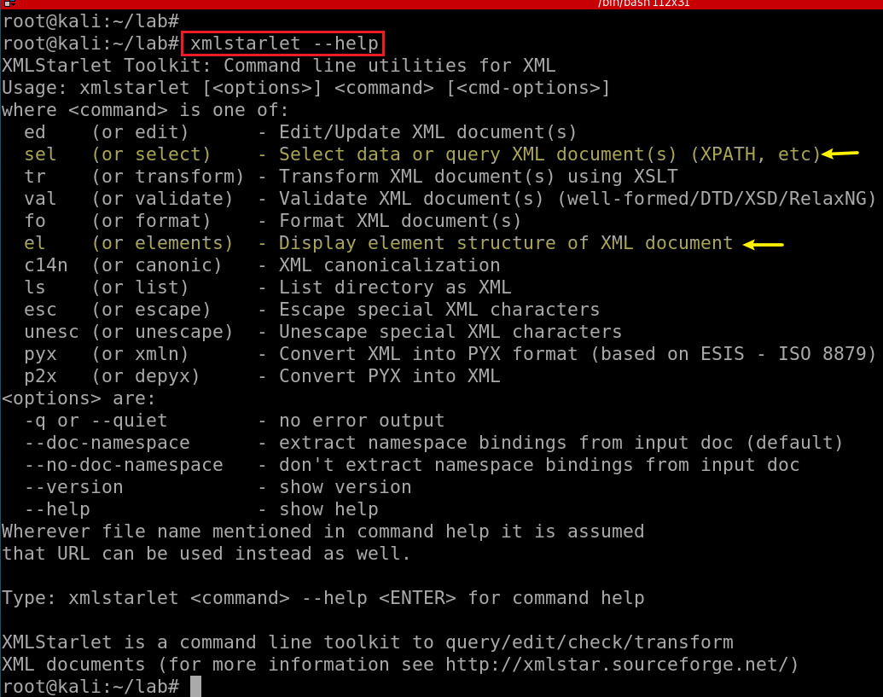

Slide 10
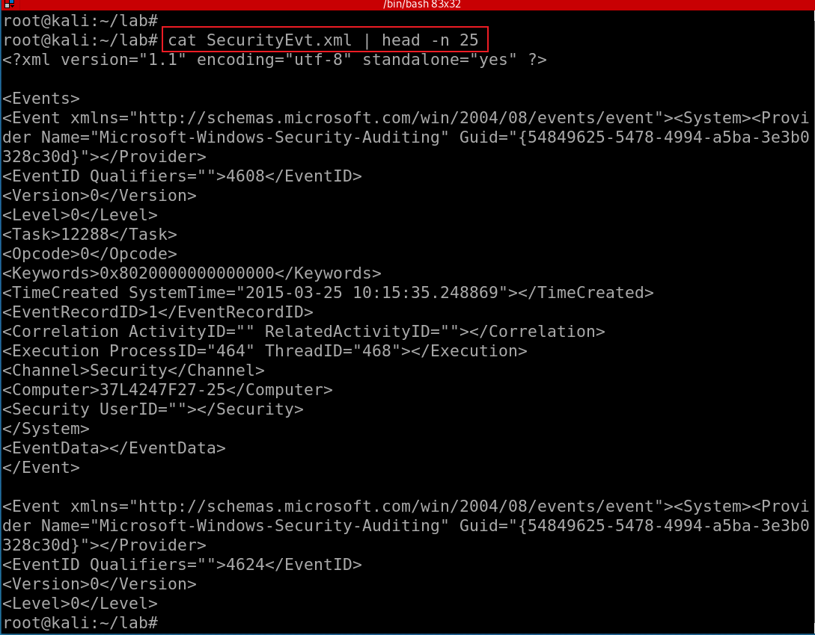
Show SecurityEvt.xml
XML Namespaces provide a method to avoid element name conflicts.
defined by an xmlns attribute in the start tag of an element.
xmlns:prefix="URI".
<table> <tr> <td>Apples</td> <td>Bananas</td> </tr> </table>
<table> <name>African Coffee Table</name> <width>80</width> <length>120</length> </table
Notes:
https://www.w3schools.com/xml/xml_namespaces.asp

Slide 11
validating XML documents

Slide 12
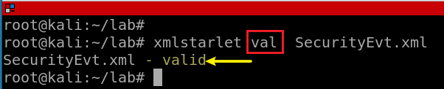
Notes:
xmlstarlet val SecurityEvt.xml

Slide 13
Display element structure of XML document
or elements

Slide 14
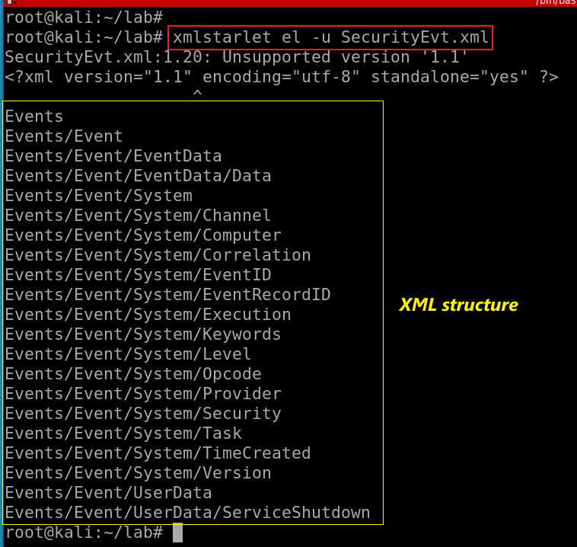
Show the element structure of SecurityEvt.xml
el: Display element structure of XML document
-u: print out sorted unique lines
Notes:
xmlstarlet el -u SecurityEvt.xml
xmlstarlet el -u SecurityEvt.xml 2>/dev/null

Slide 15
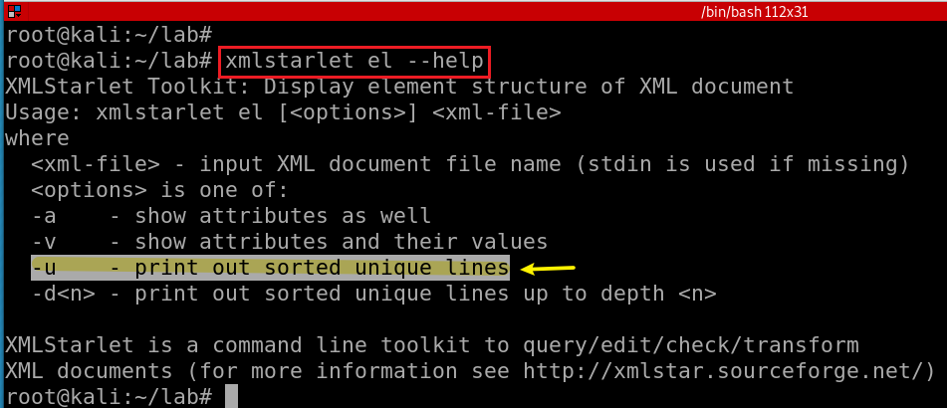
Notes:
xmlstarlet el --help

Slide 16
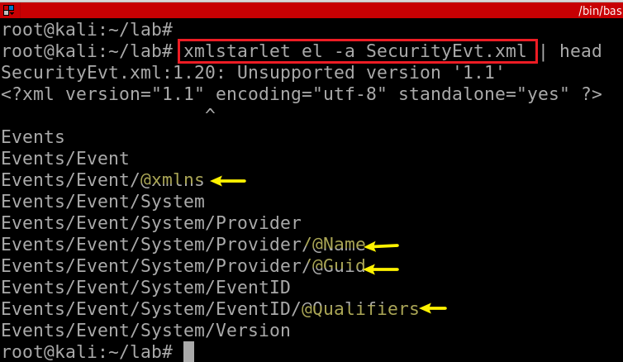
Show the element (attributes) structure of SecurityEvt.xml
-a: show attributes

Slide 17
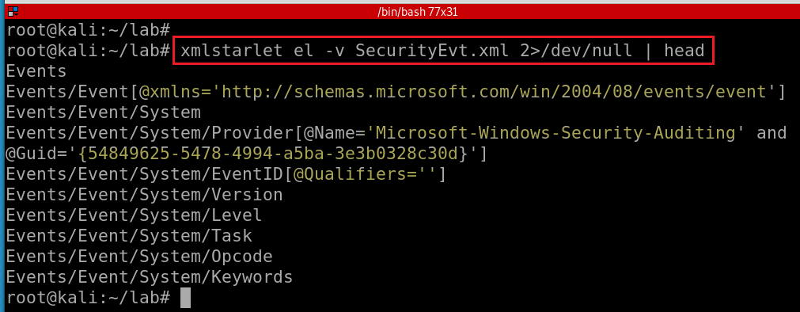
Show element attributes and their values
-v : show attributes and their values
Notes:
xmlstarlet el -v SecurityEvt.xml 2>/dev/null | head

Slide 18
format XML document

Slide 19
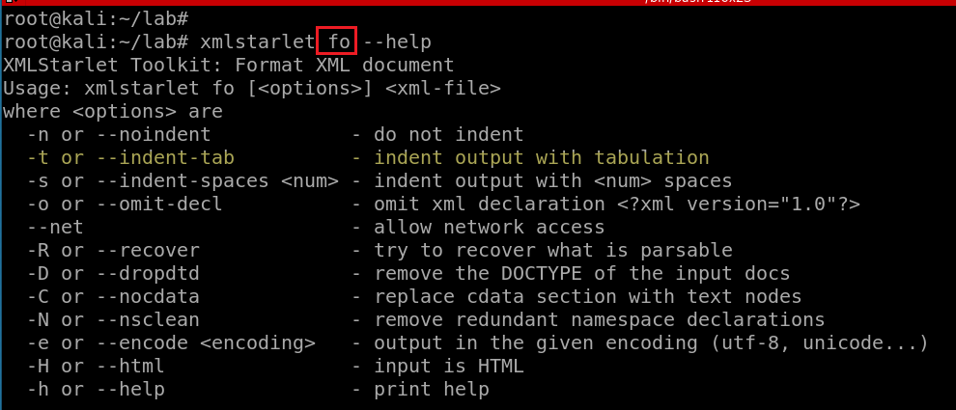

Slide 20
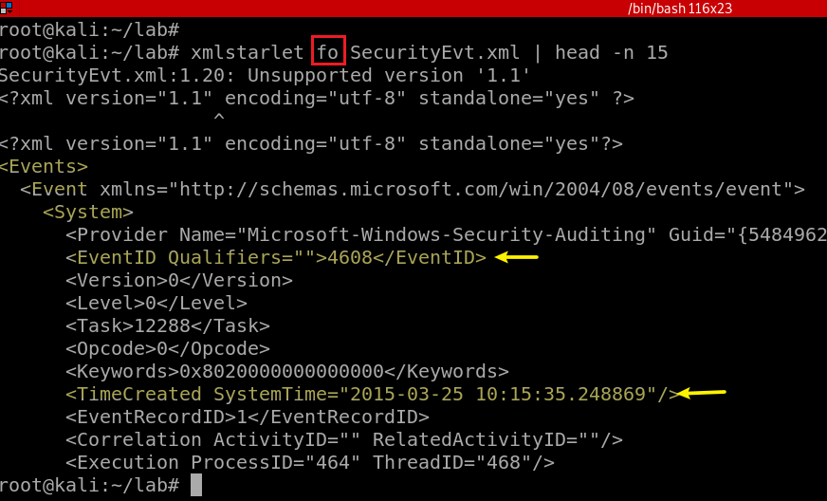
Notes:
xmlstarlet fo -n SecurityEvt.xml | head -n 15

Slide 21
select data or query XML document(s) (XPATH, etc)

Slide 22
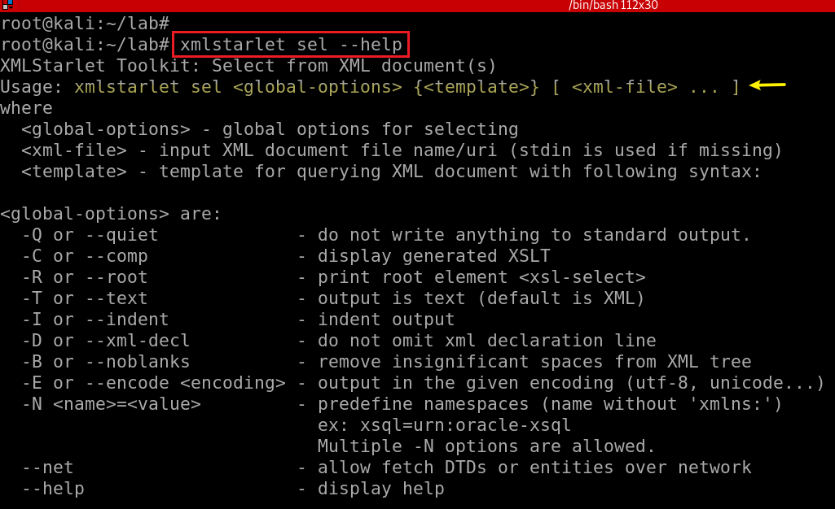

Slide 23
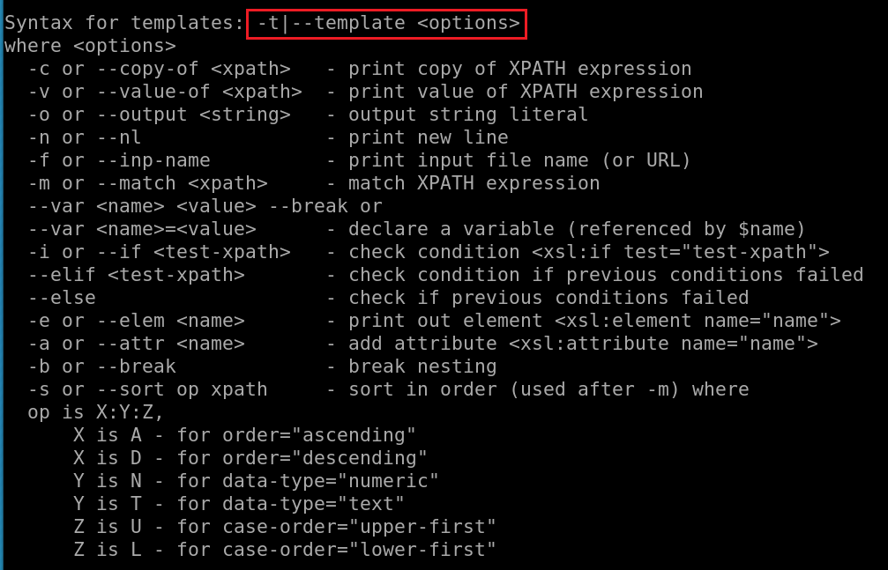
What is XPATH expression?

Slide 24
Xpath expressions
Xpath uses path expressions to select nodes or node-sets in an XML document.
Xpath expressions look very much like the expressions you see when you work with a traditional computer file system.
Must provide XML namespace for queuing data

Slide 25
Xpath expressions
“//” operator, a convenient shorthand for selecting nodes at any level in a document.
x: namespace variable, e.g., x=http://schemas.microsoft.com/win/2004/08/events/event
First Event node
//x:Event[1]
Last event
//x:Event[last()]
Last two events
//x:Event[position()<3]
EventID with an attribute named Qualifiers
//x:EventID[@Qualifiers]
Notes:
https://www.marklogic.com/blog/xpath-punctuation-part-1/

Slide 26
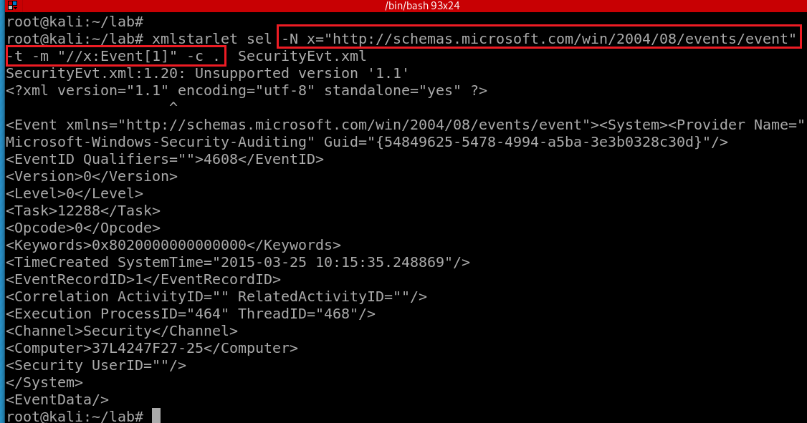
Select the first event by matching the xpath and print the context node
-N: namespace
x: namespace variable
The dot (“.”) : the “context item expression” because it refers to the context item.
This could be a node (such as an element, attribute, or text node), or an atomic value (such as a string, number, or boolean).
When it’s a node, it’s also called the context node.
-c or --copy-of <xpath>: print copy of XPATH expression
options
-m: match XPATH expression
-t|--template <options>
Notes:
xmlstarlet sel -N x="http://schemas.microsoft.com/win/2004/08/events/event" -t -m "//x:Event[1]" -c . SecurityEvt.xml

Slide 27
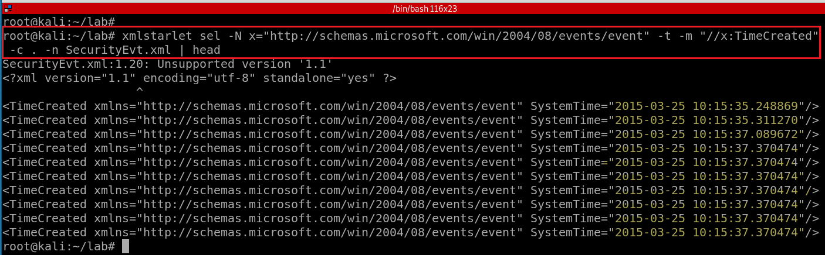
Select TimeCreated of events and print the context node
Notes:
xmlstarlet sel -N x="http://schemas.microsoft.com/win/2004/08/events/event" -t -m "//x:TimeCreated" -c . -n SecurityEvt.xml
http://xmlstar.sourceforge.net/doc/UG/xmlstarlet-ug.html#idm47077139523728

Slide 28
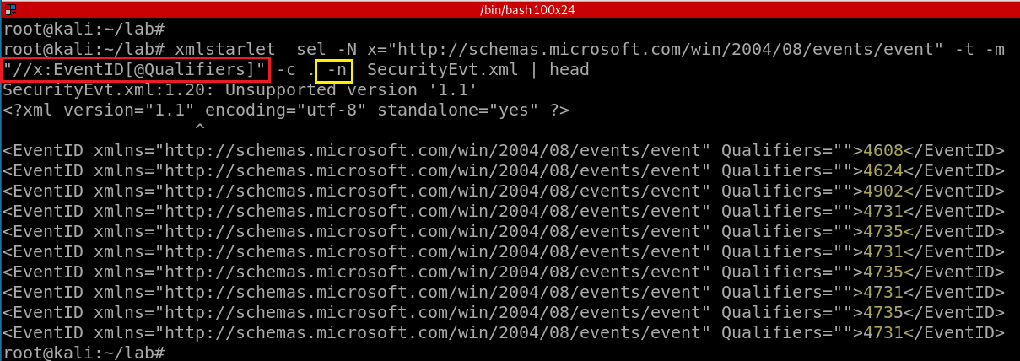
4608 (Windows is starting up)
1100 (service shutdown)
4624 (successful logon)
4634 (logoff)
4625 (logon failure)
4647 (a user initiated the logoff process)...
Select a property of EventID and print the context node
-n: print new line
Notes:
xmlstarlet sel -N x="http://schemas.microsoft.com/win/2004/08/events/event" -t -m "//x:EventID[@Qualifiers]" -c . -n SecurityEvt.xml | head

Slide 29
Substitute xmlstarlet sel results using sed
Notes:
https://www.grymoire.com/Unix/Sed.html#uh-1

Slide 30
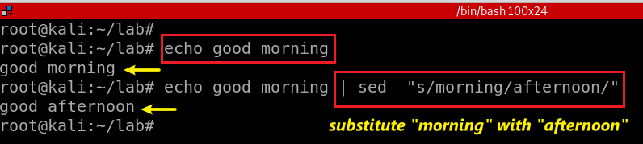
stream editor
Used to perform basic text transformations on an input stream (a file or input from a pipeline).
Can apply regular expression
Substitute morning in text stream with afternoon
Notes:
echo good morning | sed "s/morning/afternoon/"

Slide 31
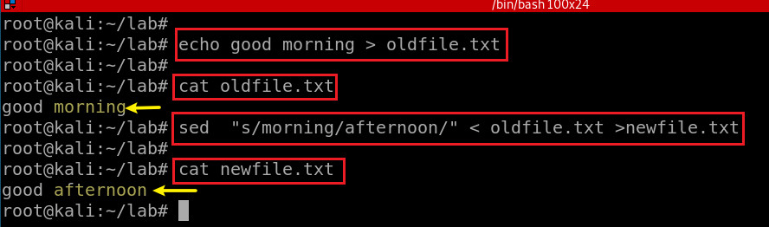
Substitute morning in text stream with afternoon

Slide 32
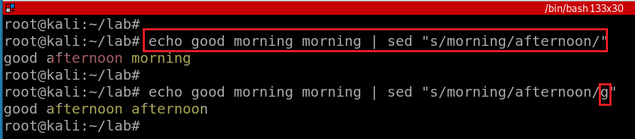
/g - Global replacement

Slide 33
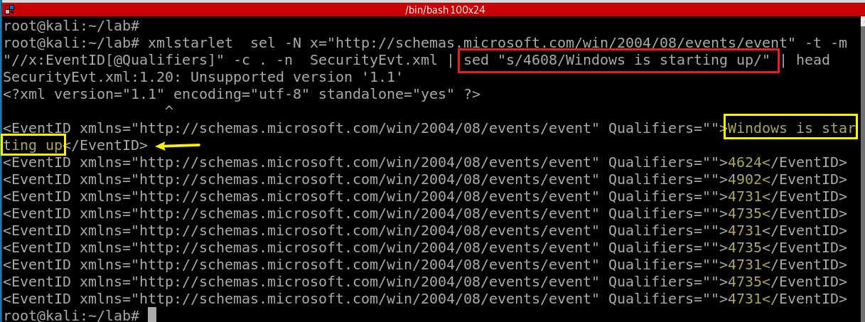
4608 (Windows is starting up)
1100 (service shutdown)
4624 (successful logon)
4634 (logoff)
4625 (logon failure)
4647 (a user initiated the logoff process)...
Notes:
https://www.grymoire.com/Unix/Sed.html

Slide 34
edit XML document(s)

Slide 35
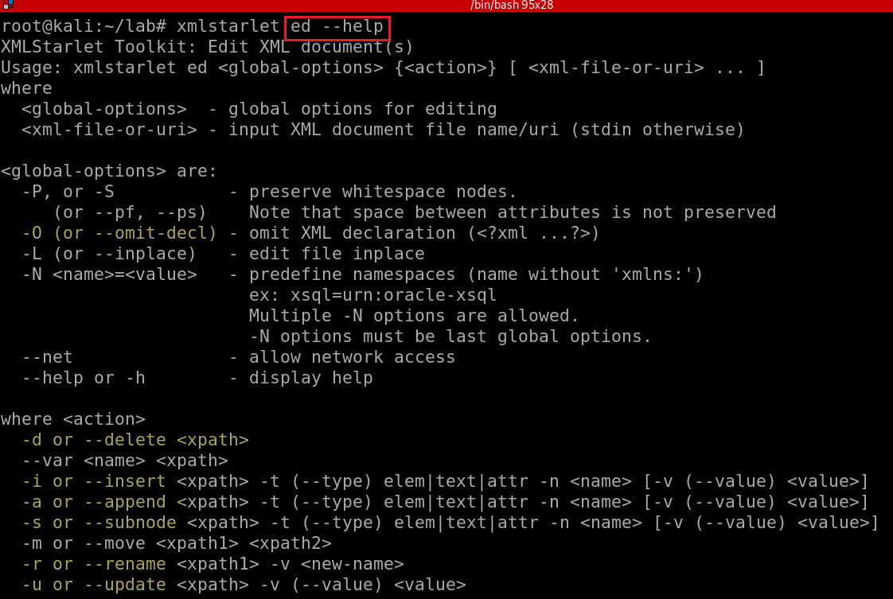
Notes:
xmlstarlet ed --help

Slide 36
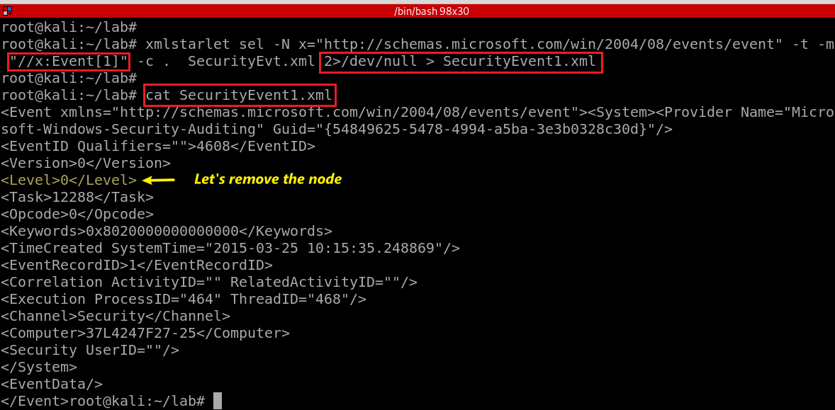
Notes:
xmlstarlet sel -N x="http://schemas.microsoft.com/win/2004/08/events/event" -t -m "//x:Event[1]" -c . SecurityEvt.xml 2>/dev/null > SecurityEvent1.xml

Slide 37
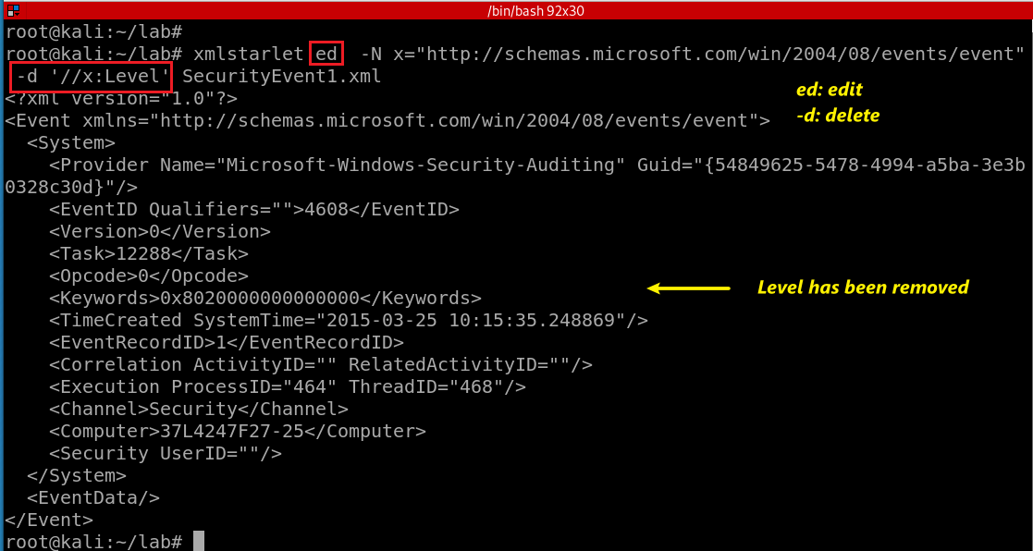
“delete” the node <Level></Level>
Notes:
xmlstarlet ed -N x="http://schemas.microsoft.com/win/2004/08/events/event" -d '//x:Level' SecurityEvent1.xml

Slide 38
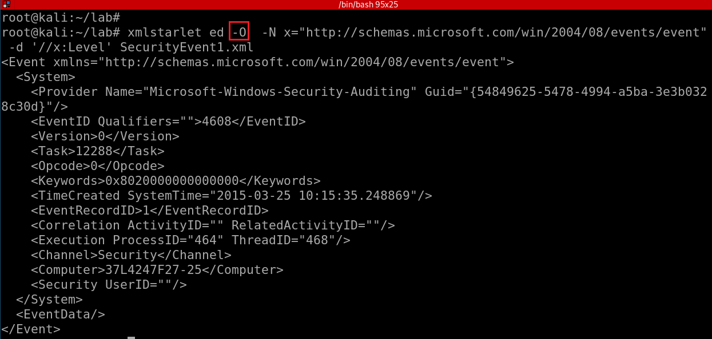
Omit XML declaration (<?xml ...?>) and “delete” the node <Level></Level>
-d: is not actually deleting the note,
only show deleted stream
How to actually delete a node?
Notes:
xmlstarlet ed -O -N x="http://schemas.microsoft.com/win/2004/08/events/event" -d '//x:Level' SecurityEvent1.xml

Slide 39
Deleting namespace declarations
Notes:
http://xmlstar.sourceforge.net/doc/UG/xmlstarlet-ug.html#idm47077139529952
xml ed -N N="http://www.c.com/xyz" -d '//N:*' ns2.xml | \ sed -e 's/ xmlns.*=".*"//g'

Slide 40
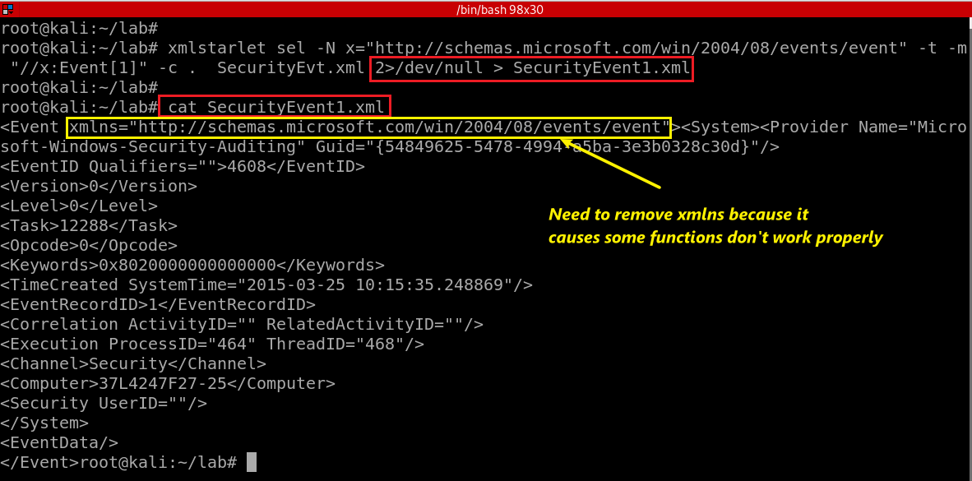
Notes:
xmlstarlet sel -N x="http://schemas.microsoft.com/win/2004/08/events/event" -t -m "//x:Event[1]" -c . SecurityEvt.xml 2>/dev/null > SecurityEvent1.xml

Slide 41
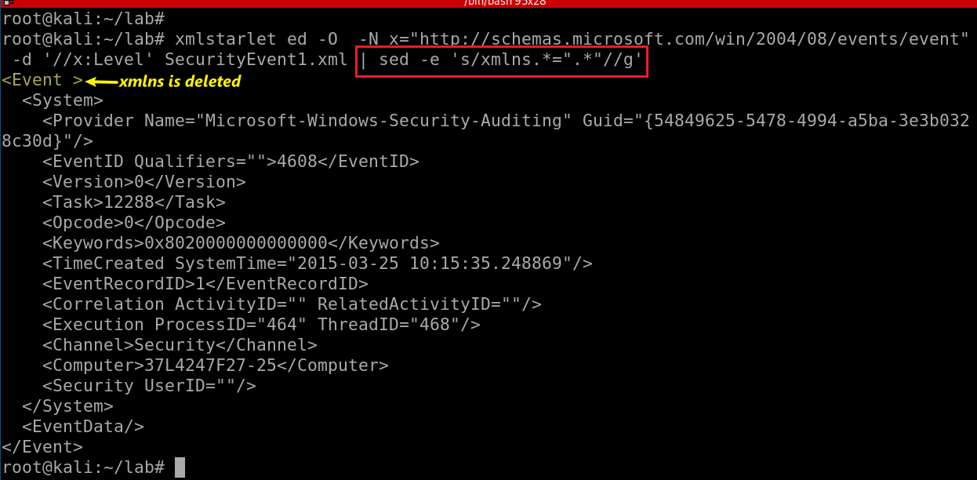
Substitute xmlns with nothing (remove xmlns)
-e: regular expression
s/e1/e2/g:
s: substitute
e1: regex
e2: regex
g: globe
Notes:
xmlstarlet ed -O -N x="http://schemas.microsoft.com/win/2004/08/events/event" -d '//x:Level' SecurityEvent1.xml | sed -e 's/xmlns.*=".*"//g'
http://xmlstar.sourceforge.net/doc/UG/xmlstarlet-ug.html#idm47077139529952

Slide 42
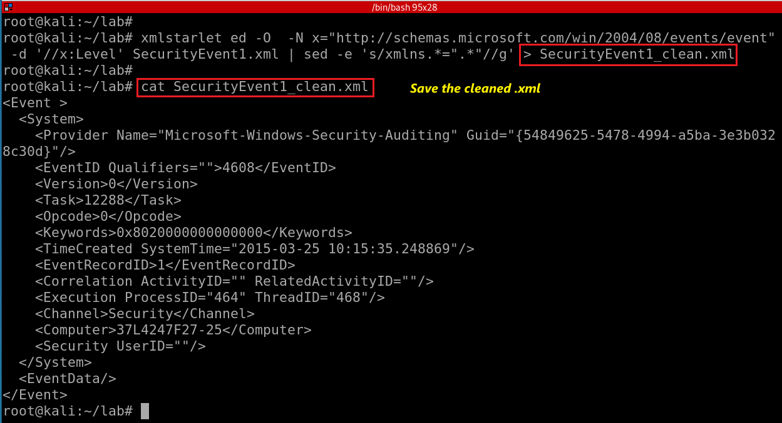
Notes:
xmlstarlet sel -N x="http://schemas.microsoft.com/win/2004/08/events/event" -t -m "//x:Event[1]" -c . SecurityEvt.xml 2>/dev/null > SecurityEvent1.xml
xmlstarlet ed -O -N x="http://schemas.microsoft.com/win/2004/08/events/event" -d '//x:Level' SecurityEvent1.xml | sed -e 's/xmlns.*=".*"//g' > SecurityEvent1_clean.xml

Slide 43
Transforming an XML Document into a CSV

Slide 44
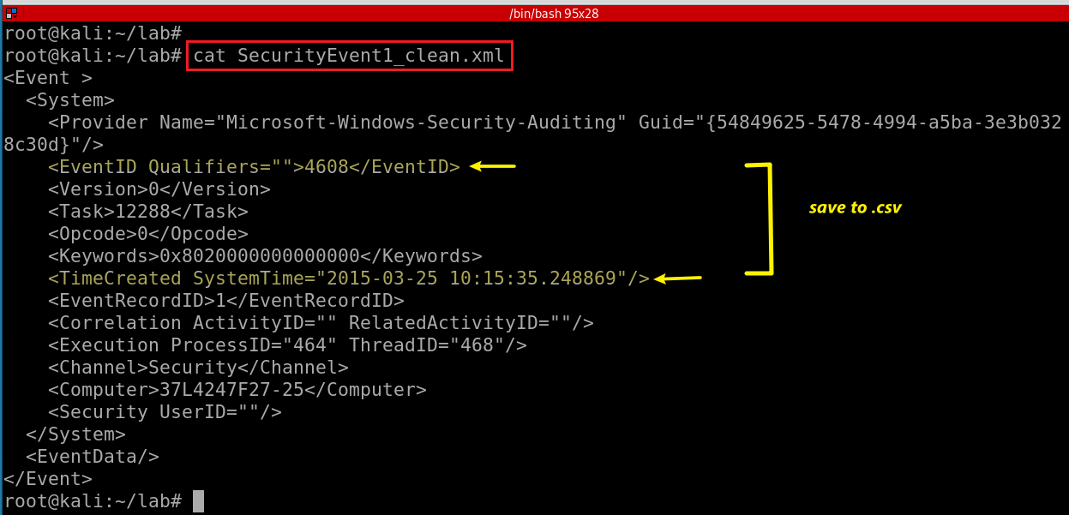
We want to save EventID and ItemCreated to .csv

Slide 45
<Event><System><Provider Name="Microsoft-Windows-Security-Auditing" Guid="{54849625-5478-4994-a5ba-3e3b0328c30d}"></Provider>
<EventID Qualifiers="">4608</EventID>
<Version>0</Version>
<Level>0</Level>
<Task>12288</Task>
<Opcode>0</Opcode>
<Keywords>0x8020000000000000</Keywords>
<TimeCreated SystemTime="2015-03-25 10:15:35.248869"></TimeCreated>
<EventRecordID>1</EventRecordID>
<Correlation ActivityID="" RelatedActivityID=""></Correlation>
<Execution ProcessID="464" ThreadID="468"></Execution>
<Channel>Security</Channel>
<Computer>37L4247F27-25</Computer>
<Security UserID=""></Security>
</System>
<EventData></EventData>
</Event>
Notes:
https://www.joyofdata.de/blog/transforming-xml-document-into-csv-using-xmlstarlet/

Slide 46
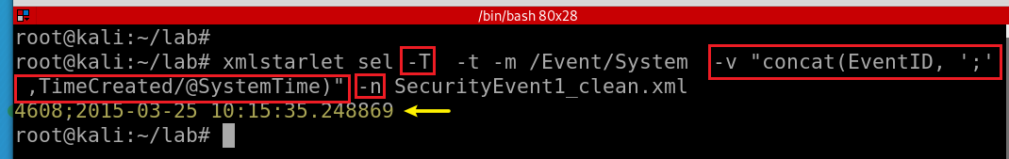
-T: output is text
-t: template
-m: template
-v: print value of xpath
-n: new line
Display EventID and ItemCreated in text
Notes:
xmlstarlet sel -T -t -m /Event/System -v "concat(EventID, ';' ,TimeCreated/@SystemTime)" -n SecurityEvent1_clean.xml

Slide 47
Assignments

Slide 48
Assignments
Timestamp conversion
Convert all events to .csv

