Slide 1
Morris Worm Investigations

Slide 2
Overview
Memory and process
Analyze network ports used by Morris Worm
Analyze worm running processes
Create a timeline with file timestamps

Slide 3
Memory and Process
A process is the instance of a computer program that is being executed by one or many threads.

Slide 4
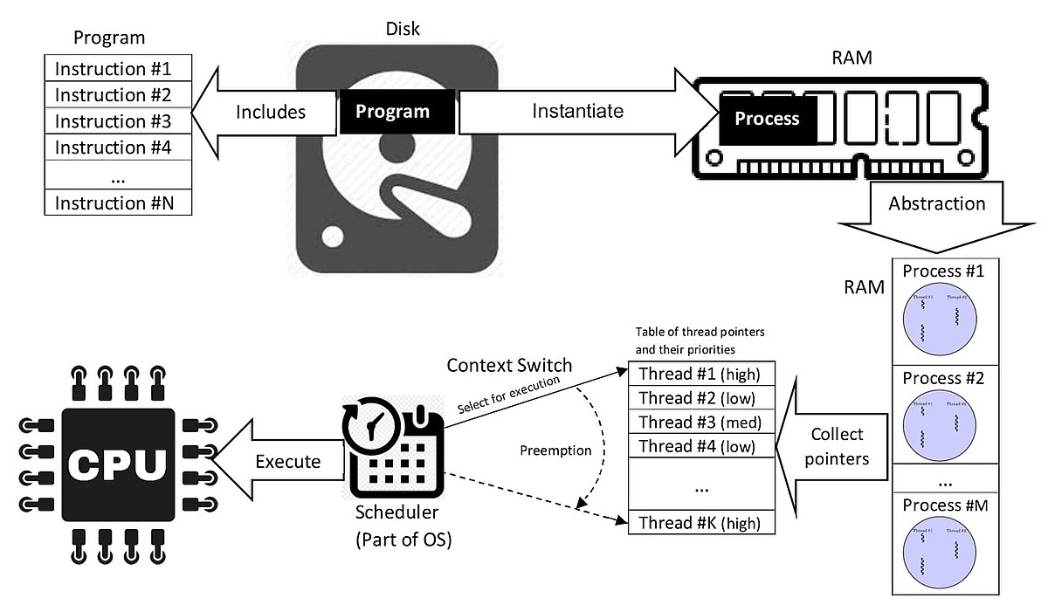

Slide 5
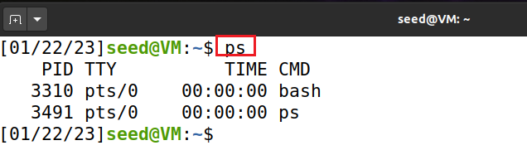
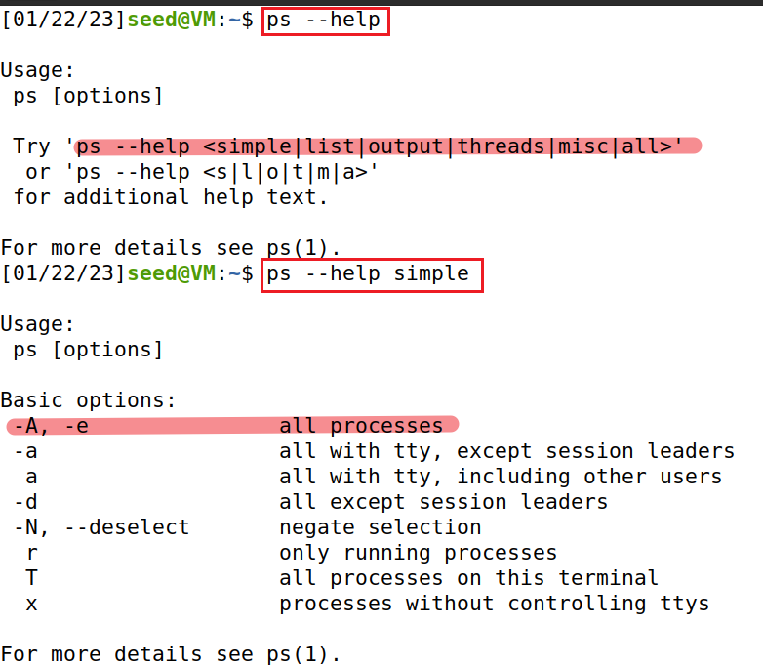
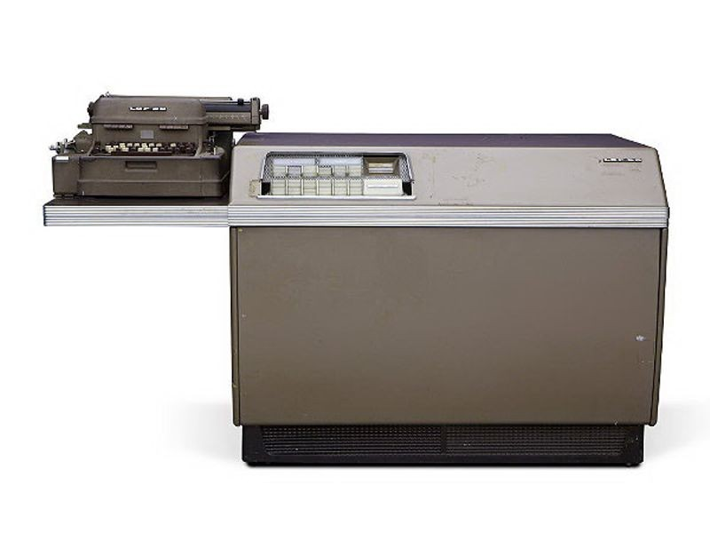
List All Processes in Current Shell
Help function
PID: The process ID number of the process.
TTY (Teletypewriter): The name of the console that the user is logged in at.
TIME: The amount of CPU processing time that the process has used.
CMD: The name of the command that launched the process
Notes:
https://itsfoss.com/content/images/wordpress/2021/12/LGP-30-early-computer-1956.jpg

Slide 6
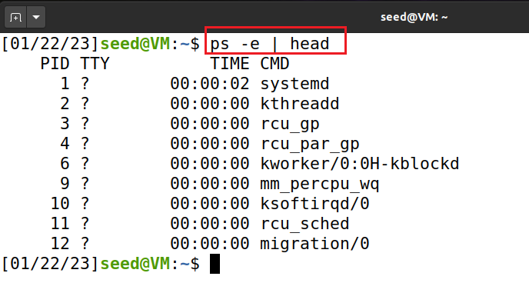
Listing (selecting all) Process for All Users
not started from a terminal window.

Slide 7
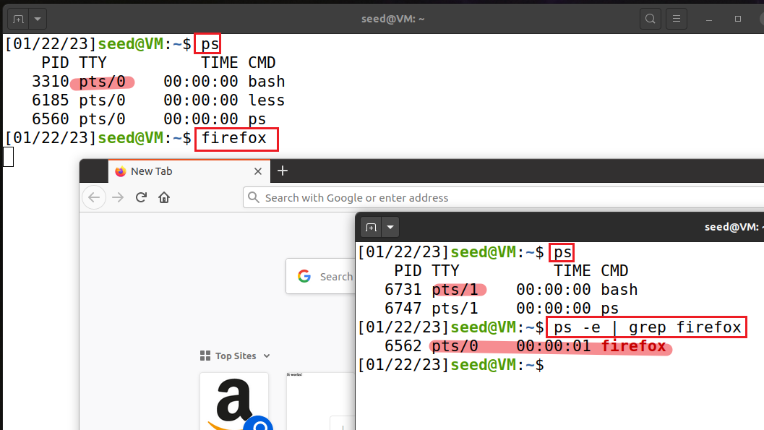
Listing Processes by Name (Firefox). Firefox is launched in tty0 and observed in tty1

Slide 8
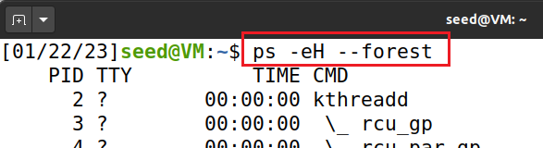
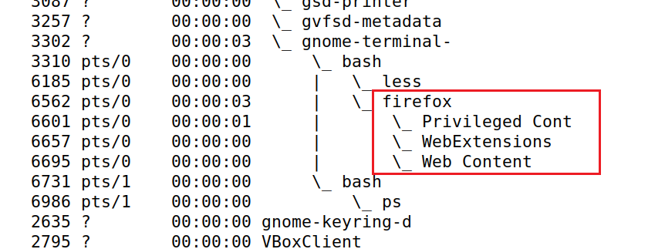
Showing Process Hierarchy as a tree

Slide 9
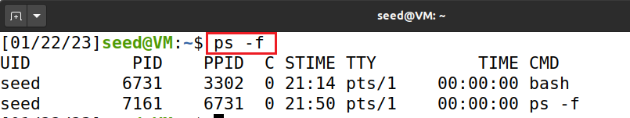
Showing full-format
UID: The user ID of the owner of this process.
PID: The process ID of the process.
PPID: Parent process ID of the process.
C: The number of children the process has.
STIME: Start time. The time when the process commenced.
TTY: The name of the console that the user is logged in at.
TIME: The amount of CPU processing time that the process has used.
CMD: The name of the command that launched the process.

Slide 10
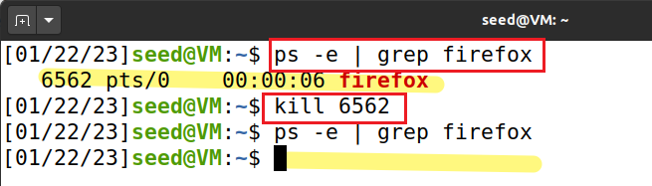
Kill a process

Slide 11
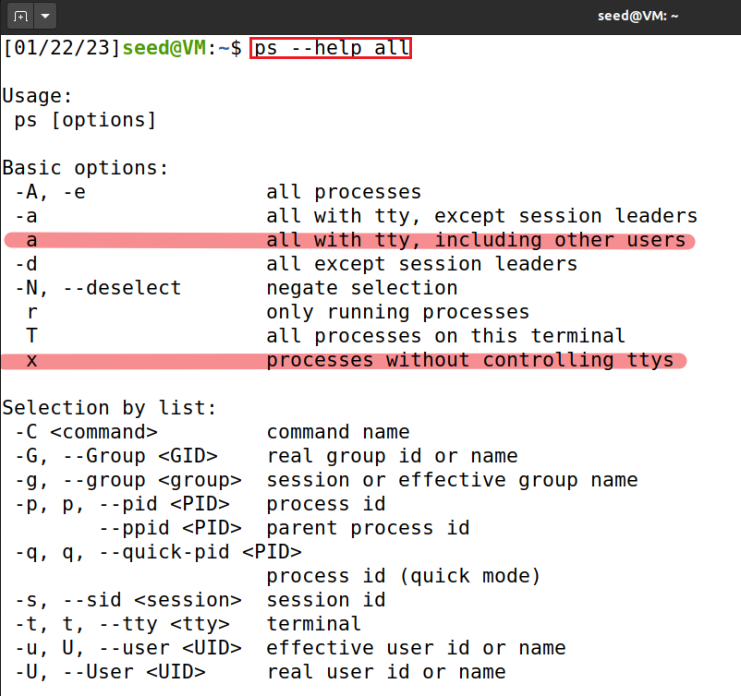
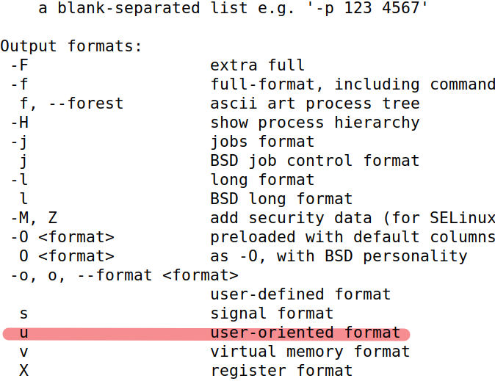
ps aux/-aux displays the most amount of information a user usually needs to understand the current state of their system’s running processes

Slide 12
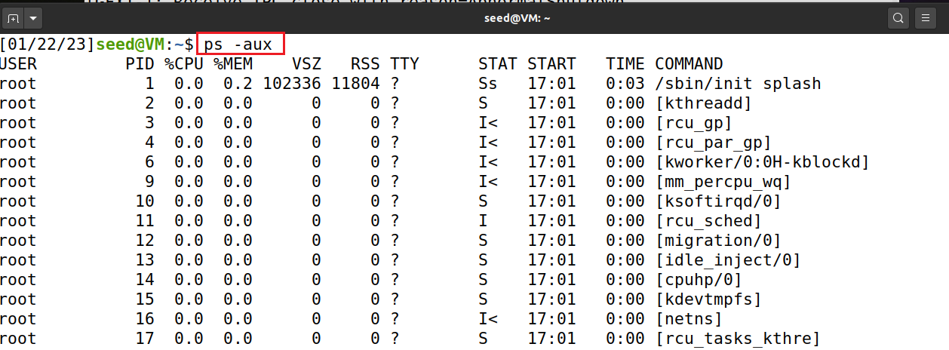
UNIX-style option: MUST has -
BSD-style options: ps aux without -
sate information

Slide 13
Analyze network ports used by Morris Worm

Slide 14
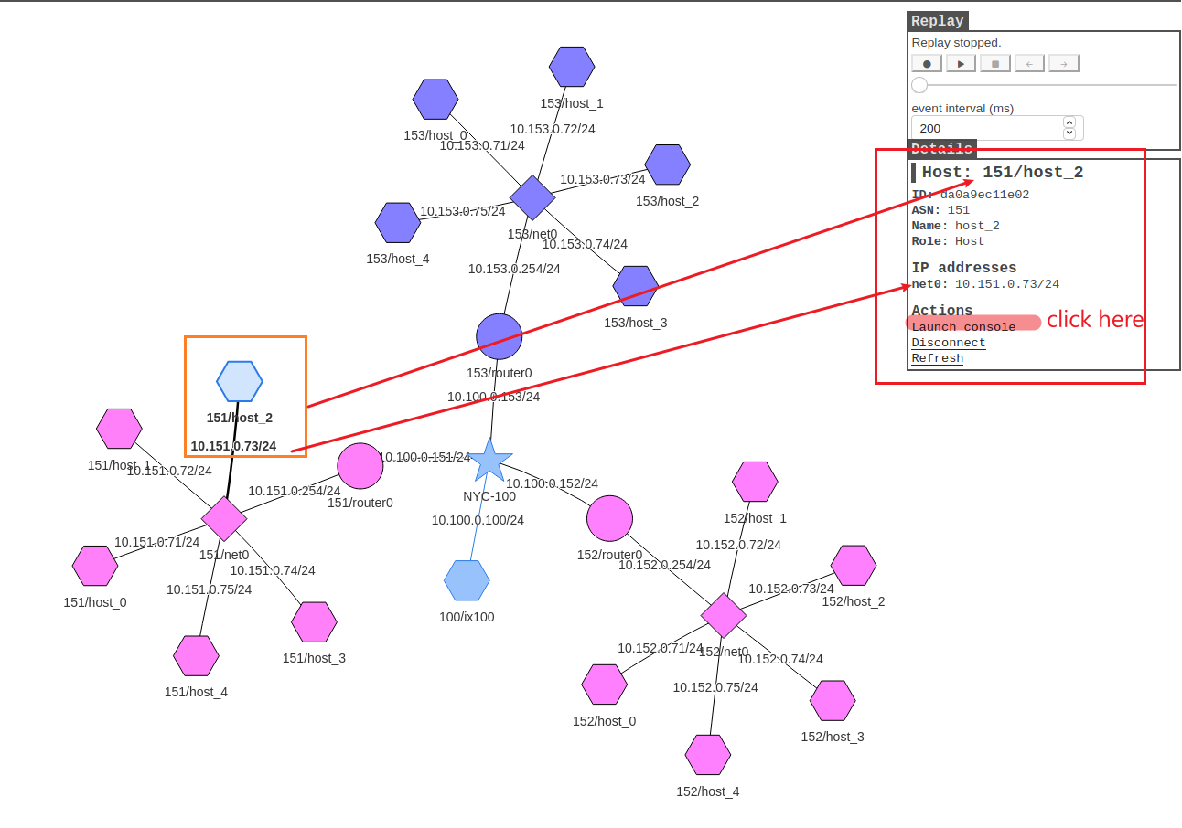

Slide 15
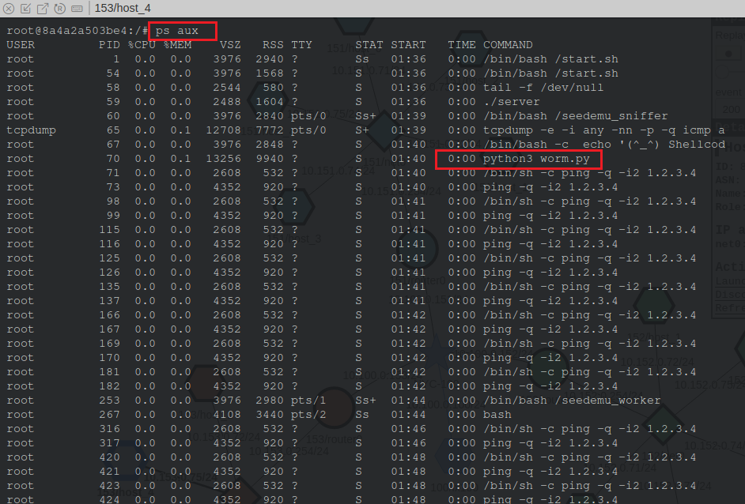
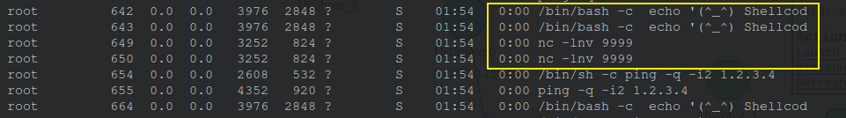
Check processes
s: a session leader (i.e., the root process).
S: an interruptible sleep state, and is waiting for some event
worm.py process
listening to port 9999

Slide 16
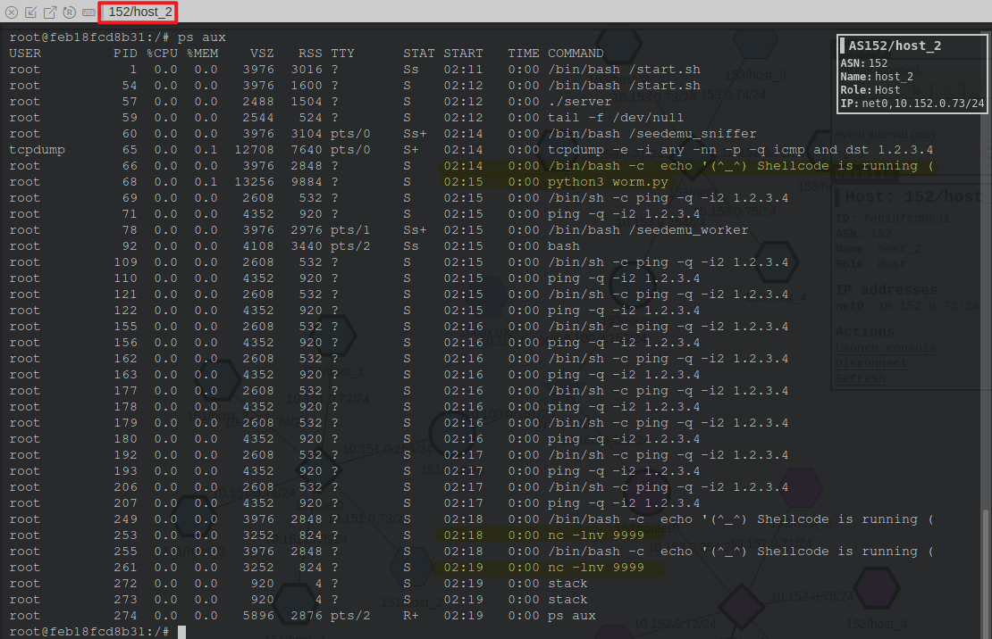
Another machine

Slide 17
Analyze worm running processes

Slide 18
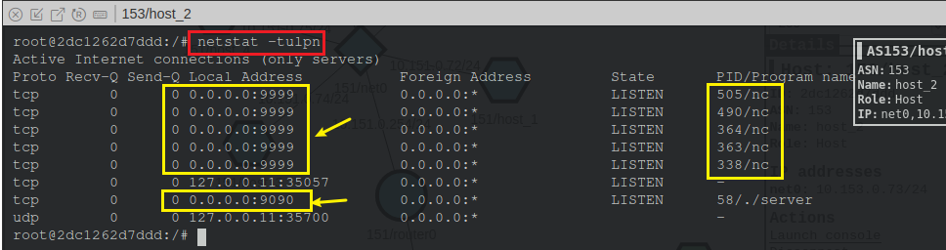
What ports are listening?
nc command
listen to port 9999
Notes:
netstat -tulpn | grep LISTEN

Slide 19
Create a timeline with file timestamps

Slide 20
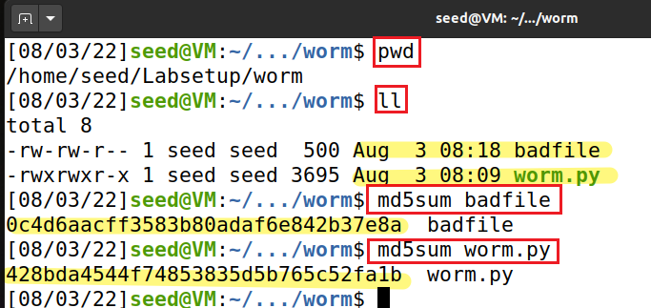
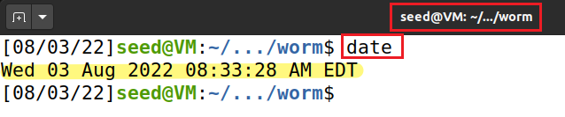
Check attack files hash code
Check time zone
The investigation date/EDT

Slide 21
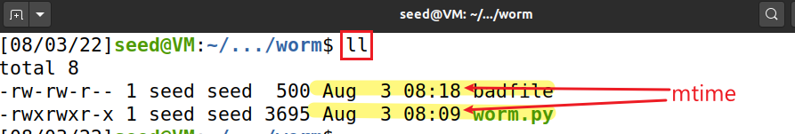
Check time stamps
Changes C
 | File Contents are Modified | Metadata is Modified | File Accessed | Command to Use
mtime | C |  |  | ls -l or stat
ctime |  | C |  | ls -cl or stat
atime |  |  | C | ls -ul or stat
Note that changes of mtime may change ctime and atime as well.

Slide 22
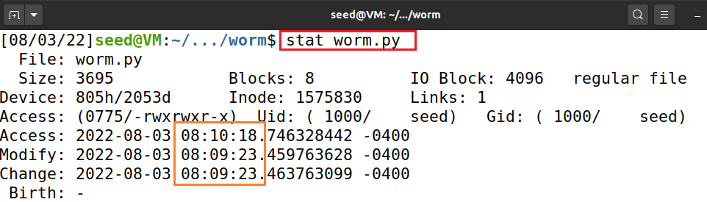
Check time stamps of worm.py
worm.py
A user changed content on 2022-8-3 08:09:23
Accessed on 55 second later (e.g., read file)

Slide 23
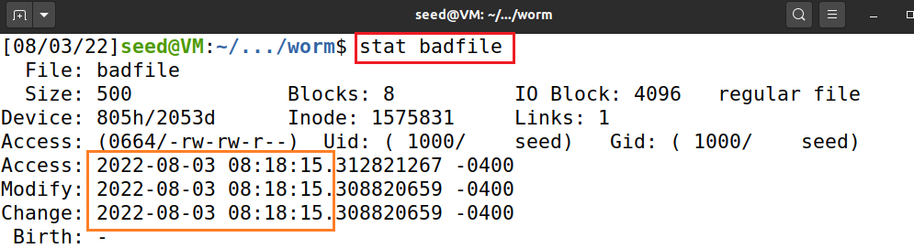
Check time stamps of badfile
badfile
created on 2022-08-03 08:18:15
because badfile was created
worm.py last time modified
worm.py was read
worm.py was executed
2022-8-3 08:09:23
08:10:18AM
08:18:15AM

Slide 24
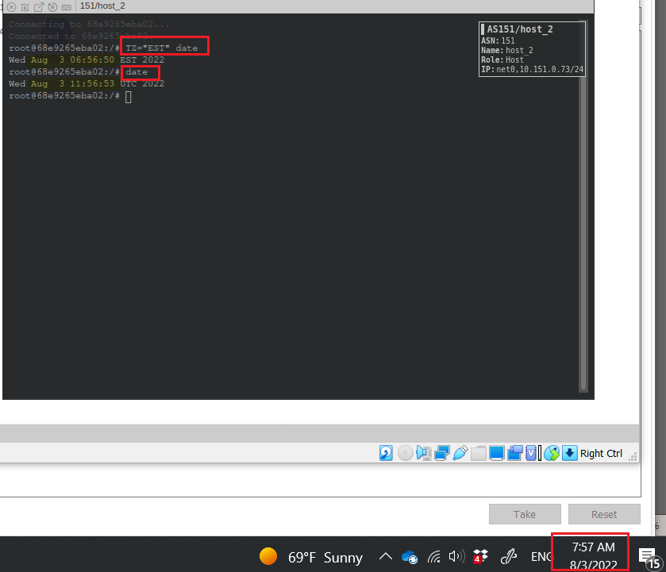
The server time is incorrect! One hour late.
Notes:
5 hours

Slide 25
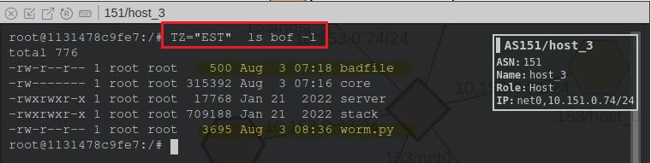
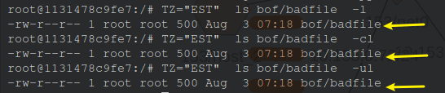
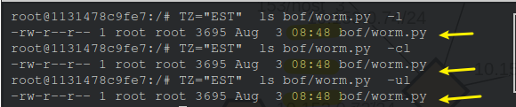
remember +1 hour
Notes:
TZ=“EST” ls bof -l

Slide 26




Attack Machine
Victim Machine
worm.py (the first time) was received/executed
worm.py (again) was received /executed/stopped
worm.py (the last time) was modified
worm.py was read
worm.py was executed
badfile was created
2022-8-3 08:09
08:10AM
09:36AM
~08:18AM
overwrites

Slide 27
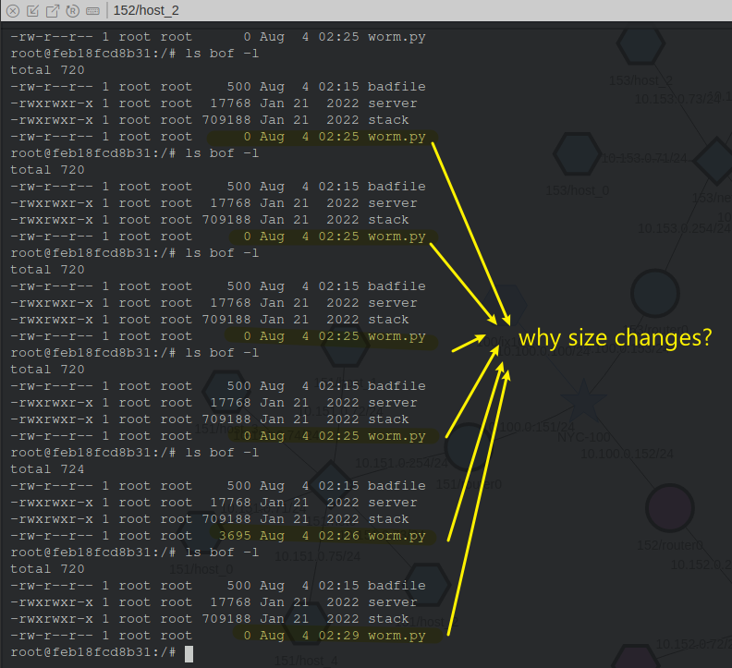
Question

