Slide 1
Email Traffic Forensics
DNS, SMTP
Traffic files: https://github.com/frankwxu/digital-forensics-lab/tree/main/Illegal_Possession_Images/lab_files/smtp.pcap
Notes:
https://www.youtube.com/watch?v=6G3qm60dfA8&ab_channel=PrashantThombre

Slide 2
Overview
Domain Name System to find the email server’s IP address
Simple Mail Transfer Protocol
Hands-on lab
Using MS Outlook email client

Slide 3
Domain Name System
find the email server IP address

Slide 4
Domain Name System (DNS)
Motivation
IP numbers are difficult to remember
Need easy-to-remember domain names
Solution: DNS
Translate human-readable domain names
www.example.com => 192.0.2.1
Think about how your computer or tablet knows where to find your favorite websites like YouTube or Roblox?
That's where DNS comes in!

Slide 5
DNS like a phone book for the internet
Just like how you can look up your friend's phone number in a phone book to call them
your computer or tablet uses DNS to look up the address of a website you want to visit on the internet.
When you type in the name of a website like YouTube
your computer or tablet sends a message to a special computer called a DNS server.
The DNS server looks up the address of YouTube and sends it back to your computer or tablet.
Then, your computer or tablet uses that address to find YouTube and show you all your favorite videos!
So, the next time you use the internet, remember that DNS is working behind the scenes to make it all possible!

Slide 6
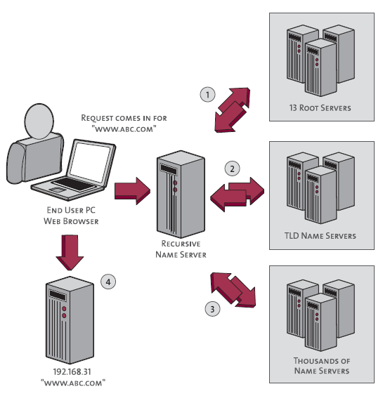
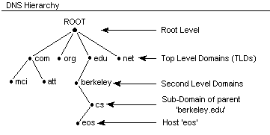
DNS is a hierarchical naming system
https://www.inetdaemon.com/tutorials/internet/dns/operation/hierarchy.shtml
https://www.pingdom.com/blog/a-visual-explanation-of-how-dns-lookups-work/

Slide 7
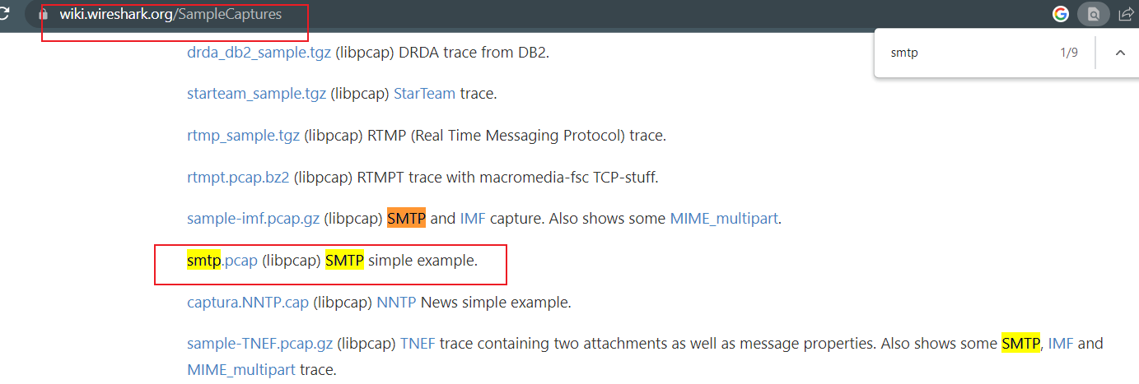
Lab Files
https://wiki.wireshark.org/SampleCaptures

Slide 8
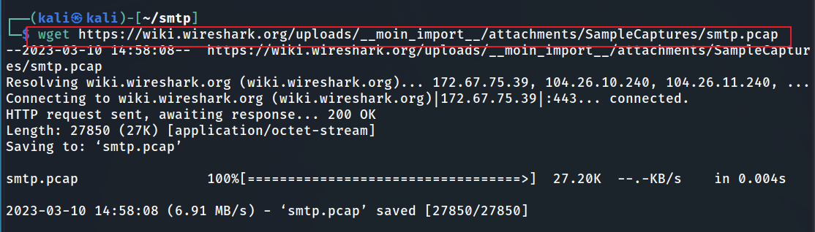
Download smtp.pcap
Notes:
wget https://wiki.wireshark.org/uploads/__moin_import__/attachments/SampleCaptures/smtp.pcap

Slide 9
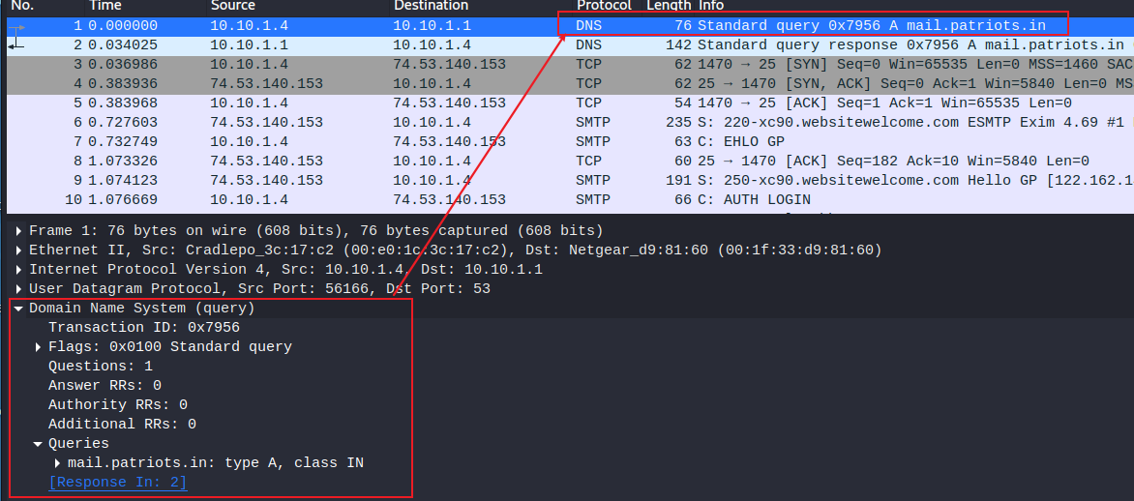





DNS query
Router, please find the IP of mail.patriots.in
Application layer protocol
asking it to return the IPv4 (Type A) address associated with a given domain name, using the Internet namespace (Class IN).

Slide 10
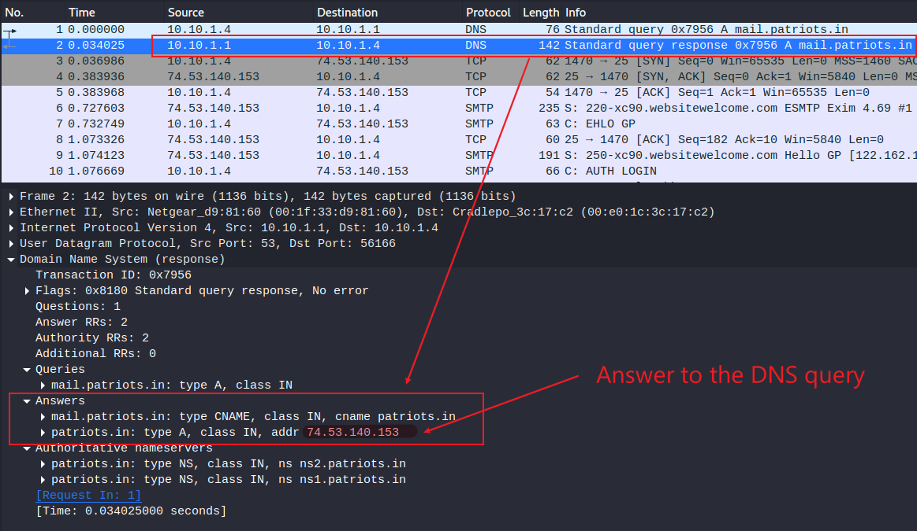
DNS query response

Slide 11
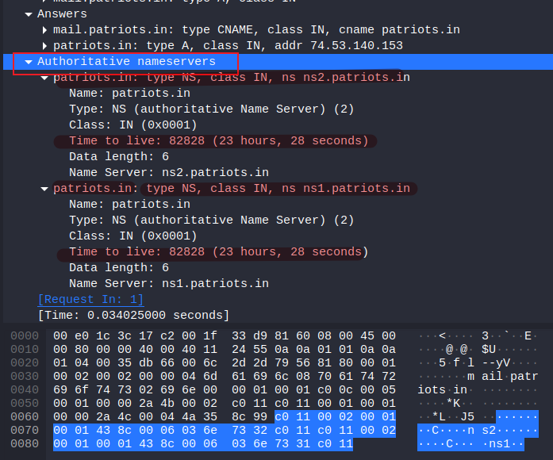
Authoritative nameservers =authoritative DNS servers
Answer from the router DNS caching
The original and official information about a domain name from ns1.patriots.in or ns1.patriots.in.
The DNS entry will expire
Possible DNS attack

Slide 12
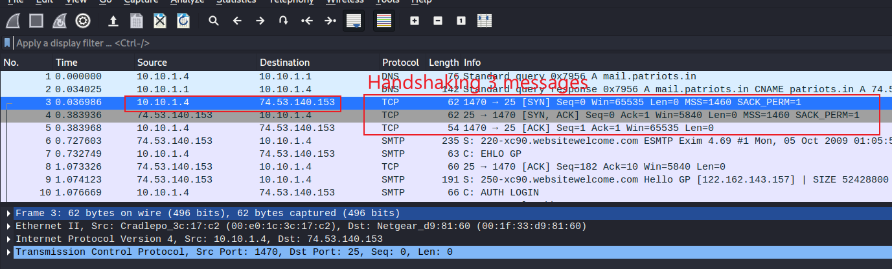
Handshaking (SYN, [SYN, ACK], ACK)

Slide 13
Simple Mail Transfer Protocol

Slide 14







Simple Mail Transfer Protocol (SMTP)
It is a protocol used for sending and receiving email messages over the Internet.
SMTP
SMTP
IMAP
SMTP (Simple Mail Transfer Protocol): sending emails
IMAP (Internet Access Message Protocol): download emails

Slide 15
Simple Mail Transfer Protocol
SMTP operates on port 25 by default, but other ports such as 587 and 465 may also be used.
SMTP uses a set of commands and responses to transfer email messages between clients and servers.
SMTP is a plain text protocol
data transmitted between clients and servers is not encrypted by default.
SMTPS for secure email transmissions
SMTP over SSL/TLS
STARTTLS

Slide 16
SSL/TLS
SSL (Secure Sockets Layer) and TLS (Transport Layer Security) are cryptographic protocols that provide secure communication over the internet.
SSL is the predecessor to TLS, and is no longer considered secure.
Key security features
Authentication: SSL and TLS provide mechanisms for authenticating the identity of the client and server, so that both parties can be sure they are communicating with the intended party.
Data encryption: SSL and TLS encrypt data transmitted over the internet, so that it cannot be intercepted and read by unauthorized parties.
Data integrity: SSL and TLS ensure the integrity of data transmitted over the internet, so that it cannot be modified in transit without detection.

Slide 17
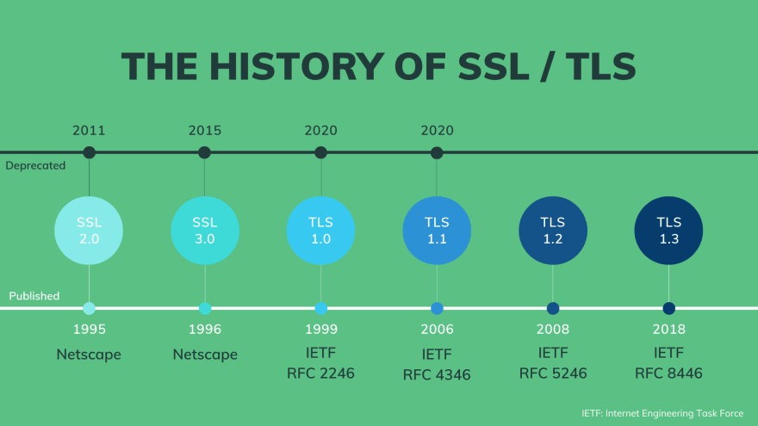
https://dev.to/techschoolguru/a-complete-overview-of-ssl-tls-and-its-cryptographic-system-36pd

Slide 18
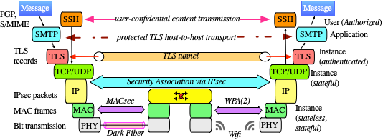
SMTP is an application layer protocol
https://www.fehcom.de/qmail/smtptls.html

Slide 19
Hands-on Lab

Slide 20
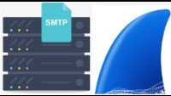
Capture Emails traffic With Wireshark

Slide 21
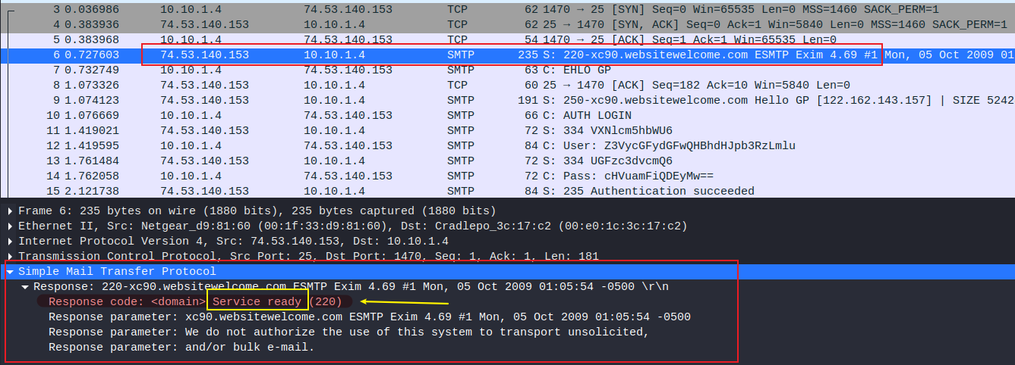
SMTP first response “service ready”
indicates that
the device is running an SMTP server and is ready to receive email messages.
additional information about the server and a warning that the server does not authorize the use of its system to send unsolicited or bulk emails.

Slide 22
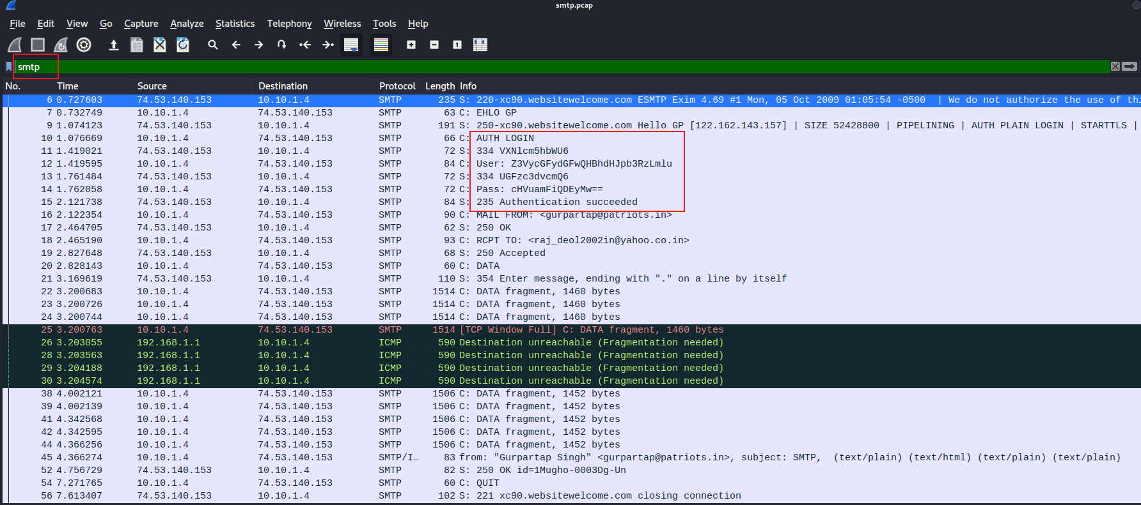
Username and password are base64 encoded

Slide 23
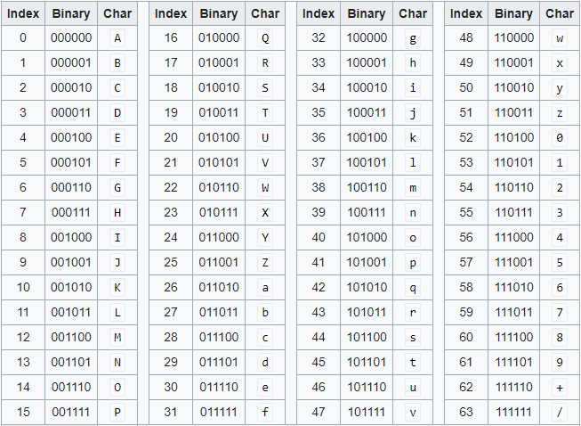
What is Base64 encoding
Base64 encoding is a way to represent binary data in a text format.
It is often used in email messages, HTML pages, and other types of text-based communication to transfer binary data such as images, audio files, or other types of non-text data.

Slide 24
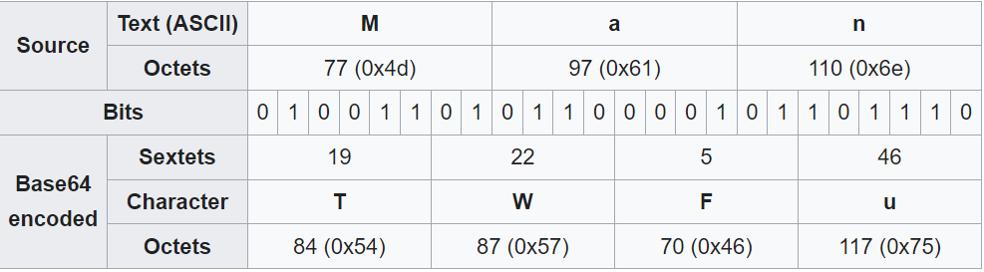
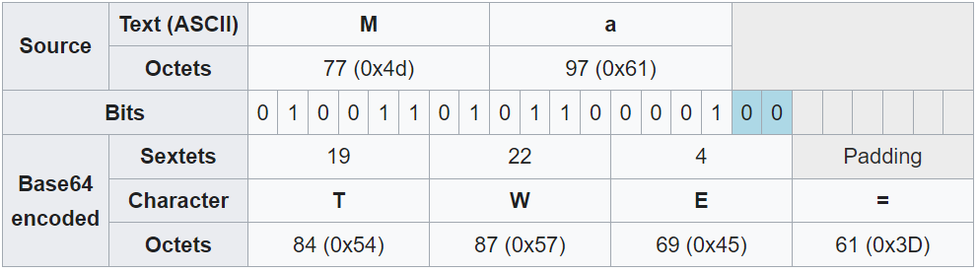
Conversion

Slide 25
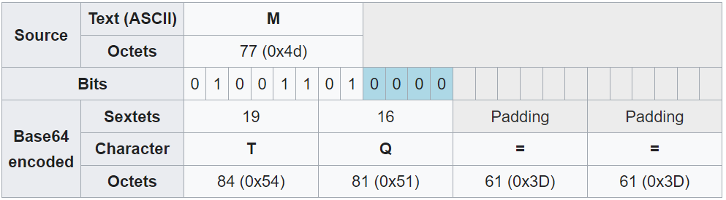

Slide 26
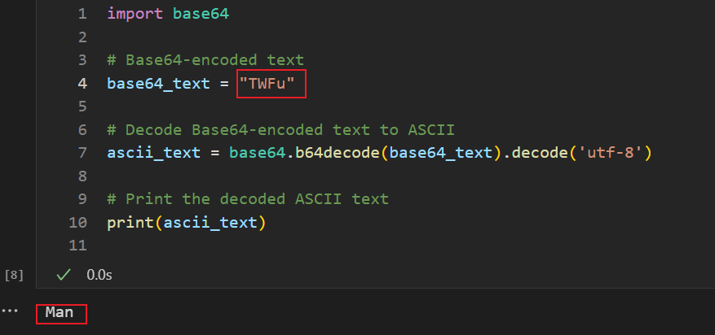
Decoding Based64 to text

Slide 27
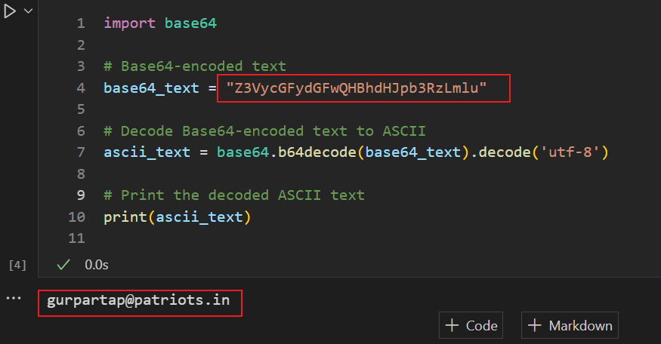
Decoding username
Notes:
import base64
# Base64-encoded text
base64_text = "Z3VycGFydGFwQHBhdHJpb3RzLmlu"
# Decode Base64-encoded text to ASCII
ascii_text = base64.b64decode(base64_text).decode('utf-8')
# Print the decoded ASCII text
print(ascii_text)

Slide 28
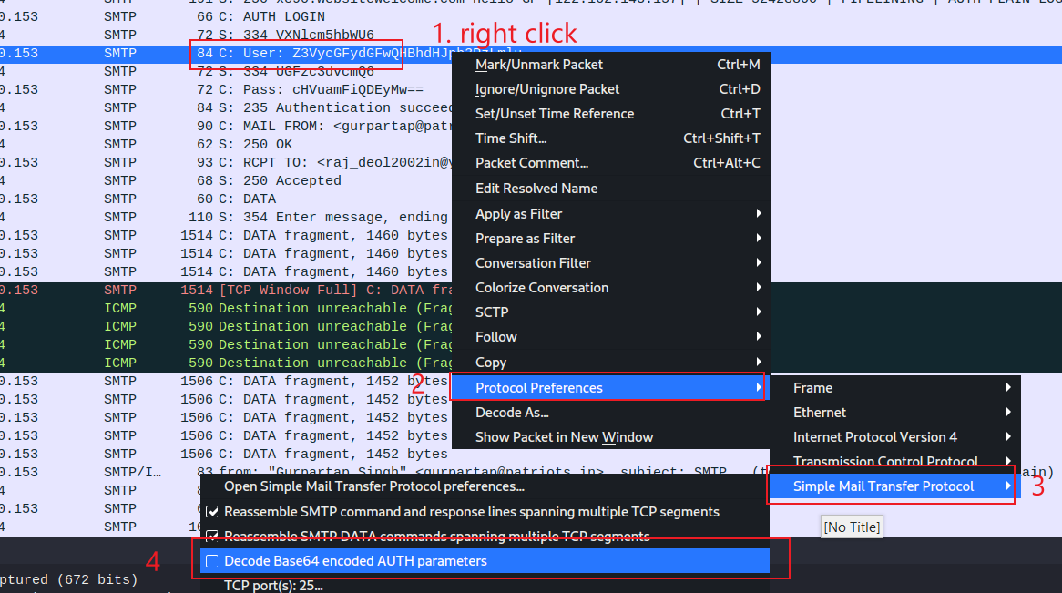

Slide 29
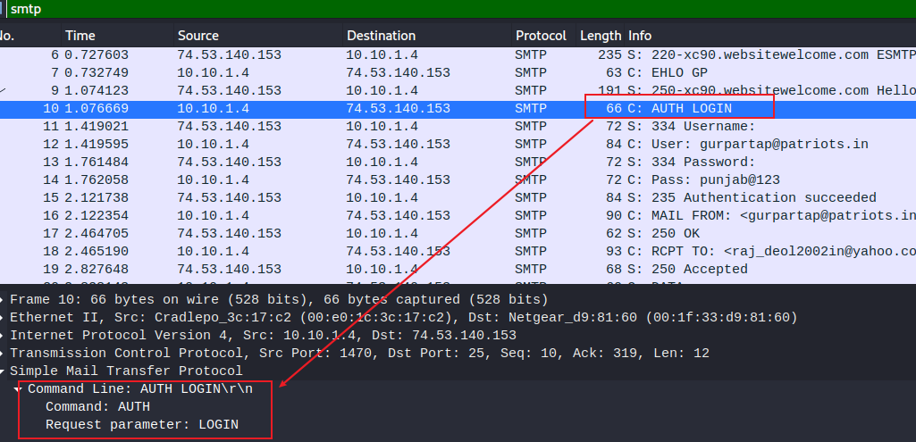

Slide 30
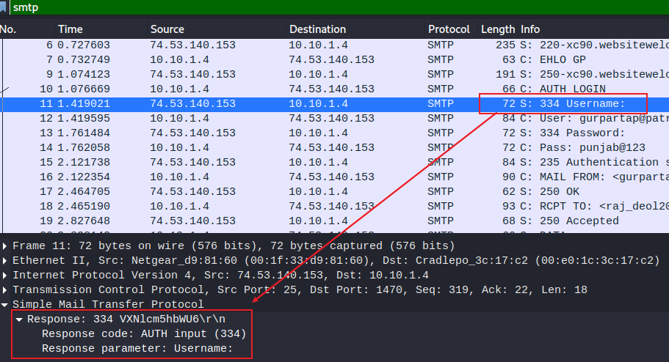

Slide 31
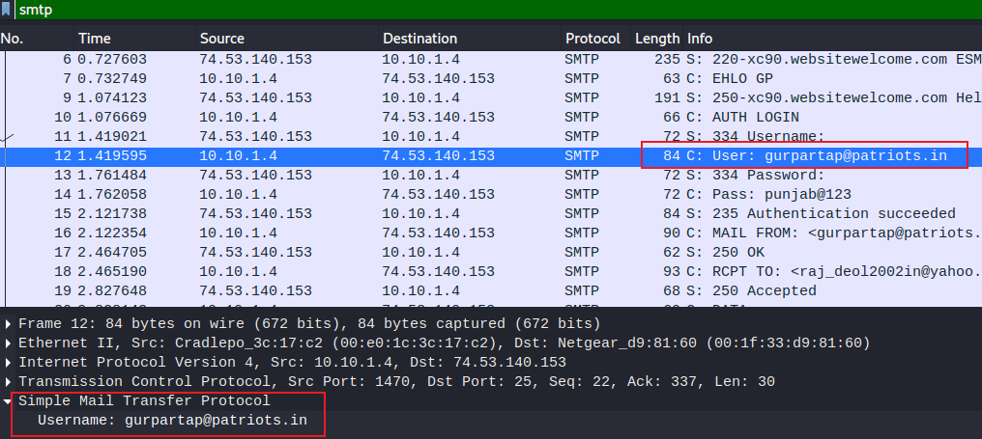

Slide 32
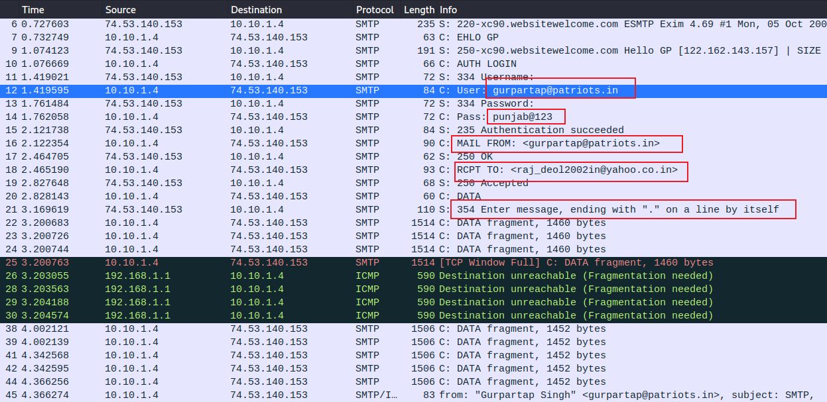
ignore them

Slide 33
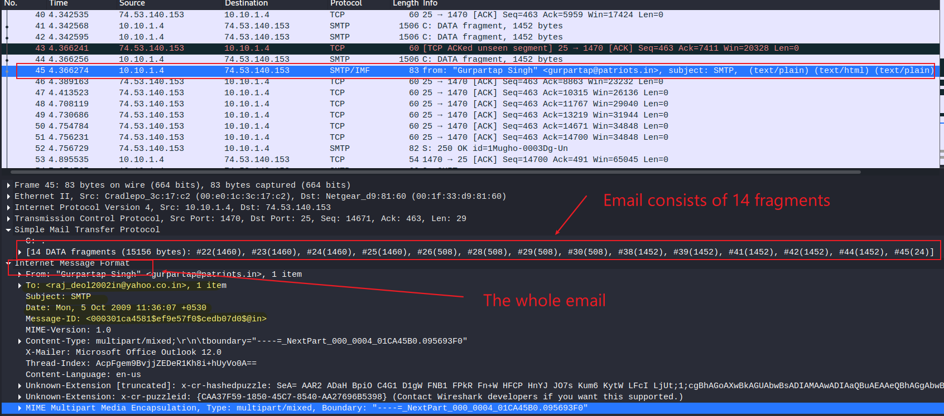
Show email content (14 fragments, Wireshark reassemble them at 45)
email client: office outlook 12.0

Slide 34
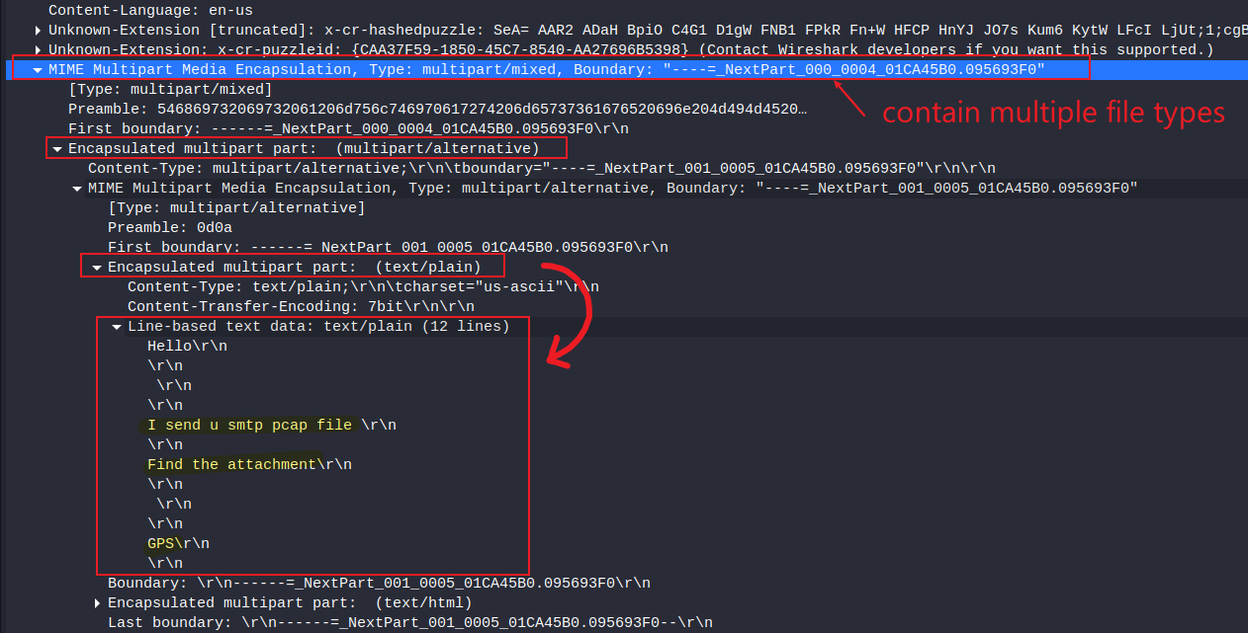
Show email content (text content)
first part

Slide 35
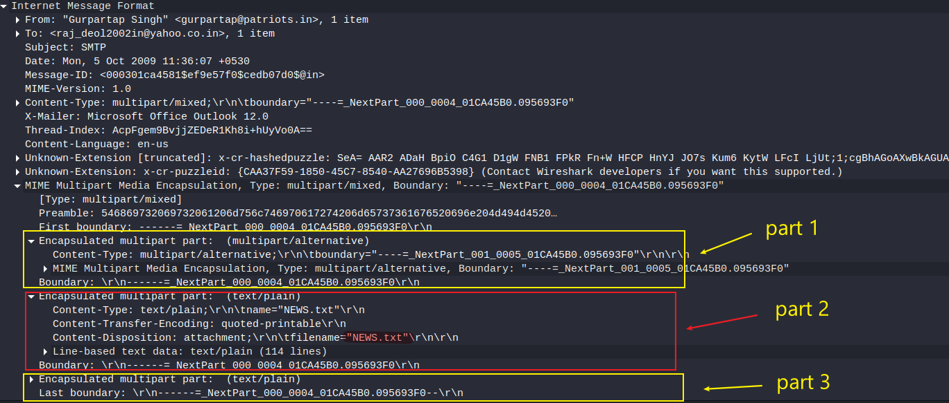

Slide 36
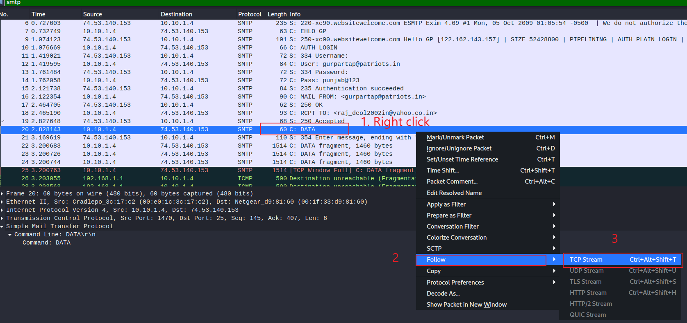
Show email content (Alternative approach: follow TCP)

Slide 37
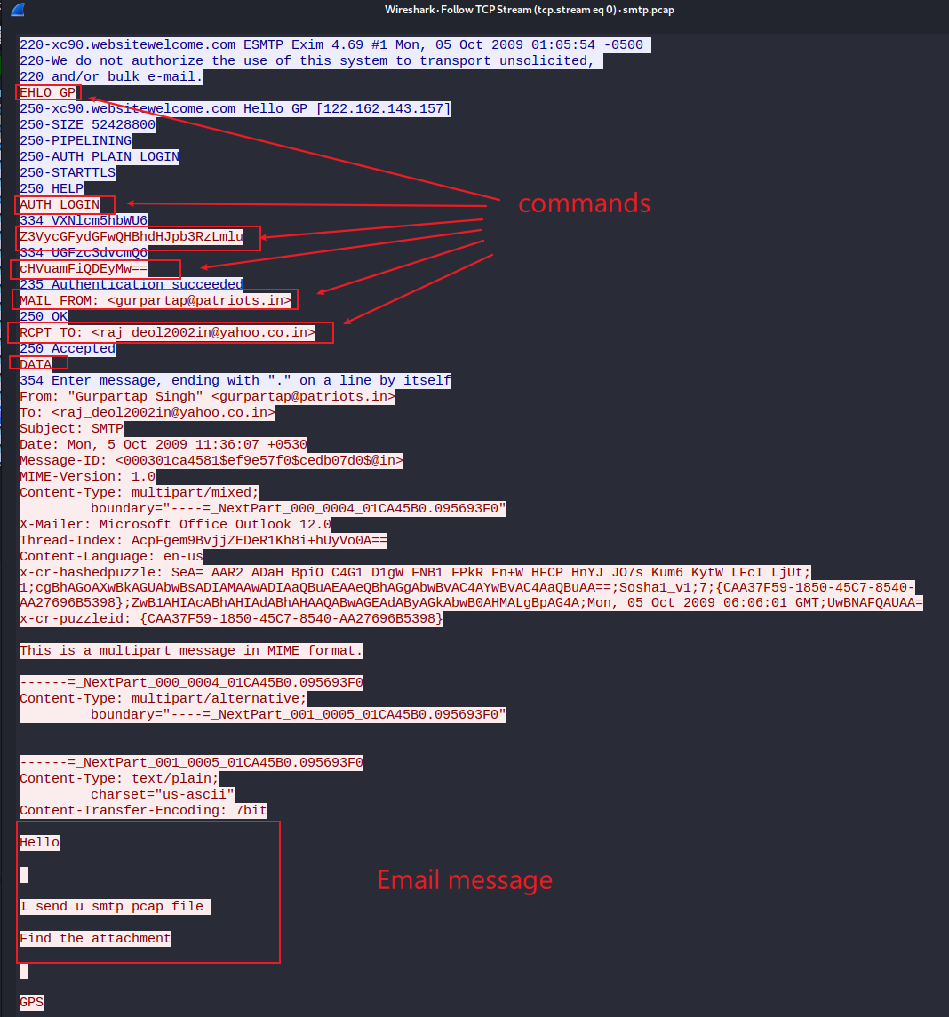

Slide 38
Questions you need to answer
When did it happen?
the timestamps email
The email client
outlook
The content of the email
multiple parts
What was the approach?
ports (sender and receiver)
IP addresses (sender and receiver)
Mac addresses (sender and receiver)

Slide 39
Extra credits
Sniff SMTP traffic

