Slide 1
List Image Partitions

Slide 2
Require Plaso
Plaso is a Python-based engine used by several tools for automatic creation of timelines.
Plaso uses a list of wrappers to access the C library.
Example: Python binding for The Sleuth Kit (TSK)
TSK is a collection of forensic tools for analyzing disk images and file systems.
The wrappers are provided by pytsk3, a Python binding for TSK.
pytsk3 allows Plaso to use TSK functions in Python code.
We use Python bindings to process the information we needed

Slide 3
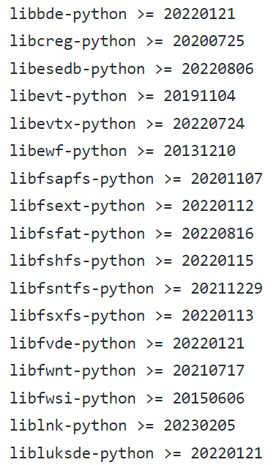
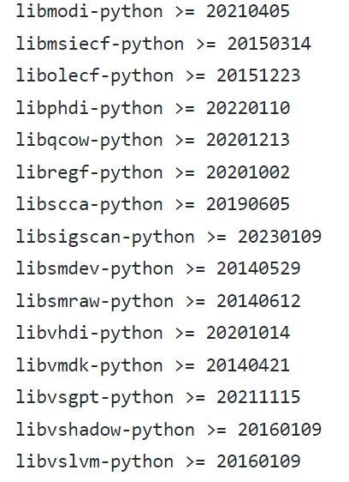
Other Python Bindings
https://github.com/log2timeline/plaso/blob/main/requirements.txt
Notes:
python3 list_partitions.py cfreds_2015_data_leakage_pc.dd

Slide 4
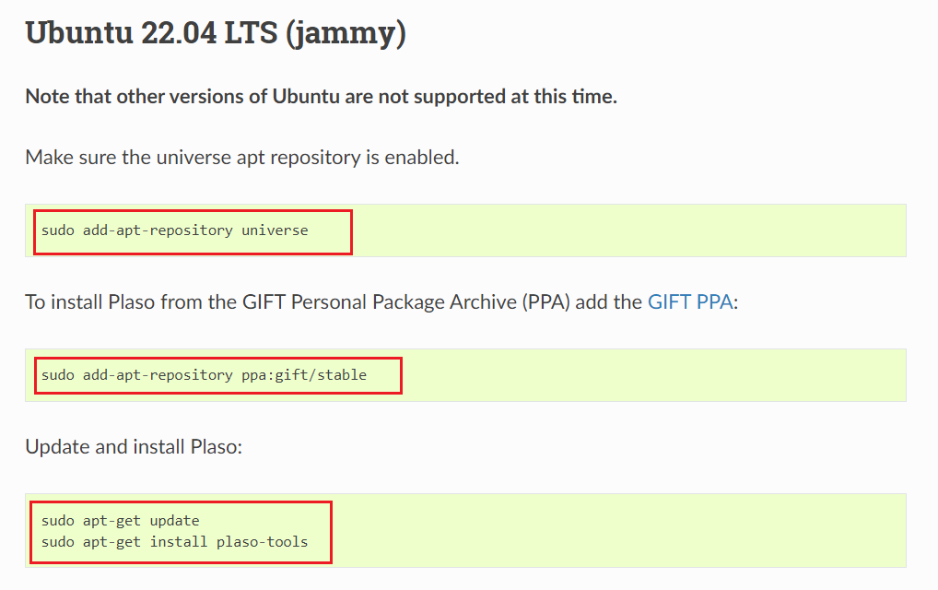
Prerequisite: Installing Plaso on Ubuntu
https://plaso.readthedocs.io/en/latest/sources/user/Ubuntu-Packaged-Release.html
Notes:
sudo add-apt-repository universe
sudo add-apt-repository ppa:gift/stable
sudo apt-get update sudo apt-get install plaso-tools

Slide 5
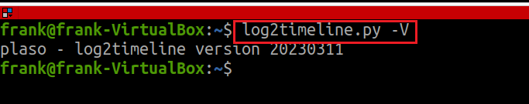
Test Plaso
Show version of Plaso
Notes:
log2timeline.py -V

Slide 6

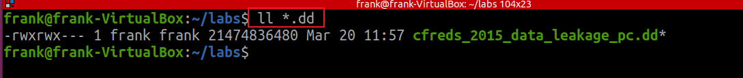
Get a dd image
Follow the PPT to get a dd image to the folder
https://github.com/frankwxu/digital-forensics-lab/blob/main/NIST_Data_Leakage_Case/NIST_Data_Leakage_00_Env_Setting.pptx

Slide 7
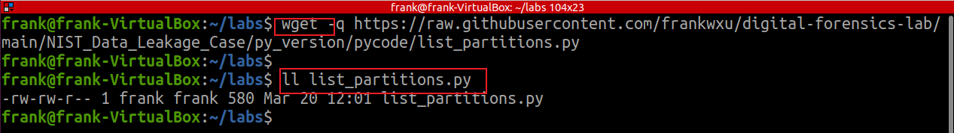
Notes:
wget -q https://raw.githubusercontent.com/frankwxu/digital-forensics-lab/main/NIST_Data_Leakage_Case/py_version/pycode/list_partitions.py

Slide 8
