Slide 1
Wine Installation

Slide 2
Wine
An acronym for "Wine Is Not an Emulator"
A compatibility layer capable of running Windows applications
on several POSIX-compliant operating systems, such as Linux, macOS, & BSD.
Instead of simulating internal Windows logic like a virtual machine or emulator,
Wine translates Windows API calls into POSIX calls on-the-fly, eliminating the performance and memory penalties of other methods and allowing you to cleanly integrate Windows applications into your desktop.

Slide 3
Install Commands
wget https://dl.winehq.org/wine/wine-mono/5.1.1/wine-mono-5.1.1-x86.msi
sudo apt-get install winetricks
winetricks
wine uninstaller (optional)

Slide 4


Download Wine
Install
Run

Slide 5
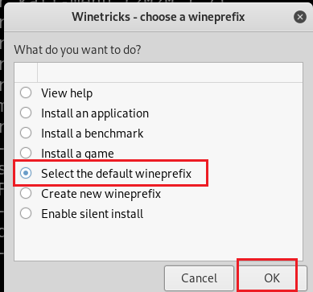
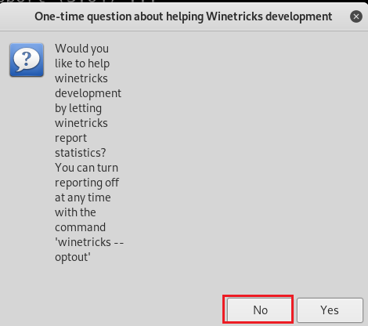

Slide 6
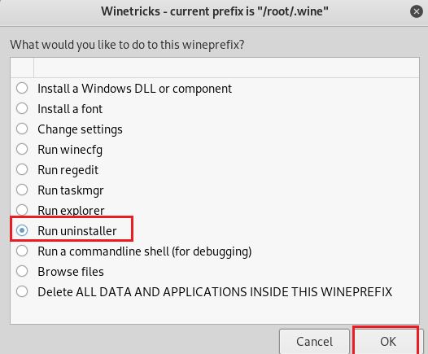
It is weird you will see the screen a few time. You can click cancel

Slide 7
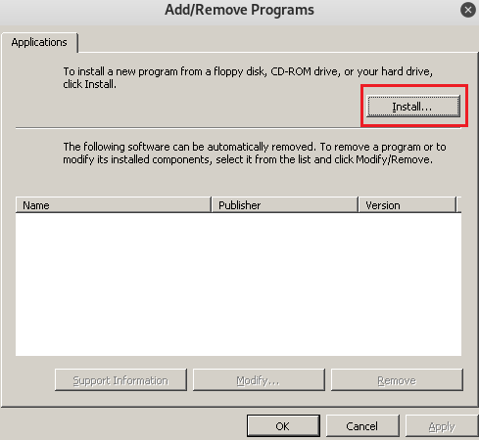
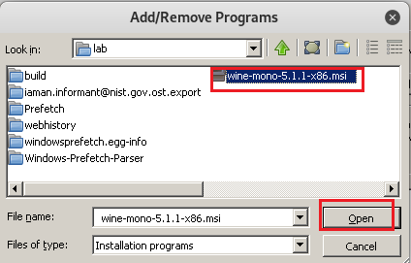

Slide 8
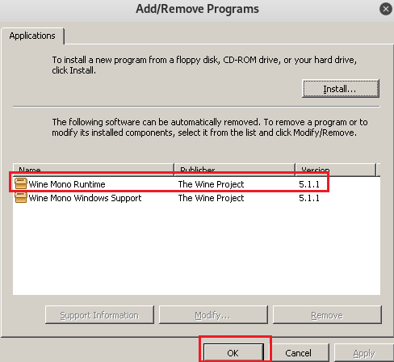
It is weird you will see the screen a few times. You can click cancel

Slide 9
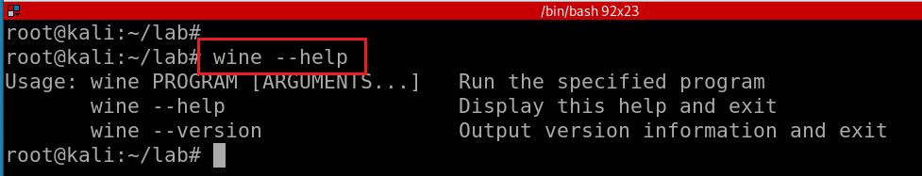
Test wine installation

