Slide 1
Investigate Data Leakage Case
Keywords: USN Journaling
Notes:
http://xmlstar.sourceforge.net/doc/UG/

Slide 2
23. Identify all traces related to ‘renaming’ of files in Windows Desktop.
Backup whole volume is time consuming
Solution: only save changed files -> keep tracking of changed files
Doesn’t need to include the details of data changes
USN (Update Sequence Number) Journal
Is a feature of the Windows NT file system (NTFS)
Records all files changes (e.g.., rename) that are made to volume
Changes are described using bit flags
From Win7, Journal Function is activated by default
USN is a treasure trove of information for a forensic investigation.
Keep track of suspect’s behaviors to volumes
Notes:
https://en.wikipedia.org/wiki/USN_Journal#:~:text=The%20USN%20Journal%20(Update%20Sequence,the%20NTFS%20file%20system%20journaling.

Slide 3
Format of record of USN Journal
Time of change
Reason for the change
File/directory’s name
File/directory’s attributes
File/directory’s MFT record number
File record number of the file’s parent directory
Security ID
USN of the record
Information about the source of the change

Slide 4
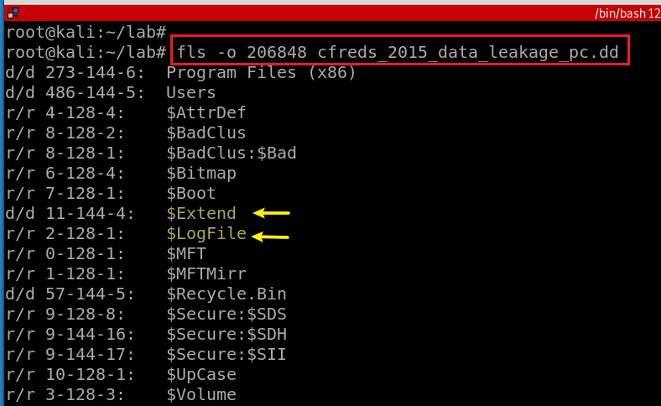
USN Journal location $Extend
Notes:
fls -o 206848 cfreds_2015_data_leakage_pc.dd

Slide 5
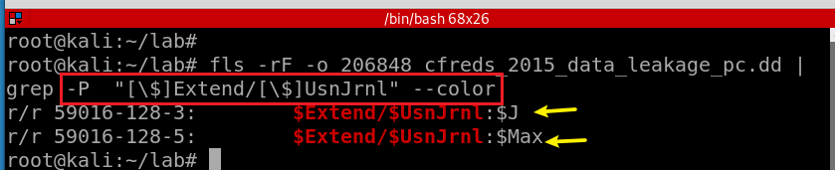
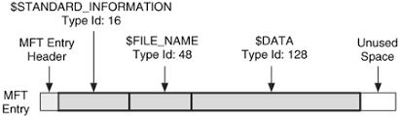
$Extend\$UsnJrnl contains two alternate data streams
Search for $Extend\$UsnJrnl
[ ]: Match a single character
$J: The actual change log records: the date and time of the change, the reason for the change, the Master File Table (MFT) entry, the parent entry and others.
$Max: The meta data of change log: e.g., the maximum size.
Notes:
fls -rF -o 206848 cfreds_2015_data_leakage_pc.dd | grep -P "[\$]Extend/[\$]UsnJrnl" --color
https://countuponsecurity.com/tag/ntfs-logfile/

Slide 6
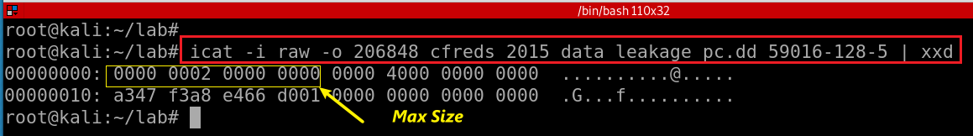
$Extend\$UsnJrnl: $Max attribute
Offset | Size | Stored | Information Detail
0x00 | 8 | Maximum Size | The maximum size of Journaling data
0x08 | 8 | Allocation Size | The size of allocated area when new log data is saved.
0x10 | 8 | Time | The creation time of "$UsnJrnl" file(FILETIME)
0x18 | 8 | Lowest Valid USN | The least value of USN in current records With this value, investigator can approach the start point of first record within "$J" attribute
Notes:
icat -i raw -o 206848 cfreds_2015_data_leakage_pc.dd 59016-128-5 | xxd
http://forensicinsight.org/wp-content/uploads/2013/07/F-INSIGHT-Advanced-UsnJrnl-Forensics-English.pdf

Slide 7
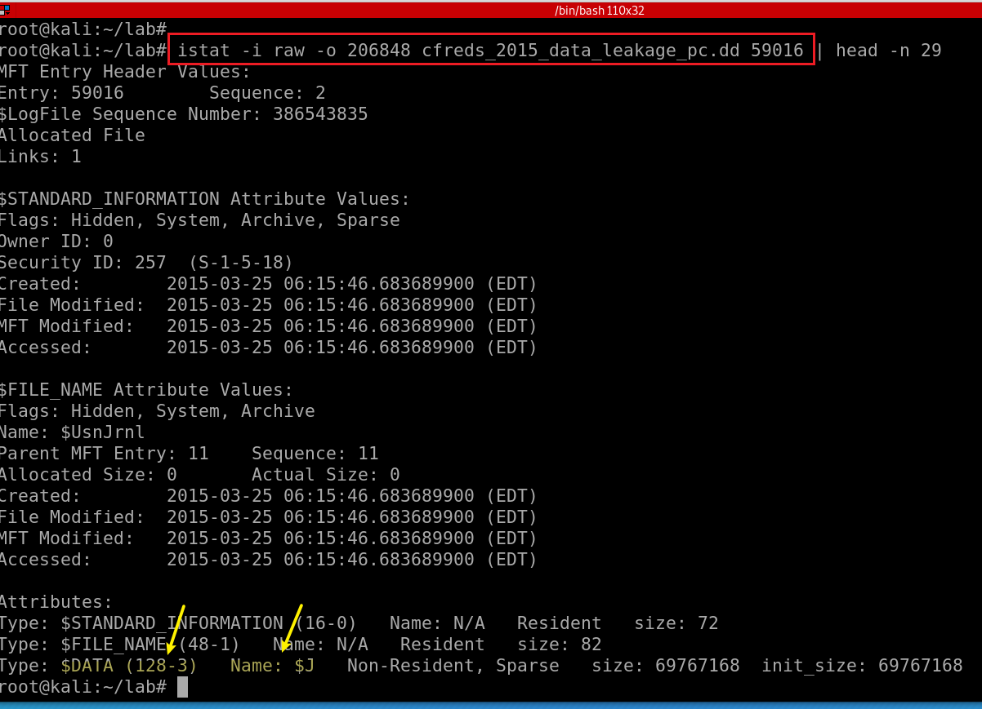
View $Extend\$UsnJrnl: $J $MFT Entry
uncommon timestamp notations
Modification ( M )
Access ( A )
Created ( C )
Entry Modified ( E )
MFT File Reference Number (8 bits) =
MFT Entry (inode #, 6 bits): 59016 +
MFT sequence (Number of times this mft record has been reused 2 bits): 2
$STD timestamp
can be modified by user/application-level processes.
Easy to be changed for anti-forensics
B/created/birth: when a file a birth/created
M/mtime: the last time the content a file has been changed
C/ctime: change time, is when the file's property changes
A/atime: access time, grep, cat
$FILE_NAME timestamps
can only be changed by the system kernel.
Difficult to be modified by users/application.
More important
shown in dir results
Anti-forensics indication: $FILE_NAME time occurs after the $STANDARD_INFORMATION Creation Time.
Notes:
istat -i raw -o 206848 cfreds_2015_data_leakage_pc.dd 59016 | head -n 29
https://jmharkness.wordpress.com/2011/01/27/mft-file-reference-number/
https://flatcap.org/linux-ntfs/ntfs/concepts/file_record.html
https://forensicswiki.xyz/wiki/index.php?title=MAC_times#:~:text=The%20term%20MAC%20times%20refers,ctime)%20of%20a%20certain%20file.&text=The%20latter%20refers%20to%20the,MFT%20entry%20itself%20was%20modified.

Slide 8
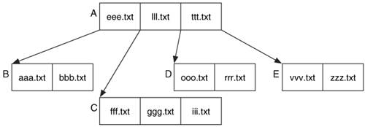
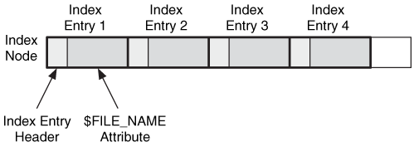
Which timestamp is used when list a directory using dir?
OS walks through a directory index containing references to child files and directories.
using directory index = performance
What is directory index?
is a B-Trees
includes $FILE_NAME
includes security information
$FILE_NAME in directory index in sync with $FILE_NAME in $MFT
a file is created, copied, moved to another volume.
Notes:
https://flylib.com/books/en/2.48.1/indexes.html
https://dfir.ru/2021/01/10/standard_information-vs-file_name/

Slide 9
MACB timestamps for different file systems
File System | M | A | C | B
Ext4 | Modified | Accessed | Changed | Created
Ext2/3 | Modified | Accessed | Changed | N/A
FAT | Written | Accessed | N/A | Created
NTFS | File Modified | Accessed | $MFT Modified | Created
UFS | Modified | Accessed | Changed | N/A
Notes:
https://forensixchange.com/posts/19_04_22_win10_ntfs_time_rules/#:~:text=The%20MACB%20timestamps%20are%20stored,%24STANDARD_INFORMATION%20and%20%24FILE_NAME%20attribute.&text=One%20important%20difference%20is%20that,changed%20by%20the%20system%20kernel.

Slide 10
General rules, but not always true because file operations may involve both app and system level APIs
Condition | Modified (is content modified?) | $MFT Modified? | Accessed (need to read file?) | Created (birth of a new file?)
When renaming a file | No | ? | No | No
When moving a file between folders | No | ? | No | No
When moving a file between disks or partitions | No | ? | Time of move | No
When copying a file | No | ? | Time of copy | Time of copy
When writing a new file | Time of creation | ? | Time of creation | Time of creation
When modifying an existing file | Time modified | ? | No | No
When accessing an existing file | No | ? | Updated within an hour if enabled, otherwise Preserved | No
On various operating systems the update of the access time can be disabled. This means when a file is accessed the atime in the corresponding file system entry is not updated.
HKEY_LOCAL_MACHINE\SYSTEM\CurrentControlSet\Control\FileSystem\NtfsDisableLastAccessUpdate
Notes:
https://forensicswiki.xyz/wiki/index.php?title=MAC_times#:~:text=The%20term%20MAC%20times%20refers,ctime)%20of%20a%20certain%20file.&text=The%20latter%20refers%20to%20the,MFT%20entry%20itself%20was%20modified.

Slide 11
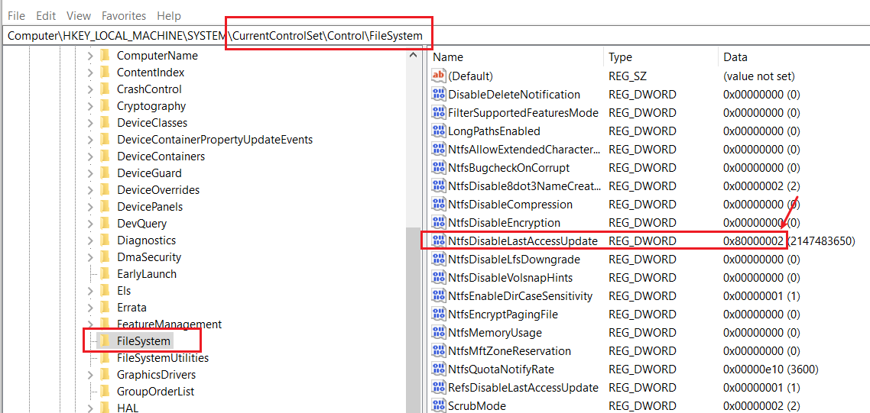
'User Managed’ mode
disabled: the last access time stamp remains unchanged during the boot, regardless of the volume size.
enabled: the OS changes it only when a user activity occur.
'System Managed' mode
disabled: completely disables the Last Access Time Stamp feature for NTFS
enabled: the last access time stamp is modified during the boot, once the OS mounts volumes. Windows 10 doesn't change it for large volumes (>128GB), it is a performance-maintenance trade off.
0 = User Managed, Last Access Updates Enabled
1 = User Managed, Last Access Updates Disabled
2 = System Managed, Last Access Updates Enabled (default)
3 = System Managed, Last Access Updates Disabled
Notes:
https://winaero.com/disable-ntfs-last-access-time-updates-in-windows-10/

Slide 12
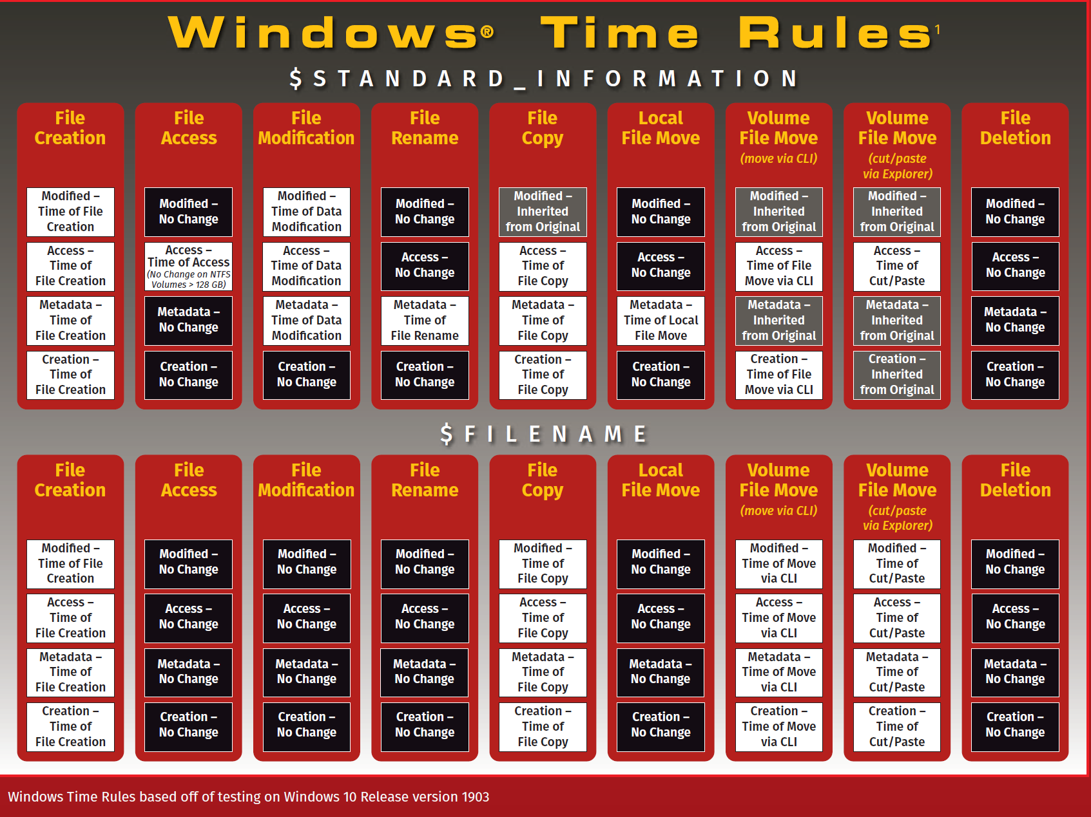
Notes:
https://www.sans.org/security-resources/posters/windows-forensic-analysis/170/download

Slide 13
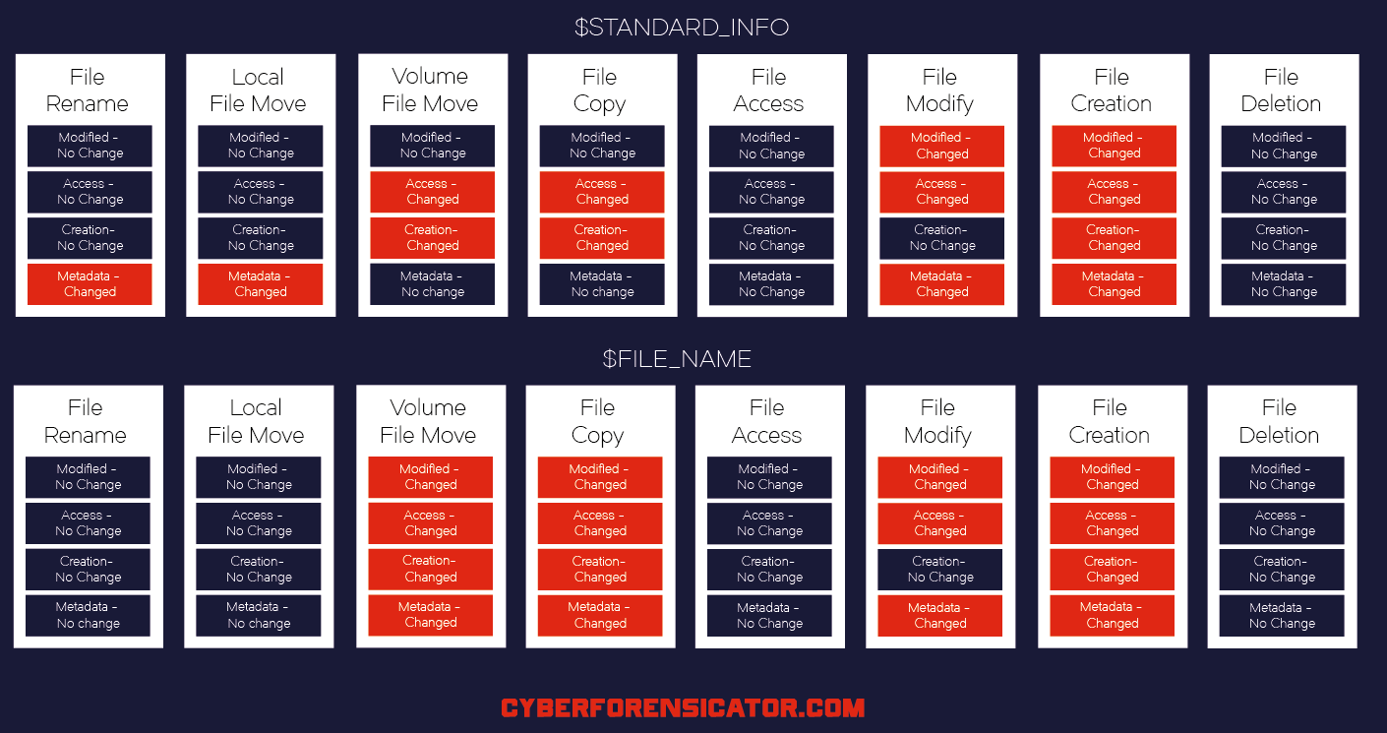
using .docx for experiments
Notes:
https://cyberforensicator.com/wp-content/uploads/2018/03/Windows-10-Time-Rules-Cyber-Forensicator_2.png
https://cyberforensicator.com/2018/03/25/windows-10-time-rules/

Slide 14
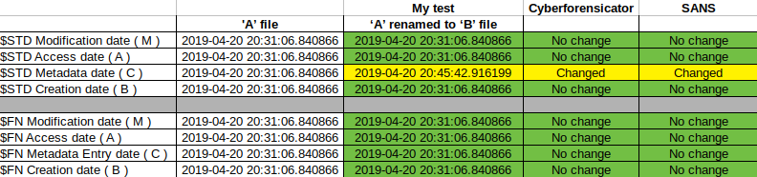
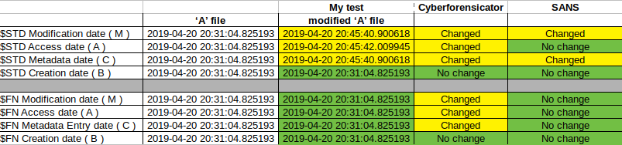
File Rename
using .txt for experiments
File Modification
Check here for comprehensive study results
Notes:
https://forensixchange.com/posts/19_04_22_win10_ntfs_time_rules/#:~:text=The%20MACB%20timestamps%20are%20stored,%24STANDARD_INFORMATION%20and%20%24FILE_NAME%20attribute.&text=One%20important%20difference%20is%20that,changed%20by%20the%20system%20kernel.

Slide 15
$Extend\$UsnJrnl: $J
It begins as an empty file.
Whenever a change is made to the volume, a record is added to the file.
Each record is identified by a 64-bit Update Sequence Number (USN, for this reason Change Journals are sometimes called USN Journals).
Each record in the Change Journal contains the USN, the name of the file, and information about what the change was.
It does not include all the data or details associated with the change.
Cannot be used to undo operations on files within NTFS
Will be reused when journal reaches its maximum size
Clusters of the journal’s disk space are marked unallocated by OS
Unallocated space can be extremely valuable

Slide 16
The Structure of $J
"Sparse Area“ : zero-filled
The structure allows OS to keep the same size of the log data
The new records are added at the end of the attribute.
Sparse Area | USN1 | USN2 | USN3 | USN4 | … | USNn
Lowest Valid USN

Slide 17
$J record format
Offset | Size | Stored Information | Explaination
0x08 | 8 | File Reference Number | The ordinal number of the file or directory for which this record notes changes.
0x10 | 8 | Parent File Reference Number | The ordinal number of the directory where the file or directory that is associated with this record is located.
0x18 | 8 | Usn | The USN of this record
0x20 | 8 | TimeStamp | The standard UTC time stamp (FILETIME) of this record, in 64-bit format.
0x28 | 4 | Reason flag | The flags that identify reasons for changes that have accumulated in this file or directory journal record since the file or directory opened.
0x34 | 4 | File Attributes | The attributes for the file or directory associated with this record, as returned by the GetFileAttributes function. Attributes of streams associated with the file or directory are excluded.
0x3A | 2 | FileNameOffset | The offset of the FileName member from the beginning of the structure.
0x3C | N | Filename | The name of the file or directory associated with this record in Unicode format.
Notes:
https://docs.microsoft.com/en-us/windows/win32/api/winioctl/ns-winioctl-usn_record_v2?redirectedfrom=MSDN

Slide 18
Reason Flag
When a file or directory closes,
A final USN record is generated with the USN_REASON_CLOSE flag set.
The next change (for example, after the next open operation or deletion) starts a new record with a new set of reason flags.
A rename or move operation
Generates two USN records, one that records the old parent directory for the item, and one that records a new parent.

Slide 19
Flag | Value | Description
0x00000100 | FILE_CREATE | The file or directory is created for the first time.
0x00000002 | DATA_EXTEND | The file or directory is extended (added to).
0x00002000 | RENAME_NEW_NAME | A file or directory is renamed, and the file name in the USN_RECORD_V2 structure is the new name.
0x00001000 | RENAME_OLD_NAME | The file or directory is renamed, and the file name in the USN_RECORD_V2 structure is the previous name.
0x00000200 | FILE_DELETE | The file or directory is deleted.
0x80000000 | CLOSE | The file or directory is closed.
0x00008000 | BASIC_INFO_CHANGE | A user has either changed one or more file or directory attributes (for example, the read-only, hidden, system, archive, or sparse attribute), or one or more time stamps.
0x00010000 | HARD_LINK_CHANGE | An NTFS file system hard link is added to or removed from the file or directory.
0x00000004 | DATA_TRUNCATION | The file or directory is truncated.
Hard link: you need a file stored in two different folders.

Slide 20
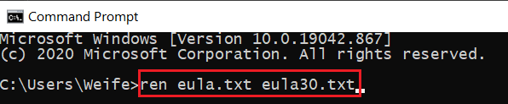
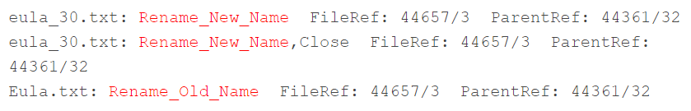
USN Journal when renaming a file
USN Journal
Notes:
http://windowsir.blogspot.com/2014/07/file-system-ops-effects-on-mft-records.html

Slide 21
How to read $Extend\$UsnJrnl
(Scenario 1) If the change journal doesn’t reach its maximum size
icat : extract binary or https://github.com/jschicht/ExtractUsnJrnl
bless/xxd or UsnJrnl2Csv: convert to csv
(Scenario 2) As the change journal reaches its maximum size
Clusters of the journal's disk space are marked unallocated by OS
That space to be used when needed at a later time
usncarve: usncarve records in unallocated space
Usnparser: convert to csv

Slide 22
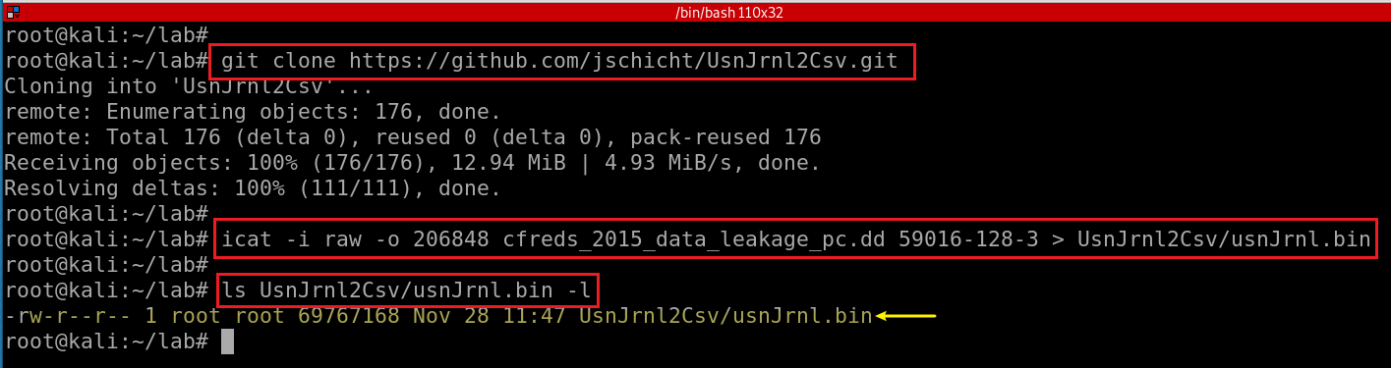
Scenario 1
Install UsnJrnl2Csv tool
Notes:
git clone https://github.com/jschicht/UsnJrnl2Csv.git

Slide 23
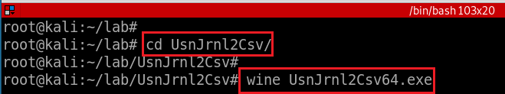
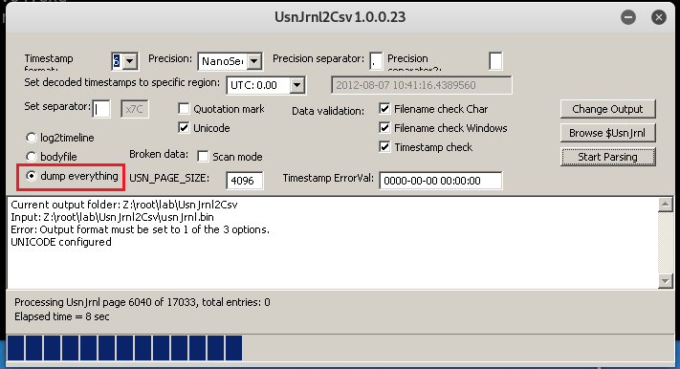
Run UsnJrnl2.exe to covert UsnJrnl.bin to .csv
Set configuration: Browser to usnJrnl.bin
Issue of using usnJrnl.bin extracted from icat
$J may be sparse, which would mean parts of the data is just 00's.
This may be a significant portion of the total data, and most tools will extract this data stream to its full size (which is annoying and a huge waste of disk space).
Consider using the tool https://github.com/jschicht/ExtractUsnJrnl
This process might take some time,

Slide 24
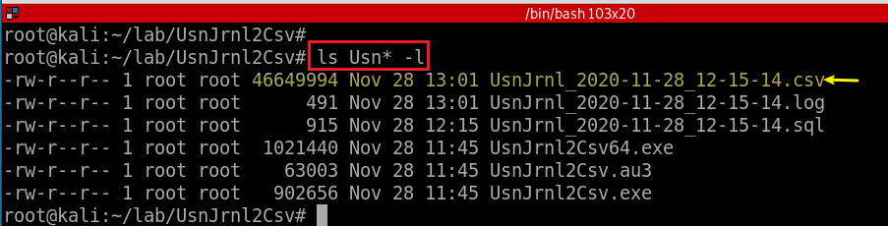
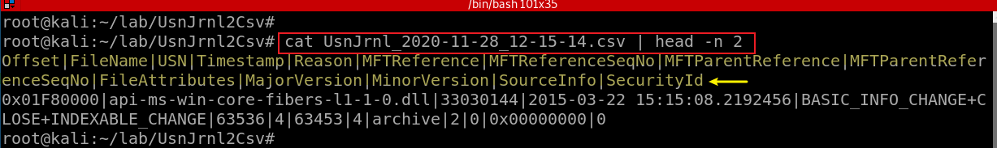
Show the extract USN journal file

Slide 25
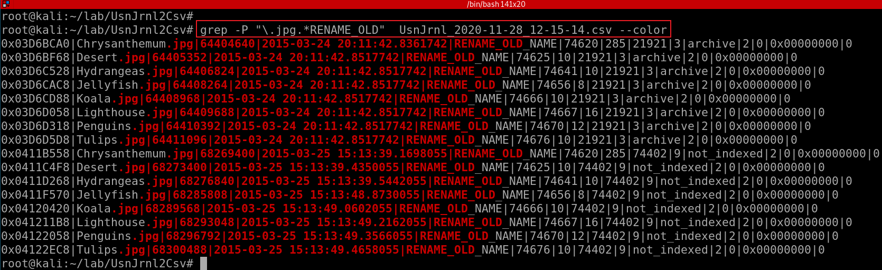
Offset|FileName|USN|Timestamp|Reason|MFTReference|MFTReferenceSeqNo|MFTParentReference|MFTParentReferenceSeqNo|FileAttributes|MajorVersion|MinorVersion|SourceInfo|SecurityId
Only show “RENAME_OLD” information of any .jpg files
Timestamps are written UTC 0.00 by default. You have to configure it.
With NTFS journal file only, it may be hard to find full paths.
(+ $MFT for identifying full paths of files)
You can consider the Registry ShellBags for further information.
Notes:
grep -P "\.jpg.*RENAME_OLD" UsnJrnl_2020-11-28_12-15-14.csv --color

Slide 26
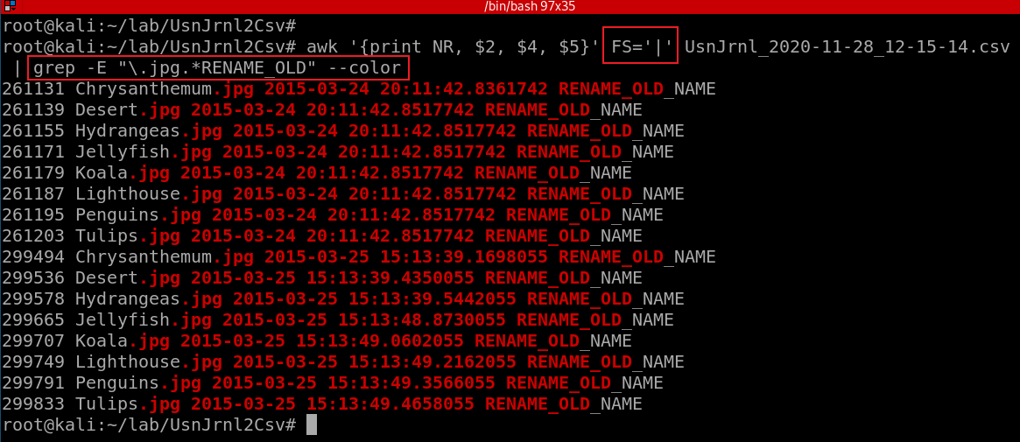
Offset|FileName|USN|Timestamp|Reason|MFTReference|MFTReferenceSeqNo|MFTParentReference|MFTParentReferenceSeqNo|FileAttributes|MajorVersion|MinorVersion|SourceInfo|SecurityId
Only show “RENAME_OLD” information of any .jpg files. Only show three columns, FileName, Timestamp, Reason

Slide 27
Notes: USN and malware infection
The use of the USN change journal can also be useful in identifying activity that occurs during a malware infection. For example, in some cases, malware may create a downloader, use that to download another bit of malware, and then delete the original downloader. The USN change journal can help you identify that activity, even if the MFT record for the original downloader has been reused and overwritten.
Notes:
http://windowsir.blogspot.com/2014/07/file-system-ops-effects-on-mft-records.html
could be a research topic

Slide 28
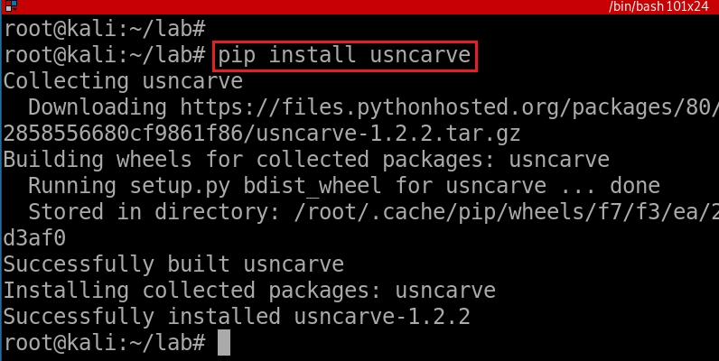
Scenario 2
Install usncarve tool (note we have changed the path)
Notes:
pip install usncarve

Slide 29
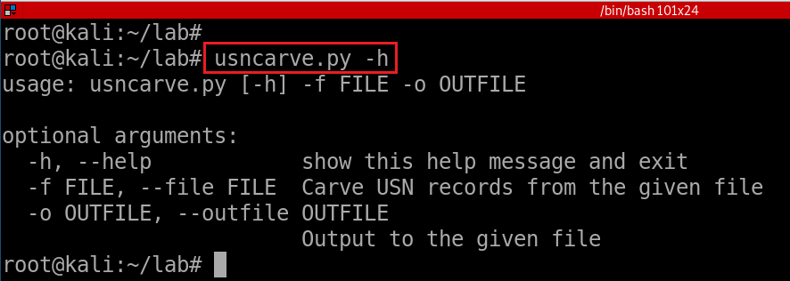
Verify installation
Notes:
usncarve.py -h

Slide 30
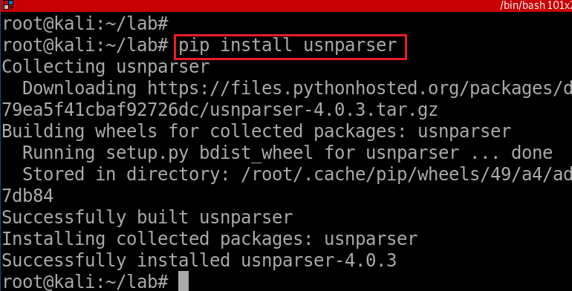
Install usnparser tool
Install via pip
Notes:
pip install usnparser

Slide 31
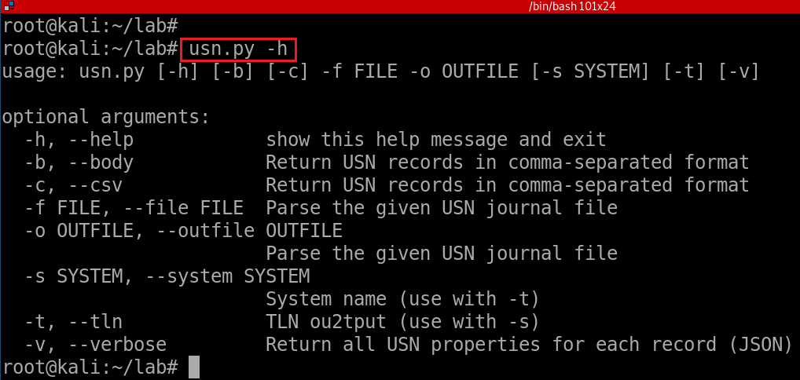
Verify installation
Notes:
usn.py -h

Slide 32
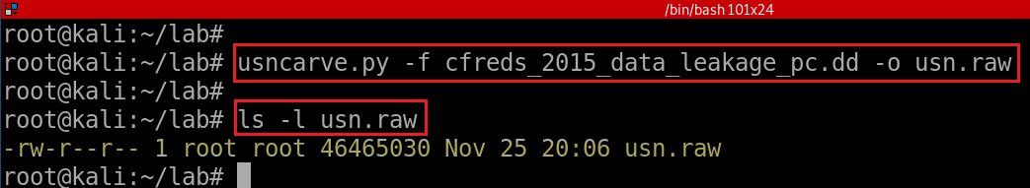
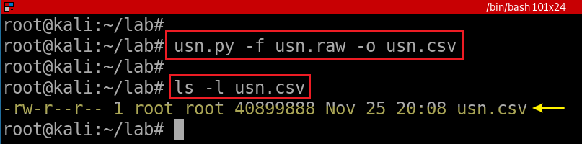
usncarve.py -f input file -o output file
usn.py -f input file -o output file
Notes:
usncarve.py -f cfreds_2015_data_leakage_pc.dd -o usn.raw
usn.py -f usn.raw -o usn.csv

Slide 33
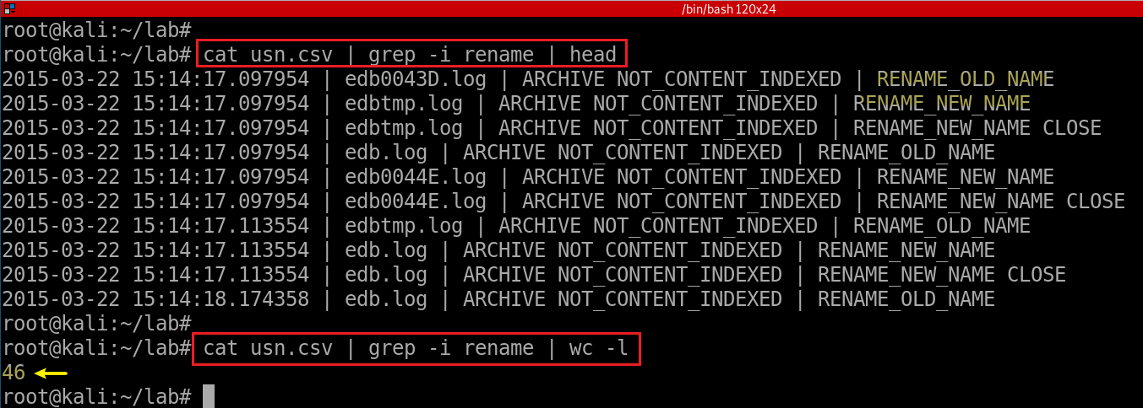
View renamed files
- NTFS journal file analysis (→ $UsnJrnl)
- \$Extend\$UsnJrnl·$J (+ $MFT for identifying full paths of files)
- You can also consider the Windows Search database. (See Questions 46)

Slide 34
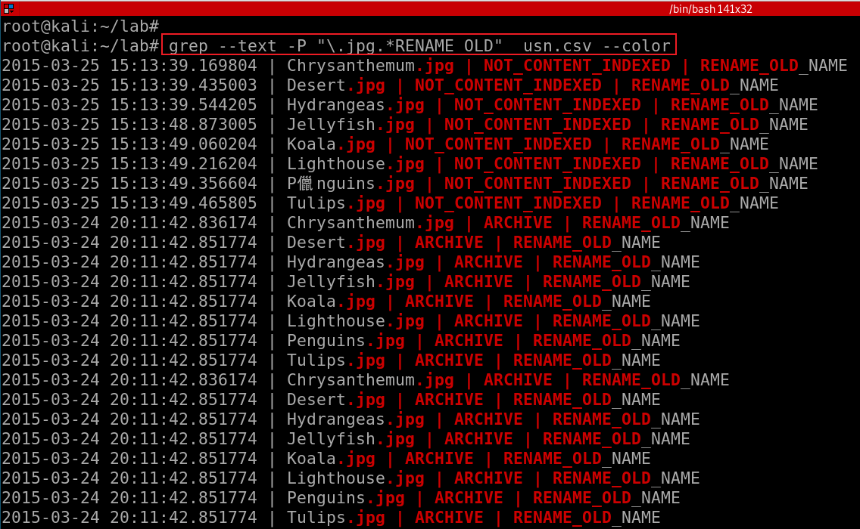
--text: equivalent to --binary-files=text
Notes:
grep --text -P "\.jpg.*RENAME_OLD" usn.csv –color
Without --text, it will show “binary file .cvs matches”

Slide 35
USN Journal vs. NTFS file system journaling
NTFS file journaling uses the NTFS Log ($LogFile) to record metadata changes to the volume.
USN Journal only has change flags, no metadata.
NTFS file journaling ensures that its complex internal data structures will remain consistent in case of
system crashes or data moves performed by the defragmentation API,
NTFS file journaling allows easy rollback of uncommitted changes to these critical data structures when the volume is remounted.

