Slide 1
Investigate Data Leakage Case
Keywords: Network, Shellbag, Jumplist
Notes:
http://xmlstar.sourceforge.net/doc/UG/

Slide 2
24. What is the IP address of company’s shared network drive?
Possible Answer | 10.11.11.128
Considerations | HKU\informant\Software\Microsoft\Windows\CurrentVersion\Explorer\RunMRU\ > timestamp: 2015-03-23 16:23:28 Mon > value: b > data: ‘\\10.11.11.128\secured_drive’ HKU\informant\Software\Microsoft\Windows\CurrentVersion\Explorer\Map Network Drive MRU\ > timestamp: 2015-03-23 16:26:04 Mon > value: a > data: ‘\\10.11.11.128\secured_drive’ HKU\informant\Software\Classes\Local Settings\Software\Microsoft\Windows\Shell\BagMRU\8\0\ ……

Slide 3
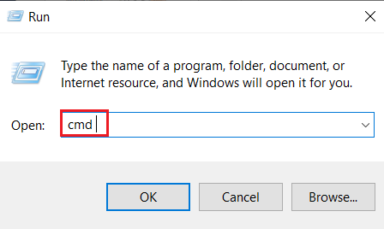
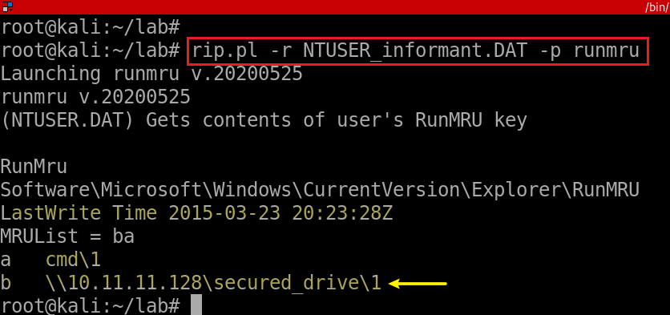
Method 1: MRU commands via Start-> Run
Most Recently Used (MRU) : recently opened webpages, documents, files, images and other applications.
For example, when a computer user opens Microsoft Word, he/she may see a list of previously opened Word documents within the application.
Again, seems the timestamp is inaccurate.
Notes:
rip.pl -r NTUSER_informant.DAT -p runmru

Slide 4
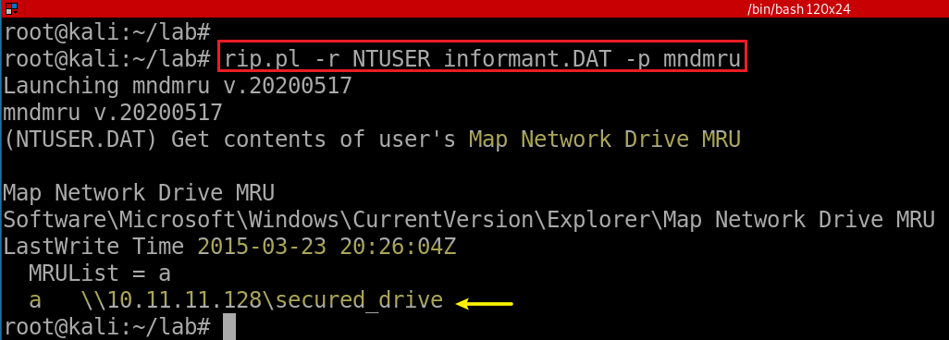
Method 2: MRU map network drive
Map Network Drive Most Recently Used
Notes:
rip.pl -r NTUSER_informant.DAT -p mndmru

Slide 5
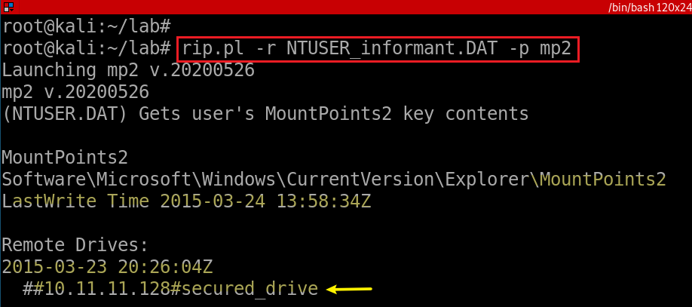
Method 3
Notes:
rip.pl -r NTUSER_informant.DAT -p mp2

Slide 6
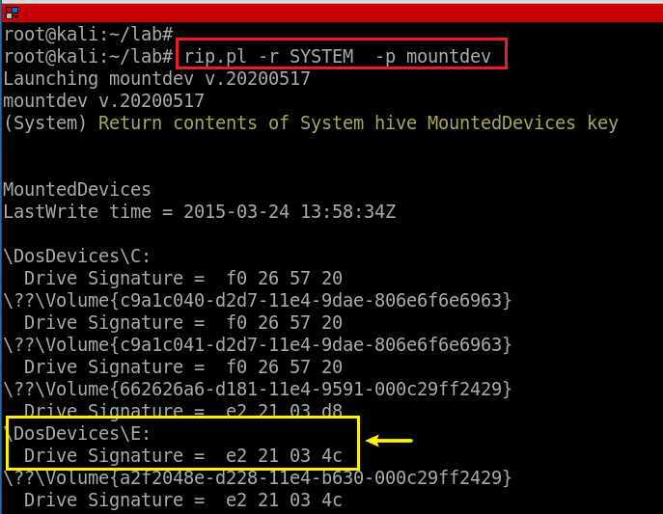
Method 4
Notes:
rip.pl -r SYSTEM -p mountdev

Slide 7
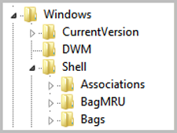
25. List all directories that were traversed in ‘RM#2’.
Track user behavior using Shellbags
Windows uses the Shellbag keys to store user preferences for GUI folder display within Windows Explorer.
to improve user experience and “remember” preferences
Remember display mode (icons, details, list, etc.), browsing folders, etc.,
Shellbags can be used to answer the difficult questions of
Data enumeration in intrusion cases,
Identify the contents of long-gone removable devices
Show the contents of previously mounted encrypted volumes.
Notes:
wget -q https://www.cfreds.nist.gov/data_leakage_case/images/rm%232/cfreds_2015_data_leakage_rm%232.7z
7z e cfreds_2015_data_leakage_rm#2.7z

Slide 8
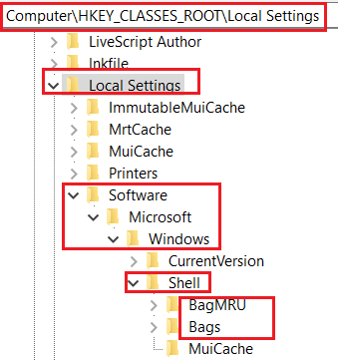
25.1 What are registry keys that shellbags are structured from?
Structured from two main registry keys
BagMRU: stores folder names and records folder paths by creating the similar tree structure.
Bags: stores the view preferences such as the window size, location and view mode
Physical location (Win7 +)
%UserProfile%\NTUSER.dat
%UserProfile%\AppData\Local\Microsoft\Windows\UsrClass.dat.

Slide 9
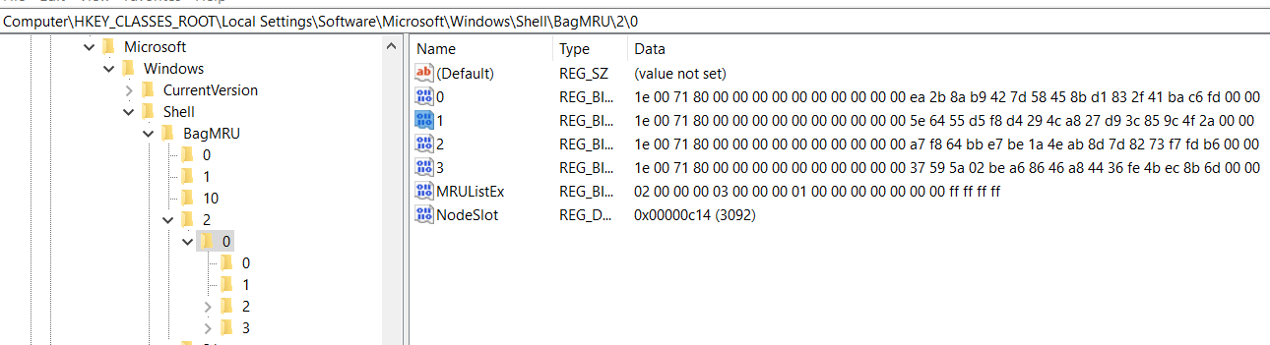
25.2 How shellbags are structured?
Structured In hierarchy
each numbered folder representing a parent or child folder of the one previous.
ShellBag information is available only for folders that have been opened and closed in Windows Explorer at least once.
Notes:
https://www.sans.org/reading-room/whitepapers/forensics/windows-shellbag-forensics-in-depth-34545

Slide 10
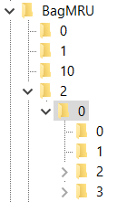
Desktop
File 0
File 1
File 2
My PC
C: \
Folder02
Folder03
Notes:
https://www.sans.org/reading-room/whitepapers/forensics/windows-shellbag-forensics-in-depth-34545

Slide 11
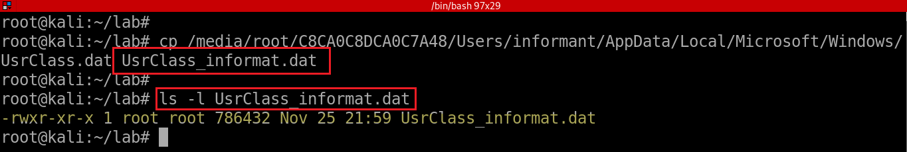
25.3 How shellbags are saved?
The UsrClass.dat stores the Shellbags information
Including the Desktop, ZIP files, remote folders, local folders, Windows special folders and virtual folders.
Copy UsrClass.dat file and rename it to UsrClass_informat.dat
Notes:
losetup --partscan --find --show --read-only cfreds_2015_data_leakage_pc.dd

Slide 12
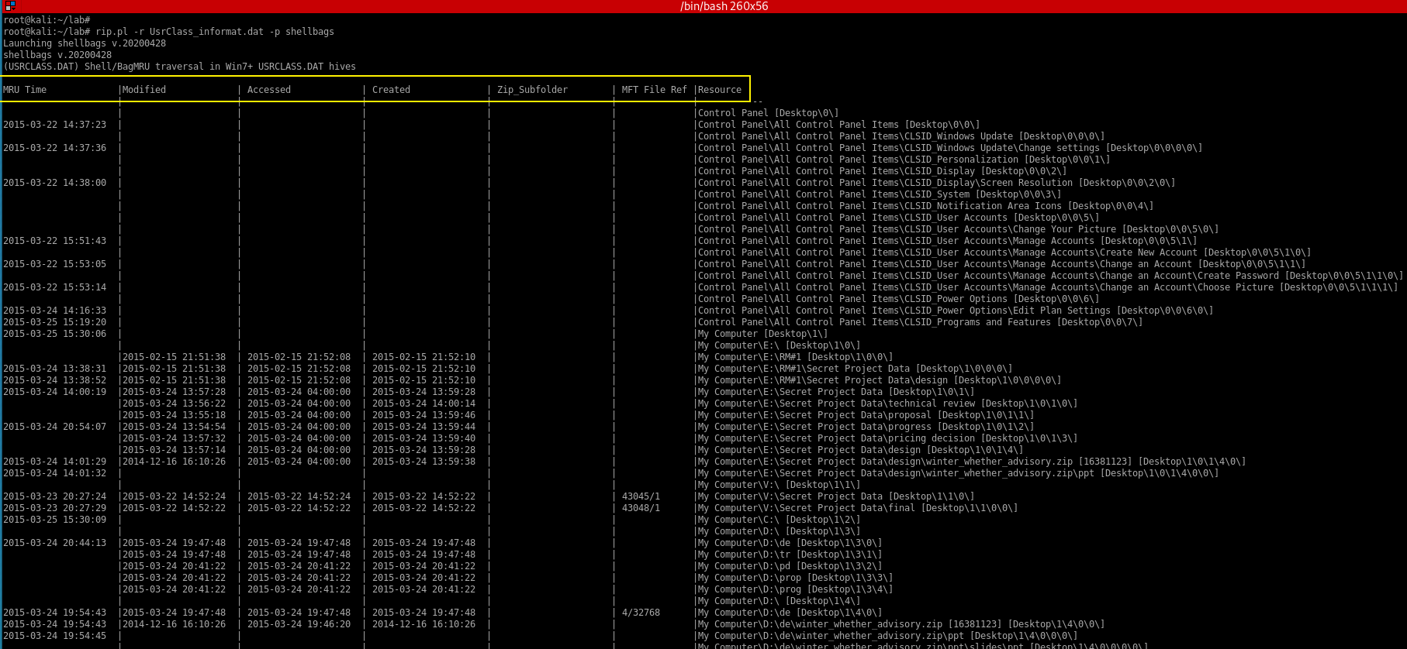
Open a ZIP file in Windows Explorer and close it or open a folder in the same window

Slide 13
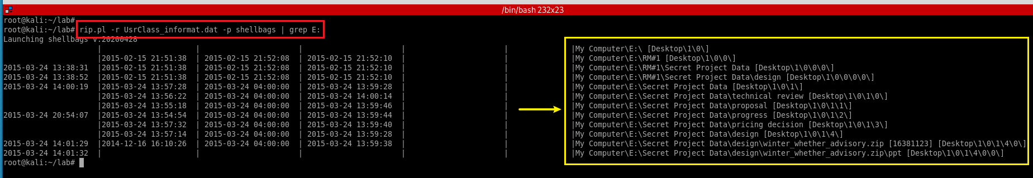
Notes:
rip.pl -r UsrClass_informat.dat -p shellbags | grep E:

Slide 14
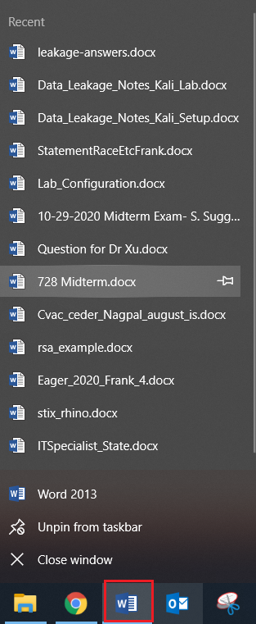
26. List all files that were opened in ‘RM#2’.
Jump Lists provide users a graphical indication of recent items accessed by each application
Jump Lists are indicative of user activity.
\Users\<username>\AppData\Roaming\Microsoft\Windows\Recent\CustomDestinations-m
The service itself can be configured by the user
Notes:
https://www.blackbagtech.com/blog/windows-10-jump-list-forensics/

Slide 15
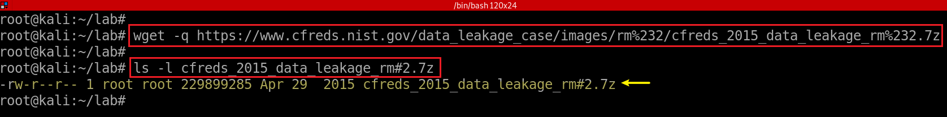
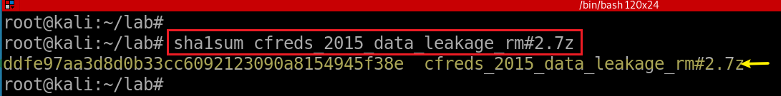
Download RM#2 DD images
Notes:
wget -q https://www.cfreds.nist.gov/data_leakage_case/images/rm%232/cfreds_2015_data_leakage_rm%232.7z
7z e cfreds_2015_data_leakage_rm#2.7z

Slide 16
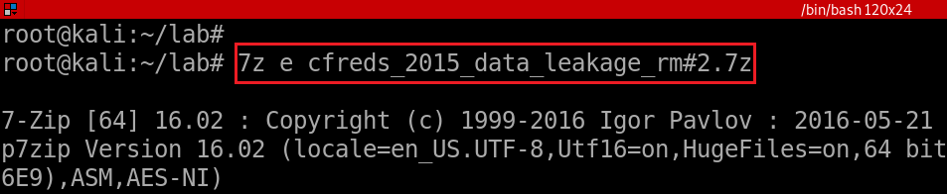
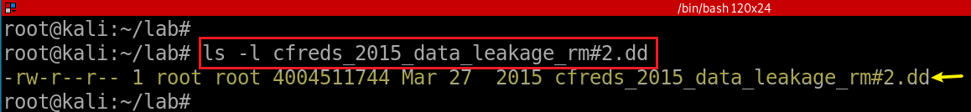
unzipped the DD image
Verify the unzipped DD image
Notes:
7z e cfreds_2015_data_leakage_rm#2.7z
sha1sum cfreds_2015_data_leakage_rm#2.7z

Slide 17
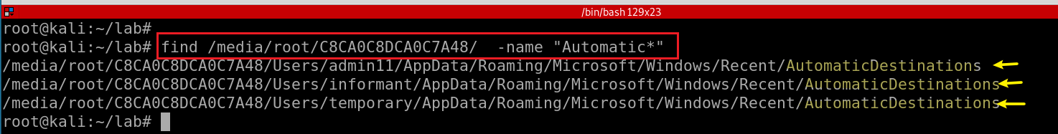
Analysis Of Jump Lists: AutomaticDestinations-ms
When a user interacts with the system performing such acts as opening applications or accessing files.
\Users\<username>\AppData\Roaming\Microsoft\Windows\Recent\AutomaticDestinations-ms
List all AutomaticDestinations-ms directories
Notes:
https://www.blackbagtech.com/blog/windows-10-jump-list-forensics/
find /media/root/C8CA0C8DCA0C7A48/ -name "Automatic*"

Slide 18
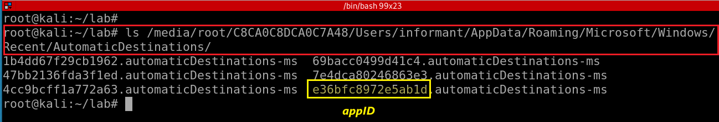
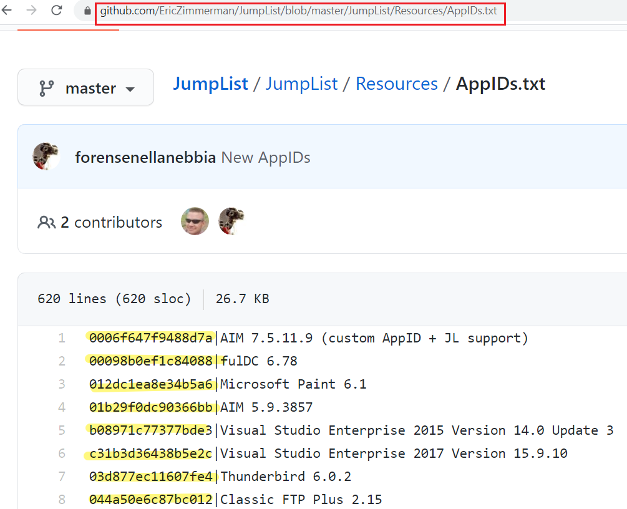
List informant’s AutomaticDestinations-ms
https://github.com/EricZimmerman/JumpList/blob/master/JumpList/Resources/AppIDs.txt
28c8b86deab549a1.automaticDestinations-ms = IE8 Pinned and Recent a7bd71699cd38d1c.automaticDestinations-ms = Word 2010 Pinned and Recent adecfb853d77462a.automaticDestinations-ms = Word 2007 Pinned and Recent a8c43ef36da523b1.automaticDestinations-ms = Word 2003 Pinned and Recent 1b4dd67f29cb1962.automaticDestinations-ms = Windows Explorer Pinned and Recent 918e0ecb43d17e23.automaticDestinations-ms = Notepad Pinned and Recent d7528034b5bd6f28.automaticDestinations-ms = Windows Live Mail Pinned and Recent c7a4093872176c74.automaticDestinations-ms = Paint Shop Pro Pinned and Recent b91050d8b077a4e8.automaticDestinations-ms = Media Center f5ac5390b9115fdb.automaticDestinations-ms = PowerPoint 2007 23646679aaccfae0.automaticDestinations-ms = Adobe Reader 9 aff2ffdd0862ff5c.automaticDestinations-ms = Visual Studio 2012
Notes:
ls /media/root/C8CA0C8DCA0C7A48/Users/informant/AppData/Roaming/Microsoft/Windows/Recent/AutomaticDestinations/

Slide 19
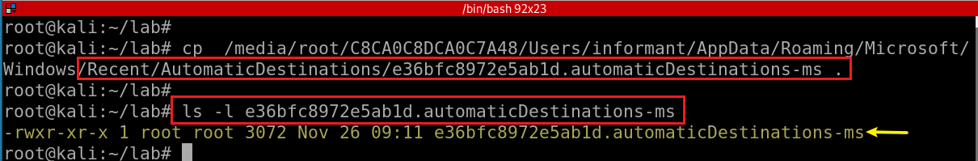
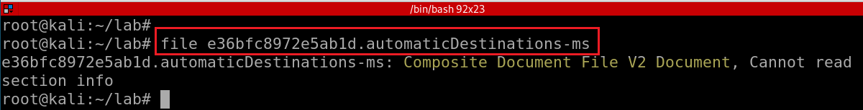
Copy one AutomaticDestinations-ms to the current directory
Determine AutomaticDestinations-ms file format
Notes:
cp /media/root/C8CA0C8DCA0C7A48/Users/informant/AppData/Roaming/Microsoft/Windows/Recent/AutomaticDestinations/e36bfc8972e5ab1d.automaticDestinations-ms .
ls -l e36bfc8972e5ab1d.automaticDestinations-ms

Slide 20
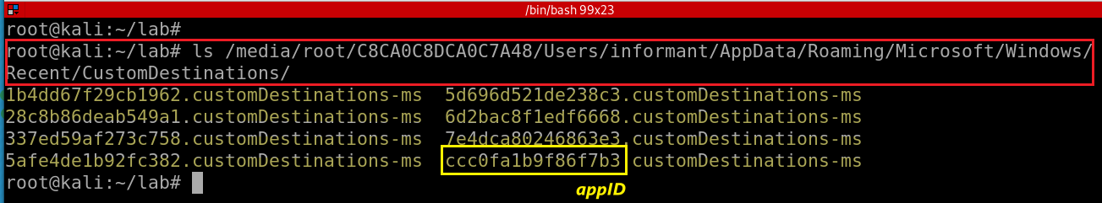
Analysis Of Jump Lists: CustomDestinations-ms
CustomDestinations-ms
when a user “pins” a file to the Start Menu or Task Bar
\Users\<username>\AppData\Roaming\Microsoft\Windows\Recent\CustomDestinations-ms
Notes:
https://www.blackbagtech.com/blog/windows-10-jump-list-forensics/

Slide 21
How to read AutomaticDestinations-ms?
JLECmd: Jump List Explorer Command line
A tool to decode information contained in custom and automatic destinations jump list files found on Windows operating systems
Windows 7 - 10
JLECmd only runs on Win
Need Wine to run Windows applications on Linux
We need to install Wine first
Refer to Wine installation tutorial
Notes:
https://binaryforay.blogspot.com/2016/03/introducing-jlecmd.html
https://www.youtube.com/watch?v=RSM4wygz39Q&ab_channel=KernelPanic%21AtTheDisco

Slide 22
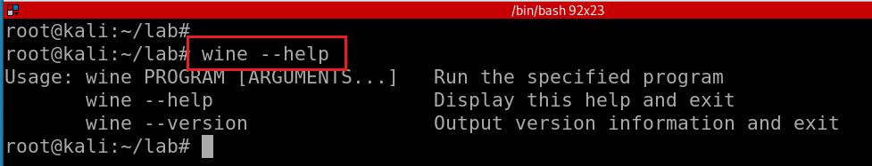
Test wine installation

Slide 23
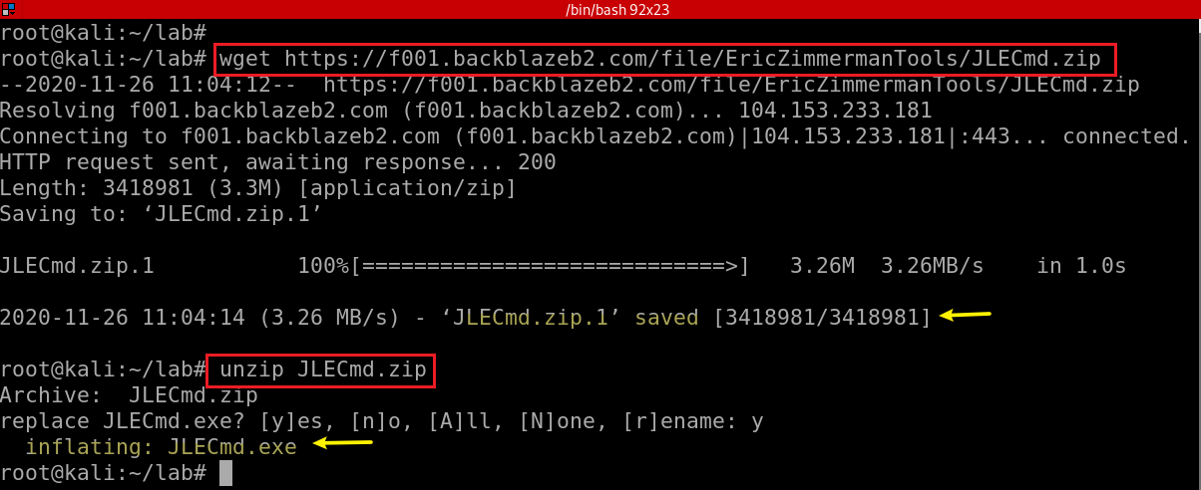
Download JLECmd.zip
Notes:
wget https://f001.backblazeb2.com/file/EricZimmermanTools/JLECmd.zip
unzip JLECmd.zip

Slide 24
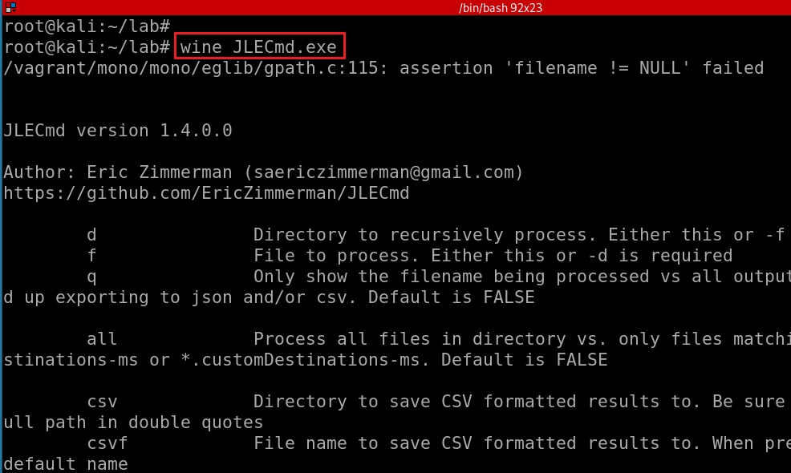
Test wine and JLECmd.exe
Notes:
https://binaryforay.blogspot.com/2016/03/introducing-jlecmd.html
https://ericzimmerman.github.io/#!index.md

Slide 25
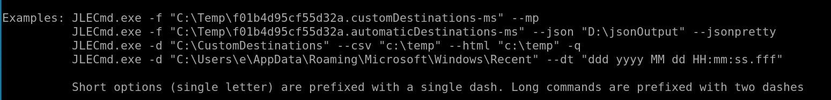

Slide 26
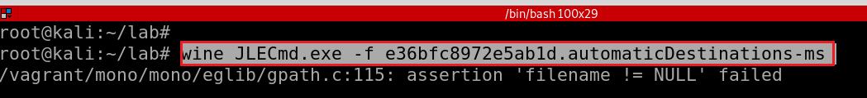
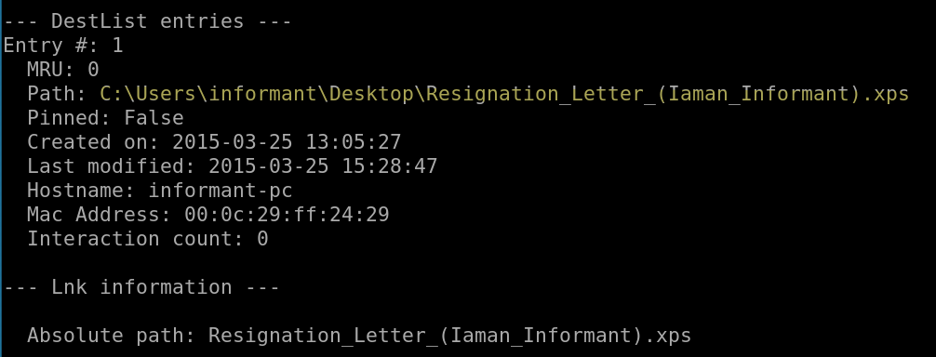
Test one opened file e36bfc8972e5ab1d.automaticDestinations-ms
-f: file
Notes:
wine JLECmd.exe -f e36bfc8972e5ab1d.automaticDestinations-ms

Slide 27
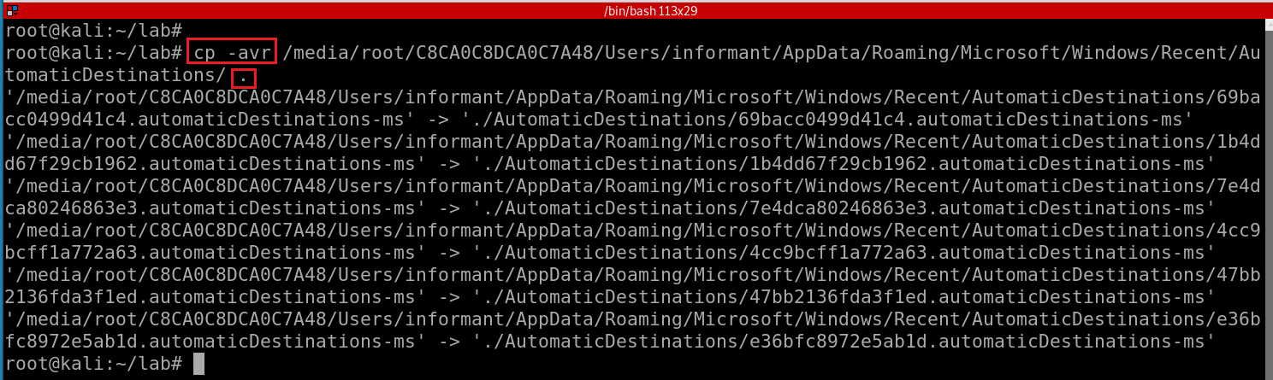
Copy the whole folder of AutomaticDestinations
-a : Preserve the specified attributes such as directory an file mode, ownership, timestamps, if possible additional attributes: context, links, xattr, all.
-v : Verbose output.
-r : Copy directories recursively.
Notes:
cp -avr /media/root/C8CA0C8DCA0C7A48/Users/informant/AppData/Roaming/Microsoft/Windows/Recent/AutomaticDestinations/ .

Slide 28
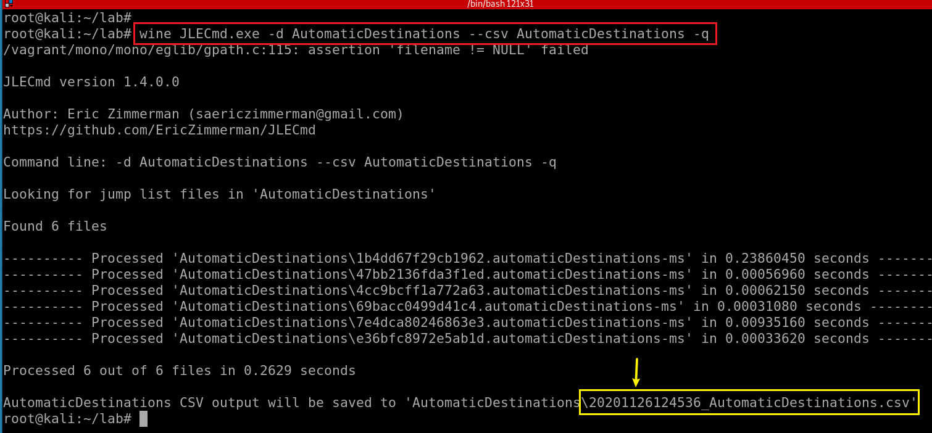
Extract all Jump list and save to a .csv file
Notes:
wine JLECmd.exe -d AutomaticDestinations --csv AutomaticDestinations -q

Slide 29
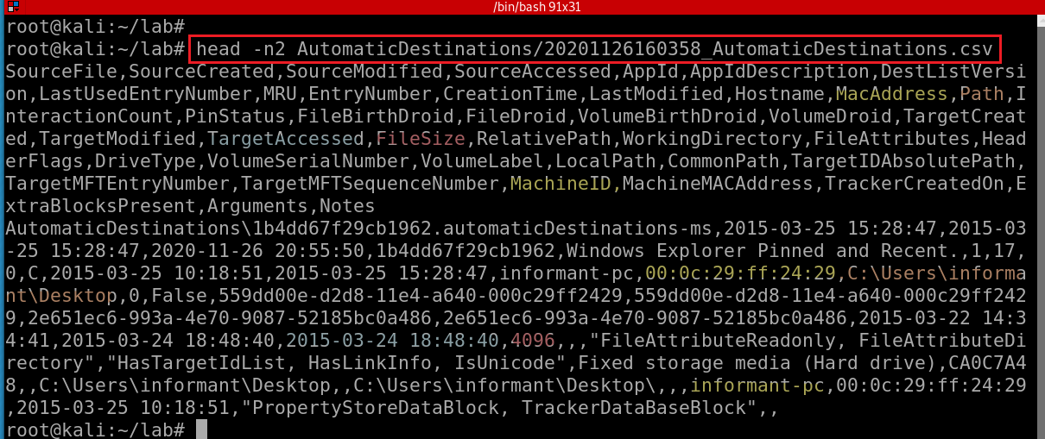
Notes:
head -n2 AutomaticDestinations/20201126160358_AutomaticDestinations.csv
SourceFile,SourceCreated,SourceModified,SourceAccessed,AppId,AppIdDescription,DestListVersion,LastUsedEntryNumber,MRU,EntryNumber,CreationTime,LastModified,Hostname,MacAddress,Path,InteractionCount,PinStatus,FileBirthDroid,FileDroid,VolumeBirthDroid,VolumeDroid,TargetCreated,TargetModified,TargetAccessed,FileSize,RelativePath,WorkingDirectory,FileAttributes,HeaderFlags,DriveType,VolumeSerialNumber,VolumeLabel,LocalPath,CommonPath,TargetIDAbsolutePath,TargetMFTEntryNumber,TargetMFTSequenceNumber,MachineID,MachineMACAddress,TrackerCreatedOn,ExtraBlocksPresent,Arguments,Notes

Slide 30
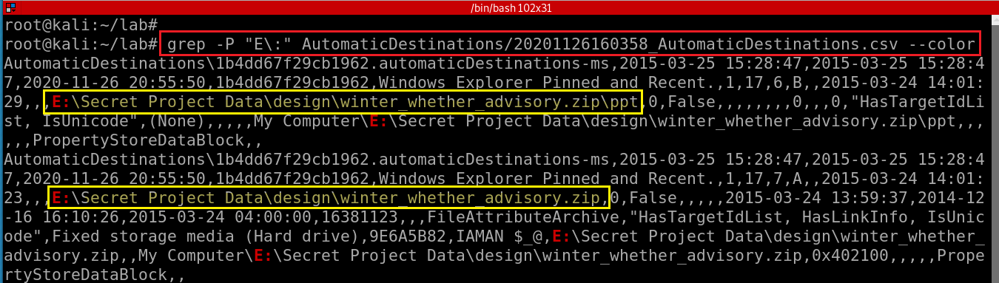
List opened files or applications
Notes:
grep -P "E\:" AutomaticDestinations/20201126160358_AutomaticDestinations.csv --color

Slide 31
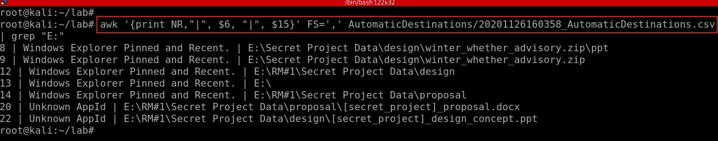
$6: AppIdDescription
$15: Path
List opened files in E: volumn using akw
Notes:
awk '{print NR,"|", $6, "|", $15}' FS=',' AutomaticDestinations/20201126160358_AutomaticDestinations.csv | grep "E:"

