Slide 1
RISC-V: From MIPS to a Modern Open ISA
Tianbo Yang
20721163

Slide 2
What is RISC-V
RISC-V is an open-source, royalty-free Instruction Set Architecture (ISA) based on the principles of Reduced Instruction Set Computing (RISC), developed by the University of California, Berkeley in the 2010s.
The interface specification between software and hardware.
What it is
RISC-V is an Instruction Set Architecture (ISA) — a set of instructions that defines how a processor operates.
Licensing
It is open-source and royalty-free, meaning anyone can use it to design processors without paying any licensing fees.
Design Philosophy
It is based on the principles of Reduced Instruction Set Computing (RISC), which emphasizes simple and efficient instructions.
Origin
It was developed by the University of California, Berkeley in the 2010s.
OPPO
CISC

Slide 3
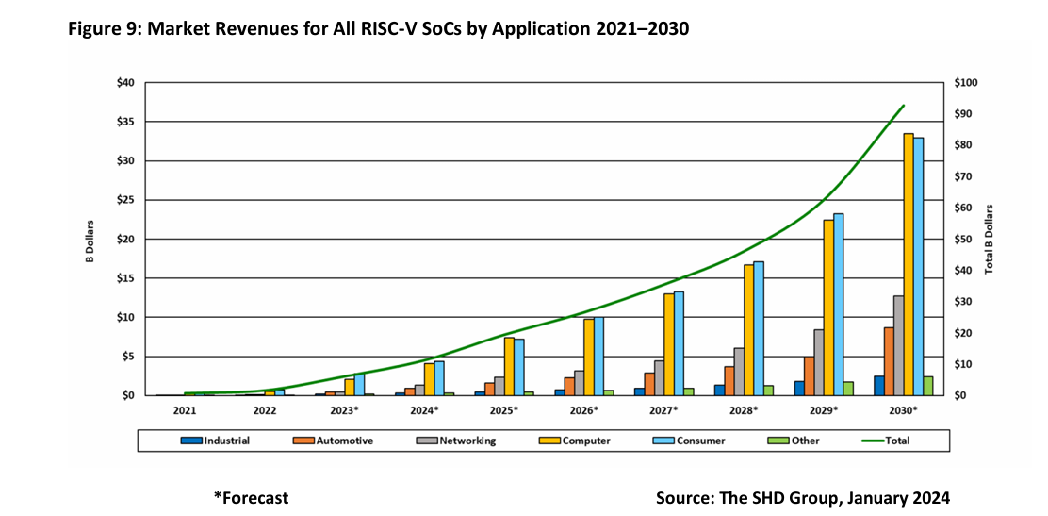
Data Evidence of RISC-V's Rising Popularity

Slide 4

Reasons Behind the Popularity of RISC-V (Industry)
no licensing fees
Open & Royalty-Free
Any company can implement, manufacture, and sell RISC-V based chips without paying royalties
lowering the barrier to entry especially for startups chip designers.
Better than MIPS and ARM
MIPS and ARM have licensing fees

Slide 5

Reasons Behind the Popularity of RISC-V (Industry)
Open & Customizable: Modular & Scalable
base + extension design
Selective ALU and Control unit
tailor the architecture precisely to their product needs
without carrying unnecessary hardware overhead.

Slide 6
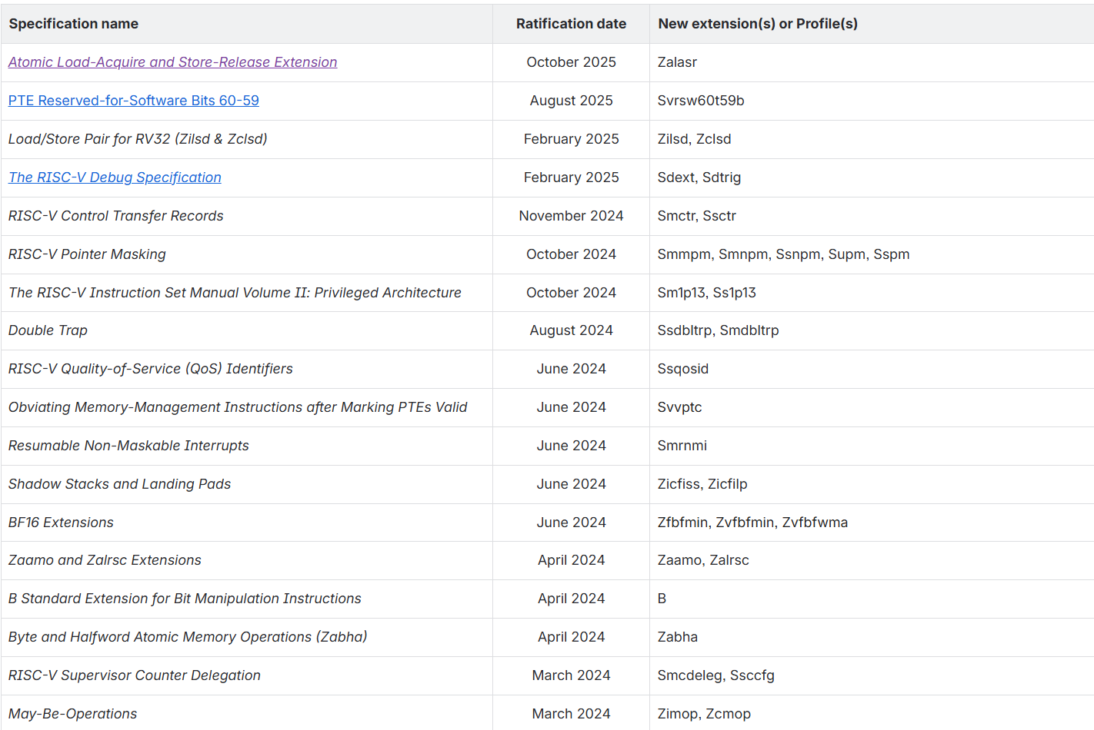
Reasons Behind the Popularity of RISC-V (Industry)
ratified extension that is not yet merged into the published specifications:
Base Integer Instruction Set:
RV32I / RV64I
Embedded: RV32E / RV64E
Common Standard Extensions:
"M" Extension for Integer Multiplication and Division
"A" Extension for Atomic Instructions
"F" Extension for Single-Precision Floating-Point
"D" Extension for Double-Precision Floating-Point
"Q" Extension for Quad-Precision Floating-Point
"C" Extension for Compressed Instructions
“B” Bit Manipulation Extensions
"V" Standard Extension for Vector Operations
e.g. Scenario: An ADAS (Advanced Driver Assistance System) chip
RV64I + M + A + F + D + V + C + H
(RISC-V International, 2025)

Slide 7
Reasons Behind the Popularity of RISC-V (academia)
Open & Customizable: Open Access Open Access for Research Researchers can freely modify and extend the ISA, implement custom microarchitectures, and publish results — without legal or licensing barriers that proprietary ISAs like ARM would impose.
Origin
Born from Academia RISC-V originated at UC Berkeley in 2010, designed explicitly for teaching and research. Its clean, minimal design makes it an ideal subject for studying ISA design principles.

Slide 8
A 5-Week Teaching Plan
Week 1
1
Introduction to RISC-V & Computer Performance
2
Week 2
RISC-V Assembly Programming: Basics & Operands & Operations
Week 3
3
Register operands, Memory operands, Immediate operand
RISC-V Assembly Programming: Control Flow & Procedures
4
Week 4
RISC-V Instruction Set Architecture & Encoding
Week 5
5
Single-Cycle RISC-V Processor Design
The plan mirrors the structure students know from MIPS, easing the transition while progressively introducing RISC-V's advantages.

Slide 9

WEEK 1 — ISA COMPARISON
MIPS vs. RISC-V: Foundational Differences
Dimension
MIPS
RISC-V
License & Ownership
Proprietary — requires licensing fees; restricts commercial and academic use
Fully open ISA — free to use, implement, and extend with no licensing fees
Origin
Stanford University, 1981 — pioneered RISC principles
UC Berkeley, 2010 — benefits from nearly 30 years of ISA design hindsight
Modular: base RV32I + optional extensions (M, F, C, V) for multiply, float, compressed, vector
ISA Structure
Fixed, monolithic ISA — all instructions bundled together
RISC-V's modular design means a microcontroller and a supercomputer can share the same base ISA — a key pedagogical and industry advantage.

Slide 10
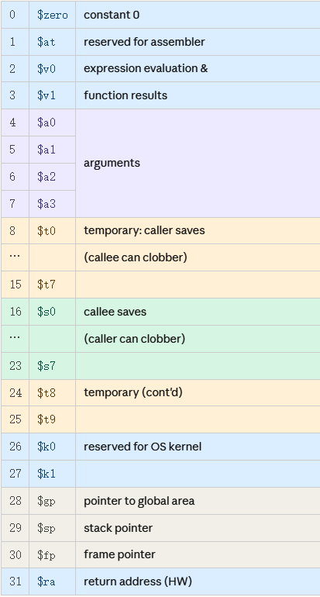
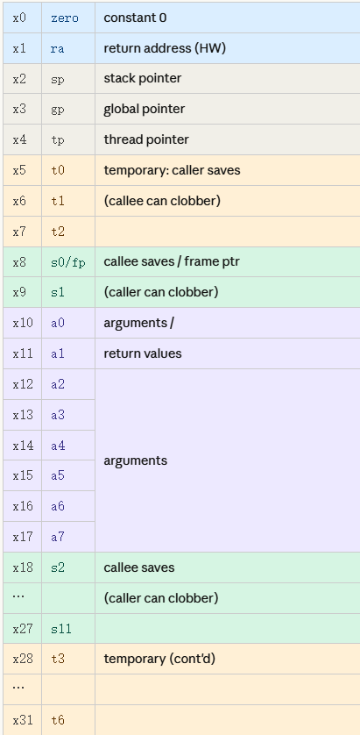
Week 2 Different Operands
32 Registers in Register file
MIPS:
RISC-V:
Operands Key Different:
Register Operands:
Register Naming
Argument Registers
MIPS: $zero, $t0–$t9, $s0–$s7, $a0–$a3, $v0–$v1
MIPS: 4 registers ($a0–$a3)
RISC-V: 8 registers (a0–a7) — fewer stack spills in function calls
RISC-V: x0–x31 with ABI aliases zero, t0–t6, s0–s11, a0–a7
Immediate Operands:
Saved Registers
Immediate Width
MIPS: 8 registers ($s0–$s7)
MIPS: 16-bit
RISC-V: 12 registers (s0–s11) — more local variable capacity
RISC-V: 12-bit

Slide 11
Week 2 Different Operations
The deeper point here is that RISC-V makes this two-step process visible, rather than hiding it like MIPS does. That transparency is exactly what makes it a better teaching architecture — you can see how the hardware actually handles large constants, step by step.
lui + ori
RISC-V Large Immediate Example
Large Immediates
# Load 0x12345678 into t0
lui t0, 0x12345 # upper 20 bits
addi t0, t0, 0x678 # lower 12 bits
MIPS: li pseudo-instruction hides complexity
RISC-V: Explicit lui + addi — transparent two-step process
MIPS Equivalent
# Single pseudo-instruction
li $t0, 0x12345678 # assembler expands internally
# Load 0x12345678 into $t0
lui $t0, 0x1234 # upper 16 bits
ori $t0, $t0, 0x5678 # lower 16 bits
ori is a pure bitwise operation — it doesn't care whether the top bit is 0 or 1, it just stitches the bits together. addi, however, treats its 12-bit immediate as a signed number. If the top bit is 1, the hardware sign-extends it — filling all the upper bits with 1s — which means the value is interpreted as negative. For example, 0x800 becomes -2048 instead of +2048, making the result 4096 too small.
So how does RISC-V fix this? The assembler handles it automatically. When it sees a lui followed by an addi whose lower 12 bits have a top bit of 1, it quietly adds 1 to the lui value — effectively adding 4096 upfront to cancel out the -4096 that addi will introduce. The result is always correct, and the programmer never has to think about it.
RISC-V makes the two-step load explicit — reinforcing how hardware actually handles large constants, a valuable teaching moment.

Slide 12

e.g.
bgt a, b, L = blt b, a, L ble a, b, L = bge b, a, L
RISC-V follows a minimal instruction set philosophy — if an operation can be achieved by reusing an existing instruction with swapped operands, no new instruction is needed. bgt and ble are redundant: swapping the two register operands in blt and bge produces identical behaviour, so RISC-V deliberately omits them to reduce hardware complexity.
WEEK 3
Branch Instructions
Control Flow & Procedures
MIPS provides beq, bne, blt, bgt, ble, bge. RISC-V uses beq, bne, blt, bge, bltu, bgeu — no bgt/ble; swap operands instead.
Comparison Method
e.g.
MIPS: slt $t0, $s0, $s1
bne $t0, $zero, L
RISC-V: blt x18, x19, L
MIPS uses slt combined with beq/bne. RISC-V branch instructions directly compare two registers — fewer instructions, cleaner code.
Function Return
MIPS: jr $ra — RISC-V: ret (expands to jalr x0, ra, 0), more descriptive and readable.
Branch Delay Slot
MIPS: Branch instructions have a delay slot — the instruction immediately after a branch always executes regardless of the outcome, forcing programmers and compilers to manually fill this slot or waste a cycle with nop.
RISC-V: No delay slot exists — branches take effect immediately, making code behaviour intuitive and eliminating a legacy workaround that was only needed for 1980s pipeline designs.

Slide 13
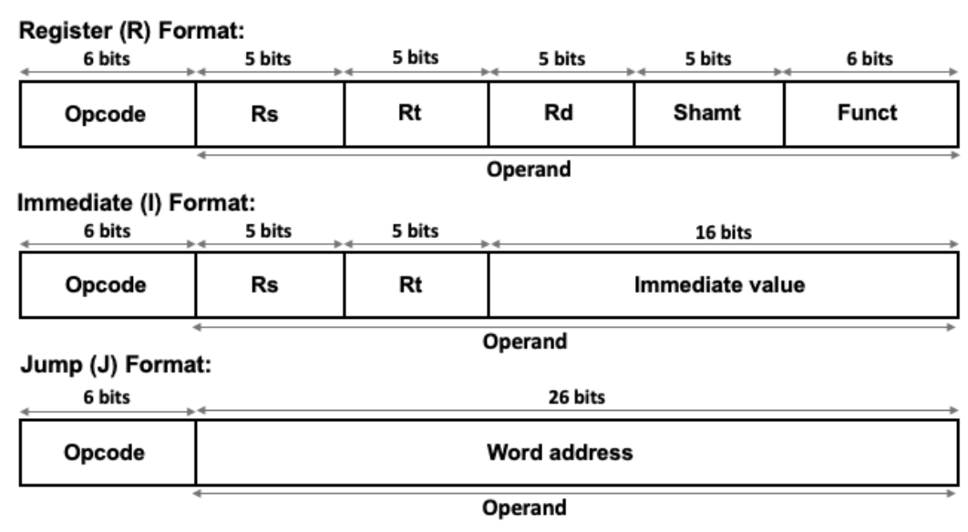
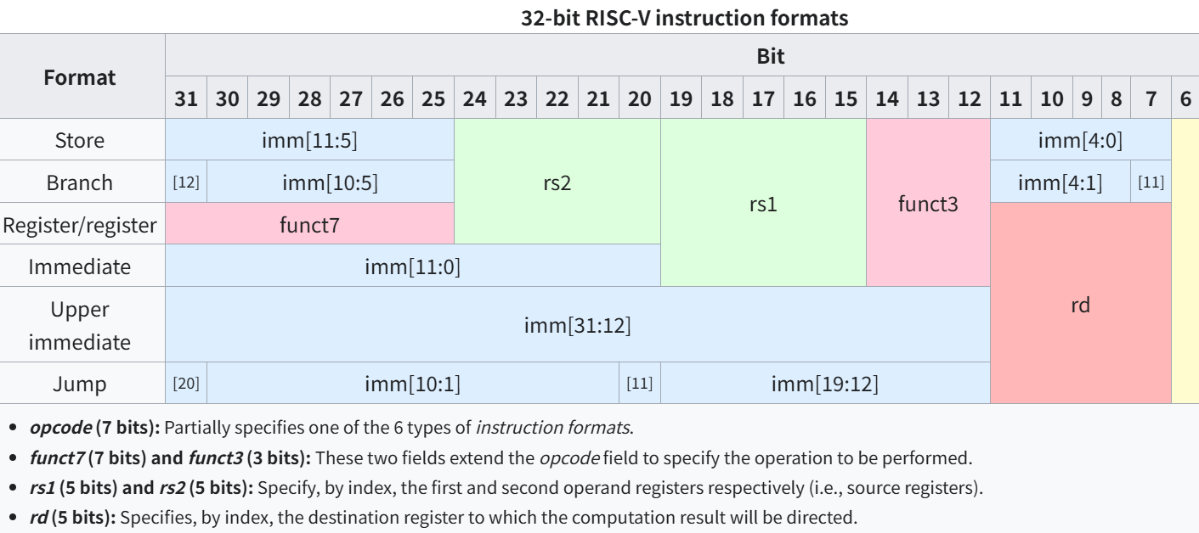

WEEK 4
ISA Encoding & Instruction Formats
https://www.researchgate.net/figure/Three-different-32-bit-instruction-formats-of-MIPS-architecture-37-Rs-Source_fig2_359971270
PC-Relative Addressing
https://en.wikipedia.org/wiki/RISC-V#ISA_base_and_extensions
MIPS：pseudo-absolute addressing — the jump instruction stores a 26-bit target field, which is combined with the upper 4 bits of the current PC to form a 32-bit address, locking jumps within the current 256MB memory region. j 0x1000_0050 → target = PC[31:28] + 26-bit field + 00
RISC-V: PC-relative addressing — the jump instruction stores only a signed offset from the current PC, so the program runs correctly regardless of where it is loaded in memory. jal ra, foo → target = PC + 0x50
Instruction Formats
Opcode Width
Fixed Register Positions
MIPS: 3 formats (R, I, J).
MIPS: 6-bit opcode → 64
opcodes.
RISC-V: RISC-V keeps rd, rs1, rs2 at identical bit positions across all formats — dramatically simplifying hardware decode logic.
RISC-V: 6 formats (R, I, S, B, U, J) — separating store, branch, and upper-immediate operations.
RISC-V: 7-bit opcode → 128 opcodes, leaving room for future extensions.

Slide 14

WEEK 5
Single-Cycle Processor Design
Decode
Execute
MIPS fully decodes before register read; variable fields.
MIPS uses simple contiguous sign-extension of immediates.
e.g.
I instruction
lw $t0, 0($s0) → rt = $t0, bits 20–16, destination (write) sw $t0, 0($s0) → rt = $t0, bits 20–16, source (read)
Fetch
Control
PC+4 logic identical in both ISAs.
MIPS:6+6 bits; RISC-V:7+3+7 control fields.
MIPS Datapath
RISC-V Datapath
Requires full decode before register file read. Simple contiguous immediate fields. Control driven by 6-bit opcode + 6-bit funct.
Fixed register field positions allow early register read — before full decode completes. Split immediates require reassembly logic. Control uses 7-bit opcode + funct3 + funct7 — more structured and extensible.

Slide 15
RISC-V Teaching Tools
Two open-source simulators for learning and researching the RISC-V architecture — from classroom to lab.
BEGINNER FRIENDLY
ADVANCED / RESEARCH
RARS
Spike
RISC-V Assembler and Runtime Simulator — successor to the MIPS simulator MARS.
RISC-V ISA Simulator — official reference simulator by RISC-V International, the industry gold standard.
License: MIT, free and open-source
Run: java -jar rars.jar (JDK required)
ISA: RV32I / RV64I
Features: code editing, assembly, single-step execution, register & memory visualization
Ideal for: beginners, classroom demonstrations
License: BSD, free and open-source
Platform: Linux / macOS, paired with RISC-V GNU Toolchain
ISA: RV32/64 IMAFDC and all major extensions
Features: ISA verification, GDB debugging, low-level behavior simulation
Ideal for: advanced learners, academic research
github.com/TheThirdOne/rars
github.com/riscv-software-src/riscv-isa-sim
Feature
RARS
Spike
Interface
Graphical GUI
Command-line
Installation
Easy — JDK only
Moderate — build from source
Target Audience
Beginners, students
Advanced learners, researchers
Primary Use
Classroom demos, labs
ISA verification, research

Slide 16
Reference list
The SHD Group (2024) RISC-V Market Report: Application Forecasts in a Heterogeneous World (Abridged version). SHD101A.b-24. The SHD Group.
RISC-V International. (2021). RISC-V Unprivileged Specification
https://en.wikipedia.org/wiki/RISC-V#ISA_base_and_extensions
https://www.researchgate.net/figure/Three-different-32-bit-instruction-formats-of-MIPS-architecture-37-Rs-Source_fig2_359971270
github.com/TheThirdOne/rars
github.com/riscv-software-src/riscv-isa-sim

