Slide 1
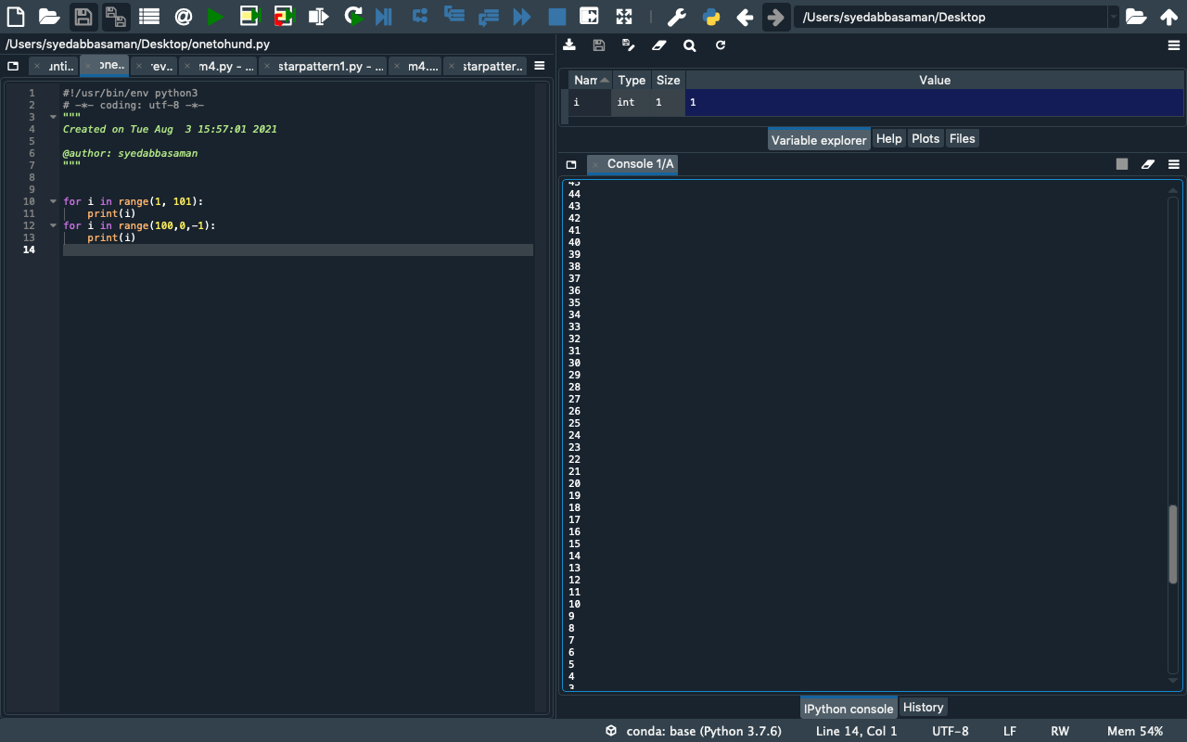
Program1:1 to 100

Slide 2
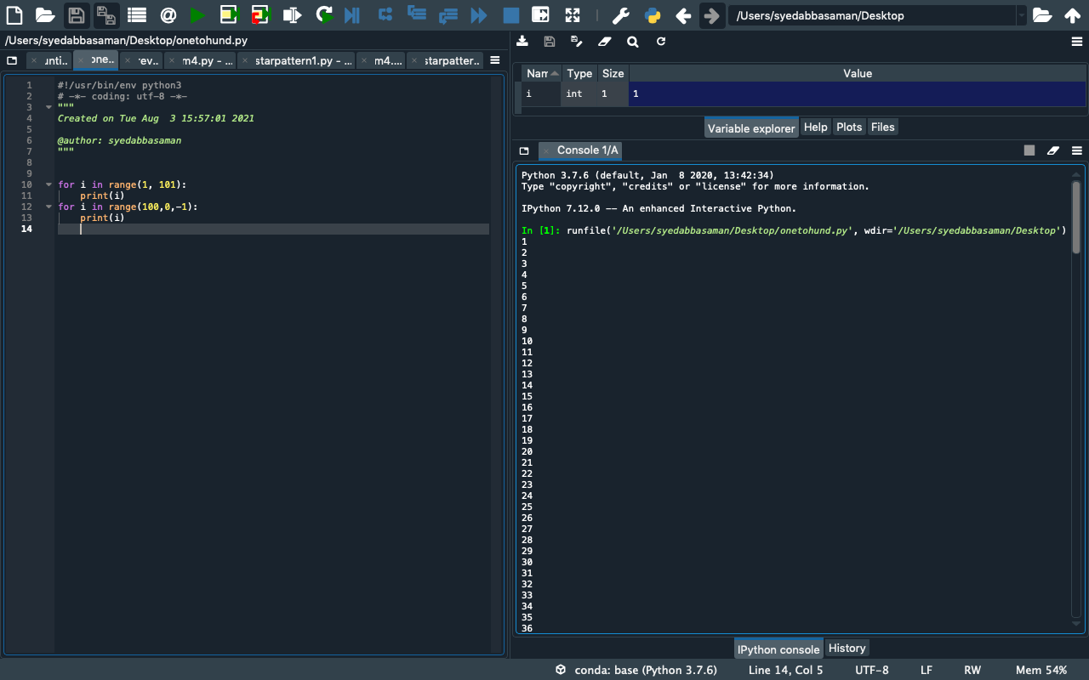
Program1:

Slide 3
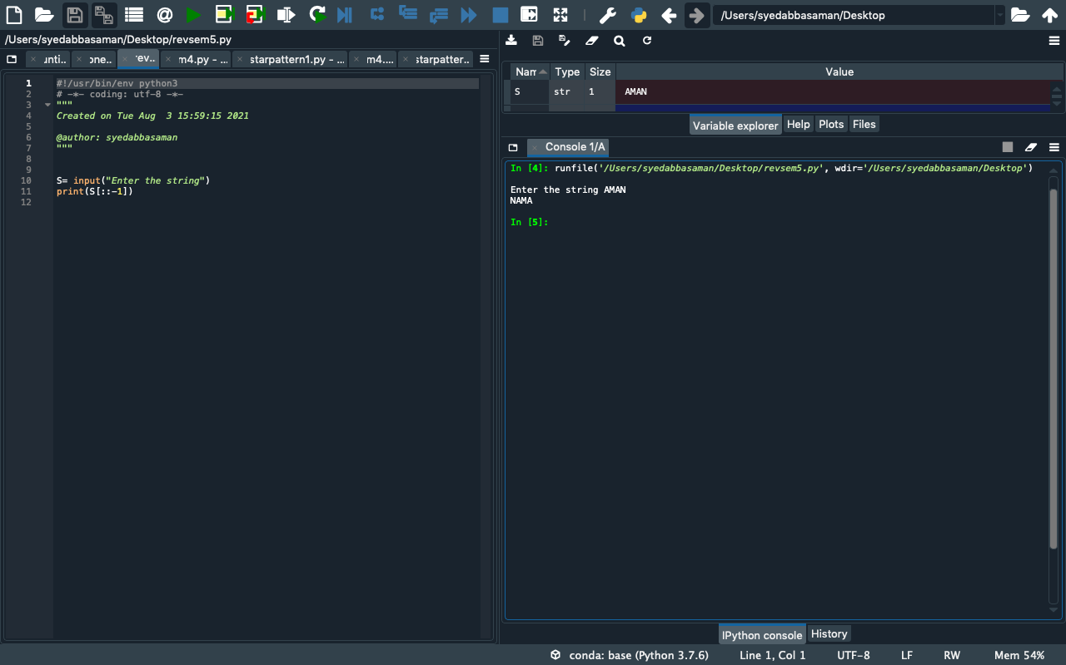
PROGRAM2: Reverse String

Slide 4
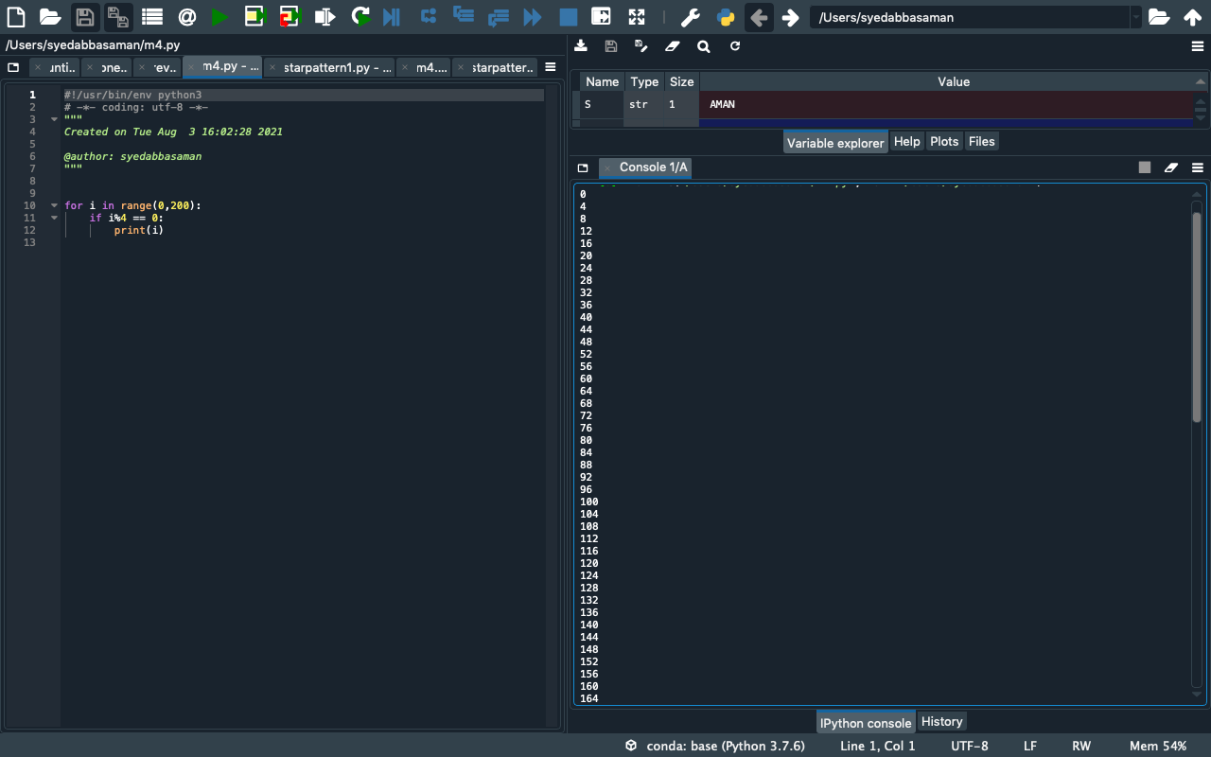
PROGRAM 3: Multiple of 4

Slide 5
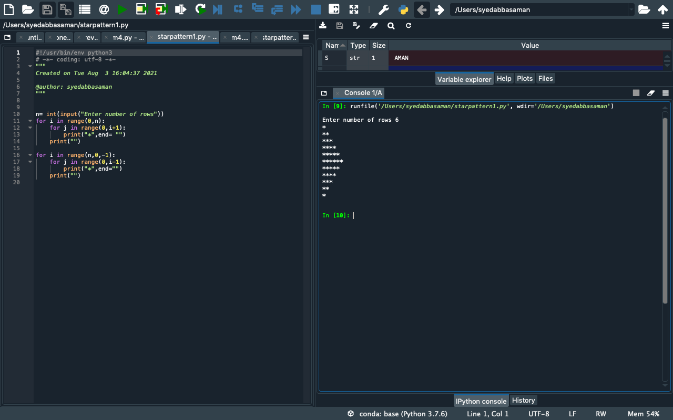
PROGRAM4: PATTERN

