Slide 1

Personal Finance Portfolio Manager
Avon Joshi
Dhruuv Naik
Pratham Junghare
Savio Mampilly
GUIDED BY- Prof. Nilesh Ghavate
COORDINATOR – Prof. Tayyabali Sayyad

Slide 2
OUTLINE OF PPT
WHAT is Crest ?
WHY we need crest?
Prototype design
Database
Role of members
Progress development
Github link

Slide 3
Problem statement:
We are making a system that will help make investment related decisions easier.

Slide 4
WHAT IS CREST ?
Crest is basically a financial calculator.
Crest helps user to make financial decision related to investment and loan.
Crest also provide user financial advisor service.

Slide 5
SCOPE OF PROJECT
Will help make investment related decisions, without confusing the user.
With it’s user friendly UI, the user simply has to input values to obtain the result.
Stock market investment guidance is out of bound of our project.
CREST also takes into consideration the inflation rate and has a target amount feature available in it.

Slide 6
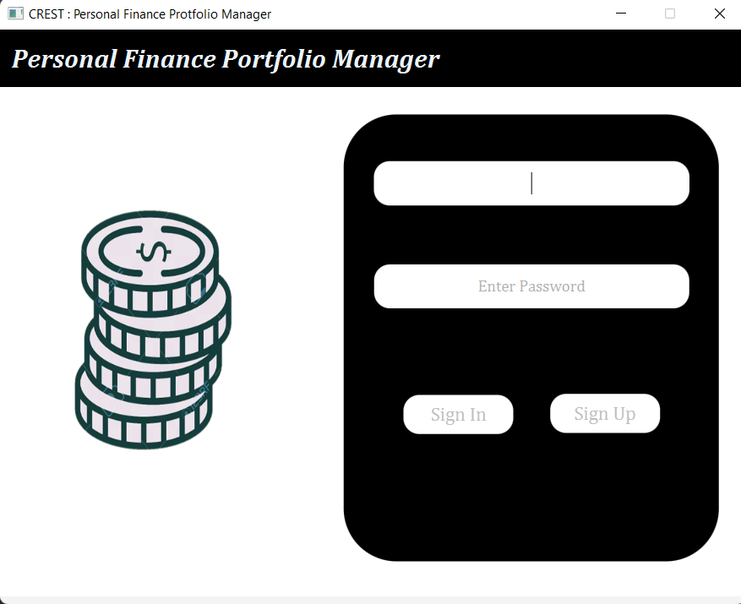
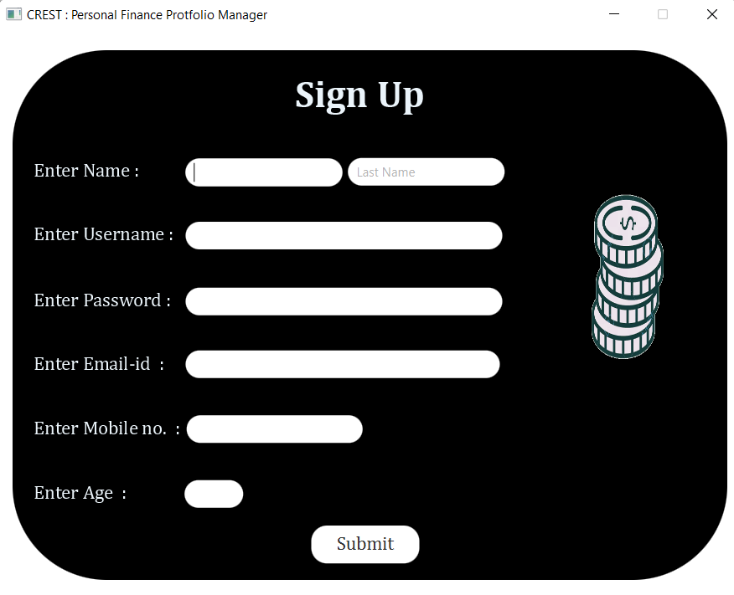
PROTOTYPE – UI design

Slide 7
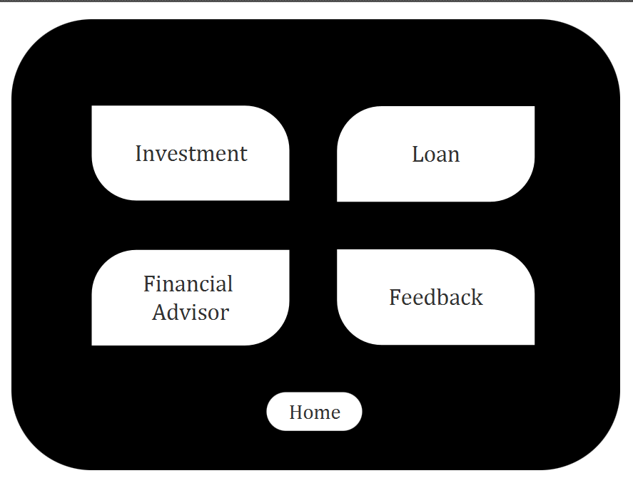
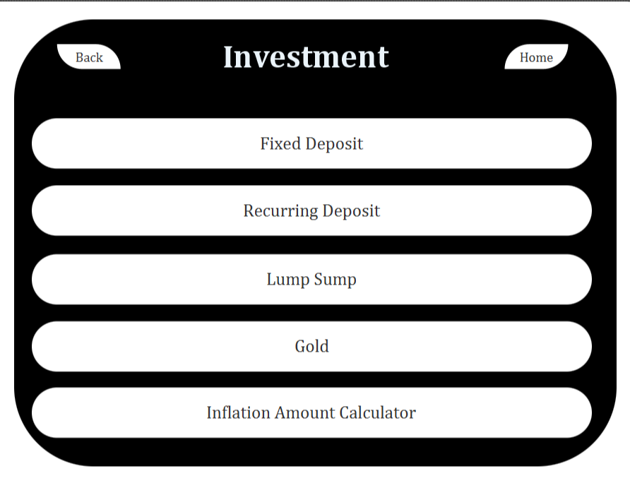
PROTOTYPE – UI design

Slide 8
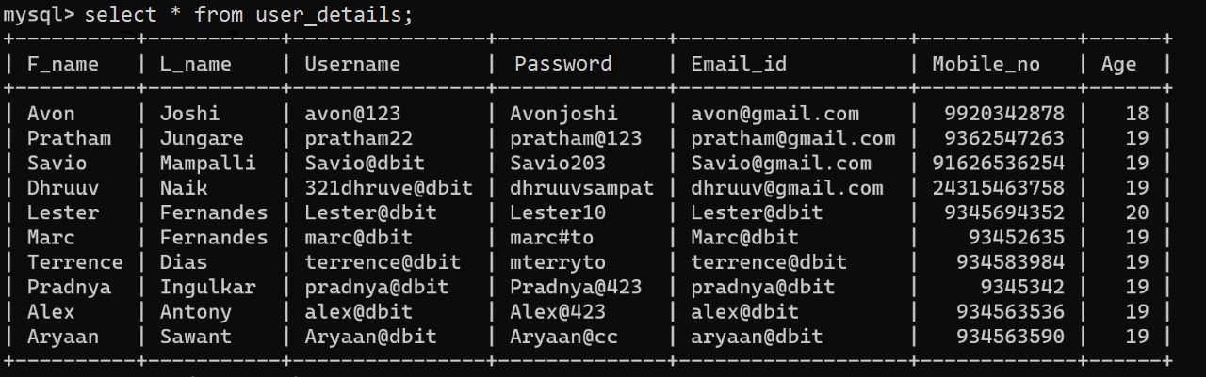
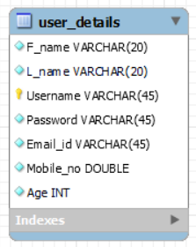
DATA BASE DESIGN Is still being refined

Slide 9
ROLE OF MEMBERS
Pratham- Research and Backend
Dhruuv- UI design and Backend
Avon- Data base management
Savio- UI design and Presentation

Slide 10
Development tools used:
Intellij idea
JavaFX Scenebuilder
MYSQL

Slide 11
PROGRESS DEVELOPMENT
Database has been created and filled with data.
All the separate frames(scenes) have been connected via the use of buttons.

Slide 12
GITHUB LINK
https://github.com/321dhruuv0037/Java_mini_project.git

Slide 13
Reference
https://youtu.be/YSOY_NyOg40
https://www.bankbazaar.com/calculators.html
https://www.indiainfoline.com/business-partners/financial-advisor-fees-cost-charges-in-india
https://youtu.be/gxwo9aSFzV8

