Slide 1

CREST INVESTMENT PORTFOLIO MANGER
Avon Joshi
Dhruuv Naik
Pratham Junghare
Savio Mampilly
GUIDED BY- Prof. Nilesh Ghavate
COORDINATOR – Prof. Tayyabali Sayyad

Slide 2
OUTLINE OF PPT
WHAT is Crest ?
WHY we need crest?
Prototype design
Database
Role of members
Progress development
Github link

Slide 3
Problem statement:
To write a program that makes making investment related decisions easier.

Slide 4
WHAT IS CREST ?
Crest is basically a financial calculator.
Crest helps user to make financial decision related to investment and loan.
Crest also provide user financial advisor service.

Slide 5
SCOPE OF PROJECT
Will help make investment related decisions, without confusing the user.
With it’s user friendly UI, the user simply has to input values to obtain the result.
Guidance.

Slide 6
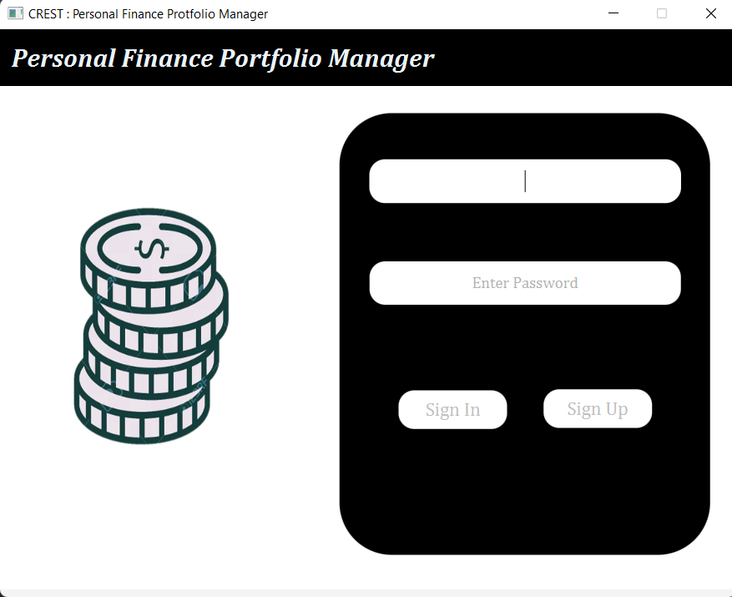
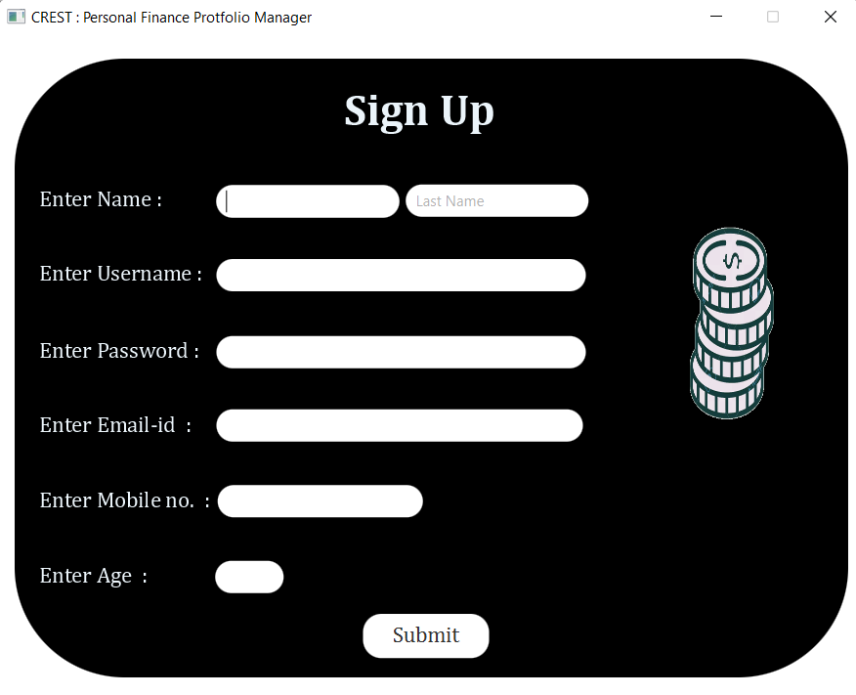
PROTOTYPE

Slide 7
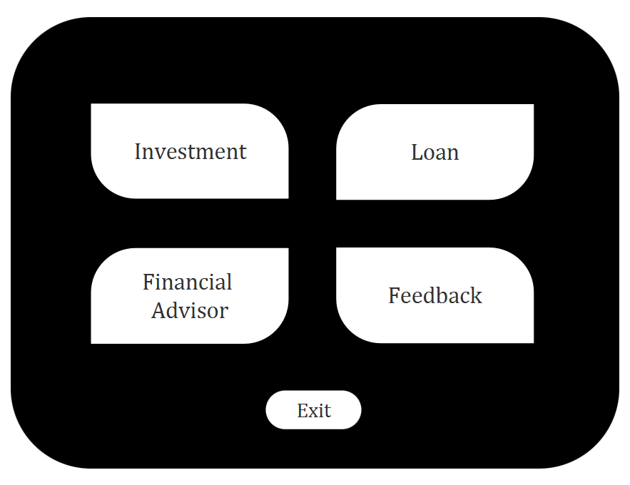
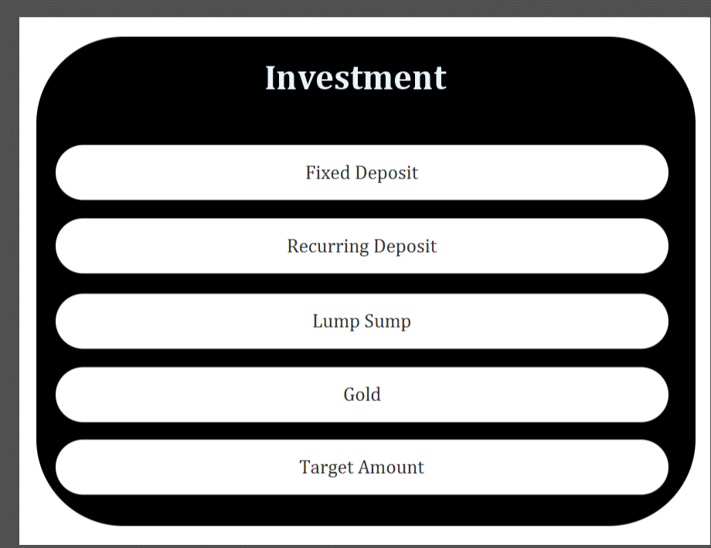
PROTOTYPE

Slide 8
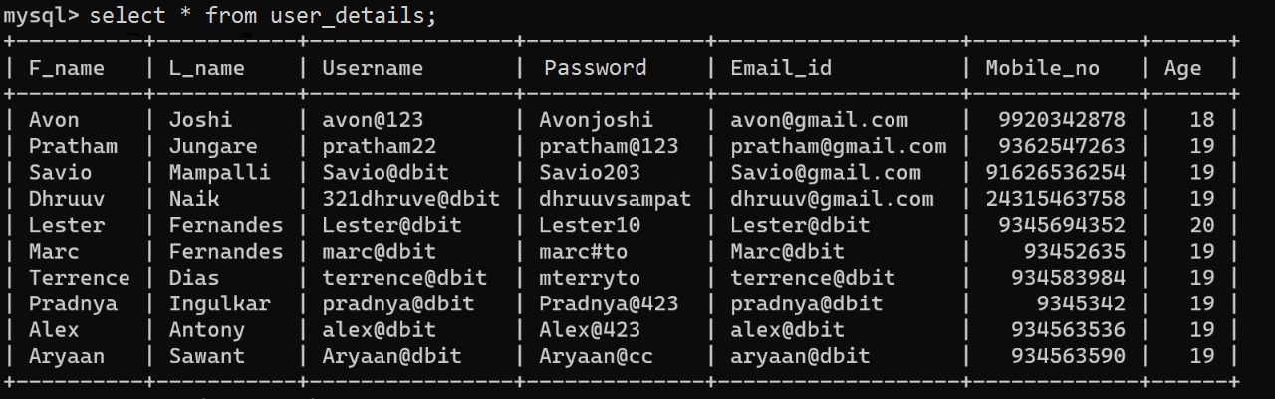
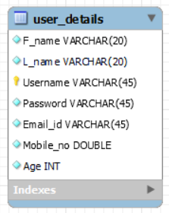
DATA BASE

Slide 9
ROLE OF MEMBERS
Pratham- Presentation and Backend
Dhruuv- UI design and Backend
Avon- Data base management
Savio- UI design and Research

Slide 10
PROGRESS DEVELOPMENT
Database has been created and filled with data.
All the separate frames(scenes) have been connected via the use of buttons.

Slide 11
GITHUB LINK
https://github.com/321dhruuv0037/Java_mini_project.git

Slide 12
Reference

