Slide 1
Venue Management System Project Guide:- Prof. Nilesh Ghavate
Team Members:-
Advay Gujar (25)
Dhruuv Naik (43)
Aryaan Sawant (55)

Slide 2
Outline
Introduction
Problem Statement
Scope of the project
Current scenario
Need for proposed system
Review of literature
System architecture
Technology used
References
Github repository link

Slide 3
Introduction
There are more than 6 departments sharing the same venues (basketball court, football ground, Mondini hall, etc.) in our college campus. This leads to unnecessary crowding/clashes at times. Why not allow students to book certain venues for particular time slots so as to reduce unnecessary crowding and clashes.
As facilities like basketball court and football ground are well maintained but not often used after 5pm, why not allow non college affiliates to use these facilities by charging them on hourly basis. Many colleges having such well maintained facilities, allow outsiders to conduct coaching or use these venues by charging them on hourly basis.

Slide 4
Problem Statement
To create an intuitive and user-friendly web application that streamlines the booking process, improves accessibility and ensures optimum utilization of the college’s facilities.

Slide 5
Scope of the Project
Our project aims to create and streamline a way to book time slots for basketball court, football ground and other venues. We will also take into consideration the hierarchy among our organization’s affiliates while designing the booking system.
We will be using pay on spot as our payment method initially and might add payment gateway service later, if time permits. We will be catering to DBIT & DBCL venues for this project duration.

Slide 6
Current Scenario
Currently there is no quick and easily accessible system to book timeslots for facilities such as football ground, basketball court and top court.
These well maintained facilities are inefficiently used by not allowing non college affiliates to book them after college hours. This will generate side revenue, helping out with the high maintenance cost of such facilities.

Slide 7
Need for Proposed System
Colleges face challenges in effectively allocating resources, prioritizing bookings, and generating revenue to cover maintenance costs.
Some common challenges include: Inefficient resource allocation due to a lack of hierarchy in the booking system. Difficulties in managing and coordinating bookings from faculties with different levels of authority.
Limited revenue streams to sustain high maintenance costs.
Inadequate utilization of facilities during after-college hours.

Slide 8
Review of Literature
Author | Title | Description | Gap
Lalitha V, Mangesh K, Selvanarayanan A, Keertheshwaran G | Online College Event-Hall Booking Reservation System | This system is a comprehensive hall management software with an administrator account for overseeing operations, enabling advance reservations, and tracking hall status. It offers user-friendly access for departments to reserve halls, view amenities, and receive notifications for upcoming events. | Only departments are allowed to book halls/venues. They haven’t considered allowing faculties or student chapters and other higher authorities to book facilities as users. [4]
Can Li, Junjie Li, Hongxiang Cao and Zhan Meng | Design and Implementation of Online Booking System of University Sports Venues | To solve the imbalanced use of university sports venues, the online booking system of university sports venues based on the table tennis hall of Zhengzhou University is designed, combining the experience of the existing online booking systems, the main methods and the major ideal of building these systems both at home and aboard. | The system does not follow hierarchy that is present in an organization. [5]

Slide 9
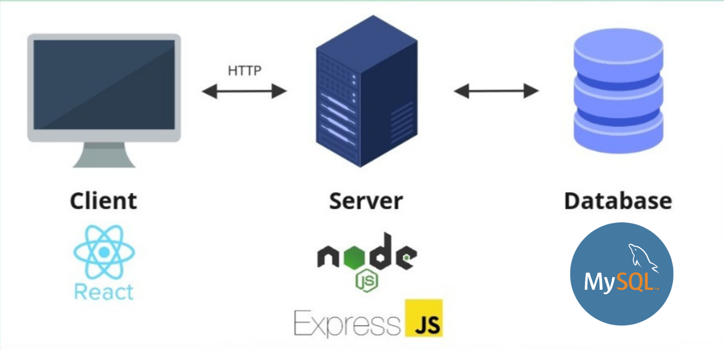
System Design

Slide 10




Technology Used

Slide 11
References
[1] KheloMore, "KheloMore - India's most trusted sports platform," [Online]. Available: https://www.khelomore.com. [Accessed: July 15, 2023].
[2] Hudle, "Hudle - Sports venue booking platform," [Online]. Available: https://hudle.in. [Accessed: July 15, 2023].
[3] PhD Essay, "Facility Management: A Literature Review," [Online]. Available: https://phdessay.com/facility-management-a-literature-review/. [Accessed: July 16, 2023].
[4] L. V, M. K, S. A and K. G, "Online College Event-Hall Booking Reservation System," 2022 1st International Conference on Computational Science and Technology (ICCST), CHENNAI, India, 2022, pp. 972-975, DOI: 10.1109/ICCST55948.2022.10040388.
[5] Can Li, Junjie Li, Hongxiang Cao, Zhan Meng, “Design and Implementation of Online Booking System of University Sports Venues”, MATEC Web Conf. 100 02024 (2017), DOI: 10.1051/matecconf/201710002024

Slide 12
GitHub Repository Link
https://github.com/321dhruuv0037/Web_mp

Slide 13
Thank you!

