Slide 1

Team Members:-
Aditya Gothiwarekar (24)
Dhruuv Naik (43)
Pratham Junghare (30)
Yashas Khot (35)
Project Guide:-
Prof. Shiv Negi

Slide 2
Outline
Introduction
Problem Statement
Scope and present scenario
Proposed solution
Project status
Screenshot/Demo
Feasibility and requirements
Group Members
References

Slide 3
INTRODUCTION

Slide 4
INTRODUCTION
This project aims to use various Python libraries such as plotly, seaborn, NumPy, pandas, and matplotlib to visualize student data(academic performance, demographic information,etc.) and analyze their performance and help make policymakers appropriate decisions. The data used in this project has been generated through synthetic data generation techniques, which will allow for a more comprehensive analysis of the data. It also uses Machine Learning.

Slide 5
PROBLEM STATEMENT

Slide 6
PROBLEM STATEMENT
It is very difficult for a person to interpret textual/tabular data.
We want to develop a project that will help understand student data(academic performance, demographic,etc.) more efficiently by using data visualization, as people tend to understand information better when provided with visual data.

Slide 7
SCOPE &
PRESENT SCENARIO

Slide 8
SCOPE & PRESENT SCENARIO
Data is crucial for policymakers as it enables them to make informed decisions, drive growth and improve operations.
We have used libraries like matplotlib and plotly to visualize student database.

Slide 9
PROPOSED SOLUTION

Slide 10
PROPOSED SOLUTION
Our project aims to present student data(academic performance, demographic,etc.) in a clear and effective manner.
Data will be presented in form of graphs & pie charts. Geographical dispersion will be displayed using maps.

Slide 11
PROJECT STATUS

Slide 12
PROJECT STATUS
The graphs displaying JEE/MHCET percentile, parent income, sex ratio, etc. have been created that will help management make appropriate decisions that will benefit the organization.
Data has been generated via Synthetic Data Generation method.
We have tried to implement a machine learning model into our project.

Slide 13
SCREENSHOTS

Slide 14
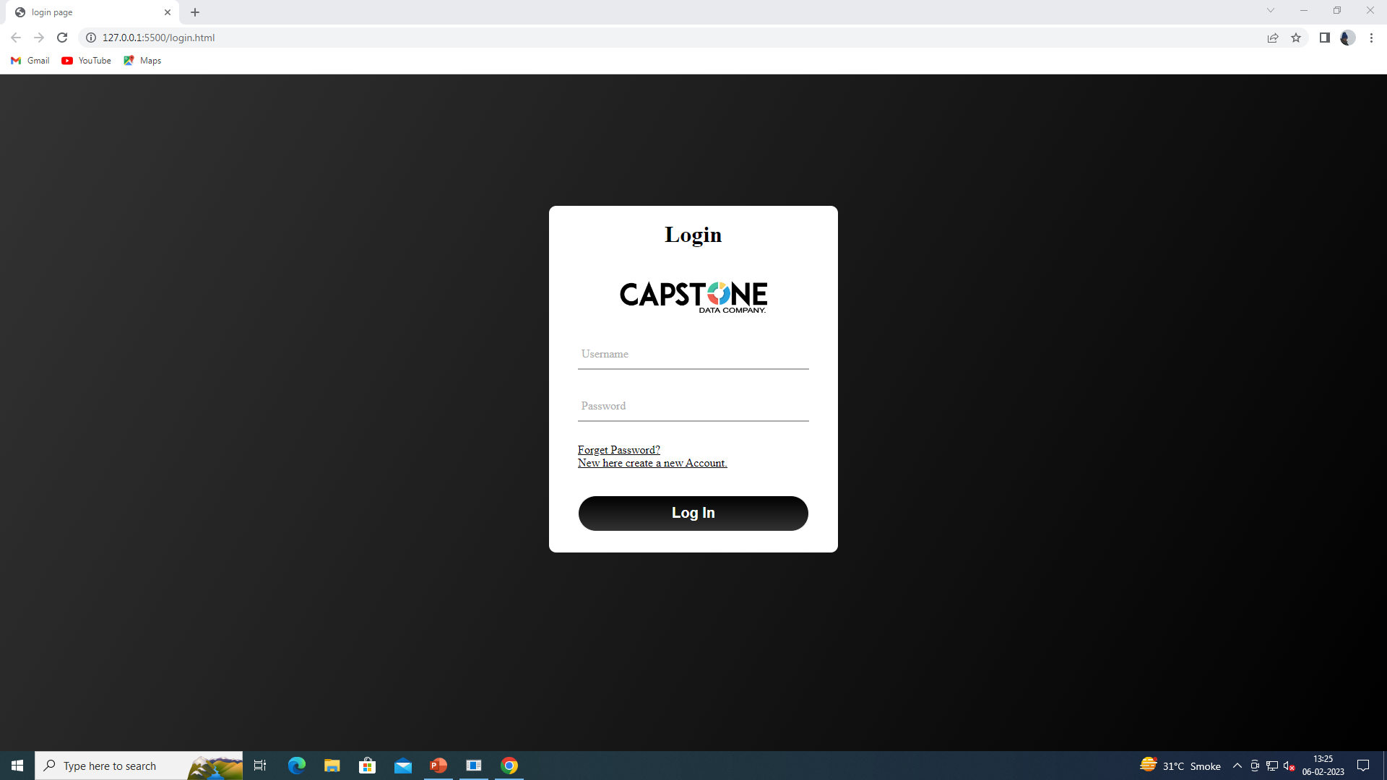
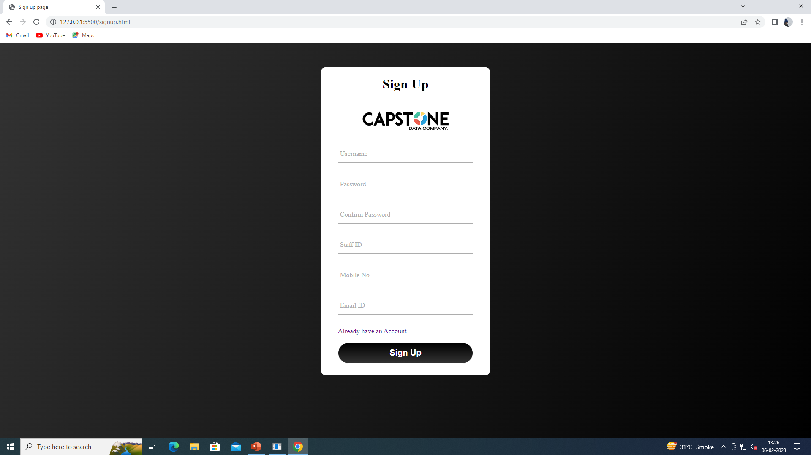
SCREENSHOTS

Slide 15
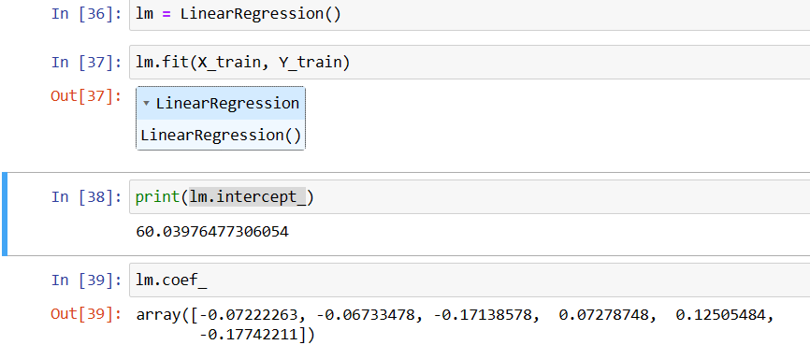
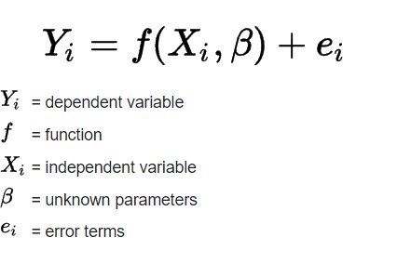
MACHINE LEARNING
Linear regression analysis is used to predict the value of a variable based on the value of another variable. The variable you want to predict is called the dependent variable. The variable you are using to predict the other variable's value is called the independent variable.

Slide 16
FEASIBILITY & REQUIREMENTS

Slide 17
FEASIBILITY & REQUIREMENTS
The proposed project is highly feasible, as it utilizes well-established libraries and techniques in python such as plotly , seaborn, NumPy, pandas, and matplotlib for data visualization, and synthetic data generation techniques such as Random Number Generation and Monte Carlo Simulation for generating data.
Additionally, the use of synthetic data generation techniques allows for a more comprehensive analysis of the student's performance. This is because it can be used to generate a large amount of data that can be used to identify patterns and trends.

Slide 18
GROUP MEMBERS :
ROLE & RESPONSIBILITY

Slide 19
GROUP MEMBERS :
ROLE & RESPONSIBILITY
Dhruuv Naik - Synthetic Data Generation
Pratham Junghare – User Interface and Research
Yashas Khot - Data Analysis and Research
Aditya Gothiwarekar - Data Visualization and Machine Learning

Slide 20
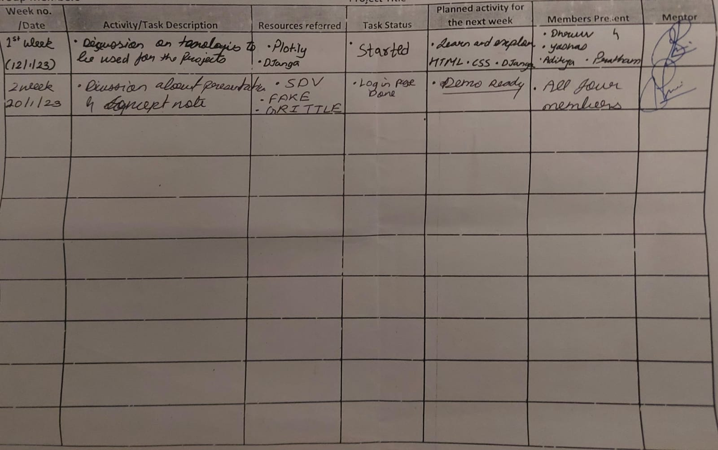
Activity Sheet

Slide 21
REFERENCES

Slide 22
s
REFERENCES
Udemy resources
https://www.udemy.com/course/python-for-data-science-and-machine-learning-bootcamp/learn/lecture/5733420#overview
Dash app creation
https://dash.plotly.com/ml-and-ai-templates
Linear Regression
ML | Linear Regression – GeeksforGeeks
Synthetic Data Generation
https://fakerjs.dev/
Introduction to Random Numbers in NumPy (w3schools.com)

Slide 23
Thank You!

