Slide 1

Home_Price
Data Preprocessing, EDA, Feature Engineering and Model Selection

Slide 2
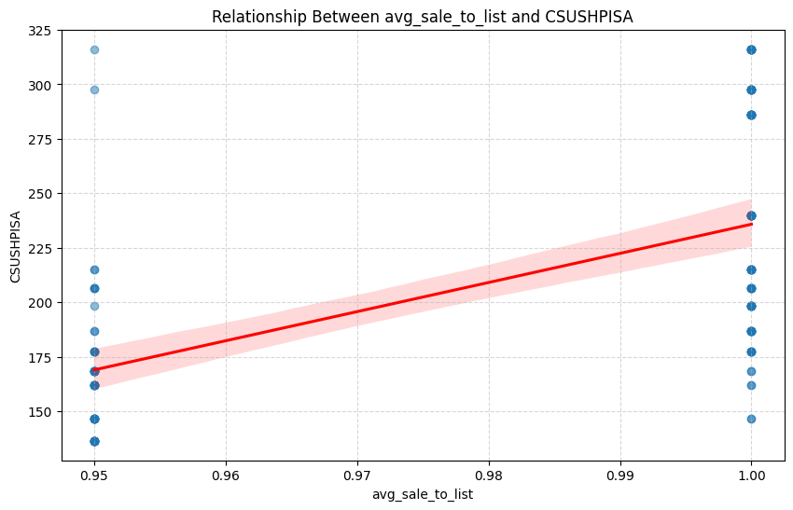
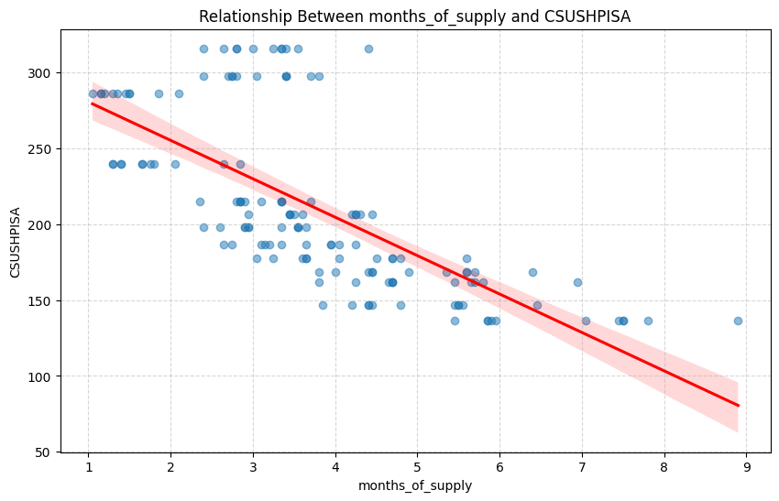
Explanatory Data Analysis – EDA (showcasing the most affecting feature)
Key Insights:
Strong correlations identified between CSUSHPISA and features like median_sale_price, inventory, and homes_sold.
Seasonal trends observed in inventory and sales metrics.
Outliers detected in median_sale_price and inventory.
Visualizations:
Correlation heatmap for feature relationships.
Time-series trends for CSUSHPISA and key features.
Boxplots for outlier detection.

Slide 3
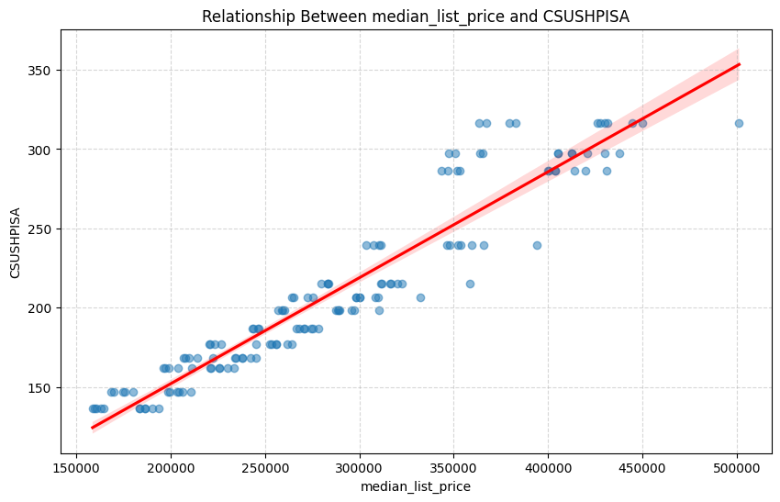
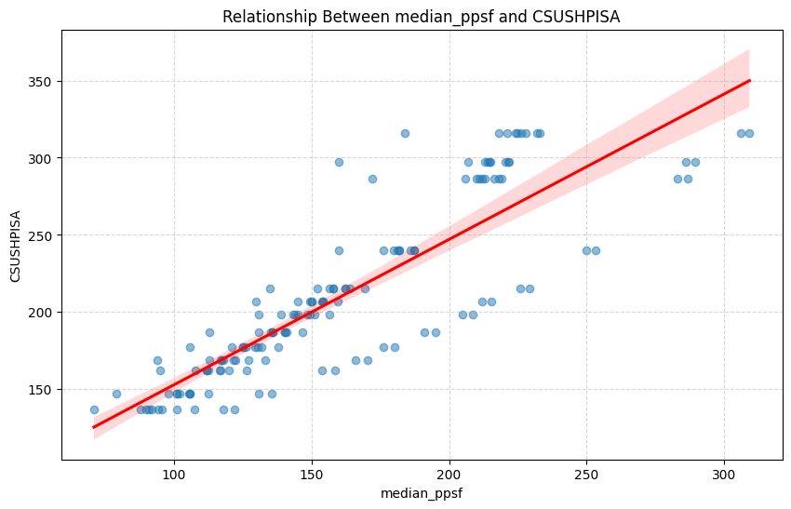
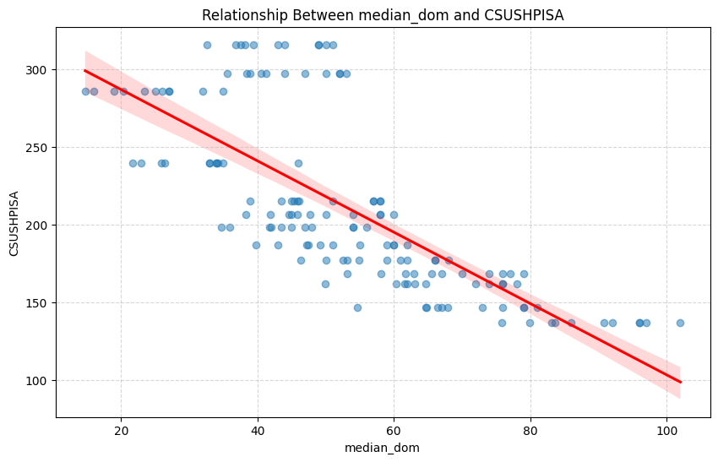
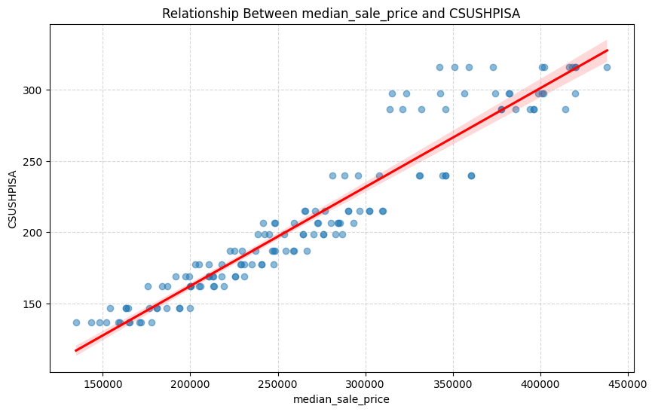

Slide 4
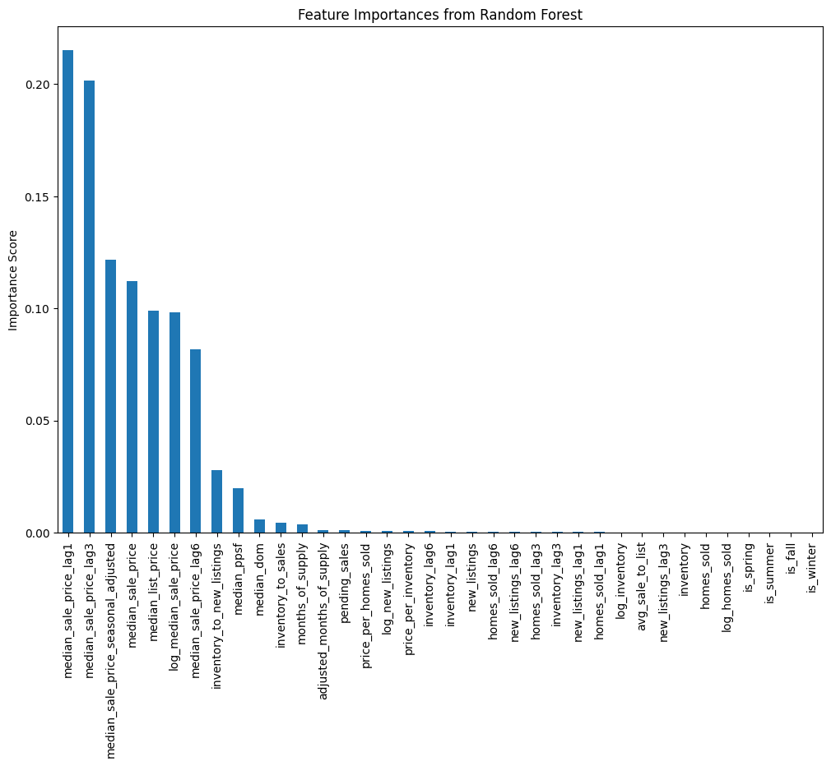
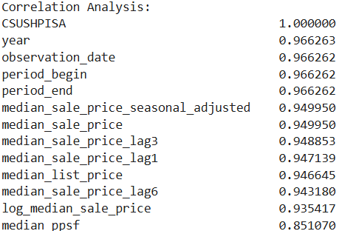
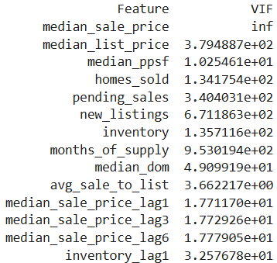
Feature extraction w.r.t CSUSHPISA

Slide 5

Feature Engineering Steps
Lagged Features:
Created 1, 3, and 6-month lags for critical metrics (e.g., median_sale_price, inventory).
Seasonality Adjustments:
Added seasonal indicators (e.g., is_spring, is_summer).
Seasonally adjusted median_sale_price.
Derived Metrics:
Inventory-to-sales ratio, price-per-unit metrics, and adjusted months of supply.
Log Transformations:
Applied to skewed features like median_sale_price and inventory.
Final Features:
Selected top features using Random Forest feature importance and correlation analysis.

Slide 6
Final dataset after applying eda and feature engineering
year | median_sale_price_lag1 | median_sale_price_lag3 | median_sale_price_lag6 | median_sale_price | median_list_price | log_median_sale_price | median_ppsf | homes_sold_lag1 | homes_sold_lag3 | inventory_to_sales | inventory_to_new_listings | median_sale_price_seasonal_adjusted | CSUSHPISA
2012 | 134703.00 | 170747.80 | 143553.55 | 152198.00 | 160420.00 | 11.932944 | 101.00 | 32672.00 | 395277.90 | 7.036442 | 4.028379 | 0.564327 | 136.6
2012 | 152198.00 | 165518.40 | 177702.15 | 148058.00 | 164294.00 | 11.905366 | 71.00 | 22090.00 | 31868.50 | 8.910852 | 4.598782 | 0.548976 | 136.6
2012 | 148058.00 | 134703.00 | 158876.00 | 171650.05 | 186478.55 | 12.053219 | 95.70 | 6865.00 | 32672.00 | 5.640796 | 4.072382 | 0.636452 | 136.6
2012 | 171650.05 | 152198.00 | 170747.80 | 165019.00 | 190335.00 | 12.013822 | 88.00 | 386652.05 | 22090.00 | 7.472938 | 4.260074 | 0.611865 | 136.6
2012 | 165019.00 | 148058.00 | 165518.40 | 159672.00 | 183524.00 | 11.980883 | 91.00 | 213083.00 | 6865.00 | 7.479624 | 4.236058 | 0.592039 | 136.6

Slide 7
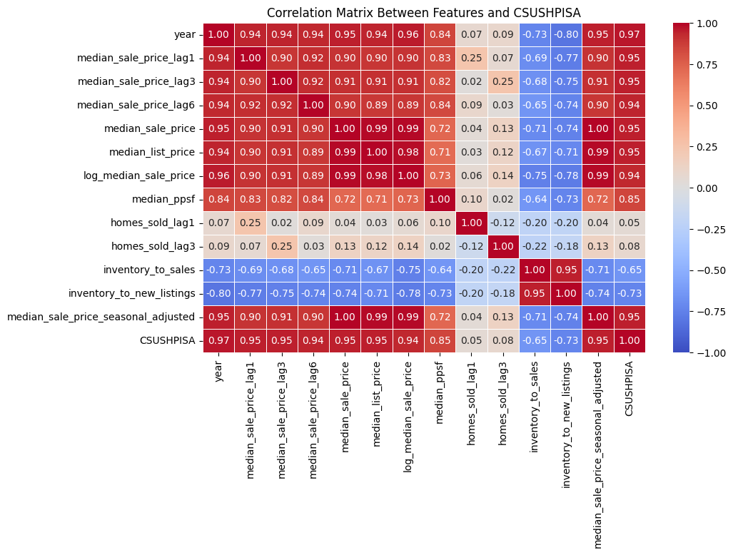
Correlation matrix between the final features for the model and CSUSHPISA

Slide 8
Score comparison for all the Base models
Model | R² | MAE | RMSE
Linear Regression | 0.972525 | 7.280401e+00 | 9.396792e+00
Decision Tree | 1.000000 | 9.135549e-15 | 1.936613e-14
Random Forest | 0.999041 | 1.244732e+00 | 1.755848e+00
XGBoost | 1.000000 | 4.146031e-04 | 8.053193e-04

Slide 9
Score on Prediction data after fine tunning the Random Forest model
R²: | 0.9992023730006738
MAE: | 1.0771821428567907
RMSE: | 1.6010706066563858

