Slide 1
Solving Fibonacci Problem and 0/1 Knapsack Problem Using Dynamic Programming
Presented By - Bikram Sarkar
Roll – 302411001008
3rd year, 2nd Semester
Date – 19th march, 2026

Slide 2
Concept of Dynamic Programming
Techniques to solve complex problems by breaking them into subproblems.
Stores results of subproblems to avoid recomputation.
There are two approaches : Memorization(Top-Down Approach) and Tabulation approach(Bottom-Up).
Used when problems have overlapping subproblems and optimal substructure.

Slide 3
Fibonacci Problem
Recursive relation: F(n) = F(n-1) + F(n-2)
Base Case: F(0) = 0, F(1) = 1
The Recursive approach has exponential time complexity
DP reduces time complexity to O(n)

Slide 4
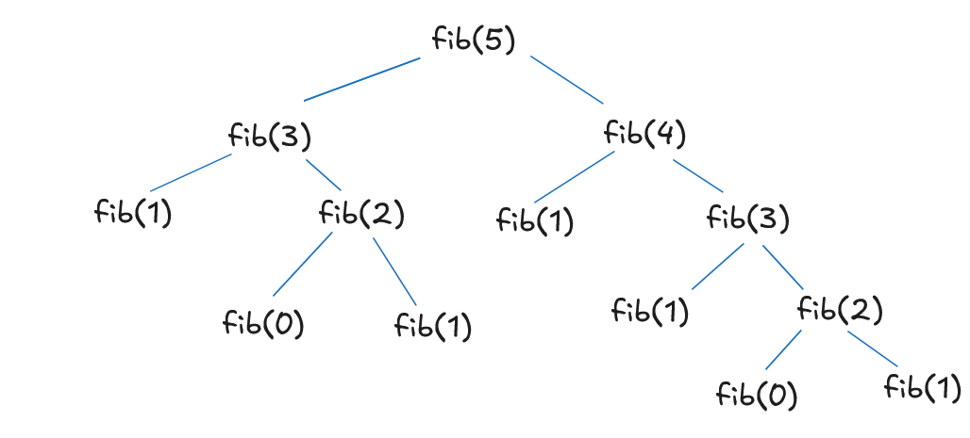
Fibonacci Decision Tree (Recursive)

Slide 5
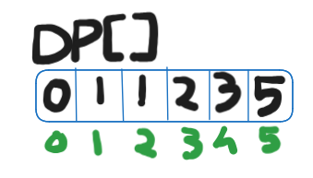
Fibonacci Using DP
Memorization: Store computed values in array.
Tabulation: Build solution from bottom
Example:
dp[0]=0, dp[1]=1
for i <- 2 in to n:
dp[i]=dp[i-1]+dp[i-2]
Time: O(n), Space: O(n)
Optimized: use only 2 variables
Recurrence Relation: 2T(n-1)+1

Slide 6
Fibonacci Decision Tree (DP)

Slide 7
Knapsack Problem (0/1)
Given weights and values of items
Goal: Maximize value within capacity
Each item can be taken or not taken
Recursive decision:
max(include, exclude)
Can be represented in variable {X2,X4} or fixed size {0,1,0,1} solution format.

Slide 8
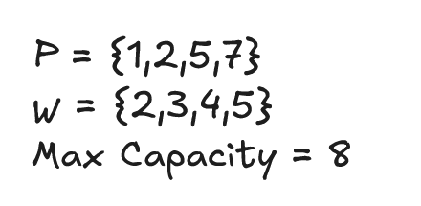
Solving Using Tabular Methode
Let there is 4 items with weights and profit are given -
Cells are filled using formula: V[i,w] = max{V[i-1, w], V[i-1,w-w[i]]+P[i]}
Since max weight is 8 so there will be 8 columns and 4 rows for 4 elements.

Slide 9
Solving Using Tabular Methode
index | 0 | 1 | 2 | 3 | 4 | 5 | 6 | 7 | 8
0 | 0 | 0 | 0 | 0 | 0 | 0 | 0 | 0 | 0
1 | 0 | 0 | 1 | 1 | 1 | 1 | 1 | 1 | 1
2 | 0 | 0 | 1 | 2 | 2 | 3 | 3 | 3 | 3
3 | 0 | 0 | 1 | 2 | 5 | 5 | 6 | 7 | 7
4 | 0 | 0 | 1 | 2 | 5 | 6 | 6 | 7 | 8
Taking the max profit 8. That is for X4 and profit is 6 so remaining, 8-6 = 2. X4 is included.
Profit of 2 was achieved before X3, so X3 isn’t considered.
For X2 profit of 2 is achieved. 2-2 = 0. X2 is included.
Profit 0 was present before X1 so its not taken.
Final answer: {X2, X4} or {0,1,0,1}

Slide 10
Thank You

