Slide 1


Final Year Project
NeuraWall
Supervisor: Mr. Osama Raza (Senior Lecturer)
Co-supervisor: Mr. Awais Nawaz (Teaching Fellow)

Slide 2
Project Team
Umar Abdullah (33073)
Muhammad Ubaid Ullah (32602)
Hamza Gulzar (31621)

Slide 3
Table of Content
Opportunity & Stakeholders
Market Research
Problem Statement
Solution
Progress Report Summary
Requirements
Software System (Design + Implementation + Testing)
Endeavour (Team + Work + Way of Working)
Next Steps
Prototype / Report

Slide 4
Opportunity & Stakeholders

Slide 5
Opportunity & Stakeholders
Opportunity:
There exists a gap in the market as there are no open-source AI based firewalls in the market.
Traditional firewalls rely on static rules, failing to adapt to new threats.
Growing demand for AI-driven, adaptable cybersecurity solutions.
Stakeholders:
Direct: Network administrators, IT security teams, and organizations with sensitive data.
Indirect: End-users benefiting from secure networks, compliance and regulatory bodies.

Slide 6
Market Research
Existing Solutions:
Intrusion Detection Systems (e.g., Snort, Suricata) lack adaptability to unknown threats.
Rule-based firewalls struggle with zero-day attacks.
There is no open-source AI driven Firewall in the market.
Gaps Identified:
Lack of integration between AI detection and real-time network control.
Limited user-friendly interfaces for monitoring and response.
Rule-based Firewalls lack adaptability to new threats.

Slide 7
Problem Statement
Traditional firewalls struggle to detect and prevent modern, dynamic cyber threats.
Manual rule creation and updates are time-intensive and error-prone.
Need for an intelligent, real-time solution capable of adapting to evolving attack patterns.

Slide 8
Solution
NeuraWall: AI-Driven Firewall
Combines machine learning models (One-Class SVM and Gradient Boosting) for anomaly detection.
Real-time detection and blocking of malicious IPs.
Web-based GUI for logs, metrics, and malicious traffic visualization.
Key Features:
Handles real time traffic.
Dynamic adaptability to network environments.
VPN and Wazuh integration for enhanced security.

Slide 9
PROGRESS REPORT Summary

Slide 10
Progress Report Summary
Completed Tasks:
Data preprocessing and model training using CIC-IDS datasets.
Two Models trained for better attack detection.
Backend Flask API for communication with the AI model.
Basic React frontend for visualization.
Initial prototype with Real-time traffic handling.
Upcoming Tasks:
Wazuh and VPN integration with the current pipeline.
Adding general quality of life changes to the GUI.
Adding a database to the whole system.

Slide 11
Requirements
Hardware Requirements:
8 GB RAM, Quad-core processor, 50 GB disk space.
Software Requirements:
Python 3.9, Flask, ReactJS, CICFlowMeter, Scikit-learn.
VPN and Wazuh configurations for security layers.
Data Requirements:
Preprocessed CICFlowMeter outputs (network traffic features).
Labeled datasets for model training.

Slide 12
Requirements
Functional Requirements:
User-friendly GUI for logs, metrics, and malicious IP visualization.
Real-time detection of malicious traffic using AI.
Automatic IP blocking and logging of flagged events.
Integration with Wazuh for alerting and detection.
pfSense VPN for secure communication.
Non-Functional Requirements:
Scalability to handle increasing traffic volumes.
High availability and minimal downtime.
Ensure quick response times for traffic analysis and blocking.
Maintain data privacy and integrity.

Slide 13
Design
Implementation (current):
Feature extraction using CICFlowMeter.
Preprocessing data and passing to the AI models.
Malicious IP identification through AI models.
IP Blocking using Windows Firewall.
React Js and flask backend for Web based dashboard.

Slide 14
Design
Anomaly Detection with One-Class SVM
Purpose: Identifies deviations from normal network behavior.
Dataset: Trained on a dataset specific to the native network environment to ensure anomaly detection.
Traffic Classification with Gradient Boosting
Purpose: Classifies traffic into malicious and non-malicious categories.
Dataset: Trained on the CICIDS 2017 dataset, a comprehensive benchmark for intrusion detection systems.

Slide 15
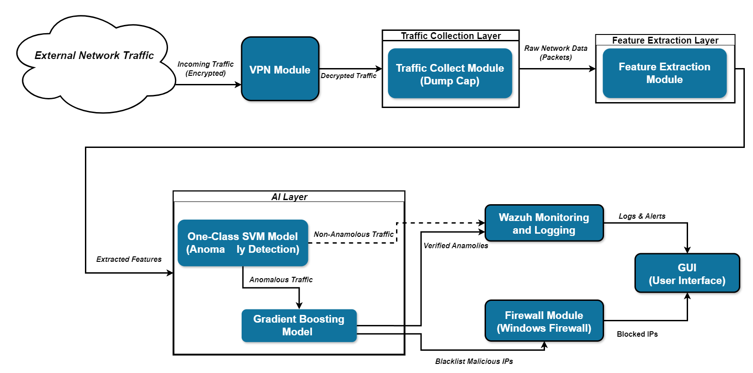
Design
Architecture Diagram

Slide 16
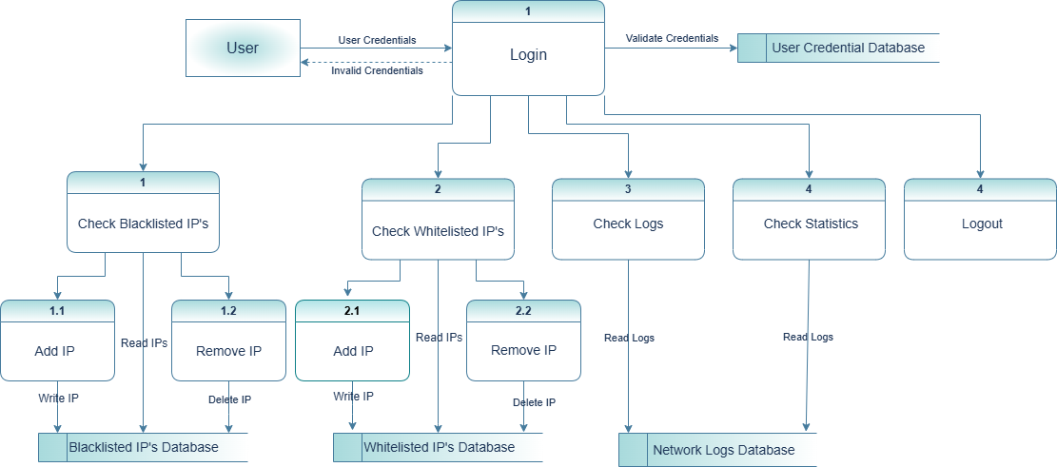
Design
Data Flow Diagram

Slide 17
Implementation
Tools:
CICFlowMeter for feature extraction.
pfSense
Wazuh.
Technologies:
Python
Flask
ReactJS
Version Control:
Used Git for source code management.

Slide 18
Implementation
Libraries:
Scikit-learn, Joblib, and Pandas for AI and visualization.
Watchdogs for CSV handling
React-Bootstrap for GUI components.
Flask for communicating between GUI and AI models.
Web Services:
REST APIs for backend communication.
Wazuh for monitoring and alerts.
pfSense for network traffic management.

Slide 19
Testing
Testing:
Simulated attacks using tools like Nmap and Hydra.
Evaluation metrics: 90% Attacks like Port scanning, Dos and Brute forcing successfully detected.

Slide 20
Endeavour

Slide 21
Endeavour
Team Structure:
Umar Abdullah (Frontend & Backend developer)
Hamza Gulzar (Frontend & Backend developer)
Muhammad Ubaid Ullah (Data scientist)
Work Done:
Real-time traffic handling pipeline
AI models training and integration into pipeline
Frontend Dashboard and Backend API creation.
Way of Working:
Agile methodology with iterative sprints.
Weekly team sync-ups for progress tracking.

Slide 22
NEXT STEPS

Slide 23
Work Breakdown Structure
Major Deliverable 1
Sub Deliverable 1 of 1: Initial dataset preprocessing and cleaning.
Sub Deliverable 2 of 1: AI model selection and training.
Sub Deliverable 3 of 1: Backend Flask API setup.
Major Deliverable 2
Sub Deliverable 1 of 3: CICFlowMeter integration for feature extraction.
Sub Deliverable 2 of 3: Basic React frontend development.
Sub Deliverable 3 of 3: Real-time traffic analysis module.
Major Deliverable 3
Sub Deliverable 1 of 3: Enhanced GUI with interactive charts.
Sub Deliverable 2 of 3: Wazuh integration for logging and anomaly detection.
Sub Deliverable 3 of 3: pfSense setup for encrypted network traffic control.
Major Deliverable 4
Sub Deliverable 1 of 3: Prototype testing and debugging.
Sub Deliverable 2 of 3: Final report preparation and presentation.
Sub Deliverable 3 of 3: Future recommendations and scalability plans.

Slide 24
Challenges
Feature Selection:
Ensuring extracted features were relevant for anomaly detection and avoided overfitting.
AI Model Selection:
Choosing a machine learning model that performs well with network traffic data.
Addressing differences between the CIC IDS 2017 dataset and native traffic to ensure the model generalizes effectively.
Real Time Processing:
Building a pipeline to capture, preprocess, and analyze live traffic using the AI model.
Ensuring predictions and actions, such as blocking malicious IPs, occurred with minimal delays.
Optimizing the pipeline to balance speed and accuracy for real-time threat detection.

Slide 25
Challenges
Consistency in Preprocessing Real-Time Traffic:
Replicating the preprocessing steps used in the CIC IDS 2017 dataset for live traffic.
Resource Constraints:
Addressing computational overheads of AI models to run on moderate hardware.
Managing memory and CPU usage for real-time processing.
User Interface Challenges:
Designing a user-friendly and interactive dashboard.
Visualizing metrics and logs effectively for network administrators.

Slide 26
Prototype & Report

Slide 27
Prototype
Prototype Highlights:
Fully functional AI-driven traffic analysis module.
GUI showcasing logs, metrics, and flagged malicious IPs.
Real-time IP blocking mechanism integrated with the Windows Firewall.
Report Overview:
Detailed documentation of design, implementation, and testing phases.
Insights into model performance and accuracy metrics.

Slide 28
Report
Chapter 1: Introduction
Chapter 2: Market Survey
Chapter 3: Requirements and System Design
Chapter 4: Proposed Solution

