Slide 1

Final Year Project
NeuraWall
Supervised By: Mr. Osama Raza (Senior Lecturer),
Mr. Awais Nawaz (Teaching Fellow)

Slide 2
Project Team
Umar Abdullah (33073)
Muhammad Ubaid Ullah (32602)
Hamza Gulzar (31621)

Slide 3
Table of Content
Background and Introduction
Market Research
Problem Statement
Project Scope
Proposed Solution
Requirements Summary
Design Summary
Methodology
Implementation Summary
Experiments and Results Summary
Testing Summary
Conclusion and Outlook

Slide 4
BACKGROUND AND INTRODUCTION

Slide 5
Background and Introduction
Cybersecurity threats have grown in complexity, outpacing traditional firewall capabilities.
Traditional firewalls are rule-based, making them static and ineffective against unknown threats.

Slide 6
Background and Introduction
NeuraWall is a multi-layered security framework.
AI-driven firewall.
Wazuh-based logging and SIEM.
VPN tunnel for encrypted communication.
This layered design enhances security at different stages, minimizing single points of failure.

Slide 7
Background and Introduction
Limitations of Traditional Firewalls
Rely on static, manually configured rules.
Any new or evolving threat requires updating rules, which is time-consuming and requires expert supervision.
Managing frequent rule changes can be tedious and increases the administrative burden

Slide 8
Background and Introduction
Evolution to Smart Defense
Shift towards intelligent, adaptive systems using AI.
Our solution adds a predictive layer to firewall functionality.
Integrates into a broader "Defense in Depth" strategy, creating multiple barriers against threats.

Slide 9
Market Research

Slide 10
Market Research
Industry Need
SMEs are vulnerable due to limited budgets and lack of AI tools.
Real-time traffic analysis tools are niche and often enterprise-only.
Rising demand for real-time threat detection, especially among SMEs and enterprise edge networks.

Slide 11
Market Research
Existing Solutions & Gaps
Traditional firewalls are good at handling known threats but suffer from.
High false positive rates.
Manual rule updates.
Poor scalability in dynamic environments.

Slide 12
PROBLEM STATEMENT

Slide 13
Problem Statement
Static detection mechanisms can’t keep up with modern threats.
Rule-based firewalls fail against evolving threats.
Manual updates increase operational complexity.
NeuraWall aims to provide a dynamic, AI-powered firewall that Detects and mitigates threats in real-time.
Requires minimal manual intervention.

Slide 14
ENDEAVOUR

Slide 15
Endeavour
Team Structure:
Umar Abdullah (Frontend & Backend developer)
Hamza Gulzar (Frontend & Backend developer)
Muhammad Ubaid Ullah (Data scientist)
Work Done:
Real-time traffic handling pipeline
AI models training and integration into pipeline
Frontend Dashboard and Backend API creation.
Wazuh Integration in the Dashboard.
VPN Configured for Secure Communication.
Way of Working:
Agile methodology with iterative sprints.
Weekly team sync-ups for progress tracking.

Slide 16
PROPOSED SOLUTION

Slide 17
Proposed Solution
Hybrid AI Model: One-Class SVM + Gradient Boosting.
Real-time traffic capture (Dumpcap), processing (CICFlowMeter).
Blocking via Windows Firewall.
Wazuh for Host-Based Detection.
GUI for visualization.

Slide 18
Proposed Solution
Key Components
AI Based Firewall
Wazuh
VPN

Slide 19
Proposed Solution
Defense in Depth
Provides intelligent internal filtering.
Complements antivirus, IDS/IPS, and Wazuh.
Functions as an active detection layer in a multi-layered security system.

Slide 20
Requirements Summary
Functional Requirements
Real-time traffic capture and feature extraction.
Real-time detection of malicious traffic using AI.
Model inference and decision-making.
Logging and alerting.
Block/allow list management.
Automatic IP blocking and logging of flagged events.
Integration with Wazuh host-based detection.
PfSense VPN for secure communication.

Slide 21
Requirements Summary
Non-Functional Requirements
Fast processing with low system overhead.
Scalable architecture.
Secure communication between components.
Scalability to handle increasing traffic volumes.
High availability and minimal downtime.
Ensure quick response times for traffic analysis and blocking.
Maintain data privacy and integrity.

Slide 22
Design Summary
Firewall Component:
Acts as the first line of defense for unencrypted traffic.
Captures traffic via Dumpcap, extracts features using CICFlowMeter.
Uses One-Class SVM and Gradient Boosting for hybrid detection.
Real-time detection and blocking using Windows Firewall APIs.

Slide 23
Design Summary
Wazuh Component:
Provides SIEM functionality: monitors, logs, and visualizes threats.
Parses firewall and agent logs in real-time.
Logs on Dashboard on potential breaches.

Slide 24
Design Summary
VPN Component:
Provides secure encrypted channel between Devices and the network to enhance security.
Adds an extra layer of security into the whole framework.

Slide 25
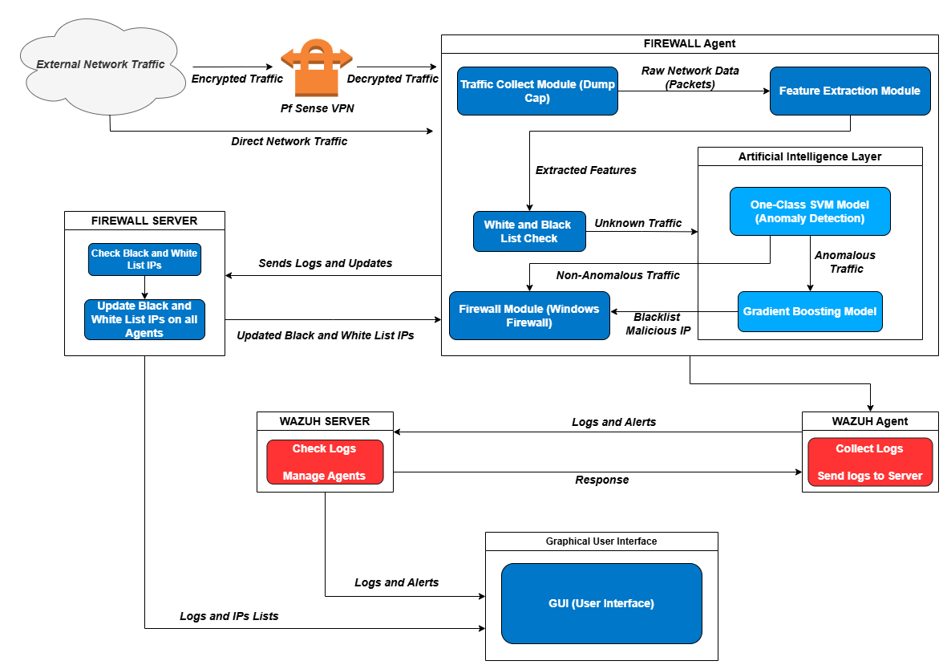
Design Summary
Architecture Diagram

Slide 26
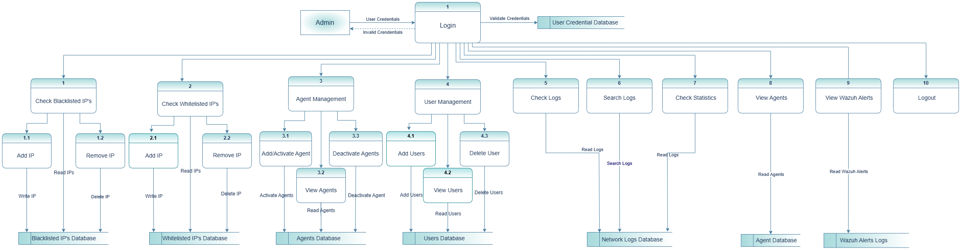
Design Summary
Data Flow Diagram

Slide 27
Methodology
Data: Real traffic (Dumpcap) + CIC (Canadian Institute of Cyber Security) IDS Dataset.
Preprocessing: Filtering, Labeling, Outlier Removal.
ML Models: One-Class SVM & Gradient Boosting.

Slide 28
Implementation Summary
Component Responsibilities
Agent: It captures traffic processes it and makes predictions and then pushes predictions to the server.
Server: Central logging and IP management.
Dashboard: Visual representation of logs and controls.

Slide 29
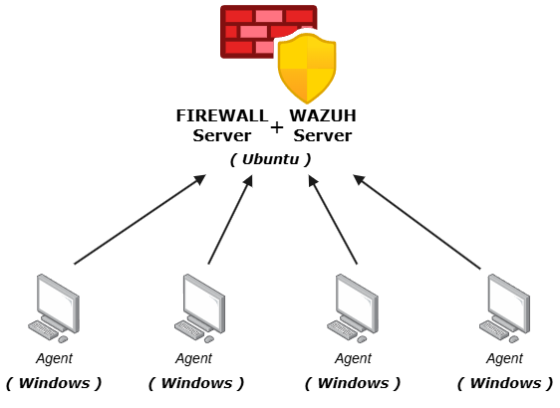
Implementation Summary
Server-Agent Model

Slide 30
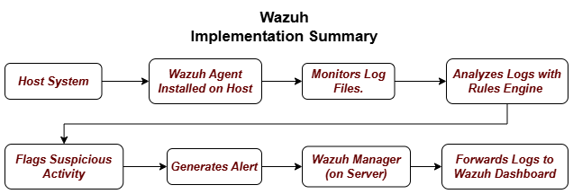
Implementation Summary

Slide 31
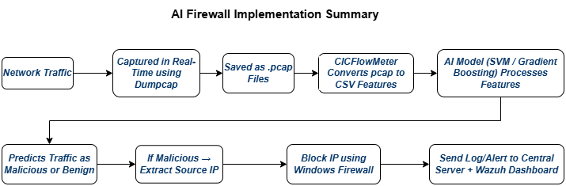
Implementation Summary

Slide 32
Implementation Summary
Backend: Flask, Python, Scikit-learn
Frontend: React.js
Tools: Dumpcap, CICFlowMeter, Windows Firewall API.
CICFlowMeter Enhancements:
Upgraded to latest Java version.
Removed GUI dependencies to enable headless CLI-based operation.
Modified internal classes to streamline batch feature extraction and automation.

Slide 33
Implementation Summary
Dashboard Features
Pages: Login, Live Logs, Blocked IPs, Whitelist Manager.
Built with React and connected via RESTful APIs.
Simple, clean design with filtering and searching options.

Slide 34
Testing Summary

Slide 35
Testing Summary
Testing Types
Unit tests on data parsing, firewall commands.
Integration tests for agent-server communication.
UI tests for dashboard responsiveness and log display.
Unit + Integration Tests: Agent, Server, Wazuh, VPN.
Simulated attacks tested: DDoS, Port scan, Brute force.

Slide 36
Testing Summary
Real-World Scenario Testing
Used simulated malicious traffic in lab environment.
Validated detection rates and block actions.
Confirmed log syncing and dashboard updates.

Slide 37
CONCLUSION AND OUTLOOK

Slide 38
Conclusion & Outlook
Summary:
Built an end-to-end AI firewall system.
Adds a predictive filtering layer to Defense in Depth.
Real-time AI detection, GUI, Server-Agent model.
Wazuh integration for host-based detection.
This project demonstrates a functional proof of concept.
Successfully detected threats using hybrid AI models.
Achieved integration across firewall, VPN, and Wazuh.

Slide 39
Conclusion & Outlook
Future Directions
Model retraining via user feedback.
Expand agent deployment to cloud and IoT systems.
Live retraining, threat intelligence feeds.
With future upgrades, it can evolve into a production-grade NDR (Network Detection & Response) system.
Use more diverse and real-world datasets.
Upgrade Wazuh to handle multi-source correlation and incident response.
Expand VPN to full enterprise-grade secure communications.
Potential future expansion: full traffic tunneling, geo-routing, kill-switch logic.
Extendable with deeper analytics, correlation rules, and threat intelligence feeds.
Can be improved with online learning and deep learning models.

Slide 40
Thank You

