Slide 1
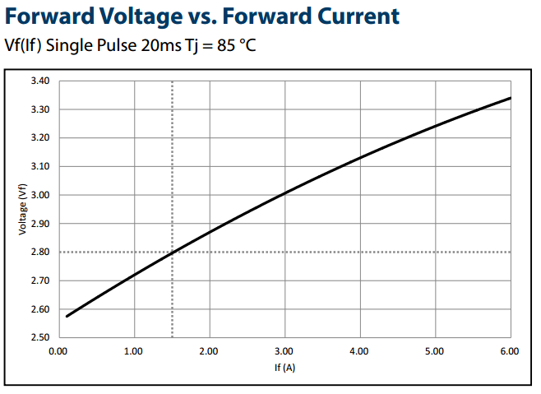
2.63V
0.43A

Slide 2
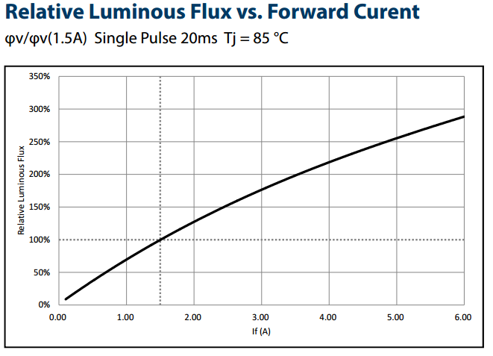
31%
0.43A

