Slide 1
2 0 1 6

Slide 2
Text something here
Part one
Part two
Part three
Part four

Slide 3
Part one
having something to eat when you are hungry

Slide 4
Text something here
Happiness is not about being immortal nor having food or rights in one's hand.
Happiness is not about being immortal nor having food or rights in one's hand.
PPT模板下载：www.1ppt.com/moban/ 行业PPT模板：www.1ppt.com/hangye/
节日PPT模板：www.1ppt.com/jieri/ PPT素材下载：www.1ppt.com/sucai/
PPT背景图片：www.1ppt.com/beijing/ PPT图表下载：www.1ppt.com/tubiao/
优秀PPT下载：www.1ppt.com/xiazai/ PPT教程： www.1ppt.com/powerpoint/
Word教程： www.1ppt.com/word/ Excel教程：www.1ppt.com/excel/
资料下载：www.1ppt.com/ziliao/ PPT课件下载：www.1ppt.com/kejian/
范文下载：www.1ppt.com/fanwen/ 试卷下载：www.1ppt.com/shiti/
教案下载：www.1ppt.com/jiaoan/ PPT论坛：www.1ppt.cn
5%
7%
8%
9%
Happiness is not about being immortal nor having food or rights in one's hand.
Happiness is not about being immortal nor having food or rights in one's hand.

Slide 5
Happiness is not about being immortal nor having food or rights in one's hand. It’s about having each tiny wish come true, or having something to eat when you are hungry or having someone's love when you need love.
类别一
类别二
类别三
类别四

Slide 6
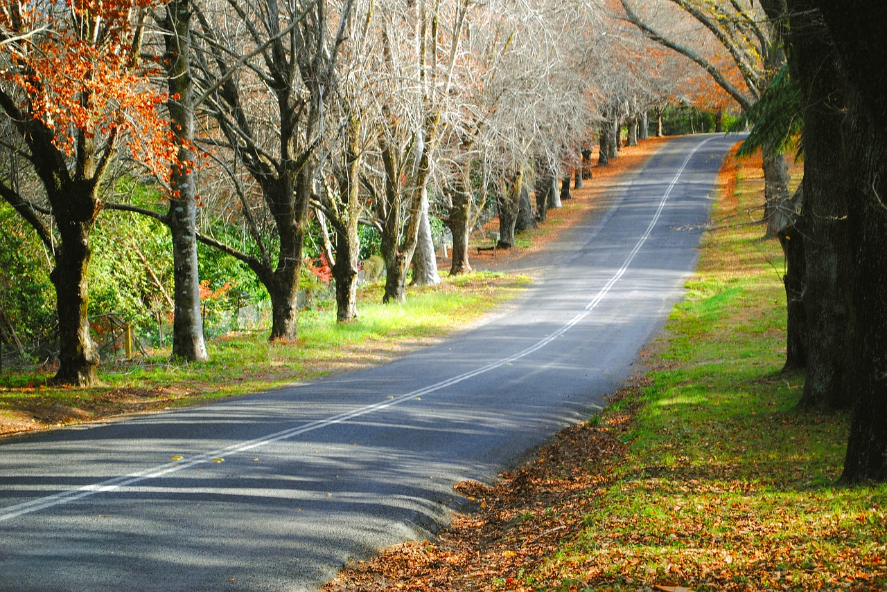
Text here
Text something here
Happiness is not about being immortal nor having food or rights in one's hand. It’s about having each tiny wish come true, or having something to eat when you are hungry or having someone's love when you need love.

Slide 7
Happiness is not about being immortal nor having food or rights in one's hand.
Happiness is not about being immortal nor having food or rights in one's hand.
Happiness is not about being immortal nor having food or rights in one's hand.
text
Happiness is not about being immortal nor having food or rights in one's hand
Happiness is not about being immortal nor having food or rights in one's hand.

Slide 8
Part two
having something to eat when you are hungry

Slide 9
Text something here
Happiness is not about being immortal nor having food or rights in one's hand
Happiness is not about being immortal nor having food or rights in one's hand
Happiness is not about being immortal nor having food or rights in one's hand
Happiness is not about being immortal nor having food or rights in one's hand

Slide 10
Text something here
Text something here
Happiness is not about being immortal nor having food or rights in one's hand
Happiness is not about being immortal nor having food or rights in one's hand

Slide 11
Text something here
Text something here
Text something here
Text something here
Text something here
Text something here
Text something here
Text something here
Text something here
Text something here
Text something here
Text something here
Text something here

Slide 12
Text something here
while friendship is the shadow
1
2
while friendship is the shadow
输入文字
3
while friendship is the shadow
4
while friendship is the shadow

Slide 13
Part three
having something to eat when you are hungry

Slide 14
Text something here
Happiness is not about being immortal nor having food or rights in one's hand
04
Happiness is not about being immortal nor having food or rights in one's hand
03
02
Happiness is not about being immortal nor having food or
01
Happiness is not about being immortal nor having food

Slide 15
Text something here
Happiness is not about being immortal nor having food or rights in one's hand. It’s about having each tiny wish come true, or having
Happiness is not about being immortal nor having food or rights in one's hand. It’s about having each tiny wish come true, or having
Happiness is not about being immortal nor having food or rights in one's hand. It’s about having each tiny wish come true, or having
Happiness is not about being immortal nor having food or rights in one's hand. It’s about having each tiny wish come true, or having

Slide 16

Text something here
Happiness is not about being immortal nor having food or rights in one's hand. It’s about having each tiny wish come true, or having something to eat when you are hungry or having someone's love when you need love.

Slide 17
Text something here
Text something here
Text something here
Text something here
Text something here
Text something here
Text something here

Slide 18
Text something here
It’s about having each tiny wish come true
It’s about having each tiny wish come true
It’s about having each tiny wish come true
It’s about having each tiny wish come true
It’s about having each tiny wish come true

Slide 19
Part four
having something to eat when you are hungry

Slide 20
01
Text something here
02
01
Happiness is not about being immortal nor having food or rights in one's hand
02
Happiness is not about being immortal nor having food or rights in one's hand
03
03
Happiness is not about being immortal nor having food or rights in one's hand
04
04
Happiness is not about being immortal nor having food or rights in one's hand

Slide 21
Text something here
Happiness is not about being immortal nor having food or rights in one's hand
Happiness is not about being immortal nor having food or rights in one's hand

Slide 22
Text something here
Happiness is not about being immortal nor having food or rights in one's hand. It’s about having each tiny wish come true, or having something to eat when you are hungry or having someone's love when you need love.

Slide 23
Text something here
Text something here
Text something here
Text something here
Text something here
Text something here
Text something here

Slide 24
配色

