Slide 1




INTRODUCTION
OPENRATE FRAMEWORK
Nguyễn Đức Hinh - PM4
09th Oct 2013

Slide 2
AGENDA
Part 1
  Overview the rating &mediation problem
  Introduce OpenRate framework
  Processing models
  Input, output module, adapter
  Price & Rating model
Part 2
  Lookup resource, customer, static data
  Data model
  Algorithm, In memory db, sharing cache
  How to implementation

Slide 3

OVERVIEW THE RATING &MEDIATION PROBLEM
VinaPhone
MSC
OCG
GGSN
Use voice call service
C1RT
RATING
CHARGING
PROMO
Postpaid customer
Rated CDRs
CCBS
ELCOM
Send bills
RE-RATE
MEDIATION
BILLING
INVOICE

Slide 4







OVERVIEW THE RATING &MEDIATION PROBLEM
Roaming
108
1714 VDC
CDR reformat
Voucher server
CCC
SAPI
ORP
CCWS
Existing CCBS
CDR reformat
Rerating
C1RT
Recharge gateway
FTP
UDP
SAPI
HLR
SERVICE PROVISIONING
VNP
Dataware house
SOG
Batch file
CCWS
SAPI
Application
PCAT tool
MAP
SMPP
CAP2
CAP2/
CAP3
Diameter
SMNP
STP
SMSCs
OCG
MSCs
GGSN
NMS

Slide 5
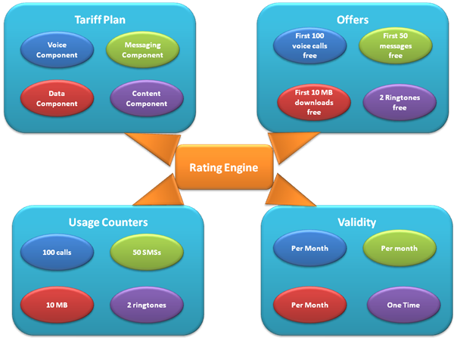
OVERVIEW THE RATING &MEDIATION PROBLEM

Slide 6
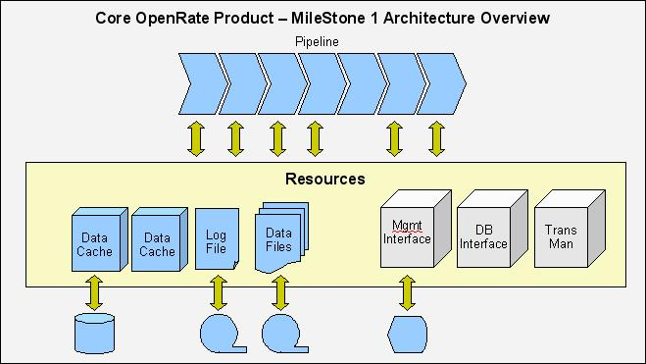
INTRODUCE OPENRATE FRAMEWORK
The profile
  It has grown out of 15 years experience commercial by Tiger Shore Management Limited
  Pipeline processing architecture
  Native Java
  High performance: serve 5000 events/s (3700 events/s in DB) can be reach 25k/s
  Any DB with JDBC

Slide 7
INTRODUCE OPENRATE FRAMEWORK
..continue
  Data source input/output can be files, DBs, TCP socket
  exploit the multi-processor architecture of professional systems & trend to multi-processing in consumer systems
What’s good?
  Decompose problem in to logical elements
  Flexible with properties and scripting language
  Complex processing tasks
  Handling files, DB, share sources
  Support development and testing cycles
What’s not good?
  Difficult
  Ad-hod rules and low number of records or small files

Slide 8
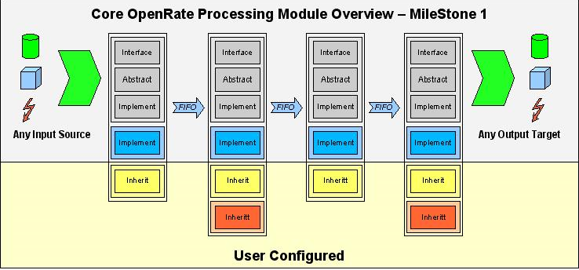
INTRODUCE OPENRATE FRAMEWORK

Slide 9
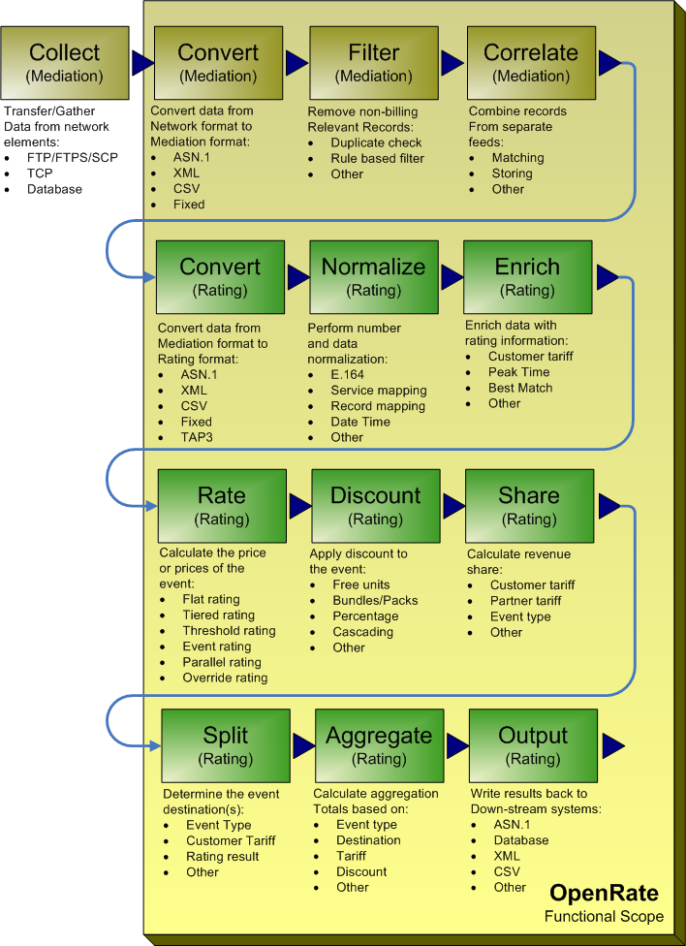
INTRODUCE OPENRATE FRAMEWORK

Slide 10
PROCESSING MODELS
Concepts
  Framework
  Pipelines
  Modules
  Records
  Resources
  Transactions
Framework
  Provide the environment to process records
  Each Framework can contain multiple Pipelines
  Boot sequence:
(1)Module configuration -> (2) The resources -> (3) The modules -> (4) The module resources -> (5) Register to Module Service by Client Manager -> (6) Loading resources->(7) Initialize Modules-> terminate.
  Resource
  Synchronization flag (ECI)

Slide 11
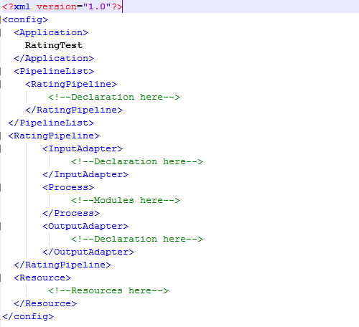
PROCESSING MODELS
Framework configuration

Slide 12
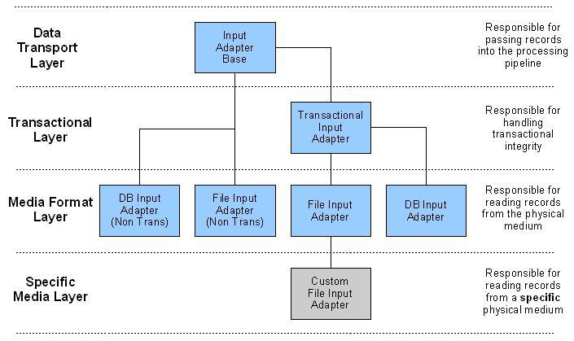
PROCESSING MODELS
Pipeline
  Linked series of modules: Input adapter, processing modules, output adapter
  Flexible
  FIFO buffers
  Multiple instances with multiple threads
  Pipeline processing mode
    Serial
    Parallel
    Chained
    Free
Modules
  Divide into different layers
  Call Module Stack
Input module

Slide 13
PROCESSING MODELS
Resource
  Initial load when startup
  Sharing
  Divided two categories:
    Service resource
      Log, Event Handler, Transaction manager, Data Source manager, Data Cache controller
    Data resource
  Sync Point
Transaction
  Transaction & non-transaction
  Safe way by vote
  Client type &Transaction manager state

Slide 14
INPUT & OUTPUT MODULE
Input module
  Read external information
  Currently defined in OpenRate:
    Flat File Input Adapter
    Binary File Input Adapter
    DB Input Adapter
    TCP Input Adapter
    ASN.1 Input Adapter
    TAP Input Adapter
    Buffer Input Adapter
Output module
  Write processed records to external
  Currently defined :
    Flat File Output Adapter
    Flat File Multi Stream Output Adapter
    JDBC Output Adapter
    JDBC Batch Output Adapter
    TCP Output Adapter (In preparation)
    XML File Output Adapter
    Null Output Adapter
    Null NT Output Adapter
    TAP Output Adapter

Slide 15
PRICE & RATING MODEL
Price model
  Define how rating by scheme
  Multiple Price Models can be grouped together into a Price Group
  Definitions:
    Tier
    Beat
    Factor
    ChargeBase
Rating model
  Support 4 basic models:
    Tiered rating
    Threshold rating
    Event rating
    Flat rating
  Override rating
  Multiple parallel & segment rating ( interconnection & reconciliation )
RUM (Rateable Usage Metric) rating model

Slide 16

4x4+4x4+4-4x4=?

Slide 17


Slide 18
AGENDA
Part 1
  Overview the rating &mediation problem
  Introduce OpenRate framework
  Processing models
  Input, output module, adapter
  Price & Rating model
Part 2
  Lookup resources, customer, static data
  Algorithm, In memory db, sharing cache
  Data model
  How to implementation

Slide 19
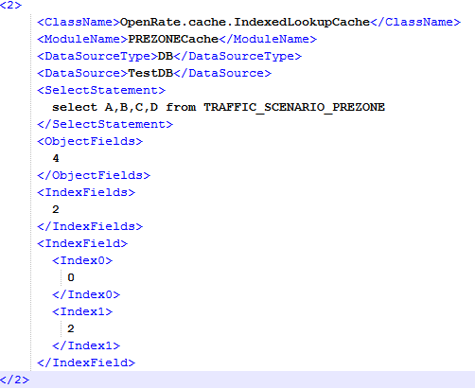
LOOK UP RESOURCE & CUSTOMER DATA
Lookup Resource
  Types: service & data
  Loading order: log->configuration->transaction-> data ->others
  Accessing resource
  How to lookup?

Slide 20
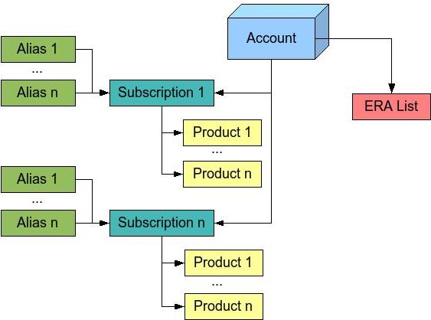
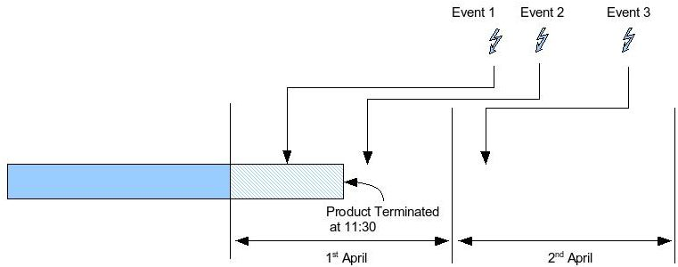
LOOK UP RESOURCE & CUSTOMER DATA
Customer Data
  Logical:
    Account
    Account Alias
    Subscription
    Product
    Extended Rating Attributes "ERAs“
  Lookup customer, product
  Audit

Slide 21
SHARING CACHE, IN MEMORY DB & ALGORITHM
Sharing cache
  Linked buffer cache
  Duplicate Check Cache
  Conversion cache
  Balance Cache
  Rate cache
  Time model cache
Algorithm
  Best Match Algorithm
  Regex Match Algorithm
  RUM best
  Time match

Slide 22
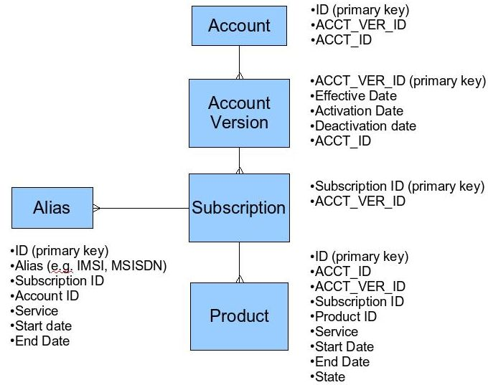
DATA MODELS

Slide 23
HOW TO IMPLETATION?

Slide 24
4x4+4x4+4-4x4=?

