Slide 1
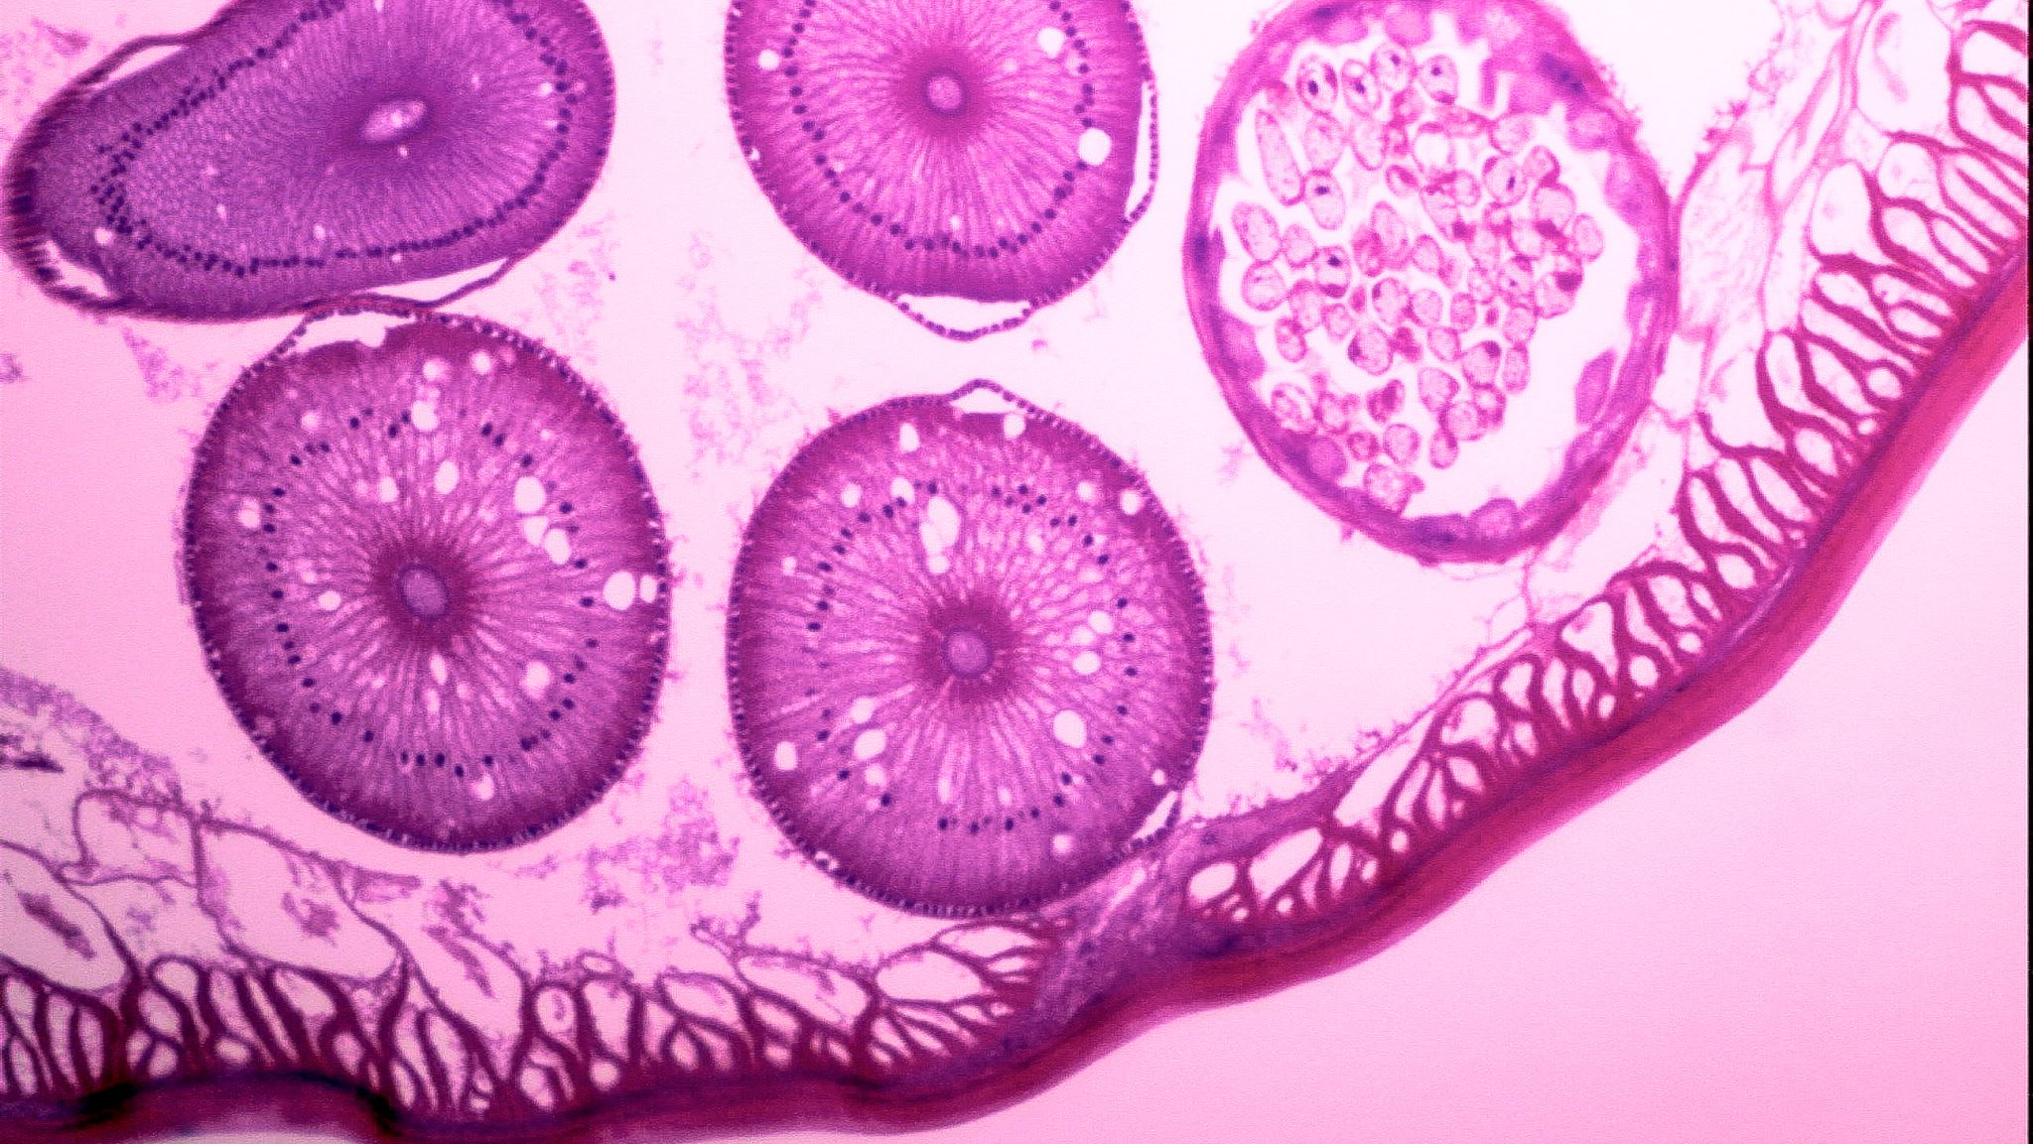
Enhancing Tumor Visibility in Mammography through Advanced Image Processing Techniques
Sepehr LATIFI AZAD – 190254082
Melih YILDIZ – 190254063

Slide 2

Project Purpose
The purpose of this project is to explore and apply advanced image processing techniques to mammography images to enhance the detection and visualization of possible tumors.

Slide 3
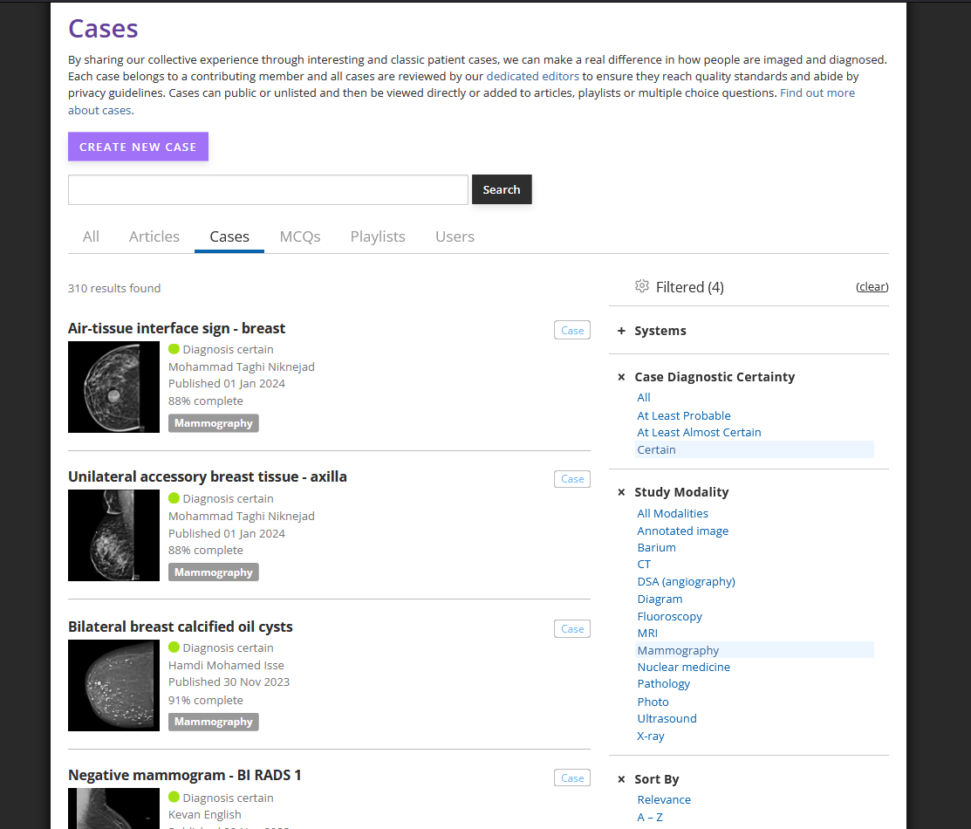
Project Dataset
Radiopaedia: A web application for radiologists and pathologists where they share their cases and asks second opinion.

Slide 4


Materials

Slide 5
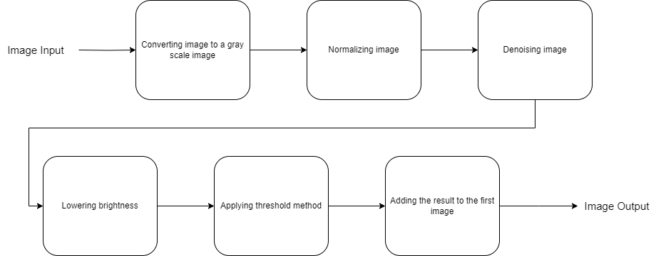
Method

Slide 6
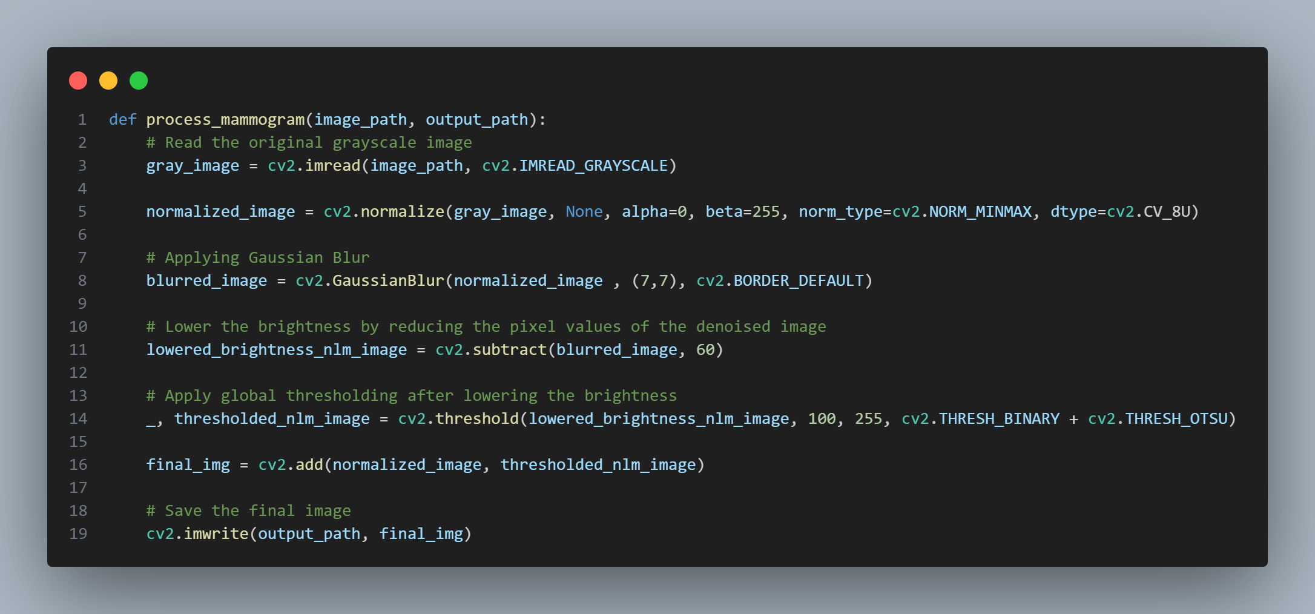
Implementation

Slide 7
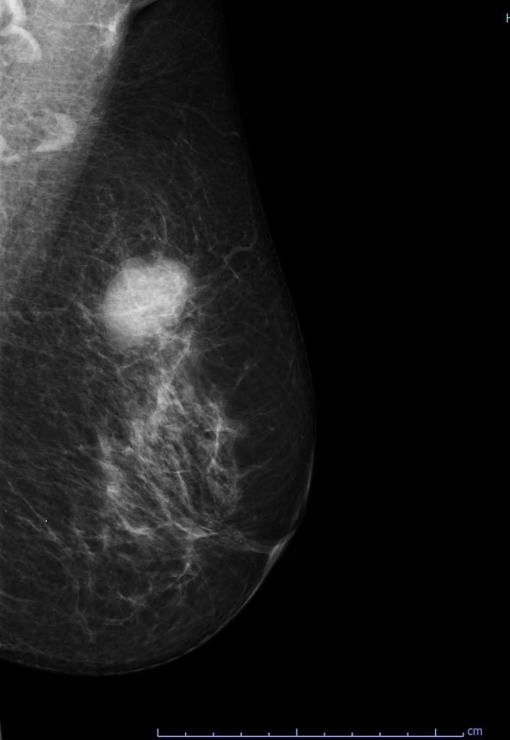
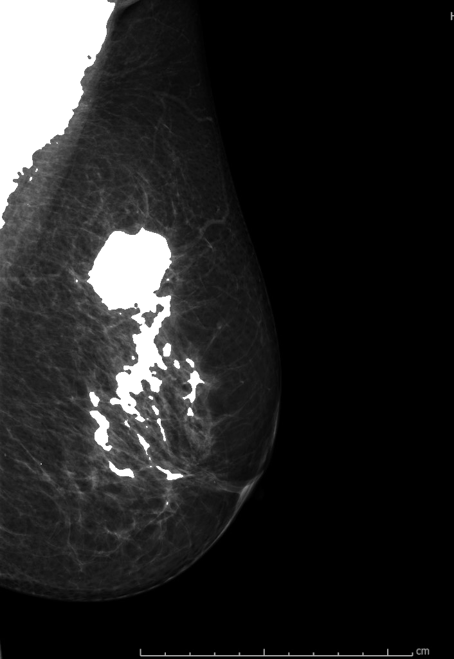
Applying Method on Mammogram Images

Slide 8
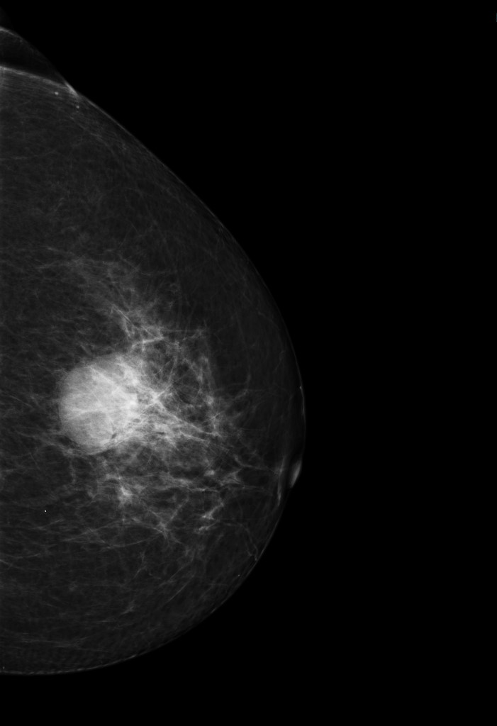

Applying Method on Mammogram Images

Slide 9
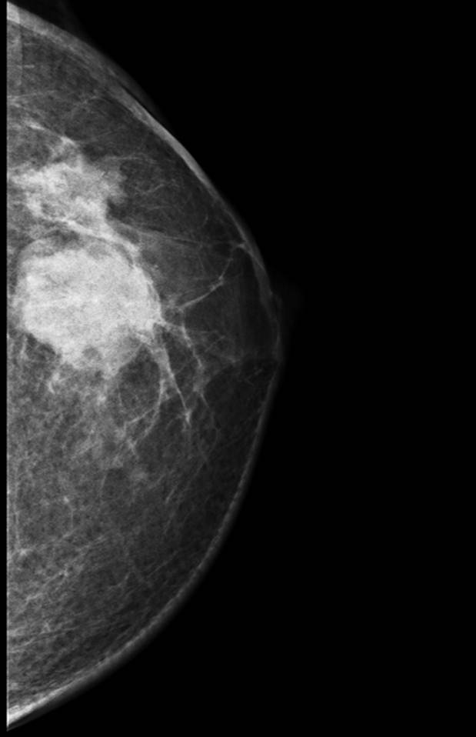
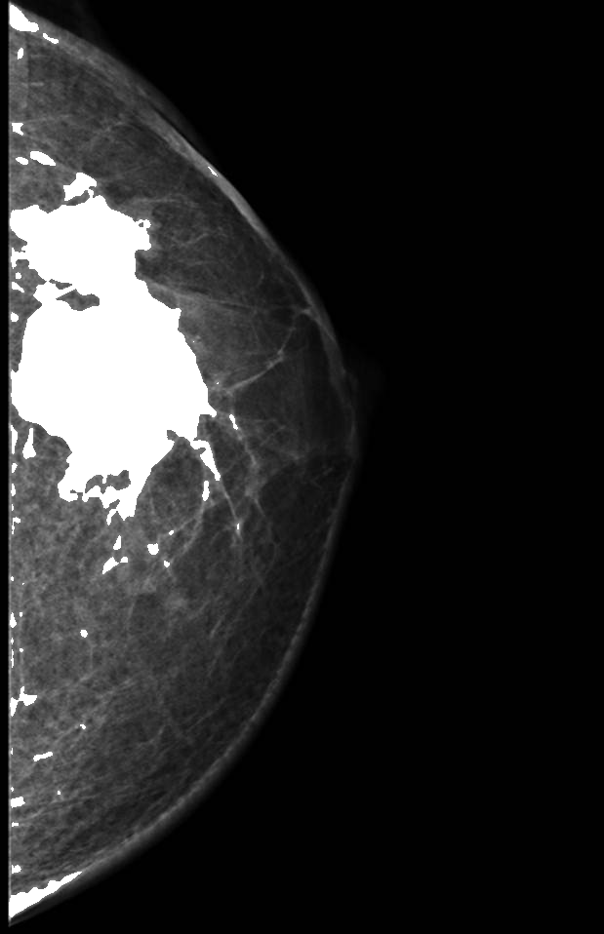
Applying Method on Mammogram Images

Slide 10
References
https://radiopaedia.org
https://docs.opencv.org

Slide 11
Thank You

