Slide 1
OASIS FINDER
OASIS FINDER
COMMERCIAL TRANSPARENCY METHOD
COMMERCIAL TRANSPARENCY METHOD
01 / 10
01 / 10
Oasis
Finder
Will shoppers buy more when a product exposes its supply chain?
Our product is a merchant-facing transparency method: show the product, split it into components, then let users inspect evidence before purchase.
OPEN-SOURCE LINK
github.com/3351666087/Oasis-Finder
Group 9
Rui Huang + Zixiu Wang
8m
Presentation promise
Every slide is readable enough for a weak-memory live presentation.
Oasis Finder | Group 9 | Rui Huang and Zixiu Wang
Notes:
Rui opens. Say: Oasis Finder is not just a dashboard. It is a method for merchants to show credible supply-chain evidence at the exact buying moment.
[APA sources / evidence]
- Ge, L. (2022). To buy or not to buy? Frontiers in Psychology, 13, 873941. https://doi.org/10.3389/fpsyg.2022.873941
- Tran, D., Schouteten, J. J., Gellynck, X., & De Steur, H. (2024). How do consumers value food traceability? Food Control, 162, 110453. https://doi.org/10.1016/j.foodcont.2024.110453

Slide 2
OASIS FINDER
QUESTIONNAIRE SIGNAL
02 / 10
Users prefer visible supply-chain evidence for high-trust food
We framed the questionnaire around buying probability after merchants show route, time, place, quality, and temperature evidence.
1
Cake / bakery
Ingredients and freshness are hard to judge from appearance alone.
2
Chilled meat
Safety and cold-chain trust matter before purchase.
3
Dairy
Directional coding: 1 = weak lift, 5 = strong lift. The exact response file can replace this chart in the same schema.
Temperature and expiry evidence can reduce perceived risk.
4
Fresh produce
Origin and handling evidence make freshness easier to believe.
Oasis Finder | Group 9 | Rui Huang and Zixiu Wang
Ge (2022); Tran et al. (2024); Group 9 questionnaire direction
Notes:
Rui explains the teacher-feedback pivot. The point is no longer to compare competitor dashboards. The point is whether supply-chain display increases buying probability.
[APA sources / evidence]
- Group 9 questionnaire direction (2026). Directional 1-5 coding; raw response file not stored in repository.
- Ge, L. (2022). To buy or not to buy? Frontiers in Psychology, 13, 873941. https://doi.org/10.3389/fpsyg.2022.873941
- Tran, D., Schouteten, J. J., Gellynck, X., & De Steur, H. (2024). How do consumers value food traceability? Food Control, 162, 110453. https://doi.org/10.1016/j.foodcont.2024.110453

Slide 3
OASIS FINDER
CUSTOMER METHOD
03 / 10
The user experience is intentionally simple
Like a Hema or Sam's Club product page: product first, evidence second, technical graph only when the user asks for it.
1
Choose a product
2
Split into modules
3
Inspect the route
Users start from name, category, price, and proof score.
Cake becomes cake base and cream; meat becomes input, packaging, QR label, and cold-chain pack.
Click a component to switch from whole-product supply chain to module-level supply chain.
Plain-language promise: customers do not need to understand databases. They only need to see where the product came from, when it moved, and why it is safe enough to buy.
Oasis Finder | Group 9 | Rui Huang and Zixiu Wang
Notes:
Rui explains the frontend logic in friendly language. Avoid over-technical wording. Emphasize that module dissection makes a complex supply chain understandable.
[APA sources / evidence]
- Wang, E. S.-T., Lin, H.-C., & Tsai, M.-C. (2021). Effect of institutional trust on traceable fresh food. Foods, 10(12), 2898. https://doi.org/10.3390/foods10122898
- GS1. (n.d.). Traceability standards. https://www.gs1.org/standards/traceability

Slide 4
OASIS FINDER
BROWSER ARCHITECTURE
04 / 10
We removed PySide6 and rebuilt it as a browser system
Frontend and backend run together. Backend edits push live updates to the customer page.
Merchant backend
FastAPI service
MySQL digital twin
Customer frontend
React / admin route
edit data, upload images
REST API + WebSocket
media upload and broadcast
products, batches, lots
shipments, risk, inspections
React / product route
module graph and proof panel
REALTIME CHANNEL
BACKEND URL
FRONTEND URL
WebSocket /ws/updates
127.0.0.1:8000
127.0.0.1:5173
Oasis Finder | Group 9 | Rui Huang and Zixiu Wang
Repository runtime validation, 2026-04-28
Notes:
Rui covers engineering. Say clearly that the project is now browser-based: FastAPI backend, React frontend, MySQL digital twin, and WebSocket live update.
[APA sources / evidence]
- Oasis Finder repository and local validation evidence. https://github.com/3351666087/Oasis-Finder

Slide 5
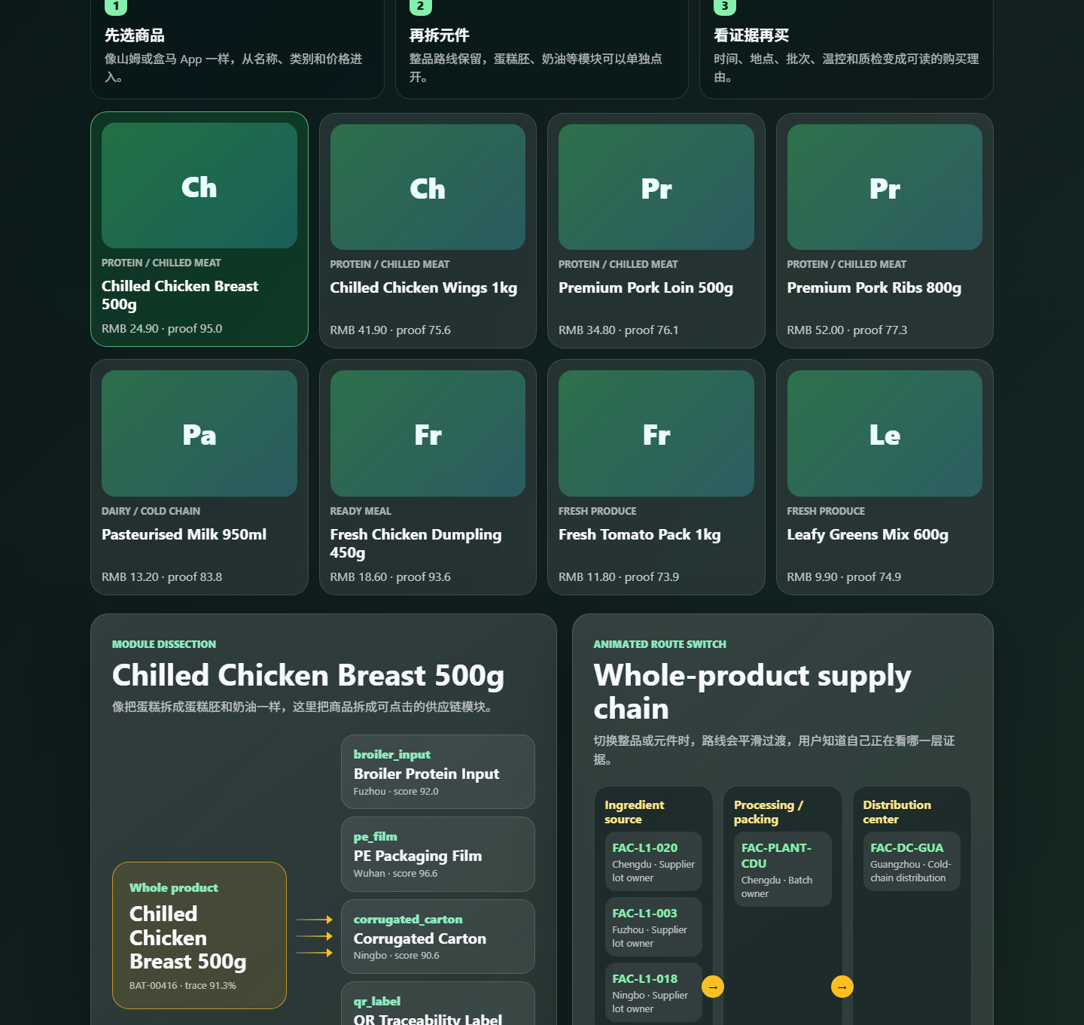
OASIS FINDER
CUSTOMER FRONTEND WALKTHROUGH
05 / 10
Customer frontend: how a shopper uses it
The homepage keeps the product shelf for marketing, then opens the inspectable supply-chain route.
1
Start with product cards
Name, category, price, proof score, and simple visual placeholder.
2
Read the plain guide
The page tells users what to do without technical vocabulary.
3
Choose SKU
Changing product reloads the matching route, modules, and evidence.
Oasis Finder | Group 9 | Rui Huang and Zixiu Wang
Live screenshot from local browser frontend
Notes:
Rui should walk through this slowly: open the customer page, show the product shelf, click one product, then point out that the UI does not begin with a scary data table.
[APA sources / evidence]
- Oasis Finder repository and local validation evidence. https://github.com/3351666087/Oasis-Finder

Slide 6
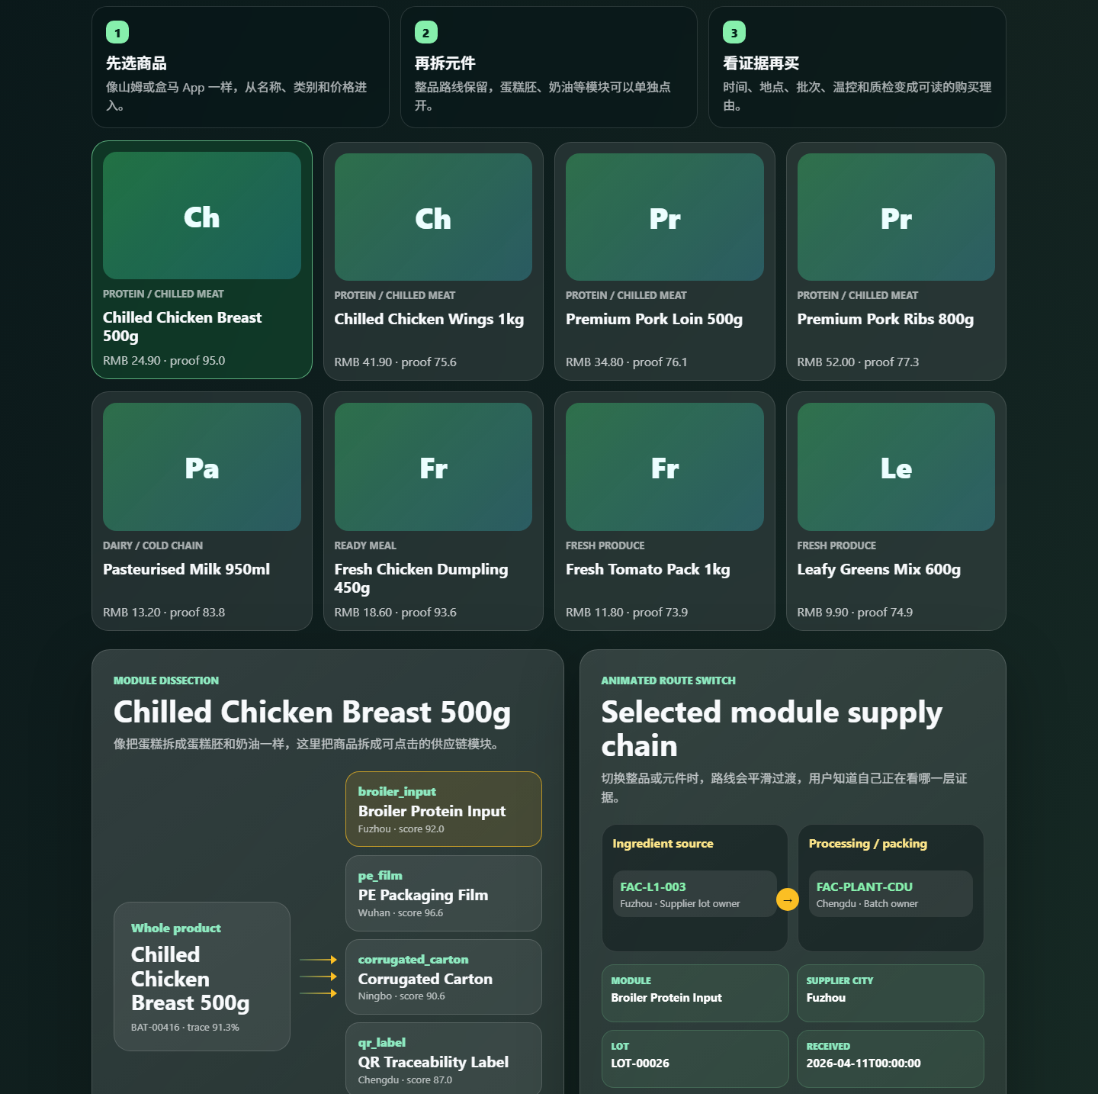
OASIS FINDER
MODULE ROUTE PROOF
06 / 10
Click a component, then inspect module proof
The whole product route stays available. One click focuses on a specific component and its supplier evidence.
MODULE
SUPPLIER CITY
Broiler Protein Input
Fuzhou
LOT
RECEIVED
LOT-00026
2026-04-11
INSPECTION
TRACEABILITY
89.2
96.0%
Transition behavior: switching between Whole product and any module redraws the route panel with a soft animated change, so users understand exactly which layer of evidence they are viewing.
Oasis Finder | Group 9 | Rui Huang and Zixiu Wang
Live screenshot from local browser frontend
Notes:
Zixiu starts here after Rui hands over. Explain the module click. The key point is the values: module, city, lot, received date, inspection, traceability.
[APA sources / evidence]
- GS1. (n.d.). Traceability standards. https://www.gs1.org/standards/traceability
- U.S. FDA. (2024). FSMA Food Traceability Rule: Critical Tracking Events and Key Data Elements. https://www.fda.gov/food/food-safety-modernization-act-fsma/fsma-final-rule-requirements-additional-traceability-records-certain-foods

Slide 7
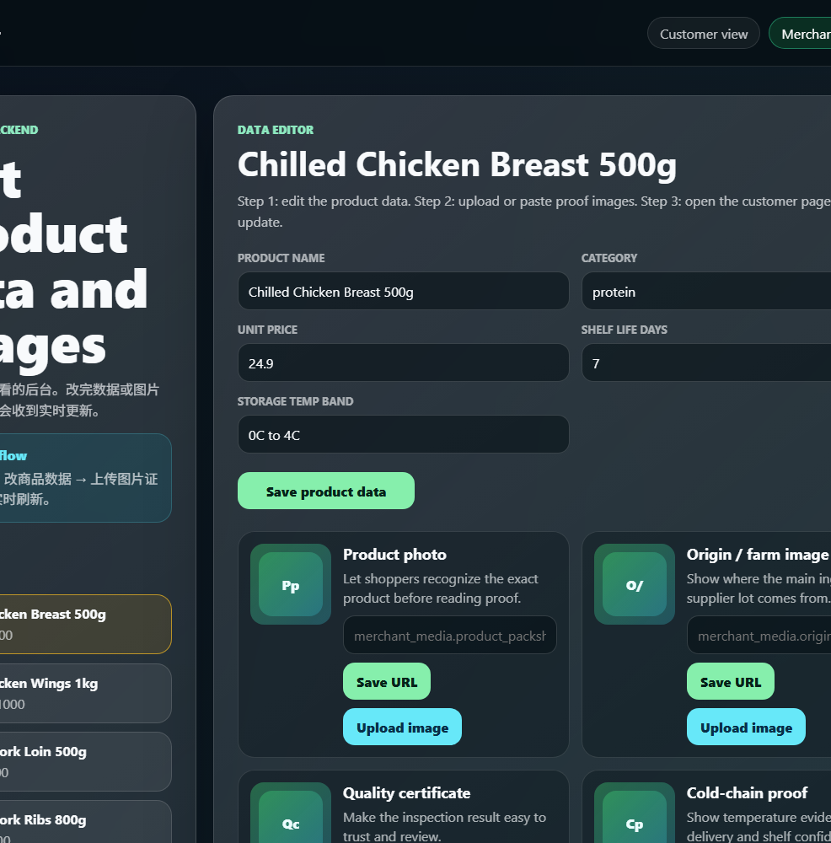
OASIS FINDER
MERCHANT BACKEND WALKTHROUGH
07 / 10
Merchant backend: edit data and images
Seller-side workflow: choose SKU, edit product facts, then upload or paste evidence media.
1
Select SKU
Merchant chooses the product to edit from the left product list.
2
Edit data
Name, category, price, shelf life, and storage temperature are editable.
3
Upload or paste image
Media slots are reserved for product photo, origin image, certificate, and cold-chain proof.
Oasis Finder | Group 9 | Rui Huang and Zixiu Wang
Backend sends live update events to the customer frontend
Notes:
Zixiu explains the backend in very simple steps. Also mention that merchants can provide their own images later; for now icon-style placeholders make the interface ready.
[APA sources / evidence]
- Oasis Finder repository and local validation evidence. https://github.com/3351666087/Oasis-Finder

Slide 8
OASIS FINDER
DATA RESPONSIBILITY AND API SLOTS
08 / 10
Open code, but merchant data must still be verified
Oasis Finder provides the interface and evidence slots. We do not guarantee a company's data truthfulness for them.
Identity
Critical event
Location
SKU / GTIN, QR, batch ID, lot ID
harvest, production, receiving, shipping, arrival
supplier, plant, warehouse, retail node, location code
Condition
Quality
Owner
temperature range, breach minutes, shelf-life state
inspection score, package score, residue/pathogen checks
supplier, carrier, auditor, certificate URI, signed file
Production recommendation: validate these fields with QR events, IoT logs, supplier records, ERP/WMS integrations, and third-party audits.
Oasis Finder | Group 9 | Rui Huang and Zixiu Wang
FDA FSMA 204; GS1 Traceability
Notes:
Zixiu covers responsibility. Say: our code is open and the API is ready, but large companies remain responsible for proving their own data.
[APA sources / evidence]
- U.S. FDA. (2024). FSMA Food Traceability Rule: Critical Tracking Events and Key Data Elements. https://www.fda.gov/food/food-safety-modernization-act-fsma/fsma-final-rule-requirements-additional-traceability-records-certain-foods
- GS1. (n.d.). Traceability standards. https://www.gs1.org/standards/traceability

Slide 9
OASIS FINDER
CP GROUP FIT AND MERCHANT VALUE
09 / 10
Why CP Group fits, and why the method is not CP-only
CP Group has agro-food, retail, distribution, e-commerce, and traceability contexts. That makes it a strong pilot, not a limit.
1
CP fit
MERCHANT UPSIDE
AD FORMAT
Feed, farm, food, retail, and distribution can be connected into one product evidence page.
higher trust
evidence page
2
Not CP-only
Any merchant can use the same schema if it can provide SKU, batch, supplier, shipment, inspection, and media proof.
PILOT PRODUCT
cake / meat / dairy
3
Revenue logic
Transparency can improve conversion, premium tolerance, retention, and reduced refund/complaint friction.
A/B test: baseline page versus Oasis Finder evidence page.
Oasis Finder | Group 9 | Rui Huang and Zixiu Wang
CP Group; CPF; CP Axtra official pages
Notes:
Zixiu explains CP Group. CP Group is suitable because the method can connect upstream and retail information. But Oasis Finder is a general merchant method.
[APA sources / evidence]
- Charoen Pokphand Group. Our Business. https://www.cpgroupglobal.com/en/about-cp-group/our-business
- Charoen Pokphand Foods. Farm business. https://www.cpfworldwide.com/en/business/farm
- CP Axtra. Corporate website. https://www.cpaxtra.com/
- Ge, L. (2022). To buy or not to buy? Frontiers in Psychology, 13, 873941. https://doi.org/10.3389/fpsyg.2022.873941
- Wang, E. S.-T., Lin, H.-C., & Tsai, M.-C. (2021). Effect of institutional trust on traceable fresh food. Foods, 10(12), 2898. https://doi.org/10.3390/foods10122898

Slide 10
OASIS FINDER
BUILD STORY AND CLOSE
10 / 10
What we can prove today
The rebuild is now a running browser product with verified backend API, frontend build, product modules, merchant editing, and live screenshots.
1
Architecture
2
Frontend
PySide6 removed; FastAPI + React/Vite + MySQL running locally.
Customer shelf, module dissection, route transition, variable proof panel.
3
Backend
4
Validation
Merchant editor, upload/image URL slots, WebSocket live-update bus.
compileall PASS, health-check PASS, npm build PASS, API smoke PASS.
Final line: We do not ask users to trust a slogan. We let them inspect the chain behind the product.
https://github.com/3351666087/Oasis-Finder
Oasis Finder | Group 9 | Rui Huang and Zixiu Wang
References in notes: Ge 2022; Tran et al. 2024; Wang et al. 2021; FDA; GS1; CP official pages
Notes:
Zixiu closes. Mention validations quickly, point to GitHub, and say the final line slowly. Then invite questions.
[APA sources / evidence]
- Oasis Finder repository and local validation evidence. https://github.com/3351666087/Oasis-Finder
- Ge, L. (2022). To buy or not to buy? Frontiers in Psychology, 13, 873941. https://doi.org/10.3389/fpsyg.2022.873941
- Tran, D., Schouteten, J. J., Gellynck, X., & De Steur, H. (2024). How do consumers value food traceability? Food Control, 162, 110453. https://doi.org/10.1016/j.foodcont.2024.110453
- Wang, E. S.-T., Lin, H.-C., & Tsai, M.-C. (2021). Effect of institutional trust on traceable fresh food. Foods, 10(12), 2898. https://doi.org/10.3390/foods10122898
- U.S. FDA. (2024). FSMA Food Traceability Rule: Critical Tracking Events and Key Data Elements. https://www.fda.gov/food/food-safety-modernization-act-fsma/fsma-final-rule-requirements-additional-traceability-records-certain-foods
- GS1. (n.d.). Traceability standards. https://www.gs1.org/standards/traceability

