Slide 1
Oasis
Finder
Does supply-chain visibility make users more likely to buy?
Our product is not a single app feature. It is a way for merchants to show credible product evidence at the buying moment.
Supply-chain transparency as a merchant conversion method
Thesis: more credible supply-chain evidence reduces perceived risk and increases purchase confidence, especially for perishable or high-trust foods.
Open-source prototype
https://github.com/3351666087/Oasis-Finder
Group 9
Rui Huang + Zixiu Wang
8-minute flow: problem -> questionnaire signal -> product proof -> merchant value -> build story
Group 9 | Rui Huang and Zixiu Wang | 8-minute presentation
Notes:
Opening. Reframe Oasis Finder as a commercial transparency method: merchants show supply-chain structure and evidence so users feel safer and are more likely to buy.
[APA sources / evidence]
- Ge, L. (2022). To buy or not to buy? A research on the relationship between traceable food extrinsic cues and consumers' purchase intention. Frontiers in Psychology, 13, 873941. https://doi.org/10.3389/fpsyg.2022.873941
- Tran, D., Schouteten, J. J., Gellynck, X., & De Steur, H. (2024). How do consumers value food traceability? A meta-analysis. Food Control, 162, 110453. https://doi.org/10.1016/j.foodcont.2024.110453

Slide 2
COMMERCIAL SIGNAL
02 / 12
Evidence visibility becomes a buying trigger
Relative buying-lift signal by category
The question is not whether supply-chain data exists. The question is whether the shopper sees enough proof to trust the product before purchase.
CLAIM
BUYER PAIN
MERCHANT ASK
trust lift
risk
proof page
visible origin, batch, QC and temperature evidence
freshness and safety are hard to inspect by eye
convert evidence into a sales asset
Sales line: show the journey behind the food, so quality is no longer just a promise.
Directional 1-5 response coding. It supports commercial positioning; it should be validated later with real product-page A/B testing.
Cake / bakery
freshness + ingredients + allergy trust
Seafood
cold-chain and origin risk
Meat
safety expiry inspection
Dairy
safety expiry inspection
Group 9 | Rui Huang and Zixiu Wang | 8-minute presentation
Ge (2022); Tran et al. (2024); Group 9 questionnaire direction
Notes:
Rui: explain the revised premise. We are testing purchase probability after a merchant shows supply-chain structure. Do not claim a precise sample statistic unless raw survey data is available.
[APA sources / evidence]
- Group 9 internal questionnaire direction (2026); raw response file is not stored in this repository, so charts are treated as directional evidence rather than population statistics.
- Ge, L. (2022). To buy or not to buy? A research on the relationship between traceable food extrinsic cues and consumers' purchase intention. Frontiers in Psychology, 13, 873941. https://doi.org/10.3389/fpsyg.2022.873941
- Tran, D., Schouteten, J. J., Gellynck, X., & De Steur, H. (2024). How do consumers value food traceability? A meta-analysis. Food Control, 162, 110453. https://doi.org/10.1016/j.foodcont.2024.110453

Slide 3
WHY IT PAYS
03 / 12
The commercial mechanism is risk reduction
Transparency works as advertising because it turns an invisible quality claim into a visible decision cue.
1
Evidence shown
2
Risk drops
3
Value rises
4
Revenue improves
Supplier map, batch, timestamp, location, temperature, certificate.
Consumers feel less uncertainty about freshness and safety.
The product becomes easier to trust and easier to justify.
Higher conversion, premium tolerance, and repeat intention.
Advertising claim moves from “trust us” to “inspect the evidence”. That is why the same product page can become more persuasive.
Group 9 | Rui Huang and Zixiu Wang | 8-minute presentation
Ge (2022); Wang et al. (2021)
Notes:
Rui: explain why merchants would pay for this method. It is a marketing tool because traceable information quality and certification credibility affect perceived risk, perceived value, and purchase intention.
[APA sources / evidence]
- Ge, L. (2022). To buy or not to buy? A research on the relationship between traceable food extrinsic cues and consumers' purchase intention. Frontiers in Psychology, 13, 873941. https://doi.org/10.3389/fpsyg.2022.873941
- Wang, E. S.-T., Lin, H.-C., & Tsai, M.-C. (2021). Effect of institutional trust on consumers' health and safety perceptions and repurchase intention for traceable fresh food. Foods, 10(12), 2898. https://doi.org/10.3390/foods10122898

Slide 4
PRODUCT METHOD
04 / 12
What a merchant should show
Oasis Finder is a display method plus data schema. We open-source the code, but merchants remain responsible for the truth of their data.
Product identity
Place
Time
SKU / GTIN, QR code, batch or lot ID
supplier, plant, warehouse, location code
harvest, production, receiving, shipping, arrival
Condition
Quality proof
Evidence owner
temperature, breach minutes, freshness, shelf life
inspection result, package score, residue/pathogen checks
supplier, auditor, carrier, certificate URI or hash
Data disclaimer: Oasis Finder provides interface, schema, and API slots. We do not guarantee merchant data authenticity; audits, IoT logs, and supplier records should validate claims.
Group 9 | Rui Huang and Zixiu Wang | 8-minute presentation
FDA FSMA 204; GS1 Traceability Standard
Notes:
Rui: connect this to teacher feedback. The product layer must show exactly what variables appear when the user clicks a node. Mention FDA CTE/KDE logic and GS1 traceability ideas.
[APA sources / evidence]
- U.S. Food and Drug Administration. (2024). Food Traceability Rule: Critical Tracking Events and Key Data Elements. https://www.fda.gov/food/food-safety-modernization-act-fsma/fsma-proposed-rule-food-traceability
- GS1. (n.d.). Traceability standards: Critical Tracking Events and Key Data Elements. https://www.gs1.org/standards/traceability
- https://github.com/3351666087/Oasis-Finder; local health check on 2026-04-27; artifacts/risk_metrics.json; artifacts/forecast_metrics.json.

Slide 5
COURSE METHOD + BUILD STORY
05 / 12
Course concepts shaped the product logic
The project uses Week 2-8 knowledge as a chain: strategic question, evidence plan, coding, survey signal, and mixed-method recommendation.
Week 2
Week 5
Week 6
Week 7
Week 8
Evidence decision
Data plan
Open coding
Questionnaire
Integration
Define one decision: can proof at the buying moment increase confidence?
Turn uncertainty into variables: trust, proof score, route clicks, purchase intent.
Convert route evidence into reusable tags, patterns, and insight labels.
Use DV/IV logic: visibility of evidence -> stated buying probability.
Combine survey direction, qualitative meaning, secondary sources, and prototype proof.
Build narrative: course method -> evidence requirement -> working proof page -> merchant sales story.
Group 9 | Rui Huang and Zixiu Wang | 8-minute presentation
Source: ENT_结构化知识点整理_重构版.docx; Week 2-8
Notes:
Rui: tell the build story. We started with a broad transparency idea, used research to narrow it, built the data foundation, and then added the click-to-inspect product evidence view.
[APA sources / evidence]
- https://github.com/3351666087/Oasis-Finder; local health check on 2026-04-27; artifacts/risk_metrics.json; artifacts/forecast_metrics.json.
- Badia-Melis, R., Mishra, P., & Ruiz-García, L. (2015). Food traceability: New trends and recent advances. Food Control, 57, 393-401. https://doi.org/10.1016/j.foodcont.2015.05.005
- World Economic Forum. (2019). Innovation with a purpose: Improving traceability in food value chains through technology innovations. https://www.weforum.org/publications/innovation-with-a-purpose-improving-traceability-in-food-value-chains-through-technology-innovations/

Slide 6
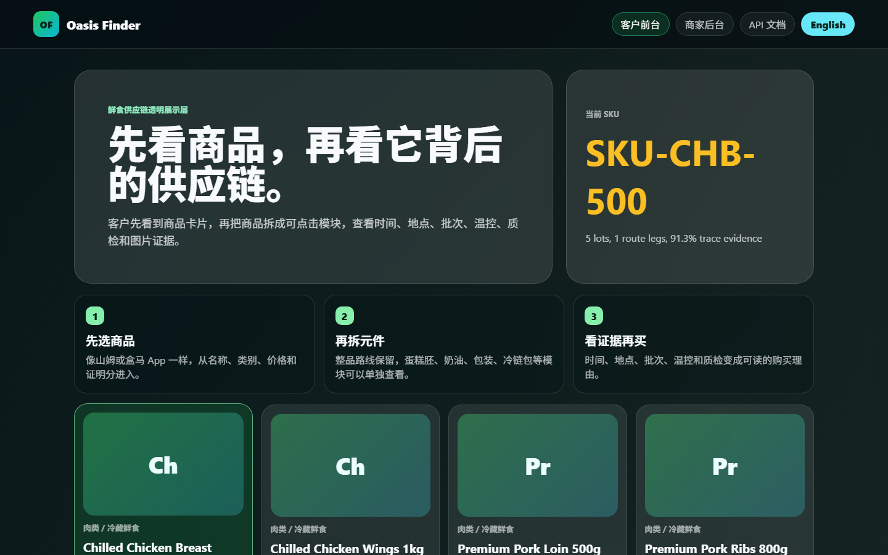
COMMERCIAL PITCH
06 / 12
Turn proof into a conversion asset
Oasis Finder lets a merchant sell the same product with stronger trust signals: route proof, quality proof, and freshness proof are visible before checkout.
Trust hook
Origin, batch, QC and cold-chain evidence reduce uncertainty.
Price defense
Premium products become easier to justify when proof is inspectable.
Pitch line: same SKU, stronger proof, lower hesitation.
Repeat path
QR and evidence panels keep the product memorable after purchase.
Group 9 | Rui Huang and Zixiu Wang | 8-minute presentation
Indexed sales model for pitch use; validate with A/B testing
Notes:
Zixiu: present this as commercialization. The screenshot is not a tutorial; it is proof that the sales page can surface trust evidence. The chart is an index model for the pitch, not a guaranteed forecast.
[APA sources / evidence]
- Ge, L. (2022). To buy or not to buy? A research on the relationship between traceable food extrinsic cues and consumers' purchase intention. Frontiers in Psychology, 13, 873941. https://doi.org/10.3389/fpsyg.2022.873941
- Tran, D., Schouteten, J. J., Gellynck, X., & De Steur, H. (2024). How do consumers value food traceability? A meta-analysis. Food Control, 162, 110453. https://doi.org/10.1016/j.foodcont.2024.110453
- https://github.com/3351666087/Oasis-Finder; local health check on 2026-04-27; artifacts/risk_metrics.json; artifacts/forecast_metrics.json.

Slide 7
MERCHANT OFFER
07 / 12
Sell the method as a trust layer
The merchant offer is not a software feature list. It is a product-page trust layer for high-risk or premium fresh food.
Starter
Pro
Enterprise
QR route proof
Route + QC + media proof
API + audit + IoT links
For merchants that need a simple origin story.
For premium perishables where trust affects price.
For large chains that need supplier governance.
low setup
best fit
scalable
Group 9 | Rui Huang and Zixiu Wang | 8-minute presentation
Commercial packaging model for merchant pitch
Notes:
Zixiu: this is the sales packaging slide. Do not explain controls. Sell the trust layer as Starter, Pro, and Enterprise packages.
[APA sources / evidence]
- Tran, D., Schouteten, J. J., Gellynck, X., & De Steur, H. (2024). How do consumers value food traceability? A meta-analysis. Food Control, 162, 110453. https://doi.org/10.1016/j.foodcont.2024.110453
- https://github.com/3351666087/Oasis-Finder; local health check on 2026-04-27; artifacts/risk_metrics.json; artifacts/forecast_metrics.json.

Slide 8
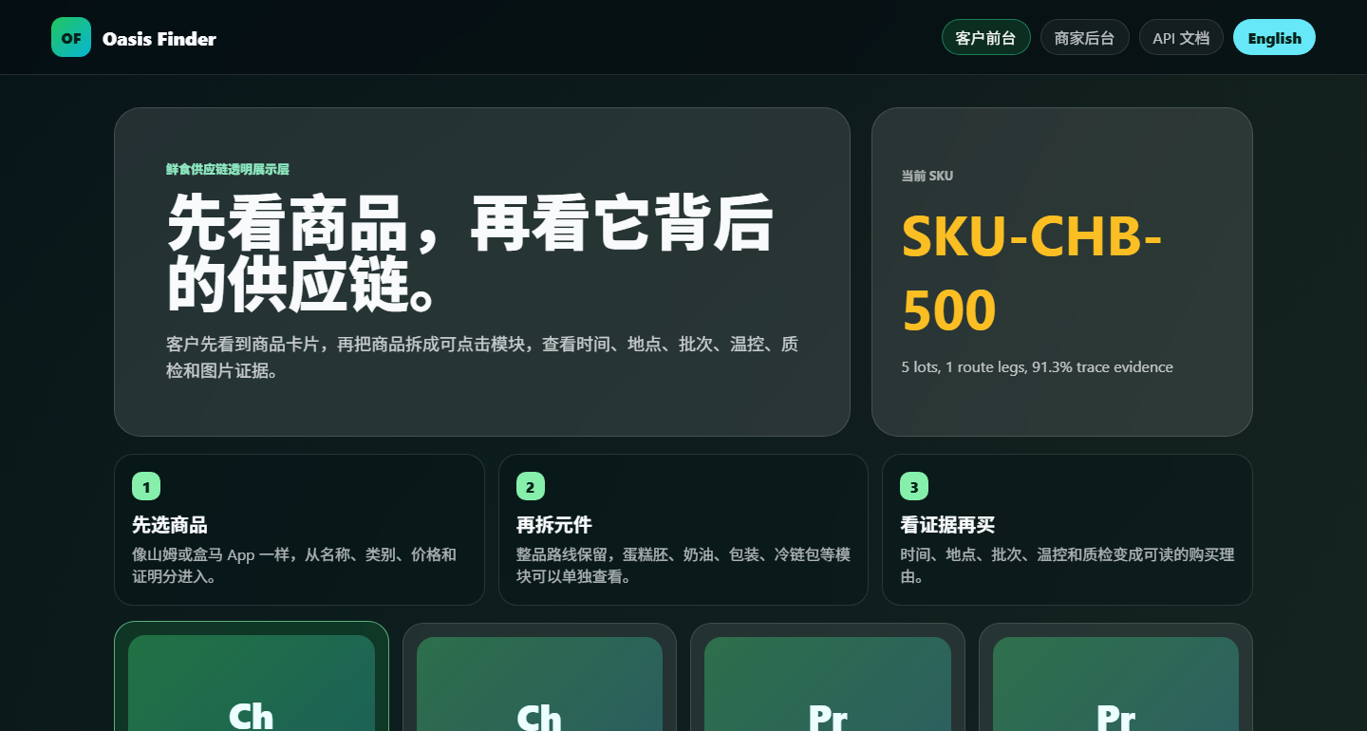
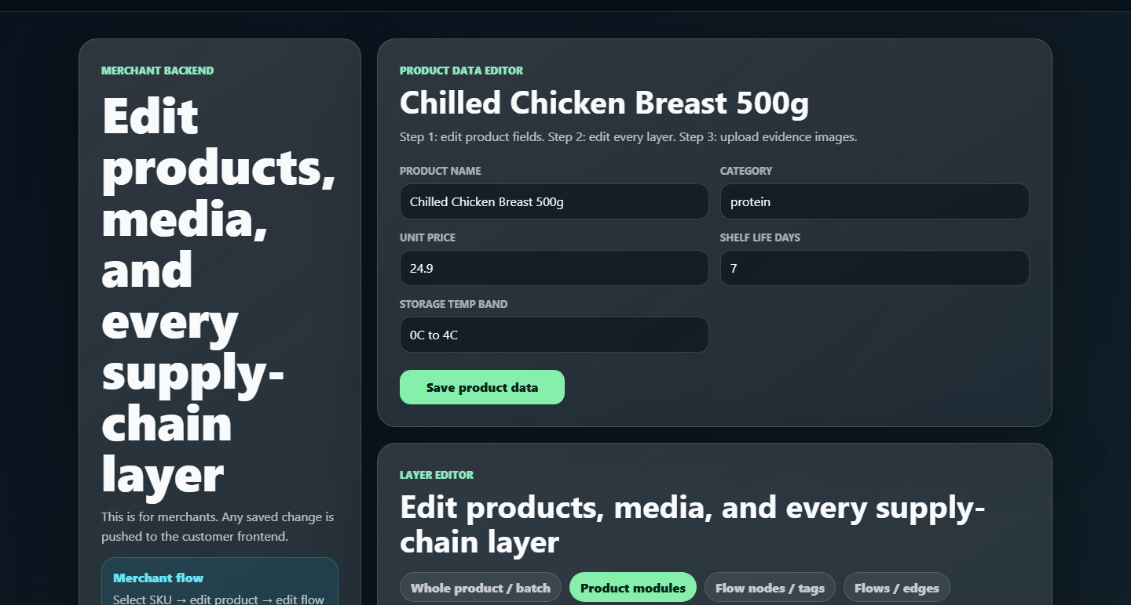
LIVE PRODUCT PROOF
08 / 12
The current product is already demonstrable
Instead of explaining a workflow page by page, we show the live customer page and merchant studio as proof that the commercial method can run.
CUSTOMER PAGE
MERCHANT STUDIO
PACKAGED DEMO
OPEN DEMO URL
route proof
flow editor
offline route
127.0.0.1
thumbnail-first product evidence
tagged nodes and arrow logic
fallback data for new PCs
browser showcase launcher
Group 9 | Rui Huang and Zixiu Wang | 8-minute presentation
Current local screenshots; packaged demo fallback
Notes:
Zixiu: this slide replaces tutorial pages. It shows the current product state and the commercial proof of readiness: customer route, merchant editor, and packaged demo route.
[APA sources / evidence]
- https://github.com/3351666087/Oasis-Finder; local health check on 2026-04-27; artifacts/risk_metrics.json; artifacts/forecast_metrics.json.

Slide 9
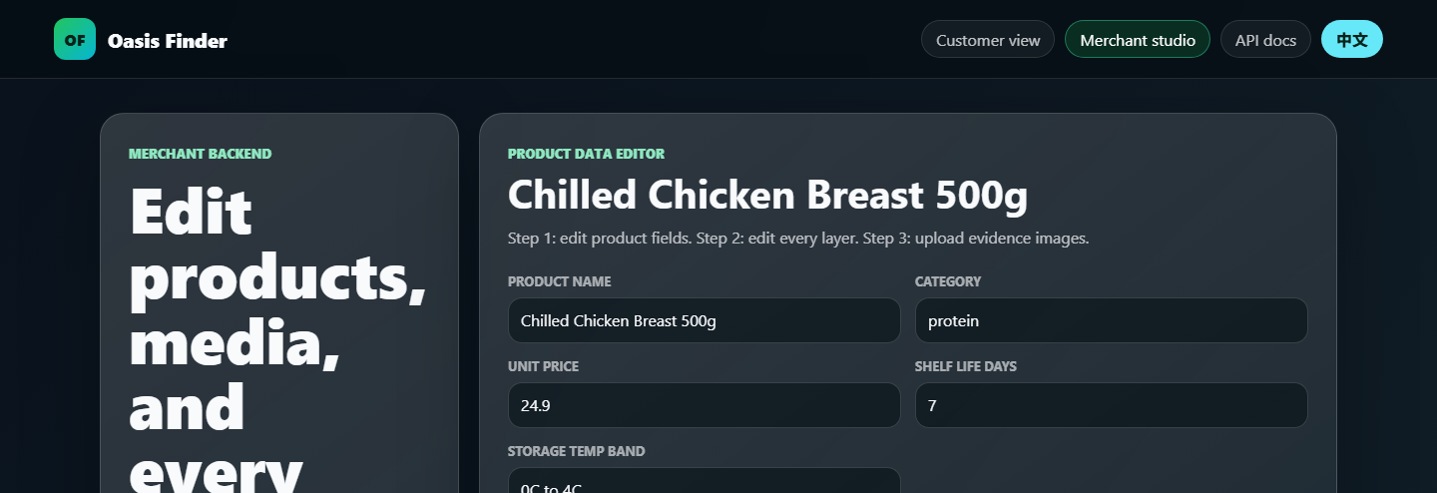
TECHNICAL CAPABILITY
09 / 12
A real backend supports the sales promise
The commercial trust layer is backed by route data, editable flow logic, packaged fallback data, and an operational model.
FACILITIES
ACTIVE LINKS
BATCHES
FORECAST DAYS
97
200
418
30
nodes across supplier, plant, downstream, and service tiers
material and distribution relationships
finished-goods batches with trace paths
planning horizon for demand and inventory
Group 9 | Rui Huang and Zixiu Wang | 8-minute presentation
CSV: technical_model_metrics.csv; current flow editor screenshot
Notes:
Zixiu: show that the sales promise is backed by product data, a route graph, and a merchant editor. Mention 97 facilities, 200 links, 418 batches, and the packaged fallback route.
[APA sources / evidence]
- https://github.com/3351666087/Oasis-Finder; local health check on 2026-04-27; artifacts/risk_metrics.json; artifacts/forecast_metrics.json.

Slide 10
MERCHANT VALUE
10 / 12
Why merchants can earn more with this method
Oasis Finder is useful to merchants because it makes premium quality easier to believe before purchase.
Conversion
lower uncertainty at the exact buying moment
Premium
traceability is linked with WTP and perceived value
Retention
clearer evidence supports repeat intention and fewer disputes
Use as ad copy: "scan the product journey, not just the package."
Group 9 | Rui Huang and Zixiu Wang | 8-minute presentation
CSV: merchant_value_index.csv; Tran et al. (2024)
Notes:
Zixiu: this slide answers why merchants gain. It is an indexed value model, not a guaranteed financial forecast. Tie it to WTP, purchase intention, perceived risk, and perceived value.
[APA sources / evidence]
- Tran, D., Schouteten, J. J., Gellynck, X., & De Steur, H. (2024). How do consumers value food traceability? A meta-analysis. Food Control, 162, 110453. https://doi.org/10.1016/j.foodcont.2024.110453
- Ge, L. (2022). To buy or not to buy? A research on the relationship between traceable food extrinsic cues and consumers' purchase intention. Frontiers in Psychology, 13, 873941. https://doi.org/10.3389/fpsyg.2022.873941
- Wang, E. S.-T., Lin, H.-C., & Tsai, M.-C. (2021). Effect of institutional trust on consumers' health and safety perceptions and repurchase intention for traceable fresh food. Foods, 10(12), 2898. https://doi.org/10.3390/foods10122898

Slide 11
PILOT VALIDATION
11 / 12
Next proof: merchant A/B test
After the questionnaire signal, the next step is a real product-page experiment that links transparency to purchase behavior.
Test setup
Product cells
Same product, same price, two product pages: baseline page versus Oasis Finder evidence page.
Cake, seafood, meat, dairy, and ready-to-eat meals because freshness and safety concerns are high.
Outcome metrics
Decision rule
QR scan rate, evidence-panel clicks, add-to-cart, purchase conversion, willingness-to-pay, repeat intent.
Adopt the method when purchase lift and trust lift both improve without increasing confusion.
Commercial validation target: prove that inspectable supply-chain evidence changes real purchase behavior, not only stated preference.
Group 9 | Rui Huang and Zixiu Wang | 8-minute presentation
Pilot metrics prepared for CSV event export
Notes:
Use this as the future-validation slide. It replaces the internal speaking-flow page, which is not useful for assessors. Explain that the project can move from stated preference to merchant A/B testing.
[APA sources / evidence]
- Group 9 internal questionnaire direction (2026); raw response file is not stored in this repository, so charts are treated as directional evidence rather than population statistics.
- Ge, L. (2022). To buy or not to buy? A research on the relationship between traceable food extrinsic cues and consumers' purchase intention. Frontiers in Psychology, 13, 873941. https://doi.org/10.3389/fpsyg.2022.873941
- Tran, D., Schouteten, J. J., Gellynck, X., & De Steur, H. (2024). How do consumers value food traceability? A meta-analysis. Food Control, 162, 110453. https://doi.org/10.1016/j.foodcont.2024.110453

Slide 12
APA REFERENCES
12 / 12
References and closing claim
Oasis Finder is a transparent-commerce method: open code, clear fields, and inspectable product evidence.
Ge, L. (2022). To buy or not to buy? A research on the relationship between traceable food extrinsic cues and consumers' purchase intention. Frontiers in Psychology, 13, 873941. https://doi.org/10.3389/fpsyg.2022.873941
Tran, D., Schouteten, J. J., Gellynck, X., & De Steur, H. (2024). How do consumers value food traceability? A meta-analysis. Food Control, 162, 110453. https://doi.org/10.1016/j.foodcont.2024.110453
Wang, E. S.-T., Lin, H.-C., & Tsai, M.-C. (2021). Effect of institutional trust on consumers' health and safety perceptions and repurchase intention for traceable fresh food. Foods, 10(12), 2898. https://doi.org/10.3390/foods10122898
Badia-Melis, R., Mishra, P., & Ruiz-García, L. (2015). Food traceability: New trends and recent advances. Food Control, 57, 393-401. https://doi.org/10.1016/j.foodcont.2015.05.005
World Economic Forum. (2019). Innovation with a purpose: Improving traceability in food value chains through technology innovations. https://www.weforum.org/publications/innovation-with-a-purpose-improving-traceability-in-food-value-chains-through-technology-innovations/
U.S. Food and Drug Administration. (2024). Food Traceability Rule: Critical Tracking Events and Key Data Elements. https://www.fda.gov/food/food-safety-modernization-act-fsma/fsma-proposed-rule-food-traceability
GS1. (n.d.). Traceability standards: Critical Tracking Events and Key Data Elements. https://www.gs1.org/standards/traceability
Final line: We do not ask users to trust a slogan. We let them inspect the chain behind the product.
Group 9 | Rui Huang and Zixiu Wang | 8-minute presentation
Notes:
Closing. State the final line slowly, then invite questions.
[APA sources / evidence]
- Ge, L. (2022). To buy or not to buy? A research on the relationship between traceable food extrinsic cues and consumers' purchase intention. Frontiers in Psychology, 13, 873941. https://doi.org/10.3389/fpsyg.2022.873941
- Tran, D., Schouteten, J. J., Gellynck, X., & De Steur, H. (2024). How do consumers value food traceability? A meta-analysis. Food Control, 162, 110453. https://doi.org/10.1016/j.foodcont.2024.110453
- Wang, E. S.-T., Lin, H.-C., & Tsai, M.-C. (2021). Effect of institutional trust on consumers' health and safety perceptions and repurchase intention for traceable fresh food. Foods, 10(12), 2898. https://doi.org/10.3390/foods10122898
- Badia-Melis, R., Mishra, P., & Ruiz-García, L. (2015). Food traceability: New trends and recent advances. Food Control, 57, 393-401. https://doi.org/10.1016/j.foodcont.2015.05.005
- World Economic Forum. (2019). Innovation with a purpose: Improving traceability in food value chains through technology innovations. https://www.weforum.org/publications/innovation-with-a-purpose-improving-traceability-in-food-value-chains-through-technology-innovations/
- U.S. Food and Drug Administration. (2024). Food Traceability Rule: Critical Tracking Events and Key Data Elements. https://www.fda.gov/food/food-safety-modernization-act-fsma/fsma-proposed-rule-food-traceability
- GS1. (n.d.). Traceability standards: Critical Tracking Events and Key Data Elements. https://www.gs1.org/standards/traceability
- https://github.com/3351666087/Oasis-Finder; local health check on 2026-04-27; artifacts/risk_metrics.json; artifacts/forecast_metrics.json.

