Slide 1
OASIS FINDER
QUESTIONNAIRE SIGNAL
01 / 10
Users prefer visible supply-chain evidence for high-trust food
We framed the questionnaire around buying probability after merchants show route, time, place, quality, and temperature evidence.
1
Cake / bakery
Ingredients and freshness are hard to judge from appearance alone.
2
Chilled meat
Safety and cold-chain trust matter before purchase.
3
Dairy
Directional coding: 1 = weak lift, 5 = strong lift. The exact response file can replace this chart in the same schema.
Temperature and expiry evidence can reduce perceived risk.
4
Fresh produce
Origin and handling evidence make freshness easier to believe.
Oasis Finder | Group 9 | Rui Huang and Zixiu Wang
Ge (2022); Tran et al. (2024); Group 9 questionnaire direction
Notes:
Rui explains the teacher-feedback pivot. The point is no longer to compare competitor dashboards. The point is whether supply-chain display increases buying probability.
[APA sources / evidence]
- Group 9 questionnaire direction (2026). Directional 1-5 coding; raw response file not stored in repository.
- Ge, L. (2022). To buy or not to buy? Frontiers in Psychology, 13, 873941. https://doi.org/10.3389/fpsyg.2022.873941
- Tran, D., Schouteten, J. J., Gellynck, X., & De Steur, H. (2024). How do consumers value food traceability? Food Control, 162, 110453. https://doi.org/10.1016/j.foodcont.2024.110453

Slide 2
OASIS FINDER
COURSE KNOWLEDGE MAP
02 / 10
Course knowledge used in Oasis Finder
Mapped from ENT_结构化知识点整理_重构版.docx. Weeks 2–8 guide our strategic question, evidence plan, coding, questionnaire signal, and mixed-method recommendation.
WEEK 2
WEEK 3
WEEK 4
Evidence-based decision
Industry and competition
PESTEL and secondary data
We reframed Oasis Finder from a dashboard into intelligence for one decision: will supply-chain proof increase buying confidence?
CP Group is positioned as a pilot case; merchant value is explained through differentiation, trust, and competitive response.
Food safety, traceability standards, ESG expectations, and consumer-trust trends define why evidence pages matter now.
WEEK 5
WEEK 6
WEEK 7
Data collection planning
Qualitative coding
Quantitative questionnaire
The project follows Strategic Question → Data → Insight → Decision, with variables such as trust, proof score, and purchase intention.
Open coding logic turns documents, comments, and route meanings into reusable tags, patterns, insights, and graph labels.
The questionnaire slide uses DV/IV and hypothesis-testing logic: supply-chain visibility as the signal, purchase likelihood as the outcome.
WEEK 8
Mixed-method integration
We combine survey direction, qualitative evidence interpretation, secondary sources, and the live prototype into one actionable recommendation.
Oasis Finder | Course application evidence | Source: ENT_结构化知识点整理_重构版.docx

Slide 3
OASIS FINDER
CUSTOMER METHOD
03 / 10
The user experience is intentionally simple
Like a Hema or Sam's Club product page: product first, evidence second, technical graph only when the user asks for it.
1
Choose a product
2
Split into modules
3
Inspect the route
Users start from name, category, price, and proof score.
Cake becomes cake base and cream; meat becomes input, packaging, QR label, and cold-chain pack.
Click a component to switch from whole-product supply chain to module-level supply chain.
Plain-language promise: customers do not need to understand databases. They only need to see where the product came from, when it moved, and why it is safe enough to buy.
Oasis Finder | Group 9 | Rui Huang and Zixiu Wang
Notes:
Rui explains the frontend logic in friendly language. Avoid over-technical wording. Emphasize that module dissection makes a complex supply chain understandable.
[APA sources / evidence]
- Wang, E. S.-T., Lin, H.-C., & Tsai, M.-C. (2021). Effect of institutional trust on traceable fresh food. Foods, 10(12), 2898. https://doi.org/10.3390/foods10122898
- GS1. (n.d.). Traceability standards. https://www.gs1.org/standards/traceability

Slide 4
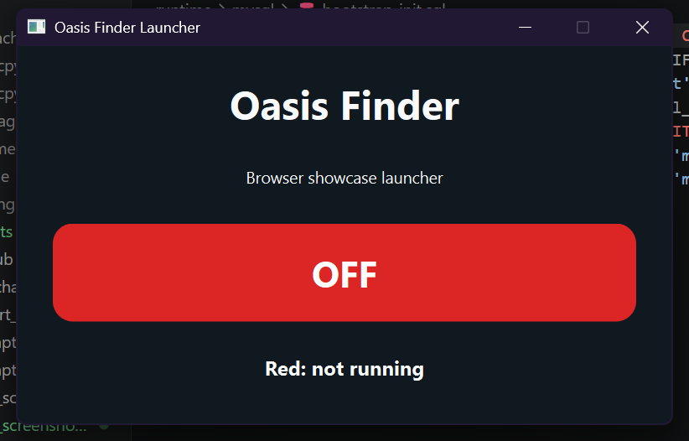
OASIS FINDER
BROWSER ARCHITECTURE
04 / 10
PySide6 is now only a one-switch launcher
The real product is a browser system: bilingual customer frontend, merchant backend, FastAPI service, and MySQL digital twin.
PySide6 switch
FastAPI service
MySQL digital twin
Bilingual browser UI
red by default
turns green and opens browser
serves API + built React
WebSocket live broadcast
products, batches, lots
shipments, risk, inspections
Chinese / English
customer page + admin page
OPEN LIVE BROWSER DEMO
http://127.0.0.1:8000
REALTIME CHANNEL
BACKEND URL
BROWSER ROUTE
WebSocket /ws/updates
127.0.0.1:8000
/?lang=zh or ?lang=en
Oasis Finder | Group 9 | Rui Huang and Zixiu Wang
Repository runtime validation, 2026-04-28
Notes:
Rui covers engineering. Say clearly that PySide6 is not the main interface anymore. It is a clean one-switch launcher; the business UI is browser-based.
[APA sources / evidence]
- Oasis Finder repository and local validation evidence. https://github.com/3351666087/Oasis-Finder

Slide 5
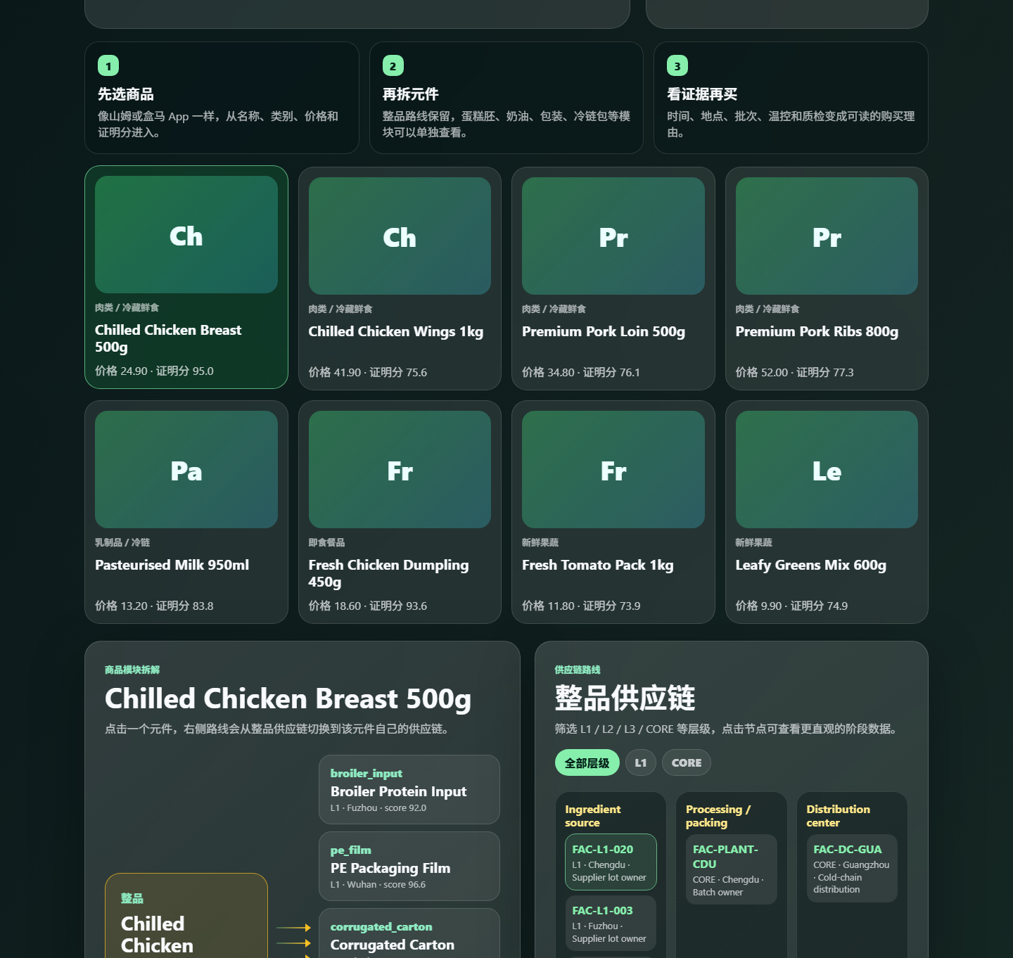
OASIS FINDER
CUSTOMER FRONTEND WALKTHROUGH
05 / 10
Customer frontend: how a shopper uses it
The homepage keeps the product shelf for marketing, then opens the inspectable supply-chain route.
1
Start with product cards
Name, category, price, proof score, and simple visual placeholder.
2
Use Chinese or English
Language toggle changes the whole webpage, not just one label.
3
Choose SKU
Changing product reloads the matching route, modules, and evidence.
Oasis Finder | Group 9 | Rui Huang and Zixiu Wang
Live screenshot from local browser frontend
Notes:
Rui should walk through this slowly: open the customer page, show the product shelf, click one product, then point out that the UI does not begin with a scary data table.
[APA sources / evidence]
- Oasis Finder repository and local validation evidence. https://github.com/3351666087/Oasis-Finder

Slide 6
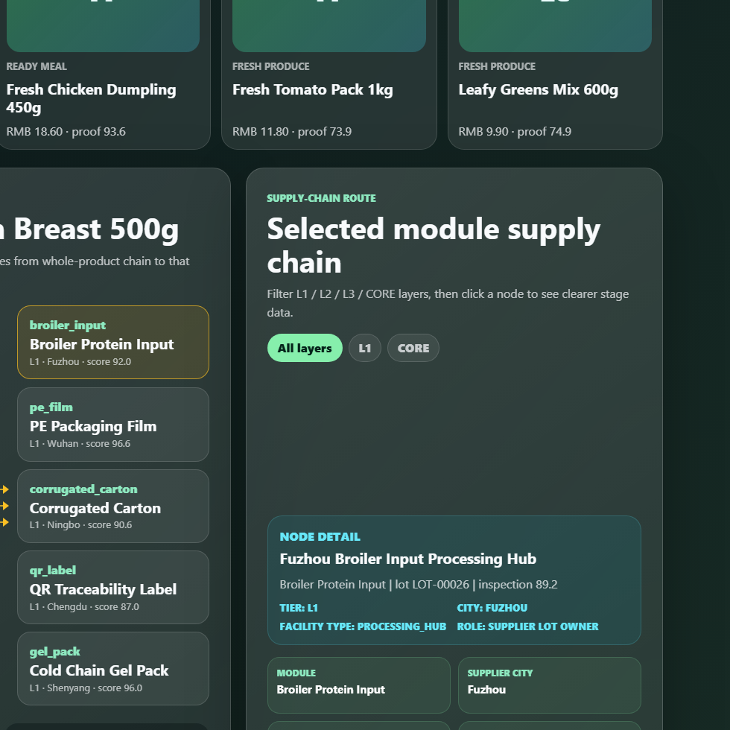
OASIS FINDER
MODULE ROUTE PROOF
06 / 10
Click a component, then inspect module proof
The whole product route stays available. One click focuses on a specific component and its supplier evidence.
MODULE
SUPPLIER CITY
Broiler Protein Input
Fuzhou
LOT
RECEIVED
LOT-00026
2026-04-11
INSPECTION
TRACEABILITY
89.2
96.0%
Transition behavior: switching between Whole product and any module redraws the route panel with a soft animated change, so users understand exactly which layer of evidence they are viewing.
Oasis Finder | Group 9 | Rui Huang and Zixiu Wang
Live screenshot from local browser frontend
Notes:
Zixiu starts here after Rui hands over. Explain the module click. The key point is the values: module, city, lot, received date, inspection, traceability.
[APA sources / evidence]
- GS1. (n.d.). Traceability standards. https://www.gs1.org/standards/traceability
- U.S. FDA. (2024). FSMA Food Traceability Rule: Critical Tracking Events and Key Data Elements. https://www.fda.gov/food/food-safety-modernization-act-fsma/fsma-final-rule-requirements-additional-traceability-records-certain-foods

Slide 7
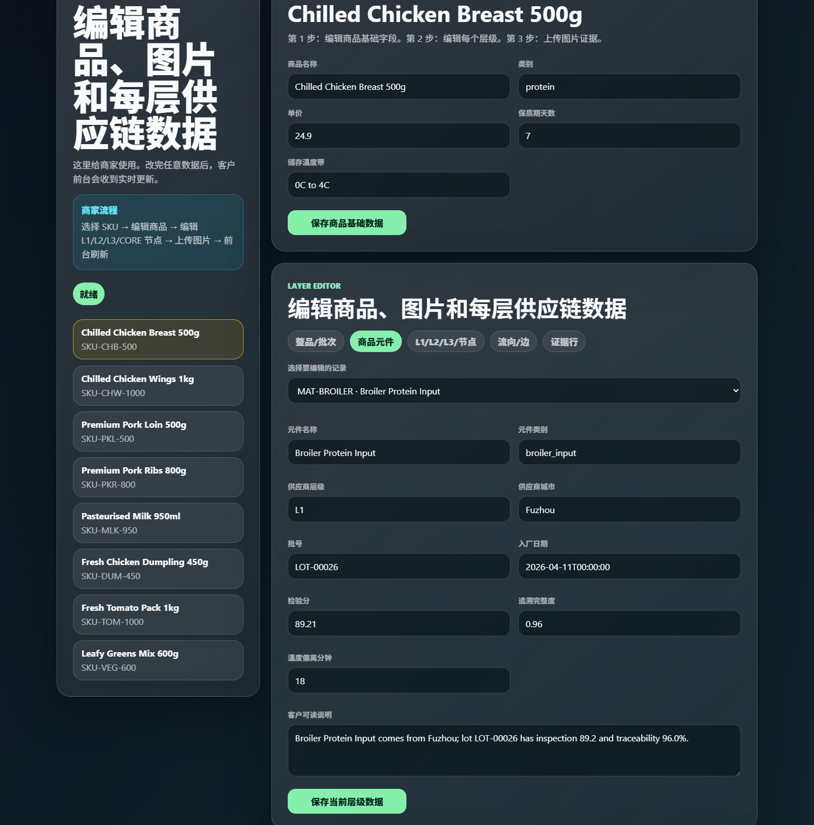
OASIS FINDER
MERCHANT BACKEND WALKTHROUGH
07 / 10
Merchant backend: edit every layer
The backend now supports whole-product fields, modules, custom tagged nodes, route edges, evidence records, and image slots.
1
Choose a layer
Overview, modules, route nodes, route edges, and evidence are separate tabs.
2
Edit the selected record
Each tagged node can store city, time, role, risk, visible value, and custom color overlays.
3
Save and broadcast
The backend sends update events so the customer page can refresh without a restart.
Oasis Finder | Group 9 | Rui Huang and Zixiu Wang
Backend sends live update events to the customer frontend
Notes:
Zixiu explains the backend in very simple steps. Also mention that merchants can provide their own images later; for now icon-style placeholders make the interface ready.
[APA sources / evidence]
- Oasis Finder repository and local validation evidence. https://github.com/3351666087/Oasis-Finder

Slide 8
OASIS FINDER
DATA RESPONSIBILITY AND API SLOTS
08 / 10
Open code, but merchant data must still be verified
Oasis Finder provides the interface and evidence slots. We do not guarantee a company's data truthfulness for them.
Identity
Critical event
Location
SKU / GTIN, QR, batch ID, lot ID
harvest, production, receiving, shipping, arrival
supplier, plant, warehouse, retail node, location code
Condition
Quality
Owner
temperature range, breach minutes, shelf-life state
inspection score, package score, residue/pathogen checks
supplier, carrier, auditor, certificate URI, signed file
Production recommendation: validate these fields with QR events, IoT logs, supplier records, ERP/WMS integrations, and third-party audits.
Oasis Finder | Group 9 | Rui Huang and Zixiu Wang
FDA FSMA 204; GS1 Traceability
Notes:
Zixiu covers responsibility. Say: our code is open and the API is ready, but large companies remain responsible for proving their own data.
[APA sources / evidence]
- U.S. FDA. (2024). FSMA Food Traceability Rule: Critical Tracking Events and Key Data Elements. https://www.fda.gov/food/food-safety-modernization-act-fsma/fsma-final-rule-requirements-additional-traceability-records-certain-foods
- GS1. (n.d.). Traceability standards. https://www.gs1.org/standards/traceability

Slide 9
OASIS FINDER
CP GROUP FIT AND MERCHANT VALUE
09 / 10
Why CP Group fits, and why the method is not CP-only
CP Group has agro-food, retail, distribution, e-commerce, and traceability contexts. That makes it a strong pilot, not a limit.
1
CP fit
MERCHANT UPSIDE
AD FORMAT
Feed, farm, food, retail, and distribution can be connected into one product evidence page.
higher trust
evidence page
2
Not CP-only
Any merchant can use the same schema if it can provide SKU, batch, supplier, shipment, inspection, and media proof.
PILOT PRODUCT
cake / meat / dairy
3
Revenue logic
Transparency can improve conversion, premium tolerance, retention, and reduced refund/complaint friction.
A/B test: baseline page versus Oasis Finder evidence page.
Oasis Finder | Group 9 | Rui Huang and Zixiu Wang
CP Group; CPF; CP Axtra official pages
Notes:
Zixiu explains CP Group. CP Group is suitable because the method can connect upstream and retail information. But Oasis Finder is a general merchant method.
[APA sources / evidence]
- Charoen Pokphand Group. Our Business. https://www.cpgroupglobal.com/en/about-cp-group/our-business
- Charoen Pokphand Foods. Farm business. https://www.cpfworldwide.com/en/business/farm
- CP Axtra. Corporate website. https://www.cpaxtra.com/
- Ge, L. (2022). To buy or not to buy? Frontiers in Psychology, 13, 873941. https://doi.org/10.3389/fpsyg.2022.873941
- Wang, E. S.-T., Lin, H.-C., & Tsai, M.-C. (2021). Effect of institutional trust on traceable fresh food. Foods, 10(12), 2898. https://doi.org/10.3390/foods10122898

Slide 10
OASIS FINDER
BUILD STORY AND CLOSE
10 / 10
What we can prove today
The rebuild is now a bilingual browser product delivered as an exe installer with verified API, frontend build, layer editor, and live screenshots.
1
Bilingual UI
2
Customer frontend
Chinese and English pages for both customer and merchant flows.
Product shelf, module dissection, route switch, variable proof panel.
3
Merchant backend
4
Delivery
Editable tagged nodes, modules, route edges, evidence, image slots, and Visio-style flow editing.
PyInstaller onedir plus Inno Setup installer; launcher smoke test PASS.
Final line: We do not ask users to trust a slogan. We let them inspect the chain behind the product.
https://github.com/3351666087/Oasis-Finder
Oasis Finder | Group 9 | Rui Huang and Zixiu Wang
References in notes: Ge 2022; Tran et al. 2024; Wang et al. 2021; FDA; GS1; CP official pages
Notes:
Zixiu closes. Mention validations quickly, point to GitHub, and say the final line slowly. Then invite questions.
[APA sources / evidence]
- Oasis Finder repository and local validation evidence. https://github.com/3351666087/Oasis-Finder
- Ge, L. (2022). To buy or not to buy? Frontiers in Psychology, 13, 873941. https://doi.org/10.3389/fpsyg.2022.873941
- Tran, D., Schouteten, J. J., Gellynck, X., & De Steur, H. (2024). How do consumers value food traceability? Food Control, 162, 110453. https://doi.org/10.1016/j.foodcont.2024.110453
- Wang, E. S.-T., Lin, H.-C., & Tsai, M.-C. (2021). Effect of institutional trust on traceable fresh food. Foods, 10(12), 2898. https://doi.org/10.3390/foods10122898
- U.S. FDA. (2024). FSMA Food Traceability Rule: Critical Tracking Events and Key Data Elements. https://www.fda.gov/food/food-safety-modernization-act-fsma/fsma-final-rule-requirements-additional-traceability-records-certain-foods
- GS1. (n.d.). Traceability standards. https://www.gs1.org/standards/traceability

