Slide 1
Oasis
Finder
Does supply-chain visibility make users more likely to buy?
Our product is not a single app feature. It is a way for merchants to show credible product evidence at the buying moment.
Supply-chain transparency as a merchant conversion method
Thesis: more credible supply-chain evidence reduces perceived risk and increases purchase confidence, especially for perishable or high-trust foods.
Open-source prototype
https://github.com/3351666087/Oasis-Finder
Group 9
Rui Huang + Zixiu Wang
8-minute flow: problem -> questionnaire signal -> product proof -> merchant value -> build story
Group 9 | Rui Huang and Zixiu Wang | 8-minute presentation
Notes:
Opening. Reframe Oasis Finder as a commercial transparency method: merchants show supply-chain structure and evidence so users feel safer and are more likely to buy.
[APA sources / evidence]
- Ge, L. (2022). To buy or not to buy? A research on the relationship between traceable food extrinsic cues and consumers' purchase intention. Frontiers in Psychology, 13, 873941. https://doi.org/10.3389/fpsyg.2022.873941
- Tran, D., Schouteten, J. J., Gellynck, X., & De Steur, H. (2024). How do consumers value food traceability? A meta-analysis. Food Control, 162, 110453. https://doi.org/10.1016/j.foodcont.2024.110453

Slide 2
REBUILT RESEARCH FOCUS
02 / 11
Questionnaire: transparency changes buying probability
The research focus is direct: can visible supply-chain evidence increase buying confidence at the product page?
Question asked: If a merchant shows supplier nodes, time, place, quality checks, temperature, and batch movement, are you more likely to buy?
Cake / bakery
freshness + ingredients + allergy trust
Seafood
cold-chain and origin risk
CSV-backed directional 1-5 response coding; replace with exact raw counts when the final questionnaire file is available.
Meat
safety expiry inspection
Dairy
safety expiry inspection
Group 9 | Rui Huang and Zixiu Wang | 8-minute presentation
Ge (2022); Tran et al. (2024); Group 9 questionnaire direction
Notes:
Rui: explain the revised premise. We are testing purchase probability after a merchant shows supply-chain structure. Do not claim a precise sample statistic unless raw survey data is available.
[APA sources / evidence]
- Group 9 internal questionnaire direction (2026); raw response file is not stored in this repository, so charts are treated as directional evidence rather than population statistics.
- Ge, L. (2022). To buy or not to buy? A research on the relationship between traceable food extrinsic cues and consumers' purchase intention. Frontiers in Psychology, 13, 873941. https://doi.org/10.3389/fpsyg.2022.873941
- Tran, D., Schouteten, J. J., Gellynck, X., & De Steur, H. (2024). How do consumers value food traceability? A meta-analysis. Food Control, 162, 110453. https://doi.org/10.1016/j.foodcont.2024.110453

Slide 3
WHY IT PAYS
03 / 11
The commercial mechanism is risk reduction
Transparency works as advertising because it turns an invisible quality claim into a visible decision cue.
1
Evidence shown
2
Risk drops
3
Value rises
4
Revenue improves
Supplier map, batch, timestamp, location, temperature, certificate.
Consumers feel less uncertainty about freshness and safety.
The product becomes easier to trust and easier to justify.
Higher conversion, premium tolerance, and repeat intention.
Advertising claim moves from “trust us” to “inspect the evidence”. That is why the same product page can become more persuasive.
Group 9 | Rui Huang and Zixiu Wang | 8-minute presentation
Ge (2022); Wang et al. (2021)
Notes:
Rui: explain why merchants would pay for this method. It is a marketing tool because traceable information quality and certification credibility affect perceived risk, perceived value, and purchase intention.
[APA sources / evidence]
- Ge, L. (2022). To buy or not to buy? A research on the relationship between traceable food extrinsic cues and consumers' purchase intention. Frontiers in Psychology, 13, 873941. https://doi.org/10.3389/fpsyg.2022.873941
- Wang, E. S.-T., Lin, H.-C., & Tsai, M.-C. (2021). Effect of institutional trust on consumers' health and safety perceptions and repurchase intention for traceable fresh food. Foods, 10(12), 2898. https://doi.org/10.3390/foods10122898

Slide 4
PRODUCT METHOD
04 / 11
What a merchant should show
Oasis Finder is a display method plus data schema. We open-source the code, but merchants remain responsible for the truth of their data.
Product identity
Place
Time
SKU / GTIN, QR code, batch or lot ID
supplier, plant, warehouse, location code
harvest, production, receiving, shipping, arrival
Condition
Quality proof
Evidence owner
temperature, breach minutes, freshness, shelf life
inspection result, package score, residue/pathogen checks
supplier, auditor, carrier, certificate URI or hash
Data disclaimer: Oasis Finder provides interface, schema, and API slots. We do not guarantee merchant data authenticity; audits, IoT logs, and supplier records should validate claims.
Group 9 | Rui Huang and Zixiu Wang | 8-minute presentation
FDA FSMA 204; GS1 Traceability Standard
Notes:
Rui: connect this to teacher feedback. The product layer must show exactly what variables appear when the user clicks a node. Mention FDA CTE/KDE logic and GS1 traceability ideas.
[APA sources / evidence]
- U.S. Food and Drug Administration. (2024). Food Traceability Rule: Critical Tracking Events and Key Data Elements. https://www.fda.gov/food/food-safety-modernization-act-fsma/fsma-proposed-rule-food-traceability
- GS1. (n.d.). Traceability standards: Critical Tracking Events and Key Data Elements. https://www.gs1.org/standards/traceability
- https://github.com/3351666087/Oasis-Finder; local health check on 2026-04-27; artifacts/risk_metrics.json; artifacts/forecast_metrics.json.

Slide 5
BUILD STORY
05 / 11
How we built the product
The story is simple: research corrected the feature idea, then engineering turned the method into a working evidence system.
Week 6
INF
Prototype
Now
Open coding
Data model
Control tower
Node click proof
QR traceability and analytics beat superficial visibility.
17 tables connect facilities, lots, batches, shipments, risk, demand.
PySide6 interface shows dashboard, mesh, traceability, forecast, scenario.
Every supply node exposes stage variables and preset values.
This turns the presentation from a concept pitch into a build narrative: question -> evidence -> system -> proof.
Group 9 | Rui Huang and Zixiu Wang | 8-minute presentation
Week 6 artefacts; INF report; repository runtime
Notes:
Rui: tell the build story. We started with a broad transparency idea, used research to narrow it, built the data foundation, and then added the click-to-inspect product evidence view.
[APA sources / evidence]
- https://github.com/3351666087/Oasis-Finder; local health check on 2026-04-27; artifacts/risk_metrics.json; artifacts/forecast_metrics.json.
- Badia-Melis, R., Mishra, P., & Ruiz-García, L. (2015). Food traceability: New trends and recent advances. Food Control, 57, 393-401. https://doi.org/10.1016/j.foodcont.2015.05.005
- World Economic Forum. (2019). Innovation with a purpose: Improving traceability in food value chains through technology innovations. https://www.weforum.org/publications/innovation-with-a-purpose-improving-traceability-in-food-value-chains-through-technology-innovations/

Slide 6
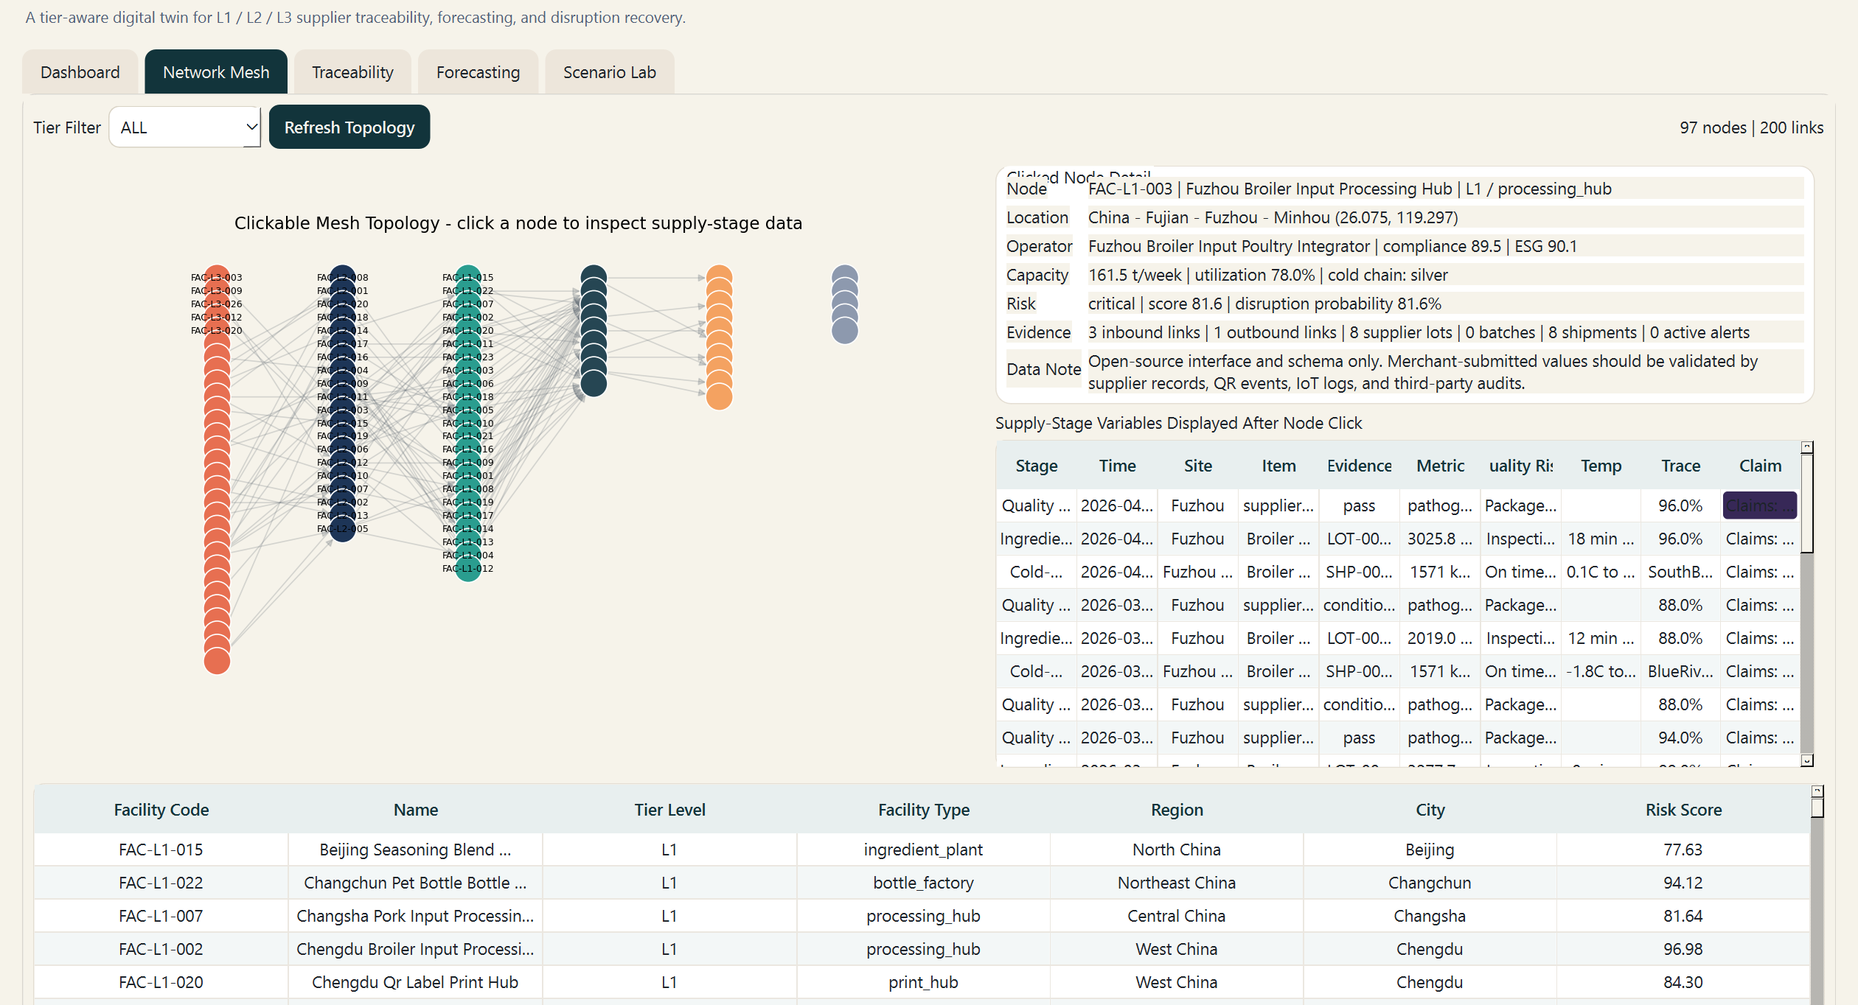
PRODUCT PROOF
06 / 11
Click a node, inspect the evidence
The revised product proof: a user sees concrete stage data, not just a decorative supply-chain map.
Example node: FAC-L1-003
Location
China - Fujian - Fuzhou - Minhou
Time
2026-04-11 09:00 quality checkpoint
Stage
Ingredient lot -> cold-chain shipment
Quality
Package 95.8 | trace 96.0%
Temperature
0.1C to 4.1C | breach 0 min
Risk
critical | score 81.6
Group 9 | Rui Huang and Zixiu Wang | 8-minute presentation
Local runtime screenshot; repository code
Notes:
Zixiu: this is the central product slide. Say that a merchant can use this exact view, or a web/QR version of it, to show evidence at the product page. Point to variables: time, place, stage, quality, temperature, risk.
[APA sources / evidence]
- https://github.com/3351666087/Oasis-Finder; local health check on 2026-04-27; artifacts/risk_metrics.json; artifacts/forecast_metrics.json.
- U.S. Food and Drug Administration. (2024). Food Traceability Rule: Critical Tracking Events and Key Data Elements. https://www.fda.gov/food/food-safety-modernization-act-fsma/fsma-proposed-rule-food-traceability
- GS1. (n.d.). Traceability standards: Critical Tracking Events and Key Data Elements. https://www.gs1.org/standards/traceability

Slide 7
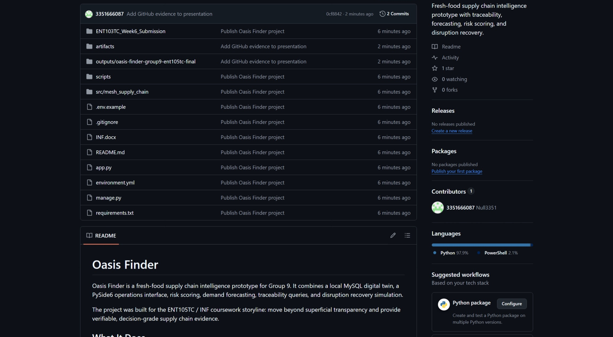
OPEN SOURCE + INTERFACE
07 / 11
GitHub proves code openness, not merchant truth
Reviewers can inspect our method. Merchant data still needs supplier, IoT, and audit validation.
OPEN CODE
HEALTH GATE
main
pass
reproducible setup and evidence assets
database, traces, forecasts, scenario checks
DATA TRUTH
AI LAYER
merchant
optional
supplier records, QR events, IoT logs, audits
summarize evidence; never certify it alone
https://github.com/3351666087/Oasis-Finder
Group 9 | Rui Huang and Zixiu Wang | 8-minute presentation
GitHub repository; FDA/GS1 data-field logic
Notes:
Zixiu: clarify the data-responsibility point. Our code is open source, and the product reserves interfaces. We do not guarantee a big company's or any merchant's data authenticity.
[APA sources / evidence]
- https://github.com/3351666087/Oasis-Finder; local health check on 2026-04-27; artifacts/risk_metrics.json; artifacts/forecast_metrics.json.
- U.S. Food and Drug Administration. (2024). Food Traceability Rule: Critical Tracking Events and Key Data Elements. https://www.fda.gov/food/food-safety-modernization-act-fsma/fsma-proposed-rule-food-traceability
- GS1. (n.d.). Traceability standards: Critical Tracking Events and Key Data Elements. https://www.gs1.org/standards/traceability

Slide 8
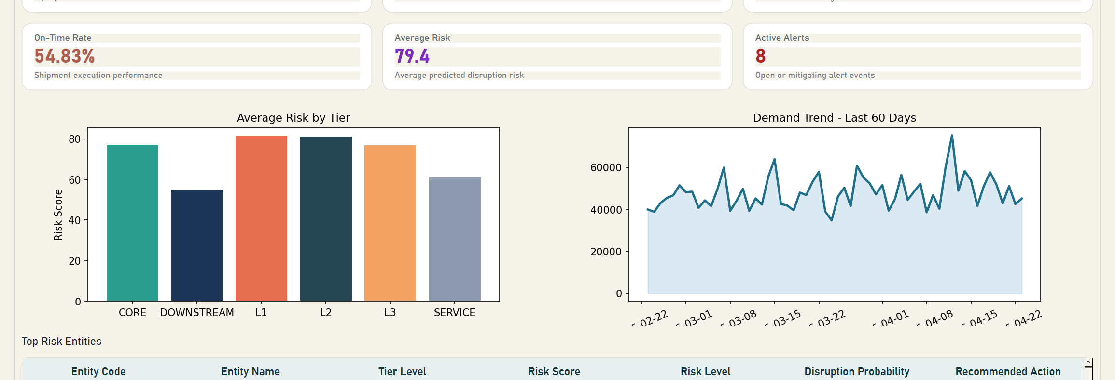
TECHNICAL CAPABILITY
08 / 11
A working digital twin supports the ad method
The consumer-facing transparency layer is backed by an operational model, not a static poster.
FACILITIES
ACTIVE LINKS
BATCHES
FORECAST DAYS
97
200
418
30
nodes across supplier, plant, downstream, and service tiers
material and distribution relationships
finished-goods batches with trace paths
planning horizon for demand and inventory
Group 9 | Rui Huang and Zixiu Wang | 8-minute presentation
CSV: technical_model_metrics.csv; local health check
Notes:
Zixiu: show that we can back the marketing interface with operational data. Mention 97 facilities, 200 links, 418 batches, and model metrics.
[APA sources / evidence]
- https://github.com/3351666087/Oasis-Finder; local health check on 2026-04-27; artifacts/risk_metrics.json; artifacts/forecast_metrics.json.

Slide 9
MERCHANT VALUE
09 / 11
Why merchants can earn more with this method
Oasis Finder is useful to merchants because it makes premium quality easier to believe before purchase.
Conversion
lower uncertainty at the exact buying moment
Premium
traceability is linked with WTP and perceived value
Retention
clearer evidence supports repeat intention and fewer disputes
Use as ad copy: “scan the product journey, not just the package.”
Group 9 | Rui Huang and Zixiu Wang | 8-minute presentation
CSV: merchant_value_index.csv; Tran et al. (2024)
Notes:
Zixiu: this slide answers why merchants gain. It is an indexed value model, not a guaranteed financial forecast. Tie it to WTP, purchase intention, perceived risk, and perceived value.
[APA sources / evidence]
- Tran, D., Schouteten, J. J., Gellynck, X., & De Steur, H. (2024). How do consumers value food traceability? A meta-analysis. Food Control, 162, 110453. https://doi.org/10.1016/j.foodcont.2024.110453
- Ge, L. (2022). To buy or not to buy? A research on the relationship between traceable food extrinsic cues and consumers' purchase intention. Frontiers in Psychology, 13, 873941. https://doi.org/10.3389/fpsyg.2022.873941
- Wang, E. S.-T., Lin, H.-C., & Tsai, M.-C. (2021). Effect of institutional trust on consumers' health and safety perceptions and repurchase intention for traceable fresh food. Foods, 10(12), 2898. https://doi.org/10.3390/foods10122898

Slide 10
PILOT VALIDATION
10 / 11
Next proof: merchant A/B test
After the questionnaire signal, the next step is a real product-page experiment that links transparency to purchase behavior.
Test setup
Product cells
Same product, same price, two product pages: baseline page versus Oasis Finder evidence page.
Cake, seafood, meat, dairy, and ready-to-eat meals because freshness and safety concerns are high.
Outcome metrics
Decision rule
QR scan rate, evidence-panel clicks, add-to-cart, purchase conversion, willingness-to-pay, repeat intent.
Adopt the method when purchase lift and trust lift both improve without increasing confusion.
Commercial validation target: prove that inspectable supply-chain evidence changes real purchase behavior, not only stated preference.
Group 9 | Rui Huang and Zixiu Wang | 8-minute presentation
Pilot metrics prepared for CSV event export
Notes:
Use this as the future-validation slide. It replaces the internal speaking-flow page, which is not useful for assessors. Explain that the project can move from stated preference to merchant A/B testing.
[APA sources / evidence]
- Group 9 internal questionnaire direction (2026); raw response file is not stored in this repository, so charts are treated as directional evidence rather than population statistics.
- Ge, L. (2022). To buy or not to buy? A research on the relationship between traceable food extrinsic cues and consumers' purchase intention. Frontiers in Psychology, 13, 873941. https://doi.org/10.3389/fpsyg.2022.873941
- Tran, D., Schouteten, J. J., Gellynck, X., & De Steur, H. (2024). How do consumers value food traceability? A meta-analysis. Food Control, 162, 110453. https://doi.org/10.1016/j.foodcont.2024.110453

Slide 11
APA REFERENCES
11 / 11
References and closing claim
Oasis Finder is a transparent-commerce method: open code, clear fields, and inspectable product evidence.
Ge, L. (2022). To buy or not to buy? A research on the relationship between traceable food extrinsic cues and consumers' purchase intention. Frontiers in Psychology, 13, 873941. https://doi.org/10.3389/fpsyg.2022.873941
Tran, D., Schouteten, J. J., Gellynck, X., & De Steur, H. (2024). How do consumers value food traceability? A meta-analysis. Food Control, 162, 110453. https://doi.org/10.1016/j.foodcont.2024.110453
Wang, E. S.-T., Lin, H.-C., & Tsai, M.-C. (2021). Effect of institutional trust on consumers' health and safety perceptions and repurchase intention for traceable fresh food. Foods, 10(12), 2898. https://doi.org/10.3390/foods10122898
Badia-Melis, R., Mishra, P., & Ruiz-García, L. (2015). Food traceability: New trends and recent advances. Food Control, 57, 393-401. https://doi.org/10.1016/j.foodcont.2015.05.005
World Economic Forum. (2019). Innovation with a purpose: Improving traceability in food value chains through technology innovations. https://www.weforum.org/publications/innovation-with-a-purpose-improving-traceability-in-food-value-chains-through-technology-innovations/
U.S. Food and Drug Administration. (2024). Food Traceability Rule: Critical Tracking Events and Key Data Elements. https://www.fda.gov/food/food-safety-modernization-act-fsma/fsma-proposed-rule-food-traceability
GS1. (n.d.). Traceability standards: Critical Tracking Events and Key Data Elements. https://www.gs1.org/standards/traceability
Final line: We do not ask users to trust a slogan. We let them inspect the chain behind the product.
Group 9 | Rui Huang and Zixiu Wang | 8-minute presentation
Notes:
Closing. State the final line slowly, then invite questions.
[APA sources / evidence]
- Ge, L. (2022). To buy or not to buy? A research on the relationship between traceable food extrinsic cues and consumers' purchase intention. Frontiers in Psychology, 13, 873941. https://doi.org/10.3389/fpsyg.2022.873941
- Tran, D., Schouteten, J. J., Gellynck, X., & De Steur, H. (2024). How do consumers value food traceability? A meta-analysis. Food Control, 162, 110453. https://doi.org/10.1016/j.foodcont.2024.110453
- Wang, E. S.-T., Lin, H.-C., & Tsai, M.-C. (2021). Effect of institutional trust on consumers' health and safety perceptions and repurchase intention for traceable fresh food. Foods, 10(12), 2898. https://doi.org/10.3390/foods10122898
- Badia-Melis, R., Mishra, P., & Ruiz-García, L. (2015). Food traceability: New trends and recent advances. Food Control, 57, 393-401. https://doi.org/10.1016/j.foodcont.2015.05.005
- World Economic Forum. (2019). Innovation with a purpose: Improving traceability in food value chains through technology innovations. https://www.weforum.org/publications/innovation-with-a-purpose-improving-traceability-in-food-value-chains-through-technology-innovations/
- U.S. Food and Drug Administration. (2024). Food Traceability Rule: Critical Tracking Events and Key Data Elements. https://www.fda.gov/food/food-safety-modernization-act-fsma/fsma-proposed-rule-food-traceability
- GS1. (n.d.). Traceability standards: Critical Tracking Events and Key Data Elements. https://www.gs1.org/standards/traceability
- https://github.com/3351666087/Oasis-Finder; local health check on 2026-04-27; artifacts/risk_metrics.json; artifacts/forecast_metrics.json.

