Slide 1
IOT104TC PROJECT
Smart Classroom
UNO Edge Node
Sensors, state machine and actuators
Energy-Saving, Safety
& Asset Monitoring System
UART + ACK
Local-first classroom control with real sensors, actuators, MQTT operations, dashboard analytics and AI-assisted commands.
ESP32 Gateway
Wi-Fi, MQTT and dashboard bridge
9+
5
1s
432m
hardware signals
priority modes
telemetry cadence
recorded evidence
Local safety works even when the network is offline.

Slide 2
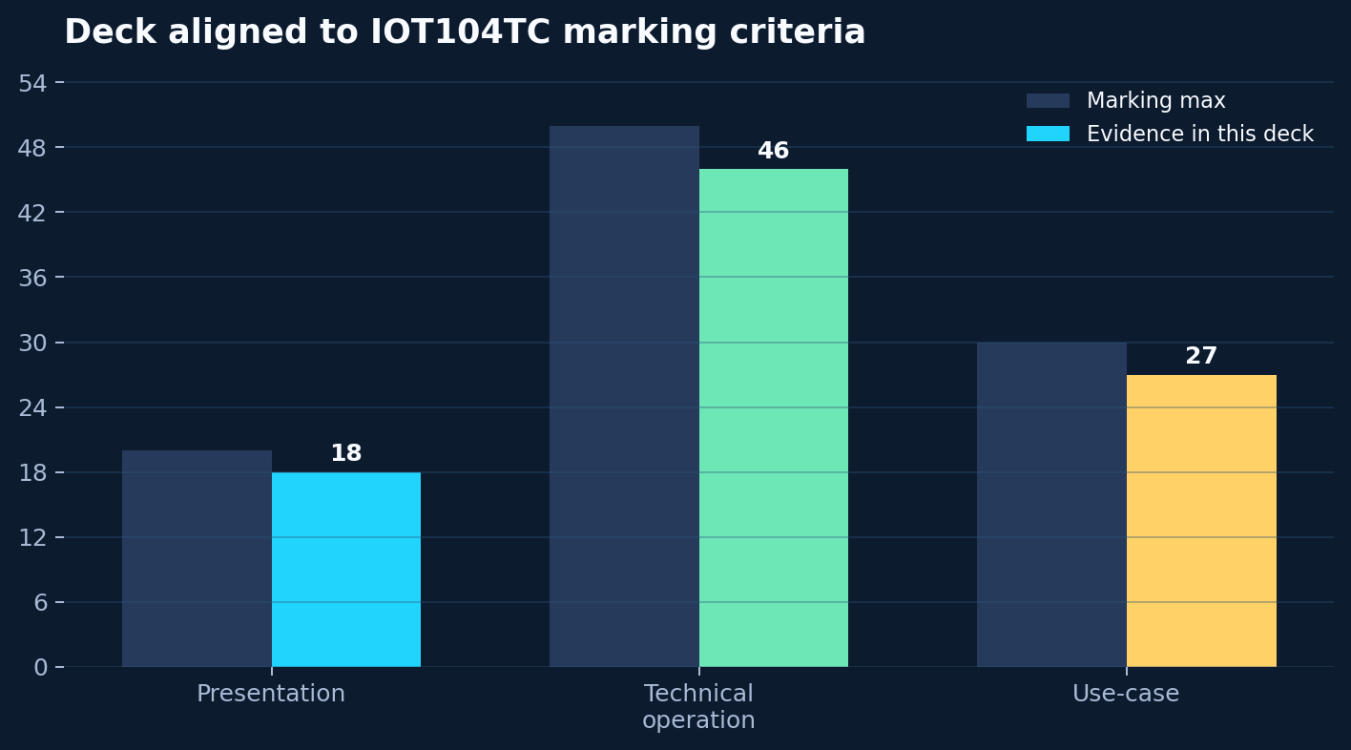
ASSESSMENT FIT
02
Built around the marking scheme
The demo connects hardware, software, architecture, security/privacy, operations and a practical classroom use-case.
Application
Architecture
Energy, comfort and safety in one classroom service.
UNO local control. ESP32 MQTT gateway.
Evidence
Security
Telemetry, screenshots and self-check.
Fail-safe local control and ignored secrets.
Smart Classroom IoT104TC

Slide 3
USE-CASE
03
A classroom that reacts locally and reports globally
The system behaves like a small building-management service, not a sensor list.
01
02
03
04
Sense
Decide
Act
Operate
>
>
>
Occupancy, light, temperature, gas, flame and emergency button.
Priority state machine: safety first, then comfort and energy saving.
Lamp, fan, PWM, tach, buzzer and status light.
MQTT dashboard, manual override, presets, charts and AI timeline.
Safety
Comfort
Ops
Data
highest priority
adaptive fan/lamp
ACK + persistence
charts + history
Smart Classroom IoT104TC

Slide 4
SYSTEM ARCHITECTURE
04
Real-time control stays on UNO
Networking adds visibility and commands, but does not become a dependency for safety.
Input
Edge
Gateway
Service
Sensors
Arduino UNO
ESP32
Laptop
D2 PIR / A0 Light
A1 Gas / A2 LM35
D8/A3 Flame
D4 Button
>
millis loop
state machine
relay / PWM / tach
buzzer + status light
>
Serial2 UART
Wi-Fi reconnect
MQTT publish
command bridge
>
Mosquitto
web dashboard
history store
AI planner
Design decision: ESP32 is a gateway; UNO remains the controller of record.
Smart Classroom IoT104TC

Slide 5
HARDWARE EVIDENCE
05
Dense hardware, clean responsibility
The build is complex, but each module has a clear role in the service.
48-kit modules
External components
Wiring rules
#18 PIR
#31 TEMT6000
#25 Gas Sensor
#16 Flame Sensor
#5 Active Buzzer
Traffic Light Module
UNO R3
ESP32 Gateway
LM35 powered from ESP32 5V
6-channel relay
12V 4-wire fan
LED + resistor
Common ground is required.
UNO A5 to ESP32 RX2 uses divider.
Relay logic uses RELAY_ON / RELAY_OFF.
No capacitor is added in this build.
ENGINEERING FIX
LM35 became stable after moving power to ESP32 5V and adding ADC guard compensation.
Smart Classroom IoT104TC

Slide 6
EDGE INTELLIGENCE
06
Priority is a state machine
Mixed behavior stays predictable because safety, sensor health, manual control, cooling, lighting and saving are ordered.
SAFETY_ALARM
gas/flame/button
WHY IT MATTERS
SENSOR_ERROR
invalid sensor state
Dashboard explains what happened and why.
MANUAL
operator override
COOLING
temperature high
LIGHTING
occupied + dark
That turns raw telemetry into an operational classroom service.
ENERGY_SAVING
empty or bright
NORMAL
monitoring
Smart Classroom IoT104TC

Slide 7
SAFETY ALARM
07
The highest-priority path is visible and local
The button gives a safe live demo while gas and flame remain the real sensor paths.
Trigger
Decision
Action
Three inputs
SAFETY ALARM
Physical response
gasDanger
flameDetected
demoEmergency
>
Overrides lighting, cooling and energy-saving logic immediately.
>
red light
pulsed buzzer
fan relay ON
PWM = 255
Demo first: press D4, then watch red light, buzzer, fan and dashboard alarm.
Smart Classroom IoT104TC

Slide 8
COMFORT + ENERGY
08
Human-friendly automation
The classroom avoids waste without making the controls feel abrupt.
Lighting
Cooling
Bright room: lamp stays off even if PIR sees motion.
Dark room + occupied: lamp turns on.
No occupancy timeout: lamp turns off.
Temperature threshold starts the relay.
PWM ramps fan intensity.
Tach RPM is interrupt-based and never blocks the system.
10s
PWM
ACK
Local
occupancy timeout
smooth fan path
config confirmed
works offline
Smart Classroom IoT104TC

Slide 9
MQTT NETWORK LAYER
09
Telemetry goes up; commands come back with ACK
The protocol is simple enough to debug and structured enough for a dashboard.
SC2,mode=SAFETY_ALARM,pir=1,temp10=286,gas=520
fan=1,pwm=255,rpm=1320,status=R
UNO
ESP32
MQTT
Web
Emit
>
Parse
>
Publish
>
Operate
SoftwareSerial line every second
Serial2 + Wi-Fi reconnect
JSON plus key topics
Config + presets
manual mode
ACK loop proves the command actually landed on the UNO.
Smart Classroom IoT104TC

Slide 10
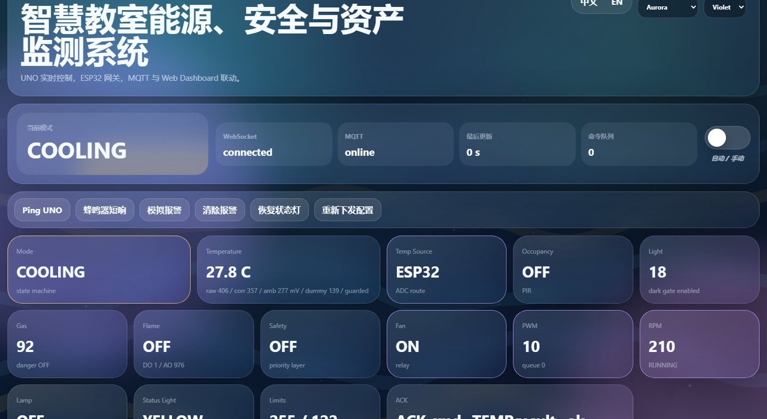
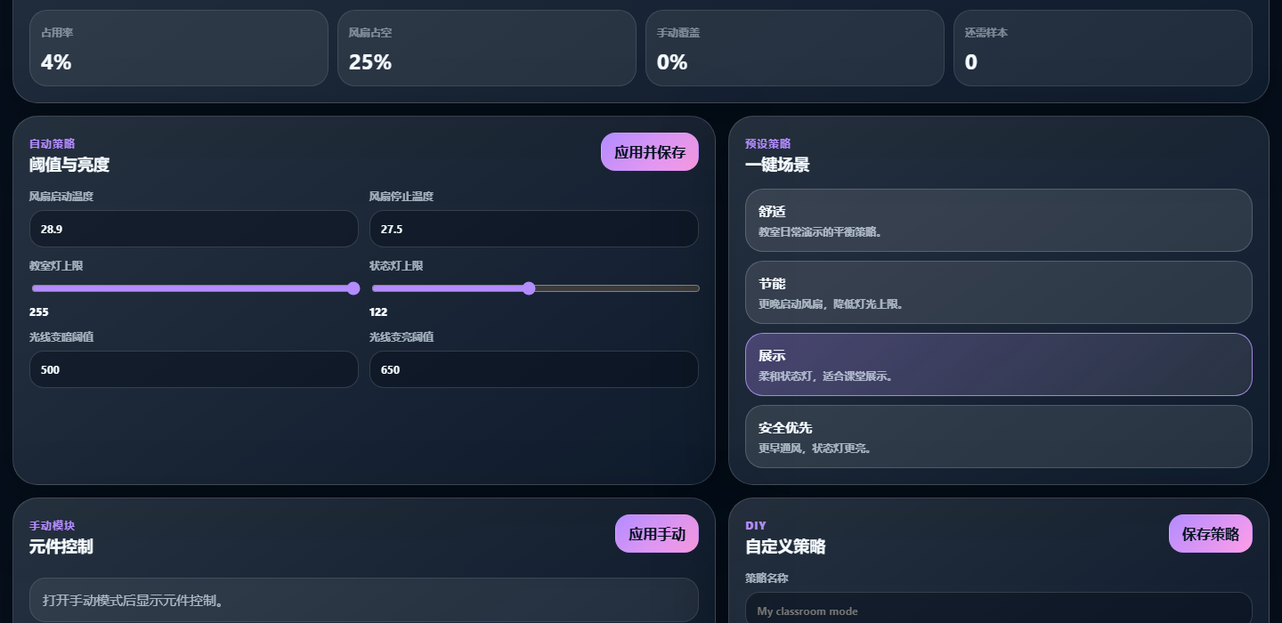
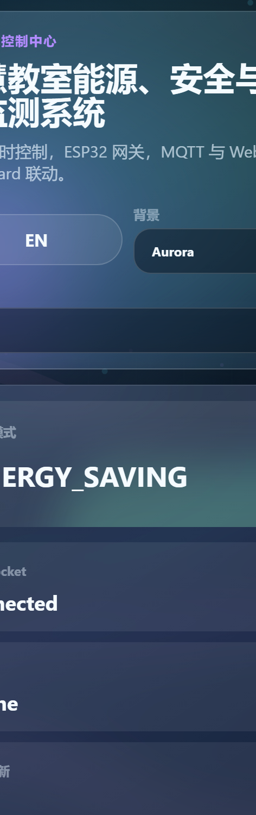
DASHBOARD
10
An operator console, not a raw JSON page
Large cards, live charts, mobile access, manual mode and scene presets make the system usable.
Auto
Scenes
manual switch
one-click presets
Dashboard screenshots captured from the local running system.

Slide 11
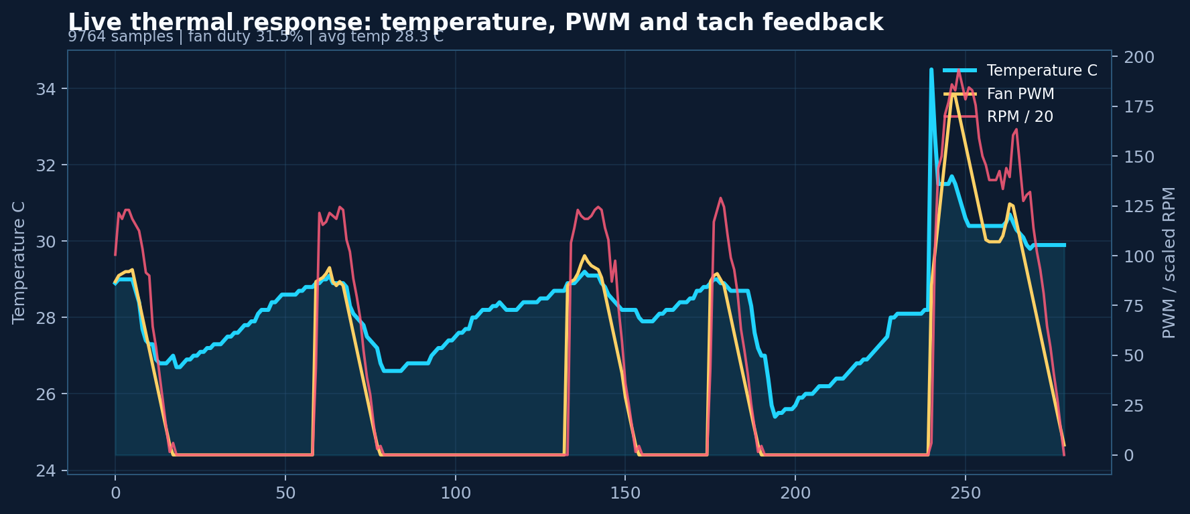
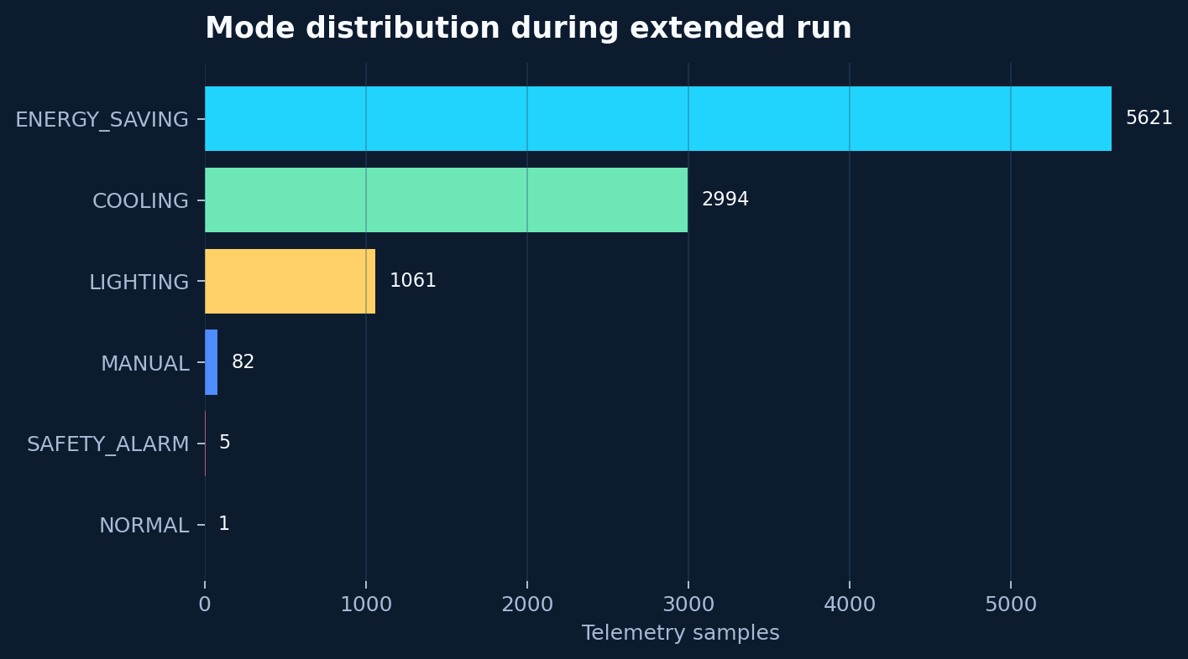
TELEMETRY EVIDENCE
11
The demo has history, not just live values
Recorded data supports behavior explanation: modes, temperature response, fan duty and safety events.
9,764 samples | avg temp 28.3C | fan duty 31.5% | safety events 5
Smart Classroom IoT104TC

Slide 12
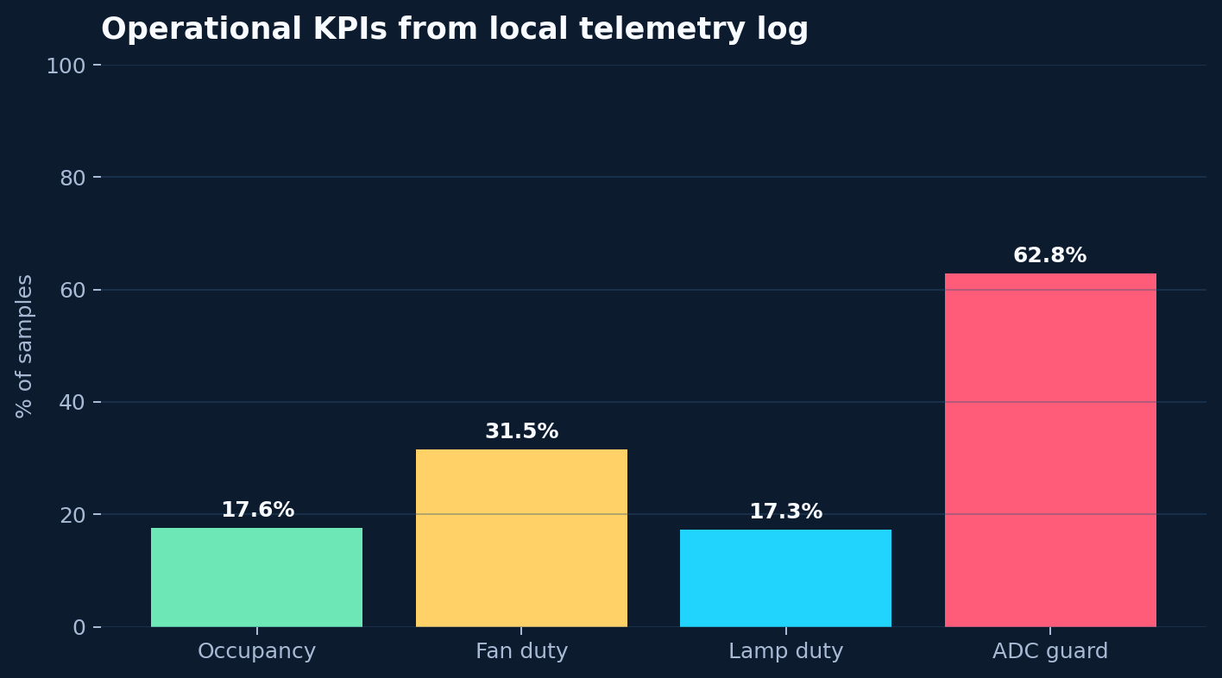
MEASURED COMPLEXITY
12
Complexity comes from closed loops
Sensors, control, gateway, dashboard, persistence and AI all interact with the same physical system.
9,764
12+
telemetry samples
MQTT topics
2-way
Local-first
UART command + ACK
safety path offline
34/34
delivery self-check PASS
Smart Classroom IoT104TC

Slide 13
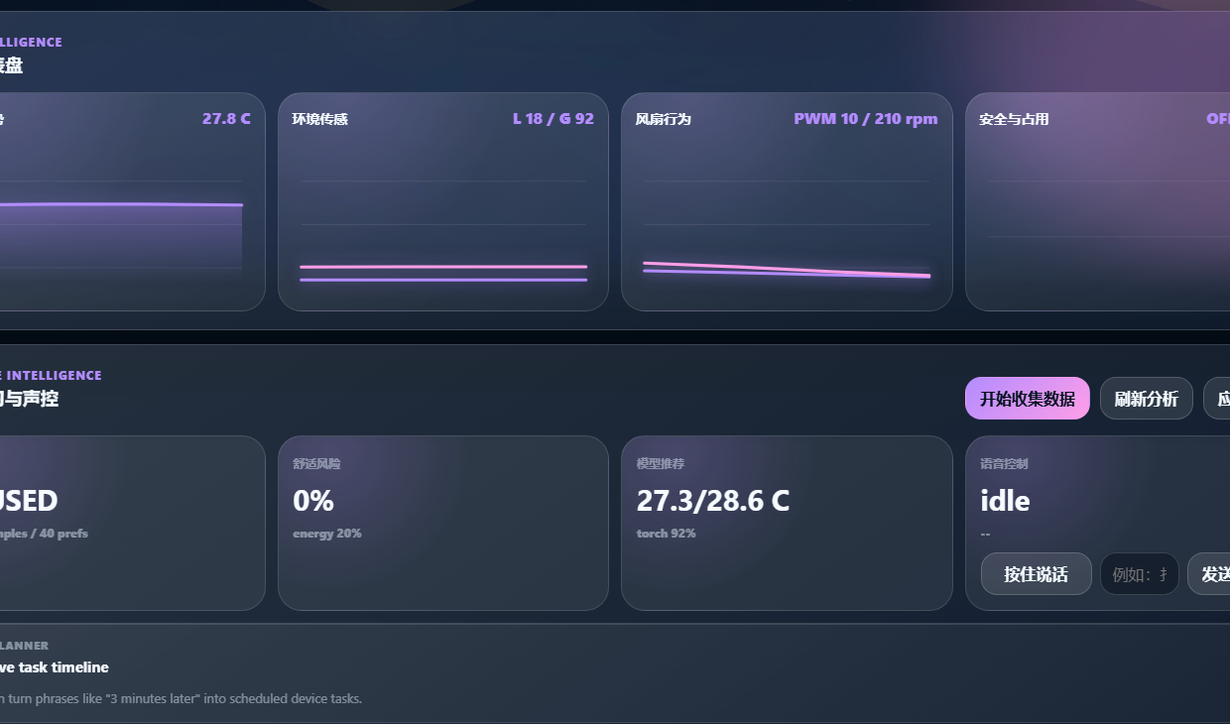
AI OPERATIONS LAYER
13
Natural language becomes structured control
AI is useful because it turns vague operator intent into ordered tasks and timed actions.
Voice
STT
Qwen
Capture
>
Text
>
Plan
Browser mic input
faster-whisper
structured tasks
Timeline
Data
Delayed actions auto-clear after completion.
Overrides guide comfort.
Smart Classroom IoT104TC

Slide 14
SECURITY, PRIVACY & OPERATIONS
14
Demo-friendly, but risk-aware
The project separates safety-critical local control from network convenience and AI assistance.
Safety boundary
Privacy boundary
Operations boundary
Safety alarm, buzzer, red light and fan response are local on UNO.
Microphone is user-triggered and requires browser permission.
MQTT status, ACK logs, persistence and self-check reduce demo risk.
Production hardening path: authenticated MQTT, TLS, enclosure, fuse, isolation and power filtering.
Smart Classroom IoT104TC

Slide 15
DEMO CHOREOGRAPHY
15
Show the strongest engineering first
The audience should see safety and edge control before dashboard polish and AI features.
P1
P2
P3
P4
P5
Safety
Edge
Energy
IoT
AI
>
>
>
>
button -> red light -> buzzer -> fan high
UNO local controller and priority modes
PIR + light + temp drive lamp and fan
UART, MQTT topics and ACK command loop
voice, Qwen, timeline and data preference
Do not open with AI. Open with physical safety response.
Smart Classroom IoT104TC

Slide 16
REFERENCES + SELF-CHECK
16
Ready to inspect, rebuild and present
The final package includes sources, assembly materials, scripts and a repeatable delivery check.
References
Self-check gates
Arduino UNO R3 docs
Espressif Arduino-ESP32 Serial docs
Eclipse Mosquitto config docs
Arduino PubSubClient docs
Texas Instruments LM35 page
PPT structure
required docs
firmware presence
secret scan
Node/Python syntax
UNO + ESP32 compile
Final claim: a local-first IoT classroom controller with safety, energy saving, operations and evidence-backed intelligence.
Smart Classroom IoT104TC final presentation package

