Slide 1
Retrospective previous 6 chapters

Slide 2
Content of Table
Stage
Layer and Hierarchy
Input & Output parameter
Local & Global variable
Data Type
Publish
Business object
Basic Architecture

Slide 3
Stage
Calculation
Link
Which stages are usually used?
Decision
Anchor
Collection
Action
Data Item
Page
Loop
Process

Slide 4
Layer and Hierarchy
Upper Page
Main Process
Sub Process1
Page Reference
Sub Process2
Main Page
Sub Page1
Sub Page2
Lower Page

Slide 5
Input & Output parameter
Main Page/Process
Sub Page/Process
Input Data Item
Start stage get input data by an input parameter
Do some logic…
Output Data Item
End stage output a data by
A output parameter

Slide 6
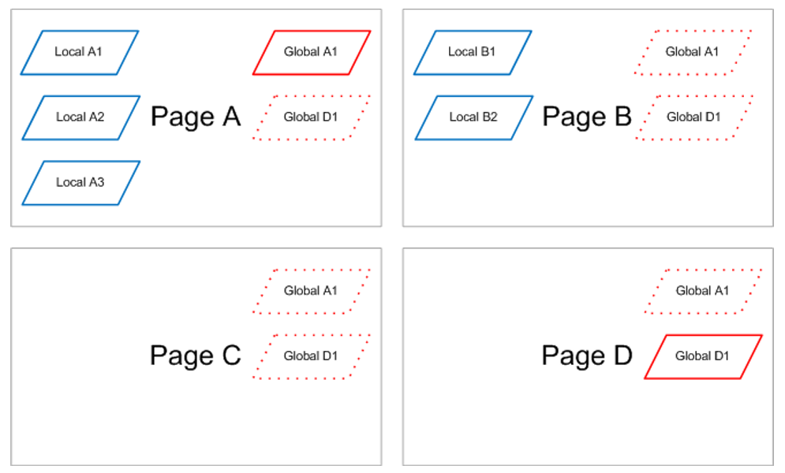
Local & Global variable
By default, Data Items can only be used by stages on the same page as them, but this can be changed if necessary.
Local Variable: visibility is on the same page
Global Variable: visibility is on all of page
There are error message when you try to create a local variable with the same name of global

Slide 7
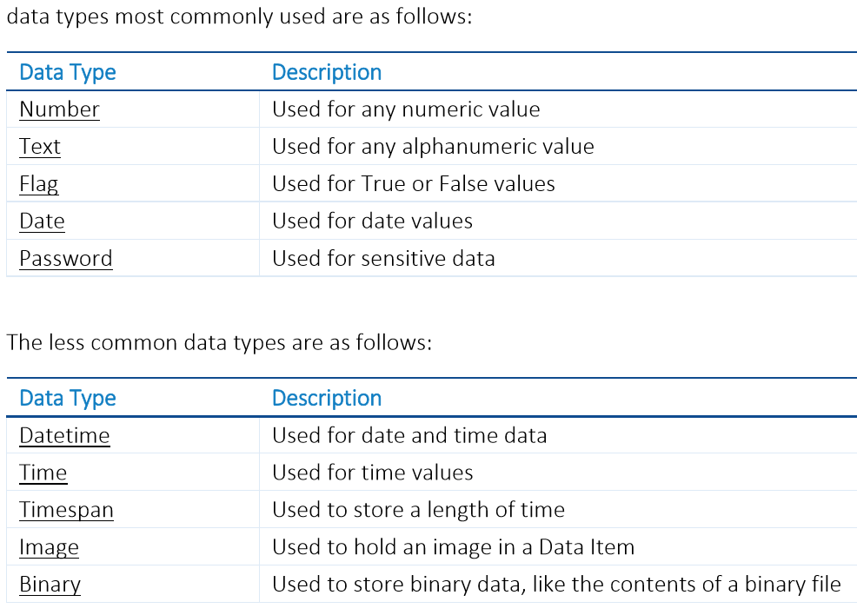
Data Type
Commonly used Data Type?

Slide 8
Publish Process & Objects
1. Only “published” Processes are visible in Control Room, and new Processes are always “unpublished” to begin with.
2. Machines installed with Blue Prism are known as Resources, and an instance of a Process running on a Resource is known as a Session.
3. A Session can only run once; to run a Process again a new session must be created.

Slide 9
Business object - Usage
Object Studio is used to capture the functionality of an application so that it can be employed by Processes. A Process is used to combine the application functionality with business rules in order to perform useful work. This application functionality is known as a Business Object

Slide 10
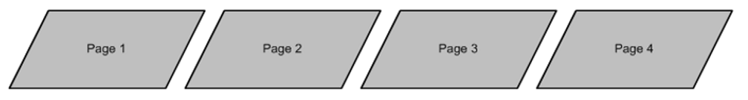
Business object - Structure
1. Object Studio does not have a Main Page but it does have two default pages (one is initialise, other is clean up)
2. Pages are organized as a flat group rather than the hierarchy we have seen in Process Studio

Slide 11
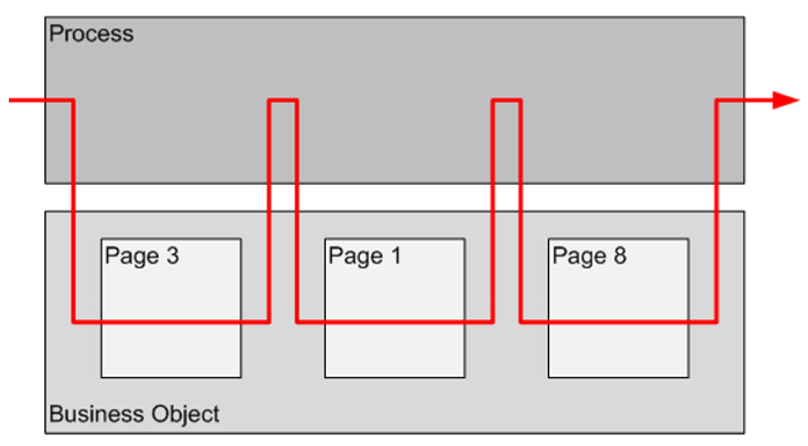
Business object – Logical Flow
Business Object pages run one at a time and are usually not interconnected like the pages of a Business Process. A Process can select which Business Object pages to use and use them in any order

Slide 12
Business object – Application Modeler & Stage
Usage of Application Modeler?
Navigate
Special Stages?
Read
Wait
Write

Slide 13
Basic Architecture of PRA
Process
Process uses Action empoly Objects
Business Objects
Application Modeler forms attributes into elements
Object Studio uses elements to manipulate the application
Application Modeler
the application provides data to Application Modeler
APP
(Windows exe/Java app/Browser app)

