Slide 1
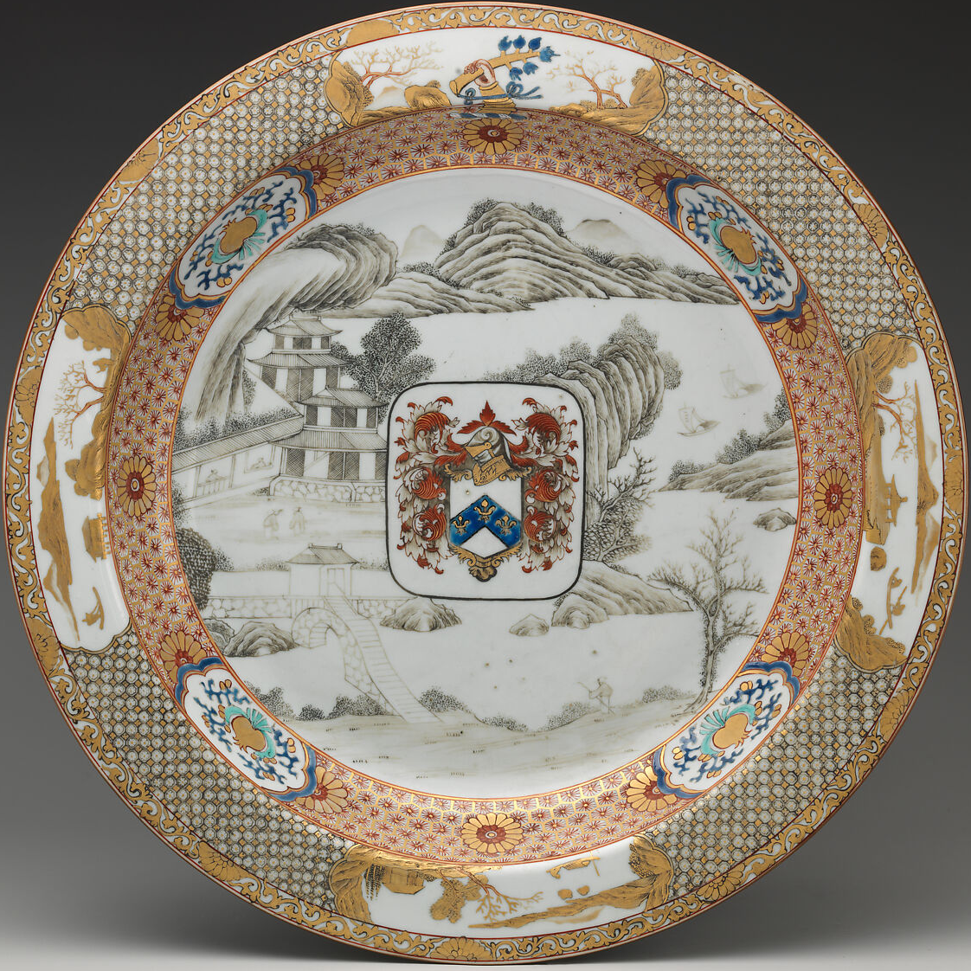
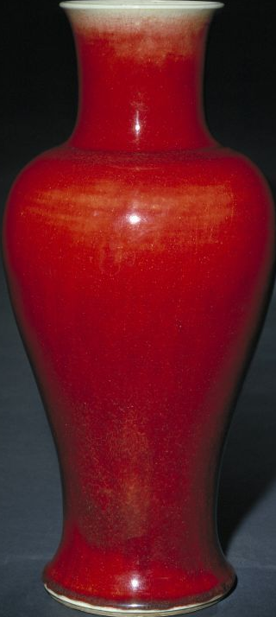
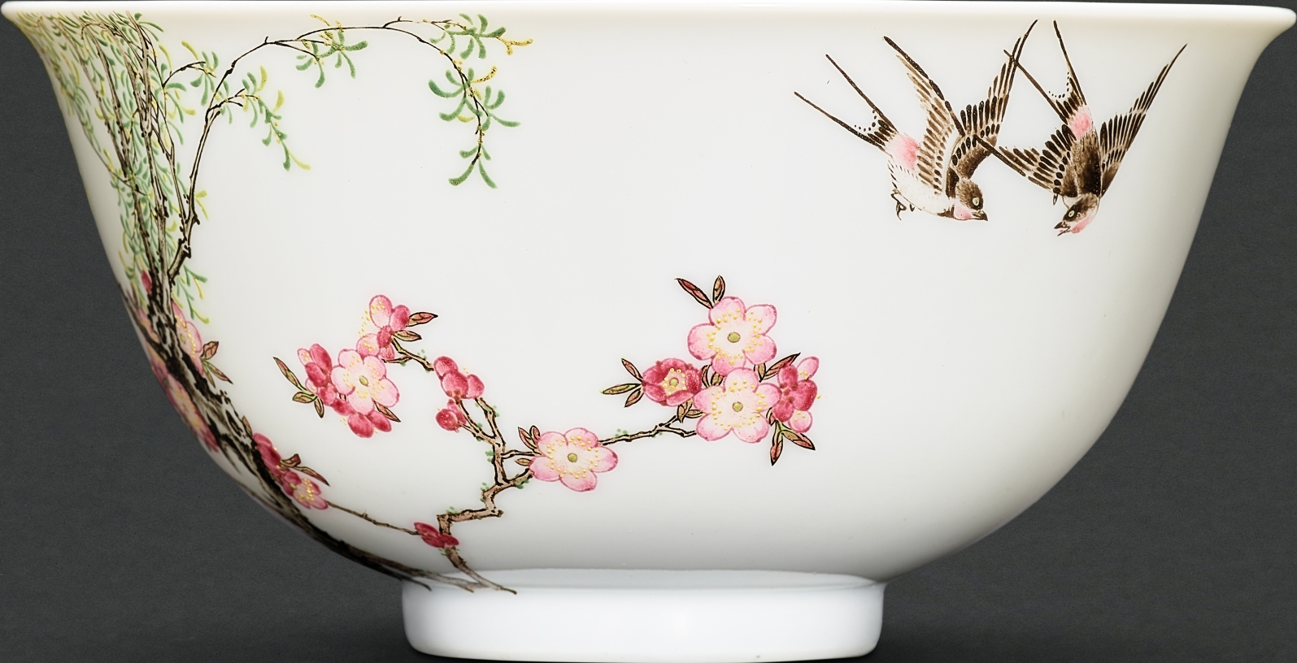
PORCELAIN / EMPIRE / EXCHANGE
HY5305
Same Clay,
Three Worlds
Tradition. Translation. Trade.
QING CHINA
02 / TRANSLATION
Imperial enamels
01 / TRADITION
Swallows bowl · Qianlong [2]
Langyao red
European technique. Imperial taste.
Guanyin vase · Kangxi [1]
03 / TRADE
Ming red, reimagined.
Armorial porcelain
Elwick service · 1725–30 [3]
Chinese craft.
European identity.
Jingdezhen
porcelain blanks
enamel knowledge
Chinese makers.
Global meanings.
Beijing
porcelain
Images: [1] Palace Museum · [2] Sotheby’s · [3] The Met
Guangzhou
designs
Europe
Notes:
CONTENT AUTHORITY
Adapted and translated from the user-provided Chinese project outline, 海报大纲中文版.docx. One editable slide, standard widescreen PowerPoint size (13⅓ × 7½ inches, 16:9). The title is an interpretive metaphor for the shared Chinese porcelain tradition, not a claim that the three objects have identical clay compositions. No empirical findings have been invented.
OBJECT 1
The Palace Museum, Langyao red-glazed Guanyin vase, Qing dynasty, Kangxi reign; height 45.5 cm. Museum catalogue number 故00148232. The current Chinese catalogue title uses 观音瓶; Guanyin vase preserves the object type named in the user's outline. The caption identifies the reign, not a precisely dated manufacture year. The discussion concerns imperial kiln culture; it does not assert a documented personal commission by the Kangxi emperor for this individual vase.
https://www.dpm.org.cn/collection/ceramic/226751.html
Image: https://img.dpm.org.cn/Uploads/Picture/dc/143[1024].jpg
Image credit: The Palace Museum. Original image embedded, with native picture clipping.
OBJECT 2
Imperial falangcai bowl with apricot blossoms, willow and spring swallows, Qianlong blue-enamel four-character mark and period (1736–1795), diameter 11.3 cm. Christie's, Imperial Chinese Ceramics from the Robert Chang Collection – Jade Shears and Shimmering Feathers, Hong Kong, 28 November 2006, lot 1309. Lot essay by Rosemary Scott. The initial working draft used the top-left view in Christie's multi-view photograph; the delivered poster uses Sotheby's high-resolution image of the same bowl. No current ownership is asserted.
https://www.christies.com/en/lot/lot-4823606
Image: https://www.christies.com/img/LotImages/2006/HGK/2006_HGK_02323_1309_000(011212).jpg?mode=max
Image credit: Christie's. Original image embedded, with native picture clipping.
OBJECT 3
Plate, Chinese, for the British market, 1725–1730; hard-paste porcelain; diameter 38.7 cm. The Metropolitan Museum of Art, accession 67.237. Part of a service made for John Elwick of Cornhill, London (died 1730), a director of the English East India Company. The outline did not name an individual armorial plate; this documented object was selected as the representative example.
https://www.metmuseum.org/art/collection/search/204811
Image: https://images.metmuseum.org/CRDImages/es/original/DP-12307-022.jpg
Credit line: Helena Woolworth McCann Collection, Purchase, Winfield Foundation Gift, 1967. The Met identifies this image as Public Domain.
CONTEXT AND DIAGRAM
The Met, Embracing Color: Enamel in Chinese Decorative Arts, 1300–1900, explains the introduction of European enamel materials and techniques to the Qing court and the active creation of new colours and styles by Chinese artists.
https://www.metmuseum.org/exhibitions/embracing-color
The diagram follows the outline's conceptual network. Solid blue arrows show porcelain objects; dashed red arrows show orders and heraldic designs; dashed green arrows show enamel expertise. Routes are schematic and do not claim a verified individual shipping itinerary for any of the three objects. Beijing is the court workshop destination for blanks; Guangzhou is the export-trade node. Objects are not reproduced to relative physical scale.
All sources accessed 17 September 2026. Full sources are linked on images and the source line.
1
VISUAL REVISION
The user requested fewer words, no fixed three-column structure, and decorative motifs. The final poster uses an asymmetric composition, native vector botanical and wave ornaments, three real object photographs, concise English labels, and a schematic network. The ornaments are modern design elements, not documented features of the objects.
BOWL IMAGE UPDATE
The higher-resolution photograph is from Sotheby’s, A Timeless Ode to Spring: The Dr Alice Cheng Falangcai Bowl, 8 April 2023, lot 1. Same object as Christie’s 2006 lot 1309, as established by provenance. The Sotheby’s catalogue dates the enamel decoration to circa 1736, possibly on a Yongzheng-period porcelain body; the visible poster label retains the broader Qianlong attribution.
https://www.sothebys.com/en/buy/auction/2023/a-timeless-ode-to-spring-the-dr-alice-cheng-falangcai-bowl/a-highly-important-and-superbly-enamelled-imperial
Image: https://sothebys-brightspot.s3.amazonaws.com/media-desk/0c/ee/857380b54b3e9aea30d205a95e92/hk1386-b78v8-t1-01-v1.jpg
Image credit: Sotheby’s. The original photograph is embedded with native PowerPoint crop geometry.
CORE INTERPRETATION
Jingdezhen potters revived Ming copper-red glazes through demanding high-temperature firing. Technical reinvention connected the Qing present to a prestigious Chinese past. European enamel knowledge met Jingdezhen porcelain, Chinese bird-and-flower painting and Beijing court workshops, translating new techniques into imperial taste. Chinese makers adapted European heraldic designs for overseas patrons; John Elwick’s service made Chinese porcelain a display of British family identity and wealth. Together the cases foreground the active choices of Chinese craftspeople and court institutions in cross-cultural exchange.

