Slide 1

Azure Artifacts

Slide 2
What is a package?
Mechanism to create, share and consume code and components
Contains (compiled) code with metadata content for consuming packages

Slide 3





Types of packages
Microsoft platform and .NET artifacts
Node.js modules
Python scripts
Universal packages
Java packages
Docker images
NuGet Microsoft development platform and .NET artifacts
Npm node.js modules
Maven Java packages
Python Python script
Universal Set of related files
Docker Container images
Symbols Symbol files

Slide 4
Package feeds
Centralized storage of package artifacts
Public or privately available
Offer secure access for private feeds
Versioned storage of packages
Managed by tooling
Also known as
Package repositories
Package registry

Slide 5
Private and public feeds
Public
NuGet.org
Npmjs.org
PyPi.org
Docker Hub
Private feeds
MyGet
Azure Container Registry
Azure Artifacts
Self-hosted solution

Slide 6
Package feed managers
Manages feed
Search and list packages from feed
Consume packages
Maintain local installation cache
Publish packages
Choose tooling:
Command-line tooling
Integrated in build and release pipelines

Slide 7
Public sources
NuGet Gallery https://nuget.org
NPMjs https://npmjs.org
Maven https://search.maven.org
Docker Hub https://hub.docker.com
Python Package Index https://pypi.org

Slide 8
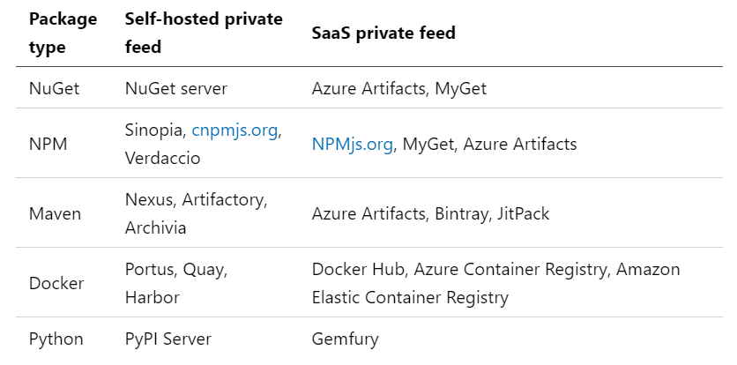
Self-hosted and SaaS based private package feeds

Slide 9
Consuming packages
Identify a required dependency in your codebase
Find a component that satisfies the requirements for the project
Search the package sources for a package offering a correct version of the component
Install the package into the codebase and development machine
Create the software implementation that uses the new components from the package.

Slide 10
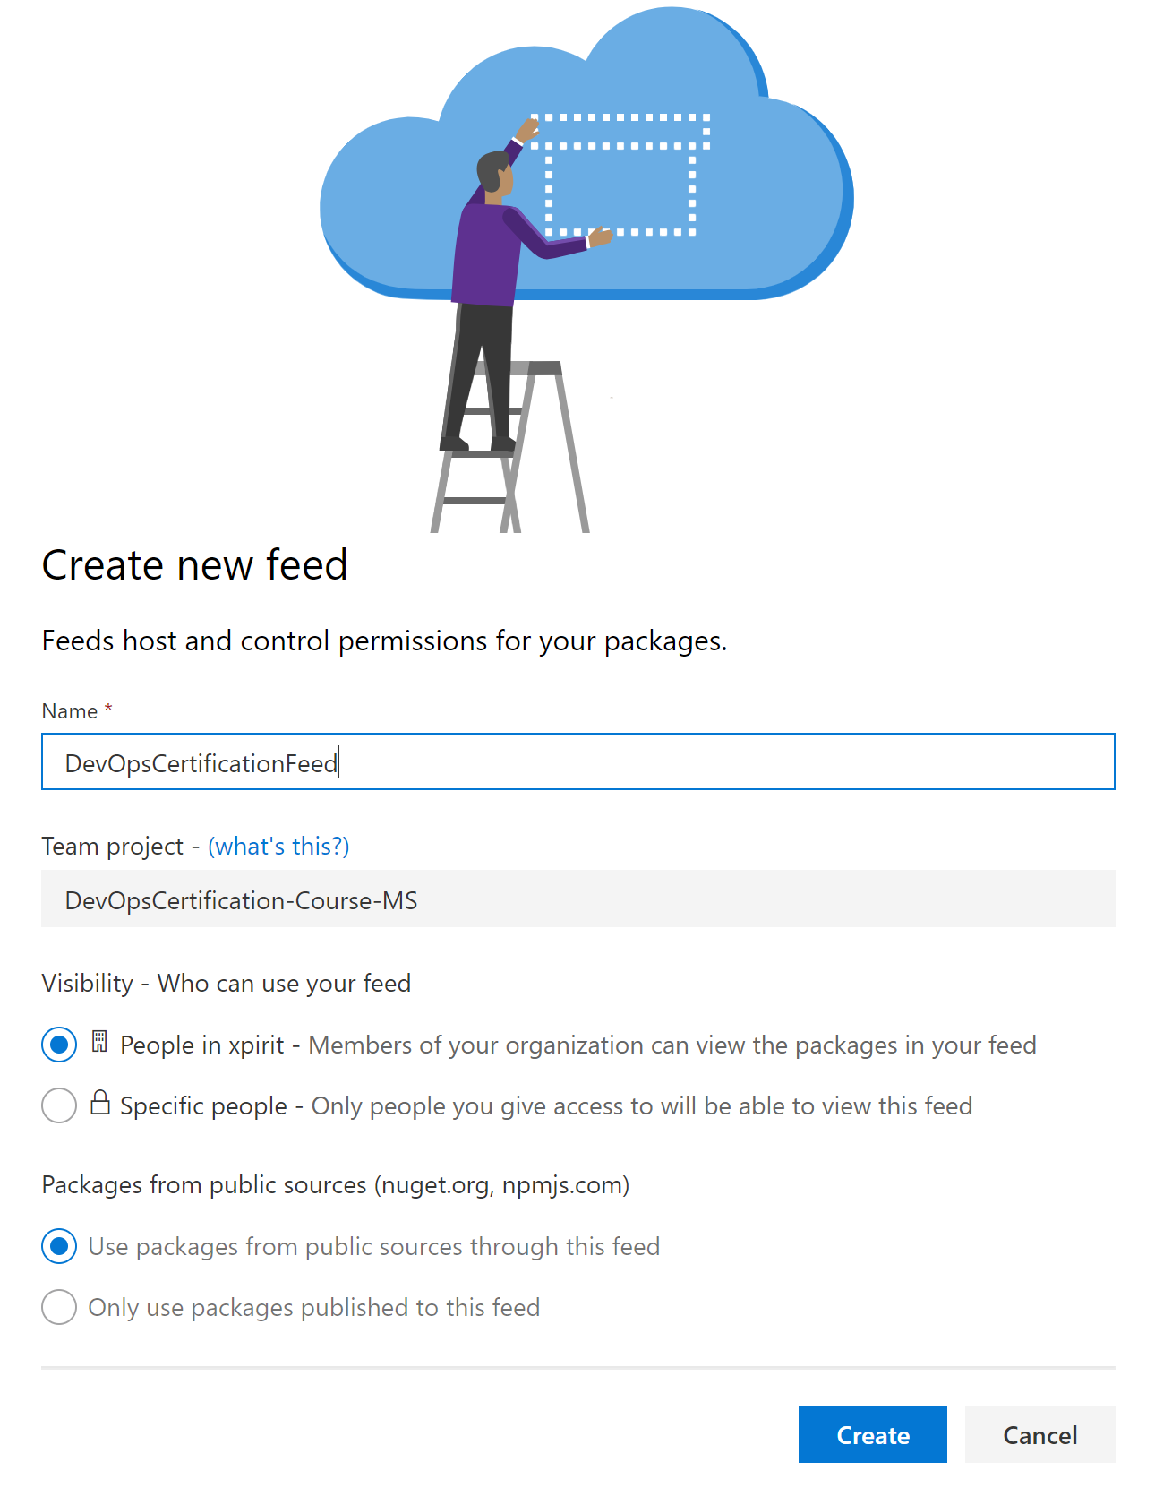
Creating a feed
From Azure DevOps portal
Feeds are centralized
Specify
Name
Visibility
Public sources as upstreams

Slide 11
Push packages to feed
Authenticate to feed
Push package using command-line tooling of package manager
Example NuGet:
nuget.exe push
-Source {NuGet package source URL}
-ApiKey YourKey
YourPackage\YourPackage.nupkg

Slide 12
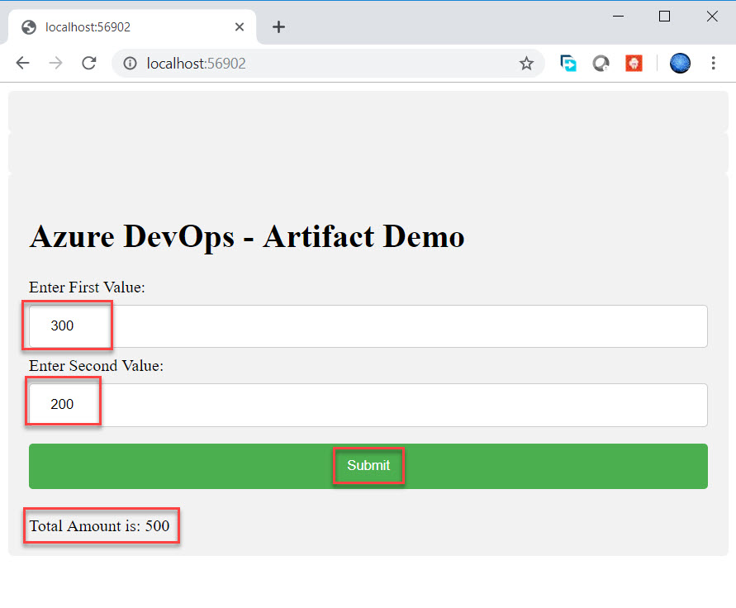
Use Case - Calculator

Slide 13
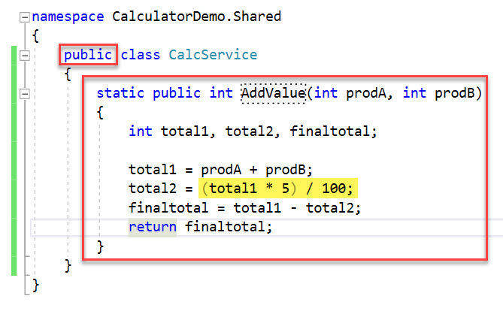
Shared Library

Slide 14
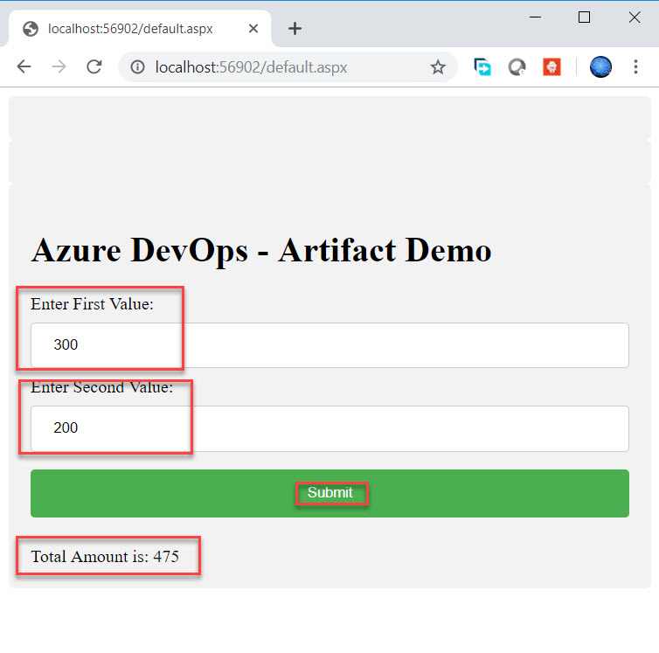
Use Case - Calculator

