Slide 1
Automating cloud deployments using Azure Resource Manager and Puppet

Slide 2
Problem statement
In an envisioning session conducted by the team, RISCO described how the current deployment process suffered from long release cycles, inconsistencies between QA and production environments, and issues with synchronization between the IT and R&D groups. To improve and optimize the release process, the R&D and IT teams have been planning to adopt several DevOps practices such as continuous integration (CI) and continuous delivery (CD). Adopting these practices required a lot of effort from both teams at RISCO and so the company’s DevOps journey had to be taken in steps.

Slide 3
Problem statement
As the discussion moved forward, it quickly became clear that a major pain point to be addressed was a bottleneck in the deployment process of cloud environments for the use of the R&D team that took days and even weeks. Mitigating this pain point seemed like a good place to start because it could optimize an important part of the current flow and also pave the way to the implementation of CI/CD in the future.

Slide 4
Problem statement
The team decided to focus on this key pain point, which can be described as follows:
When members of the RISCO R&D team want a virtual cloud environment for development or testing, they request specific environments from IT, which must manually create them. These environments are multitiered and include various Azure services, so manual deployment includes creating these services, setting network configurations, and installing various modules on Windows and Linux virtual machines. This means that the time between an environment request to its deployment and availability to the requester can be as long as days and even a week, depending on the IT department’s load. This has severe consequences on R&D processes. RISCO has a need to automate the process and make dev/test environments available to developers on demand via an easy “one-click” process that will take minutes instead of days, thereby helping to optimize and streamline deployments. This process can also be extended in the future to be triggered automatically as part of a CI/CD process.

Slide 5
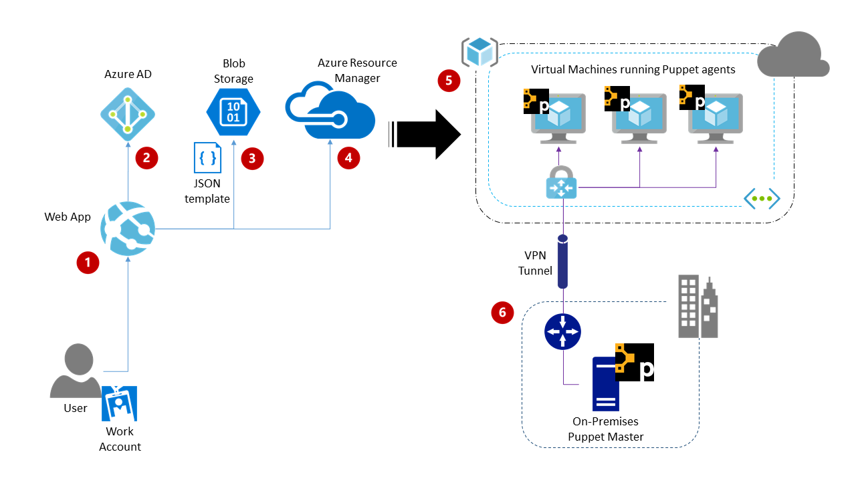
Solution, Steps and Delivery

Slide 6
Solution, Steps and Delivery
Users access the self-service portal, a web app deployed on Azure App Service.
Users are authenticated using Azure Active Directory using their work account.
Environments available for deployment are defined by Resource Manager templates that are stored in a blob storage container.
The web app requests a new deployment from the Azure Resource Manager using the chosen template and the Azure .NET SDK.
Azure Resource Manager deploys the requested environment, which includes virtual machines running Puppet agents.
An on-premises Puppet master serves configuration catalogs to the Puppet agents, which configure the virtual machines and perform necessary software installations.

Slide 7
Solution Implementation
Implementing the self-service portal.
Authoring a Resource Manager template to deploy as an example environment.
Using Puppet to automate post-deployment configuration.

