Slide 1
Yaml

Slide 2
Overview
YAML is the abbreviated form of “YAML Ain’t markup language” is a data serialization language which is designed to be human -friendly and works well with other programming languages for everyday tasks. This tutorial covers in detail about some important neuro linguistic programming skills that helps you to master the art of sales and persuading your potential buyer.
Basically, the data you enter in a YAML file is used in conjunction with a library to create the pages

Slide 3
Basic Rules
There are some rules that YAML has in place to avoid issues related to ambiguity in relation to various languages and editing programs. These rules make it possible for a single YAML file to be interpreted consistently, regardless of which application and/or library is being used to interpret it.
YAML files should end in .yaml whenever possible in Grav.
YAML is case sensitive.
YAML does not allow the use of tabs. Spaces are used instead as tabs are not universally supported.

Slide 4
Mappings
pets:
- Cat
- Dog
- Goldfish

Slide 5
Defining groups - user/config/groups.yaml
registered:
icon: users
readableName: 'Registered Users'
description: 'The group of registered users'
access:
site:
login: true
paid:
readableName: 'Paid Members'
description: 'The group of paid members'
icon: money
access:
site:
login: true
paid: true
administrators:
groupname: administrators
readableName: Administrators
description: 'The group of administrators'
icon: child
access:
admin:
login: true
site:
login: true

Slide 6
Pipeline structure
PipelineJob 1
Step 1.1
Step 1.2
...
Job 2
Step 2.1
Step 2.2
...
...

Slide 7
Conventions
Conventions used in this topic:
To the left of : are literal keywords used in pipeline definitions.
To the right of : are data types. These can be primitives like string or references to rich structures defined elsewhere in this topic.
[ datatype ] indicates an array of the mentioned data type. For instance, [ string ] is an array of strings.
{ datatype : datatype } indicates a mapping of one data type to another. For instance, { string: string } is a mapping of strings to strings.
| indicates there are multiple data types available for the keyword. For instance, job | templateReference means either a job definition or a template reference are allowed.

Slide 8
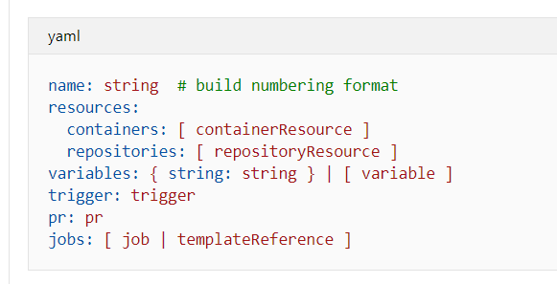
Pipeline

