Slide 1
Project Presentation of CO-OP Project at Industry (Module-2) (22CS421)
On
Comparative Analysis of Polars and Pandas Performance for Data-Intensive Tasks in FastAPI Microservices
Submitted By:
Navjot Singh (2210991964)
Divyansh (2210991535)
Bhavik Sharma (2210990217)
Supervised By
Prof. Dr. S. B. Goyal
Dean, Department of Computer Science & Engineering
Department of Computer Science and Engineering,
Chitkara University, Punjab

Slide 2
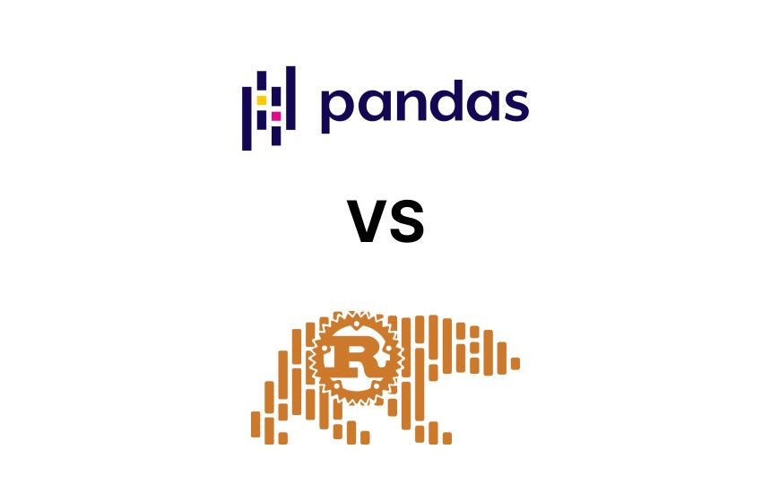
Introduction
Modern microservice architectures rely on high-concurrency, low-latency data processing, often utilizing frameworks like FastAPI.
Traditional libraries like Pandas, while popular, face significant architectural constraints:
Eager Evaluation: Relies on in-memory data duplication.
GIL Constraints: Single-threaded execution leads to bottlenecks in asynchronous environments.
Resource Intensive: Prone to Out-of-Memory (OOM) failures under concurrent traffic.
Polars emerges as a powerful alternative, written in Rust, leveraging multithreading and lazy evaluation to maximize efficiency.
Main Objective: To empirically compare the performance and resource utilization of Pandas and Polars when deployed as synchronous and asynchronous endpoints within FastAPI-based microservices under varying, simulated concurrent workloads.
‹#›

Slide 3




Tech Stack
Programming Languages:
Python 3.10+
JavaScript (for k6 load scripts)
Web Framework:
FastAPI
Uvicorn (ASGI server)
Data Processing Engines:
Pandas
Polars
PyArrow / fastparquet
Containerization:
Docker,
Docker Compose
Load Testing:
k6 (by Grafana Labs)
Data Visualization:
Matplotlib
Seaborn
Development Environment:
Windows Subsystem for Linux (WSL)
VS Code
‹#›

Slide 4
Experiment Methodology
These are operations performed for benchmarking -
Heavy Joins Inner merges across multiple tables (Orders, Customers, Products) testing memory duplication. | Aggregations High-cardinality multi-dimensional grouping with unique counts and hashing efficiency. | Window Functions Dense rankings partitioned by region, testing sequential processing vs vectorization.
String Processing Extracting substring features (email domains) testing Apache Arrow vs Python objects. | Time-Series Temporal alignment and dynamic downsampling with rolling-window computations. | Null Imputation Data cleaning task measuring full-column scan efficiency and conditional replacement speed.
‹#›

Slide 5
Architecture
API Layer: Two identical FastAPI application servers (Uvicorn) routing HTTP GET requests to their respective data processing backends.
Processing Layer (Pandas): Implements synchronous endpoint functions (def), utilizing eager evaluation, in-memory object allocation, and single-threaded execution.
Processing Layer (Polars): Implements out-of-core streaming (streaming=True), lazy execution graphs, and multithreaded processing restricted via POLARS_MAX_THREADS=2 to prevent event-loop contention.
Load Generation Layer: A Grafana k6 engine configured to simulate realistic concurrent virtual users (VUs) with defined ramp-up, sustained, and cooldown phases.
Telemetry & Orchestration Layer: A master Python orchestrator that coordinates the starting/stopping of background resource monitors, fires the k6 scripts, and generates the final Matplotlib graphs.
‹#›

Slide 6
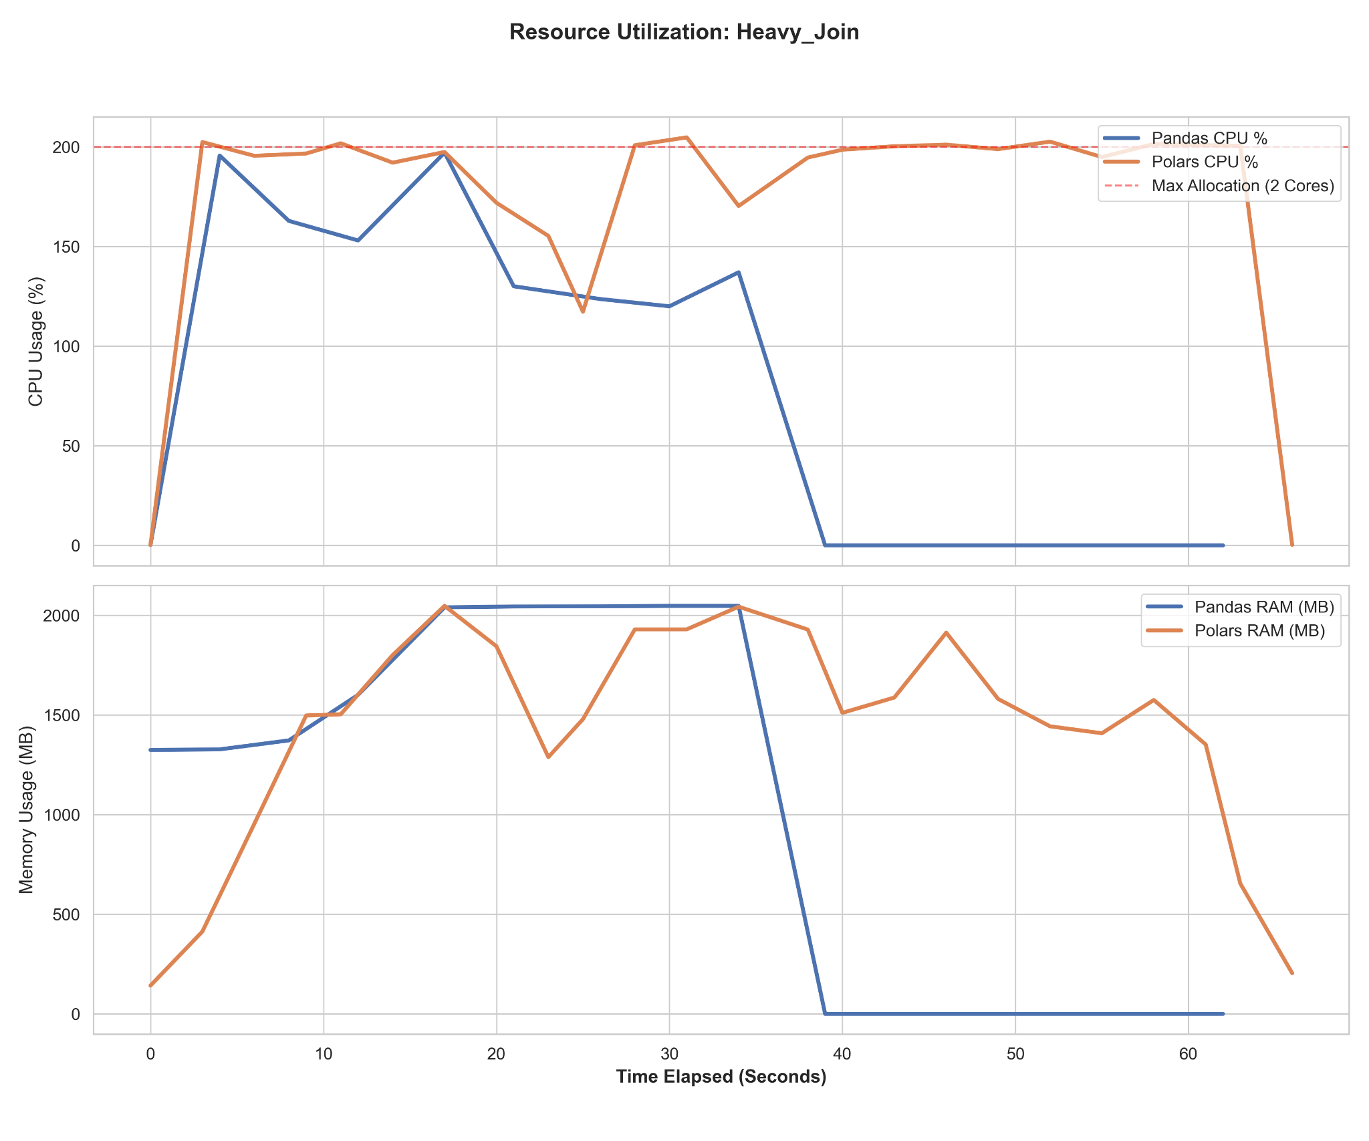
Result
Memory Consumption & OOM Stability while load testing during heavy join operation:
Pandas Bottleneck Exponential memory duplication during concurrent merges results in Out-Of-Memory (OOM) failures.
Polars Advantage
Lazy evaluation and out-of-core streaming maintain a dynamic, stable memory footprint under load.
‹#›

Slide 7
Conclusion & Recommendation
Architectural Superiority: Polars' Rust-based multithreaded engine bypasses the Python GIL, making it essential for high-concurrency microservices.
Resource Efficiency: Transitioning to lazy evaluation graphs reduces peak memory usage by over 50% compared to Pandas' eager model.
Scalability: Polars survives severe stress tests (20+ concurrent users) where Pandas microservices experience catastrophic container failure.
The Verdict: For real-time, data-intensive FastAPI microservices, Polars is the recommended production-grade DataFrame engine.
‹#›

Slide 8
Thank You
‹#›

