Slide 1
Verifying Large Multipliers by Combining SAT and Computer Algebra
By:-
Daniela Kaufmann, Armin Biere, Manuel Kauers
Presented at:-
2019 Formal Methods in Computer Aided Design (FMCAD)

Slide 2
Brief Overview
Problem Statement
Don’t know what to name it
How SAT can solve this ….. (Main Contribution of this Paper)
Comparison with previous state of the art
Attempt at Bonus Marks

Slide 3
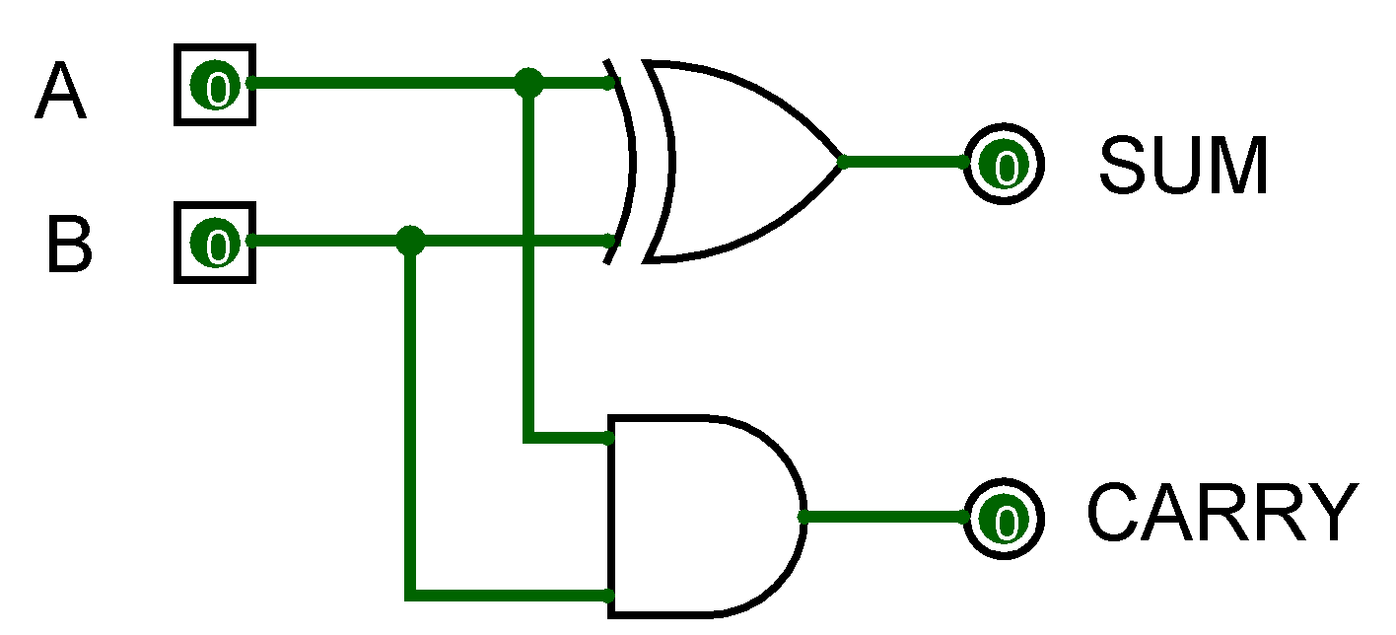
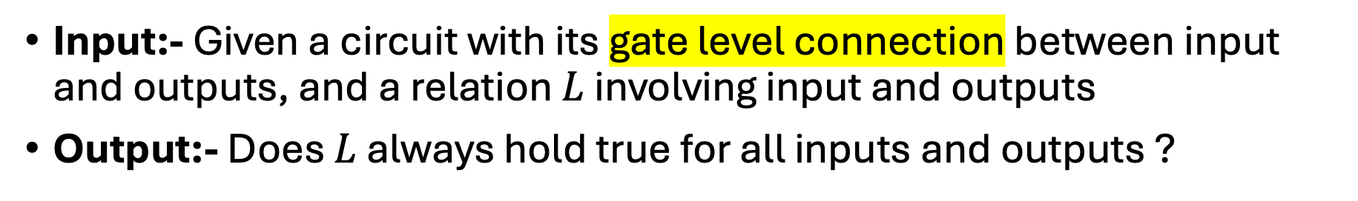
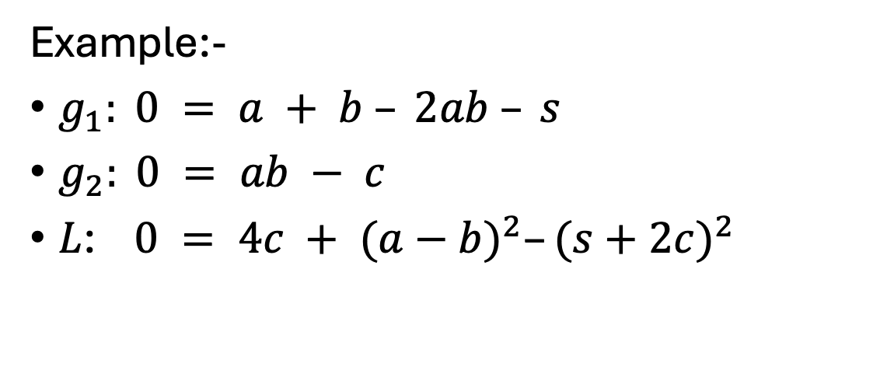
Problem Statement
Input:- Given a circuit with its gate level connection between input and outputs, and a relation $L$ involving input and outputs
Output:- Does $L$ always hold true for all inputs and outputs ?
g1
Example:-
$g_{1}: 0 = a + b – 2ab – s$
$g_{2}: 0 = ab − c$
$L$: $0 = 4c + {(a−b)}^{2}–{(s+2c)}^{2}$
g2
$$L=g_{1}\left(a+b+s−2c\right)+2g_{2}(a+b+s−2c−2)$$

Slide 4
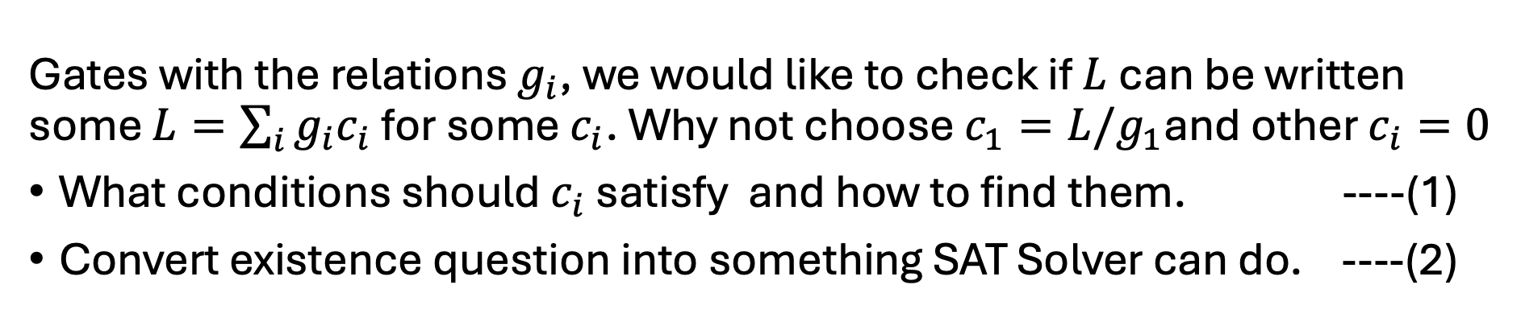
How will we approach the problem ?
Gates with the relations $g_{i}$, we would like to check if $L$can be written some $L=\sum_{i}{g_{i}c_{i}}$ for some $c_{i}$. Why not choose $c_{1}=L/g_{1}$and other $c_{i}=0$
What conditions should $c_{i}$ satisfy and how to find them. ----(1)
Convert existence question into something SAT Solver can do. ----(2)
Why is it necessary or Why do we care ?
For the project
Complicated gate level implementation to solve problems faster
Even simple circuits can grow very fast, Wallace 8 Bit Multiplier has 600-750 gates as compared to simple multiplier with 300-350 gates

Slide 5
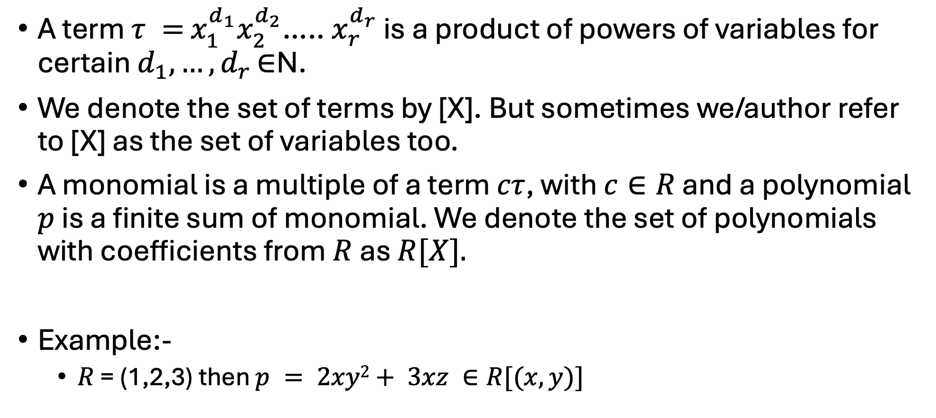
Term and Polynomials
A term $τ =$ $x_{1}^{d_{1}}x_{2}^{d_{2}}$….. $x_{r}^{d_{r}}$ is a product of powers of variables for certain $d_{1}, …,d_{r }$∈N.
We denote the set of terms by [X]. But sometimes we/author refer to [X] as the set of variables too.
A monomial is a multiple of a term $cτ$, with $c∈R$ and a polynomial $p$ is a finite sum of monomial. We denote the set of polynomials with coefficients from $R$ as $R[X].$
Example:-
$R$ = (1,2,3) then $p = 2xy2+ 3xz ∈R[(x,y)]$
Note:- R is not Real Numbers, can be anything
Note:- We will focus more on the case where R(coefficients) form a ring with a multiplicative identity

Slide 6
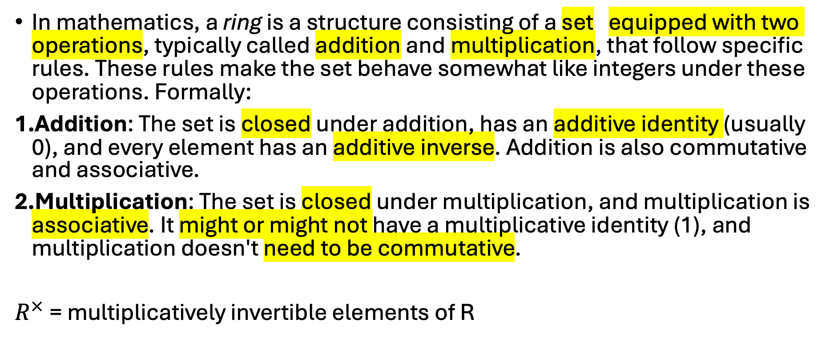
Ring Recap
In mathematics, a ring is a structure consisting of a set equipped with two operations, typically called addition and multiplication, that follow specific rules. These rules make the set behave somewhat like integers under these operations. Formally:
Addition: The set is closed under addition, has an additive identity (usually 0), and every element has an additive inverse. Addition is also commutative and associative.
Multiplication: The set is closed under multiplication, and multiplication is associative. It might or might not have a multiplicative identity (1), and multiplication doesn't need to be commutative.
$R^{×}$ = multiplicatively invertible elements of R

Slide 7
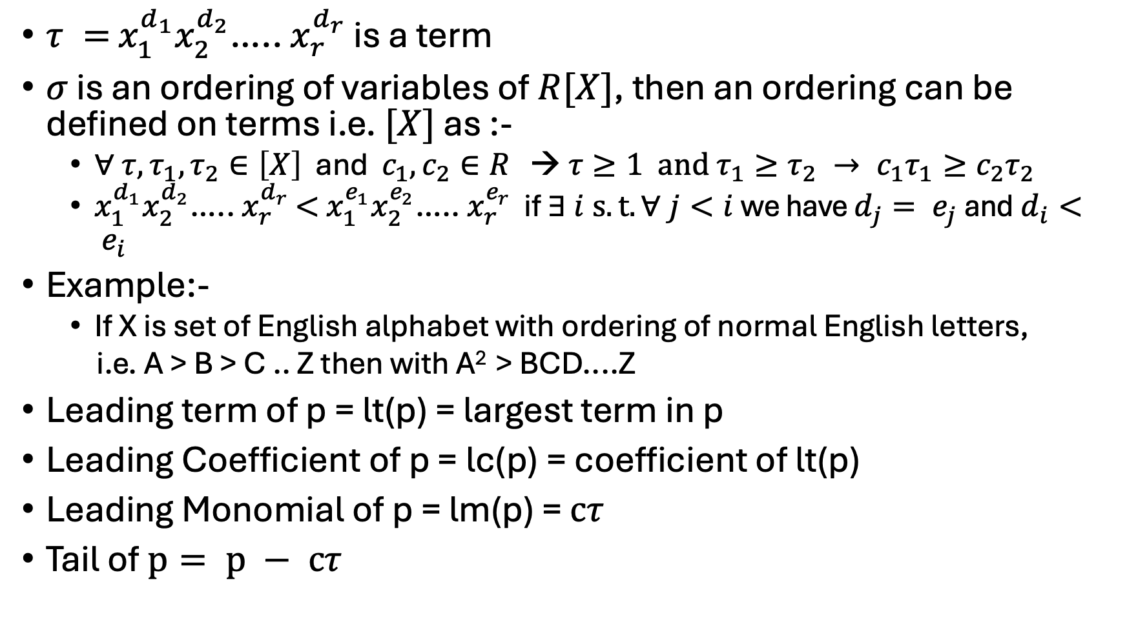
Lexicographic Ordering on Terms
$τ =$ $x_{1}^{d_{1}}x_{2}^{d_{2}}$….. $x_{r}^{d_{r}}$ is a term
$σ$ is an ordering of variables of $R[X]$, then an ordering can be defined on terms i.e. $[X]$ as :-
$∀ {τ, τ}_{1},τ_{2}∈\left[X\right]$ and $c_{1},c_{2}∈R$ → $τ≥1 and{ τ_{1}≥τ_{2} → c}_{1}τ_{1}≥c_{2}τ_{2}$
$x_{1}^{d_{1}}x_{2}^{d_{2}}$….. $x_{r}^{d_{r}}$ $<$ $x_{1}^{e_{1}}x_{2}^{e_{2}}$….. $x_{r}^{e_{r}}$ if $∃ i s.t. ∀ j<i$we have $d_{j}= e_{j}$and$d_{i}< e_{i}$
Example:-
If X is set of English alphabet with ordering of normal English letters,
i.e. A > B > C .. Z then with A² > BCD....Z
Leading term of p = lt(p) = largest term in p
Leading Coefficient of p = lc(p) = coefficient of lt(p)
Leading Monomial of p = lm(p) = $cτ$
Tail of $p= p − cτ$

Slide 8
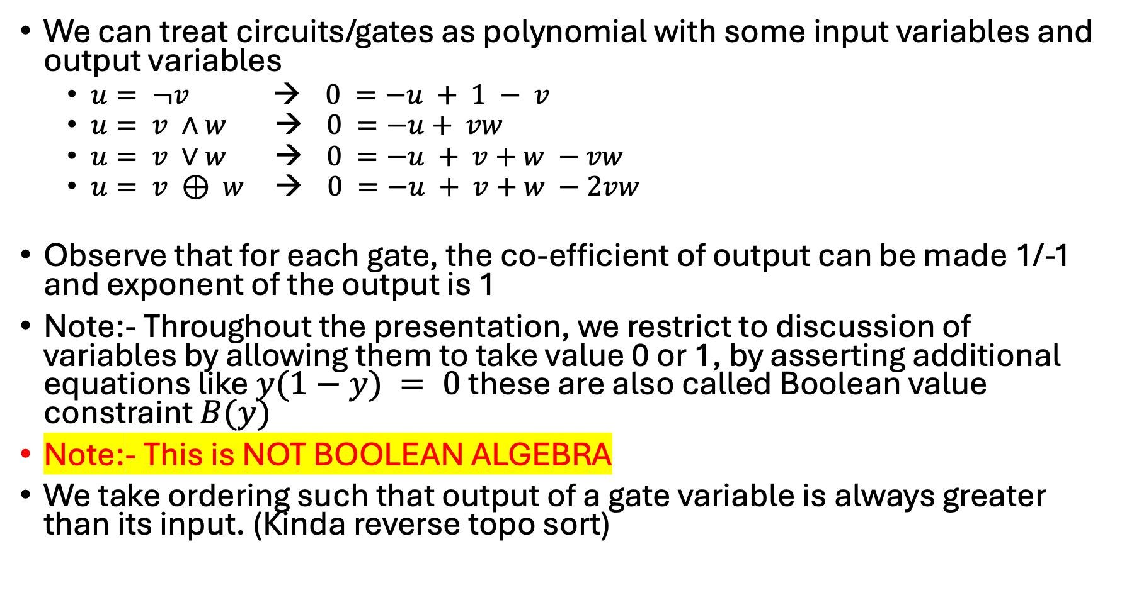
What’s the point ?
We can treat circuits/gates as polynomial with some input variables and output variables
$u= ¬v$ → $0 =−u + 1 − v$
$u= v ∧w$ → $0 =−u+ vw$
$u= v ∨w$ → $0 =−u + v+w −vw$
$u= v ⊕ w$ → $0 =−u + v+w −2vw$
Observe that for each gate, the co-efficient of output can be made 1/-1 and exponent of the output is 1
Note:- Throughout the presentation, we restrict to discussion of variables by allowing them to take value 0 or 1, by asserting additional equations like $y(1−y) = 0$these are also called Boolean value constraint $B(y)$
Note:- This is NOT BOOLEAN ALGEBRA
We take ordering such that output of a gate variable is always greater than its input. (Kinda reverse topo sort)

Slide 9
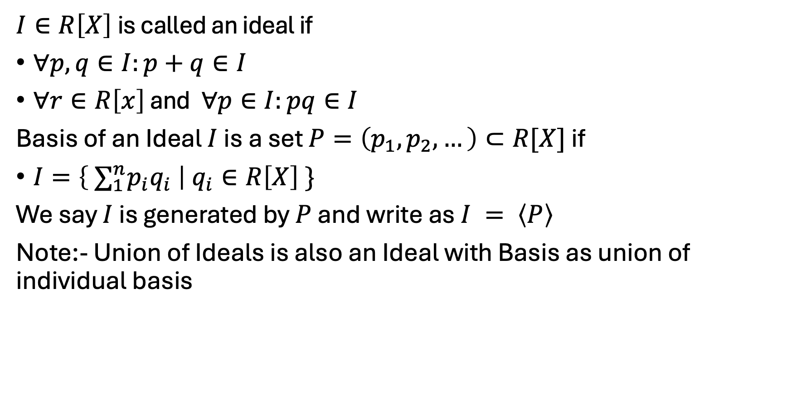
Ideals and Basis of Ideals
$I∈R\left[X\right]$is called an ideal if
$∀p,q∈I:p+q∈I$
$∀r∈R\left[x\right]$ and $∀p∈I:pq∈I$
Basis of an Ideal $I$ is a set $P=\left(p_{1},p_{2},…\right)⊂R[X]$ if
$I=\left\{ ∑_{1}^{n}p_{i}q_{i} \right| q_{i}∈R\left[X\right] \}$
We say $I$ is generated by $P$ and write as $I = \left\langle P\right\rangle$
Note:- Union of Ideals is also an Ideal with Basis as union of individual basis
Note that q_{i} belongs to R[X]

Slide 10

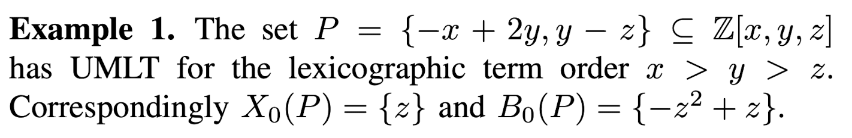
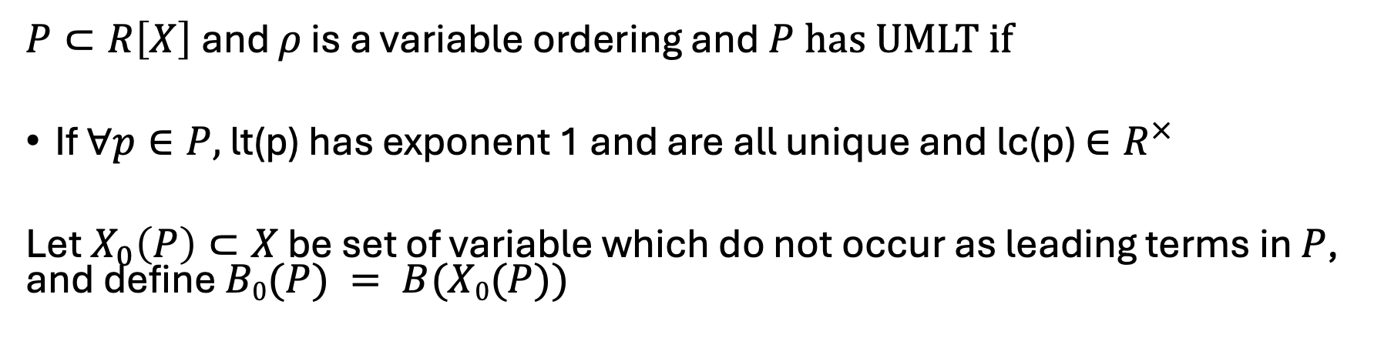
Unique Monic Leading Term (UMLT)
$P⊂R\left[X\right]$and $ρ$ is a variable ordering and$P$has UMLT if
If $∀p∈P,$lt(p) has exponent 1 and are all unique and lc(p) $∈R^{×}$
Let $X_{0}\left(P\right)⊂X$ be set of variable which do not occur as leading terms in $P$, and define $B0(P) = B(X0(P))$
1. Unique Leading Term
2. Exponent = 1
3. Leading Coefficient is invertible

Slide 11

Deduction
Let $P⊂R\left[X\right]$ be a finite set with UMLT, then a polynomial $q$ can be “deduced” from $P$ if $q∈ \left\langle P\right\rangle + \left\langle B_{0}(P)\right\rangle$ and is written as $P ⊢_{R}q$
Models
A model is an assignment $φ$such that $∀p∈P:φ(p) = 0$, for a polynomial $q$, we write $P ⊨_{R}q$ if every model of $P$ is also a model of $\{q\}$

Slide 12
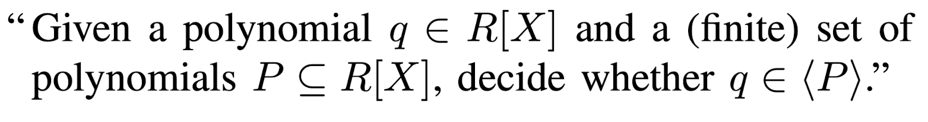

Sneak Peak into the Future
We will show by the end of the presentation that whether $L$ (constraint among input-output) is implied by gate polynomials $C$ can be reduced to Ideal Membership Test.

Slide 13
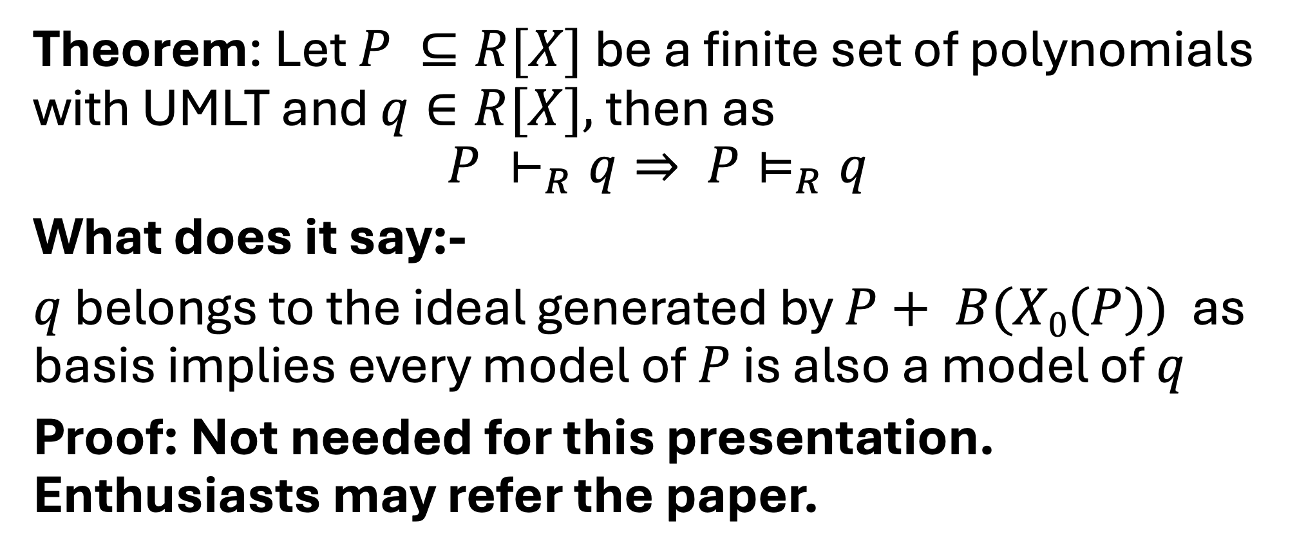
Soundness
Theorem: Let $P ⊆R[X]$ be a finite set of polynomials with UMLT and $q∈R[X],$then as
$$P ⊢_{R}q⇒ P⊨_{R}q$$
What does it say:-
$q$ belongs to the ideal generated by $P+ B(X0(P))$ as basis implies every model of $P$ is also a model of $q$
Proof: Not needed for this presentation. Enthusiasts may refer the paper.

Slide 14
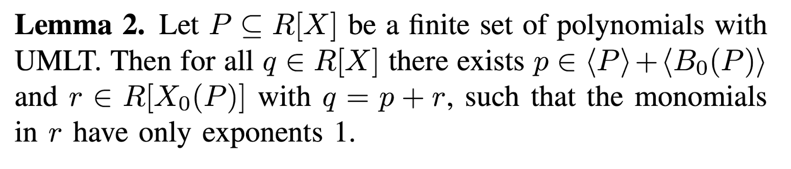
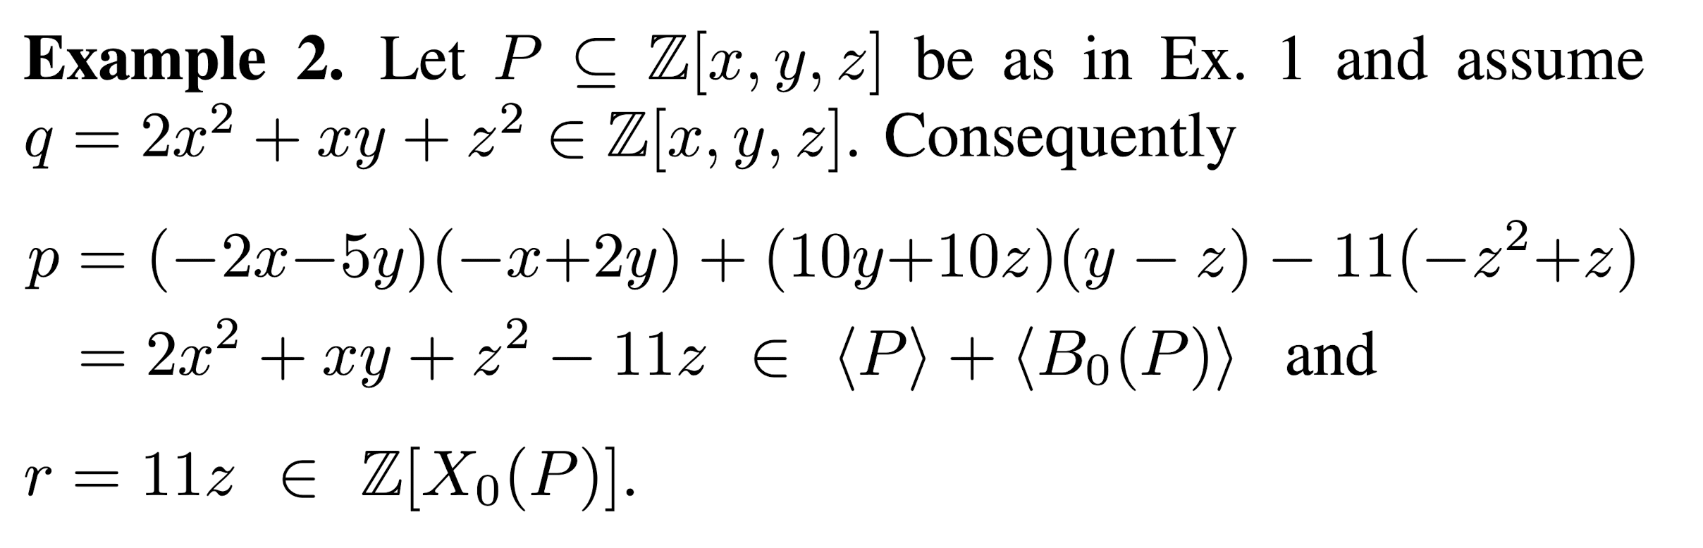

Soundness
Lemma1:- If $P⊨_{R}p$and $P⊨_{R}q$then $P⊨_{R}p+q$

Slide 15
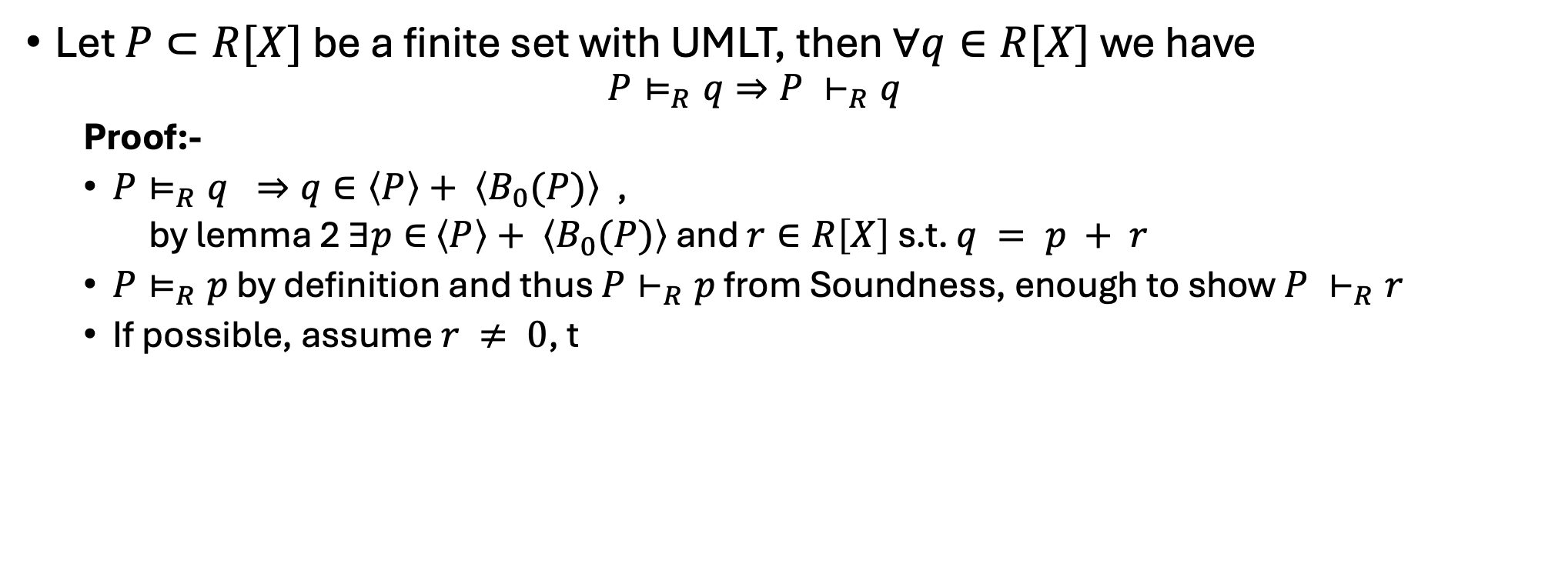
Completeness
Let $P⊂R[X]$ be a finite set with UMLT, then $∀q∈R[X]$ we have
$$P⊨_{R}q⇒P ⊢_{R}q$$
Proof:-
$P⊨_{R}q ⇒q∈\left\langle P\right\rangle + \left\langle B_{0}(P)\right\rangle$ ,
by lemma 2 $∃p∈$ $\left\langle P\right\rangle + \left\langle B_{0}(P)\right\rangle$ and $r∈R\left[X\right]$ s.t. $q = p + r$
$P⊨_{R}p$ by definition and thus $P⊢_{R}p$ from Soundness, enough to show $P ⊢_{R}r$
If possible, assume $r ≠ 0$, t

Slide 16
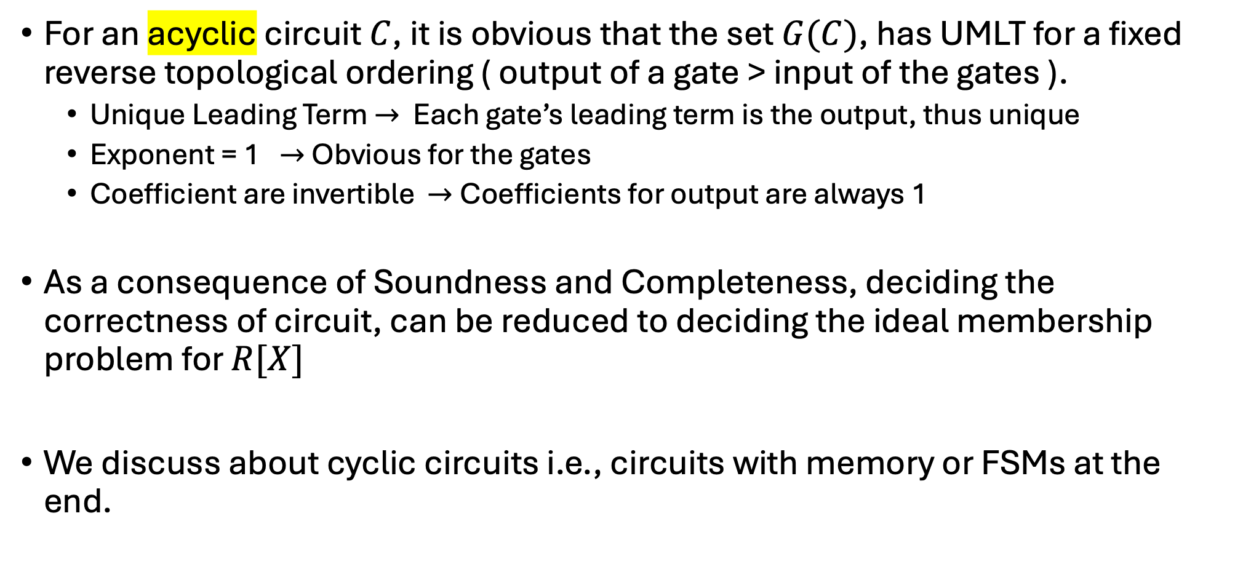
Don’t know what to name
For an acyclic circuit $C$, it is obvious that the set $G(C)$, has UMLT for a fixed reverse topological ordering ( output of a gate > input of the gates ).
Unique Leading Term $→$ Each gate’s leading term is the output, thus unique
Exponent = 1 $→$Obvious for the gates
Coefficient are invertible $→$Coefficients for output are always 1
As a consequence of Soundness and Completeness, deciding the correctness of circuit, can be reduced to deciding the ideal membership problem for $R[X]$
We discuss about cyclic circuits i.e., circuits with memory or FSMs at the end.

Slide 17


$I$ and $J$ and $U$
Let $I\left(C\right)=\left\{f∈R\left[X\right]:G\left(C\right)⊨_{R}f\right\}.$
Let $B_{0}\left(C\right)= B_{0}(G\left(C\right))$ then define $J\left(C\right)= \left\langle G\left(C\right)⋃B_{0}(C)\right\rangle$
$𝒰_{n}=(\sum_{i=0}^{2n−1}{2^{i}s_{i})−(\sum_{i=0}^{n−1}{2^{i}a_{i}})(\sum_{i=0}^{n−1}{2^{i}b_{i}})}$
For all assignments $φ$ we have $φ\left(𝒰_{n}\right)∈[{−2}^{2n}+1,2^{2n}−1]$

Slide 18
D- Gröbner Basis
The question whether a circuit fulfills a given specification can be answered by an ideal membership test.
The theory of Gröbner bases [4] offers a decision procedure for this problem.
Gröbner bases were introduced by Bruno Buchberger in his 1965 Ph.D. thesis, which also included an algorithm to compute them (Buchberger's algorithm).
Gröbner basis is a particular kind of generating set of an ideal in a polynomial ring D[x₁, ..., x_{n}] over a field D. D is

Slide 19
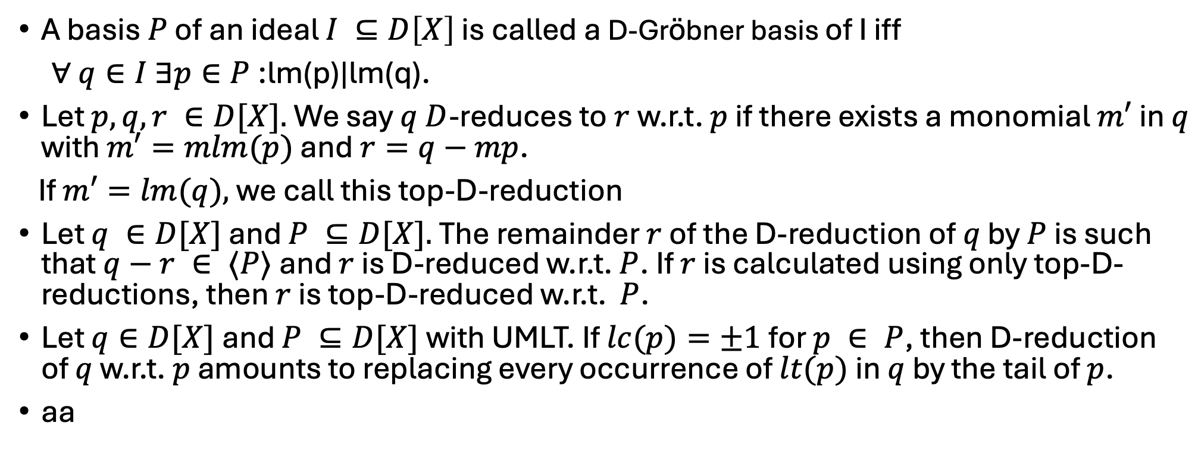
Reduction
A basis $P$ of an ideal $I ⊆D\left[X\right]$ is called a D-Gröbner basis of I iff
∀ $q∈I ∃p∈P$:lm(p)|lm(q).
Let $p,q,r ∈D[X].$We say $q D$-reduces to$r$w.r.t. $p$ if there exists a monomial $m′$in $q$ with $m′=mlm(p)$ and $r=q−mp$.
If $m′=lm(q),$we call this top-D-reduction
Let $q ∈D[X]$ and $P ⊆D[X].$The remainder $r$ of the D-reduction of $q$ by $P$ is such that $q−r ∈ ⟨P⟩$and $r$ is D-reduced w.r.t. $P$. If $r$ is calculated using only top-D-reductions, then $r$ is top-D-reduced w.r.t. $P$.
Let $q∈D[X]$and $P ⊆D[X]$with UMLT. If $lc(p)=±1$for $p ∈ P$, then D-reduction of $q$ w.r.t. $p$ amounts to replacing every occurrence of $lt(p)$in $q$ by the tail of $p$.
aa

